Slide 1
Dissertation Inventory Analysis in 230 bedded hospital - “Aakash Healthcare” Dwarka
Jyoti Pandey
PGDHM- Hospital Stream
Guided by: Dr. Anandhi Ramachandran

Slide 2
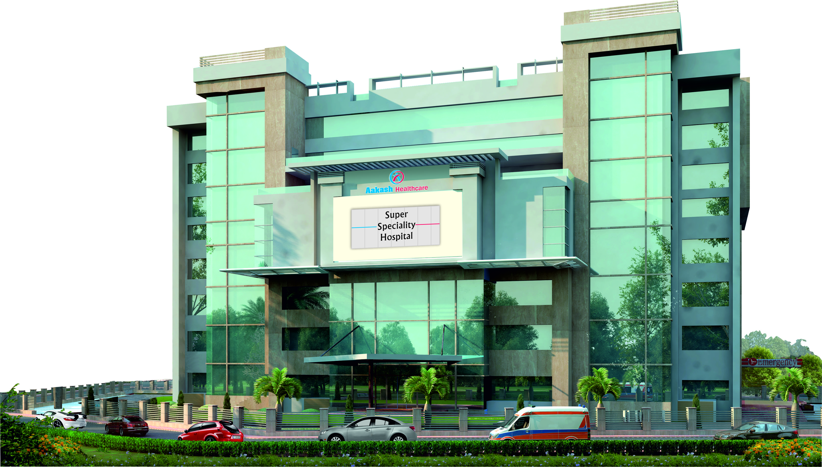
ABOUT AAKASH HEALTHCARE - SECTOR 3 , DWARKA

Slide 3
INTRODUCTION
Aakash Healthcare is a Private Limited Company (AHPL). It was incorporated on 19th November, 2013.
Dr. Aashish Chaudhry is the founder and Managing Director of Aakash Healthcare is a celebrated orthopaedic surgeon, having performed innumerable successful orthopaedic surgeries. Dr. Chaudhry aims to make Aakash Healthcare ‘the healthcare destination’ for all health concerns.
CORE VALUES: ICARE
Integrity
Compassion
Accountability
Respect
Excellence

Slide 4
SCOPE OF SERVICES
Key Specialties
ORTHOPAEDICS & JOINT REPLACEMENT | GENERAL & MINIMAL ACCESS SURGERY | MOTHER & CHILD
CARDIOLOGY & CARDIAC SURGERY | OPHTHALMOLOGY & REFRACTIVE SURGERY | NEPHROLOGY
Other Specialties
INTERNAL MEDICINE |  | LAB MEDICINE
DERMATOLOGY | COSMETOLOGY & PLASTIC SURGERY | HEARING AND SPEECH
GASTROENTEROLOGY & HEPATOBILLIARY SCIENCES | OBSTETRICS | PULMONOLOGY & RESPIRATORY MEDICINE
PHYSIOTHERAPY & REHABILITION | ER & TRAUMA | ENDOCRINOLOGY/DIABETES & METABOLIC DISORDERS
MENTAL HEALTH & BEHAVIORAL SCIENCES | DENTAL SCIENCES | INTERVENTIONAL RADIOLOGY
RHEUMATOLOGY | NEUROSURGERY | NEUROLOGY
PREVENTIVE HEALTH CHECK UP | SURGICAL ONCOLOGY | MEDICAL ONCOLOGY
G I SURGERY | GYNAECOLOGY | RADIOLOGY
CRITICAL CARE | ENT | BLOOD BANK & TRANSFUSION MEDICINE

Slide 5
Internship
Gantt Chart for the Period Feb 2018- till now
S.No | Departments | Feb-18 |  |  |  | Mar-18 |  |  |  | Apr-18 |  |  |  | May-18
1 | Marketing & Sales
 | Orientation of HealthCamps
 | Analysis of Revenue Generated
2 | Supply Chain
 | Purchase Order development
 | Inventory Analysis
3 | Operations
 | Orientation of Discharge Process
 | Monitoring of Discharge Process at two floors
 | Monitoring Discharge Patients Medicines availability

Slide 6
Learnings
Organizing Health Camps
Analysis of revenues generated through health camps and referrals
Purchase order generation with and without indent
Developing goods receipt notes
Inventory Analysis and defining ROL
Monitoring discharge processes

Slide 7
DISSERTATION REPORT
Inventory Analysis in a 230 Bedded Hospital “Aakash Healthcare” Dwarka

Slide 8
BACKGROUND
Number of materials actually required vis-a vis finances involved and cost containment
Inventory analysis- Examination of inventory – maintaining optimum amount
Lack of proper inventory mechanism
Serious functional dislocation of patient care services
Important and essential drugs are not available
Less quality care
Loss of patient life ( at extreme conditions)
Patient dissatisfaction
Compromise on brand name
Loss of revenue

Slide 9
Continued…
A combination of ABC and FSN analysis (FSN-ABC matrix) can be gainfully employed to evolve a meaningful control over the material supplies.
Category (I) include all Fast moving and expensive items (FA, FB, FC, NA, SA). Category II includes the remaining items of the E and B groups (SB, SC, and NB). Category III includes the Non Moving and cheaper group of items (NC).

Slide 10
Review of literature
R. Ramanathan “ABC inventory classification with multiple-criteria using weighted linear optimization”- how to classify
JK Das et al, - “Essentials of Logistics and Equipment Management” - importance of inventory management technique like VED, ABC and ABC-VED Matrix.
Nitin Gupta, Pushpanjali Krishnappa- -developed a inventory control plan for a private dental institution by categorizing the materials utilizing an ABC-VED coupling matrix.

Slide 11
OBJECTIVES
General Objective:
To perform an inventory analysis and establish re-order levels for the IP pharmacy
Specific Objectives:
To analyze the consumption rate for the available item in the pharmacy.
To categorize the available items in the IP pharmacy based on FSN &ABC Matrix.
To establish safety stock level, lead time and re-order level for the available items in the pharmacy.

Slide 12
METHODOLOGY:
Study Design – cross sectional and quantitative study
Study Area - Aakash Healthcare Pvt. Ltd. Location- IP Pharmacy
Study Time Period – 27 Dec - 27 March 2018(3 months)
Sample size- Total items available in IP pharmacy.
Mode of Data Collection – Primary and Secondary Data
Technique- ABC, FSN & ABC- FSN matrix
Tools – HMIS ( for data extraction), Excel for inventory analysis

Slide 13
Results
1. Functioning of material management:
1 Level | Level 2 | Level 3
Material Planning | Purchasing | Store & Inventory control
Estimating the individual requirement | Finalization the level of inventories & Quotations | Physical control of material
Preparing the budget | Selection of source of supply | Minimization of obsolence & damage through efficient handling
Forecasting the level of inventories | Placement of purchase order

Slide 14
Process flow of supply chain
requisition made by user department
requisition approved by HOD
place the order against intend
Ensure reciept of material through GRN
Making payment (Finance Dep)
Issue items to user department

Slide 15
Distribution of 2599 items

Slide 16
ABC and FSN Analysis- Medical consumable
 | A | B | C
F | 13(17%) | 2(7%) | 0(0%)
S | 28(31%) | 12(46%) | 5(2%)
N | 81(52%) | 162(48%) | 626(98%)

Slide 17
ABC and FSN Analysis- Drugs
 | A | B | C
F | 63(74%) | 55(34%) | 17(6%)
S | 2619%) | 84(86%) | 86(22%)
N | 12(6%) | 43(22%) | 392(72%)

Slide 18
ABC and FSN Analysis- Other Drugs
 | A | B | C
F | 27(40%) | 28(21%) | 5(2%)
S | 25(35%) | 44(25%) | 44(14%)
N | 17(25%) | 82(53%) | 604(84%)

Slide 19
ABC Analysis of Other Drugs
Category | % Of Annual Consumption | % No of items
A | 39% | 8%
B | 2% | 18%
C | 0% | 75%

Slide 20
ROL
Calculated per day consumption.
Find out the maximum, minimum and safety stock level and lead time in days.
Reorder level = (Per Day Consumption x lead time) + Safety stock
Category | ROL (days) | No of items
A | 34 | 69
B | 10 | 154
C | 1 | 652

Slide 21
CONCLUSION
1.Category I composed of FA, FB, FC, NA, SA
2.Category II composed of SB, SC, NB
3. Category III includes NC.
The use of inventory control techniques in the 230 bedded hospital could help in bringing about substantial improvement not only in patient care but also in form of optimal use of resources.
With the right implementation of key inventory management principles Holding cost, ordering cost, Inventory cost can be brought down to a minimum.
This enables organizations with much more liquidity and hence up scaling their business, growth and expansion potential.

Slide 22
Recommendations
Reduce the ROL days of Category A
Increase the Safety Stock for less expensive and items with more shelf life & more consumption
Two bin inventory control is suggested – two storage bins ( working stock, reserve stock)

Slide 23
REFERENCES
1 .ABC and VED Analysis in Medical Stores Inventory Control,Lt Col R Gupta*, Col KK Gupta (Retd)+, Brig BR Jain (Retd)#, Maj Gen RK Garg**
2. Inventory Analysis in a Private Dental Hospital in Bangalore, India, NITIN GUPTA1, PUSHPANJALI KRISHNAPPA2.
3. Prortized ABC-FSN analysis of inventory management in private and hospital pharmacy followed by questionnaire
4. R. Ramanathan “ABC inventory classification with multiple-criteria using weighted linear optimization”

Slide 24
THANK YOU

