Slide 1
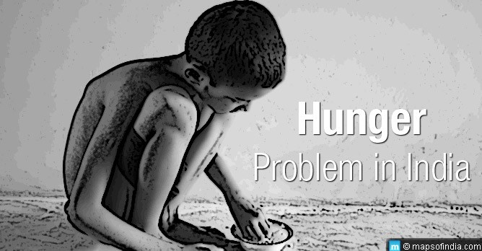
Global Hunger Index of India: Analysis of all states, UTs and 114 Backward districts of India
Presented by :
Dr. Ratan Shekhawat

Slide 2
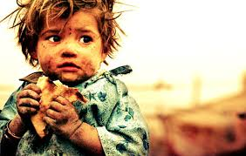
Preface
Introduction
Objective
Methodology
Result
Factors
Conclusion
References

Slide 3
Introduction
Around 795 million people in the world do not have enough food to lead a healthy active life.
Asia is on top among all continents with 2/3rd hungry people.
100 million children in developing countries are underweight .

Slide 4
Among Asian countries, India has a “serious” hunger problem and it ranks 100th out of 119 countries on the global hunger index.
The country's serious hunger level is driven by high child malnutrition.
More than 1/5th of Indian children under five weight too little for their height and over a third are too short for their age. (IFPRI)
According to IFPRI score is 31.4 in 2017, which is towards seriousness on GHI scale.

Slide 5
Objective
To obtain the Global hunger index of States, UT’s and 114 backward Districts of India.
To discuss the factors responsible for hunger situation.

Slide 6
Methodology
A secondary research was conducted using NFHS 4 and CENSUS 2011 data.
36 states ,UT’s and 114 backward district are selected.
Data for U5MR of Districts was not there in NFHS4, so taken from Census 2011.

Slide 7
Data entry was done in Microsoft Excel and GHI was calculated by using new formula given by IFPRI.
There are four components in GHI formula:-
1. Undernourishment
2. Child stunting
3. Child wasting
4. U5MR

Slide 8
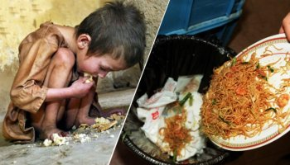
Steps for calculating GHI

Slide 9
Standardise the component indicator
Measure the result against 100 point scale GHI score.
Aggregate component indicators
Determine the values for each of the component indicators

Slide 10
GHI Scale
s.no | GHI score | Category
1 | < = 9.9 | Low
2 | 10.9 to 19.9 | Moderate
3 | 20.0 to 34.9 | Serious
4 | 35.0 to 49.9 | Alarming
5 | >= 50.0 | Extremely alarming

Slide 11
Results
There are disparities in hunger situation of Indian states and UT’s and Districts.
States having worst score are Jharkhand with 38.37 ,MP with 36.86 and Dadar and Nagar Haveli with 35.60.
Out of 10 worst performing districts 4 districts are of Jharkhand , they are West Singhubhum (52.55), Kunti (50.82 ), Dumka (47.95 ), and Simdega (47.77).

Slide 14
In India none of the state, UT”s and districts fall in low category.
Himachal Pradesh and Manipur falls under moderate category with score 15.38 and 19.47.
Despite of having all indicators good,Kerala is in serious category of GHI with score 20.41

Slide 15
factors
Availability, accessibility and affordability
Food grain production
Income and gender inequality
Political involvement
Poverty
Breast feeding practices

Slide 16
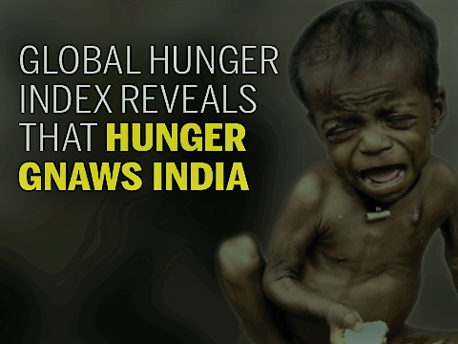
Conclusion
Different states and districts have different reasons for hunger status, therefore require different or according to situations interventions to overcome the hunger.

Slide 17
References
.International Journal of Community Medicine and Public Health Khobragade AW et al. Int J Community Med Public Health. 2017 Aug;4(8):2783-2786
International Institute for Population Sciences (IIPS). National Family Health Survey 2015-16. Available at: http://rchiips.org/NFHS/factsheet_ NFHS-4.shtml
Registrar General & Census Commissioner, India. State of literacy, 2011. Available at:http://censusindia.gov.in/2011-prov-results/data_files/india/Final_PPT_2011_ chapter6 .pdf

Slide 18
International Food Policy Research Institute (IFPRI) Global Hunger Index. 2016 Available at: http://www.ifpri.org/topic/global-hunger-index Accessed on 3 November 2016
Von Braun J. The 2009 Global Hunger Index: More Attention to Women’s Role Needed. (Cover story). 2009;89:4–7.
http://unicef.in/Whatwedo/10/Stunting

Slide 19
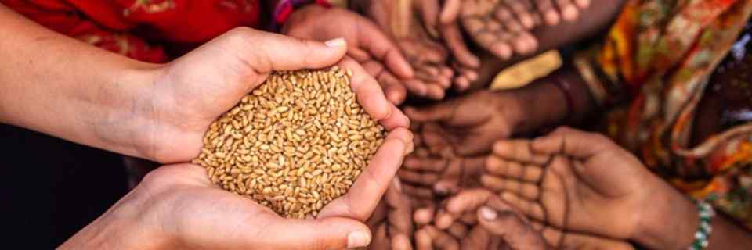
Thank you

