Slide 1
DISSERTATION
Assessment of Quality of Life of patients on Maintenance Hemodialysis and determine the factors affecting it
Presented By:
Ms. Daimee Sethi
PG/16/011
Guided By:
Mrs. Kirti Udayai

Slide 2
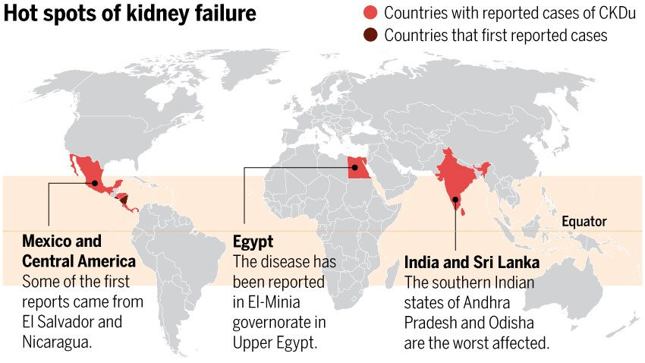
IMAGE: http://www.sciencemag.org/news/2016/03/mysterious-kidney-disease-goes-global

Slide 3
BACKGROUND
Overall prevalence of CKD in India is 17.2%
ESRD leads to impaired QOL; causes high disability in different domains
Type of renal replacement therapy affect the quality of life (QOL) in patients with ESRD
Hemodialysis : most common type of renal replacement therapy
HD has improved mortality and morbidity associated with CKD; QOL parameter still remains unassessed
Hemodialysis: fluid and dietary restrictions, time-intensive, loss of freedom, disruption of marital, family, and social life
All four domains i.e. physical, psychological, socioeconomic, and environmental aspects negatively affected, leading to compromised QOL

Slide 4
LITERATURE REVIEW
Research on QOL first began in Western countries
Studies from Iran, Brazil, the Philippines, India, and Turkey
Study conducted in Lahore, to assess the QOL of hemodialysis patients and compare it with caregivers
Similar study conducted in Nepal. Results show QOL is poor in hemodialysis patients
Age, gender and education status have a strong bearing on the QOL
Patients undergone kidney transplant (KT) achieved better QOL compared to dialysis patients

Slide 5
OBJECTIVES
GENERAL OBJECTIVE
To assess the quality of life of CKD patients on maintenance hemodialysis and determine the factors affecting it
SPECIFIC OBJECTIVES
To study the effect of gender on quality of life of HD patients
To study the effect of age on quality of life of HD patients
To study the effect of working status on quality of life of HD patients
To study the effect of co-morbidities on quality of life of HD patient

Slide 6
METHODOLOGY
Study Design
Cross-sectional
Study Area
DCDC Dialysis Unit, Venkateshwar Hospital
Study Time Period
3 Months (1 Feb- 30 April 2018)
Study Population
Patients on regular MHD
Inclusion Criterion
ERSD patients >18 years of either sex
Patients on regular MHD > 3 Months

Slide 7
METHODOLOGY
Sampling Technique
Sample Size
Analysis
Convenience sampling
75 patients
Mode of Data Collection
Questionnaire: WHOQOL-BREF
SPSS
ANOVA and Post-hoc tests
Pearson’s correlation

Slide 8
FINDINGS

Slide 9
GRAPHS SHOWING DEMOGRAPHIC DETAILS

Slide 10
GRAPHS SHOWING DEMOGRAPHIC DETAILS

Slide 11
GRAPH SHOWING QOL SCORES IN DIFFERENT DOMAINS

Slide 12
ASSOCIATION BETWEEN DEMOGRAPHIC CHARACTERS AND QOL

Slide 13
ASSOCIATION BETWEEN CO-MORBIDITIES AND QOL

Slide 14
PEARSON'S CORRELATION BETWEEN DEMOGRAPHIC CHARACTERISTICS, CO-MORBIDITIES AND DIMENSIONS OF WHOQOL-BREF
**: Correlation is significant at the 0.01 level (two-tailed)
*: Correlation is significant at the 0.05 level (two-tailed)

Slide 15
DISCUSSION
QOL scores of hemodialysis patients poor to moderate in all four domains
Impact of gender on QOL scores very minimal
  Environmental domain QOL score of females observed to be significantly higher
Age, a very significant factor affecting QOL scores.
  Overall QOL of patients below 30 years of age substantially better than those in the higher age group
Employed patients exhibited substantially better QOL scores than retired and the unemployed groups.
Influence of co-morbidities on QOL was very limited
  Diabetes affected environmental domain
  Hypertension affects physical and psychological health
  Cardiac problems have no effect

Slide 16
CONCLUSION
QOL of patients severely impaired
Gender affects environmental domain significantly
Age group affects all domains significantly
Employment status major determinant of the physical, psychological and social of health
Diabetes affected environmental domain
Hypertension affects physical and psychological health
Cardiac problems have no effect

Slide 17
LIMITATIONS
Period of study was limited to three months
Sample size was small
Utility of the questionnaire limited based on interpretation by the patients
Quality of responses limited due to recall bias

Slide 18
REFERENCES
    B. S. Sathvik, G. Parthasarathi, M. G. Narahari, K. C. Gurudev Indian J Nephrol. 2008 Oct; 18(4): 141–149. doi: 10.4103/0971-4065.45288, PMCID: PMC2813538
    Kwabena T. Awuah, Susan H. Finkelstein, Fredric O. Finkelstein. Quality of life of chronic kidney disease patients in developing countries
    Md. Yusop NB, Yoke Mun C, Shariff ZM, Beng Huat C (2013) Factors Associated with Quality of Life among Hemodialysis Patients in Malaysia. PLoS ONE 8(12): e84152. https://doi.org/10.1371/journal.pone.0084152

Slide 19

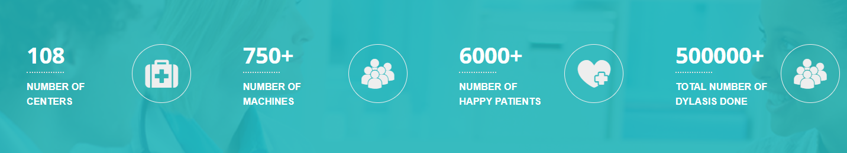
ABOUT DCDC
One of the most trusted institutions in Dialysis care delivery in Delhi / NCR
As an epitome of trust and compassionate care
Standardized dialysis protocol, well trained renal professionals and backend technology procedures
State of the art equipment, RO system and support on life style management
First dialysis institute to offer home hemodialysis at an affordable cost and with no initial investment
  Good evidence that quality of life of these patients is much better

Slide 20
ABOUT DIALYSIS UNIT
Outsourced to DCDC Health Services Pvt. LTD since February 2018
Equipped with 10 hemodialysis machines and one CRRT machine
Runs four shifts a day, seven days a week
Caters to IPD and emergency dialysis along with daily OPD dialysis

Slide 21
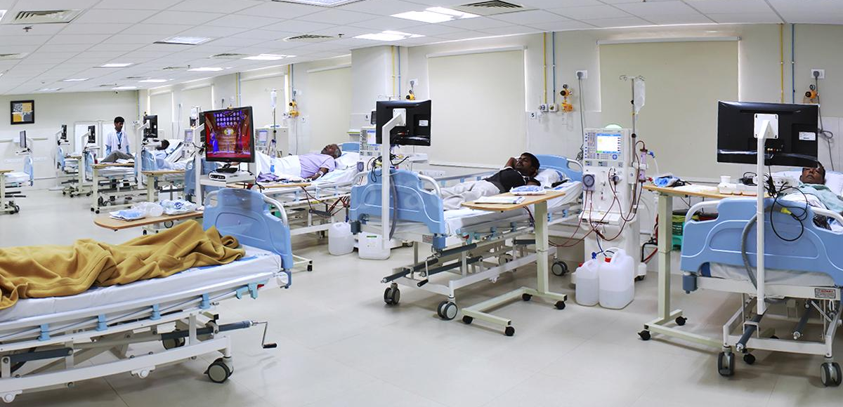
DIALYSIS UNIT

Slide 22
THANK YOU

