Slide 1
Service Readiness and Utilization of Reproductive and Child Health Services at Public Health Center of Ukhimath, District Rudraprayag,Uttrakhand
International Institute of Health Management Research
New Delhi- 11075
Mentor
Dr Anandi Ramachandran
Associate Professor
IIHMR, New Delhi
Presented
by Col Aman Negi
Roll No PG/17/006

Slide 2
Introduction
Area of 55,845 sq. km
Two divisions (Garhwal and Kumaon)
13 districts
16,826 inhabited villages
86 small towns
It has only five cities with a population over one lakh
93 percent State is hilly
63 percent of it is covered with forests
small villages with 89 % of the villages having less than 500 people

Slide 3
Demographic and Health profile of Uttarakhand State compared to India
Indicator | UKhand | India
Total population (in millions) | 10.3 | 12.11
Rural population (% Census 2001) | 74 | 68.88
Population density | 158 | 382
Institutional deliveries (% of total -NFHS III) | 40.8 | 36
Infant Mortality Rate (SRS 2011) | 38 | 47
Maternal Mortality Ratio (SRS 2011) | 188 | 212
Sex Ratio (Census 2001) | 962 | 942
Complete Immunisation (%NFHS- III) | 62.99 | 43.5

Slide 4
Availability of Health Care Infrastructure and Human Resources
Particulars | Required | In position | Shortfall
Sub-centre | 1294 | 1765 | -
Primary Health Centre | 214 | 239 | -
FHW (Female)/ANM at SC & PHCs | 2004 | 1903 | 101
MHW at Sub Centres | 1765 | 616 | 1149
Health Assistant (Male) at PHCs | 239 | 417 | -
Doctor at PHCs | 239 | 866 | -
Gynaecologists at CHCs | 55 | 30 | 25
Physicians at CHCs | 55 | 4 | 51
Paediatricians at CHCs | 55 | 18 | 37
Total specialists at CHCs | 220 | 67 | 153
Nurse/Midwife | 624 | 292 | 332

Slide 5
Motherhood is the most important phase in a woman’s life
Main program of NRHM is to strengthen ‘RCH’ Care
Components of antenatal, delivery and postnatal care
Antenatal Care
Focused ANC Visits and referral
Early detection and diagnosis of disease/abnormality
Components of ANC
Counseling on health promotion
Delivery Care
Birth and emergency preparedness
Postnatal Care
Promotion of healthy behaviours
Extra care for low birth weight babies
Check up by doctors within 48 hours of delivery

Slide 6
Literature Review
Assessing Indian Public Health Standards for 24 × 7 Primary Health Centers : A case study with special reference to newborn care service | Prahlad Rai Sodani, Kalpa Sharma, Professor & Dean (Training), Institute of Health Management Research, Jaipur, Rajasthan, India
Perceived Barriers to Utilization of Maternal Health and Child Health Services: Qualitative Insights from Rural Uttar Pradesh, India | Neelanjana Pandey, International Institute for Population Sciences, India
Workload Assessment of Auxillary Nurse Midwives and Infrastructure Assessment of Subcenters in Selected High and Non High Priority Districts of Uttar Pradesh | International Institute of Health Management Research, New Delhi
Quality of maternal healthcare in India: Has the National Rural Health Mission made a difference? | By Harish Nair, Rajmohan Panda , Centre for Population Health Sciences and Global Health Academy, University of Edinburgh, Scotland, UK

Slide 7
Purpose, Rationale & Problem Defination
Purpose
Understand the current situation related to healthcare
service preparedness
readiness to provide services
their existing utilization at PHC Ukhimath, under CHC Agustmuni in Rudraprayag District of Uttrakhand
Rationale and Problem Definition
Imposes peculiar challenges to health service delivery due to inhospitable terrain and its geography.
Population of PHC Ukhimath is 52,280 (Year 2019)
11 Sub-centers
Seven SADs (State Allopathic Dispensaries)

Slide 8
Objective
To evaluate the Readiness of PHC Ukhimath and its associate Health centers ( SC and SADs) to provide RCH services and their utilization
Provide recommendations to improve the availability and provision of RCH services
Specific Objectives
To identify the existing gap in health care services provided in PHC and Subcentres
To evaluate the existing coverage of RCH services related to antenatal checkups, immunization services, Institutional/safe deliveries, and JSY Beneficiaries
To understand the extent of ANMs and ASHA’s involvement in the provision of care and the barriers and challenges faced by them
To learn about the use of technology in the provision of services and from best practices adopted by non-Public Health centers in the area.
Based on the above provide possible recommendations

Slide 9
Materials and Methodology
Approval of the CMO Rudraprayag
Study Design : Descriptive study based on Mix Method Approach
Sample Units :
PHC Ukhimath
Subcentres/SADs located at Kalimath, Mansoona, Parkandi, Guptkashi, Jaggibhagwan, Makkumath, Ransi, Phata and Diara ( 8 Sub-centers out of 11 and 4 SADs out of 7)
Rationale for selection : based on their accessibility, distance and road condition from the PHC, Ukhimath

Slide 10
Sub-Centre/ SADs | Distance (Kms) |  |  | Surveyed for
 | PHC | CHC | Dist Hosp
Ukhimath** | - | 25 | 44 | Infrastructure and MCH
Mansoona* | 7.5 | 32 | 51.4 | -do-
Kalimath * | 21.8 | 31 | 21 | -do-
Makkumath | 28.5 | 29 | 48 | -do-
Jaggibhagwan | 25 | 50 | 68 | -do-
Parkandi *(SC) | 18.4 | 19 | 38 | -do-
Guptkashi* | 20 | 30 | 24 | MCH Only
Daira* | 11.3 | 34 | 35 | Infrastructure Only
Ransi | 20.2 | 45 | 64.2 | - do-
Phata | 29 | 38 | 26 | -do-
Paldwari | 30.3 | 28 | 49
Gaurikund * | 44 | 53 | 72.4

Slide 11
Target Population:
ANMs, ASHAs, CMO, Pharmacist, Centres in Charge and community (Pregnant women & mothers with children < age 2 years)
Exclusion Criteria: Mothers whose child died during delivery
Sample Size: As under
Stakeholders: Doctors, CMOs, Pharmacists, Lab Assistant: 10 (approx. 1 from each center)
ASHA & ANMs: 15 based on their availability during the survey
Community: 28 (approx. 4 from each center)
Data Type & Data Collection Method: As under
Primary Data: Quantitative - Facility Survey to assess health Subcentres Questionnaire and Checklist as for service assessment (IPHS Guideline).
Qualitative: Interviews/ Focused Group Discussions (FGDs) and Exit Interviews of relevant Stakeholders (Health providers and Community)
Secondary Data: Literature Review and Registers
Tools: Questionnaires ( as given at Appendices ’A’,’B’, ‘C’ and ‘D’)

Slide 13
RESULTS

Slide 14
To identify the existing gap in health care services provided in PHC and Subcentres

Slide 15
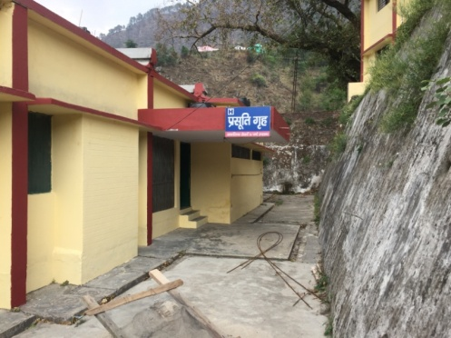
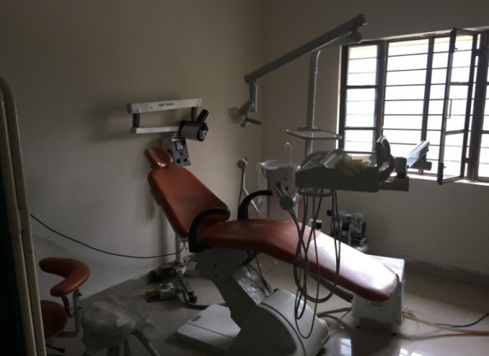
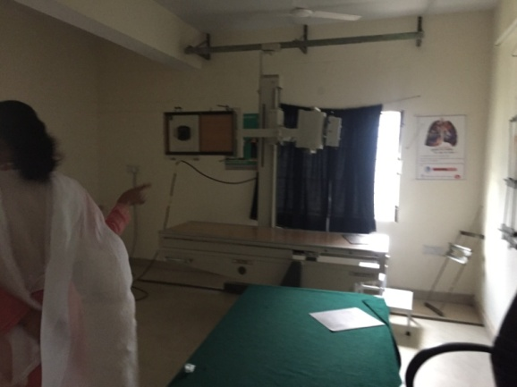
PHC, Ukhimath

Slide 16
Utilisation of MCH Services: PHC ( Last One Year)
Case | Numbers
Number of cases provided with ANC services | 350
Number of Deliveries performed | 180
If deliveries performed, beneficiaries of Janani Suraksha Yojana | 180
Complicated pregnancies/ delivery cases referred | 24 (18 High-Risk ANC ( before delivery) and 6 High-Risk PNC ( after delivery))
Women provided with PNC services | 224
Number of newborn care provided | 224
Number of children treated for Acute Respiratory Tract Infection (ARI) | 2
Number of infants and children immunized | 224

Slide 17
Utilisation of Family Planning and Contraception/Other Services
Type | Numbers
No. of oral pills users | 50
No. of condom users | 400
No. of women given EC pills | 300
No. of IUD insertion cases | 300
Number of Sterilization cases | Males – 10 ( from the village of Trigunnarayan) Females - 60
Observations
Approximately 30-40 Patients come to PHC on a daily basis
Poor utilisation of ANC & FP services. Sterilization prominent in women
ECG and Pulse reader and Autoclave either not available or under repair
Lab facility does not cater TLC/DLC and Rapid Plasma Reagin Tests
Doctors are generally Dental Doctors. Dental OPD taken
No facility for Ultrasound etc
Vaccines are distributed to Subcentres in vaccine carriers
No Communication facilities

Slide 18
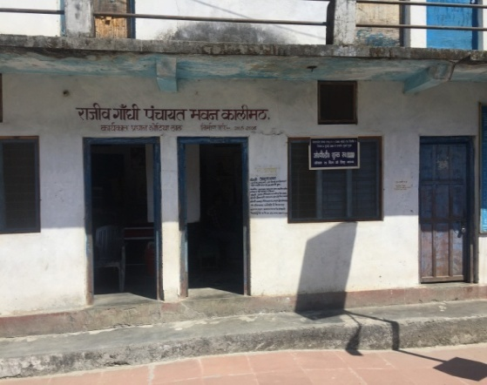
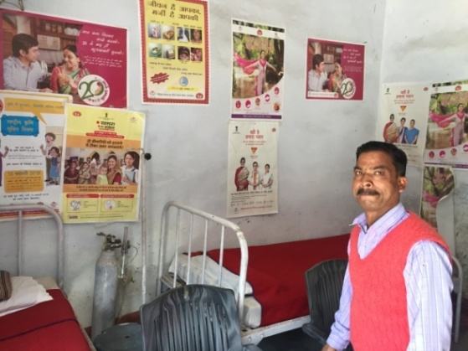
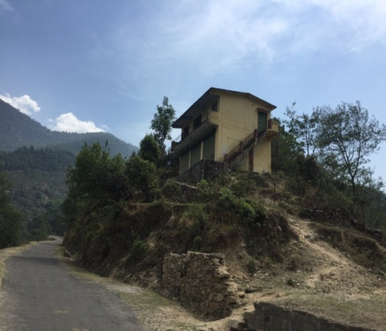
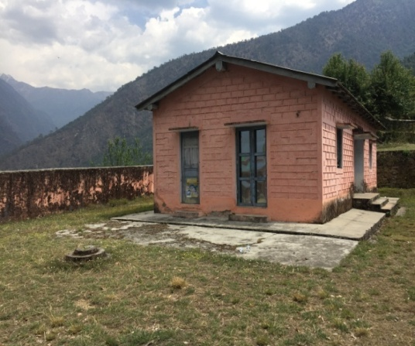
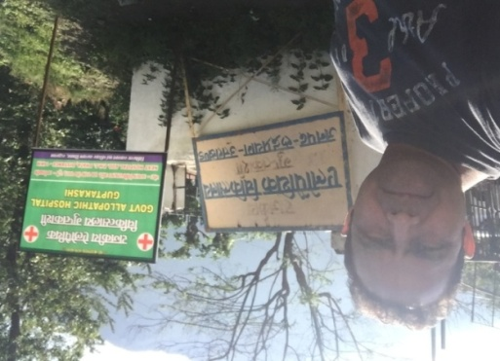
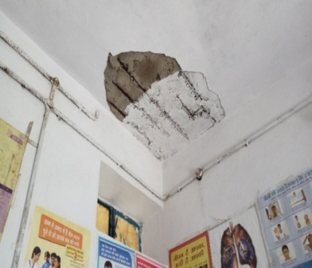
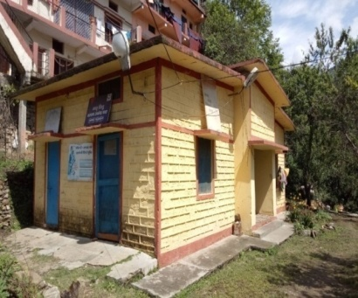
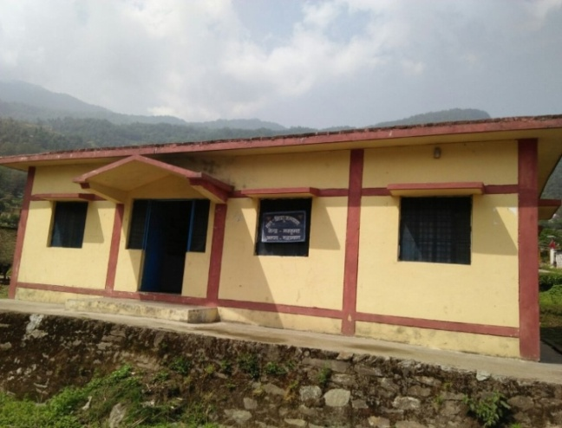
Sub-centers under PHC, Ukhimath

Slide 19
Items | Kalimath | Jaggi-bhagwan | Parkandi | Makku | Mansoona | Ransi | Daira | Phata
Population | 4141 | 2139 | 1812 | 1816 | 4016 | 2013 | 3622 | 6130
Distance from PHC ( Kms) | 22 | 21(8 km trek to Mansoona) | 19 | 29 | 7.5 | 20 | 12 | 27
Distance from CHC | 31 | 40 | 20 | 29 | 32 | 44 | 34 | 39
Labour Room Facilities | ✗ | ✗ | ✗ | ✗ | ✗ | ✗ | ✗ | ✓(SAD)
Family Planning | ✓ | ✓ | ✓ | ✓ | ✓ | ✓ | ✓ | ✓
Field Visits | ✓ | ✓ | ✓ | ✓ | ✓ | ✓ | ✓ | ✓
Own Bldg | ✗ | ✗ | ✗ | ✓ | ✓ | ✓ | ✓ | ✓
Manpower held | ANM | - | ANM | ANM & Pharmacist | ANM( 2 Sub-centres) | ANM & Pharmacist | ANM | ANM*
Facility for ANM to Stay at Sub-centres | ✗ | ✗ | ✗ | ✗ | ✗ | ✓ | ✓ | ✓
ANM Staying at Sub-centres | ✗ | ✗ | ✗ | ✗ | ✗ | ✓ | ✗ | ✓
Location(Inside) | ✓ | ✗ | ✓ | ✓ | ✗ | ✓ | ✗ | ✓
Accessibility | ✓ | ✗ | ✓ | ✓ | ✗ | ✓ | ✗ | ✓
Building | Old | - | SAD | Old | Old | Old | New | Old
Water | ✗ | ✗ | ✓ | ✗ | ✗ | ✗ | ✓ | ✓
Electricity | ✓ | ✗ | ✓ | ✗ | ✗ | ✓ | ✗ | ✓
Conduct of Immunisation | ✓ | ✓ | ✓ | ✓ | ✓ | ✓ | ✓ | ✓

Slide 20
Population Coverage
Population Covered by Subcentres ( Nos) | No of Subcentres ( N=8)
2000 and less | 3 ( 42%)
2001- 4000 | 2 (28%)
4001 – 5000 | 2 (28%)
>5000 | 1 (14%)
Availability of services in the sub-center
Services | No of Subcentres ( N=8)
Nonavailability of ANM | 1 (14%)
Availability of Labour room | 1 (14%)
Family planning and Field Visits | 8 ( 100%)
National Health programs | 8 ( 100%)

Slide 21
Existing Human Resources at the Sub-Centres
Human Resource as per IPHS | As per IPHS (for 8 SCs) | Available ( N=8)
ANMs | 8 | 7 ( 87%)
Pharmacists/ MHW | 8 | 2 (25%)
Housekeeping Staff( Parttime/fulltime) | 8 | -
Distance of the Sub-centers from PHC, CHC and District Hospital
Distance in Kms | PHC | CHC | District Hospital
> 10 | 87% | 100% | 100%
10 to 20 | 50% | 100% | 100%
20 to 30 | 25% | 25% | 25%
>30 | 13% | 75% | 75%

Slide 22
Maintenance and upkeep of the building and surroundings
State of Building | No of subcentres (N=8)
Building in good condition | 6 (75%)
Building in bad condition | 2 (25%)
Building Floor, Ceiling and walls broken at places | 6 (75%)
Boundary wall
Complete | 1 (12.5%)
Partial | 3 (37%)
Not there | 4 (50%)
Condition of Plaster, Ceiling, and walls
Good | 3 (37%)
Coming out at few places | 3 (37%)
Very poor condition | 2 (25%)
Condition of Floor
Good | 3 (37%)
Coming out at few places | 4 (50%)
Very poor condition | 1 (12.5%)

Slide 23
Patient utilities, Water and Electricity
Utilities Available | No of subcentres (N=8)
Display Boards | 8(100%)
Toilets | 1( 12%)
Toilets ( Separate for males and females) | 0
Water | 3 (37%)
Electricity | 4 (50%)
Suggestion/complaint box | 7 (87%)
Ambulance | 0
Facilities for staff
Facilities for staff | No of subcentres (N=8)
Residence for ANM | 4 (50%)
ANMs staying at Sub-center | 3 (37%)
Residence for MHW | 0
Telephone provided by the department | Nil ( earlier had a CUG)
Transport | 0

Slide 24
Barriers & Challenges
ANMS not staying at Sub-centers
Sub-centers/SADs not located in the village (Diara and Mansoona)
SC/SADs do not have water and electricity
Deficiency of manpower. Too much of a rotation.
Deficiency of accomodation
Shortages of medicines
Located away from Road head
ANM not posted to a sub-center

Slide 25
Qualitative Assessment : Interaction
Due to location of the SAD, very few patients come to the SAD, no patient suffering from Joint pain.
SAD/SC has been reconstructed again at the same location in spite of it being distant from the RH.
No proper chair for the MO IC and benches for the Patients have been provided.
No deliveries can be undertaken due to location and non availability of water at the Sub center. Saline is being used by doctors to wash hands for and after dressing.
SC is away from the Village and a path through the Jungle leads to the Subcentre. Inhabited by wild bears and Leopards.
Villagers are apprehensive about getting their children immunized
ANM has dedicated one room in her own house
Subcentre is located around 1.5 Kms away from the Village at a hill top
Shows another SC across in a opposite mountain at Jaggibhagwan
I purchase few medicines myself.

Slide 26
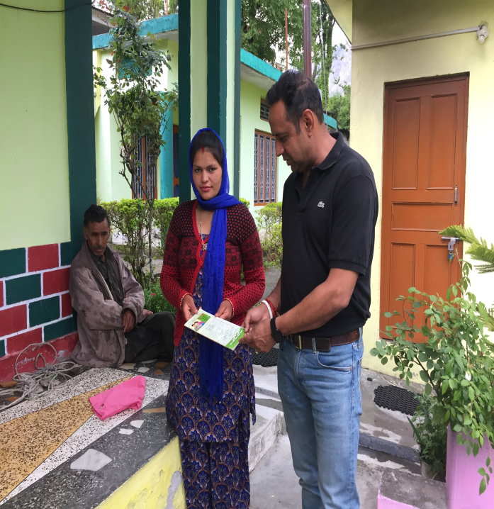
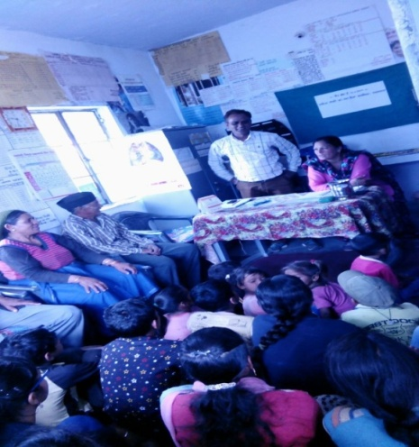
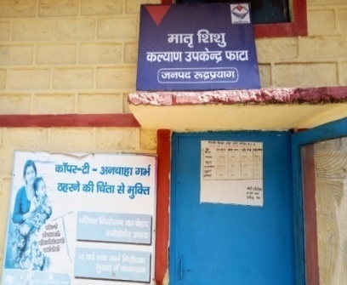
To evaluate the existing coverage of RCH services related to antenatal checkups, immunization services, Institutional/safe deliveries, and JSY Beneficiaries

Slide 27
Antenatal, Natal and Post Natal Care
 | Mothers with children < age 2 years | Pregnant women | Total | %
ANC received at
Subcentre | 7 | 12 | 19 | 79
PHC | 1 | - | 1 | 4
CHC | - | 1 | 1 | 4
Dist Hospital | 1 | 1 | 2 | 8
Home | 1 | - | 1 | 4
Pregnancy registered at
Subcentre | 6 | 12 | 18 | 75
Anganwadi | 1 | 1 | 2 | 8
Dist Hospital | 3 | 1 | 4 | 17

Slide 28
No of IFA tablets received from
Sub-center | 7 | 12 | 19 | 79
Hospital | 3 | 1 | 4 | 17
Yet to get | - | 1 | 1 | 4
Tetanus Injection Given
Yes | 9 | 12 | 21 | 88
Yet to get | - | 1 | 1 | 4
Don’t know | 1 | 1 | 2 | 8
Motivated by whom for ANC
ANM/ASHA | 5 | 9 | 14 | 58
ANM | 5 | 4 | 9 | 37.5
ASHA | - | 1 | 1 | 4

Slide 29
Delivery conducted by
Doctor | 2 | NA | 2 | 20
ANM | 6 | NA | 6 | 60
Staff Nurse | 1 | NA | 1 | 10
DAI | 1 | NA | 1 | 10
Mode of Transport taken to reach the Delivery location
Ambulance | 6 | NA | 6 | 60
Jeep | 2 | NA | 2 | 20
At home | 2 | NA | 2 | 20
Transport arranged by
ASHA | 6 | NA | 6 | 60
Family | 2 | NA | 2 | 20
At Home | 2 | NA | 2 | 20

Slide 30
Received Govt Financial assistance ( JSY) |  |  |  | %
Yes | 7 | NA | 7 | 70
Don’t know | 1 | NA | 1 | 10
First, check up of child at
PHC | 6 | NA | 6 | 60
CHC | 1 | NA | 1 | 10
Hospital | 2 | NA | 2 | 20
Home | 1 | NA | 1 | 10
Exclusive breast feeding for
6 months | 9 | NA | 9 | 90
3 months | 1 | NA | 1 | 10
Vaccination carried out
Complete | 10 | NA | 10 | 10

Slide 31
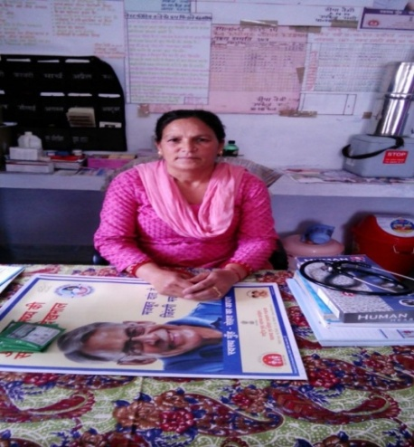
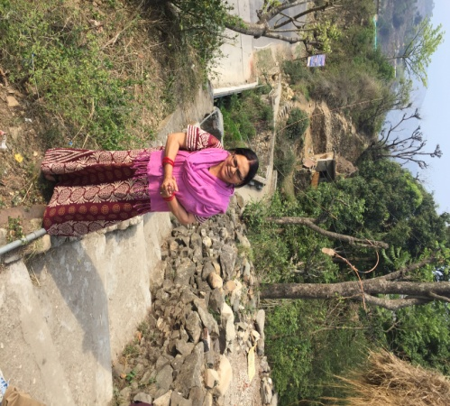
To understand the extent of ANMs and ASHA’s involvement in the provision of care and the barriers and challenges faced by them
ANMs under PHC Ukhimath have an experience atleast of more than 25 years, except one recently posted

Slide 32
Result from coverage of RCH services
Trend of early marriages and Pregnancy: By age of 23, 82 % were married and 79% were pregnant with first child
Educational Qualification : 33% were educated only till class 10th, 50 % from class 10th to class 12th and 17% were graduates and postgraduates.
Occupation: All the respondents practiced Agriculture as Occupation, 92% stayed with their husband and only 8% had their husbands away.
ANC Care and Pregnancy Registration: Maximum of the Pregnancies 75% have been registered at sub-center.
IFA Tablets and Tetanus Injection: 79% have received IFA tablets from the Sub-center itself. 88% respondents had received two tetanus injections
Delivery conducted by : 60% deliveries have been conducted by ANMs
Mode of Transport : 60% have used Ambulance arranged by ASHA
Financial Assistance under JSY: 70% have received assistance as per JSY

Slide 33
Result from coverage of RCH services
First Check up of Child : 60% checkups have taken place at PHC,
Breast feeding: 90% have breast fed for the entire 6 months
All the cases have reported that:-
Come to know about the pregnancy within three months
Underwent urine testing
Registered their pregnancy
Received antenatal check four times, except one case who was not aware
Underwent required checks during ANC
Educated about signs of Pregnancy complications
Advised on MCH activities
Received two Tetanus Injections, except one case who said ‘ Don’t know’
The newborn child was examined within 24 hrs of birth.
Are aware of care to be given to the newborn child.

Slide 34
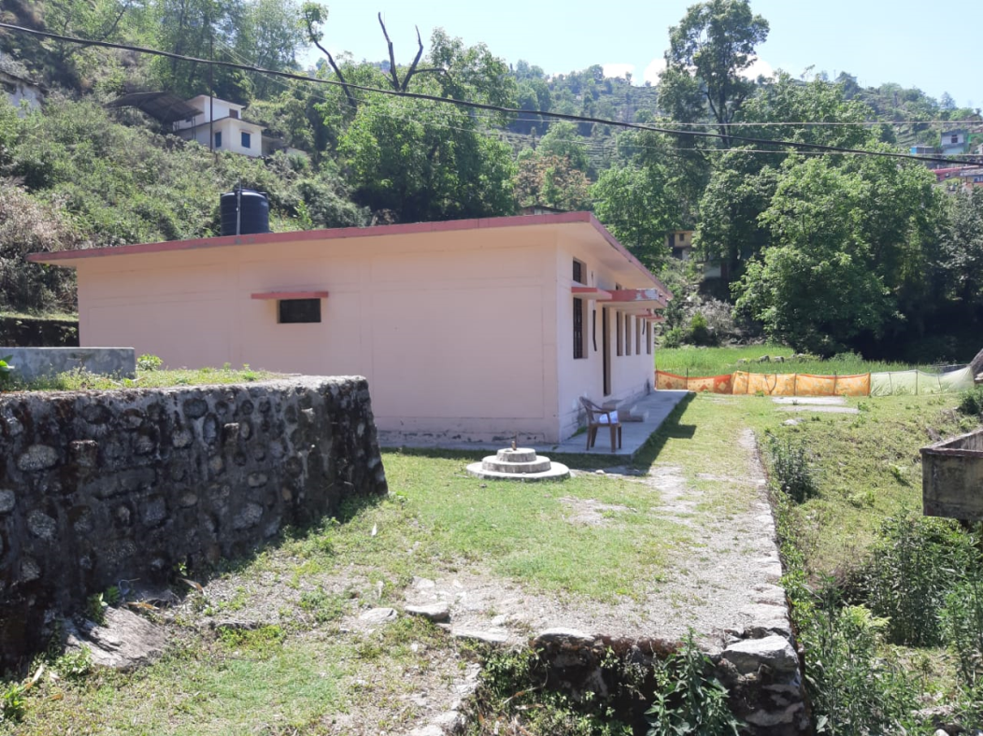
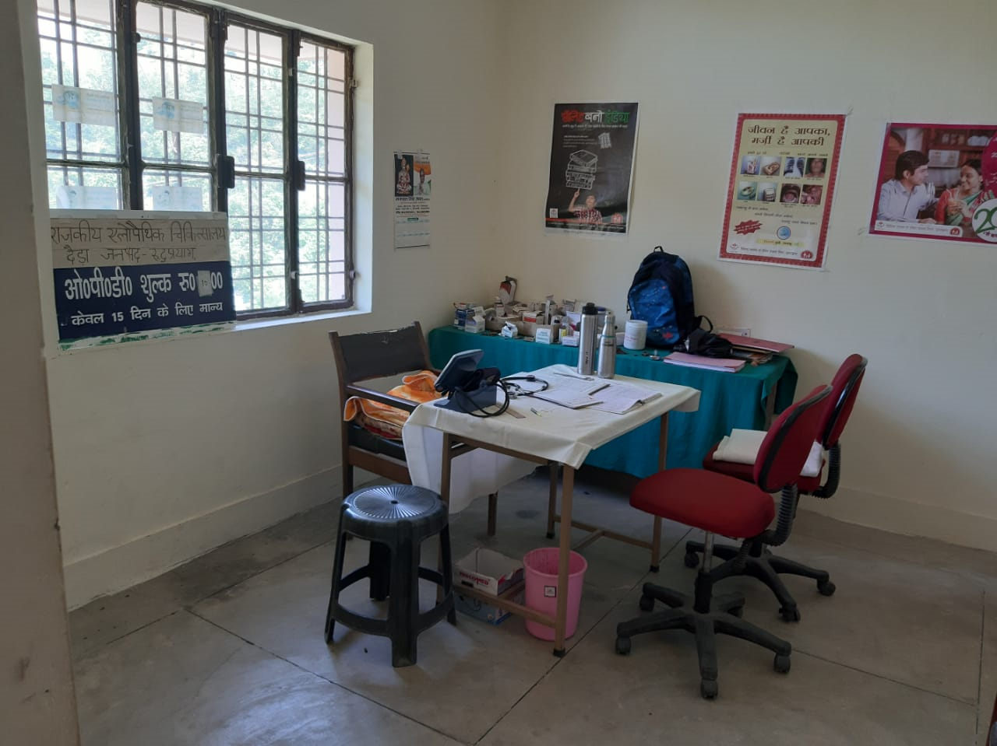
To learn about the use of technology in the provision of services and from best Practices adopted by non-Public Health centers in the area

Slide 35
Youth Foundation Uttrakhand
Youth Foundation has taken an initiative of providing rehabilitative care for Patients who probably suffer from life long diseases / injuries and been provided with dedicated care with an attendant
These patients were initially sent to Lady Harding, New Delhi . Follow up is now carried out using Skype, where they are examined on a regular basis by Doctors at Lady Harding/other Hospitals
Approx 110 patients have been treated by Youth Foundation Uttrakhand, through various Hospitals at New Delhi
Skype usage by Youth Foundation, as a tool to monitor progress is a innovative step and not only helps in routine and regular progress of Patients health but is also economical.

Slide 36
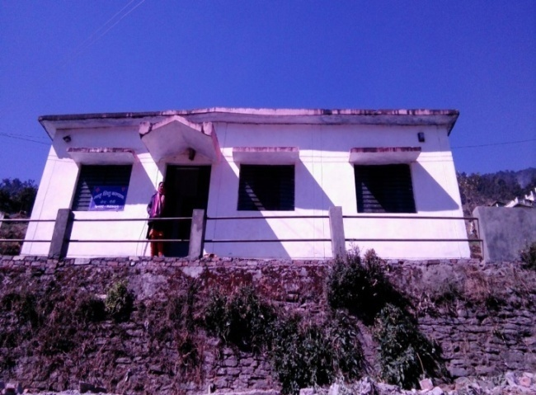
Based on the above provide possible recommendations

Slide 37
Physical Infrastructure as per IPHS
Shortage of staff needs to be made up
Provision for water and electricity to be carried out on priority
Provision of communication and transport facilities for Sub center
ASHAs to be made a formal part of health service delivery.
Gynecologist should posted to CHC Agustmuni and PHC Ukhimath. Upgradation of SAD Guptkashi to PHC be done on Priority

Slide 38
Proper planning for new Health facilities to take care of accessibility
Communication facilites and use of technology for telemedicine to be established, will assist delivery of health service to the people without having to travel large distances
Cater for Reverse innovation products like portable ultrasound machines
Provisions of Dormitories to women ( from inaccessible areas) in the last phase of their pregnancy to encourage institutional deliveries

Slide 39
Suggestion from ANMs
BCG and Measles Vaccines
BCG and Measles Vaccines should come in a smaller number of doses per vaccine. These vaccines come in a lot of 10 doses in one vaccine.
It becomes very difficult to find 10 children during each visit and this leads to wastage since BCG Vaccine has to be utilised within one hour of opening.
One of the ANM says, she has an additional task of looking after one more sub-center which can only be reached after a trek of 8 Kms from the Road Head,
during last one year there were 32 women pregnant from villages ( which are further dispersed in the mountains) under that sub-center
most of the deliveries under that Subcenter fait accompli will be at home
accommodation for women in the last stage of pregnancy should be made either at PHC/ CHC or SC

Slide 40
THANK YOU

