Slide 1
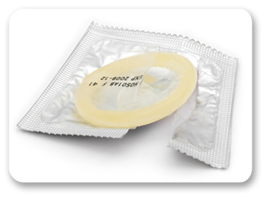
Socio-Economic differentials in contraceptive discontinuation in aspirational districts of India: Re-analysis of NFHS 4 data
By: Dr. Jaswinder Kaur
(PG/17/022)

Slide 2
rationale
Investment on FP provides multiple returns: demographic, social, health, and economic benefits
Continuation of contraceptives - a summarized outcome indicator of FP services quality.
Categories of reasons for contraceptive discontinuation:
- Method-related reasons, contraceptive failure, reduced need, and non-method-related reasons (3).
In the 5 years preceding the NFHS 4 survey, 33 % of the women who started using a contraceptive method discontinued the method in less than 12 months, major reason being need to get pregnant.
Contraceptive discontinuation rates were higher for condoms/Nirodhs (47%), pills (42%) and for IUDs/PPIUDs (26%).
NITI Aayog’s “Transformation of Aspirational Districts” programme - 115 Aspirational districts districts are encouraged to catch-up with the best district within their state
35 districts chosen by Ministry of Home affairs (on the basis of the density of violence)
50 districts by Central Ministries of GoI (on the basis of severe deficiency or sensitivity in the district) and
30 districts by NITI Aayog (out of 10 states).

Slide 3
Objectives
To examine the socio-economic and demographic differentials in discontinuation of spacing methods (Pills, IUD and condoms) in aspirational districts in India, and
To understand the reasons of discontinuation of spacing method in the aspirational districts in India.

Slide 4
Methodology
Secondary data analysis
Using the raw data from the NFHS 4 (from DHS program website), we examine the knowledge among users and discontinuation rates for various modern spacing methods of contraceptives method by socio economic groups (Place of residence, Age , Education, Religion, Caste, living children at 1st use and wealth quintile) in 115 Aspirational districts of India.
Data analysis tools used -
SPSS- Analysis was done using SPSS syntax (a programming language unique to SPSS – a statistical package) and developing various syntax commands for analyzing the raw data from NFHS 4.
Microsoft Excel (data cleaning and presentation)
Study Period : 21st February 2019 to 31st May 2019

Slide 5
RESULTs
Contraceptive discontinuation rates (NITI Aayog’s 30)- PILLS

Slide 6
RESULTs
Contraceptive discontinuation rates (NITI Aayog’s 30)- CONDOMS

Slide 7
RESULTs
Contraceptive discontinuation rates (NITI Aayog’s 30)- IUD/PPIUD

Slide 8
RESULTs
Contraceptive discontinuation rates (50 districts by Central ministries)- PILLS

Slide 9
RESULTs
Contraceptive discontinuation rates (50 districts by Central ministries)- CONDOMS

Slide 10
RESULTs
Contraceptive discontinuation rates (50 districts by Central ministries)- IUD/PPIUD

Slide 11
RESULTs
Contraceptive discontinuation rates (35 districts by Ministry of Home Affairs)- PILLS

Slide 12
RESULTs
Contraceptive discontinuation rates (35 districts by Ministry of Home Affairs)- CONDOM

Slide 13
RESULTs
Contraceptive discontinuation rates (35 districts by Ministry of Home Affairs)- IUD/PPIUD

Slide 14
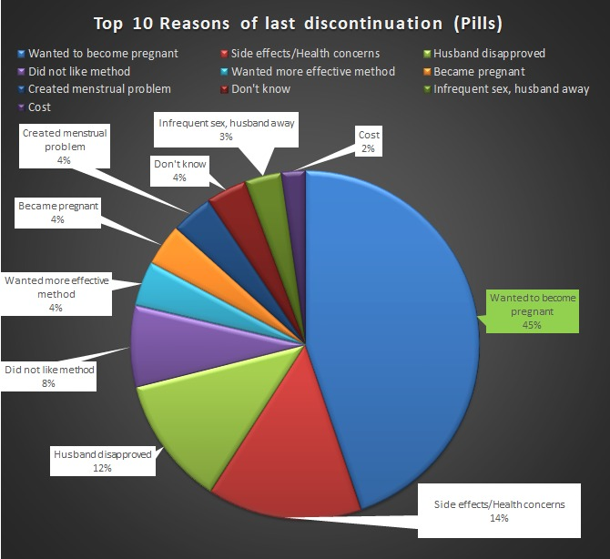
RESULTs
Reasons for discontinuation – NITI Aayog’s 30 districts

Slide 15
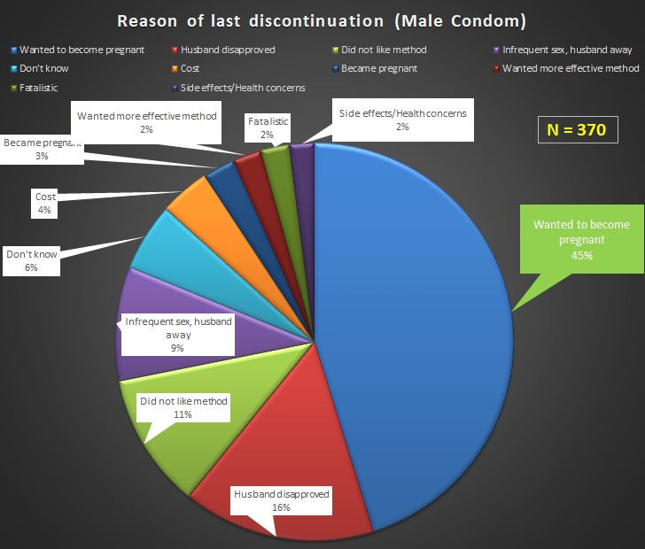
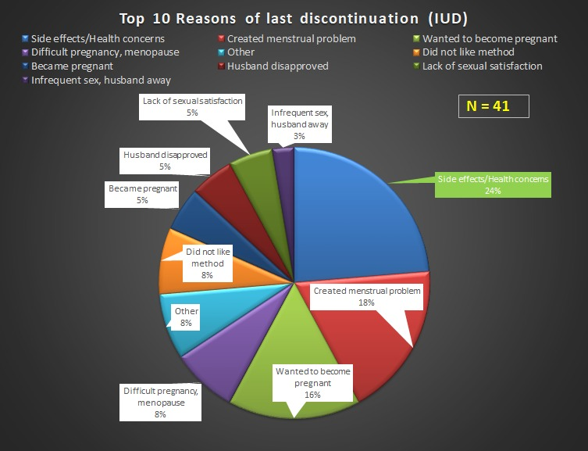
RESULTs
Reasons for discontinuation – NITI Aayog’s 30 districts

Slide 16
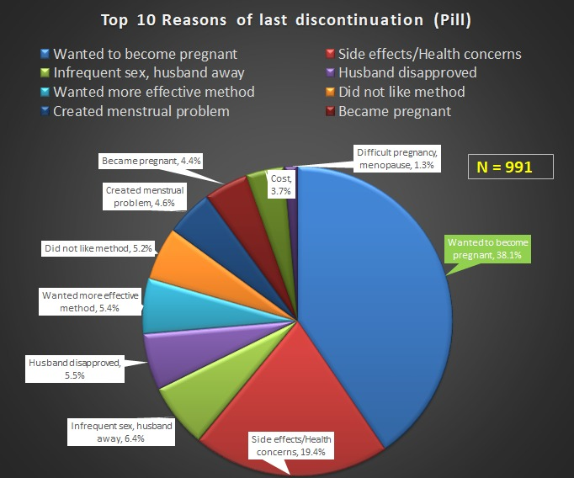
RESULTs
Reasons for discontinuation – 50 districts by Central ministries

Slide 17
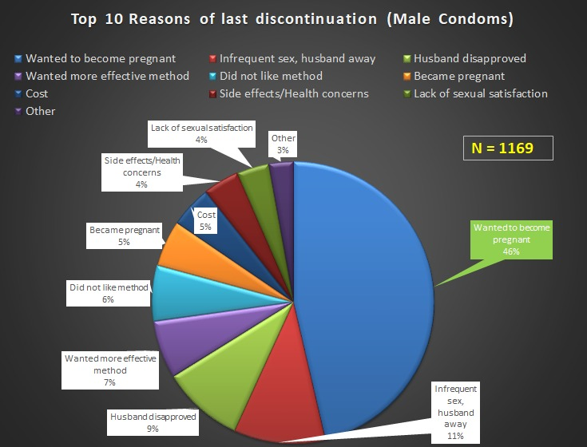
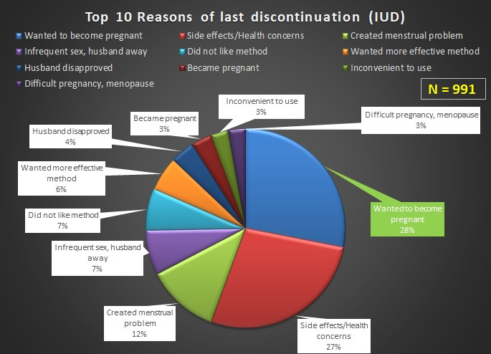
RESULTs
Reasons for discontinuation – 50 districts by Central ministries

Slide 18
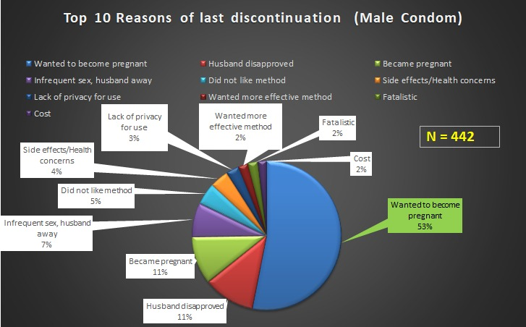
RESULTs
Reasons for discontinuation – 35 districts by Ministry of Home Affairs

Slide 19
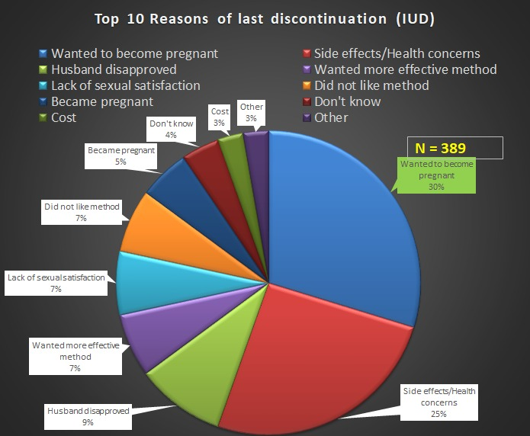
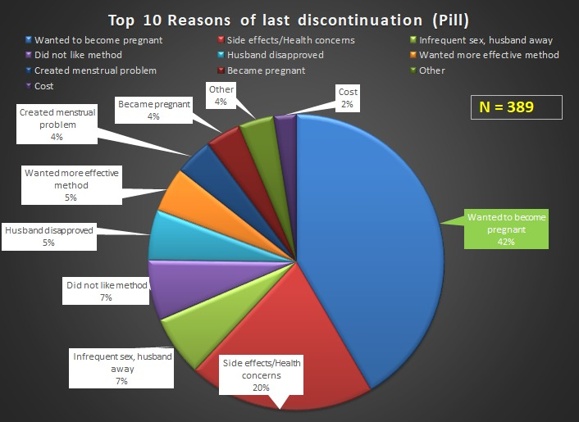
RESULTs
Reasons for discontinuation – 35 districts by Ministry of Home Affairs

Slide 20
Conclusion
The usage of contraceptives and subsequently the discontinuation rates were associated with socio economic differentials.
With increase in age, educational attainment and wealth quintile, the usage of contraceptives increased and subsequently, so did the discontinuation. Although, Higher than secondary education meant slight decrease in contraceptive discontinuation.
In terms of place of residence, the usage and discontinuation rates were more in urban and lesser in rural areas.
Scheduled Caste, schedule Tribe and other backwards class had very less usage of contraceptives and discontinuation rates.

Slide 21
Conclusion
Major reason for discontinuation observed, in various groups of aspirational districts were
wanting to become pregnant,
side effects/ health concerns and menstrual problems for IUD,
husband disapproved (for male condom),
husband being away/infrequent sex,
Wanted more effective method.

Slide 22
recommendations
Providing equitable distribution of good quality family planning services along with counselling services.
Improving the quality of family planning services includes counseling and follow-up visit in initial few months
Increasing counseling for spacing method users and Informing women about the risk of unintended pregnancies, induced abortion, and unwanted births, and promotes birth spacing
Motivating the traditional method user to use modern spacing method and
Monitoring the quality of contraceptive pills and IUDs; and
increasing provisioning of IUDs and condoms at public health centers can increase the contraceptive use and reduce the discontinuation of spacing method in India.

Slide 23
Thank you

