Slide 1
DEVELOPMENT AND ADVANCEMENT OF DIGITAL HEALTH THROUGH INTEGRATED HEALH INFORMATION PLATFORM (IHIP)
By: NAINSY KUMARI
PG/19/049
IIHMR,NEW DELHI
IN THE GUIDANCE OF
DR. ANANDHI RAMACHANDRAN
Associate PROF., IIHMR , NEW DELHI

Slide 2
JHPIEGO
Jhpiego is a nonprofit organization for international health affiliated with Johns Hopkins University.
The group was founded in 1973 and initially called the Johns Hopkins Program for International Education in Gynecology and Obstetrics, but is now referred to simply as Jhpiego.
Jhpiego creates and delivers transformative health care solutions that save lives. In partnership with national governments, health experts and local communities, Jhpiego builds health providers’ skills and develops systems that save lives now and guarantee healthier futures for women and their families.

Slide 3
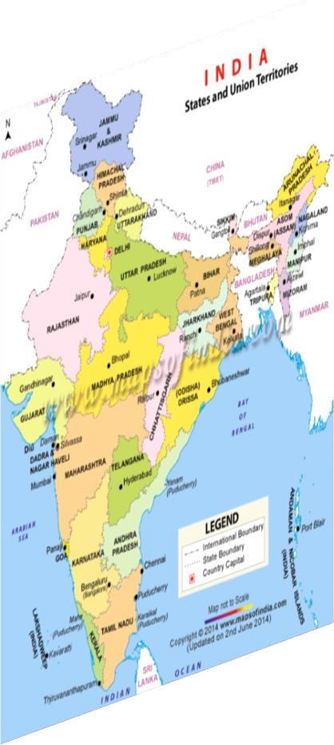
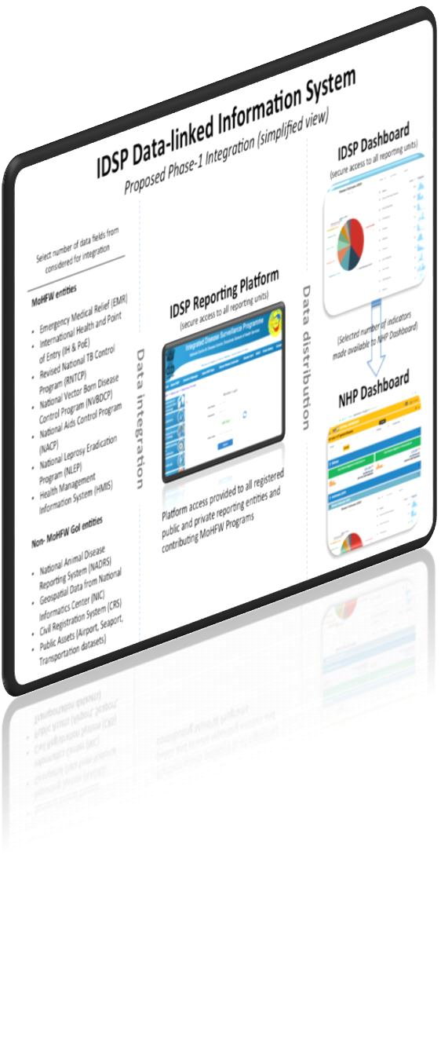
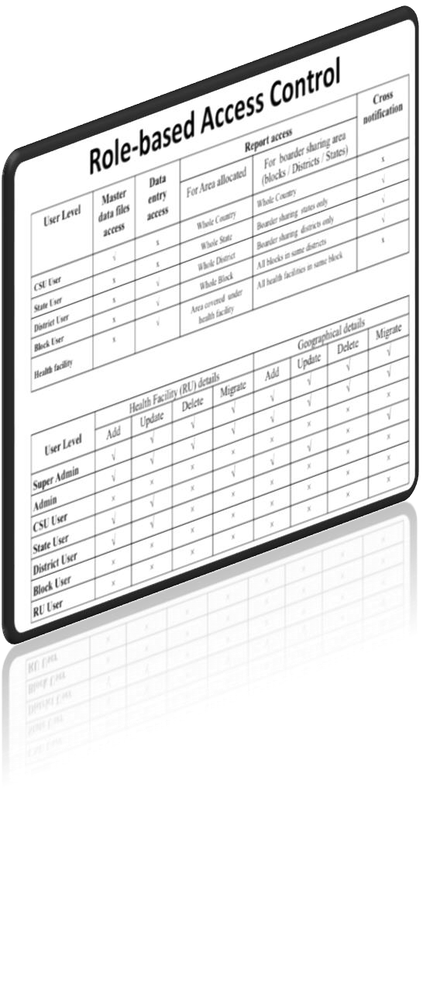
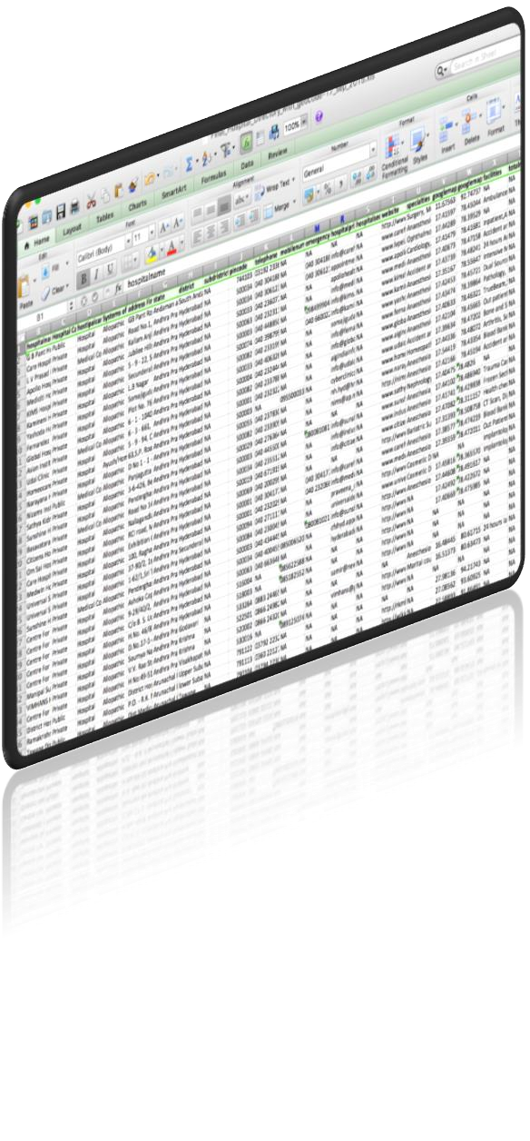
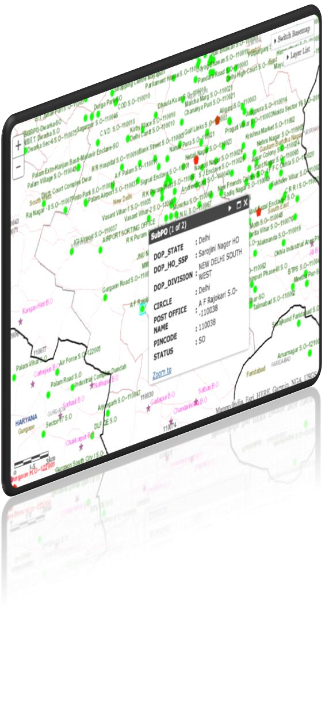
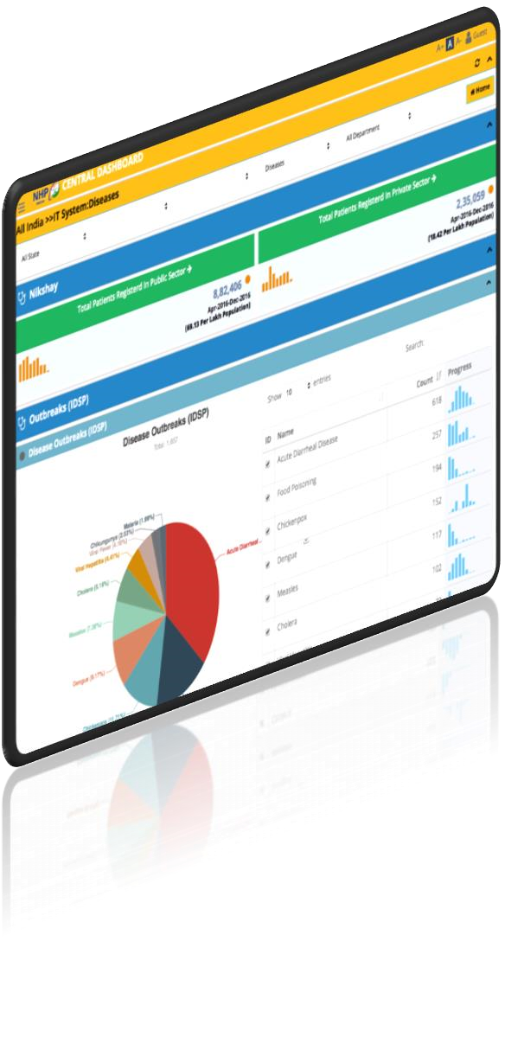
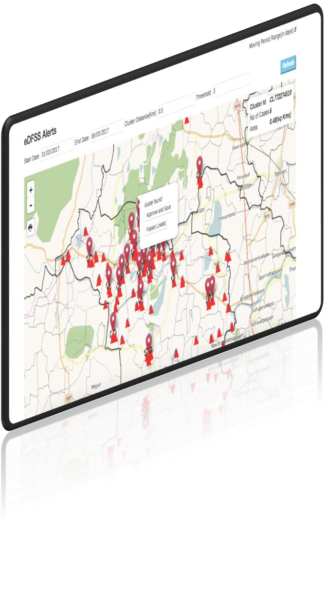
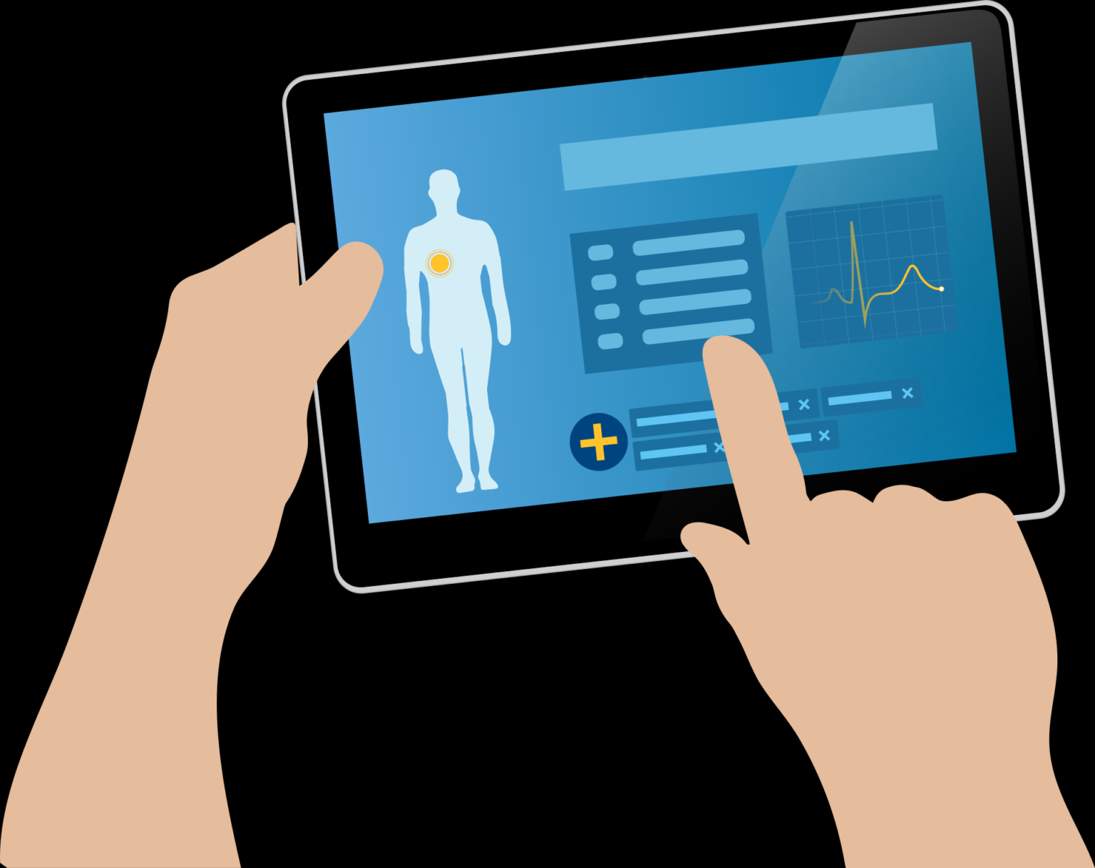
INTRODUCTION
Data Flow Analysis
Logical Data Model
Near real
NHP
IDSP Reporting Platform
-
-
Data Access
Geospatial reference
Data analytics
time feedback
IDSP Dashboard
UPDATING OF ‘S’, ‘P’ & ‘L’ FORMS ON IHIP APPLICATION

Slide 4
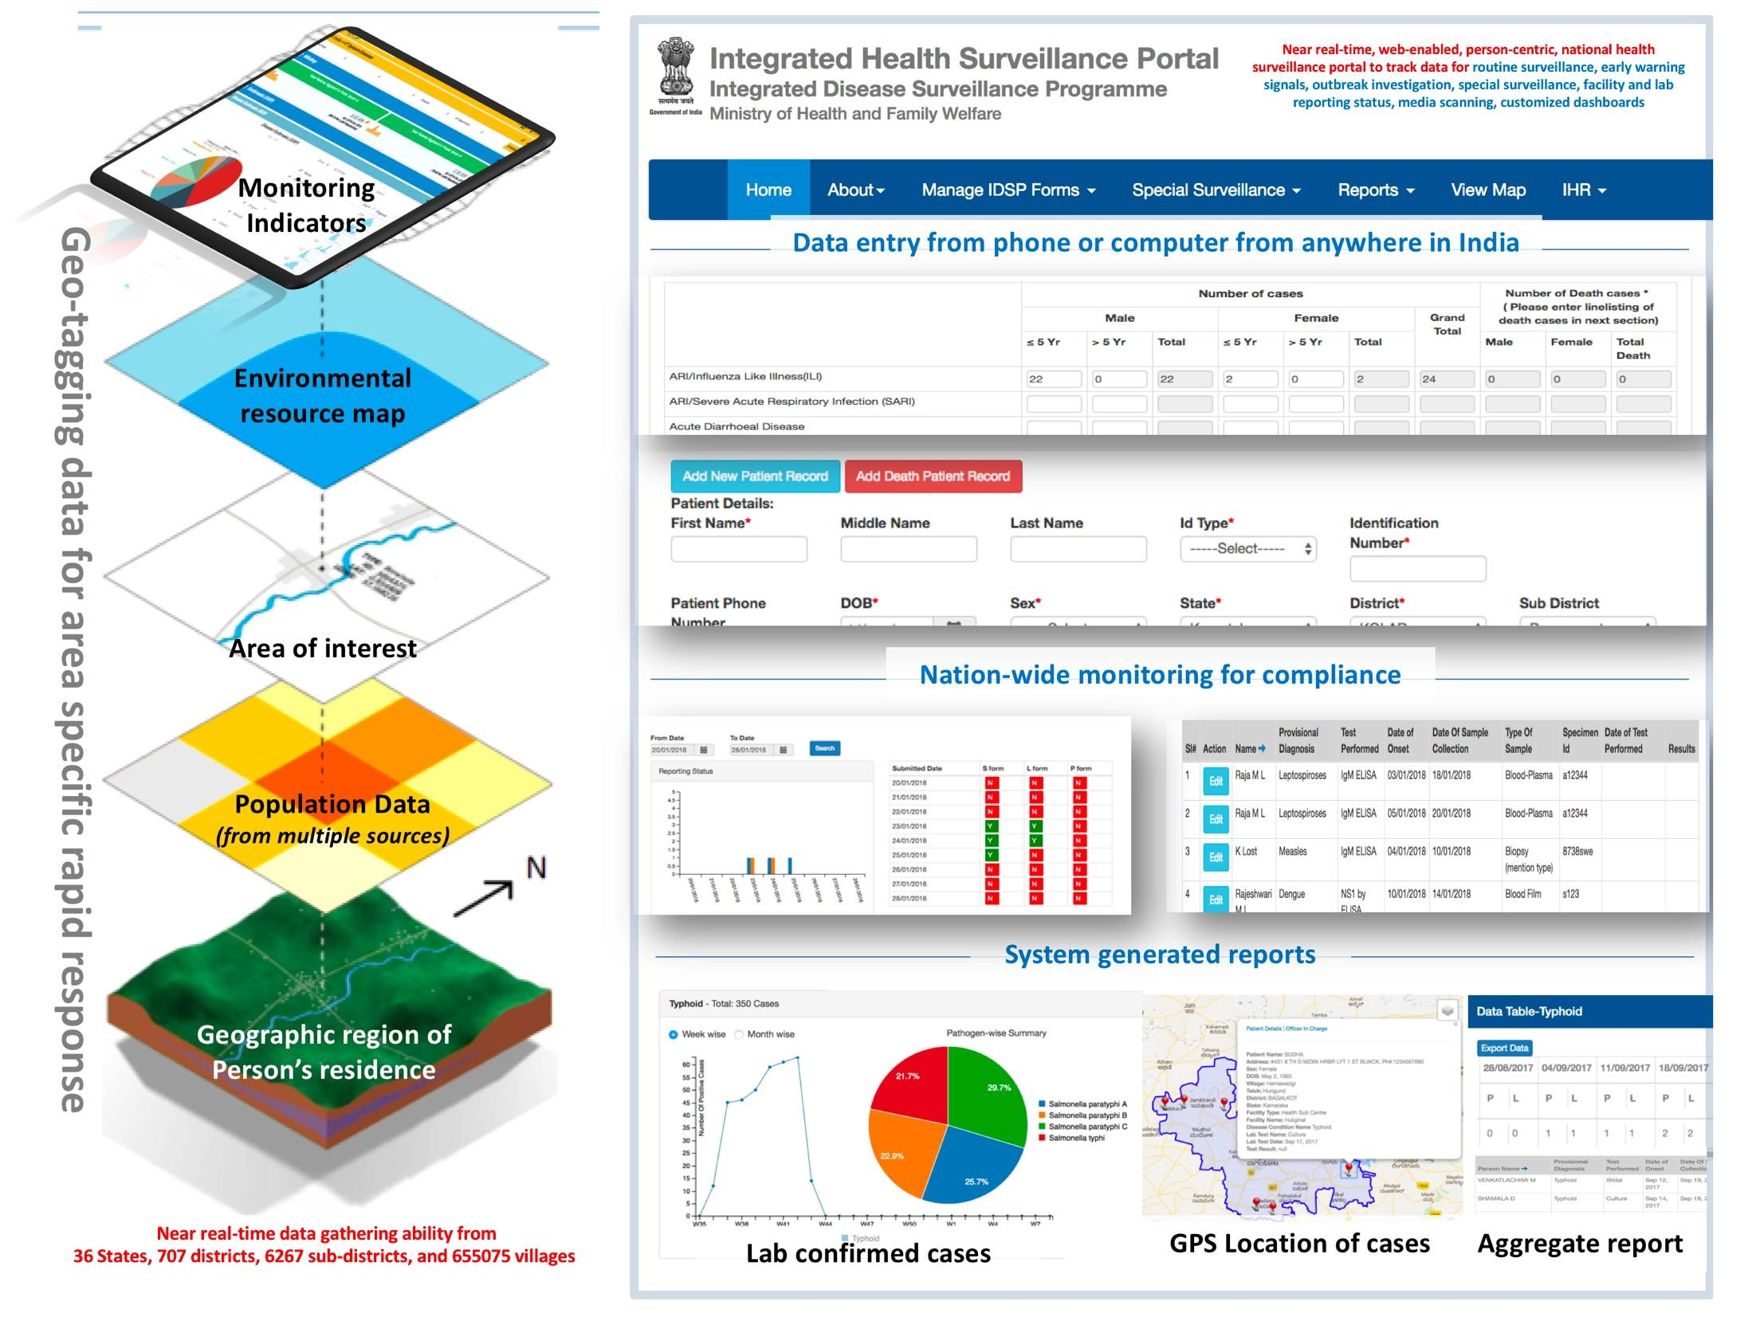

Slide 5
OBJECTIVE
To assess the status of IHIP & IDSP amongst the population and Health Workers of 15 districts of Madhya Pradesh.
To identify the process of IHIP enabling the creation of standards compliant Electronic Health Records (EHRs) of the citizens on a pan-India basis.
To provide recommendations for the adoption of IHIP and findings in the service provided by the system in view of customer relation through telephonic and field survey .

Slide 6
METHODOLOGY
Research Design- This is a descriptive study based on primary and secondary data both. The purpose of this study is to assess the development of Health Information System (Digital Health) through Integrated Health Information Platform. For Example- What major type of problems the users (Health workers and Consumers) are facing and the feedback from them like their suggestions towards the development of implementation of IHIP.
Research Approach- The respondants are be the users who were interested to cooperate. To collect data telephonic conversations were conducted with the ANMs, Pharmacists, Lab Technicians and Medical Officers of 15 districts of Madhya Pradesh.
Inclusion criteria- Analysis of IHIP portal for 3 months.
Geographical Location - India (mostly focused on Madhya Pradesh)
Language - English
Contact person - Asha Workers, ANMs, Medical Officers, Pharmacists, Lab technicians, Epidemiologists, Data Mangaers and Health surveillance employees.
Data Collection Method-The primary data was collected from the users listed above , these data were gathered directly from the respondents through in-depth interview. The secondary data were collected from different documents, guidelines, Projects published by MoHFW, GOI, IDSP.

Slide 7
FINDINGS
On an average almost 34.39% of districts are reporting on ‘S’‘P’ and ‘L’ forms respectively for the reporting cycle of March to June 2021. While the maximum percentage of districts reporting on ‘P’ form in 3 months was 88.40% that for ‘L’ form was 87.85 % and for ‘S’ form was 77.13% in the same reporting span. .
.
A synopsis of districts reporting on ‘S’‘P’&‘L’ forms is tabulated below
DISTRICTS | S Form |  | P Form |  | L Form
 | March2021 | June2021 | March2021 | June2021 | March2021 | June2021
Anuppur | 12.15 | 19.14 | 67.86 | 67.86 | 10.71 | 14.29
Rewa | 21.5 | 43.3 | 46.67 | 88.4 | 72.89 | 87.85
Satna | 24.7 | 57.5 | 36.3 | 43.1 | 26.3 | 43.1
Shahdol | 1.2 | 18.28 | 14.5 | 10.41 | 14.5 | 10.41
Sidhi1 | 4 | 8.63 | 0.27 | 0.55 | 0.27 | 0.55
Singhrauli | 7.04 | 11.4 | 0 | 0 | 0 | 0
Umaria | 29.03 | 37.9 | 57.14 | 59.8 | 47.64 | 59.3
Balaghat | 20.04 | 23.89 | 13.33 | 20.04 | 13.32 | 22.22
Chhindwara | 47.73 | 77.13 | 39.19 | 46.12 | 40.44 | 45
Dindori | 3.8 | 18.11 | 7 | 20.12 | 7 | 20.12
Jabalpur | 16.16 | 66.21 | 0 | 42.77 | 0 | 40.32
Katni | 19.78 | 53.55 | 12.08 | 50 | 12 | 50
Mandla | 0 | 15.17 | 2.1 | 39.01 | 2 | 39.01
Narsinghpur | 11.54 | 69.1 | 7.99 | 46.49 | 4.53 | 49.99
Seoni | 0 | 1.11 | 0 | 10.37 | 0 | 0
.

Slide 8
.
Priority syndromes/diseases for Integrated Disease Surveillance Programme on IHIP Platform
.
Rank | Final list of diseases after factor analysis | Syndrome/ disease
1 | Influenza-like illness | Syndrome
2 | Severe acute respiratory infection | Syndrome
3 | Dengue | Disease
4 | Dysentery | Syndrome
5 | Zika virus disease | Disease
6 | Acute hemorrhagic fever | Syndrome
7 | Acute viral hepatitis | Syndrome
Rank | Final list of diseases after factor analysis | Syndrome/ disease
Rank | Final list of diseases after factor analysis | Syndrome/ disease
9 | Chikungunya | Disease
10 | Chicken Pox (Varicella Zoster) | Disease
11 | Fever more than 7 days duration | Syndrome
12 | Malaria | Disease
13 | Scrub typhus | Disease
14 | Cholera | Disease
15 | Smallpox | Disease
16 | Enteric fever | Disease
17 | Acute flaccid paralysis | Syndrome: DD; Poliomyelitis, Gullian Barre Syndrome, Transverse myelitis
18 | Measles | Disease
19 | Acute encephalitis syndrome | Syndrome
20 | Meningitis | Syndrome
21 | Yellow fever | Disease
22 | Rubella | Disease
23 | Kyasanur Forest Disease (KFD) | Disease
24 | Mumps | Disease
25 | Anthrax | Disease
26 | Crimean-Congo hemorrhagic fever (CCHF) | Disease
27 | Leptospirosis | Disease
28 | Plague | Disease
29 | Brucellosis | Disease
30 | Pertussis | Disease
31 | Diphtheria | Disease
32 | Tetanus | Disease
8 | Acute diarrhoeal disease (except cholera) | Syndrome
*
Table 2: Priority syndromes/diseases for Integrated Disease Surveillance Programme – 2017

Slide 9
RECOMMENDATIONS
✓There should be a national core list of diseases with state specific amendments •
✓Acute respiratory infection (ARI) and influenza-like illness (ILI) need to be segregated
✓“Fever of unknown origin” to be replaced with “fever” more than 7 days duration •
✓Reduce duplication of data collection •
✓As disease priority differs from state to state, regional priority should be given importance •
✓Response components should be integrated with surveillance, Capacity building is needed on data analysis.

Slide 10
KEY SUGGETIONS
Adoption of frameworks and standards to strengthen the HIS under IDSP 
Revamping of IDSP portal to develop a GIS enabled software application, mobile technology for real time data collection and integration of SMS gateway and automated e-mail alerts
Introducing basic and advanced web analytical features in the portal
Redesigning of portal output, development of dashboard for real time visualization of data
Decentralization of data entry up to health facility level 
Development of offline data entry module
On-site data entry to prevent delays in reporting
Cross notification of positive results tested in labs to get accurate geographical disease trends 
Analysis of line list at all levels for outbreak detection.

Slide 11
CONCLUSION
IHIP needs to update the following components for all diseases that are prioritized through the consultative process: case definitions; type of surveillance to be implemented for each prioritized disease; and minimum data sets and data collection standards for each prioritized disease. It also needs to make all relevant changes to the reporting forms to reflect the amendments.
IDSP may advice all districts to conduct similar reprioritization exercises to include diseases of importance at the state level.
IHIP platform and information management need to be upgraded to confirm to the current standards. A comprehensive ICT and Information Management Master Plan document needs to be developed and maintained. The ICT Master Plan component needs to clearly define the computer network architecture (including the data layer and application layer) while the information management document must contain all aspects of data management, including data privacy and confidentiality.

Slide 12
REFERANCES
https://yourstory.com/socialstory/2021/04/union-health-ministry-launches-integrated-
health-information-platform/amp
https://pib.gov.in/PressReleaseIframePage.aspx?PRID=1709676
https://idsp.nic.in/WriteReadData/IHIP/IHIP%20ToT-Overview-Presentation.pdf
https://www.fresherslive.com/current-affairs/articles/launch-of-integrated-health-information-platform---ihip-28266
file:///D/Documents/Report_repriortization%20Diseases.pdf
https://ihip.nhp.gov.in/idsp/#!/implstatus?statecode=23&districtcode=416
https://idsp.nic.in/WriteReadData/l892s/10225372401558522642.pdf
https://idsp.nic.in/
https://idsp.nic.in/WriteReadData/l892s/13_AM.pdf
https://pib.gov.in/PressReleaseIframePage.aspx?PRID=1709676
https://yourstory.com/socialstory/2021/04/union-health-ministry-launches-integrated-health-information-platform/amp
https://www.idsp.nic.in/WriteReadData/IHIP/IHIP%20Manual-Final.pdf
https://www.researchgate.net/publication/314134187_Digital_services_How_are_they_different
https://ihiptraining.in/hmis/#!/nhealthprogram
https://journalsofindia.com/integrated-health-information-platform-ihip/
https://nhp.gov.in/NHPfiles/IHIP_queries_reply.pdf
.

Slide 13
THANK YOU

