Slide 1
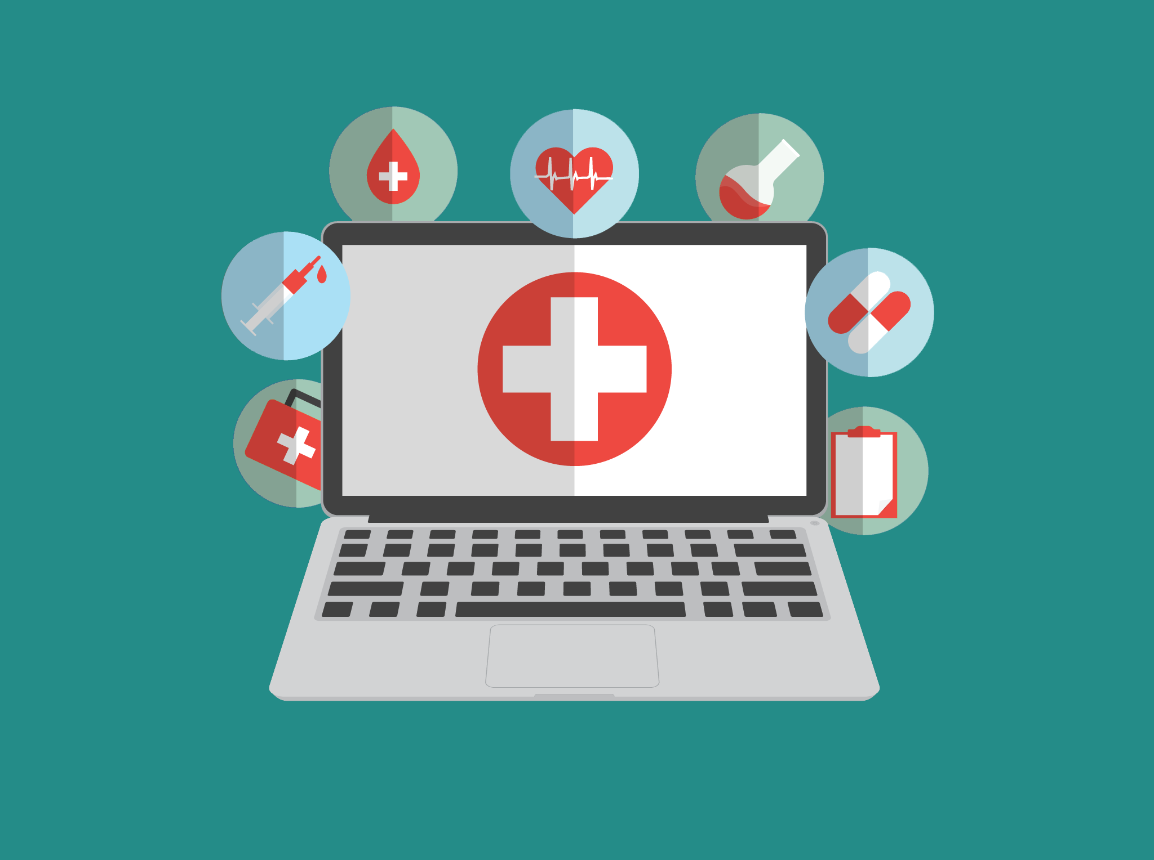
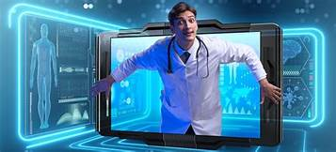
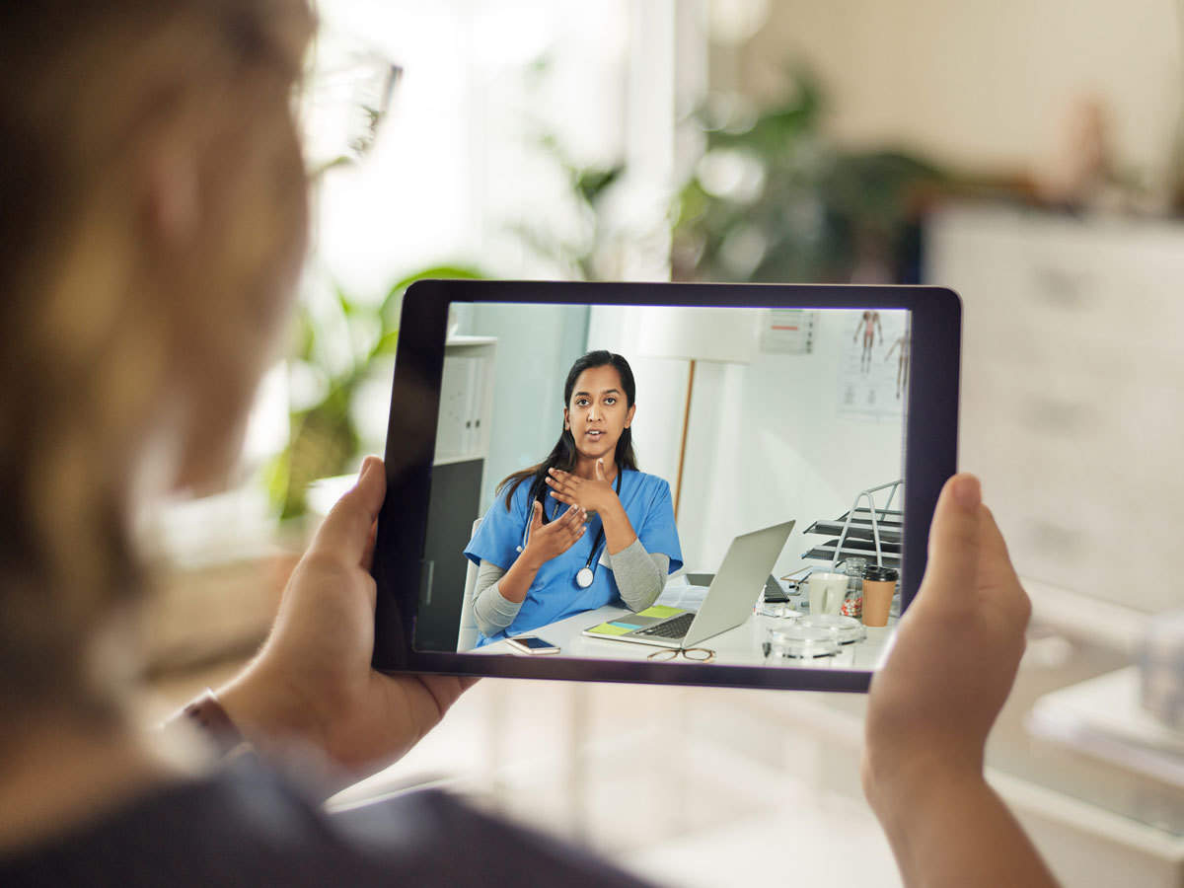
role and effectiveness of telemedicine during covid – 19 pandemic in India : study on health worker and patient perspective under guidance of - Dr. preetha
Presented by dr. Nalini Tripathi

Slide 2
introduction
The delivery of health care services , use of information and
communications technology (computer, phone, video services,
messaging) by a medical professional to provide health care
services to individuals who are some distance from
the health care provider.
Telemedicine practice guidelines 2020 by Ministry of Health and Family
Welfare.
Outbreak of COVID-19 pandemic followed by making
telemedicine a necessity in India.

Slide 3
Rationale-
Reduced healthcare costs by saving on transportation and time
Improves Remote Patient Monitoring (RPM)
Improves quality of care delivery for patients.
Improving patient satisfaction and engagement as it provides them convenience, flexibility and real-time care with their providers.
Improving provider’s satisfaction as it can balance their work and family life in really challenging and stressful environment.
Avoiding the risk of exposure and reduce chance to infect others.

Slide 4
Literature review- An in-depth review of literary articles from, pub med, google scholar, lancet etc, published reports and official websites of Indian government (MOHFWs )conducted to come up with the following themes
Widened scope of RMP
Institutionalized Platform
Need of quality audit
Patients satisfaction
Providers satisfaction
Upgradation of existing digital tools

Slide 5
OBJECTIVE
The objective of this study to quantify the role and effectiveness of telemedicine during COVID-19 pandemic in India and look into the possibility of optimizing and utilising it against impending third wave of the pandemic by alleviating the overall burden on the hospitals and patients by
Containing the spread of virus by limiting the exposure of the frontline workers, and increasing their availability as health workers in telemedicine,
Facilitating the healthcare providers to attend a greater number of patients seeking medical assistance and upgrading and equipping digital tool of practicing telemedicine.

Slide 6
Methodology
Two sets of questionnaires.
Sample size: 100 patients and 10 Doctors.
Tools for Data collection: Google forms, Telephonic and personal interviews.
Time of study: May’21 to June ‘21.

Slide 7
Ethical consideration
Research ethics is a core aspect of any primary research work, regarding which; following aspects have been kept in mind while preparing questionnaires for both patient and the doctor-
Each patient and doctor was asked for the consent before conducting the survey or interviews.
The data confidentiality aspect of participants was strictly adhered with, as during this COVID-19 pandemic, telemedicine is the platform which keeps all the data of the patient, which should be totally encrypted.
It was taken care of any risks posed to the privacy or identity of any participant during and after the completion of the study.
The duration of each survey was designed for not more than 10 to 15 minutes so as to avoid mental fatigue for the participants.
The data collected during the study will solely be used for the particular informed study and will not be distributed in any circumstances without the consent of the participant.

Slide 8
Result and analysis: Patients feedback

Slide 12
Doctors’ feedback

Slide 15
Analysis-
Benefits:
Telemedicine has appeared to be a preferred mode of consultation with more than 90% of Doctors as well as patients showing satisfaction for it.
It made getting the medical expertise and benefits possible while being at home.
It makes booking an appointment with the doctor relatively easier and less time taking.
It nearly eliminates the in office waiting time for consultation.
With elimination of in office waiting time, the time for consultation gets longer, thus comprehensive.
Telemedicine eliminates the transportation time and cost.
With Telemedicine it is relatively easier to get consultation with the specialists.
Telemedicine eliminates the interaction with the crowd thus, eliminating the chances of catching contagious diseases in the hospital facilities.

Slide 16
Complications:
Low connectivity issues pose a problem in establishing virtual connection between doctor and patient.
Lack of good telemedicine tools.
Less human interaction may lead to increase in risk of errors in clinical services.
No proper implementation of telemedicine guidelines.
No adequate telemedicine infrastructure in place.

Slide 17
TAKE AWAY-
Telemedicine could become a whole new sector of opportunities.
Telemedicine could be a one stop solution in pandemic times.
It could benefit people residing in inaccessible areas.

Slide 18
Conclusion-
The study show the potential and possibilities associated with the telemedicine system.
It’s could be a solution to avoid crowding in hospitals,
It’s could be a solution to decrease the workload on healthcare workers in hospital set ups.
The satisfaction of the doctors and patients with this system deems it to be fit for an alternate mode of doctor patient interaction in coming time.

