Slide 1
Dissertation Report-
Rising need of patient safety: Impact of Covid-19
Under the guidance of : Dr. Sumesh Kumar Associate Professor
Submitted by : Shradha Chandak
PG/019/080

Slide 2
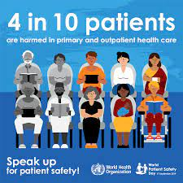
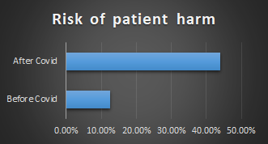
Introduction
Patient harm- any injury (major, minor, psychological) or death of a patient due to hospital negligence rather than underlying disease.
Patient safety emerged to balance the act of patient harm. It aims to reduce the risk of patient errors.
It is one of the global causes of death in the world.
Globally, 4 in 10 patients are harmed in primary and outpatient health care. Unsafe care results in over 3 million deaths each year.
Up to 80% of harm is preventable.
During the covid-19 pandemic, the risk of patient harm proportion has increased from 12.5% to 44% due to hospital-acquired infection.
To solve all the patient harm errors, several technology like, bar code medication error etc. can be used. Consistent use of technology help in improving patient safety and decrease the case of patient harm.
Thus, the study aims to access the reason for rise in cases of patient harm due to covid and what factors can help to solve the problem.

Slide 3
Objectives
To identify the reasons why there is rise in need of patient safety in hospitals.​
To identify the impact of covid-19 on patient safety​
To formulate technological factors for improvement of patient safety based on reasons identified

Slide 4
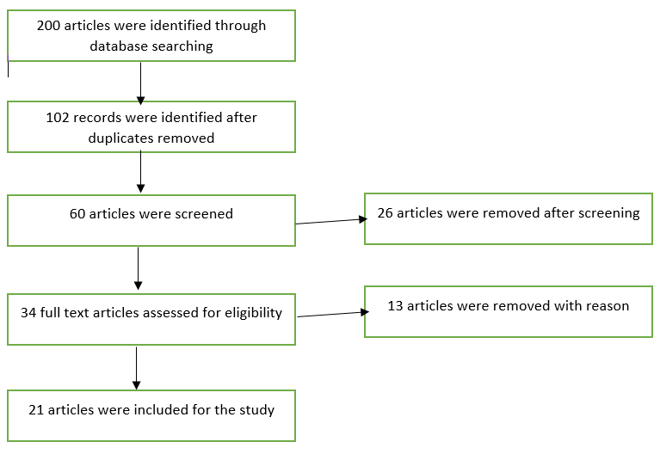
Research Methodology
Study Design- Review based study
Data collection-
Search Strategies - Database used for searching the articles were: PubMed, Google Scholar, ProQuest, and Reasearchgate.
Multi-Tier search strategy was used.
Keyword- Patient safety, Adverse events, covid-19, Patient harm
The reference section of each article was searched in find the additional details.
Study Selection- Studies were selected on the basis of titles, keywords, abstracts of the articles and inclusion/exclusion criteria.
Inclusion criteria-
The Literature review was confined only of the articles in Scientific Journals.
Articles of year range 2017-2021 were included in study.
Articles published in English were selected for review.
Exclusion Criteria
Commentaries, unpublished articles, case reports, abstracts, conferences, and dissertation were excluded.

Slide 5
Literature Review
Before Covid
Author | Year of Publication | Study Methodology and sample | Results
Li H, Dong S, Liao Z, et al | 2020 | Retrospective cohort study; data obtained from computerized database. | 72.5% (3175 claims) had medical errors. 23.4% (1025 claims) had no medical errors
Eva Montané et.al | 2018 | an analytic and and retrospective cohort study; Germans Trias Pujol Hospital, with 511 beds for a population of about 850 000 people living Barcelona | Drug Related Deaths; hospital acquired adverse drug reactions
Faris Hussain et.al | 2019 | cross-sectional mixed-methods design using an exploratory descriptive analysis and thematic analysis of patient safety incident reports. Primary data were extracted from a national database of patient safety incidents | 2288 cases of confirmed diagnostic error: 1973 (86%) delayed and 315 (14%) wrong diagnoses. Staff human factors, including mistakes, were common. Other contributory factors with these reports include inadequate skill and clinician mistakes.

Slide 6
After Covid
Author | Year of Publication | Study Methodology and sample | Results
Niccolò Buetti et.al | 2021 | matched case-cohort study; collected data from a large ICU cohort in France. Critically ill COVID-19 patients were matched with similar non-COVID-19 patients | the ICU-BSI risk was higher for COVID-19 than non-COVID-19 critically ill patients after seven days of ICU stay
Giacomo Grasselli et.al | 2020 | retrospective analysis; collected data including adult patients with severe COVID-19 | Critically ill patients with COVID-19 are at high risk of Hospital acquired infections. Hospital acquired multidrug-resistant [MDR] bacteria. Ventilator associated pneumonia
Xu Xiaominga | 2020 | Cross sectional study; An online survey | The prevalence of depression, anxiety, somatic symptoms, and SSI were 30.2%, 20.7%, 46.2%, and 6.5%, respectively. There were a high level of psychological impact and SSI among hospital workers
Technology that can be used to reduce harm and ensure patient safety
Author | Year of Publication | Study Methodology and sample | Results
Kristine M. Thompson et.al | 2018 | Intervention based study. All inpatient nursing units at a large academic medical center with recognition as a Magnet organization. Also had existing technology in the form of computerized physician order entry. | After the BCMA technology was introduced, reported medication administration errors decreased by 43.5%. the rate of harmful medication errors decreased from 0.65 per100,000 medications preintervention to 0.29 per 100,000 medications postintervention. This resulted in a 55.4% decrease in actual patient harm events.
Yasser K. Alotaibi | 2017 | Descriptive Study | There is substantial evidence that implementing an electronic medical record reduces medical errors and improves patient’s safety. Computerized physician order entry and CDS are probably one of the most beneficial health information technologies for improving patient safety

Slide 7
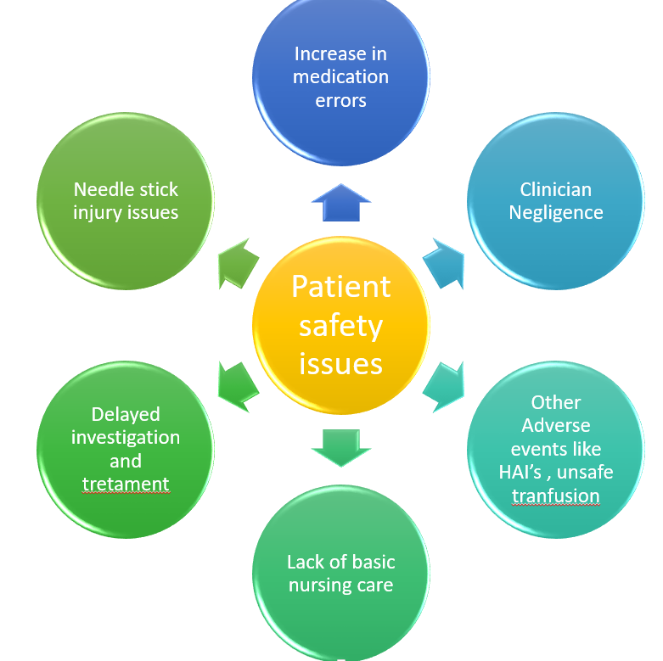
Results
Rise in need of Patient Safety- Because of the following challenges faced in hospital , there is need of patient safety
From the literatures, it was found that:
Before covid pandemic, medication error was more prominent in causing patient harm
After covid pandemic, hospital acquired infection (HAI) is more prominent in causing patient harm.
Other Patient safety issues include: Diagnostic errors, Unsafe surgical care procedures, unsafe injection practices, radiation errors, sepsis.

Slide 8
Impact of Covid-19 on patient safety
Technology to ensure patient safety
Technology | Used against Errors
Computerized physician order entry (CPOE) | Reduction in the rate of medication errors.
Bar code medication administration (BCMA) | Reduction in medication errors & adverse drug reactions. Reduction in mislabeled laboratory specimens.
Clinical Decision support (CDS) | Improvement in process adherence, medication ordering, vaccination, lab ordering and clinical outcomes.
Telemedicine - virtual visits | Improved clinical outcomes. Used in providing clinical care
Electronic Medical Record EMR | Reduction in Medication errors. Reduction in Adverse drug reactions.
Smartphone app, low-power Bluetooth technology | Digital Contact tracing (to prevent community transmission in case of covid-19)
Robotic Surgeries | to promote surgical skill proficiency and mastery and to minimize the risk of patient harm.

Slide 9
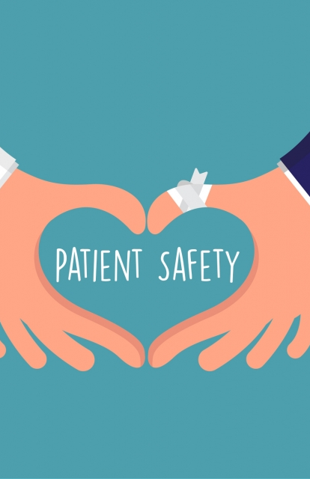
Discussion
The study was to understand the need of the patient safety as it is one of the global cause of death.
Literature was reviewed and it was found that mainly the rise in cases of patient harm in covid-19 due to clinician negligence
The provision of safe services will also help to restore people's trust in the health care systems and hence will also increase patient satisfaction.
There should be no doubt that health information technology is an important tool for improving healthcare quality and safety, but organization needs to be selective of which technology to use for which purpose.

Slide 10
Conclusion
In the study, it was concluded that there is need for patient safety due to increase number of medical errors, diagnostic errors, adverse events, HAI's to prevent patient harm.
Due to covid, the number of cases has increased several folds. The pandemic acts as an reminder for us that besides providing care, we need to improve and adapt to new things and technologies.
Healthcare technology helps in improving patient safety by reducing medication errors, adverse drug reactions, hospital acquired events, improving patient compliance .
We have a unique to transform our way of work so that once the pandemic is fully over we can look and back and appreciate the changes we made amongst ourselves and amongst the society and conclude that critical care is stronger than before.

Slide 11
Recommendations
RTLS (Real time location system technology) can be used to ensure patient safety by reducing patient risks.
More of virtual visits to hospital to reduce HAI (Hospital acquired infections) rather than physical visits.
Contactless check-in physical visits
Limitations
Research articles were taken between 2017-2021. Several cases of issues of patient harm was reported before that. However, the study searching was for limited period so could not include the cases of patient safety errors before that.
Despite the efforts, it is possible that some relevant studies and relevant data about the deaths due to patient harm has been missed.

Slide 12
How Dissertation Work Meet Program Outcomes:
Internalize the concepts of management such as healthcare delivery system, strategic planning, HR, marketing, finance and operations- 3(Substantial)
Apply knowledge of research and management techniques and functions in an integrated manner in healthcare set up- 3(Substantial)
Use of appropriate skills to support healthcare organizations to take informed decision in planning, building and managing healthcare organizations- 3(Substantial )
Utilize learning acquired from trainings and practical exposures in real time situations- 2(Moderate)

