Slide 1
Social barriers in accessing caesarean delivery by women in Assam- A descriptive study
By Aman Chugh
PG/19/009
Guided by
Dr A K Khokhar

Slide 2
Introduction
“Caesarean section (CS or C-section) is a surgical intervention which is carried out to ensure safety of mother and child when vaginal delivery is not possible (emergency CS) or when the doctors consider that the danger to the mother and baby would be greater with a vaginal delivery (planned CS) . Proportion of CS to the total births is considered as one of the important indicators of emergency obstetric care”
As an emergency operative procedure Caesarean section has contributed to improve the obstetric care at global level. Yet, Many women refuse to have caesarean birth even when it is the only option to save their lives, such cases are more prominent in low socio-economic demographics.
(World Health Organization (WHO) suggest that caesarean section is a safe method of delivery and its adoption rate should lie between 5-15%.)

Slide 3
Rationale
Assam has over 3 crore population as per the Census 2011 data, has nearly 86% population residing in rural areas and only around 14% population in urban areas. Maternal Mortality Rate (MMR) 300 (as per SRS Bulletin 2011-13) and 215(as per SRS Bulletin 2016-18). Distribution of maternal death as per district has been shown in fig 1(source HMIS). Hence, Assam is purposely selected for this study
Acc. to WHO The major complications that account for nearly 75% of all maternal deaths are :
severe bleeding (mostly bleeding after childbirth)
infections (usually after childbirth)
high blood pressure during pregnancy (pre-eclampsia and eclampsia)
complications from delivery
unsafe abortion.
Most of these complications develop during pregnancy and most are preventable or treatable.

Slide 4
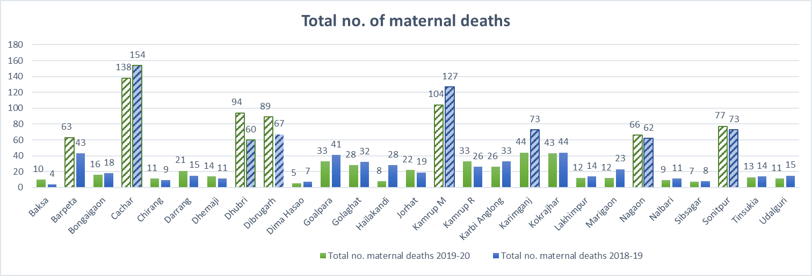
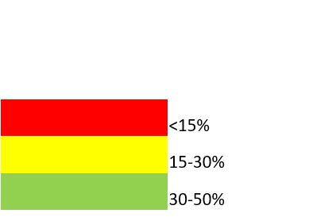
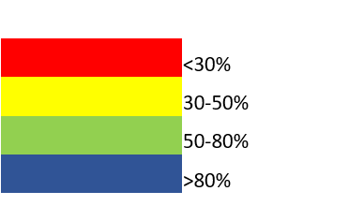
% C-sections conducted at public facilities to Deliveries conducted at public facilities (2019-2020)
% C-sections conducted at Private facilities to Deliveries conducted at private facilities (2019-2020)

Slide 5
Although overall increase in Caesarean delivery has been seen but state like Assam where majority of population (86%) live in rural areas, especially tea plantation communities (6 million people (approx.) which is around 20% of total population of Assam) and boat communities where situation is much worse and access to sexual and reproductive resources is scarce. Which in turn leads to poor maternal health. There is need to study the parameters which contributes in increasing Maternal and child deaths, hence the study aims to find the social barriers that limit the access of caesarean delivery to women in Assam.

Slide 6
objectives
As per WHO, the most causes of maternal deaths are preventable
Questions: Are there any social barriers that limit access to emergency obstetric care(caesarean delivery) when needed and hinders preventing maternal deaths during labor? If yes what are they?
1) To identify and address the social barriers that limit access to caesarean delivery in Assam.
2) To define possible solutions to improve the maternal and child health.

Slide 7
Methodology
Literature review
For qualitative data:
Relevant policy and program documents related to the C-section were reviewed, sources for information are:
• Govt websites (MOHFW, NHM, NITI Aayog, State DoH websites)
• Scientific databases: (i) PubMed, (ii) NCBI, (iii) Researchgate
• Other sources for published literature: Bibliography, subject-specific key journals/ reports and development partners’ websites, free-hand web-search
Secondary data has been reviewed from NFHS, HMIS and available literature
KEY WORDS: caesarean delivery, social barriers, Emergency obstetric care, maternal mortality, Tea garden population

Slide 8
Data collection:
For quantitative data:
Secondary data is used for this study
Data-sets for the study is collected from “THE DHS PROGRAM DEMOGRAPHY AND HEALTH SURVEYS” for KIDS RECODE India-2015-2016.
Inclusion and exclusion criteria:
1) Cases of births happened in last 5 years to women of only Assam state were taken from the datasets of India; rest were excluded
Data of Assam state was filtered and extracted out of the dataset.
Data cleaning and filtering, calculation and analysis for Assam state was done using IBM SPSS
Analysis is done on IBM SPSS, cross tabs was done for various variables and chi square test done for significance testing.
Sample size:
Total no. recorded cases of births in last 5 years in Assam were recorded to be 10309
Variable considered:
Religion; Education status; Type of place of resident; Wealth index; respondent’s occupation(grouped); respondents’ mother tongue; respondent’s caste and tribe- for women who had delivery by caesarean section.

Slide 9
Ethical consideration
Data used for study is available on public domain; registration was done for accessing DHS datasets.

Slide 10
Results

Slide 11
Literature review
STUDY TITLE | STUDY TYPE | SELECTION CRITERIA FOR SAMPLE | METHODOLOGY | RESULTS
Maternal health and maternal mortality: A study of four selected districts of Assam | Systematic literature review/ coss-sectional study | Multistage sampling to identify the villagers | Systematic literature review followed up by community survey -Secondary data collected from SRS, NFHS, NRHM -Primary data collected from 8 villages of 4 districts. Statistical methods used- one way anova, Pearson's chi-square test, Bayesian logistic regression for various variables | Districts with better socioeconomic conditions have better maternal health facility Maternal health seeking behaviours are influence by socioeconomic factors like no care taker at home for pregnant women, heavy work loads, long queue at facility; cultural factors such as hesitation and ignorance ;Lack of transport and referral support in areas of respondents
Prevalence of the Caesarean Section in India | Observational study | objective of the study was to investigate the prevalence of caesarean section among the married women, in India, so all of the 29 states are considered. The study analyzes data on ever-married women from the NFHS-II (1998-1999) and NFHS-III (2005-2006). | To assess the impact of socio-demographic factors towards the use of caesarean section, both bivariate and multivariate binary logistic regression models were used.. | The analysis confirmed that age of delivery, maternal education, choice of medical institution, place of residence and birth order were important predictors for the prevalence of caesarean sections during childbirth.
Caesarean section delivery in India: causes and concerns | A cross sectional studies | latest birth of ever-married women aged 15-49, who had given birth (both live and still birth) since January 1, 2004 and reported the type of delivery were included | To understand the trend of the rates of C-section delivery, along with DLHS-3, data from 1st, 2nd and 3rd round of NFHS has been used. A logistic regression model has been used to identify the net impact of demographic, socio-economic and institutional factors on woman’s experience of caesarean section delivery | -Higher percentage of CS is observed among non SC/ST (SC-Scheduled Caste, ST-Scheduled Tribe) women than the SC/ST group. -women who have completed 5-10 years schooling or higher are significantly more likely to experience caesarean delivery than those who never attended school. -caesarean delivery is higher among those who are under any insurance coverage/health scheme and living in urban areas. -Women from rich families are significantly more likely to undergo C-section than women from poor families

Slide 12
STUDY TITLE | STUDY TYPE | SELECTION CRITERIA FOR SAMPLE | METHODOLOGY | RESULTS
Socioeconomic inequalities in the use of caesarean section delivery in Ghana: a cross-sectional study using nationally representative data | a cross-sectional study | The data was drawn from the 2014 Ghana Demographic and Health Survey (GDHS). -study includes only females between 15 and 49 years old residing in Ghana. Based on the updated 2010 Ghana Population and housing Census (PHC) respondents were selected in all the ten regions of the country. Participants were selected into the survey in two stages. 427 clusters were selected and subsequently 30 households from each cluster were selected through systematic sampling. | Univariable and multivariable logistic regression models were fitted to examine the socioeconomic inequalities in CS use. | -the proportion of women who had a CS delivery is higher among women with higher education. -CS delivery rate was more than two-folds higher in urban residents than women living in rural areas -(27.5%) of the richest group had CS birth whilst the percentage was 5% for the poorest group. -no substantial difference in the proportion of CS births among employed and unemployed women -CS births for Christians were about twice that of the traditional and other believers;the proportion of Muslim women who reported having had a CS was 9.9%
Cesarean delivery and associated socioeconomic factors and neonatal survival outcome in Kenya and Tanzania: analysis of national survey data | Cross-sectional study | (DHS) data from Kenya (2014) and Tanzania (2015–2016) with ≥90% response rates were used. -only institutional birth records of the most recent live-born neonates were used | binary logistic regression used to analyze cross-sectional demographic and health survey data | higher rates of cesarean delivery among mothers from richest households, compared to middle class, no insurance, primary education and unemployed, respectively.
Perception and Socio-cultural Barriers to the Acceptance of Caesarean Delivery in A Tertiary Hospital in Abakaliki, South East Nigeria | A cross-sectional study | study included pregnant women attending the antenatal clinic at the Federal Teaching Hospital Abakaliki. The total sample size was 360. 16 participants were excluded from the study due to incorrectly filled questionnaires, giving a total of 344 eligible respondent | Data were collated using a self-administered questionnaire and was analyzed using SPSS version 20.0 and conclusions were drawn by means of descriptive statistics. | The major barriers to acceptance were being considered by peers as a reproductive failure, high cost and religious beliefs. more than four-fifths of the respondents had secondary and tertiary formal education, the majority continued to have aversion to caesarean.

Slide 13
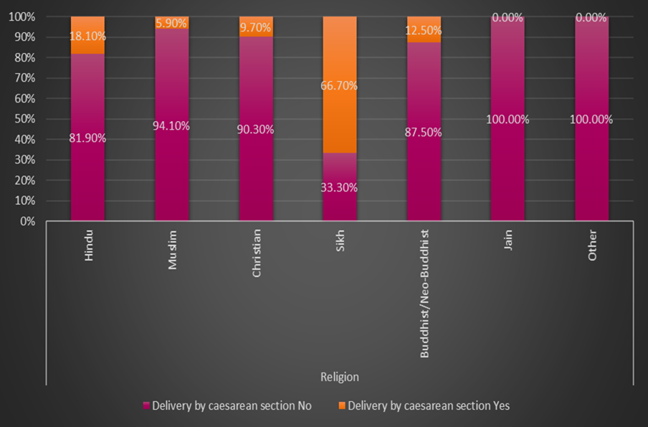
Fig2.1 (Religion * Delivery by caesarean section)
The result of this analysis show how various Religious beliefs influence in opting the caesarean delivery.
It is notable that the women belonging to Hindu and SIKH Religion has the highest percentage of 18.10% and 66.7% respectively who preferred Caesarean delivery.
The figures vary for the religions like BUDDHIST opting for 12.5%, CHRISTIANS for 9.7% and MUSLIMS as low as 5.9%.
Conversely the JAIN Community / OTHER RELIGION has the lowest percentage of 0.0% or NIL.

Slide 14
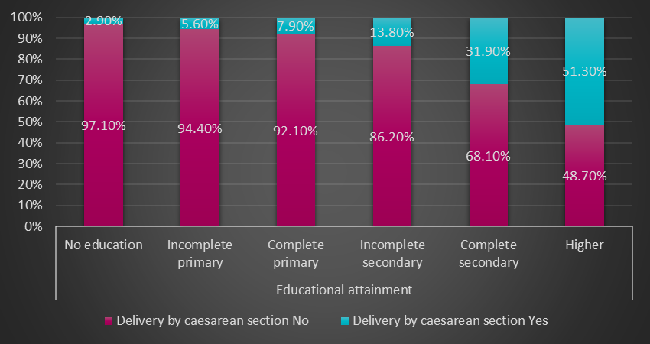
Fig2.2 (Educational attainment* Delivery by caesarean section)
This analysis was performed to see how Educational attainment affects the caesarean delivery.
It is worth discussing these crucial facts revealed by the results of the investigation.
These findings are consistent with the data showing that with Educational Attainment as low as Nil/No Education, only 2.9% people opt for caesarean delivery and 97.1% refuses for the same.
This rise exponentially with the higher education as Incomplete Primary group 5.6% opted for Caesarean delivery and 94.4% refuses.
The complete Primary group and the incomplete secondary group opted for caesarean delivery as 7.9% and 13.8% respectively.
With the attainment of education as high as complete secondary about 31.90% people opted for caesarean delivery and the number rises with Educational background as 51.30% people who have their education qualification as Higher secondary opted for caesarean delivery.

Slide 15
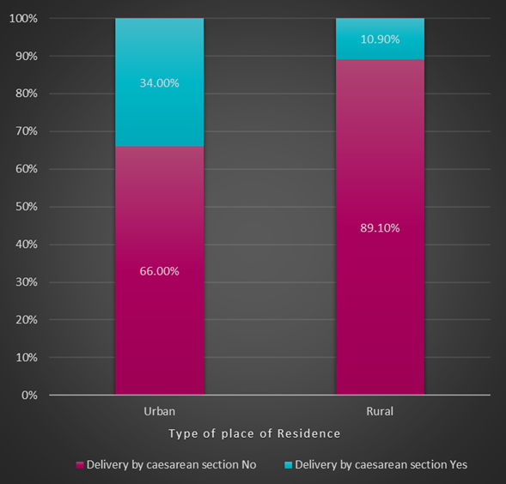
Fig2.3 (Type of place of residence * Delivery by caesarean section)
This bar graph illustrates how the Type of Residence influence in choosing the caesarean delivery.
The results of this analysis revealed there is significant difference between people's type of residence and their willingness to opt for caesarean delivery.
In the Urban areas nearly 34.0% people choose caesarean as their method of delivery while 66.0% refused.
On the contrary in the Rural areas only 10.90% people opted for caesarean delivery and nearly 89.10% refused.

Slide 16
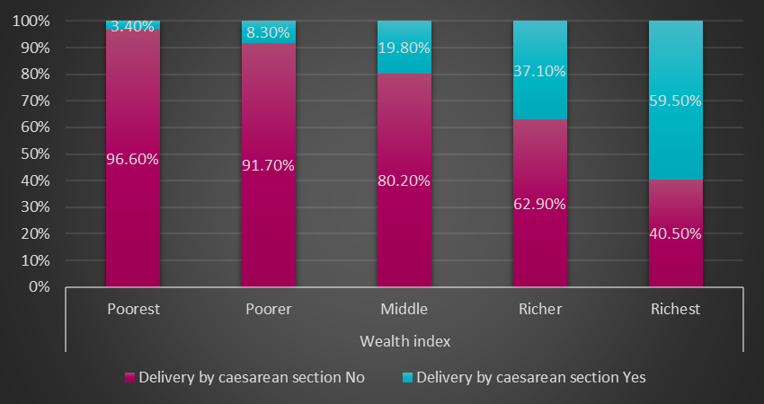
Fig2.4 (Wealth index * Delivery by caesarean section)
This analysis shows whether wealth index contributes in people's choice for opting/choosing the caesarean delivery.
These basic findings are consistent with the data showing that with the health index as Poorest only 3.40% chose for caesarean delivery.
While the 8.30% Poorer and 19.80% middle wealth index opted for caesarean delivery.
A similar pattern of results was obtained and nearly 37.10% of the Richer and 59.50% of the Richest opted for the caesarean delivery method.

Slide 17
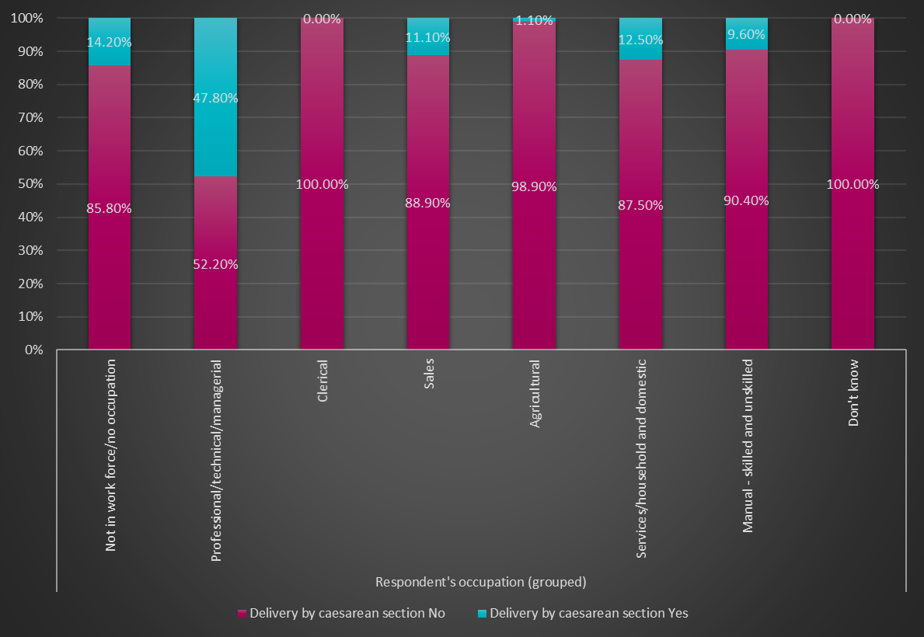
Fig2.5 (Respondent's occupation (grouped) * Delivery by caesarean section)
There is another important finding in the understanding how the respondent's occupation impacts the delivery by caesarean section.
In the professional/technical/managerial class about 47.80% people chose caesarean delivery method which is highest amongst all the classes in this category.
In the service/household/ domestic category 12.50% and in the Sales category 11.10% opt for caesarean while those are not in workforce or has no occupation about 14.20%people chose caesarean method.
The manual skilled or unskilled group has 9.60% while the clerical and agricultural has 0.00%and 1.10% people opting for C-section delivery.

Slide 18
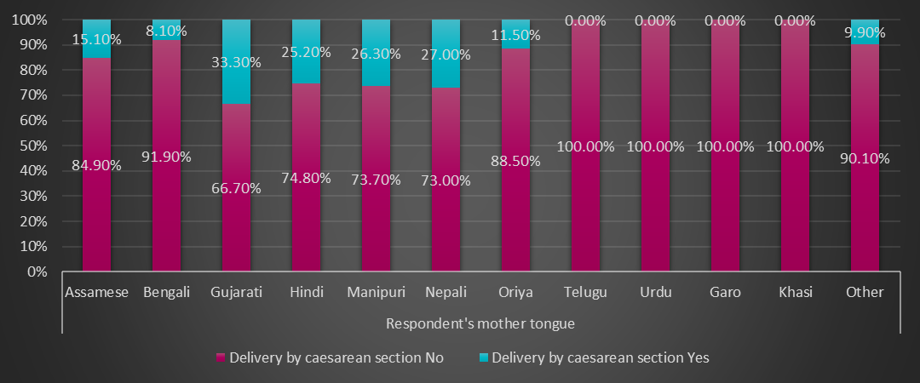
Fig2.6 (Respondent's mother tongue * Delivery by caesarean section)
We also acknowledge that there are considerable difference in data as to know how respondent's mother tongue influence the delivery by c section.
The Nepali community as 27.0%, Manipuri as 26.30%, Hindi as 25.20%, Assamese as 15.10% Oriya as 11.50% and Bengali as 8.10%.
The data depicts that the Gujarati community has the highest no as about 33.30%opting for caesarean.
While the other classes as 9.90%
However the Telugu/Urdu/Garo and Khasi has shown 0.0% or Nil C-section rates

Slide 19
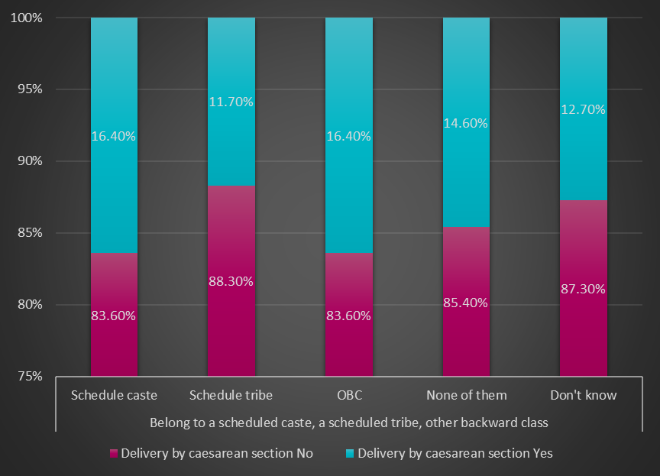
Fig2.7 (Belong to a scheduled caste, a scheduled tribe, other backward class * Delivery by caesarean section)
It is particularly important when investigating whether the caste impacts the caesarean delivery or not.
It is important to highlight the fact that 16.40% scheduled caste , 11.70% scheduled tribe and 16.40% OBC said yes to the delivery by C-section while 14.60% people lies in the none of them and 12.70% don't know about their preferences.
Data is significant as Pearson’s Chi-square value is seen to be less than 0.05% for every parameter considered.

Slide 20
Results were found as per studies reviewed
Social barriers :
Wealth index: CDs are more common among women with high wealth index mentioned in 5/6 studies
Education: CDs are more common among women with higher education mentioned in 4/6 studies
Cultural beliefs: CDs are averted where there are strict cultural norms- mentioned in 2/6 studies
1/6 studies suggest that CDs are more common among SC/ST
Other social barriers identified are:
1)High cost of procedure(OOPE)
2) Fear:
-Fear of immense pain or death due to Caesarean delivery
- fear of harming the baby(as heard from peers and relatives)
3) Myths and stigma related to caesarean deliveries
-unable to conceive
-prolonged hospital stay
4) Negative perception of the community or culture:
fear of abandonment from the community
Not accepted in the culture
Caesarean delivery is curse on a unfaithful woman
Caesarean delivery is sign of failure of her reproductive functions
Caesarean delivery is result of spiritual attacks
3) Insufficiency of roads and transport
-women avoided going to the facility due to their previous experiences during emergencies
.

Slide 21
Conclusion
women who are poor and are living in remote/tribal areas are the least likely to receive emergency obstetric care. India alone contributes 1/5 of total burden of maternal death and Assam is biggest contributer.
The major social barriers that prevent women from receiving or seeking emergency obstetric care during pregnancy and childbirth are:
poverty
lack of education/information
Religion, cultural beliefs and practices.
distance to facilities/residence
inadequate and poor quality services
To improve maternal health, barriers that limit access to quality maternal health services must be identified and addressed at both health system and societal levels.

Slide 22
Way forward
maternal mortality due to social barriers can be prevented by:
addressing inequalities in access to and quality of emergency obstetric care reproductive, maternal, and newborn health care services;
ensuring universal health coverage for comprehensive reproductive, maternal, and newborn health care;
addressing social barriers of maternal mortality, reproductive and maternal morbidities, and related disabilities and initiate Social and behavior change practices.
strengthening health systems to collect high quality data in order to respond to the needs and priorities of women and girls; and
ensuring accountability in order to improve quality of care and equity.
Addressing barriers related to gender and self efficacy, as that women are able to make decisions themselves.
Some social barriers are state specific hence, a differential approach can be adapted to address those issues.

Slide 23
Program Outcomes (rate how your course addresses the POs by giving a score of 1,2,3- 1: Slight (Low) 2: Moderate (Medium) 3: Substantial (High)
Internalize the concepts of management such as healthcare delivery system, strategic planning, HR, marketing, finance and operations | 2. Apply knowledge of research and management techniques and functions in an integrated manner in healthcare set up | 3. Use appropriate skills to support healthcare organizations to take informed decision in planning, building and managing healthcare organizations | 4. Utilize learning acquired from trainings and practical exposures in real time situations.

Slide 24
references
Emmanuel Dankwah, Shelley Kirychuk, Wu Zeng, Cindy Feng & Marwa Farag. Socioeconomic inequalities in the use of caesarean section delivery in Ghana: a cross-sectional study using nationally representative data. International Journal for Equity in Health volume. 25 October 2019. 162 (2019).
Malachi Ochieng Arunda, Anette Agardh & Benedict Oppong Asamoah. Cesarean delivery and associated socioeconomic factors and neonatal survival outcome in Kenya and Tanzania: analysis of national survey data. Global Health Action Volume 13, 2020 - Issue 1, 29 Apr 2020, 1748403
Tushar Rane, Tulika Goswami Mahanta, Manjit Boruah, Swarnali Baruah. Epidemiological study of maternal death in Assam, Clinical Epidemiology and Global Health 7(4), February 2019
Shewli Shabnam, Caesarean section delivery in India: causes and concerns.
Vivek Verma, Dilip C. Nath. Prevalence of the Caesarean Section in India
Pranti dutta, Maternal health and maternal mortality:A study of four selected districts of Assam

