Slide 1
TELECONSULTATION FOR COVID-19: OPPORTUNITIES AND CHALLENGES for PHYSICIANS
By Dr Fathima Rashid Sheikh
PG/19/030
Under guidance of Dr PREETHA GS
IIHMR ,NEW DELHI

Slide 2
INTRODUCTION
India is a developing country with over 1.3 billion population and majority residing in rural areas. There are concerns of un-equitable health care delivery due to poor access and availability along with a weak public health care system.
India has seen a surge in cases of COVID-19 despite its measures to contain the transmission of the virus by social distancing and stringent lockdown measures. Lack of access to health care is a major challenge in the period of lockdown. Such incidents have paved the way for recognition of telemedicine where health care delivery could be made ubiquitously available.
Telemedicine and related e-health facilities facilitate care from a distance through electronic information systems. For mild-to-moderate symptoms of COVID-19 or any illness, telehealth services might represent a better, efficient way to receive initial care and perform triaging.
Teleconsultation has come up with many clinical and techical challenges for physicians.
.

Slide 3
OBJECTIVES
To review recent measures of telemedicine adopted during pandemic
To enumerate the challenges and opportunities faced by physicians in tele-consultation of SARS2 COVID19 patients

Slide 4
METHODOLOGY
It is a cross sectional study using primary and secondary data.
Research Tool - Cross-Sectional Questionnaire Based Study
Sample Size: 40
Target population: General Physicians of Delhi NCR
Time of Study: April- May 2021
Research procedure – Data was collected through google form link and analyzed by using the SPSS package and Microsoft Excel Package 2020.
Aspects covered in questionnaire are as follows:
Technical challenges
Clinical challenges
Burnouts

Slide 5
Inclusion criteria
Physicians consulting SARS2 COVID19 diagnosed patients via teleconsultation.
Ethical Consideration
Informed consent was obtained from all the voluntary study participants. No personal identifiers like name,age,sex,address was used. A unique ID was given to each participant. Data is kept under my custody and no information will be shared with any person,institution or organization. Appropriate measures were taken to ensure data security, privacy, and confidentiality. Data is only used to analyze the objective of the study for internship report.(*Please refer Consent form in the Annexures.)

Slide 6
RESULT
1)Review of Telemedicine measures in India during Pandemic
Government of India delivered the 'Telemedicine Practice Guidelines' in March 2020.
The rules are centered around the Registered Medical Practitioner (RMP).
The Ayushman Bharat Telemedicine Guidelines for Health and Wellness Centers (HWC) were given in 2019.
E-Sanjeevani
Step One

Slide 7
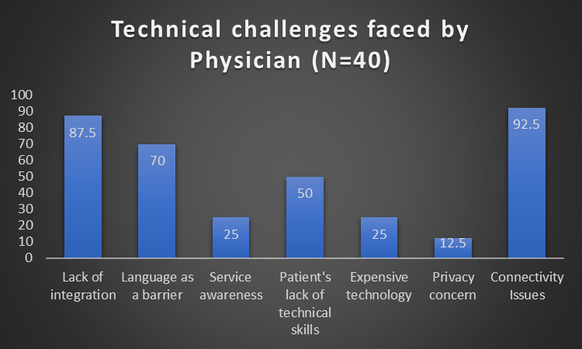
2)Enumerate the challenges and Opportunities faced by physicians in teleconsultation of SARS2 COVID-19 patients

Slide 8
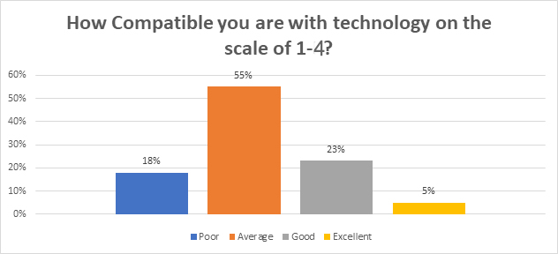
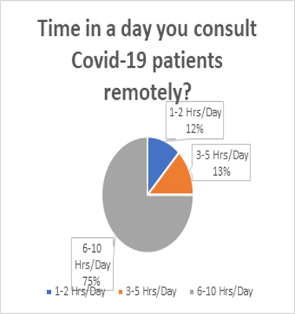
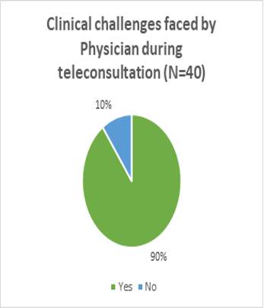

Slide 9
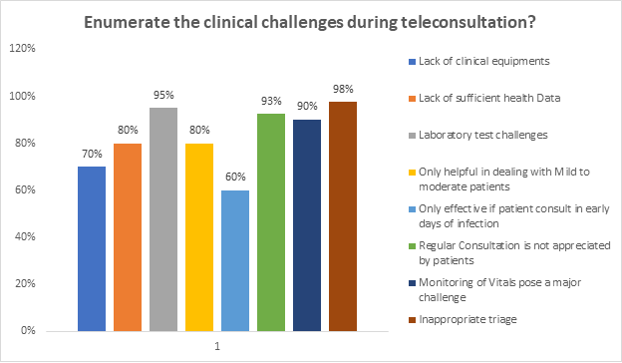

Slide 10
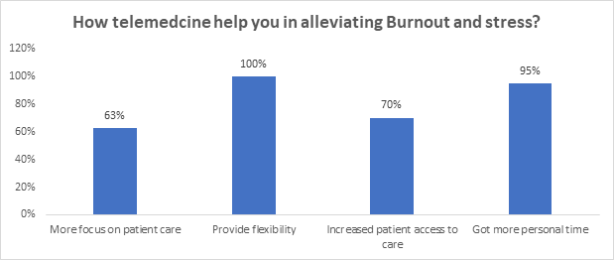

Slide 11
CONCLUSION
Technical challenges
connectivity and interoperability issues.Computer literacy, linguistic barriers between the provider and patient, and unawareness of the existence of services can lead to failure in adopting telemedicine in community
lack of expertise around 18% of the sample physicians are not well compatible with the technology.
2. Clinical challenges
90% Physicians say patients do not have vital monitoring instruments/skills, due to ignorance of diagnostic tests and follow ups resulting in severity of disease.Triaging of covid-19 severity remains the main challenge.
3. Opportunities
About 75% (30 physicians) worked for 6-10 hrs/day with the flexibility in timing and thus having more personal time and comparatively less stress.
Convenient and real time interactions with patients,easy monitoring of discharged patients
Safety to doctors
Learn new skills
Reach masses

Slide 12
RECOMMENDATIONS-
Training and change-management techniques
Reimbursement plan
Integrating EHR and Improving user experience
Incorporation of blueprint on NDH for privacy.
Good network and Camps for service awareness
Providing packages to patients with the clinical equipment, Lab testing facility, medicine delivery and follow up team of healthcare managers/coordinators along with physician is needed in this pandemic situation.
Limitation of the study- As the study was conducted at the peak time of the pandemic, there were some limitations of the study noted.
Targeted physicians were less responsive
The study area is limited to Delhi NCR private physicians only
Physicians seeing only COVID cases were reached.
Small sample size
Limited time

Slide 13
RATING: How PGDHM Course addresses the program outcomes
Iternalize the concepts of management such as healthcare delivery system,strategic planning,HR,Marketing, finance and operations- SCORE 2
Apply knowledge of research and management techniques and functions in an integrated manner-SCORE 3
Use appropriate skills to support healthcare organizatons to take informed decision in planning,building and managing organization-SCORE 3
Utilize learning acquired from trainings and practical exposure in real time situations-SCORE 2
SCORE-1:LOW 2: MEDIUM 3: HIGH

Slide 14
THANK YOU

