Slide 1
STUDY OF TELEHEALTH IN ONCOLOGY CARE: A COVID-19 RESPONSE
PRESENTED BY: PRIYANKA RUTH CHATTREE
PG/19/066
(Hospital Management)
UNDER THE GUIDANCE: PROF. DIVYA AGGARWAL

Slide 2
Introduction and Rationale
Introduction
The first half of 2020 saw the rise of COVID-19 as a pandemic, which had an immediate and drastic effect on cancer treatment. Many cancer patients, who need regular visits and intensive use of the health-care system to handle their illness and treatment complications, have had their health-care delivery disrupted by the crisis. This vulnerable population is at a higher risk of serious COVID-19 infection and mortality, as well as an elevated cancer burden due to uncontrolled tumor growth due to delayed cancer diagnosis or treatment interruption
In this situation, digital solutions have proven to be able to strengthen the healthcare system in emergency situations. The introduction of virtual care during the onset of the pandemic was an emergency strategy for treating the cancer patients. COVID-19 has sparked a rapid shift toward virtual consultations in oncology and medicine in general. Tele-oncology has been shown to increase access to treatment while also lowering health-care costs.
Rationale
The use of telehealth in routine cancer treatment during the COVID-19 pandemic has shown benefits for patients and clinicians due to the need for physical distancing and reduced foot traffic via healthcare institutions.
This study therefore focusses on the various interventions in tele-oncology and its impact on the virtualization of the oncology practices that has changed/will change the optimal care pathways of various cancer types during and post COVID 19

Slide 3
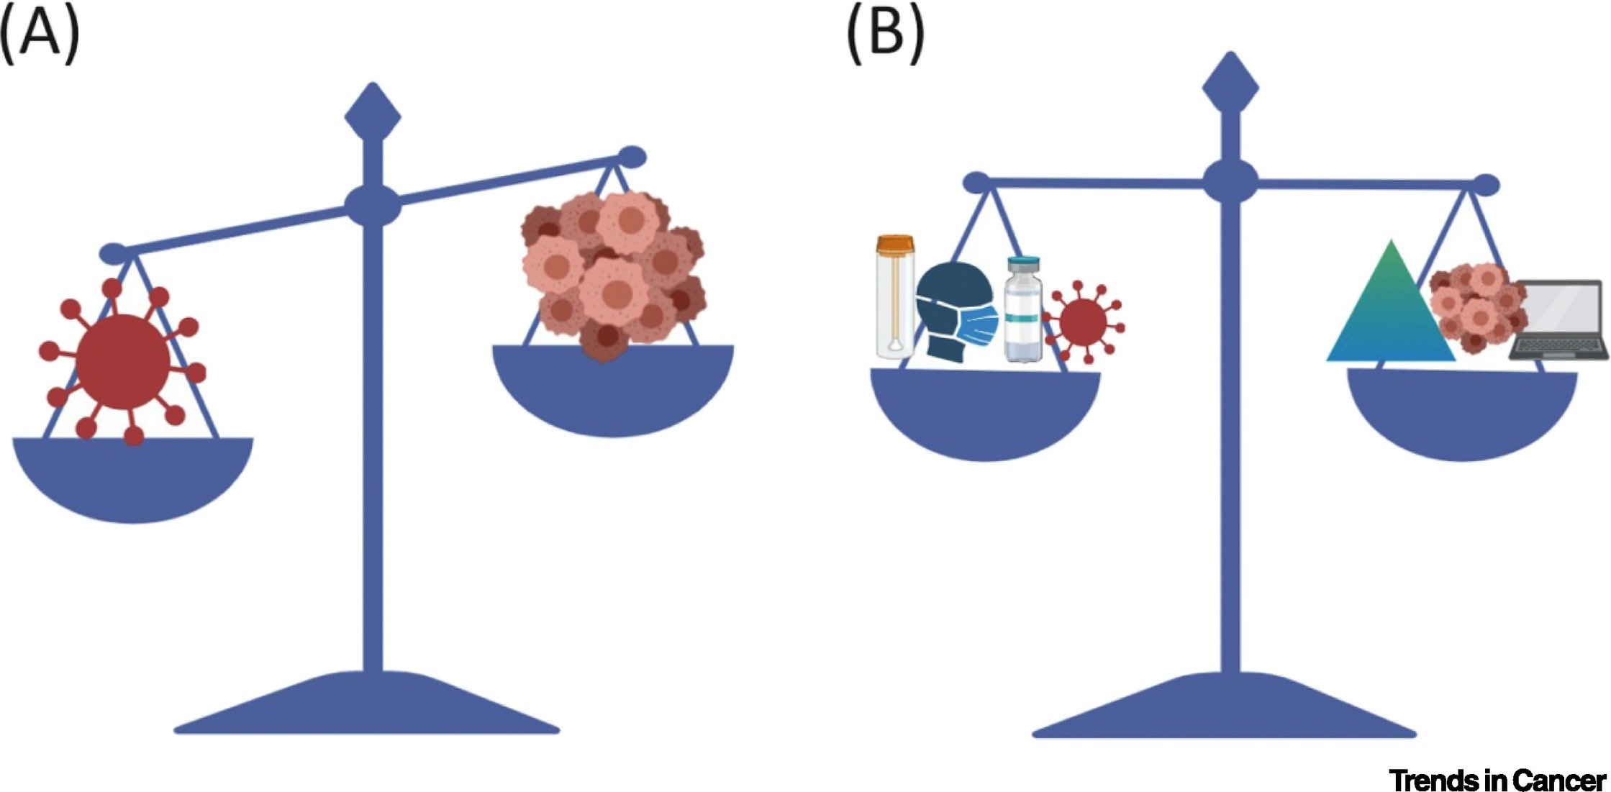
Objective and Specific Objectives
Objective
To address the impact of digital technology in cancer care during COVID 19
Specific Objective
To conduct a detailed analysis of cancer cases worldwide and its effect of COVID 19 on cancer care (US, UK and India)
To put forward the digital solutions in the care pathway of lung cancer, bottlenecks associated during the pandemic and tele-palliative care plan for cancer patients.

Slide 4
Methodology
Key Research Questions
What was the effect of COVID-19 on cancer care delivery in the most affected countries (USA, UK and India)?
How has digital solutions and telehealth helped in modelling a better optimal cancer care pathway during COVID?
What are the challenges and impact of tele-oncology during the pandemic?
Research Design- Secondary study
Literature Review- 25 articles were selected out of 44 articles from various databases like Medline, Google Scholar, ProQuest, JSTOR and Science Direct. The data of the outcomes of the study has also been collected from white papers of consulting firms and oncology journals including ASCO, National Cancer Institute.
Secondary Data - The study is based on the secondary data available from various agencies and in the cancer care. Amongst the important sources of data are from National Cancer Registry, IQVIA, National Cancer Guidelines, National Comprehensive Cancer Network.
Inclusion Criteria | Exclusion Criteria
Articles taken from the start of the COVID (2020-2021) | Articles pre- COVID
Full text articles | Abstracts
Original research, Meta-analysis, Systematic review, Scoping review | Newspaper articles, conference presentations, blogs
English language articles | Other language articles
Technology related articles related to oncology | Articles related to only oncology
 | Questionnaire studies

Slide 5
Results
(Source: IQVIA Cancer Report, 2021)
Fig 1: Impact of COVID-19 crisis on cancer treatment practice in UK
Fig 2: Impact of COVID-19 crisis on cancer treatment practice in US
Table 1: Impact of COVID-19 crisis on cancer treatment practice in India
Table 2: Top 3 Cancer Types which impacted delay in diagnosis due to the pandemic
Impact Indicator | Percentage/Number
Inaccessibility of life saving surgeries and treatment | 70%
Postponement of chemotherapy treatment and follow-ups
Decrease in patient footfall for cancer care in private clinics | 50%
Postponement of cancer surgeries | 59.7%
Cancellation of life-saving cancer surgeries | 51,100
UK | USA | India
Lung cancer | Breast cancer | Oral cancer
Breast cancer | Colorectal cancer | Cervical cancer
Colorectal cancer | Lung cancer | Breast cancer
Objective 1 (Result 1)- Effect of COVID-19 on cancer care
The decline in patients was due to the delay in four major causes which was delay and postponement in surgeries, delay in chemotherapy, conduct of fewer diagnosis and change in treatment protocols.
(Source: The Lancet, 2021)

Slide 6
Care pathway- Lung Cancer
(Pre-COVID)
Objective 2 (Result 2)-
Digital solutions and telehealth in lung cancer pathway of a patient and tele-palliative care
Metastatic Treatment
(2a)
Pain Management
(2b)
Supportive Care
(2c)
End of Life Care
(2d)
Chemotherapy
Hormone therapy
Anti-depressants
Corticosteroids
Physical therapy
Symptom treatments
Spiritual care
Red marked processes indicate the bottlenecks where the patients can be exposed to SARS Cov-2 virus within the healthcare facility to receive cancer treatment
Clinical Evaluation
(1a)
Pathology
(1b)
Imaging
(1c)
Screening results, Patient referrals
Preoperative Systemic Therapy
(2a)
Postoperative Radiation Therapy
(2c)
Postoperative Systemic Therapy
(2d)
Surgery
(2b)
The care pathway of lung cancer has been drafted from NCCN and NCG guidelines to show a complete flow chart of the journey of the cancer patient
Chemotherapy
Endocrine therapy
Lung resection
Lobectomy
Post therapeutic Care
(3)
Surveillance
Monitoring
(Source: National Comprehensive Cancer Network and National Cancer Grid, India)

Slide 7
Tele-palliative care
(Covid and Post-COVID)
Metastatic Treatment
(2a)
Pain Management
(2b)
Supportive Care
(2c)
End of Life Care
(2d)
Chemotherapy
Hormone therapy
Anti-depressants
Corticosteroids
Physical therapy
Symptom treatments
Spiritual care
Red marked pathways still seen where the patients need to visit the cancer centre , where information technology currently does not provide significant assistance
Clinical Evaluation
(1a)
Pathology
(1b)
Imaging
(1c)
Screening results, Patient referrals
Preoperative Systemic Therapy
(2a)
Postoperative Radiation Therapy
(2c)
Postoperative Systemic Therapy
(2d)
Surgery
(2b)
Chemotherapy
Endocrine therapy
Chemotherapy
Endocrine therapy
Lung resection
Lobectomy
Tele- diagnosis, Tele-surgery and Remote monitoring
(Covid and Post-COVID)
Post therapeutic Care
(3)
Surveillance
Monitoring

Slide 8
PALLIATIVE CARE PLAN FOR CANCER PATIENT-
Drafted from National Comprehensive Cancer Network (NCCN guidelines)
Presence
Yes
Death
Indication of pain
Yes
Assessment of pain
Palliative care interventions
Reassessment
After death interventions
Care plan as per the stakeholders
Physicians
Nurses
Social workers
Mental health professions
No
- Benefits of anti-cancer therapy
- Symptoms
- Spiritual distress
- Symptom management
- Spiritual support
- Social support
- Patient satisfied with response to anti-cancer therapy
- Strengthened relationship
- Personal growth
Bereavement support
Inform patient/family about anticipatory symptoms/pain
TELE- PALLIATIVE CARE PLAN FOR CANCER PATIENT- Telehealth as a solution in COVID-19
(Drafted from Palliative Care as per NCCN guidelines)
Telehealth Plan
Continue remote palliative care – virtual visit
Alarming Change
Requires admission
Indication of pain Mr. X
Assessment of pain by oncology team
Initiation of intervention
(Chemotherapy)
Re-assessment of palliative intervention
Yes
No
Telehealth Plan
Virtual visit
Telehealth Plan
Virtual visit
Telehealth Plan
Virtual visit and In-person visits
Telehealth Plan
Virtual visit and In-person visits
Telehealth Plan
Remote monitoring for alarming changes
No
Yes
Telehealth Plan
Continue remote palliative care with social workers, spiritual services
Direct admission (subject to availability of beds)

Slide 9
Challenges
Cancer patients, who are often older than the general population, may lack the knowledge to participate in a video consultation, while patients from low-income families may lack the financial resources to do so.
The second fear is that online information sharing may threaten patients' privacy, particularly during COVID-19, when more health data is shared online, increasing hackers' interest in physicians' accounts.
Recommendation
Virtual clinic visits and phone call evaluation for routine visits that do not require physical examination or activities related to oncological concerns can aid in the reduction of hospital visits for clinical encounters (cancer survivorship, palliative care, chemotherapy, online education).
Before returning to normal hospital operations post COVID, communication and care coordination must be addressed. As a result, patients who have been postponed for screening or treatment should be prioritised.
Data gathered from the delivery of care to cancer patients during COVID-19 will also be used to develop care models and policies.
Conclusion
Tele-oncology is not a new concept; nevertheless, COVID-19 has forced the broad deployment of the processes, resulting in rapid adaptation to a new mode of communication that is favoured most of the time but can also be disruptive.
Due to the pandemic, the optimal cancer care pathways need a digital automation which will help the oncologists and tumor board for a better decision making in overall cancer journey of the patient.

Slide 10
Program Outcomes
1. My topic of dissertation has a less of management concepts but has concept of technology use in healthcare delivery system which can be useful for cancer patients during and post pandemic response.
Score- Moderate (Medium)
2. My dissertation topic is a secondary study which has been conducted with all the protocols and ethical consideration about the data. The cancer guidelines from the international experts and review committees which has been referred will have a major impact in research during and post COVID for the cancer patients.
Score- Moderate (Medium)
3. The results of my dissertation will support the healthcare organizations in analysing business requirements where in the cancer pathways can be automated through automation tools and help the physicians and oncologists in recommending the optimal treatment procedure for the cancer patient during and post pandemic.
Score- Substantial
(High)
4. My dissertation will be more informative and application-based when subsequent trainings and courses for automating the cancer pathways will be taken to fulfill the doctors and oncologists’ requirements for a better care plan for the cancer patient post COVID.
Score- Substantial
(High)

Slide 11
BIBLIOGRAPHY
Becky, M. (2020, August). Could telemedicine solve the cancer backlog? The Lancet, 2, 456-457. doi:10.1016/S2589-7500(20)30194-1
Lung Cancer Guidelines. (2020, April). Retrieved from National Comprehensive Cancer Care Network: https://www.nccn.org/professionals/physician_gls/pdf/lung.pdf
Cancino S R, W. J. (2020). Impact of COVID-19 on Cancer Screening: Challenges and Opportunities. Journal of Medical Internet Research, 6(2), 1-13.
Dinesh, S. C. (2020, May). Lockdown poses new challenges for cancer care in India. The Lancet, 21, 1. doi:10.1016/S1470-2045(20)30312-0
IQVIA. (2021). Impact of COVID-19 on the Treatment of Cancer in UK.
IQVIA. (2021). Impact of COVID-19 on the Treatment of Cancer in US.
Palliative Care during Cancer. (2021, February). Retrieved from National Comprehensive Cancer Network: https://www.nccn.org/professionals/physician_gls/pdf/palliative.pdf
Liu R, S. T. (2020, May). Telehealth in Oncology During the COVID-19 Outbreak: Bringing the House Call Back Virtually. American Society of Clinical Oncology, 16(6). doi:10.1200/OP.20.00199
Organization, W. H. (2020). India Fact Sheets in Cancer Cases. International Agency for Research on Cancer. Retrieved 2021
Richards M, A. M. (2020, May). The impact of the COVID-19 pandemic on cancer care. Nature Cancer, 565-567. doi:10.1038/s43018-020-0074-y
Pareek P, V. J. (2020, August). Tele oncology: The Youngest Pillar of Oncology. American Society of Clinical Oncology, 6, 1455-1460. doi:10.1200/GO.20.
Burbury K, Y. D. (2021). Telehealth in cancer care: during and beyond the COVID-19 pandemic. Internal Medicine Journal, 51, 125-133.
Schade Caroline E, E. R. (2020, July). The psychological challenges for oncological patients in times of COVID-19 pandemic: telemedicine, a solution? Future Oncology, 16(29), pp. 2265-2268.

