Slide 1
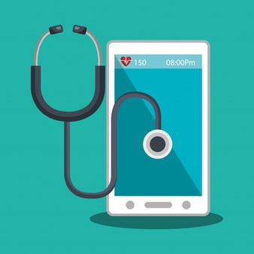
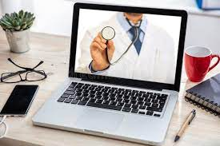
Effectiveness of Telemedicine during second COVID-19 Pandemic wave in India
Mentor
Dr Divya Aggarwal
IIHMR, DELHI
By PG/19/055
Lt Col Niteesh kumar

Slide 2
Introduction
Origin of telemedicine
Telemedicine ,telehealth ,teleconsultation and m-Health
Outbreak of COVID-19 pandemic
Telemedicine practice guidelines 2020
Second wave of pandemic in 2021

Slide 3
Rationale
Overcome barriers to health services caused by distance between patient and provider
Increased access to healthcare by overcoming geographical barriers particularly for patients in medically underserved regions and those places where clinical shortage exists
Provides access during fragmented care caused due to gap in appointments.
Reduced healthcare costs by saving on transportation and time
Improves Remote Patient Monitoring (RPM)
Improves quality of care delivery for patients.
Improving patient satisfaction and engagement as it provides them convenience , flexibility and real-time care with their providers.
Improving provider’s satisfaction as it can balance their work and family life in really challenging and stressful environment.
Avoiding the risk of exposure and reduce chance to infect others.

Slide 4
Literature Review
An in-depth review of literary articles from data sources like Pub Med, Google Scholar, Lancet, IJMR etc, published reports and official websites of Indian government (MoHFW) was conducted to come up with the following aspects pertaining to telemedicine.
Widened scope of RMP
Institutionalized Platform
Need of quality audit
Patients satisfaction
Providers satisfaction
Upgradation of existing digital tools

Slide 5
Objective
General objective is to measure the effectiveness of telemedicine during the second COVID-19 pandemic wave in India and suggest a system of quality evaluation and audit for continuous improvement in telemedicine services
Specific objectives are
Optimize use of telemedicine against impending third wave of the pandemic
Alleviating overall burden on the hospitals
Upgrading and equipping digital tools for practicing telemedicine
Provide better experience to the patients.
Widen scope for RMP
Reduce OOPE

Slide 6
Methodology
Study design | Observational and analytical study involving people infected by coronavirus and others
Study population for effectiveness of Telemedicine | For survey participants were drawn randomly who had used telemedicine services during the second wave of COVID-19 pandemic from the regions which were severely infected in India
Sampling method and sample size | Convenience sampling with initial size of 200 patients and 25 doctors ( later got restricted to 154 patients and 10 doctors)
Tools and data analysis | Two set of questionnaire were circulated for patients and doctors respectively. Ethical considerations were taken care of.
Study duration | study was conducted in the month of May 2021
Inclusion criterion | All respondents from India above 18 years of age and used telemedicine during Covid-19 pandemic and practicing telemedicine

Slide 7
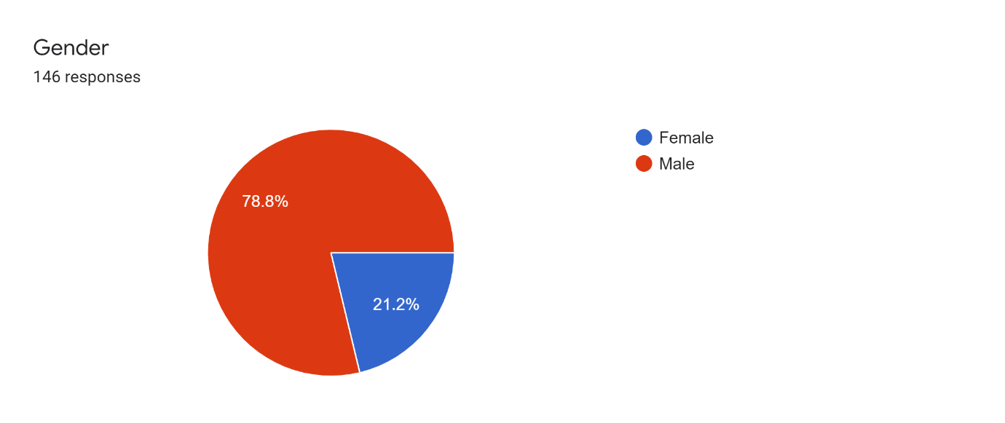
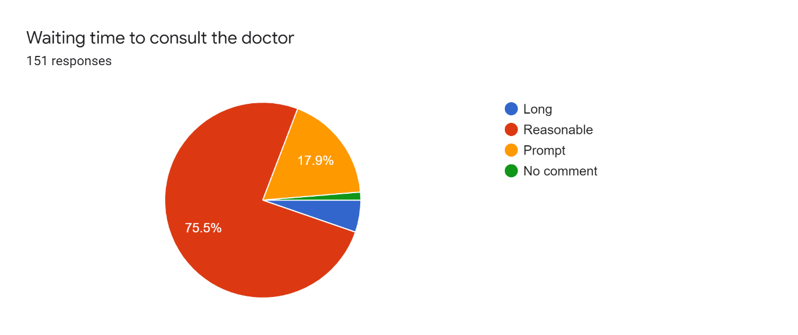
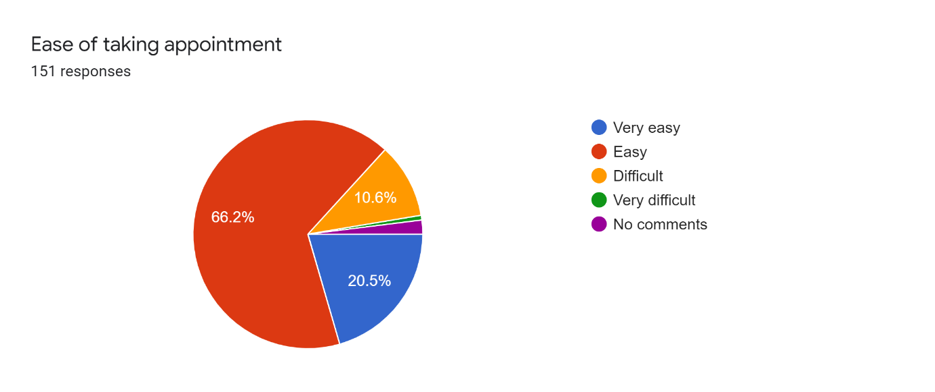
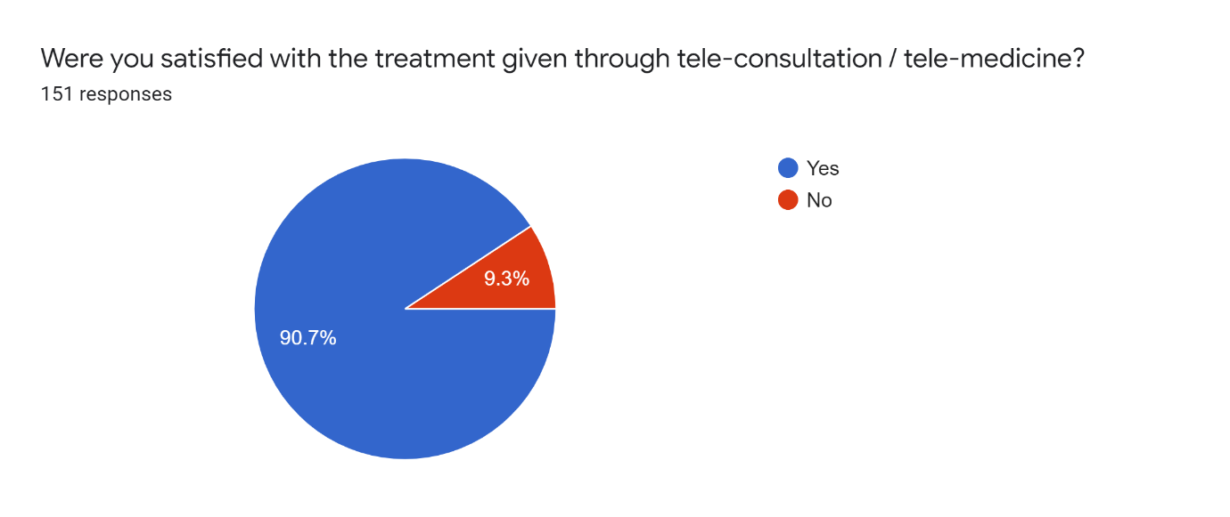
Results And Analysis
Patients feedback
v
1
3
2
4

Slide 8
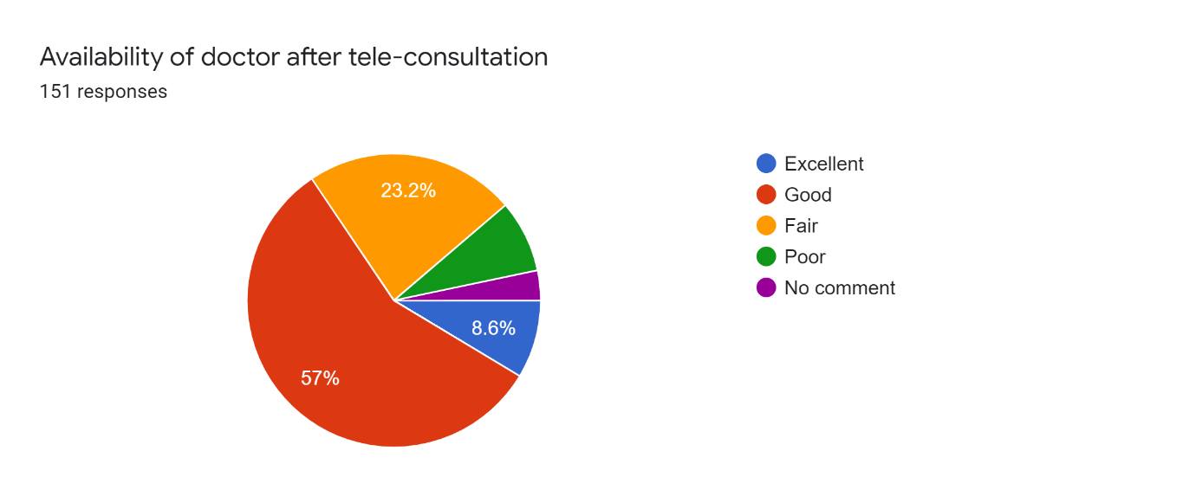
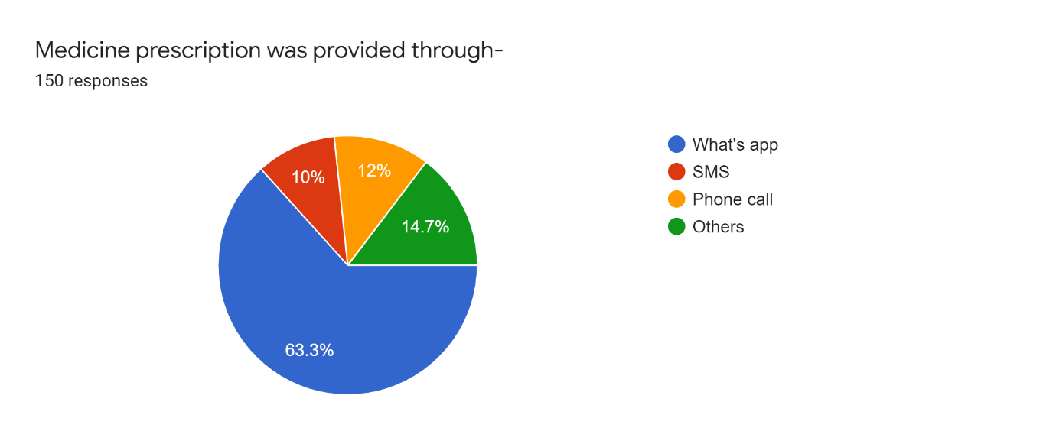
Results And Analysis
Patients feedback
5
6

Slide 9
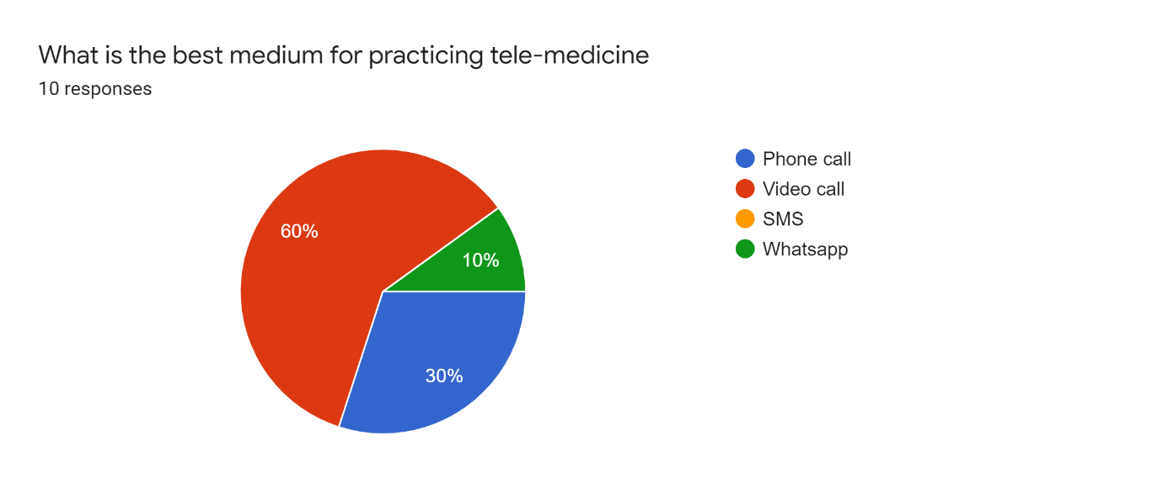
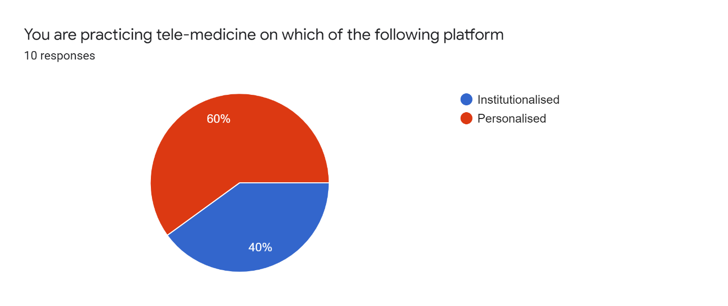
Results and analysis
Providers feedback
1
3
2
4

Slide 10
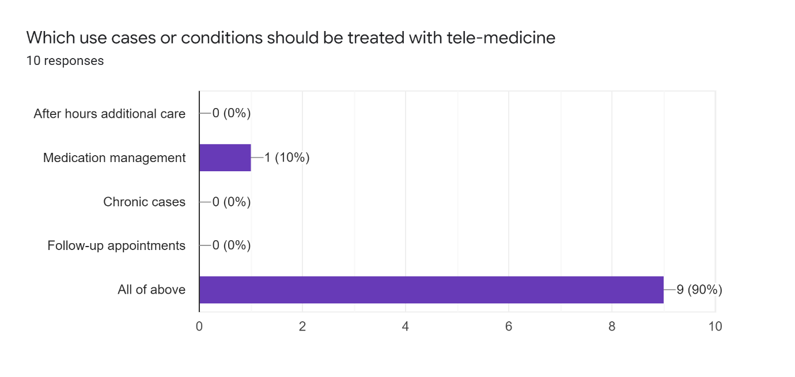
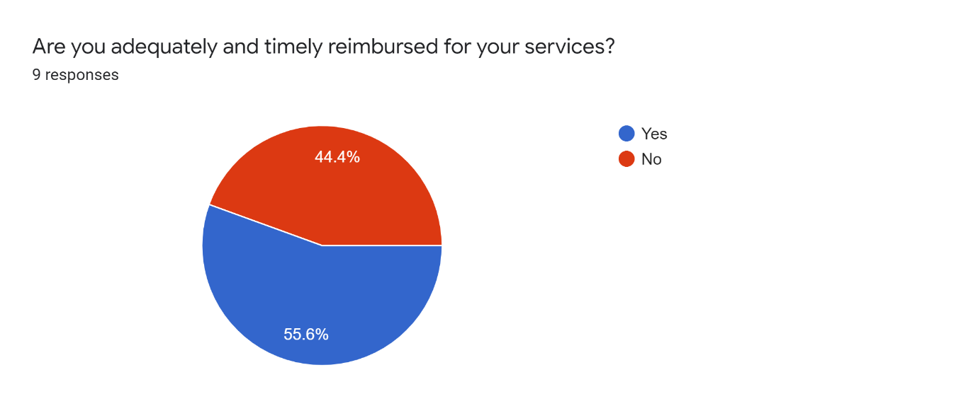
Results and analysis
Providers feedback
5
6

Slide 11
Results and analysis
Providers feedback
7
8

Slide 12
Findings-key Positives
Telemedicine made a very positive contribution healthcare during the current phase of the pandemic.
High satisfaction level amongst patients ie >80%
Doctors spend adequate time with patients
Remote monitoring of patients through telemedicine is feasible
Patient flow has increased tremendously after the telemedicine has been accorded the legal sanctity
Video conferencing- most preferred method
According to providers expected diagnosis/treatment met out to patients
containing the spread of virus by preventing symptomatic patients moving out of their homes.
Reducing the burden on hospitals by providing treatment to non-serious patients at home
Telemedicine services can be extended to various types of patients like
After hour additional care
Medication management
Chronic care
Follow up appointment
Reduced probability of frontline medical staff coming in contact with an infected person.
Tested and confirmed providers on being quarantined can be available to see patients via remote feeds

Slide 13
Findings –key negatives
Telemedicine guidelines ,though in place are yet to be implemented strictly.
Inadequate bandwidth of network for seamless streaming of data
OOPE expenditure on higher side.
Standard and robust hardware needed to ensure better patient experience .
Lack of proper evaluation and quality audit to measure effectiveness of telemedicine solution
Lack of Enterprise -based platform for customized use of telemedicine
Reimbursement issues with doctors

Slide 14
Gaps and Way ahead
One govt doctor on 10189 people
One hospital bed on 2046 people
Substantial urban –rural gap
Most quality doctor practice in large cities
Villages lack good infrastructure making travelling difficult and expensive
Gender gap
TELEMEDICINE
Good digital infrastructure
Training tele-healthcare providers
State- of- the-art medical technology
Quality evaluation and audit system
Digital literacy
UNIVERSAL HEALTH COVERAGE

Slide 15
Recommendations
A regulated quality audit mechanism should be in place to measure the effectiveness of telemedicine .
Requirement of strict adherence to telemedicine practice guidelines and constant revision from time to time.
Requirement of an institutionalized platform to enhance quality and accountability of telemedicine services.
OOPE should be reduced for wider coverage of the remote areas.
Dedicated technology for customized programs to provide teleconsultation on various ailments like stroke care, dermatitis, gynae ailments and etc .
Many telemedicine programs are hardware-agnostic, providers need to ensure that all telemedicine platforms are suitably equipped with right technology to facilitate examination of patients through better camera and sound quality.
Quality broadband network along with Wi-Fi connection within the facilities should be considered to improve the quality of video streaming and better acoustics for the transmission of clear sounds to avoid any ambiguities.
Telemedicine staff should be having proper credentials and licensing to provide the patient care.

Slide 16
conclusion
Proved to be a perfect , ready-made solution and contributed positively by providing PRECAUTION,PREVENTION and TREATMENT to stem the spread of virus during COVID-19 pandemic
Telemedicine can be a game changer for Indian healthcare system by bridging the existing gaps
Government policies should be able to provide adequate infrastructure and funding to facilitate growth of telemedicine projects
Besides focus on setting –up telemedicine program , focus on their evaluation and quality audit is very essential.
Not only addressing coronavirus , should be viewed as a long-term investment to provide a better patient experiences and achieve Universal Health Coverage.

Slide 17
Program Outcomes
1 | 2 | 3 | 4
Internalize the concepts of management such as healthcare delivery system, strategic planning, HR, marketing ,finance and operations | Apply knowledge of research and management techniques and functions in an integrated manner in healthcare set up. | Use appropriate skills to support healthcare organizations to take informed decision in planning ,building and managing healthcare organizations | Utilize learning acquired from trainings and practical exposures in real time situations
MODERATE | MODERATE | MODERATE | SUBSTANTIAL

Slide 18
References
https://www.mohfw.gov.in/pdf/Telemedicine.pdf
https://pubmed.ncbi.nlm.nih.gov/32397000/
https://pubmed.ncbi.nlm.nih.gov/32738884/
https://health.economictimes.indiatimes.com/news/health-it/covid-19-lockdown-2-0-telemedicine-in-india-to-see-continued-growth/75172147
https://www.ncbi.nlm.nih.gov/pmc/articles/PMC7652130/
https://www.ncbi.nlm.nih.gov/pmc/articles/PMC5353817/#!po=47.2973
https://www.healthcareitnews.com/news/telemedicine-during-covid-19-benefits-limitations-burdens-adaptation
https://www.ncbi.nlm.nih.gov/pmc/articles/PMC7395209/

