Slide 1
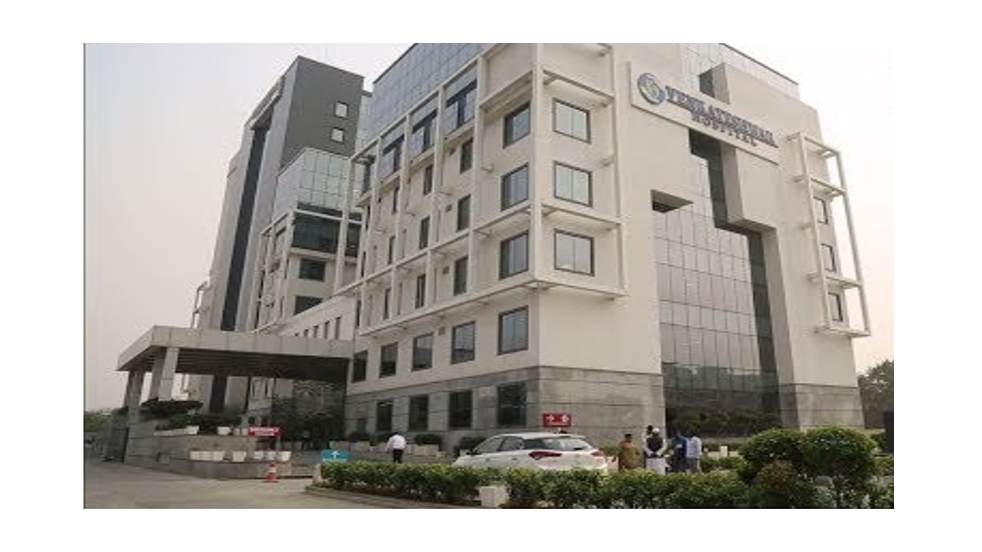
Comparative Analysis : Emergency Response Pre and During Covid-19 Times in Emergency Department of Multi-Specialty Hospital
Col MANOJ SHARMA
PG/19/042
HOSPITAL Management
Mentor
Dr. NITISH DOGRA

Slide 2
Introduction

Slide 3
Rationale
Quality of Care.
Measuring quality at critical department of hospital.
Assessing response in pre-covid times and during covid - 19.
Ascertain efficiency of work force in the ED.
Improve quality of care and patient satisfaction.
Changes in the protocols for treating patients arriving at ED during Covid-19.

Slide 4
Review of Literature
An in-depth review of literary articles from Google Scholar, Pub Med, Research Gate etc. and Hospital website was conducted to come up with the following themes
Introduction to existing ED/ER in hospitals
Desirability for comprehensive quality audit of ED/ER
Standards and protocols for quality audit
NABH standards and objective elements
Providers efficiency and patient satisfaction
Response time changes in ER pre and during Covid-19 times

Slide 5
Objectives
To conduct a comparative analysis of the emergency response time before and during Covid-19 in the Emergency Department of the Multi-Specialty Hospital in Delhi.
Specific objectives are:
Obj 1
Obj 3
Obj 4
Compare time frame for documenting initial assessment in pre and during covid times.
Analysis of accurate documentation of medication administered in pre and during covid.
Understanding the flow of emergency department procedures.
Obj 5
Obj 6
Documentation of nursing plan of care in pre and during covid times.
Provide recommendations on the steps to be taken to fill gaps.

Slide 6
Methodology
Study Design | An comparative study of secondary data.
Setting | Venkateshwar Hospital Emergency Department, Dwarka.
Study Period | Three months (Mar - May 2021).
Sample Size | Sample Size: 126 patient records during the Pre Covid-19 from Jan - Mar 2020 and during Covid-19 from March - May 2021 were assessed.
Study Tools: | Observation checklist used to assess the infrastructure and services provided by the staff of the hospital. Data sheet was developed to record relevant information from register.
Data Analysis. | Using MS Excel. All parameters in the test tool are tested under the following categories:- Compliance. Partial-compliance. Non-compliance.

Slide 7
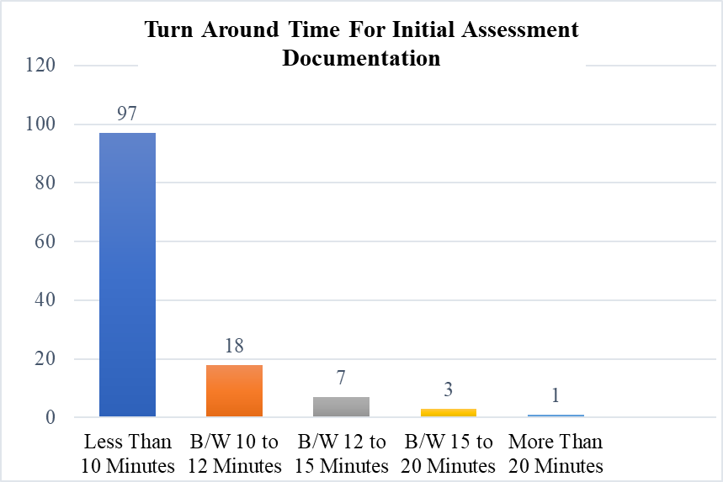
Standard 1: Time Frame for Doing and Documenting Initial Assessment
Out of a total of 126 patient files examined, 29-file (23%) showed non-compliance.
Further investigation,97 files (77%) were recorded in a typical 10 minute period.
18 (14%) files documented between 10 and 12 minutes.
7 files (6%) recorded between 12 and 15 minutes.
Remaining files took more than 15 minutes.

Slide 8
Standard 2: Accurate Documentation of Medication Administered
In a total of 126 patient files examined, it was found that the drug chart of 27 files (22%) showed partial compliance.
1 file (1%) showed partial compliance in giving the doctor's name.
3 files (2%) indicated a partial compliance with the doctor's signature.
Overall compliance was very good.

Slide 9
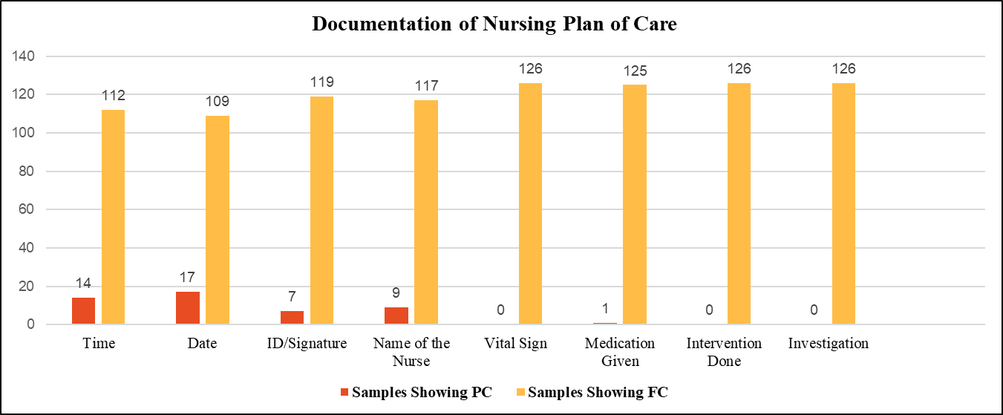
Standard 3: Documentation of Nursing Plan of Care
126 patient files were surveyed, nurses' care system in 17 (14%) records was incorrect and showed non-compliance.

Slide 10
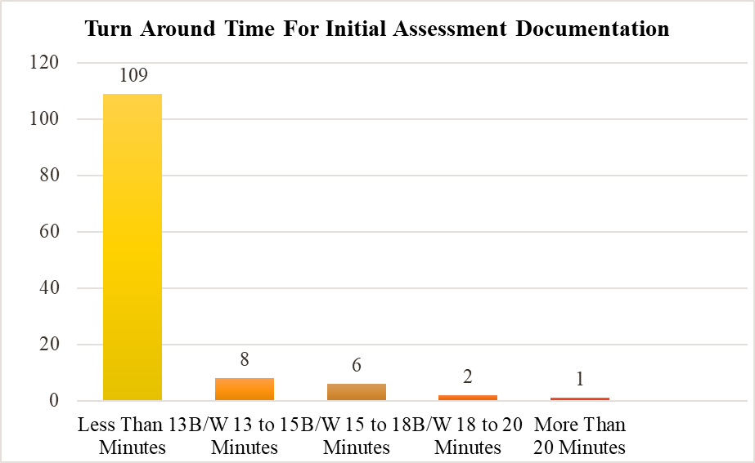
Standard 1: Time Frame for Doing and Documenting Initial Assessment : During Covid
Out of a total of 126 patient files examined, the first 9 (7%) screening form showed non-compliance.
Found that 117 files (93%) were recorded in a typical 15 minute period.
6 (5%) files were written within 15 to 18 minutes.
2 (2%) files were recorded between 18 to 20 minutes.
1 file took more than 20 minutes.

Slide 11
Standard 2: Accurate Documentation of Medication Administered : During Covid
In a total of 126 patient files examined, it was found that the drug chart of 23 files (17%) showed partial compliance.
1 file (1%) showed partial compliance with the doctor's name.
3 (2%) files demonstrated partial compliance with the doctor's signature.

Slide 12
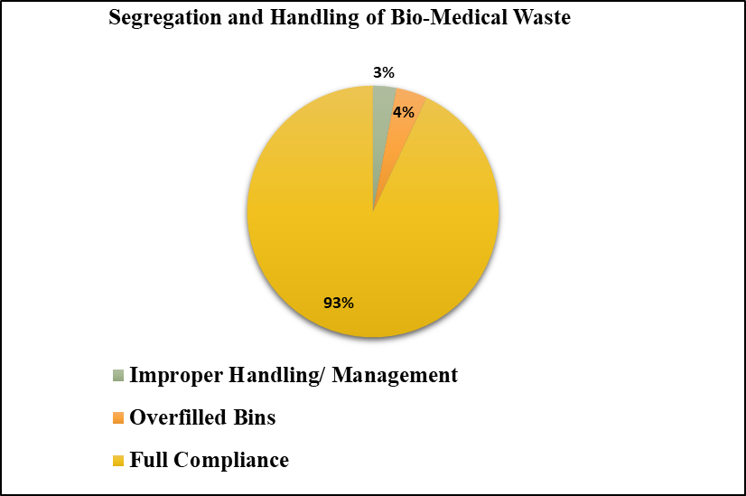
Standard 3: Segregation and Handling of Bio-Medical Waste : During Covid
In 30 studies, 2 times (7%), the separation and treatment of medical waste showed partial compliance.
1 (3%) cases were handled improperly
1 (4%) was overfilled barrels and discarded items lying on the floor.

Slide 13
Standard 4: Documentation of Nursing Plan of Care : During Covid
126 patient files were surveyed, nurses' care system in 9 (7%) records was incorrect and showed non-compliance.
In a few samples the time, date, ID / nurse name of the nurse was not available.

Slide 14
Conclusion
High percentage of compliance was observed at the emergency department level.
Cause of the identified problems remained the same in most tertiary care hospitals.
Partial non-compliance should be considered when making changes to maintain continuous quality assurance and efficiency.
Venkateshwar hospital has a well organized system in place which ensures right triaging, documentation, faster treatment and disposal of the patient arriving at the hospital

Slide 15
Recommendation
Regular internal audit needs to be conducted to identify areas of concern.
Mock Drills to be organized to ensure correct protocols followed in letter and spirit.
Bio-medical waste is an area of concern and thus need to be regularly audited and disposal procedures needs to rehearsed.
Pandemic or epidemic stretches the resources of any healthcare organizations which needs to be factored in while planning the infrastructure, processes and the outcomes.
Training of the staff a must to brief them on patient safety, their own protection and for maintaining quality of services.

Slide 16
References
1. | Lorenzetti DL, Quan H, Lucyk K, Cunningham C, Hennessy D, Jiang J, et al. Strategies for improving physician documentation in the emergency department: a systematic review. BMC Emerg Med [Internet]. 2018;18(1). Available from: http://dx.doi.org/10.1186/s12873-018-0188-z
2. | Shiferaw Y, Abebe T, Mihret A. Sharps injuries and exposure to blood and bloodstained body fluids involving medical waste handlers. Waste Manag Res. 2012;30(12):1299–305.
3. | Johnson KD, Gillespie GL, Vance K. Effects of interruptions on triage process in emergency department: A prospective, observational study. J Nurs Care Qual. 2018;33(4):375–81.
4. | Jarvis PRE. Improving emergency department patient flow. Clin Exp Emerg Med. 2016;3(2):63–8.
5. | Who.int. [cited 2021 Jun 10]. Available from: https://www.who.int/emergencies/diseases/novel-coronavirus-2019/situation-reports.
6. | Shrestha A, Shrestha A, Sonnenberg T, Shrestha R. COVID-19 emergency department protocols: Experience of protocol implementation through in-situ simulation. Open Access Emerg Med. 2020;12:293–303.
7. | Johnson KD, PhD RN, Cen GLG. Effect of Interruption on Triage Effect in Emergency Department. In the article the results of the Interruption of Photography in the Department of Emergencies. i PhD, DNP, RN, CEN, CNE, CPEN, and Kimberly Vance, MSN, RN: NE-B;
8. | Patient Flow in the Emergency Department: Phase III— after Disposition Decision through Departure. In Magee, MSN, RN, CPHQ: CPPS Senior Patient Safety/Quality Analyst Pennsylvania;
9. | Quah LJJ, Tan BKK, Fua T-P, Wee CPJ, Lim CS, Nadarajan G, et al. Reorganising the emergency department to manage the COVID-19 outbreak. Int J Emerg Med. 2020;13(1):32.

Slide 17
Program Outcomes Slight (Low), Moderate (Medium), Substantial (High)
Internalize the concepts of management such as healthcare delivery system, strategic planning, HR, marketing, finance and operation | Apply knowledge of research and management techniques and functions in an integrated manner in healthcare set up | Use appropriate skills to support healthcare organizations to take informed decision in planning, building and managing healthcare organizations | Utilize learning acquired from trainings and practical exposures in real time situations
Moderate | Substantial | Substantial | Substantial

Slide 18
Thank you

