Slide 1
QUALITY IMPROVEMENT PROJECT ON MEDICAL RECONCILIATION
SUBMITTED TO- DR. NIKITA SABHERWAL
SUBMITTED BY- DR. AAKANKSHA POPLI

Slide 2
INTRODUCTION
DEFINITION- The process of identifying the most accurate list of all medications that the patient is taking, including name, dosage, frequency, and route, by comparing the medical record to an external list of medications obtained from a patient, hospital, or other provider.
RECONCILIATION OF MEDICATIONS OCCURS AT TRANSITION POINTS OF PATIENT CARE
INTERPRETATION: The purpose of medication reconciliation is to ensure that the list of medication that a patient is to receive is complete and up-to-date with past clinical conditions and present care plan. The prescribed medications shall be checked for accuracy at the transition points, such as the time of admission, transfer of patient from one ward setting/department to another, or at the time of discharge. Its is preferable that medication reconciliation also occur after cross consultation. Medication reconciliation should be documented. There is a system for effective communication during handover regarding the reconciliation of medications.

Slide 3
AIM
The aim of medical reconciliation is to prevent adverse drug events (ADEs) at all interfaces of care (admission, transfer and discharge), for all patients and to eliminate undocumented intentional discrepancies and unintentional discrepancies by reconciling all medications, at all interfaces of care.
OBJECTIVES
Define the components of an accurate medical reconciliation.
Recognize gaps and inconsistencies in the medical reconciliation process.
Identify next steps in your practices to improve medical reconciliation.

Slide 4
METHODOLOGY
DATA COLLECTION AND METHODS
The audit included patients admitted to Fortis Hospital, Gurugram. We have used Descriptive Cross Sectional Study Design and the data used was collected by creating audit tool. This data is completely based on documented files.
SAMPLING METHOD - Simple random sampling method was used for auditing.
DATA ANALYSIS - Data collection and Analysis was done with the help of Microsoft excel.
SAMPLE SIZE- 100 IN TOTAL
TYPE OF DATA FOR THE PROJECT – Quantitative primary data
STUDY DESIGN - Descriptive Cross-Sectional study.

Slide 5
EXAMPLES OF MEDICATION ERROR
Aspirin and clopidogrel ceased in ICU and not recommenced when patient transferred to ward
Patient suffered sudden cardiac arrest resulting in death
May have contributed to patient’s death
Patient prescribed ramipril 1.25mg daily, medication chart was rewritten as ramipril 12.5mg daily
Patient suffered pre-syncopal episode, was transferred to HDU and required noradrenaline
Caused temporary harm and required intervention
Patient initiated on new cardiac medication, discharged with no summary or medicine
Patient became acutely unwell and was re-admitted
Caused temporary harm and required intervention

Slide 6
RESULTS
The audit tool was categorised into 4 categories as follows:
Medical reconciliation at the time of admission
Medical reconciliation at the time of cross consultation
Medical reconciliation at the time of unit transfer.
Medical reconciliation at the time of discharge.

Slide 7
MEDICAL RECONCILIATION AT THE TIME OF ADMISSION

Slide 8
AUDIT TOOL FOR MEDICAL RECONCILIATION AT THE TIME OF ADMISSION
PATENT'S NAME
UHID
DOCTOR'S NAME
DATE OF AUDIT
DIAGNOSIS
SPECIALITY
MEDICAL RECONCILIATION DONE AT THE TIME OF ADMISSION (YES/NO)
IF YES, LIST OF MEDICATIONS
MEDICAL RECONCILIATION DONE IN MAR SHEET (YES/NO) :
IF YES, LIST OF MEDICATIONS
REMARKS:

Slide 9
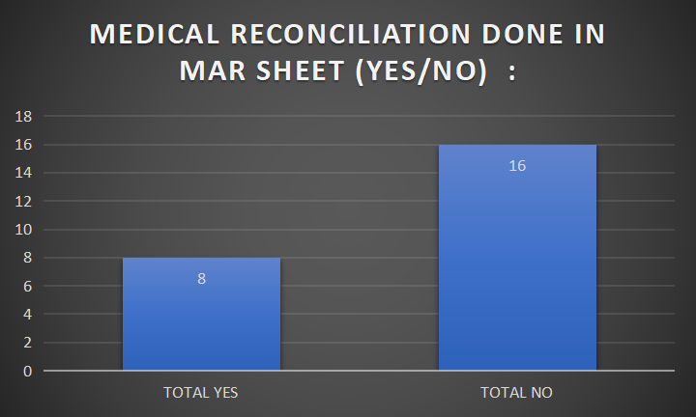
MEDICAL RECONCILIATION AT THE TIME OF ADMISSION
SAMPLE SIZE - 25

Slide 10
MEDICAL RECONCILIATION DONE AT THE TIME OF ADMISSION
PARAMETER | NON COMPLIANCE
At the time of admission | Out of 25, in 12 samples, medical reconciliation was done at the time of admission whereas in 13 samples medical reconciliation was not done. Admission assessment form was completely left unfilled in 11 samples. Current treatment column in admission form , not considered.

Slide 11
MEDICAL RECONCILIATION DONE IN MAR SHEET
PARAMETER | NON COMPLIANCE
Medical reconciliation done in MAR Sheet | Out of 25, in 8 samples medical reconciliation was done whereas in 16 samples , medical reconciliation was done. Current treatment mentioned in admission form, but previous medication not correctly mentioned in MAR sheet. Previous medication column not considered.

Slide 12
MAJOR CONCERS
At the time of admission
Admission assessment form was completely left unfilled.
Current treatment column in admission form , not considered.
In MAR Sheet
Current treatment mentioned in admission form, but previous medication not correctly mentioned in MAR sheet.
Previous medication column not considered.

Slide 13
MEDICAL RECONCILIATION AT CROSS CONSULTATION

Slide 14
AUDIT TOOL FOR MEDICAL RECONCILIATION DONE AT THE TIME OF CROSS CONSULTATION
PATIENT NAME
UHID
DOCTOR'S NAME
SPECIALITY
DIAGNOSIS
MEDICAL RECONCILATION DONE AT CROSS CONSULTATION (YES/NO)
DOCUMENTED (YES/NO)
IF YES, LIST OF MEDICATIONS
REMARKS :

Slide 15
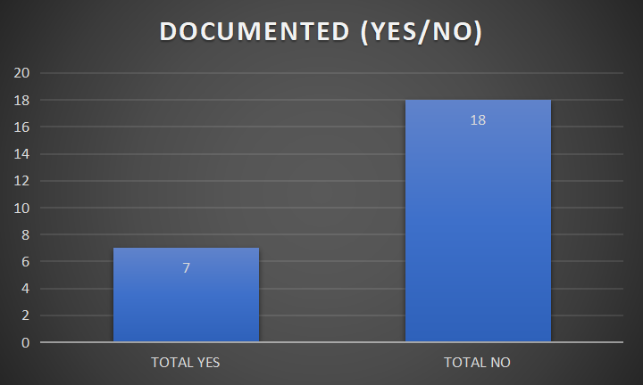
MEDICAL RECONCILIATION AT THE TIME OF CROSS CONSULTATION
SAMPLE SIZE - 25

Slide 16
DOCUMENTED (YES/NO)
SAMPLE SIZE - 25
PARAMETER | NON COMPLIANCE
Medical reconciliation done at cross consultation is documented or not. | Out of 25, in 7 samples, it was documented whereas in 18 samples, it was not documented. Not documented but was considered in MAR sheet.

Slide 17
AS PER OBSERVATION, THERE IS NO NON COMPLIANCE IN THESE 25 SAMPLES REGARDING MEDICAL RECONCILIATION
SAMPLE SIZE - 25

Slide 18
MAJOR CONCERNS
At the time of cross consultation
In most of the cases, medical reconciliation was done by assigned team and was considered in MAR sheet, but was not documented.

Slide 19
MEDICAL RECONCILIATION DONE AT THE POINT OF UNIT TRANSFER

Slide 20
AUDIT TOOL
PATIENT NAME
UHID
DATE OF AUDIT
DIAGNOSIS
SPECIALITY
DOCTOR'S NAME
MEDICAL RECONCILIATION AT UNIT TRANSFER (YES/NO)
DOCUMENTED (YES/NO)
IF YES, LIST OF MEDICATIONS

Slide 21
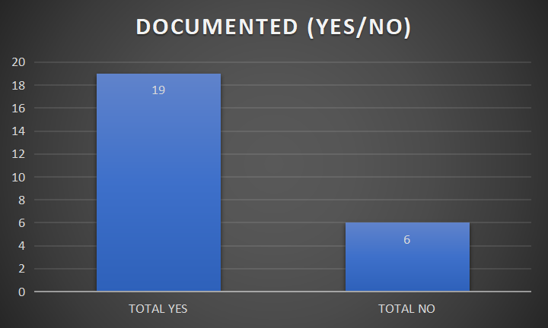
MEDICAL RECONCILIATION DONE AT THE TIME OF UNIT TRANSFER
SAMPLE SIZE=25

Slide 22
MEDICAL RECONCILIATION AT UNIT TRANSFER (YES/NO)
PARAMETER | NON COMPLIANCE
Medical reconciliation at unit transfer | Out of 25 samples, in 6 samples medical reconciliation was not done at the time of unit transfer and was not documented in progress notes.

Slide 23
DOCUMENTED (YES/NO)
PARAMETER | NON COMPLIANCE
DOCUMENTED (YES/NO) | Out of 25 samples, in 6 samples medical reconciliation was not done at the time of unit transfer and was not documented in progress notes.

Slide 24
MAJOR CONCERNS
Documentation in progress notes at the time of unit transfer was not done by the assigned team.
Uniform method not described and mentioned.

Slide 25
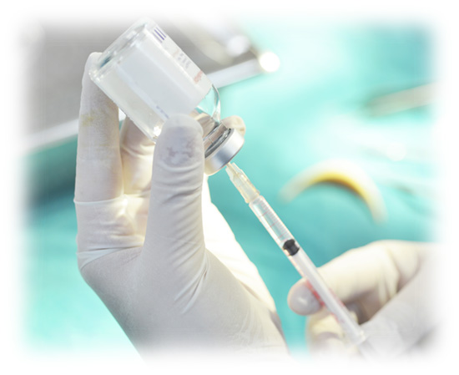
MEDICAL RECONCILIATION DONE AT THE TIME OF DISCHARGE

Slide 26
AUDIT TOOL
PATIENT'S NAME
UHID
DATE OF AUDIT
DIAGNOSIS
SPECIALITY
DOCTOR'S NAME
MEDICAL RECONSILIATION AT THE TIME OF DISCHARGE (YES/NO)
IF YES, LIST OF MEDICATIONS
MEDICAL RECONSILIATION DONE IN PROGRESS NOTES
MEDICAL RECONSILIATION DONE FROM MAR SHEET
VERIFIED BY DOCTOR

Slide 27
MEDICAL RECONCILIATION DONE AT THE TIME OF DISCHARGE

Slide 28
MEDICAL RECONCILIATION AT THE TIME OF DISCHARGE
PARAMETER | NON COMPLIANCE
Medical reconciliation done at the time of discharge | Out of 25 samples, in 20 samples medical reconciliation was not done at the time of discharge and was not mentioned in progress notes.

Slide 29
MEDICAL RECONCILIATION DONE IN PROGRESS NOTES
PARAMETER | NON COMPLIANCE
Medical reconciliation done in progress notes | Out of 25 samples, in 20 samples medical reconciliation was not done at the time of discharge and was not mentioned in progress notes.

Slide 30
MEDICAL RECONCILIATION DONE FROM MAR SHEET
PARAMETER | NON COMPLIANCE
Medical reconciliation done from MAR sheet | Out of 25 samples, in 24 samples medical reconciliation was done from MAR sheet whereas in 1 patient nothing was mentioned in MAR sheet.

Slide 31
VERIFIED BY DOCTOR
PARAMETER | NON COMPLIANCE
Verified by doctor | Out of 25 samples, in 4 samples discharge summary was not verified by doctor.

Slide 32
MAJOR CONCERNS
Documentation was not done in progress notes at the time of discharge.
Discharge summary was prepared by considering MAR sheet.
Verification of discharge summary was not done in 4 samples.

Slide 33
ANALYSIS
PEOPLE
PROCESS
Staff is not trained and oriented about medical reconciliation.
Doctors are doing 24 hours shift due to which they are not able to do their work effectively.
Providers forgetting to complete medical reconciliation
Patients don’t know medication name/ dose.
MEDICAL RECONCILIATION
Completing priorities on admission, unit transfer, cross consultation and discharges.
No accountability for not performing medical reconciliation.
Medical reconciliation form was introduced post NABH audit., but there is no implementation and compliance.
TASKS
MATERIAL RELATED

Slide 34
WHAT IS GOING GOOD | WHAT NEEDS ATTENTION
Area of documentation mentioned at the time of admission. Medical reconciliation is done in ICU’s as training of doctors is done. | No visibility in cross consultation, unit transfer and discharge. Discharge is done by floor doctors, and they are overloaded with work due to which they are not able to do medical reconciliation. There is no implementation and compliance of medical reconciliation form.

Slide 35
ACTION PLAN
WHAT NEEDS ATTENTION | SOLUTIONS SUGGESTED
No visibility in cross consultation, unit transfer and discharge. Discharge is done by floor doctors, and they are overloaded with work due to which they are not able to do medical reconciliation. There is no implementation and compliance of medical reconciliation form. | Introduction of EHR, for ease and accessibility of medical reconciliation done by doctors. adequately rostering of doctors, 6hr/8hr shift in a day. suggested increase in 1 doctor on floors so that one can look into medical reconciliation. training of doctors and nursing. Medication management plan can be introduced at the time of discharge to compare medicines

Slide 36
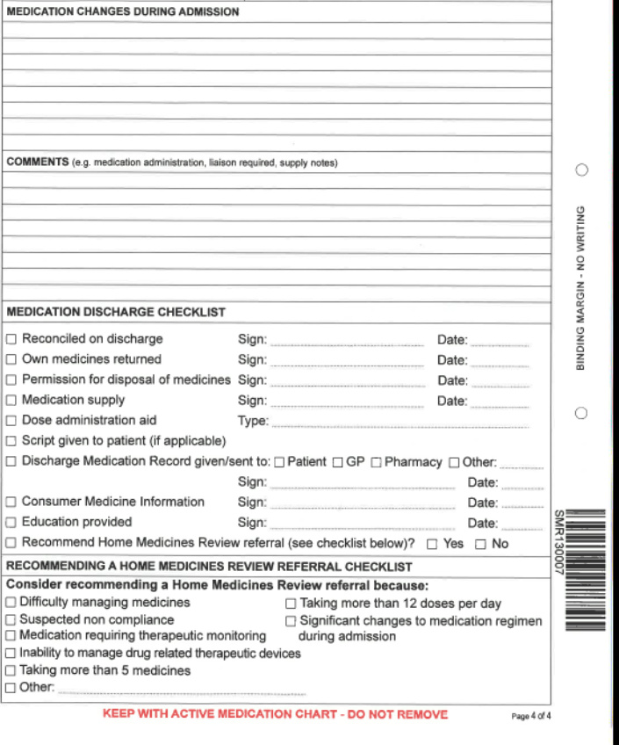
ASSISTING DISCHARGE
This form can contain a list of the patient’s pre-admission medications for comparison at discharge the MMP :
Capture medication changes during admission
Capture comments e.g. medication administration and supply requirements
Provide a discharge checklist
Identify patients for home medicines review

