Slide 1
Efficient Product Management For Developing Robust Healthcare Softwares Karkinos Healthcare Pvt. Ltd.
Dr. Afreen Hussain
PG/21/006
Mentor: Ms. Divya Agarwal
IIHMR Delhi

Slide 2
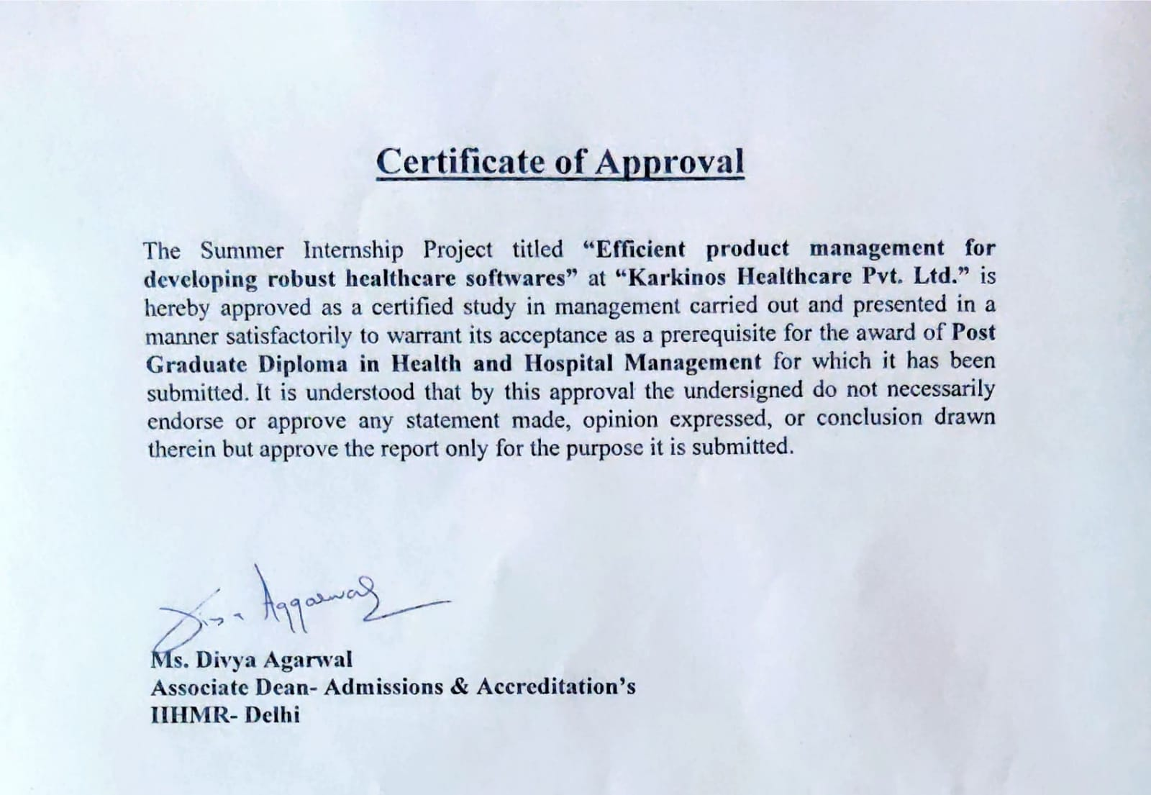
Screenshot of Approval

Slide 3
Objectives
Primary Objective
To understand the basics of product management in developing healthcare applications.
Secondary Objective
To undersatnd efficient adaptable strategies to meet the needs of end user.

Slide 4
Methodology
Study design- Narrative retrospective review
Setting- Karkinos Healthcare
Study Tool- PubMed search and google scholar search of relevant open access articles, Public blogs and unpublished articles by industry experts
Operational Definitions/Keywords- Product management, Roadmap, software lifecycle, Agile, UI/UX
Duration of study- 2 months

Slide 5
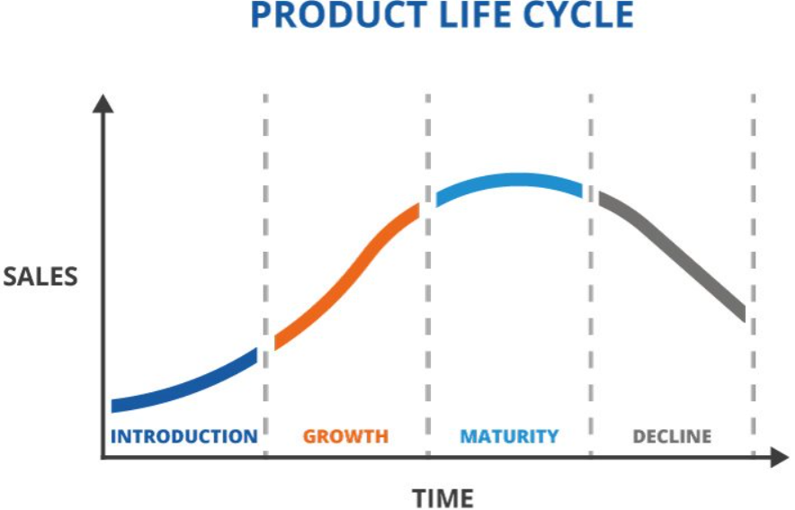
Introduction
Product management: is an organizational function that guides every step of a product’s lifecycle -from development to positioning and pricing - by focusing on the product and its customers first and foremost.

Slide 6
What is a software product
Software is a component/subset of the Higher order thing known as Product
Software products can be a combination of systems, solutions, materials and services delivered.
Classification of softwares in general:
System Softwares- Operating Systems, System support and System development softwares
Application Softwares- General and Specific purpose
Engineering/Scientific Softwares- for drawing, modeling, data interpretaion, decision making
Embedded Softwares- embedded into hardware as a part of larger systems to control its various functions
Web applications- type of application accessed over a network
Artificial Intelligence Softwares
Healthcare softwares: Standalone softwares- Appointment softwares, Health wearables using IOT, health chat bots, telemedicine, e prescription and online medication and health product delivery ; EHRs/EMRs encompassing all the standalone features with a vast array of more features etc.

Slide 7
Some Key Concepts to be understood:
Literall the UI
The Brain
Product requirement Documents (PRDs)
Wireframes
User Experience (UX)
User Interface (UI)
Tech/Solutions Stack (Frontend and Backend)
Database
Minimum Viable Product (MVP)
Application Programming Interface (API)
Interoperability

Slide 8
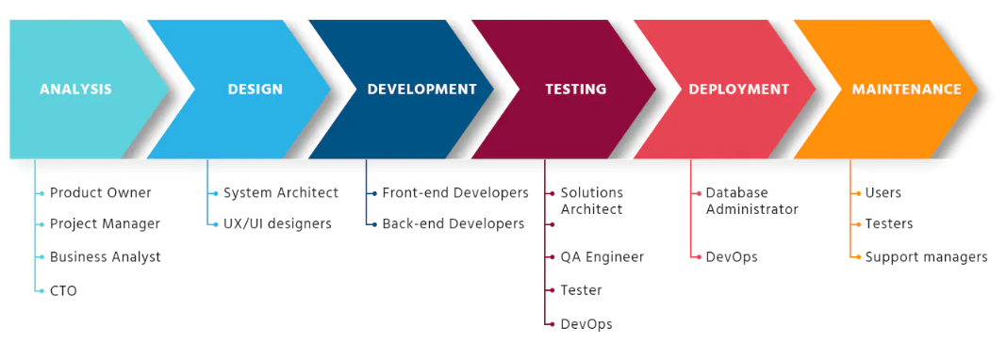
Software Development Lifecycle (SDLC)
Crucial for Product Manager and team to understand the basics of SDLC
Software lifecycle phases:
● Requirements analysis
● Software Design
● Software Development
● Testing
● Deployment
● Maintenance
Figure 1.Stages of Software Development Lifecycle (SDLC) governed by various members Healthcare IT Team
Image Source: https://brocoders.com/blog/agile-software-development-life-cycle/

Slide 9
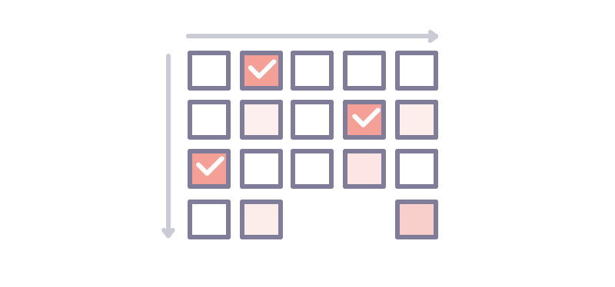
Application
Product team
Users
Bug Report/Feature Request/Environment change
Figure 2: Lifecycle of software is a never ending phase with constant maintainence, quality control and assurance

Slide 10
Software Lifecycle management models
SDLC Management is a process that aims to develop software with the lowest cost, highest quality, and in the shortest time.
Management Models:
Waterfall Model
V Model
Iterative Development Models- Rational Unified Process (RUP), Agile, Evolutionary Prototyping, Spiral
Healthcare field is ever evolving, hence iterative models are best when starting initial development of healthcare softwares

Slide 11
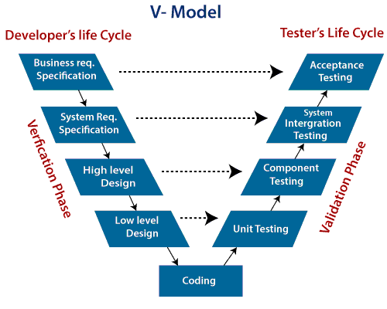
Figure 3. Waterfall Model
Creator: Sylfide | Credit: Getty Images/iStockphoto
Figure 4. V shaped Model
Source: https://www.javatpoint.com/software-engineering-v-model

Slide 12
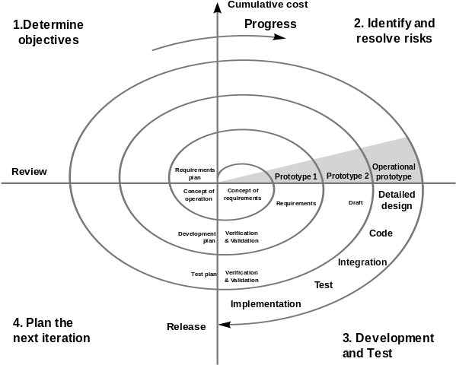
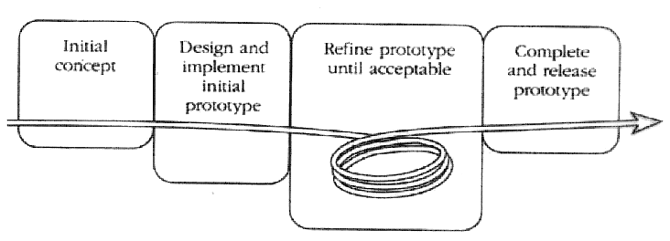
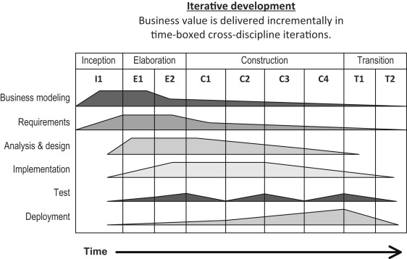
Figure 6. Evolutionary Prototyping
Source: https://hci.cs.siue.edu/NSF/Files/Semester/Week13-1/PPT-Text/Slide12.html
Figure 5. Spiral Model
Source: https://www.pngkey.com/detail/u2q8q8o0w7e6a9w7_spiral-model/
Figure 7. Rational Unified Process (RUP) Source: https://www.sciencedirect.com/topics/computer-science/rational-unified-process

Slide 13
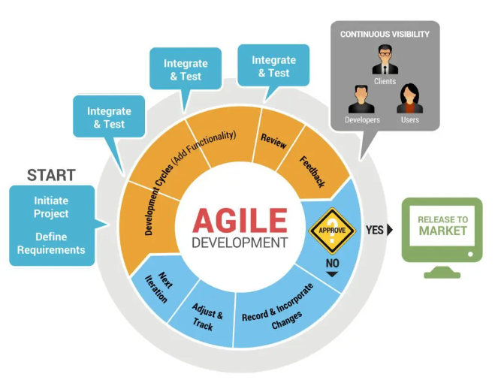
Figure 8: Agile Development Model
Source: https://cyberhoot.com/cybrary/agile-method/

Slide 14
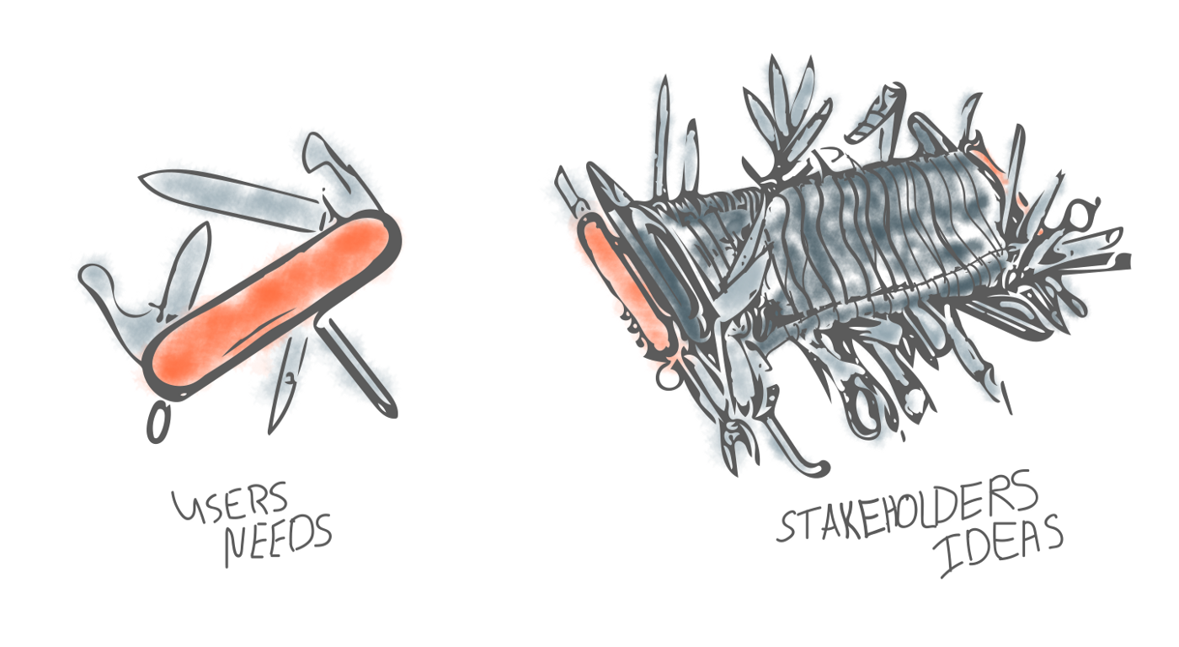
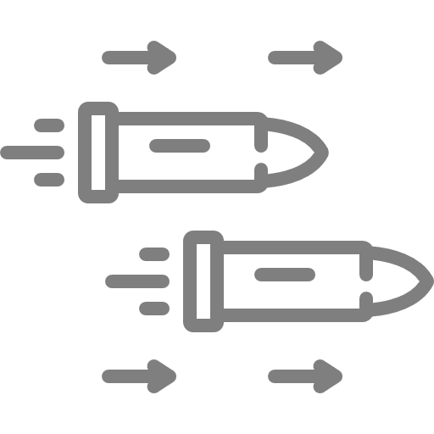
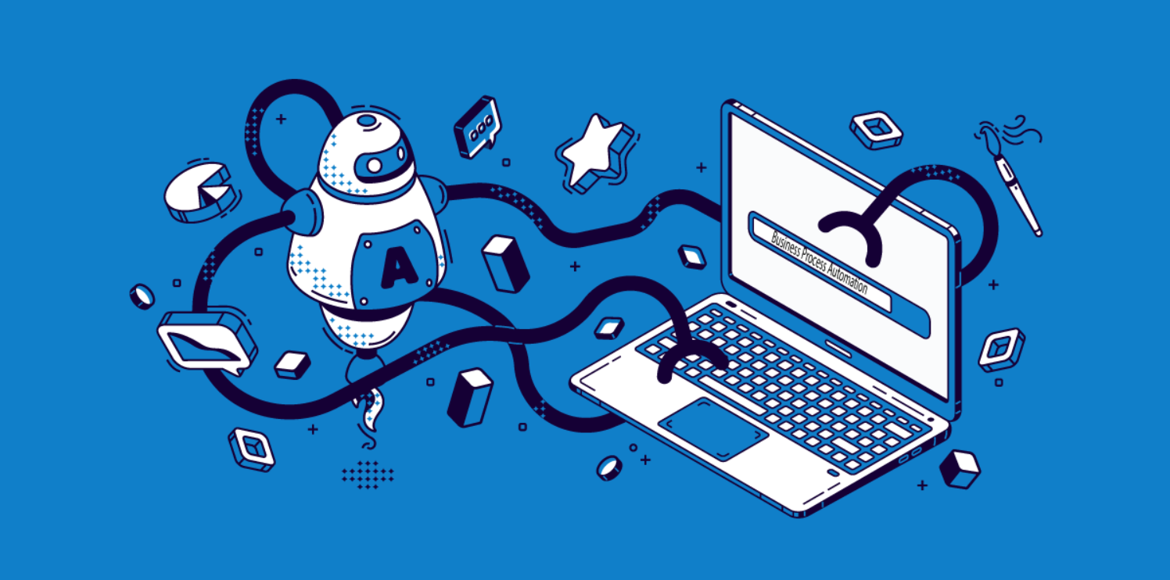
Some Classic Mistakes
People related
Process related
Product Related
Technology Related

Slide 15
Limitations of Study
Reliance on words of experts
Curated vast amounts of scattered data

Slide 16
Conclusion
Healthcare field is fast paced and ever evolving
Understand the basics of SDLC and management models
Fully own the vision and roadmap of healthcare software product areas assigned
Ability to push back on engineering estimates if project is under or over-scoped
Apply good software engineering and product management principles
Apply critical thinking to adapt to the healthcare domain and demands
Team collaboration
Apply good management priciples

Slide 17
References
https://techpearl.com/blog/product-management/
https://www.twi-global.com/technical-knowledge/faqs/what-is-a-product-life-cycle#:~:text=A%20product%20life%20cycle%20is,growth%2C%20maturity%2C%20and%20decline.
https://erbis.com/blog/6-phases-of-the-software-development-life-cycle/
https://www.upgrad.com/blog/software-process-software-process-models/

Slide 18
POSTER TEAM KARKINOS EFFICIENT PRODUCT MANAGEMENT FOR DEVELOPING ROBUST HEALTHCARE SOFTWARES
OBJECTIVES:
Primary Objective: To understand the basics of product management in developing healthcare applications.
Secondary Objective: To undersatnd efficient adaptable strategies to meet the needs of end user.
INTRODUCTION:
Product management: is an organizational function that guides every step of a product’s lifecycle -from development to positioning and pricing - by focusing on the product and its customers first and foremost.
WHAT IS A SOFTWARE PRODUCT
Software is a component/subset of the Higher order thing known as Product
Software products can be a combination of systems, solutions, materials and services delivered.
Classification of softwares in general:
System Softwares- Operating Systems, System support and System development softwares
Application Softwares- General and Specific purpose
Engineering/Scientific Softwares
Embedded Softwares
Web applications
Artificial Intelligence Softwares
SDLC MANAGEMENT MODELS
SDLC Management is a process that aims to develop software with the lowest cost, highest quality, and in the shortest time.
Management Models:
Waterfall Model
V Model
Iterative Development Models- Rational Unified Process (RUP), Agile, Evolutionary Prototyping, Spiral
Healthcare field is ever evolving, hence iterative models are best when starting initial development of healthcare softwares
METHODOLOGY:
Study design- Narrative retrospective review
Setting- Karkinos Healthcare Pvt. Ltd
Study Tool- PubMed search and google scholar search of relevant open access articles, Public blogs and unpublished articles by industry experts
Operational Definitions/Keywords- Product management, Roadmap, software lifecycle, Agile, UI/UX
Duration of study- 2 months
CONCLUSION
Healthcare field is fast paced and ever evolving
Understand the basics of SDLC and management models
Fully own the vision and roadmap of healthcare software product areas assigned
Ability to push back on engineering estimates if project is under or over-scoped
Apply good software engineering and product management principles
Apply critical thinking to adapt to the healthcare domain and demands
Team collaboration
Apply good management priciples
Application
SOFTWARE DEVELOPMENT LIFECYCLE (SDLC)
Product team
Users
Bug Report/Feature Request/Environment change

Slide 19
Internship Experiences
Skills and topics learnt:
Basics of software product management
Drafted Product requirement documents (PRDs)
Helped design low-high fidelity wireframes
Drafted User stories and user journey for features to enable the design team to incorporate them and forward the feature additions to developer team
Health dashboards
Role of automation
Backlog Prioritization

Slide 20
Suggestions Given to Organization
Enhance team communication
Keep revisiting the basics from time to time
Backlogs value estimation and resolution methods suggested

Slide 21
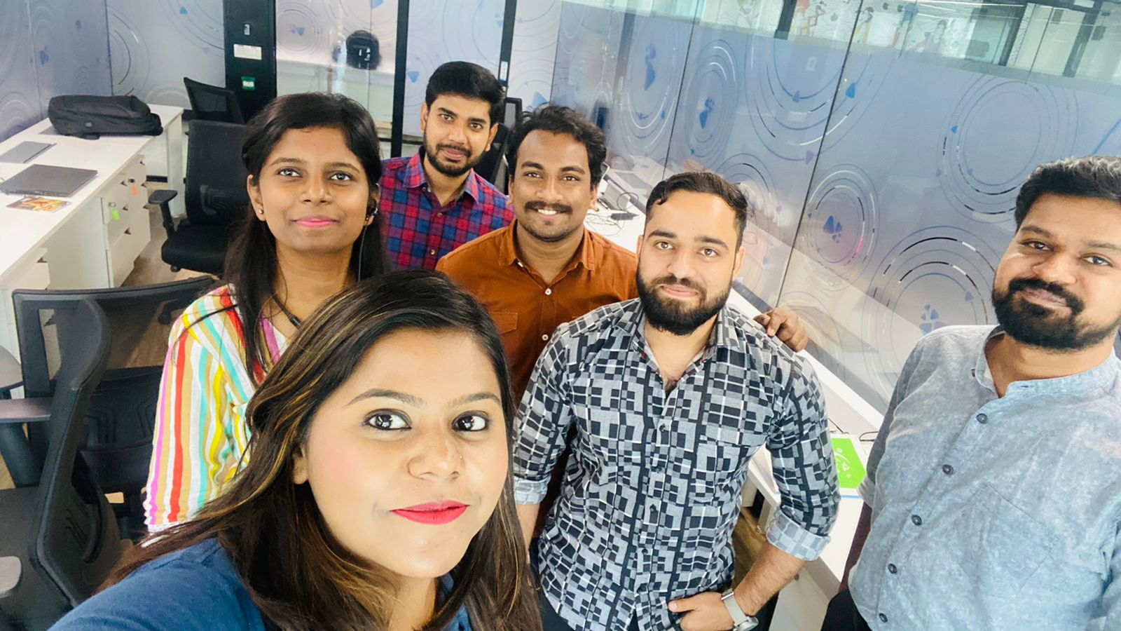
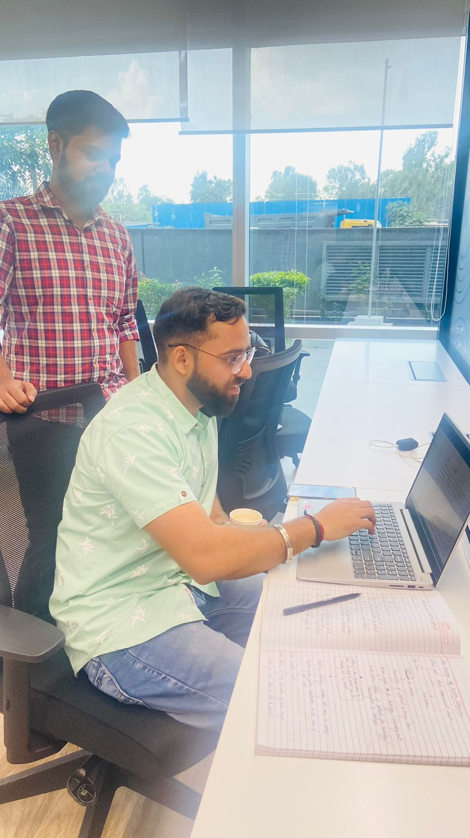
Pictorial Journey

Slide 22
Thank You

