Slide 1
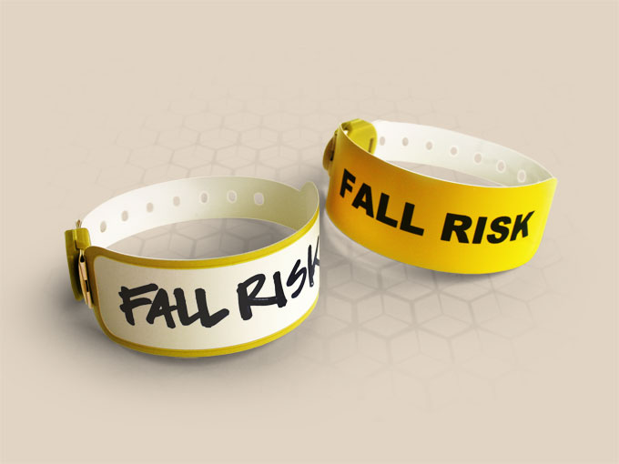
FALLS PREVENTION PROJECT
IPSG-6
Reduce the risk of patient harm resulting from Falls
SUBMITTED TO- DR. NIKITA SABHERWAL
SUBMITTED BY- DR. AKSHITA GUPTA

Slide 2
BACKGROUND
A patient fall is a sudden, unintentional descent, with or without injury to the patient, that result in the patient coming to rest on the floor, on or against some other surface (e.g. counter), or another person, or on an object (e.g. a trash can) -NDNQI, 2014
Complications of falls are the leading cause of death from injury in people aged 65 or above years.
causes of falls are always MULTIFACTORIAL. It is a complex interaction of-
Intrinsic factors (e.g. chronic disease)
Challenges to postural control (e.g. changing position)
Medication factors (e.g. high risk, situational hazards)

Slide 3
OBJECTIVES
To reduce the fall among vulnerable patients
To recognise the importance of falls in older people
Assess and manage fall risks
To precisely implement the fall risk program

Slide 4
Purpose of Fall Risk Assessment
To protect patients and promote patient safety.
To effectively identify and intervene with patients who are at risk for falling.
To educate the patients, families, and staff members on measures to prevent fall and promote safety.
To minimize/ decrease the number of patient falls.
Offer extra care to such patients in a safe and secue environment.
Scope
All OPD and IPD patients in hospital

Slide 5
METHODOLOGY
STUDY DESIGN- Prospective study
STUDY POPULATION- Patients of Fortis Memorial Research Institute, Gurugram
SAMPLE SIZE-
Total - 90 samples collected
IPD (40), OPD (45), EMERGENCY (5)
SELECTION CRITERIA- patients identified as high risk to fall in IPD and Emergency. Randomly selected patients from OPD including high risk as well as low risk.

Slide 6
FALL RISK ASSESSMENT TOOLS
HARRIS-2 TOOL FOR ADULTS
HUMPTY DUMPTY TOOL FOR PEDIATRIC PATIENTS

Slide 7
AUDIT TOOLS

Slide 8
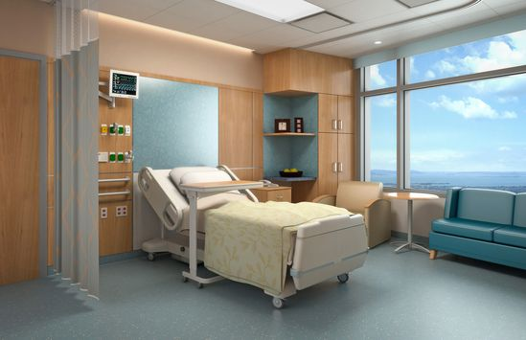
INPATIENT DEPARTMENT

Slide 9
COMPLETE IPD ANALYSIS
MAJOR CONCERNS-
11 Incomplete Daily documentation of fall. Area concerned- ICU
Patient/attendant education form-29 forms incomplete, not signed by patient/attendant or nursing staff.
22 out of 40 Individualised plan of care- either not attached or unfilled
Patient safety signages- 13 were found
24/40 beds were not in low position
NUMERATOR- 40

Slide 10
COMPLETE IPD FINDINGS:
 | TOTAL COMPLIANCE (40) | COMMENTS
Fall risk assessment on admission | 31 complete 9 partially filled | Incharge/TL sign, without calculation or miscalculation, incorrectly checked indicators, wrong scoring
Daily documentation of fall | 22 complete 9 partially filled 4 incomplete | Data missing on certain dates and shifts
Fall counselling signed by patient/attendant | 6 complete 16 partially filled 13 incomplete | Incomplete- age, medical condition, physical handicap, poly drugs, patient’s/attendant’s sign, nursing staff sign and details either not attached or incomplete
Individualised plan of care | 18 complete 7 partially filled 15 incomplete/ unattached | either not attached or incomplete (planned inteventions)
Fall risk assessment done by nursing | 33 correctly identified | PTF score was mentioned 0 instead of high risk/ low risk Randomly scored 10, incorrectly checked indicators 7 patients not identified as high risk in most recent nursing score incorrect assessment of age, length of stay, mental status, medications etc.
Bedside Observation- Signages- | 13 | AREAS OF CONCERN Nightangle ward, fourth floor, chemotherapy, ICU
Low Bed position- | 16 | Nightangle ward, third floor, fourth floor, chemotherapy, ICU
Side rails- | 32 | Nightangle ward, fourth floor
Awareness Staff awareness | 97% | Nightangle ward
Patient awareness | 83% | Nightangle ward

Slide 11
DEPARTMENT-WISE FINDINGS:
 | NIGHTANGLE WARDS (3) | THIRD FLOOR (14) | FOURTH FLOOR (13) | CHEMOTHERAPY (5) | ICU (5)
Fall risk assessment on admission | 2 complete 1 partially filled | 10 complete 4 partially filled | 9 complete 4 partially filled | all 5 complete | all 5 complete
Daily documentation of fall | 2 complete 1 partially filled | 10 complete 4 partially filled | 9 complete 4 partially filled | Not Applicable | 1 complete 4 incomplete
Fall counselling signed by patient/attendant | none | 10 signed 4 completely unfilled | 9 signed 4 completely unfilled | 2 signed 3 not signed | Not Applicable
Individualised plan of care | 2 complete 1 partially filled | 4 complete 1 partially filled 9 completely unfilled | 6 complete 2 partially filled 5 completely unfilled | 2 complete 3 partially filled | 4 complete 1 incomplete
Fall risk assessment done by nursing | only 1 identified correctly | 11 identified correctly | all 13 identified correctly | all 5 identified correctly | 3 identified correctly
Bedside Observation- Signages- | 0 | 10 | 3 | 0 | 0
Low Bed position- | 1 | 7 | 6 | 2 | 0
Side rails- | 2 | 11 | 9 | 5 | 5
Awareness Staff awareness | 67% | 100% | 100% | 100% | NA
Patient awareness | 50% | 80% | 83% | 100% | NA

Slide 12
NIGHTANGLE WARDS
MAJOR CONCERNS-
2/3 Fall risk assesment was incomplete on admission, incomplete scoring
No Patient/attendant education form was complete or not signed by patient/attendant or nursing staff.
Individualised plan of care was either not attached or unfilled
Most recent nurse score usually mentioned 0
Patient safety signages- none
2 beds were not in low position
NUMERATOR- 3

Slide 13
THIRD FLOOR
MAJOR CONCERNS-
Fall risk assesment daily- PTF risk level mentioned 0 instead of high risk or low risk, wrongly marked indicators (age, mental status, length of stay etc.)
Patient/attendant education form- incomplete or not attached
Individualised plan of care- either not attached or unfilled (no planned interventions)
7 beds were not in low position
NUMERATOR- 14

Slide 14
FOURTH FLOOR(WARDS)
MAJOR CONCERNS-
4 Fall risk assesment on admission were incompletely filled (incomplete scoring, name of TL/incharge, employee ID, sign) wrong scoring.
In 4 Fall risk assesment daily were PTF risk level mentioned 0 instead of high risk or low risk, wrongly marked indicators (age, mental status, length of stay etc.)
Patient/attendant education form- incomplete or not attached
Individualised plan of care- either not attached or unfilled (no planned interventions)
Patient safety signages- present only in 3 out of 13.
7 beds were not in low position
NUMERATOR- 13

Slide 15
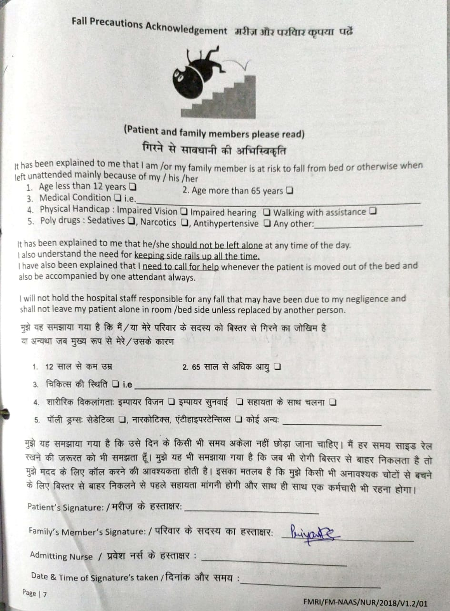
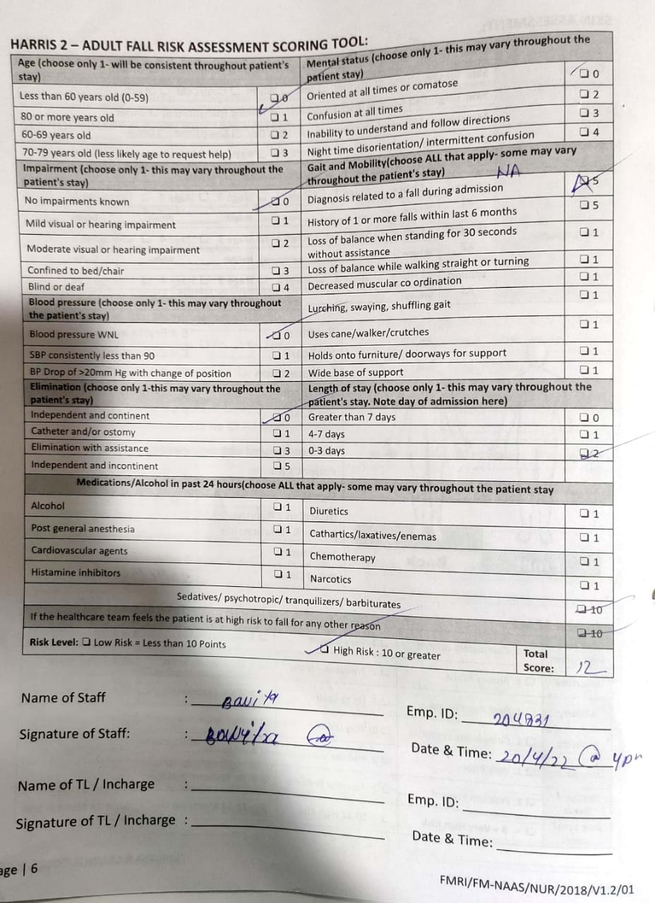
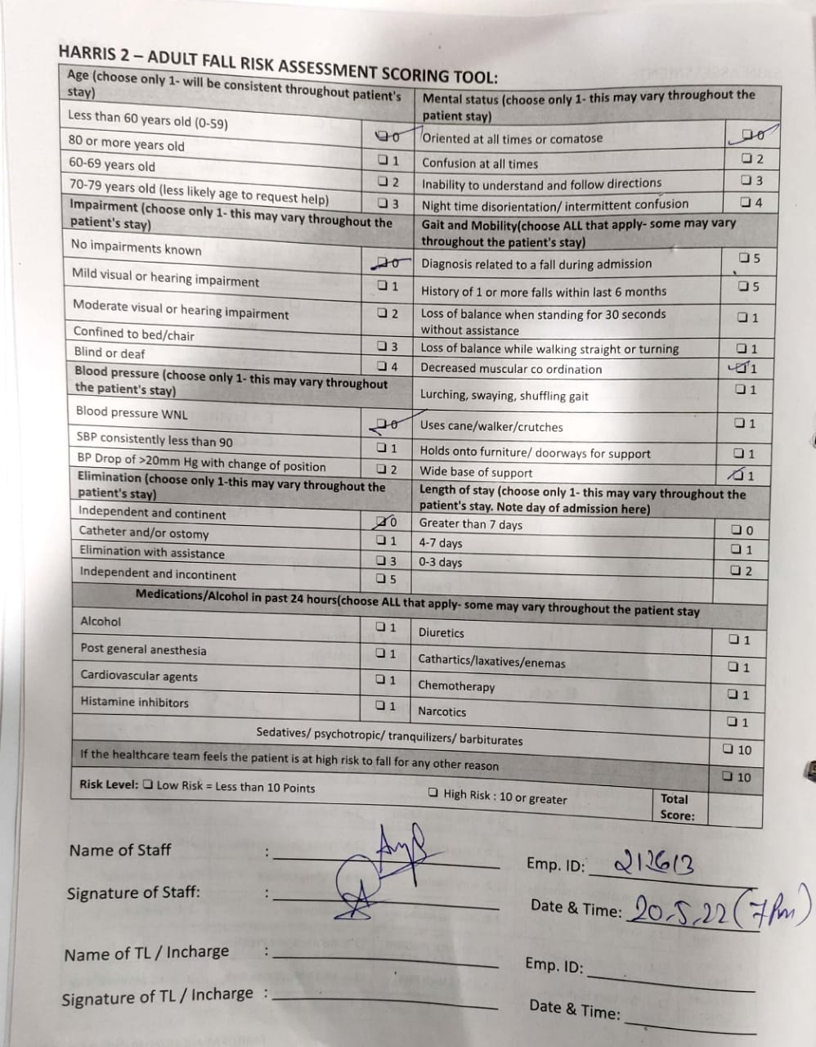
OTHER SIGNIFICANT FINDINGS:
UHID- 11689876
UHID- 11674935
Patient was on PSYCHOTROPIC DRUGS (tab. Zolfresh, tab. Lanazep) but not mentioned on HARRIS-2 tool. Also the patient was mentioned in low risk. mental status of the patient was mentioned DISORIENTED in progress notes but not documented on admission or in daily nurses flow sheet.
Wrong calculation of scores or scores not calculated, wrongly marked indicators on HARRIS-2 tool as well as daily nurses flow sheet.
Patient counselling/education form either completely unfilled or not attached. If attached always incomplete.

Slide 16
CHEMOTHERAPY
MAJOR CONCERNS-
3 Patient/attendant education forms were incomplete, not signed by patient/attendant or nursing staff.
3 Individualised plan of care were either not attached or unfilled
Patient safety signages- none
2 out 5 beds were in low position
NUMERATOR- 5

Slide 17
ICU
MAJOR CONCERNS-
Daily documentation of fall- 4 out 5 was not done.
2 out 5 files didn’t have most recent nurse score
No beds werefound in low position
NUMERATOR- 5

Slide 18
OUTPATIENT DEPARTMENT

Slide 19
OPD ANALYSIS Area Assessed- Nursing Assessment Room no. 33 and Physiotherapy
MAJOR CONCERNS-
Many nursing assessment form didn’t mark for intervention
NUMERATOR- 45

Slide 20
EMERGENCY
MAJOR CONCERNS-
Only 1 out of 5 beds were low in position and had patient safety signage.
NUMERATOR- 5

Slide 21
ALL OUT PATIENT DEPARTMENTS & EMERGENCY FINDINGS:
Departments undertaken- Nursing Assessment Room no. 33, physiotherapy, emergency.
Fall Risk Assessment (80%)- out of 45 samples (OPD), 9 were not assessed.
Intervention (49%)- out of 35 forms (excluding physiotherapy), 18 forms didn’t have the interventions checked.
PTF Risk Level (94%)- out of 35 forms (excluding physiotherapy), 2 forms were not checked for High Risk or Low Risk.
Vulnerability status (89%)- out of 35 forms (excluding physiotherapy), 4 forms were not checked for vulnerability status.
Emergency department compliance was found to be 100% except the patient safety signages and bed position was low in 1 out of 5.

Slide 22
STAFF INTERVIEW

Slide 23
PATIENT INTERVIEW

Slide 24
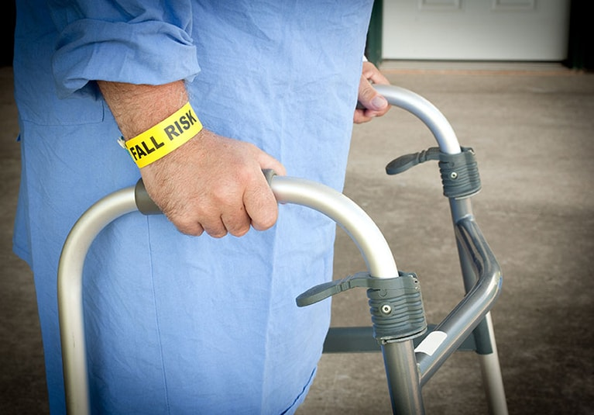
ANALYSIS
DOCUMENTATION
PATIENT FACTORS
NURSING FACTORS
Lack of communication -- --between families/patient
High risk fall patients not identified by nurses
Old age, medications, mental status, unstable - posture, gait, etc.
Fall Risk Assessment incomplete
Lack of monitoring and reviewing
Without companion
or caregiver
Workload - 1:7 staff patient ratio
Passive participation of staff
Lack of education/ cunselling regarding risk factors
Risk of injuries/ fall not assessed
INCREASE RISK OF
FALL
Call bells non- functional or out of reach
Lack of patient’s visibility from nurses station
Signages not applied for high risk patients
ENVIRONMENTAL FACTORS
Patient attached to multiple medical equipmets (IV lines, chest tube etc
EQUIPMENTS

Slide 25
ACTION PLAN
Sitters- a non-licensed patient care staff who observe the patients and maintain a safe environment.
Patient education and counselling
- patient and attendant education
- videos, audios
- bed adjustments education
Bedside observation- beds in low position
Signages for high risk patients
Medications management
Maintain average nurse patient ratio
Random audits
Training and reiteration of nurses

Slide 26
CONCLUSION
Preventing falls among patients in a healthcare setting requires a multifaceted approach, and the recognition, evaluation and prevention of patient falls are significant challenges.
Fall prevention programs can be expected to show a net positive return within a short period.

