Slide 1
TIME MOTION STUDY ON THE PROCESS OF DISCHARGE
And analyse the gaps in delay of discharge process and patient satisfaction in discharge process in hospital
ZYNOVA SHALBY MULTISPECIALITY HOSPITAL
Mrs Divya Agrawal
IIHMR Delhi

Slide 2
SCREENSHOT OF APPROVAL

Slide 3
INTRODUCTION
A hospital primarily provides two types of services: outpatient and inpatient. "An outpatient is one who receives ambulatory care in the hospital and does not require an overnight hospital stay." An "inpatient" one who has been admitted to a hospital to receive inpatient hospital services
The "Discharge Process" is one of the critical functions in a healthcare organization that must be streamlined and monitored on a regular basis.
Discharge planning should begin before admission in the case of elective care.
As per NABH, the time taken for completion of the discharge process should not exceed 180 minutes
If discharge process is monitored, it reduces errors and unnecessary delays along the patient pathway.
. A smooth Discharge Process will lead to an increase in Patient Satisfaction and the quality of service delivery.

Slide 4
Ideal discharge process
Discharge planning at the time of admission
Package patients (with fixed Length of Stay)
Doctors intimation one day prior to discharge
Tentative discharge after doctors round (Waiting for investigation/examination)
The following activities to be completed sequentially –
Discharge Intimation (Date & Time)
Actual discharge (Date & Time)
Discharge summary Ready (Time)
Nursing Clearance (Time)
Pharmacy Return (Time)
Bill ready (Time)
Bill settlement (Time)
Room vacation (Time)

Slide 5
OBJECTIVES
General Objective :
To study the time motion of the discharge process and to identify gaps in the delay of the discharge process in the hospital.
Specific Objective :
1. To track many criteria that correlate to the delay in the discharge of patients from the ward.
2. Determine the root reason of the procedure delay.
3. Analyse patient satisfaction with the process using a feedback form
Purpose of the study :
The study's primary goal is to identify problems with discharge planning, identify areas for development, and offer suggestions in accordance with the organization for strengthening and enhancing the quality of services delivered.

Slide 6
METHODOLOGY
Area of study:
This study was conducted in Zynova Shalby Hospital Mumbai, coordinated by the operations department.
Research design:
The study is both descriptive study and quantitative research. It’s a descriptive research because it comprises surveys and fact-finding enquires of various kinds, such as patient satisfaction with regards to waiting and delay in hospital discharge. It is a quantitative research since it enumerates and analyses the percentage of discharge within time, as well as the time span of each step and many other factors that lead made discharge on time or delayed.
Sampling
From the 18th of April to the 17th of June 2022, random patients who were discharged from the ward were included. (A sample of 100 Patients)
These patients fall into a range of categories, such as cash-paying or sponsored payer patient.

Slide 7
Sources of data:
Hospital staff
Patients and feedback form
Data was collected by primary and secondary sources:
I. Primary
Observation of discharge performed in hospital;
Group discussion with staff
Key informant interviews with the ward floor co-ordinators
Time motion study
II. Secondary
Procedure in each department
Registered records of particular department
Period of study:
April 18th till June 17th 2022
Statistical tool:
MS Excel

Slide 8
RESULT
Mode of Payment
Self payer were 59%
Sponsored payer were 41%
Fig: 1 (sample size=100)

Slide 9
TIME REQUIRED FOR DISCHARGE PROCESS IN HOURS
60% of discharge took more than 4 hours
30% of discharge was done in 2-4 hours
10% of discharge was done in 1-2 hours
Fig: 2 (sample size=100)

Slide 10
3) Time required for patient discharge till the billing process (self payers)
47% patient were discharged at 1-2 hour
38% patient discharge at 2-4 hour
15% patient discharge at more than 4 hours
4) Time required for patient discharge till the billing process (sponsored payer)
26.82% patient were discharged at 1-2 hour
53.65% patient discharge at 2-4 hour
19.15% patient discharge at more than 4 hours
Fig: 3 (sample size=100)
Fig: 4 (sample size=100)

Slide 11
The reasons for delay in discharge is due
Delay in billing department by 34%
Delay in pharmacy department by 12%
Delay in TPA Auditing by 21%
Delay in nursing department by 6%
Delay in payment done by the patient relatives by 12%
On time discharge by 15%
Fig: 5 (sample size=100)

Slide 12
Patient satisfaction on discharge process on the basis of grade 1-5
41 out of 100 sample of patient had given the feedback of the discharge as 5 grade while 53 mentioned as grade 4 and 4 mentioned as grade 3
Fig: 6 (sample size=100)

Slide 13
DISCUSSION
Patients were scheduled for TKR (total knee replacement), but the billing package was not defined.
Photocopies of the report took time.
Consultant’s timing is not defined
Patient usually becomes restless on seeing the final bill, which leads to their unwelcomed queries resulting in a delay in the discharge process
Delay in discharge due to lack of coordination between the department
On discharge of a surgery patient, there is a delay from the pharmacy department, and implant charges are pending due to new codes.
In case of a system error (server goes down) there is no backup plan to lead the discharge process
Lack of manpower in the billing department for auditing
While doing online payment by the bystanders of the patient, the bill is not passed till the payment is seen in the account by the accountant.
Another major concern is late Discharge Summary preparation, which entails numerous steps.
Sometimes Discharge Summary is prepared late.
Sometimes the staff tries to accumulate two or three discharges at the same time, causing a delay in completing notes of all and then sending down the files.
Sometimes everything is ready, but the patient cannot be served because the nursing staff is overburdened and the file is sent to the finance desk late.
Lack of computer in floor to prepare the discharge summary

Slide 14
CONCLUSION
Patient dissatisfaction is also influenced by the length of the discharge process.
It was discovered that the time required for billing clearance was a contributing factor to the most total time taken in the discharge process, it was also discovered that the number of planned discharges was less
It was noted that the discharge summary was prepared following the doctor's confirmation of discharge
According to the patient feedback form, patient satisfaction in the discharge process was rated as good
The delayed Discharge process leads to unnecessary bed occupancy, thus affecting both, the existing patients to be discharged and the new admissions in the hospital.

Slide 15
REFERENCE
Kulkarni M, Pandit AP, Singh P. Identifying discharge process factors causing an increased length of stay. J Nat Accred Board Hosp Healthcare Providers 2016.
Shobitha Sunil, SaralaK.S., G Shilpa. Analysis of time taken for the discharge process in a selected tertiary care hospital.
Mukotekwa, C., Carson, E., “Improving the Discharge Planning Process: A Systems Study”, Journal of Research in Nursing, Vol.12, Issue 6, 2007.
Swapnil Tak, Sheetal Kulkarni, Rahul More. A comparative time motion study of all types of patient discharges in a hospital

Slide 16
FINAL POSTER OF INTERNSHIP PRESENTATION

Slide 17
THANK YOU
Any questions

Slide 18
INTERNSHIP EXPERIENCE
Floor Coordinator- Administration Department: Discharge confirmation from RMO, Collecting patient feedback, coordinating with all departments throughout the hospital Patient grievance handling which includes Root cause analysis, informing the department responsible, ensuring whether the grievance is resolved.
NABH-National Accreditation Board for Hospitals & Healthcare Providers : Data collection, applied for pre entry level of NABH, cleared the non-confirmatives
Hospital Emergency Code The use of the color codes to designate emergencies to alert the trained specific team and respond quickly to those emergencies thereby preventing stress or panic in hospital
CODE RED – Fire and Safety Department
CODE BLUE - Clinical Department
OPEN AUDIT: Medical open audit is a chart review which is used to identify what is being done correctly and what is in need of improvement

Slide 19
SUGGESTIONS GIVEN TO ORGANIZATION
Effective and timely discharge can only be attained by interdepartmental coordination and proper communication between all the team involved in the discharge process: strategies to ensure continuity of care (4 C’s)
Communication
Coordination
Collaboration
Continual reassessment
The discharge track sheet should involve the timing of when the patient relatives pay the bill
The manpower in billing department should be increased so, that the final auditing will be complete in time
The training should be given to each staff about the software used
The timely auditing on discharge process should be made
The nurse should be aware of the expected discharge date so that she can complete her notes the night before discharge and return any remaining medications to the pharmacy.
Patient should be well informed about the time the whole discharge process will take.

Slide 20
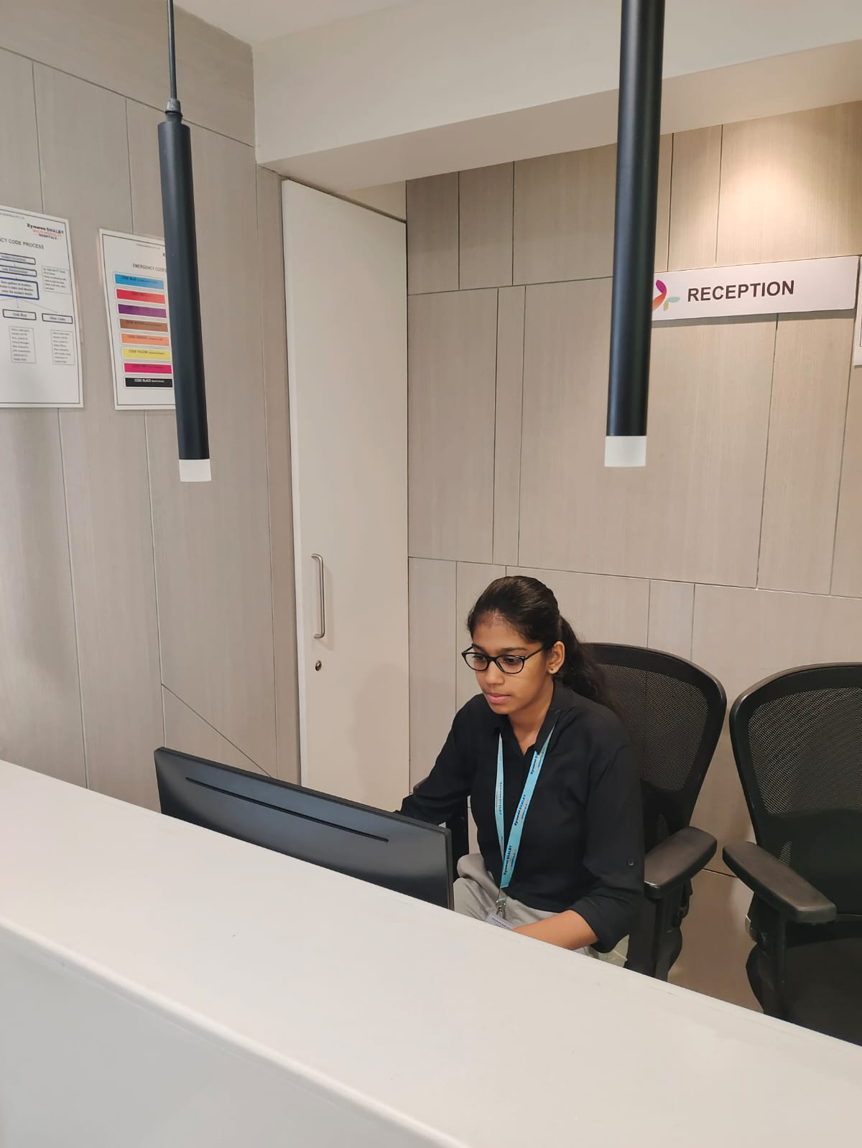
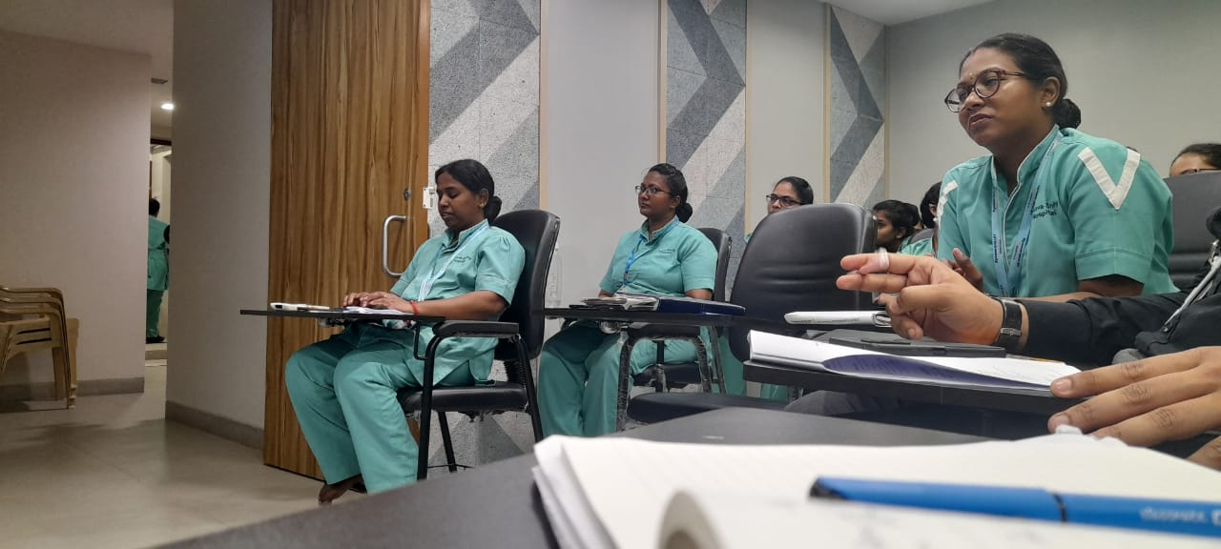
PICTORIAL JOURNEY

Slide 21
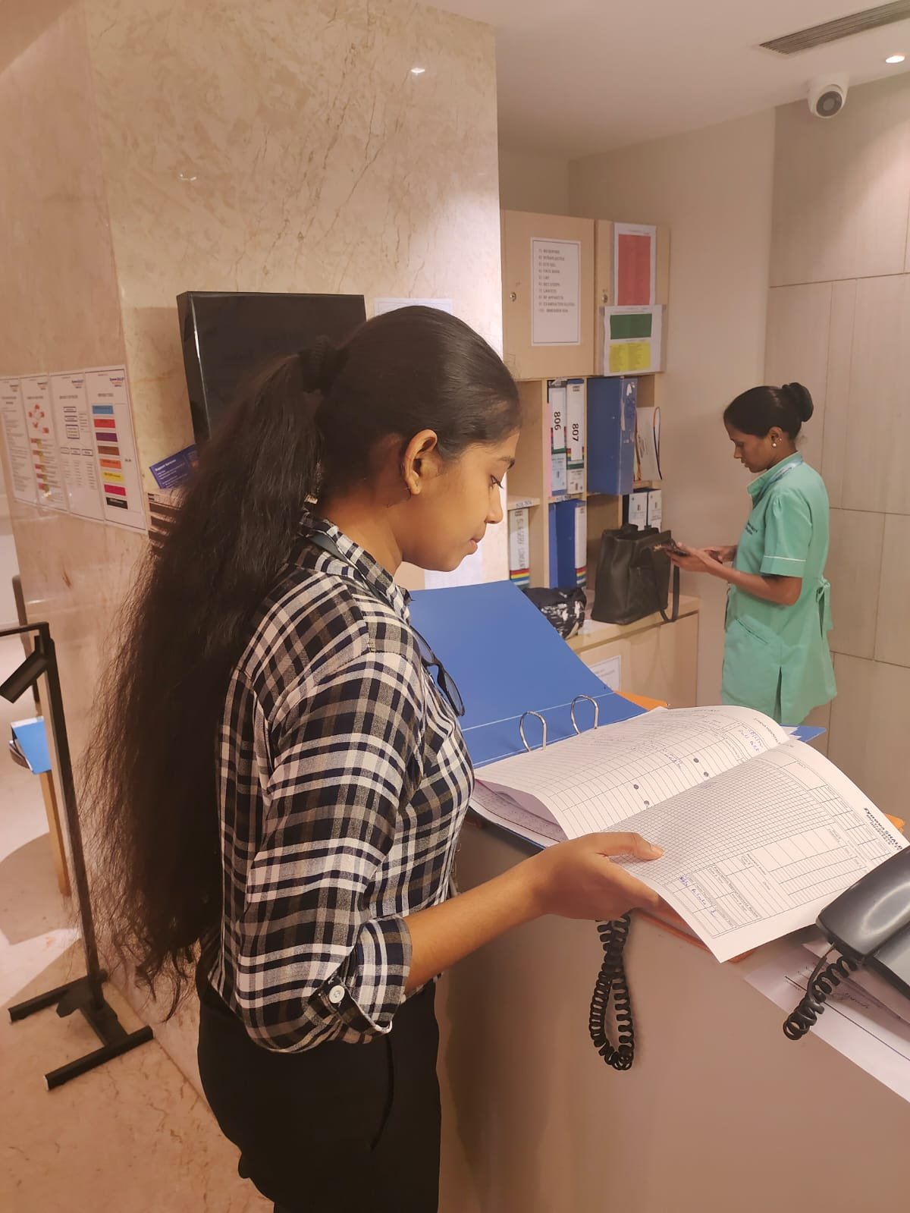
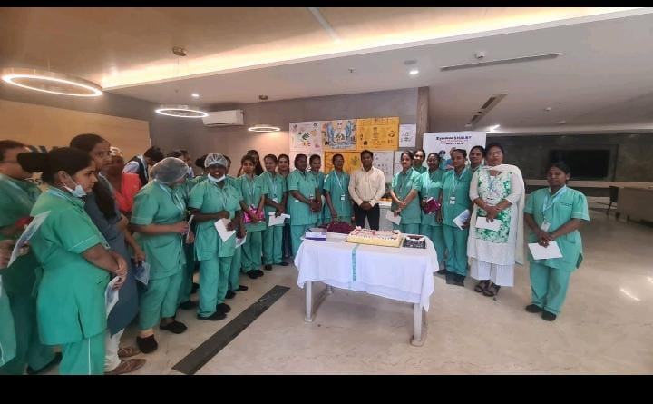

Slide 22
