Slide 1
Situation Analysis of Active Management of Third Stage of Labour (AMTSL) for Post- Partum Haemorrhage (PPH) Prevention
IPE GLOBAL
Team Name- IPE Global Dewas
Team Members- Deepali Bhardwaj, Dr Nida Shaikh, Dr jaganjeet Randhawa,Priyanka Chakraborty ,Tarang Gupta ,Akanksha Gupta
Faculty Mentor – Dr Siddharth Shekhar Mishra
IIHMR Delhi

Slide 2
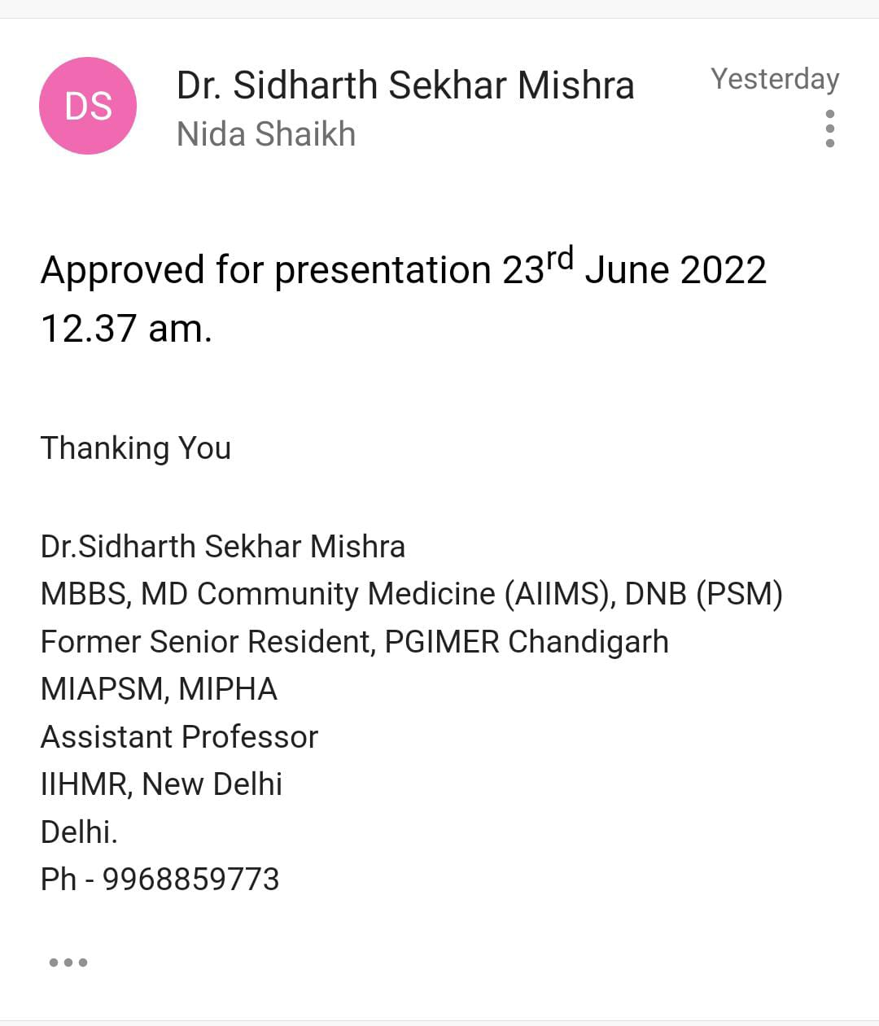
Screenshot of approval

Slide 3

Introduction-Burden of Disease
Maternal mortality is a big challenge globally - in 2020, the global MMR was 152 deaths per 100,000 live births. ⁽¹⁾
India has an MMR of 103 per 100,000 live births.
.Madhya Pradesh being one of the states with a high burden. (MMR of 163). ⁽²⁾
WHO statistics suggests that 25% of maternal deaths are due to PPH. In India, PPH accounts for 38% of maternal deaths.
According to WHO ,Postpartum hemorrhage (PPH) is defined as blood loss of 500 ml or more within 24 hours after birth. ⁽³⁾

Slide 4
Introduction
Most effective strategy for management of PPH is Active Management of Third Stage of Labour (AMTSL).
AMTSL has three components -
Administration of uterotonic drug (Injection Oxytocin-10 IU, IM or Tab Misoprostol- 600mcg, oral), Controlled cord traction (CCT) and Uterine massage. ⁽⁴⁾
According to WHO prophylactic management by provision of uterotonics provided by the SBA during AMTSL is a lifesaving procedure.
The issues with usage of Oxytocin are to maintain a proper supply chain. ⁽²⁾
This led to the initiation of the research question which was a joint collaborative project of IPE Global and IIHMR Delhi.

Slide 5
Objectives
Assess AMTSL implementation practices in all levels of public health facilities.
Assess capacity needs for AMTSL.
Assess availability, storage and supply chain management of key uterotonics.

Slide 6
Methodology
Study design: Quantitative Cross- Sectional study .
Study Setting: The analysis was done in 15 delivery points of Dewas District of Madhya Pradesh.
Study participants:
Service providers at delivery points: specialists, Medical Officers (MO), staff nurses.
Store in-charge in district, block and delivery point facilities.
Women (mothers) during immediate post-partum period at Post Natal Care (PNC) wards.
Inclusion Criteria:
Service Providers-Those who were in job for atleast 1 month.
Post- partum Mothers – post partum females who were in stable condition.

Slide 7
Methodology
Sample size : n = Z2pq/ d2
•n = 4 * 92 * 8/ 5 * 5 = 113
sample size for post-partum females = 113
Sampling: Convenient Sampling .
The criteria for selection of delivery points were:
Facility has a minimum caseload of deliveries per month
SHC/ HWC: 2 or more
PHC: 25 or more
Non-FRU CHC: 75 or more
2. Availability of Comprehensive services
FRU CHC/ SDH
District Hospital
• Out of 31 delivery points, 15 facilities fitting into the selection criteria were selected for the study.

Slide 8
Methodology
Study Variables:
Outcome variables – An understanding was developed on knowledge and practices of providers on: ​
AMTSL ​
Supply chain management including availability of cold chain ​
Perceptions of mothers on quality of care.​
Data Management :​
Data Collection: Primary data was collected by conducting interviews using semi structured pre tested questionnaires in local language (Hindi).​
Data validation – Data collected was cross checked by the state SAMVEG team.​
Data analysis - The data was analyzed and presented as a descriptive study.​

Slide 9
Result
Situational Analysis of Mothers
All 134 (100%) female respondents delivered in the hospital facility, out of which 85 (63%) women had undergone normal vaginal delivery (NVD) and 49 (37%) had undergone lower segment caesarean section (LSCS) delivery. Out of total respondents 103 (77%) were conducted at DH with 49 of them (48%) being LSCS .
Only 21 females (16%) received uterotonics for induction of labour. All of these 21 females knew that they were being administered uterotonics.
Only 21 (16%) females know about drug(s) that can induce/ augment labour. Out of these 21, 2 females had requested for administration of the drug.
49% (66) women were aware that there is danger of excess bleeding after delivery and out of which 27% (18) were aware that there are drug(s) that can prevent and treat such bleeding.

Slide 10
Result
Situational Analysis of Facility Readiness
Out of 15 facilities, AMTSL posters were displayed in 5 facilities in the labour room, in 2 facilities in the patient waiting area, in 2 facilities in the nursing area and in 2 facilities posters were displayed in areas other than these.
Out of total of 35 interviews of service providers in 15 facilities, PPH tray was available in only 9 (60%) facilities.
Out of 35 interviews of service providers, 6 service providers have undergone SBA training alone , 2 has undergone DAKSHATA training alone, 2 have undergone training other than these, 13 service providers have undergone SBA, DAKSHATA and other trainings and 12 have not undergone any training.
In case of requirement of emergency referral, from 4 facilities it takes up to 30 minutes, from 5 facilities it takes 31 minutes to 60 minutes and from 6 facilities it takes more than 60 minutes to reach the nearby referral facility

Slide 11
Result
Situational Analysis of Service Providers
In all 15 facilities acc to the previous year record total number of deliveries was 16,895. Out of these 16,895, 14,468 were NVD and 2,427 were LSCS. LSCS was done in district hospital only. Number of PPH cases in the same year were 45, 10 PPH cases were referred out and total maternal deaths were 3. Out of these 3, maternal death due to PPH were 2.
Only 9 providers administer uterotonics routinely for augmentation of labour.
All 36 service providers practice AMTSL to prevent PPH for all women.
Out of 36 providers ,34(94%) providers administer uterotonic under AMTSL immediately after birth of baby and 2(6%) providers administer 5 minutes after the birth of baby

Slide 12
Result
Situational Analysis of Service Providers
Out of total 15 facilities, refrigerator was available for storage of uterotonic at LR in 14 (93%) facilities. Out of 13 drug stores, refrigerator was available in 7 drug stores and ILR was available in 1 drug store
Out of 13 store personnel, 7 (54%) store personnel maintain cold chain while delivering Oxytocin from store to next level facilities.
Out of 13 stores , oxytocin was stock out at 1 store and misoprostol was stock out at 1 store.
All 13 store personnel, have provision of local purchase in case of stock-out situation.
Out of total 15 facilities, 1 facility had stock-out of uterotonic in last 6 months at LR of carboprostol.

Slide 13
Discussion
All the LSCS were being conducted at district hospital only. According to the previous year record, no LSCS was done in CHC Bagli, which is a CeMONC facility.
Labour was induced in slightly more than 10% of deliveries and females were being informed before administration of the drugs. Some providers administer uterotonics routinely for augmentation of labour. According to the study on factors and outcomes associated with the induction of labour in Latin America it was found that out of the total deliveries, 11.4% were induced and induced labour is, however, associated with poorer maternal and perinatal outcomes than spontaneous labour ⁽⁵⁾.
The record of time of administration of uterotonics was maintained in only 4 facilities. Some providers administer 5 minutes after the birth of baby. According to a retrospective Review by Knoll William et al. in the year 2021; commented that Each 5-minute delay in uterotonic treatment was associated with 26% higher odds of hypotension following delivery of any type. ^{(7).} The difference is because they are not aware of the importance of time of uterotonic administration and they do not consider it worth mentioning.

Slide 14
Discussion
34% service providers have not undergone any training. The Ministry of Health and Family Welfare (MoHFW), GoI, has developed an initiative termed ‘Dakshata’ to improve the quality of care at the delivery points . GoI policy initiative to empower service providers for undertaking certain life saving measures to make them competent. The gap is due to the lack of awareness and availability of such trainings. ⁽⁴⁾
All the service providers practice AMTSL to prevent PPH for all women routinely and few of them do not remember all three steps of AMTSL. A study published by Bishanga DR et al in the year 2018 ;they commented that the proportion of deliveries receiving all three AMTSL steps improved significantly by 19 percentage point. The quality of PPH prevention increase substantially in facilities that implemented competency-based training and quality improvement interventions ^{(6).}
Refrigerator was available for storage of uterotonic at LR in 14 facilities only. Out of 13 drug stores, cold chain equipment was available in only 8 drug stores. Cold chain while delivering Oxytocin from store to next level facilities was maintained in only 7 drug stores. Oxytocin has been shown to be a heat-sensitive product that requires refrigeration during transport, distribution, and storage at all points in the supply chain ⁽⁸⁾

Slide 15
Limitation
Change from initial plan of data collection as required participants could not be achieved.

Slide 16
Conclusion
Unavailability of gynaecologist in CHC Bagli which is a CeMONC facility and no LSCS were conducted in the past one year.
In slightly more than 10% deliveries, uterotonics were being used for induction of labour.Although females were being informed prior to the administration of such drug(s).
The record of time of administration of uterotonics is maintained in only 4 facilities.
34% service providers have not undergone training on LR practices including PPH prevention and management like SBA, DAKSHATA and others.
3 service providers do not remember all the three steps of AMTSL .Few of them were administrating uterotonics 5 minutes after the birth of baby.
Refrigerator was not available for storage of uterotonic at LR in 1 facility. Out of 13 drug stores, cold chain equipment was available in only 8 drug stores. Cold chain while delivering Oxytocin from store to next level facilities was not maintained in 6 drug stores.
Buffer stock was not maintained by 1 store personnel at store.
This indicates need for AMTSL implementation practices in all levels of public health facilities ,capacity needs for AMTSL and proper availability, storage and supply chain management of key uterotonics.

Slide 17
Recommendation
Availability of service providers in the facility and all service providers must have undergone training on LR practices. Providers must remember all the three steps of AMTSL and uterotonics must be administered immediately after the birth of baby.
Use of uterotonics routinely for the induction/augmentation of labour should be discontinued. The record of time of administration of uterotonics must be maintained in all facilities.
Cold chain equipment must be available in all the facilities at Labour Room and drug stores.
Cold chain while delivering Oxytocin from store to next level facilities must be maintained.
Buffer stock must be maintained in labour room and by store personnel at store in all facilities.

Slide 18
References
https://www.gatesfoundation.org/goalkeepers/report/2021-report/progress-indicators/maternal-mortality/
SRS 2017-2019
http://nhp.gov.in/disease/gynaecology-and-obstetrics/postpartum-haemorrhage
https://nhm.gov.in/index1.php?lang=1&level=1&sublinkid=794&lid=168
G V Guerra 1, J G Cecatti, J P Souza, A Faúndes, S S Morais, A M Gülmezoglu, M A Parpinelli, R Passini Jr, G Carroli, World Health Organisation 2005 Global Survey on Maternal and Perinatal Health Research Group PMID: 19906020 DOI: 10.1111/j.1471-0528.2009. 02348.x
Bishanga DR, Charles J, Tibaijuka G, Mutayoba R, Drake M, Kim YM, Plotkin M, Rusibamayila N, Rawlins B. Improvement in the active management of the third stage of labor for the prevention of postpartum hemorrhage in Tanzania: a cross-sectional study. BMC Pregnancy Childbirth. 2018 Jun 13;18(1):223. doi: 10.1186/s12884-018-1873-3. PMID: 29895276; PMCID: PMC5998542.
William Knoll, Rachel Phelan, Wilma M Hopman, Anthony M-H Ho, Marta Cenkowski, Glenio B Mizubuti, Nader Ghasemlou, Gregory Klar Retrospective Review of Time to Uterotonic Administration and Maternal Outcomes After Postpartum Hemorrhage. PMID:34844004 DOI: 10.1016/j.jogc.2021.11.011
WHO. The International Pharmacopeia, Eight Edition, 2018. 2018. http://apps.who.int/phint/en/p/about/.

Slide 19



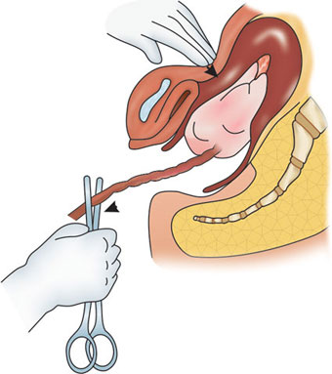
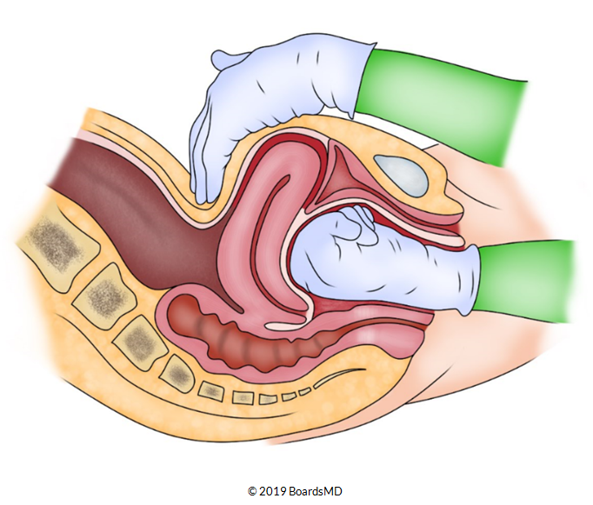
SITUATION ANALYSIS OF AMTSL FOR PPH PREVENTION
Presenter-Dr. Nida Shaikh, Deepali Bhardwaj ,Dr jaganjeet Randhawa,Priyanka
Chakraborty,Tarang Gupta,AkankshaGupta
Project guide/mentor- Dr. Sidharth Shekhar Mishra
International Institute of Health Management Research, Delhi
Introduction
Methodology
Only 21 females received uterotonics for induction of labour. All of these 21 females knew that they were being administered uterotonics.
Only 9 providers administer uterotonics routinely for augmentation of labour.
Refrigerator was available for storage of uterotonic at LR in 14 facilities. Out of 13 drug stores, cold chain equipment was available in 8 drug stores Only 7 store personnel maintain cold chain while delivering Oxytocin from store to next level facilities.
Maternal mortality is a big challenge globally - in 2020, the global MMR was 152 deaths per 100,000 live births.MP being one of the states with a high burden (MMR of 163). WHO statistics suggests that 25% of maternal deaths are due to PPH. In India, PPH accounts for 38% of maternal deaths. Most effective strategy for management of PPH is AMTSL.
Assess AMTSL implementation practices in all levels of public health facilities.
Assess capacity needs for AMTSL.
Assess availability, storage and supply chain management of key uterotonics.
Result
Study design | Quantitative Cross- Sectional study
Study Setting | The analysis was done in 15 delivery points of Dewas District of MP.
Study participants | Service providers,mothers after immediate post partum period and Store incharge .
Sampling | Convenient sampling
Data Management | Data Collection: Primary data was collected by conducting interviews using semi structured pre tested questionnaires in local language (Hindi).​ Data validation – Data collected was cross checked by the field supervisor and state SAMVEG team.​ Data analysis - The data was analyzed and presented as a descriptive study.​
The record of time of administration of uterotonics is maintained in only 4 facilities.
34% service providers have not undergone training on LR practices Buffer stock was not maintained by one store personnel at store.
.http://nhp.gov.in/disease/gynaecology-and-obstetrics/postpartum-haemorrhage
.https://nhm.gov.in/index1.php?lang=1&level=1&sublinkid=794&lid=168
.G V Guerra 1, J G Cecatti, J P Souza, A Faúndes, S S Morais, A M Gülmezoglu, M A Parpinelli, R Passini Jr, G Carroli, World Health Organisation 2005 Global Survey on Maternal and Perinatal Health Research Group PMID: 19906020 DOI: 10.1111/j.1471-0528.2009. 02348.x
Women received uterotonic for labour induction
Conclusion
Bibliography
Objectives

Slide 20
THANK YOU

Slide 21
Internship Experiences
Learn how to interact with community and team work.
Challenges during data entry and cleaning.
Learn Time management through the entire course of internship.
Explore the management system of 15 health facilities.
Difference between theory and practical world.

Slide 22
Suggestions Given to Organization
Time period was too short.
More emphasis should be given on data collection .

Slide 23
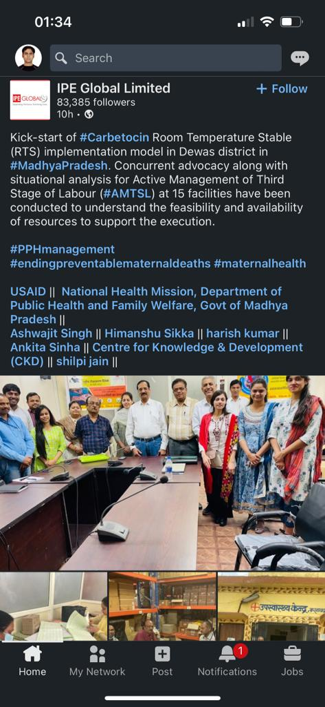
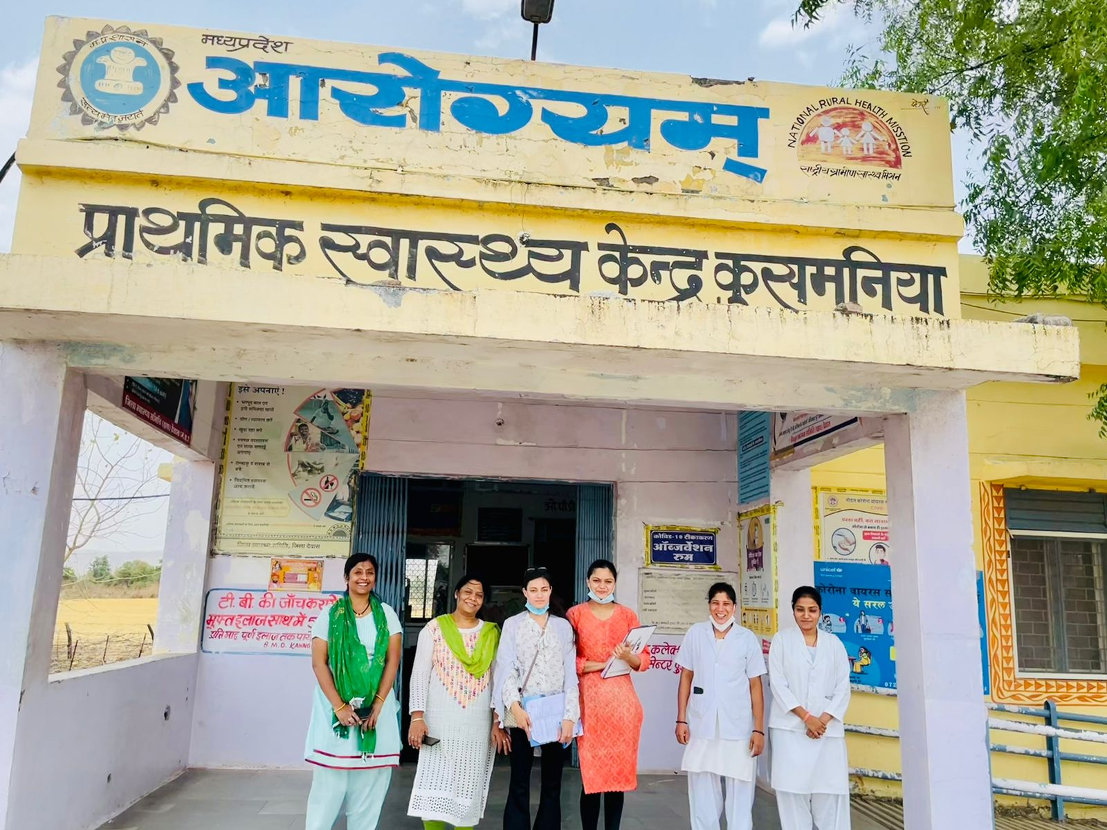
Pictorial Journey

Slide 24
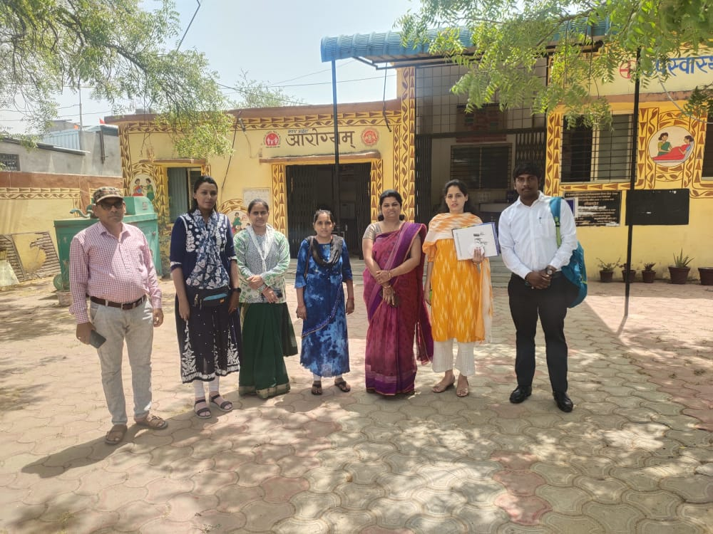
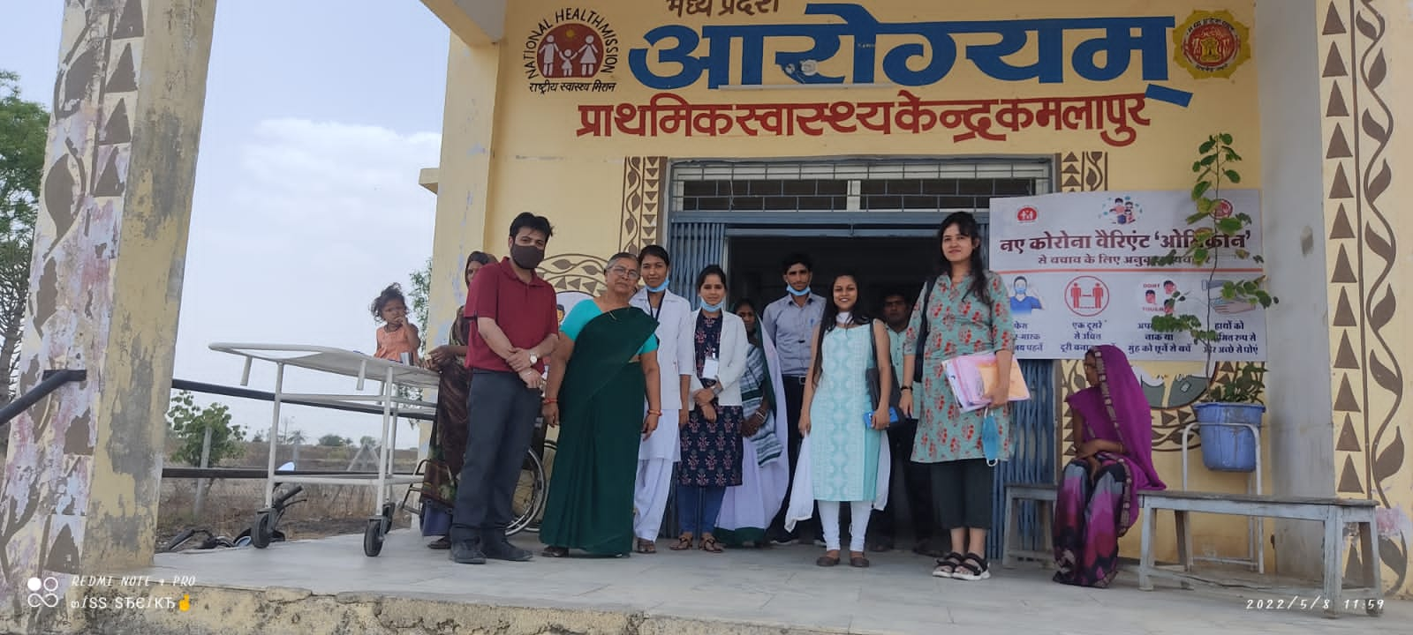
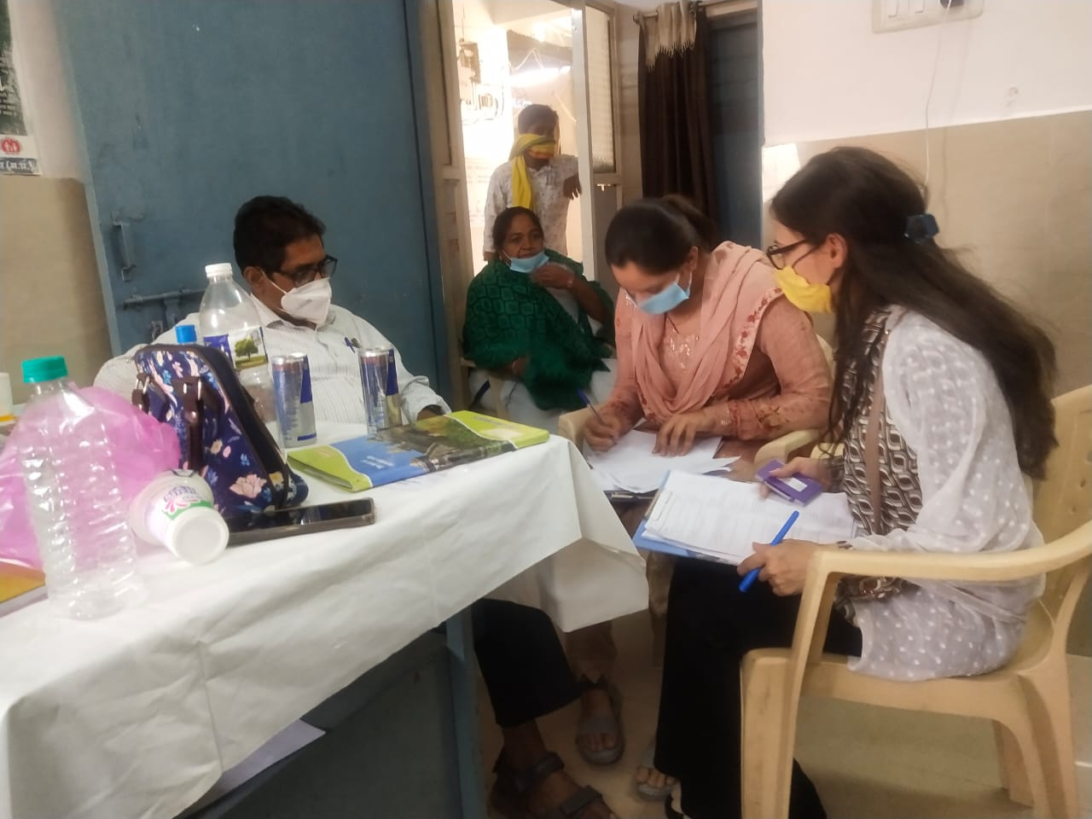
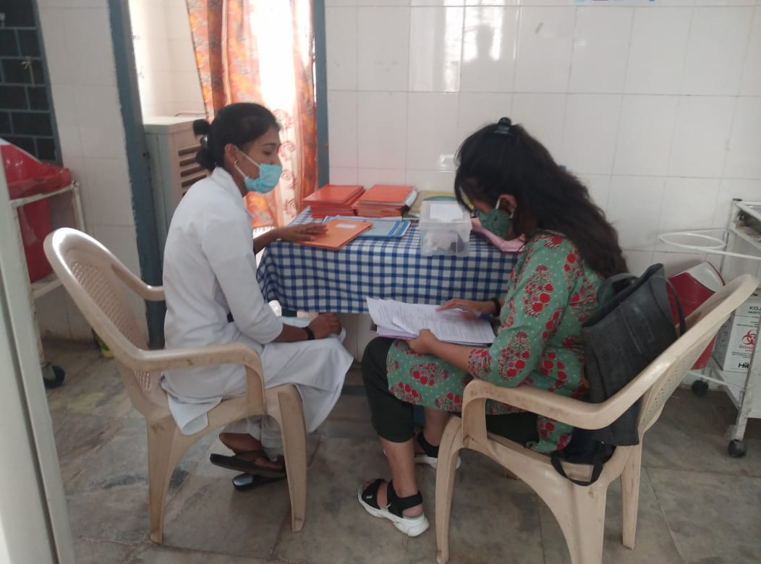
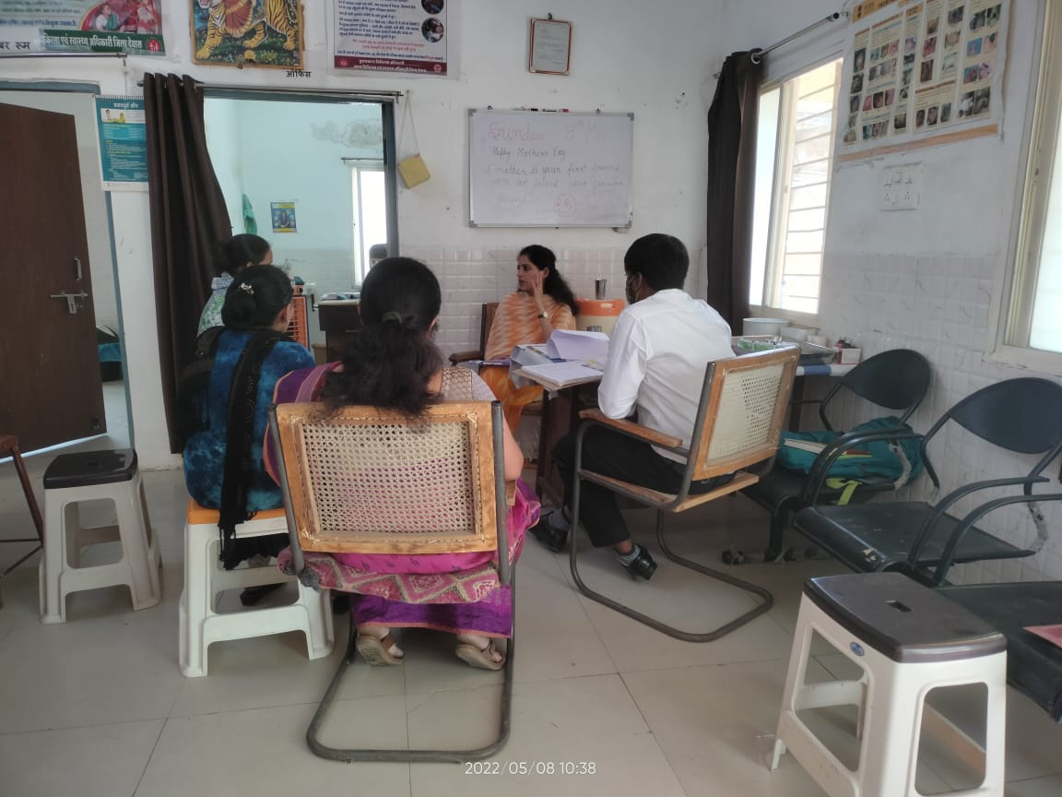
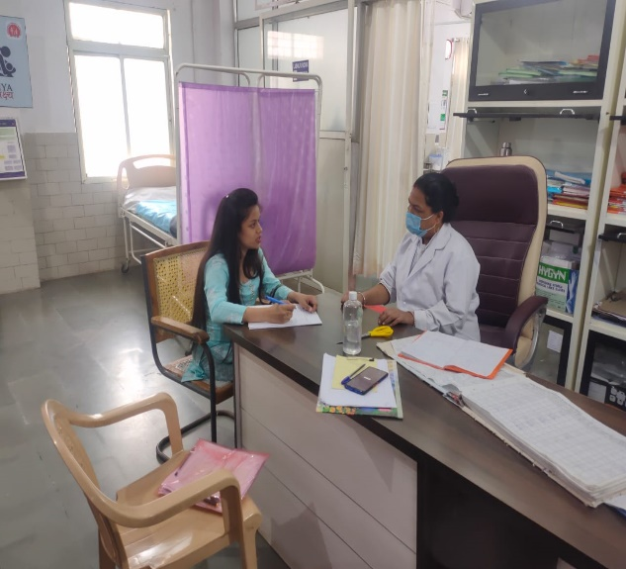
Pictorial Journey

