Slide 1
EX-SERVICEMEN CONTRIBUTORY
HEALTH SCHEME (ECHS)
By
Col Ashish Yadav - R No PG/016/21-23
Col Dhirender Malik, SM - R No PG/030/21-23
Col Jitender Mann - R No PG/043/21-23
Col Manoj Kumar R No PG/056/21-23
Col Ravinder Khatri - R No PG/080/21-23
Mentor- Dr Vinay Tripathi

Slide 2
PREVIEW
Introduction
Organisational & Functional details
Treatment process/referral procedure in ECHS
Poly-Clinic (PC), Base Hospital, Delhi Cantt
Poly-Clinic (PC), Dharuhera, Gurugram
Organizational Challenges
Limitations of Study
Conclusion

Slide 3
INTRODUCTION
Notes:
3

Slide 4
OBJECTIVES OF INTERNSHIP
Observational Learning
Familiarisation with ECHS System
ECHS Organisation
Functioning of ECHS System & Polyclinics
Specific Findings
Patient Satisfaction at ECHS Polyclinics
Reception
Medical Consultation
Pharmacy
Referral and passing of Bills/ Claims

Slide 5
CONDUCT OF STUDY
Study Area: ECHS Polyclinic, Base Hospital Delhi Cantt & Dundahera, Gurugram
Study Design: Cross-sectional survey
Data Collection Tools: Semi structured questionnaire
Study Population: ECHS Patients & Staff
Sample Size: 400
Sampling Method: Convenience
Data Analysis Tool: Microsoft Excel
Data Analysis Method : Descriptive analysis for summarizing the data collection
Exclusion Criteria - Consent not given/ unwilling
Inclusion Criteria - OPD

Slide 6
ECHS : ORGANISATIONAL & FUNCTIONAL DETAILS

Slide 7
OBJECTIVES OF ECHS
To provide comprehensive, quality and timely medical care for all possible diseases to veterans and their dependents

Slide 8
ECHS
Ex-servicemen Contributory Health Scheme (ECHS), partly financed by the GoI, launched on 01 Apr 2003 with an aim to provide comprehensive and cashless healthcare to all Ex Servicemen (ESM) and their dependents
Authorised treatment in service hospitals as well as in those civil/private hospitals which are specifically empaneled with the ECHS
ECHS Central Organization is located at Delhi Cantt
Functions under the Chief of Staff Committee (COSC) through AG’s Branch at Army HQ
Headed by Managing Director, ECHS (serving Major General)

Slide 9
EVOLUTION OF ECHS
Post- Independence
No formal entitlement for treatment of ESM in service hospital
1966
ESM pensioners & their families extended treatment facilities in MHs restricted to available local facilities.
Dependency limited to:
Spouse
Wholly dependent unmarried children
Not entitled for treatment of - Malignancies, Organ transplant, Psy illness, Leprosy / TB, Prosthodontics
01 Apr 2003
ECHS launched
Incl treatment for: Leprosy/Tuberculosis, Malignancies
Psychiatric illnesses. Organ Transplant facilities, Prosthodontics and other super specialty dental services
Dependency enhanced to
Spouse
Wholly dependent unmarried children
Wholly dependent parents
Divorced dependent daughters
Disabled dependent children of any age
18 Oct 2010
Expansion of ECHS
28 Regional Centers,
426 Polyclinics
17 Mobile Clinics,

Slide 10
ECHS : ELIGIBILITY
Eligibility for ECHS membership :-
Ex-Servicemen drawing Pension
Widows drawing Family Pension
Spouse of pensioner
Sons till they start earning or attains the age of 25 yrs or gets married whichever is earlier
Unemployed/unmarried/divorced Daughters/Sister including widow/legally divorced irrespective of age
Adopted children
Dependent parents whose combined income does not exceed Rs 9000/- plus DA per month.
Child/brother with permanent physical/mental disability (min 40%) irrespective of age
Ex-Recruit medically boarded out during training and in receipt of Disability Pension
APS persons are now eligible for ECHS Membership

Slide 11
ECHS : CONTIBUTION
Prior To 01 Jan 1996 - No Subs
01 Jun 2009 Onwards - As per table below
Grade Pay (Per Month) | Contribution | Rank
Rs 1,800/- to 2,800/- | Rs 30,000/- | Sepoy to Havildar
Rs 4,200/- | Rs 67,000/- | Naib Subedar
Rs 4,600/- to 6600/- | Rs 67,000/- | Subedar to Subedar Major
Rs 7,500/- & Above | Rs 1,20,000/- | Officers
11

Slide 12
COMMMAND & CONTROL : ECHS
RM
Admin Control
Executive Control
RRM
Chiefs of Staff Committee (COSC)
Secy ESW
Principle Pers Offrs’ Committee (PPOC)
Central Org ECHS
AG
Jt Secy ESW
DG DC & W

Slide 13
CONTROL OF ECHS
Service HQs
Provision of service manpower
Acquisition of land
Construction of Polyclinic Buildings
Hiring of buildings for use as ECHS Polyclinics(DGDE)
Procurement of medicines, medical Equipment, vehicles etc (DGAFMS/MGO)
Admin and Technical control
Provision of budget
Department of ESW
Policy formulation and issue of Govt Orders
Expansion of scheme and Eligibility Criteria
All sanctions which have financial implications
Empanelment of medical facilities

Slide 14
ECHS : ADMIN & TECHNICAL CONTROL
AG
DG (DC&W)
Comd HQ
Adm Cont
Tech Cont
Area HQ
Advice
Central Org
Sub Area HQ
Regional Centres
Stn HQ/ SEMO
Monitor
ECHS Polyclinics

Slide 15
ECHS : ORGANISATIONAL STRUCTURE
Central Organisation
(16,05,38)
Apex Body
Tri Service staffing
Manned by serving personnel
Regional Centres
(04,01,16)
28 Regional Centres
Manned by serving Personnel
Each Regional Centre controls
10 - 15 Polyclinics
Polyclinics
(Based on Type)
Manned by Contractual Staff only
Type ‘A’ to ‘E’
Mil/ Non-Mil

Slide 16
ORGANISATION: REGIONAL CENTRES
Director
Jt Dir (Estblishment)
Administration
Personnel management
Office management
Discipline
Smart Cards
Transport
Jt Dir (HS)
Technical advisor
Tech control over all PCs
Visit PC on behalf of Dir
Monitor census and morbidity rate
Periodic and surprise checks at PC and empaneled hospitals
Maintenance of referral data to empaneled hospitals
Statistical analysis of prevalence of diseases in Area of Responsibility
Jt Dir (A & A Mgt)
Finance & assets management
Maintenance of equipment & stores
Periodic and surprise checks of accts at RC
Payment of medical bills for hospitals
TDS payment
Recovery

Slide 17
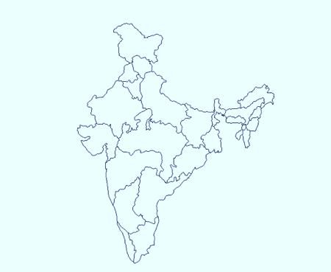
ECHS : CURRENT STATUS
Sanctioned / Functional
Regional Centres - 28 28
Polyclinics - 426 420
(India)
Polyclinics - 6 3
(Nepal)
Jammu
Yol
Chandimandir
Jalandhar
Dehradun
Ambala
Hissar
Delhi I
Delhi II
Bareilly
Jaipur
Lucknow
Guwahati
Patna
Allahabad
Ranchi
Ahmedabad
Jabalpur
Kolkata
Regional Centres -28
IN - 03
IAF - 04
IA - 21
Mumbai
Bhubneshwar
Nagpur
Pune
Vizag
Hyderabad
Bangalore
Chennai
Kochi
Coimbatore
Trivandrum

Slide 18
ECHS : CLASSIFICATION OF PCs
Polyclinics are categorized as Type A to E based on the number of ESM dependent on the PC. They are further sub categorized as Military/Non-Military PCs based on whether or not a service hospital is located in its close proximity
Categorization of PCs :-
Type A - Above - 20,000 ESM
Type B - 10,000 - 20,000 ESM
Type C - 5,000 - 10,000 ESM
Type D - 1,500 - 5,000 ESM
Type E (Mobile) - Above - 800 ESM
(for remote areas)

Slide 19
EMPANELMENT OF HOSPITALS
PRIVATE HOSPITAL
REGIONAL CENTRE ECHS
CENT ORG ECHS
NABH
QCI INSP
ONE WEEK
WITH IN 45 DAYS
CENT ORG ECHS
EMPOWERED COMMITTEE OF MOD
DIRNS FOR EMP (CENT ORG)
COPY OF MOA
(CENT ORG)
RC (SIGNING OF MOA)
NOTE: APPROX 6 MONTHS FOR INITIAL PROCESS OF EMPANELMENT
Notes:
19

Slide 20
TREATMENT/REFERRAL PROCESS
Notes:
20

Slide 21
TREATMENT/REFERRAL PROCESS IN ECHS PCs
ESM goes to ECHS Poly-clinic (PC)
Registers with Smart card at Reception & is allocated a doctor/goes to collect repeat medicine
ESM goes to Pharmacy & collect medicine
ESM goes to Medical Officer (MO)
ESM goes to Pharmacy & collect medicine
ESM goes to Medical Officer (MO)
MO prescribes medicine
MO refers ESM to
Service Hospital
To a PC which has Empanelled Hospital & is suitable to the ESM
Empanelled Hospital
MO at Service Hospital treats ESM as OPD/IPD patient (If no bed available ESM referred back to PC for referral
ESM reports to the Empanelled Hospital with the referral & gets treated on cashless basis
ESM goes to PC & gets Referral to Empanelled Hospital
ESM gets discharged & Empanelled Hospital processes claim online/manually

Slide 22
EMERGENCY TREATMENT IN
EMPANELLED HOSPITAL
ESM reports to Empanelled hospital in Emergency
Empanelled hospital assesses the Emergency & generates an Emergency Information Report(EIR) within 48 hours & sends it to the dependent PC online
PC issues an online Referral for the Empanelled Hospital based on the EIR
Empanelled Hospital treats the ESM on Cashless basis
ESM discharged after treatment & Empanelled Hospital processes the claim

Slide 23
EMERGENCY TREATMENT IN
NON-EMPANELLED HOSPITAL
ESM reports to Non-Empanelled hospital in an emergency
Non-Empanelled hospital assesses the Emergency & commences treatment of the ESM on Payment basis
ESM/ relative of the ESM reports the admission to Parent PC by any means within 48 hours & gets a Reference to process the Re-imbursement Claim later
Non-Empanelled Hospital treats the ESM on Payment basis & discharge the ESM
ESM submits the Re-imbursement claim at Parent PC
Parent PC processes the claim online/manually & the cheque is issued to the ESM

Slide 24
PC, BASE HOSPITAL DELHI CANTT
Notes:
24

Slide 25
POLYCLINIC, BH DELHI CANTT
Est - 05 JAN 2004
Cat - Type ‘A’ Mil
Designed capacity - 20000 AFVs & dependents
Regd beneficiaries - 3,76,630(Polyclinic with max wk load in the country)
Daily footfall - 1000 to 1100
Online Appt sys - ECHS App
Four Dental Chairs , 11 MOs, One Gynae. Dependent upon empaneled centres/ Hosp & BH Delhi Cantt for specialist consultation and diagnostic services

Slide 26
FACILITIES AT ECHS, PC, DELHI CANTT
Consultation by MOs
Consultation by Medical Specialists
Pharmacy
Dental treatment
Issue of medical equipments
Referral to service/empaneled hospitals

Slide 27
FACILITIES AT ECHS, PC, DELHI CANTT
Support Services
Transport Facilities
(a) Maruti Van
(b) Two golf carts to ferry patient to Base Hospital
Communication Facilities
(a) Phone No of OIC on website, Referral, Google and Just Dial
(b) Medicine enquiry Mob No to all patients
(c) Bulk SMS for ECHS Card Collection and intimation regarding receipt of Local Purchase of Medicines

Slide 28
DEPENDENCY AT ECHS, PC, DELHI CANTT
1. | ESM | 1,34,908
2. | Father | 25,162
3. | Mother | 23,343
4. | Spouse | 1,13,694
5. | Daughter | 38,345
6. | Son | 41,178
7. | Total Dependents | 2,41,722
 | Grand Total (Ser1+ Ser 7) | 3,76,630

Slide 29
ECHS POLYCLINIC – DELHI CANTT DEPENDENCY
ESM - 1,34,908
Spouse -1,13,694
Dependent parents - 48,505
Dependent children - 79,523
Total - 3,76,630 ( as against capacity of 20,000)

Slide 30
MLY FOOTFALL
Ser No | Month | OPD | Referral
1. | Jan 2022 | 18,565 | 7,793
2. | Feb 2022 | 22,724 | 7,917
3. | Mar 2022 | 28,063 | 8,569
4. | Apr 2022 | 24,100 | 11,189
5. | May 2022 | 20,275 | 10,310

Slide 31
PATIENT SATISFACTION AT PC,
DELHI CANTT
Notes:
31

Slide 32
ECHS POLYCLINIC – DELHI CANTT PATIENT SATISFACTION
Study involved 50 patients over three weeks. Veterans and dependents both included.
Findings
Wide satisfaction wrt the facilities and consultation procedure.
Quality of consultation and examination - Very high satisfaction(85%)
Availability of prescribed medicines -Avg satisfaction (55%)
Procedure of getting referral to empanelled hosp -High satisfaction(78%)

Slide 33
ECHS POLYCLINIC – DELHI CANTT PT SATISFACTION
Treatment at empanelled hosp -High satisfaction(74.6%)
Reimbursement procedure -High satisfaction (73.2 %)
Courteousness of staff and related facilities -Very high satisfaction (89 %)
Workload v/s capacity - Need for capacity building in terms of infrastructure and staff
Budgetary constraints for LP of medicines NA

Slide 35
PC, DUNDAHERA, GURUGRAM
Notes:
35

Slide 36
POLYCLINIC, DUNDAHERA, GURUGRAM
Est - 14 JAN 2004
Cat - Type ‘A’ Mil
Designed capacity - 20000 AFVs & dependents
Regd Beneficiaries - 67,267(Officers – 16,978 &
JCOs/ORs – 50,189 )
Daily Footfall - 300- 600
Online Appointment System - ECHS App
Loc - Dudahera Military Station
Dependency Area - Gurugram & Faruk Nagar

Slide 37
OBSERVATIONAL LEARNING FACILITIES AVAILABLE
Medical Facilities. 02 Dental Chairs , 06 MOs, 01 Gynae, 01 Med Spl & empaneled centres/ Hospital
Availability of MOs & Staff. Adequate staff was available on duty for functioning including MOs & Specialists
Laboratory/ Diagnostic Services. Routine tests are available, During COVID special counters for RT-PCR/ Rapid Antigen Tests were established
Medicines. The quality of medicines and their availability was also found to be satisfactory. Costly medicines at times are not available due to budgetary constraints
Referrals. Referrals are given based on requirement.
Hygiene and Cleanliness. It was ok at the polyclinic but could be improved further
Reimbursement. The cases of reimbursement of medicines were constantly monitored by the OIC with the help of MIS

Slide 38
OBSERVATIONAL LEARNING FACILITIES AVAILABLE
Ser No | Month | OPD | Referral
1. | Jan 2022 | 16,565 | 5,864
2. | Feb 2022 | 15,724 | 6,917
3. | Mar 2022 | 12,063 | 5,866
4. | Apr 2022 | 13,100 | 6,189
5. | May 2022 | 15,275 | 7,010

Slide 39
SPECIFIC LEARNING
PATIENT SATISFACTION
Aspects considered for patient satisfaction
Reception
Consultation
Pharmacy
Services
Referral
Time taken in OPD

Slide 40
SPECIFIC LEARNING PATIENT SATISFACTION

Slide 41
SPECIFIC LEARNING PATIENT SATISFACTION

Slide 42
ADDITIONAL LEARNING OOPE

Slide 43
ORGANIZATIONAL CHALLENGES AT ECHS PC
Notes:
43

Slide 44
DISCUSSION SHORTCOMINGS & SUGGESTIONS ECHS
Delay in release of funds for settlement of medical bills
Current Pendency in terms of money - Approx 50 Cr
Current Pendency in terms of time - 6 Months
Availability of Medical Specialists
Frequent Policy changes
General lack of awareness in ESM & their dependents wrt documentation & submission of claims
Installation of 64 KB Hardware and Software

Slide 45
DISCUSSION SHORTCOMINGS & SUGGESTIONS ECHS
Availability of infrastructure, ambulance, patient ferrying vehicle
Modern Lab services
Availability of costly medicines
Patient load in metro cities
Administrative inadequacies and training of newly posted personnel

Slide 46
LIMITATIONS OF STUDY
Study undertaken at 2 Polyclinics in NCR region. (420 Polyclinics)
Similar facilities not available across the board
Health Infrastructure as available across the country
Few Empaneled Hospitals in backward areas
Time Duration of Study
Most Polyclinics in Non Military Stations
Result of Study cannot be templated across all PCs

Slide 47
CONCLUSION
ECHS providing quality health care services for retired Service personnel & their dependents
Ex Serviceman growing at an average rate of 2.5 lacs every year
Additional load without corresponding increase in budget and facilities
Patient Satisfaction Above Average
Good availability of Medical facilities through Empaneled Hospitals in Metro/ Developed areas

Slide 48
REFERENCES
COECHS. (2022, JUNE 21). https://echs.gov.in/, 2018. (COECHS, Editor, & ECHS) Retrieved from Official ECHS Web Portal, maintained & managed by the COECHS | All Rights Reserved © 2018Last updated on:21/Jun/2022: https://echs.gov.in/
Department of Ex-servicemen Welfare, Ministry of Defence, GoI. (2022, June 24). http://desw.gov.in/. (M. o. Department of Ex-servicemen Welfare, Editor, & N. I. ), Producer) Retrieved from Department of Ex-Servicemen welfare: http://desw.gov.in/

Slide 50
INTERNSHIP EXPERIENCES
What did you learn (skill/ topic)?
Overall self comments on Internship
Functioning of ECHS PCs
Treatment Process
Organisational Issues
Interaction with Patients
Procedures
Medicine Demand & Disbursal procedure
Good Learning Experience
Exposure to Hospital Functioning

Slide 51
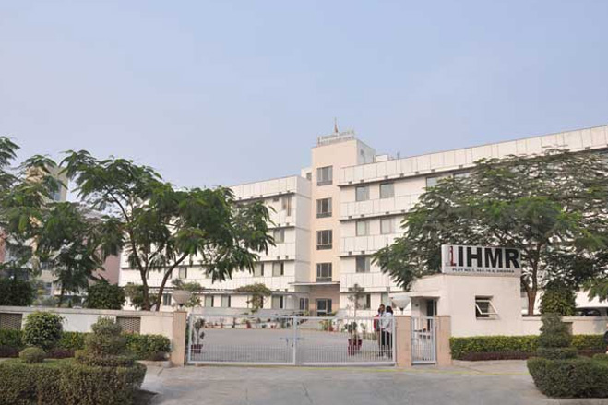
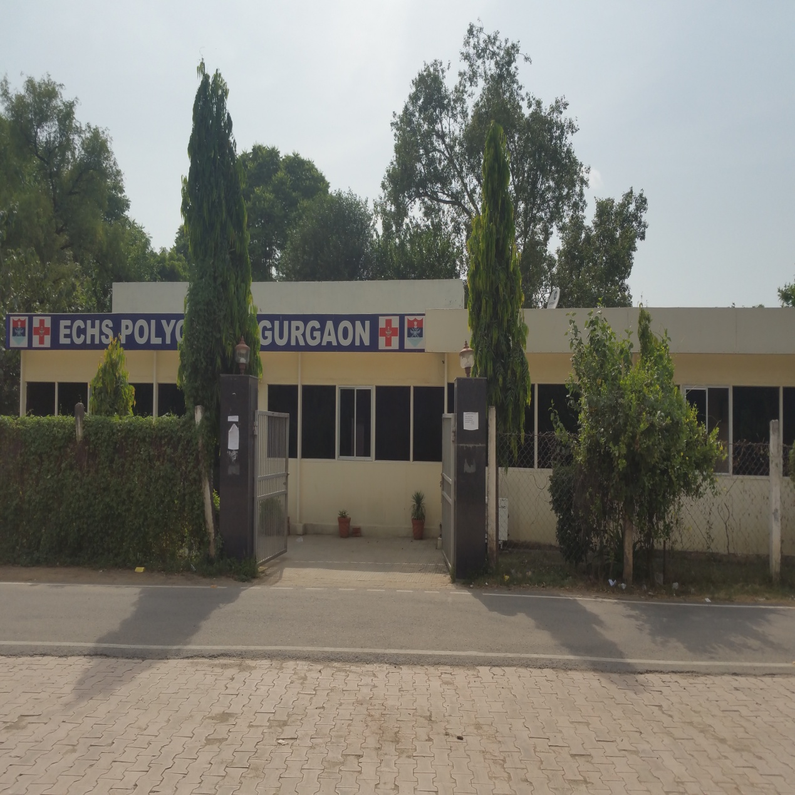
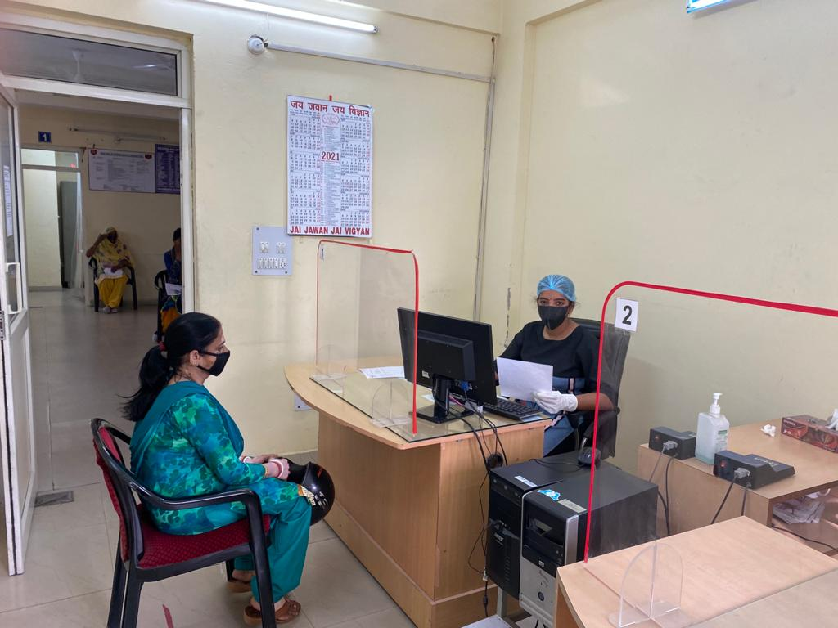
Pictorial Journey (1/2)

Slide 52
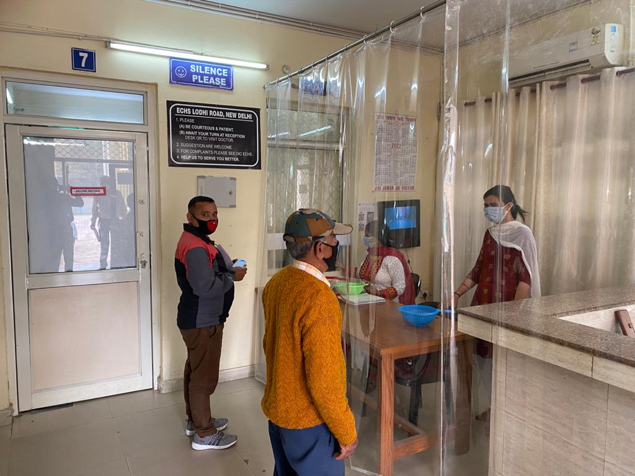
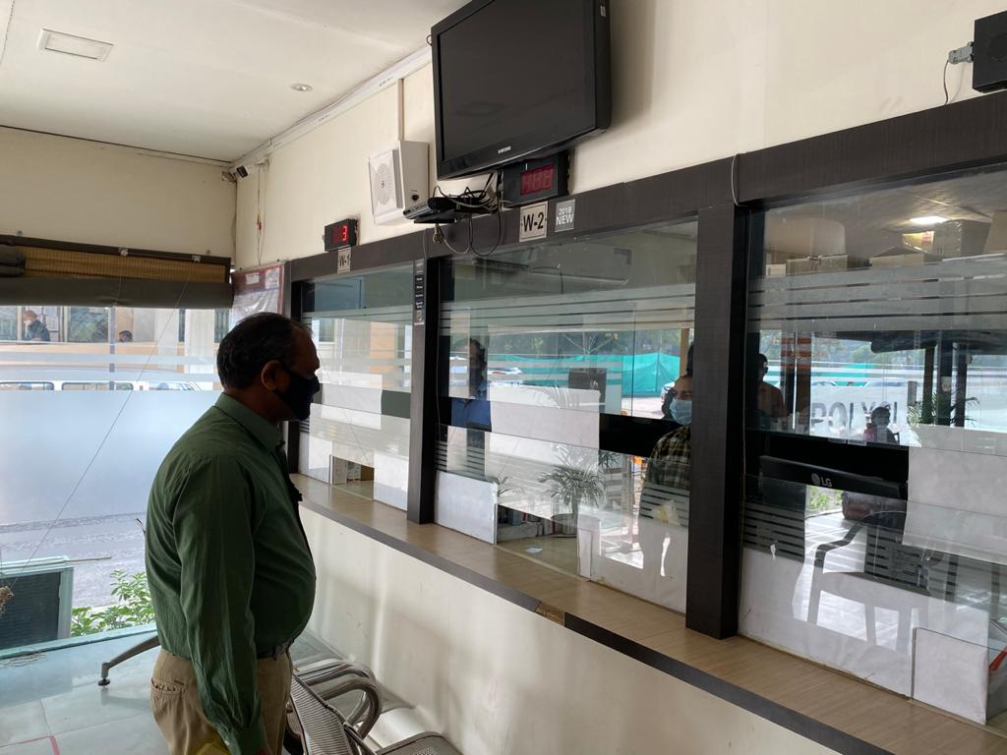
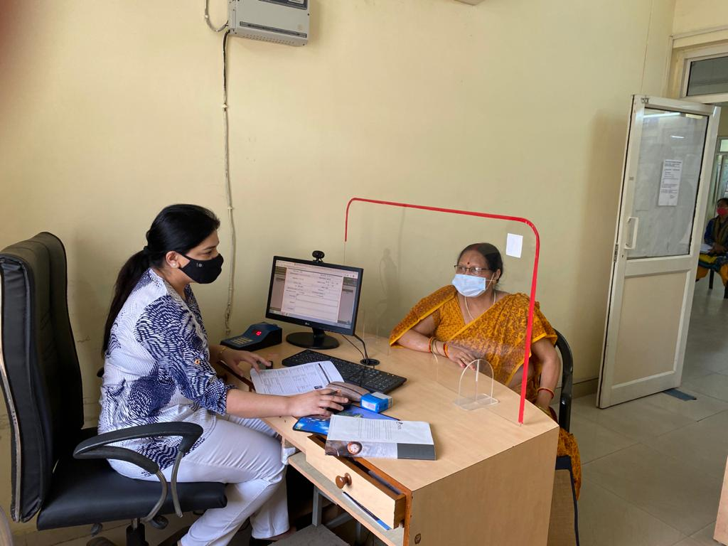
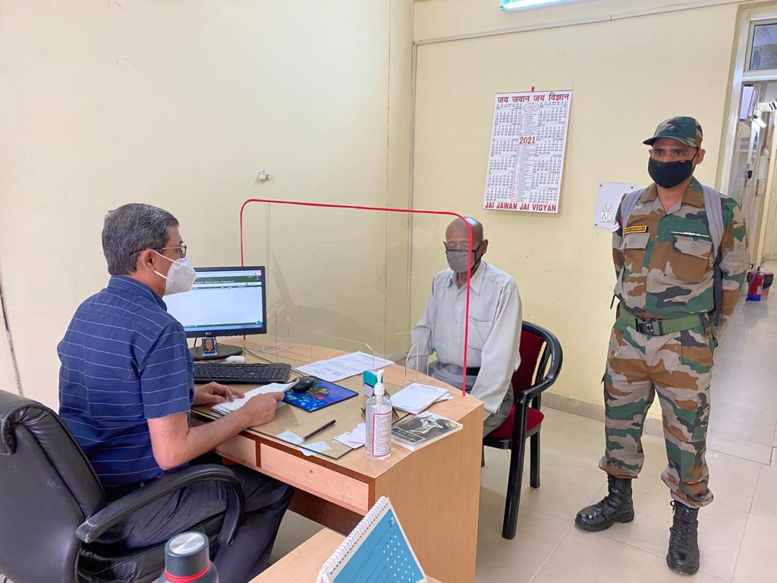
Pictorial Journey (2/2)

Slide 53
Thank You

