Slide 1
ROLE OF SOCIAL MEDIA MARKETING IN HEALTHCARE FORTIS MEMORIAL RESEARCH INSTITUTE, GURGAON
Name – Ms. Ketaki Kokate
Faculty Mentor – Dr. Nikita sabherwal
International institute of health management research, Delhi

Slide 2
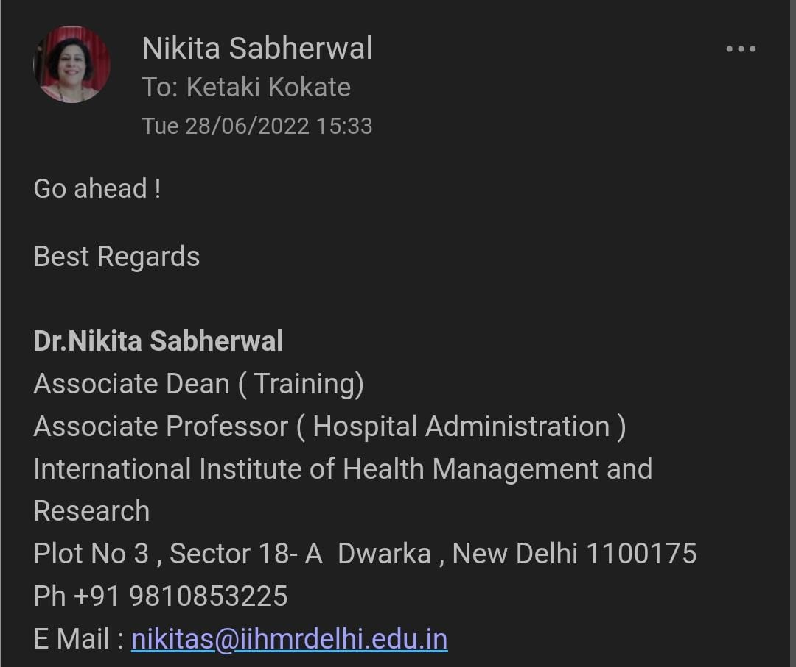
SCREENSHOT OF APPROVAL

Slide 3
INTRODUCTION (1/2)
Social Media Marketing is a form of internet marketing that uses social media platforms as a marketing tool.
Social media can primarily spread awareness about what the specific organization can offer patients in terms of medical care.
The benefits of Social Media Marketing in healthcare are –
Build relationships with patients.
Cost-effective marketing.
Showcase activities and accomplishments.
The disadvantages of Social Media Marketing in healthcare are –
Lack of control
Time consuming.
False information.

Slide 4
INTRODUCTION (2/2)
Effective strategies for Social Media Marketing used by Fortis Memorial Research Institute, Gurgaon –
Study target audience to plan the right media mix.
Handle patient queries.
Provide health information.
Create relationships and build patient loyalty.
Patient testimonials.
Reviews on post medication.
Health-related videos or images.
Posters on health-related symptoms.

Slide 5
OBJECTIVES OF THE STUDY
General objective –
To analyse and understand the impact of Social Media Marketing on the prioritisation of the patients’ decision of selecting, Fortis Memorial Research Institute, Gurgaon.
To assess the usefulness of social media in, maintaining relationship between healthcare providers and consumers.
Specific objective –
To determine the consumer perception about the use of social media in healthcare.
To find out how the healthcare providers are making use of social media in their organisation.
To find out better effective strategies for the organisation.

Slide 6
MATERIALS & METHODOLOGY
Study Design: A descriptive cross-sectional study
Study Setting: Fortis Memorial Research Institute, Gurgaon
Study Duration: Two months
Study Population: IPD, OPD, Preventive Health Check-ups, Diagnostic tests
Sample Size: 50
Sampling Method: Simple Random Sampling Method
Methods of Data Collection: Structured questionnaire was circulated among the patients or their attendees. The results obtained were recorded in Microsoft Excel Spreadsheet and was analysed using Descriptive analysis (Bar graph and Pie chart).

Slide 7
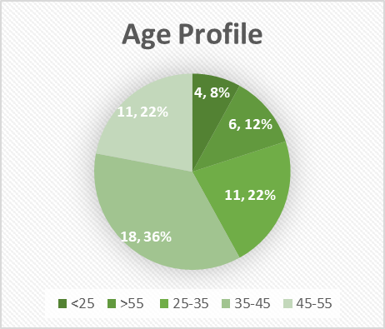
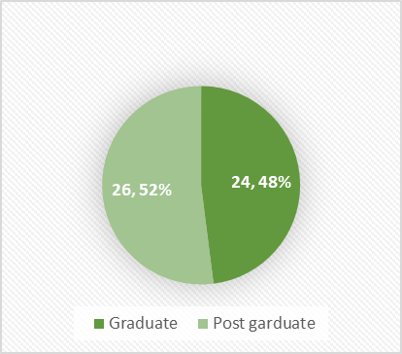
RESULTS (1/3)

Slide 8
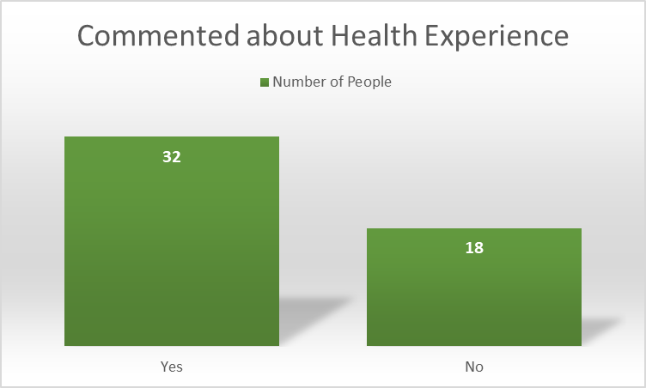
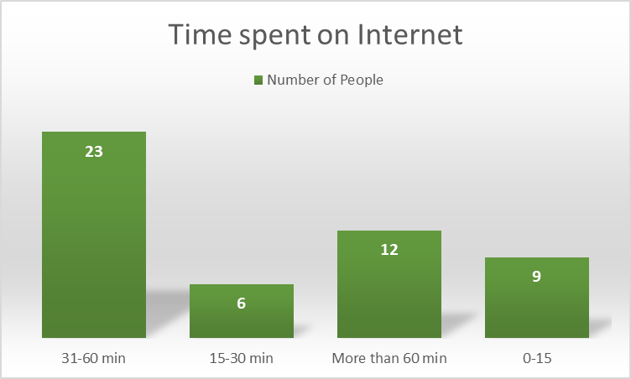
RESULTS (2/3)

Slide 9
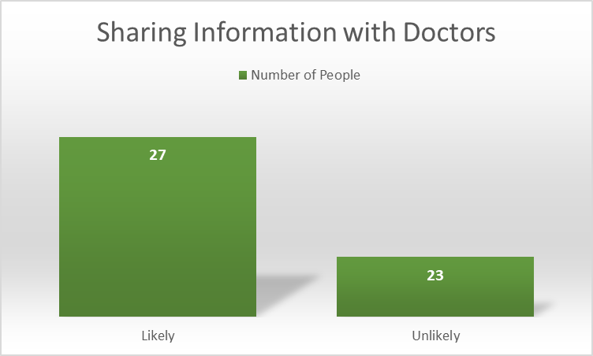
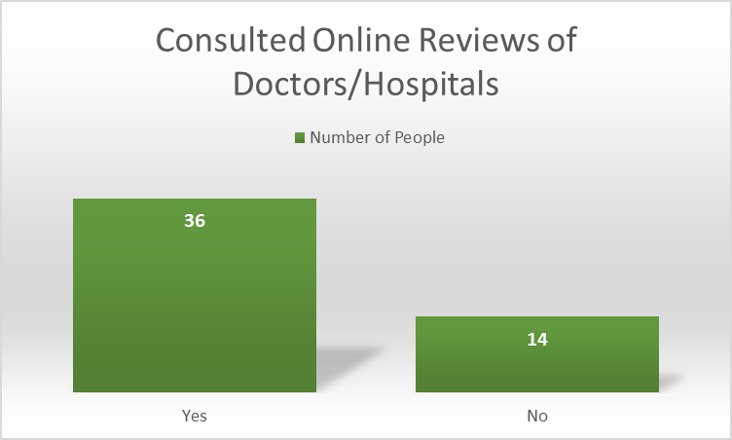
RESULTS (3/3)

Slide 10
DISCUSSION (1/2)
Social media as fundamental tool to reach target customers has most certainly arrived.
The results of the study confirm the current views on social media. Social media as a marketing tool though becoming increasingly popular is still relatively basic in complexity and sophistication.
Though the adoption rates (almost 90%) were significantly higher than other researchers, this can best be explained by the skewed social demographics of the study population. 36% of the participants were in the age group of 35-45 years with 66% male population and only 52% were graduate.
Findings pertaining to the adoption of social media for the purposes of marketing, customer relationship management, communications and brand management are very consistent with the research conducted previously.
Some research also suggests that the vast majority of institutions use social media for unidirectional communication.
Having built familiarity and comfort with basic social media use, it is now time for healthcare providers to use social media in a more advanced way to achieve their strategic goals.

Slide 11
DISCUSSION (2/2)
With millions of active users this movement of attaining new business while maintaining constant touch with the existing client base, has its foundations on mature and time-tested technology.
Research has found that some23 out of 50 of the consumers are spending up to 1 hour daily on internet and are expanding their personal peer network to online peers, and are increasingly using this network as a source of health-related information and advice.
Study found that 32 participants have commented on the health status of others and 18 have shared images and health related videos.
Many consumers report benefitting by going through the online reviews of doctors and hospitals before making the decision, 36 participants have consulted online reviews of doctors and hospitals.
Health professionals, of course, do continue to play a central role for people when they need health information and attention. 27 said they are likely to share information with doctors.

Slide 12
DISCUSSION (3/3)
Social media is presently having strong influence on where patients should go and to whom they turn to at times of need.
Healthcare providers can not only use social media to help achieve strategic goals but also look for opportunities to go beyond.
This can be via gaining insights by simply listening and connecting to the consumers while simultaneously informing them about product development and responding to patient needs in a timelier manner.
Social media can also be a tremendously powerful tool for enhancing patient satisfaction. Another important aspect of the next generation of care is patient engagement.
Social media, which often complements mobile devices, can help organization motivate patients to become more active participants in their own care and thus empowering them.

Slide 13
LIMITATIONS OF THE STUDY
Limited population – the study is limited by small sample size resulting in low statistical power.
Self-Reported Questionnaire – The current findings are solely based on Self-Reported Questionnaire thus, limiting the total elimination of reporting bias.
As with all single-site research, the findings are unlikely to generalize completely to all the consumers and healthcare providers.
Convenience sample of both the general public and healthcare provider was used and as such the potential for bias exists.

Slide 14
CONCLUSION
The use of social media by patients for health related reasons is growing.
Social media websites and platforms have ability to boost professional growth and advancement when used properly and sensibly.
In their future delivery strategies, healthcare professionals must continue to identify the optimum use for these platforms.
There are many advantages for patients of all ages, doctors, nurses, public health workers and the industry as a whole.

Slide 15
REFERENCES
Smailhodzic E, Hooijsma W, Boonstra A, Langley DJ. Social media use in healthcare: A systematic review of effects on patients and on their relationship with healthcare professionals. BMC Health Serv Res [Internet]. 2016;Available from: http://dx.doi.org/10.1186/s12913-016-1691-0
Researchgate.net. [cited2022Jun 27]. Available from: https://www.researchgate.net/publication/335714818_Effectiveness_of_Social_media_marketing
Chef F. 8 effective strategies for social media marketing in health industry [Internet]. FATbit Blog. 2014 [cited 2022 Jun 27]. Available from: https://www.fatbit.com/fab/8-effective-strategies-social-media-marketing-health-industry/

Slide 16
THANK YOU!
Any Questions?

Slide 17
You can also split your content
INTERNSHIP EXPERIENCES
I learned that every company or organization has its own culture. It’s essential to observe others and learn how they engage and interact with co-workers, or help them with projects and tasks. I quickly learned that whenever something is unclear for me, or I don’t understand, it’s fine to ask for clarification.
As an intern, I discovered it’s essential to be enthusiastic and open to learning new skills, asking for more work and being curious to learn and ask questions.
I Learned few skills like communication, team work, management skills, time management and most importantly professionalism.

Slide 18
You can also split your content
SUGGESTIONS GIVEN TO ORGANISATION
Need of manpower in Digital Marketing and graphic designs team.
Need of proper sitting arrangements in administration department.
Need of GDA’s to help employees in need.
More advanced desktops and technology.

Slide 19
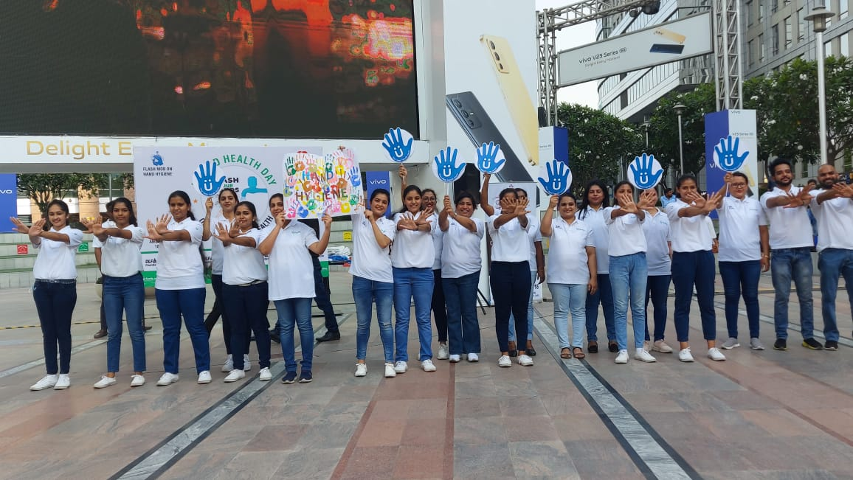
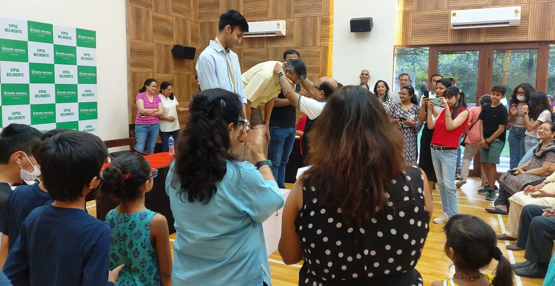
PICTORIAL JOURNEY (1/2)
Flash mob on hand hygiene and basic life support at DLF CyberHub.
Dr. Subhash Jangid health talk on sports enquiry at Vipul Belmonte.

Slide 20
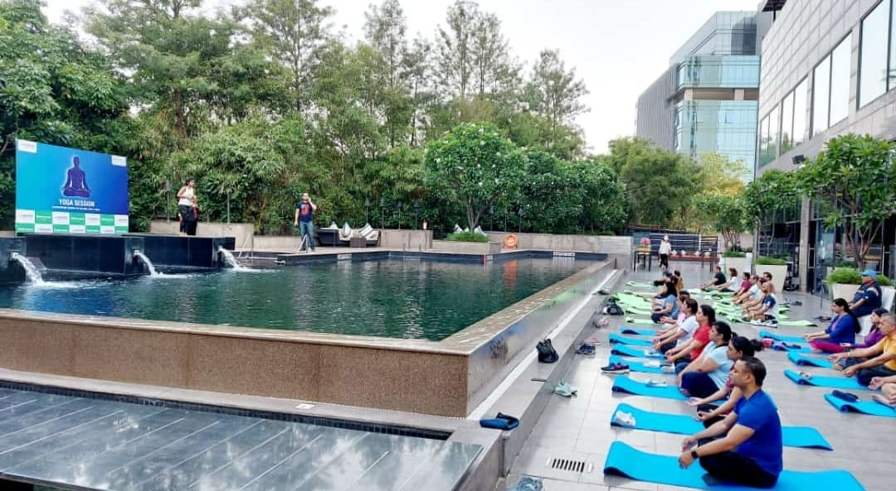
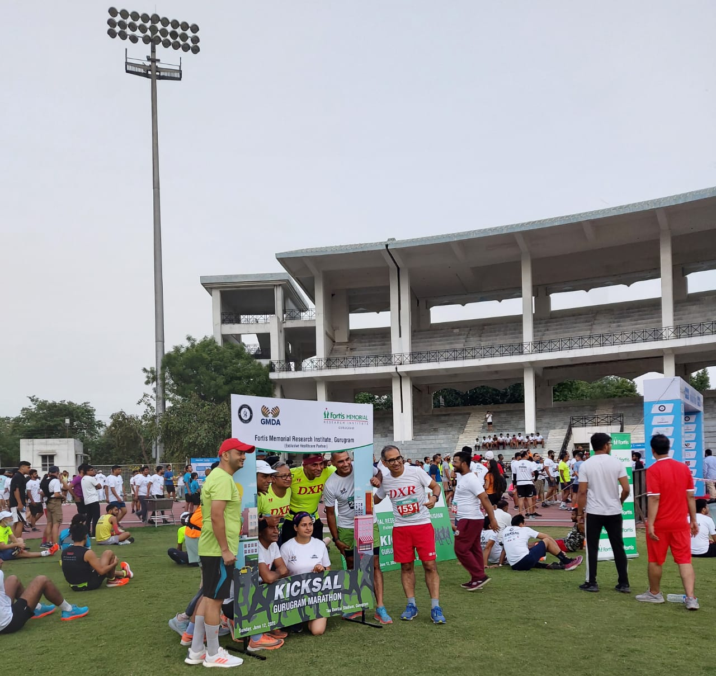
PICTORIAL JOURNEY (2/2)
Half Marathon organized by Tau Devi Lal Stadium.
Yoga Day event at LA Meridian.

