Slide 1
BLK-MAX SUPER SPECIALITY HOSPITAL
A STUDY ON THE DELAY OF DISCHARGE PROCESS
APRIL - JUNE
By - Dr.Nikita Pradhan Under the guidance of - Dr. Rupsa Banerjee IIHMR Delhi

Slide 3
INTRODUCTION
Discharge is a process by which a patient is shifted out of the hospital with all concerned medical summaries ensuring stability. The discharge process is deemed to have started when the consultant formally approves discharge and ends with the patient leaving the hospital. The purpose of study is to gain a better understanding of the entire discharge process and to identify the issues that are generating delays in the process, as well as to recommend solutions to shorten the time it takes to discharge patients.

Slide 4
DISCHARGE PROCESS FLOW CHART
PLANNED DISCHARGE
UNPLANNED DISCHARGE
PLANNED INTIMATION
UNPLANNED INTIMATION
DISCHARGE SUMMARY FREEZE
NURSING CLEARANCE
PHARMACY CLEARANCE
BILLING
BILL SETTLEMENT
BED RELEASE
HOUSE KEEPING

Slide 5
OBJECTIVES
Primary:
-To assess the delay in discharge process of cash Patients. Secondary:
•- To find out reasons for the delay in discharge process.
• -To recommend measures to reduce discharge time of Patients.

Slide 6
METHODOLOGY
Study design :
Cross-sectional study
Mixed method research(Both qualitative & quantitative research)
Study setting :
BLK-MAX Super Speciality Hospital, New Delhi
Study population :
Inclusive Criteria:
- In patients
-All Cash patients
Exclusive Criteria: - ICU / OT patients
-Out patients -PSU,EWS and TPA patient

Slide 7
METHODOLOGY
Sample size:
548 patients
Duration of study :
1month (May 2022)
Data collection:
Documents and records collected from HMIS.
Interaction with hospital personnel & patients.

Slide 8
RESULTS
T1 - Discharge Intimation Time – Time on which Doctor marks intimation indicating that the patient is ready to be discharged.
T2 - Nursing Clearance – The duration between intimation and completion of nursing duties.
T3 - Discharge Intimation Acknowledgement - done by the billing department to prepare the bill.
T4-Pharmacy clearence- The time interval between receiving nursing clearance and the pharmacy department's duty to dispense medication to the patient in accordance with the prescription.
T5 - Bill Preparation - After the pharmacy clearance bill is prepared by the billing department
T6 - Final Bill Preparation - after confirmation - After the acknowledgement of patients bill, billing department make the final bill.
T7 - Discharge from system ; once the pt settle their bill billing dpt clear the bill in the system .
T8 - Discharge slip handover ; after the bill settlement billing department gave the discharge slip to the patient.
T9 - Bed Release Updation : after the explanation of discharge summary by the nursing staff to the patient , then pt will free to go.
T10 - Bed ready - After the patient vacates the room, housekeeping staff prepares the room for the subsequent admittance.
2 2
TAT in Minutes

Slide 9
COMPARISION DISCHARGE PROCESS TAT
9
HOSPITAL TARGET TIME DISCHARGE TIME IN MONTH OF MAY 2022

Slide 10
DISCUSSION
After the analysis of data It has been found that the Discharge process is delayed by average of 71 minutes compared to the hospital’s targeted time.
The average TAT for Nursing clearance is 125minutes which exceeds 35minutes than the targeted time.
The average TAT for Pharmacy clearance is 9minutes which is under than the targeted time.
The average TAT for IP Billing department is 49minutes and 176minutes which exceeds 105minutes than the targeted time.
The average TAT for House keeping is 121minutes and 31minutes which exceeds 107minutes than the targeted time.

Slide 11
DISCUSSION
It was observed that nursing clearance, IP billing, and housekeeping consume the most time, leading to a longer discharge time. It was also found that both doctors and patients are also responsible for the delays in the process. This time can be reduced if the nursing staff, doctors, and housekeeping staff all do their responsibilities on promptly, and planned discharges are encouraged. It was also advised that a few more people be hired to ensure that the process runs well and on time.

Slide 12
REASONS FOR THE DELAYS IN DISCHARGE PROCESS
• Delay in returning of bed side medication.
• Work load
• Multi tasking
Pending investigations or investigations report.
Delayed consultant rounds in morning
Workload
Changes in the discharge summary
Unplanned discharges
• Arrangement of transportation
• Prefers to leave after lunch.
• Complications/Deteriorating health
• Even after bill clearance, few patients does not vacant the bed in time.
• Changes in bill
• Last moment discount
• Delay in cleaning rooms
• Multi tasking

Slide 13
LIMITATION OF STUDY
Includes only cash patient
Hospital policy constraints.
A Qualitative study to analyse the causes of delay from the healthcare providers in the hospital can be conducted to understand the scenario better.

Slide 14
CONCLUSION
Nursing clearance, IP Billing, House keeping is causing maximum delay.
The majority of the delays were caused by processes that may be improved with the help of care teams and managers
Any unnecessary delay in the discharge process is detrimental to both the patient and the organisation.

Slide 15
SUGGESTIONS GIVEN TO ORGANIZATION
Timely rounds of doctors especially for discharge cases.
In planned discharge, ward secretaries should make sure that all summaries are ready for signature and correction by the consultant following morning.,discharge before noon’ policy
• Before giving intimation for discharge, check to see if all investigations have been completed.
Hire Nursing ,GDA staffs. and clinincal pharmacist,

Slide 16
References
1.Arthi MS, Divya S. A study on causes of delay in discharge process in one of the prominent hospitals in Tamilnadu [Internet]. Ijcrt.org. [cited 2022 Jun 22]. Available from: https://www.ijcrt.org/papers/IJCRT2004012.pdf 2. A study on delay in discharge process, in one of multispeciality hosp… [Internet]. Slideshare.net. [cited 2022 Jun 22]. Available from: https://www.slideshare.net/ijtsrd/a-study-on-delay-in-discharge-process-in-one-of-multispeciality-hospital-in-tanjore 3. Mukadam C. Quality in hospital [Internet]. Slideshare.net. [cited 2022 Jun 22]. Available from: https://www.slideshare.net/chitramukadam2012/quality-in-hospital 4. Gov.om. [cited 2022 Jun 22]. Available from: https://www.moh.gov.om/documents/17931/25482/Quality+Assurance+STRATEGY/6dc8a4e1-f8f8-483d-ba65-6f884e617d9e 5. Ali Pirani SS. Prevention of delay in the patient discharge process: an emphasis on nurses’ role. J Nurses Staff Dev [Internet]. 2010;26(4):E1-5. Available from: http://dx.doi.org/10.1097/NND.0b013e3181b1ba74 6. Majeed MU, Williams DT, Pollock R, Amir F, Liam M, Foong KS, et al. Delay in discharge and its impact on unnecessary hospital bed occupancy. BMC Health Serv Res [Internet]. 2012;12(1):410. Available from: http://dx.doi.org/10.1186/1472-6963-12-410 7. Suji MU, Revathi K. A Study on Delay in Discharge Process, in One of Multispeciality Hospital in Tanjore. International Journal of Trend in Scientific Research and Development [Internet]. 2020 [cited 2022 Jun 22];4(4). Available from: https://www.ijtsrd.com/management/other/30919/a-study-on-delay-in-discharge-process-in-one-of-multispeciality-hospital-in-tanjore/k-revathi 8. Sunil S, Shilpa RG. Analysis of time taken for the discharge process in a selected tertiary care hospital [Internet]. Iraj.in. [cited 2022 Jun 22]. Available from: http://www.iraj.in/journal/journal_file/journal_pdf/14-308-14800658764-8.pdf

Slide 17
THE STUDY ON THE DELAY OF THE DISCHARGE PROCESS Presented by : Dr.Nikita Pradhan
INTRODUCTION
Discharge is a process by which a patient is shifted out of the hospital with all concerned medical summaries ensuring stability. The discharge process is deemed to have started when the consultant formally approves discharge and ends with the patient leaving the hospital. The purpose of study is to gain a better understanding of the entire discharge process and to identify the issues that are generating delays in the process, as well as to recommend solutions to shorten the time it takes to discharge patients.
OBJECTIVE
Primary:
-To assess the delay in discharge process of cash Patients. Secondary:
•- To find out reasons for the delay in discharge process.
• -To recommend measures to reduce discharge time of Patients.
Study design :
Cross sectional study
Mixed method research(Both qualitative & quantitative research)
Study setting :
BLK-MAX Super Speciality Hospital, New Delhi
Study population :
Inclusive Criteria : in-patients.,cash patients.
Exclusive Criteria : ICU / OT patients,out-patients,TPA,EWS Patients
Duration of study :
1month (May 2022)
Data collection :
Primary data collection : documents and records collected from HMIS.
Secondary data collection : observation , interaction with hospital personnel & patients.
R
.
METHODOLOGY
RESULT
CONCLUSION
In this study, the time taken for Discharge of Cash patients at BLK-MAX Hospital has been analyzed and It has been found that the Discharge process is delayed by 71 minutes compared to the hospital’s targeted time. Recommendations were made to reduce the discharge process while also increasing customer satisfaction, bed turnover, and hospital profitability.
Presented by
RECOMENDATIONS
HOSPITAL TARGETED DISCHARGE TIME
DICHARGE TIME IN MONTH OF MAY 2022
Timely rounds of doctors
In planned discharge, ward secretaries should make sure that all summaries are ready for signature and correction by the consultant following morning.,discharge before noon’ policy
Before giving intimation for discharge, check to see if all investigations have been completed.
OT code must be informed to the billing department by doctors on time
Improve the interdepartmental coordination.
Hire Nursing ,GDA staffs. and clinincal pharmacist,

Slide 18
Thank You
Any Questions

Slide 19
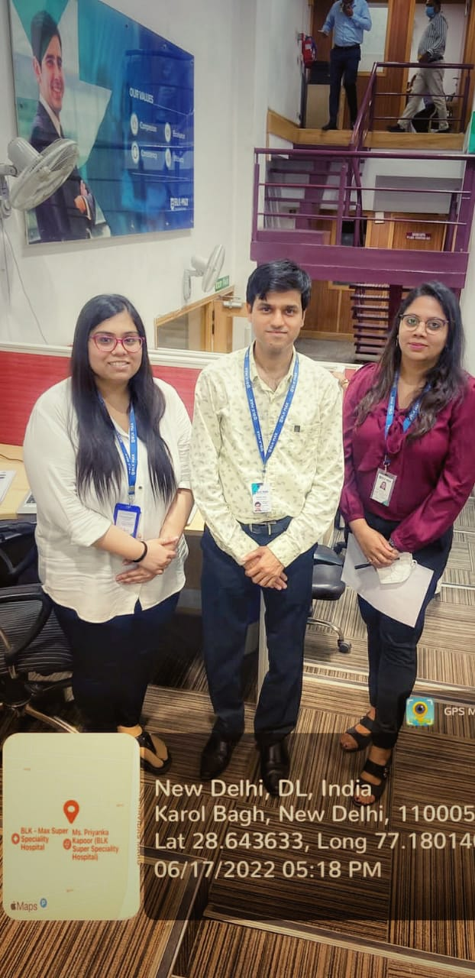
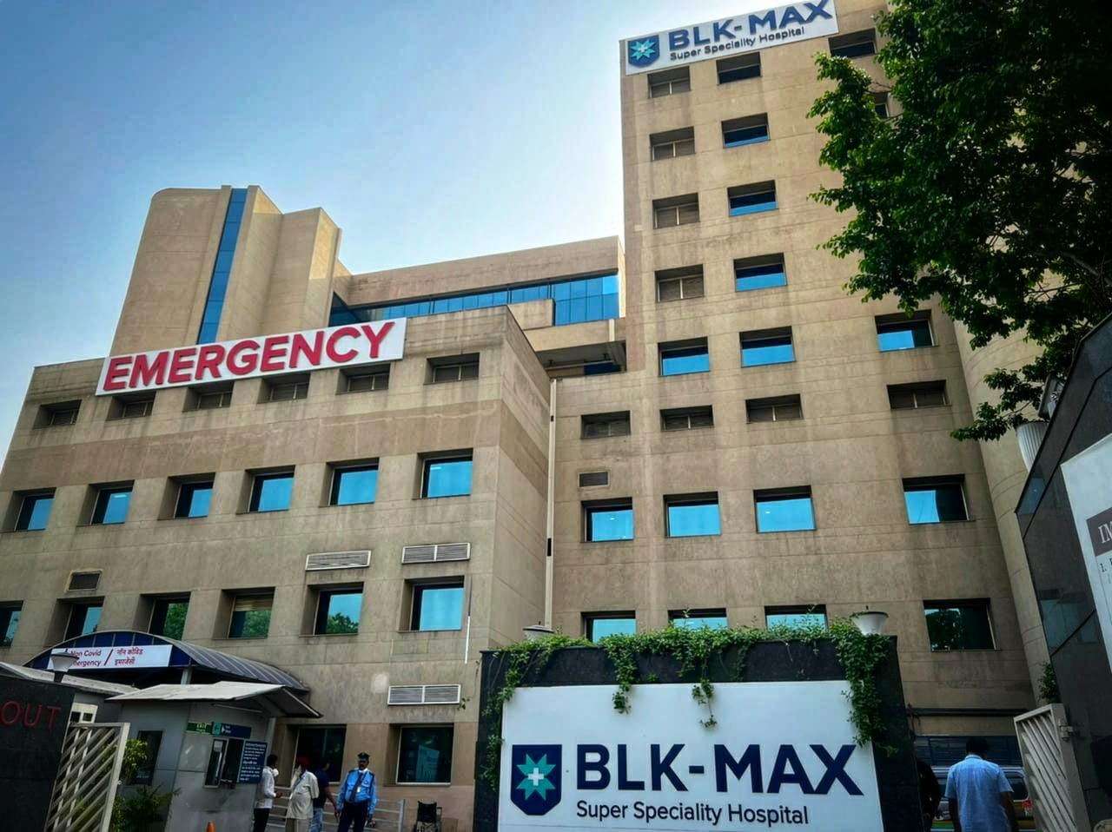
Pictorial Journey

