Slide 1
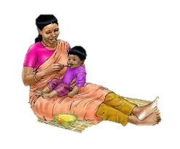
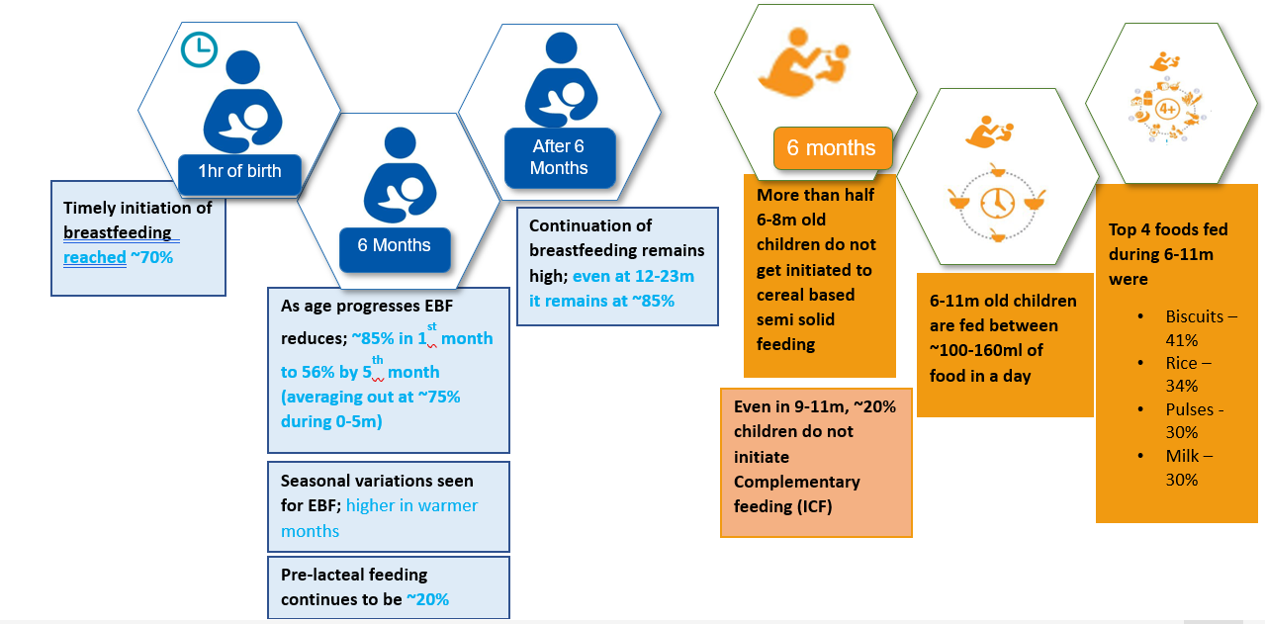
A closer look (ACL Study) – On the multidimensional modifiers of nutrition and practices in children of rural Bihar-
A qualitative deep-dive using ethnographic techniques
Presented By-
Purna Bhattacharya(PG/21/077)
Guided By: Dr. Siddharth Shekhar Mishra
International Institute of Health Management and Research, IIHMR, Delhi
INTRODUCTION
OBJECTIVE
RESULTS
Inadequate IYCF practices may contribute to the high prevalence of chronic malnutrition. Because of the high risk of growth stalling Infants aged 6 to 18 months are in a critical growth period. This is the age at which complementary foods become increasingly important part of the diet.
Child undernutrition: a major concern in developing countries. Adequate nutrition during early childhood years is very essential.. Inadequate nutrition hampers the overall child growth
Children < 2 years of age are vulnerable to undernourishment
According to NFHS 5 (2019-21), Bihar (India) 31.1 percent of children under the age of three were breastfed within one hour of birth, 58.9 percent were given EBF, 39 percent were receiving solid or semi-solid food and breastmilk, and 10.8 percent were receiving an adequate diet. 10.9 percent of children aged 6 to 23 months have a healthy diet. All remained lower than the national average. 42.9 percent of children under the age of five are stunted , 22.9 percent are wasted , and 41 percent are underweight.
After 6 months of age child requires additional nutrients while being continued breastfed.
Indicators of IYCF :
Early initiation of breastfeeding
Exclusive breastfeeding for six months
Continued breastfeeding for 1 year
Introduction of solid, semi-solid or soft foods
Minimum dietary diversity
Minimum meal frequency
Minimum acceptable diet
Consumption of iron rich or iron fortified foods
Three main practices are required to improve children's nutrition from birth to two years of age:
Continued breastfeeding or supplementation with calcium-rich foods if not breastfed.
Feeding solid, semisolid, or soft food at least once per day (minimum meal frequency), depending on age and breastfeeding status.
Consumption of at least four food groups per day (dietary diversity).
To assess the gaps in the child feeding practices among mothers of rural Bihar.
To explore ethnographic methods pertaining to the quantity and variety of foods fed to the child (barriers and facilitators of IYCF practice).
To comprehend individual and community perceptions, norms, and behaviors of IYCF practices with a focus on barriers.
Investigate ethnographic factors pertaining to the quantity and variety of foods fed to the child.
Family demographic character:
Education-The care giver of the child had mostly completed 8 years of schooling.
Age of the care giver-Majorly care givers were 25 years old
Decision making power- Decision maker of the family was mother in law.
Occupation of the family- Main occupation of the family was Daily wage labors and all care givers were doing house holds things.
Core food items infant and young:
Infants were mostly provided legumes and dairy products (milk), three items out of 8 food groups were available in most of the households.
3. Food preparation of infant and child practices:
Mostly care givers followed hand hygiene while preparing foods and feeding the child
Variety of foods were prepared but they didn’t feed their child
Care giver of the child was frequently breastfeeding the child
4. In majority no effort was made to feed the child
5. The knowledge and practices of mothers:
The idea was prevalent among the mothers/caregivers about feeding only breast milk, cow mil, water of pulses to the child, as children can’t digest animal protein/vegetables.
6. Advise received from health care professional about nutrition:
Half of households reported visits by ASHA.
7. Information received from other media like social media
8. Mostly advice regarding child feeding is given by mother-in-law.
METHODOLOGY
A mixed-method study approach incorporating a structured survey tool, in-depth interviews, photo documentation and ethnographic methods like observation, cognitive mind mapping, free listing, and 24-hour dietary recall.
Study location-2 Blocks of Patna(Daniyawan, Bikram)
Grounded-theory based on transcript, cleaning, contextualization using ATLAS-Ti for preparing the qualitative data analysis.
Sample
Beneficiary
Caregiver/Mother with child
(6-11months)
Caregiver/mother with child
(12-23months)
Market Venders/Food Suppliers
Key Informants (KIIs)
ASHA
AWW
PRI / SHG
CONCLUSION
This study reveals multiple factors influencing complimentary feeding practices.
Positive elements of hand hygiene practices followed before cooking and feeding of household level at village.
The mixed method study suggested that nutritional interventions can be supported by creating awareness among care givers, mothers by FLWs.
Child at 6 to 12 months age mostly eats liquid or semi solid food
Narratives from the interviews, observations and other ethnographic techniques done suggest presence of complex barriers and influencers of nutritional practices in the households.
There are knowledge gaps at many stakeholder levels like beneficiaries (mothers/caregivers), FLW (ASHA and AWW), Market Vendors. Our data suggested that community health workers should emphasize on creating awareness about nutritional practices, counselling of the mothers as well as the family members regarding improved IYCF practices for the better child health.
IYCF practices in Bihar (2014-2020) – Current knowledge based on Community household survey, Care Bihar Data
REFERENCES
NFHS india.pdf.
WHO www.who.int
Community household survey, Care bihar data
Dhami MV, Ogbo FA, Akombi-Inyang BJ, Torome R, Agho KE, On Behalf Of The Global M, et al. Understanding the Enablers and Barriers to Appropriate Infants and Young Child Feeding Practices in India: A Systematic Review. Nutrients. 2021;13
Burns J, Emerson JA, Amundson K, Doocy S, Caulfield LE, Klemm RDJF, et al. A qualitative analysis of barriers and facilitators to optimal breastfeeding and complementary feeding practices in South Kivu, Democratic Republic of Congo. 2016;37
Thuita FM. Gretel H. Pelto.
Umugwaneza M, Havemann-Nel L, Vorster HH, Wentzel-Viljoen EJJoNS. Factors influencing complementary feeding practices in rural and semi-urban Rwanda: a qualitative study. 2021;10.
Data Management and Analysis Plan:-
All audios were transcribed first then The analyst checked the transcripts for quality against the original recordings and against the field notes for accuracy. An inductive thematic analysis was used for coding the transcripts.
ATLAS.ti 7.5.7 used for analysis based on pre-determined themes, sub-themes & codes.
An inductive thematic analysis was used for coding the transcripts, grouped as first-order themes, second-order themes, & higher-order themes based on the codes.

