Slide 1
“COWIN: THE DIGITAL BACKBONE FOR THE COVID-19 VACCINATION PROGRAM IN INDIA”
EY, New Delhi
Mr. Rinku Yadav
PG/21/084
Mentor – Dr. Anandhi Ramachandran (Associate Professor, IIHMR Delhi)

Slide 2
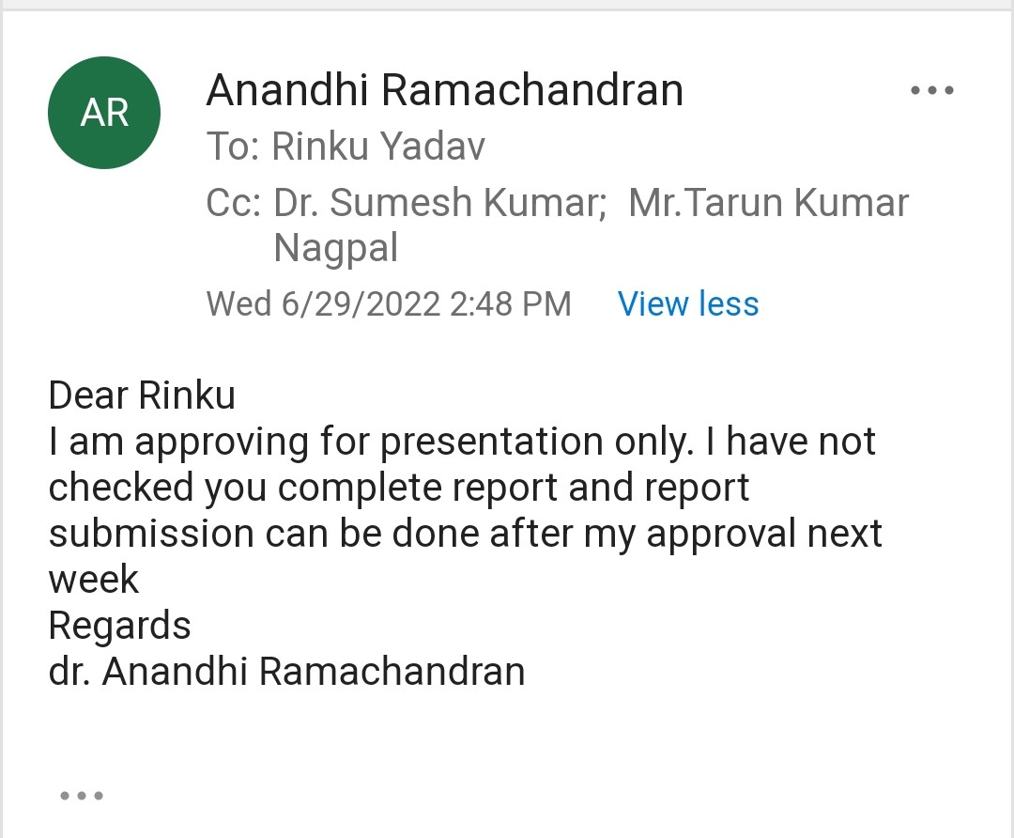
Certificate of Approval

Slide 3
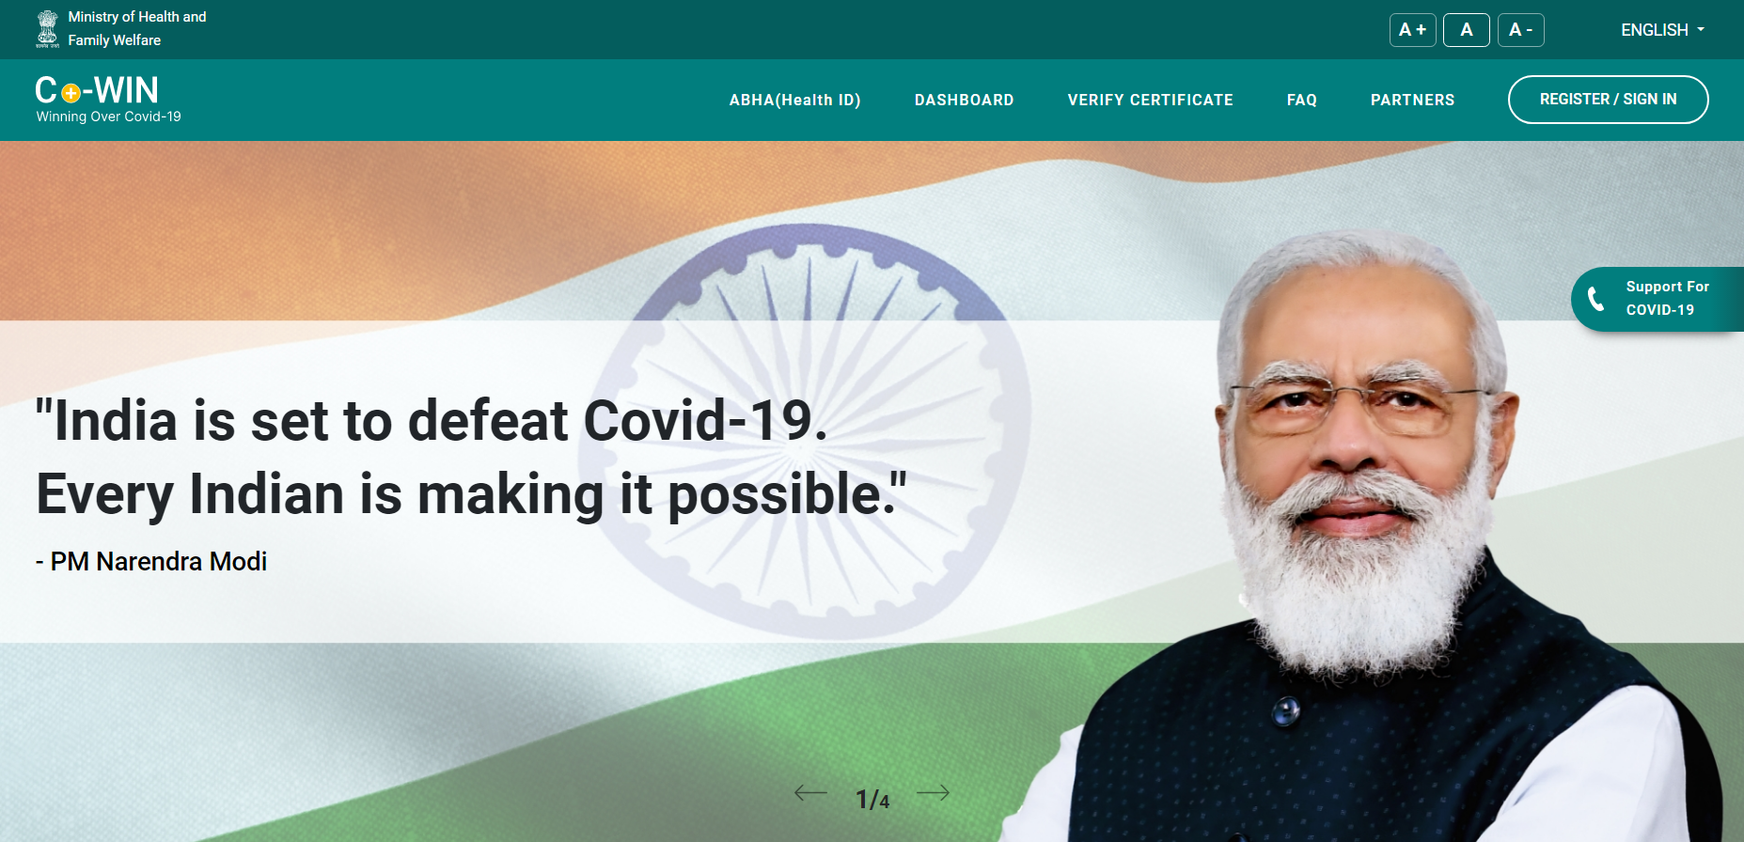
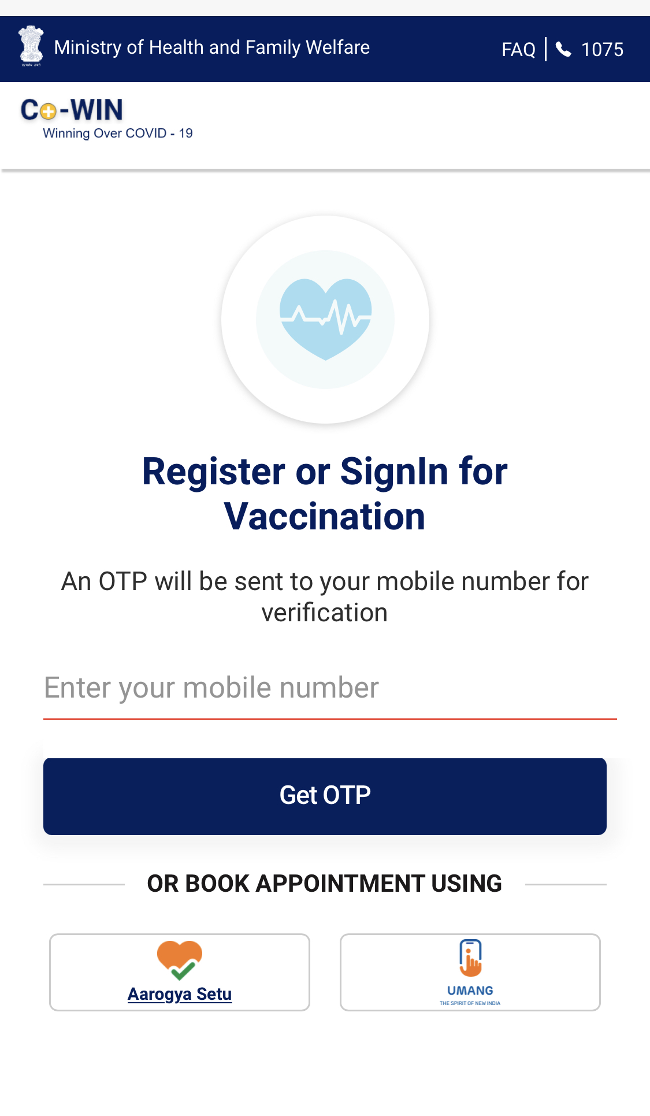
CoWIN
PM Narender Modi launched CoWIN on 16 Jan, 2021
PM Narender Modi launched CoWIN on 16 Jan, 2021
The objective is to reduce VPDs and pave the way for a return to normality.
A Scalable, Inclusive and Open Platform for Universal Vaccination to provide equitable vaccination at scale across 28 states and 8 UTs.
It connects various stakeholders that ensures flawless vaccination delivery program .
Functions - registration, appointment scheduling, identify verification, vaccination and certification of each vaccinated member.
Covid Vaccine Intelligence Network
A tech-based platform facilitating the planning, implementation, monitoring, and evaluation of Covid-19 vaccination in India
Users can access the platform by mobile, tablet and desktop in 12 languages.

Slide 4
Architecture of Co-WIN – Open and interoperable
Application Service Providers
Portal
Registration & Scheduling Module
Vaccination Facility Module
Vaccination Module
Certification Module
3rd Party Apps allowed to build above these APIs
Connected via
Protected APIs
Registration
Facility
Vaccination
Certificate
3rd Party Apps
Co-WIN Database

Slide 5
5 Modules of CoWIN
1. Orchestration Module
4. Citizen Registration Module
Appointment of Administrators
Creation of database
Allocation of Vaccine Stock
Aarogya Setu
Login, OTP
Eligible Check
Beneficiary Details
Appointment Booking
UMANG
V
CoWIN
2. Vaccine Cold Chain Module
Allocation of Vaccine work
Logistical Handling
Verifying no. of doses received
5. Certificate, Feedback and AEFI Module
Input to Certificates
Certificate Generation & Verification
Certificate Distribution
3. Vaccination Module
Issue through OTP Storage in DigiLocker
Grievance Redressal & Feedback
Verify Beneficiary ID with Aadhar/photo Id
Complete Vaccination
Update Vaccination Status
National Helpline number 1075 + Technical Helpline
Reporting of AEFI

Slide 6
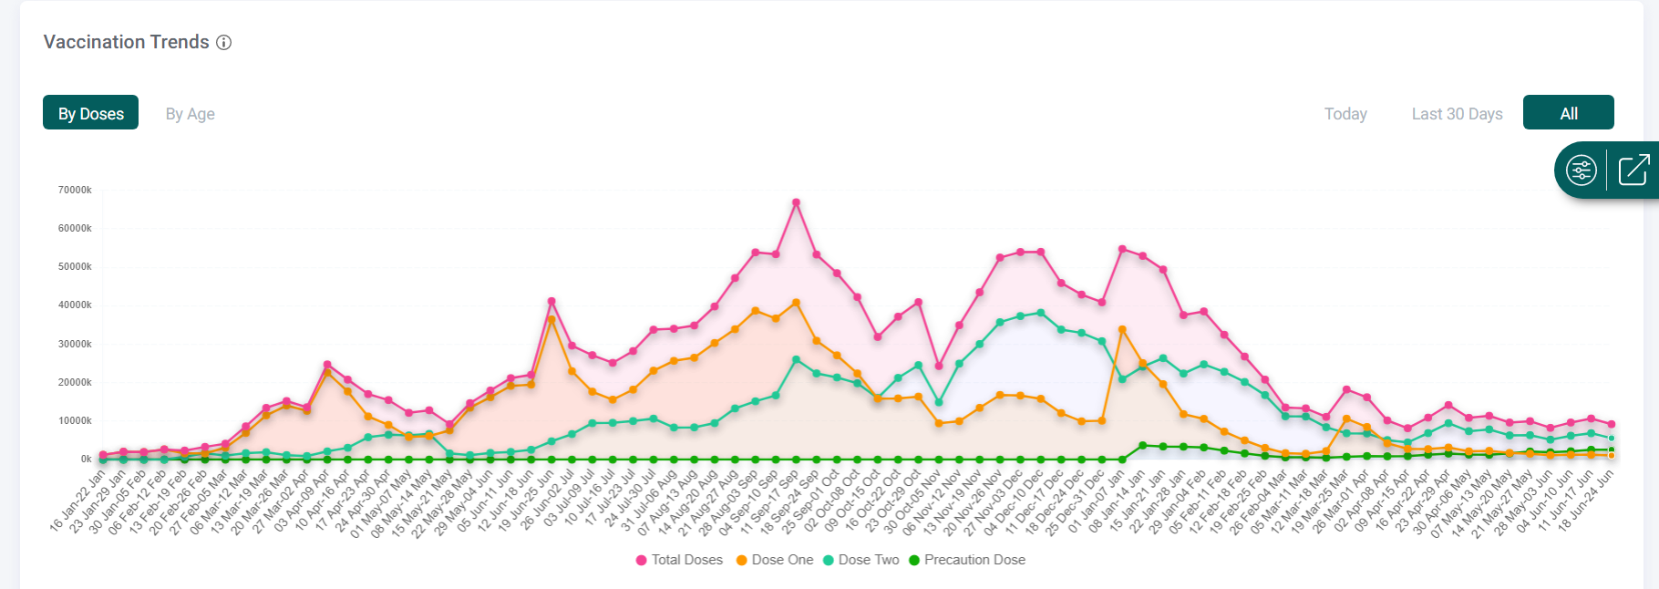
Features
https://dashboard.cowin.gov.in/
Features for Citizens
Real-time Dashboard
Statistics on Dashboard
Vaccinations Centers live
# of Citizens registered
# of Vaccines Administered
Split among Dose-1, Dose-2 & Precautionary Dose.
AEFI based on Vaccine Brand
Division by States & District
Split by Age and Gender
Split by Brand of Vaccines
Blended Registration
Choice of
Vaccine Location
Online
Slot Booking
Instant digital certificate
Features for Vaccinators
Raise an issue and get solution for it
1
3
5
Vaccination Date Correction
Merge Certificates
Report Unknown member
Vaccine Authentication
Publishing Vaccine Schedules
Verification of Citizens
Open and interoperable
6
2
4
Certification Correction
Add Passport
Transfer Member To New Number

Slide 7
Digital assets leveraged with CoWIN
It is a digital service, primarily a mobile App.
eVIN aimed at strengthening vaccine supply chain system.
SAFE-VAC – a database for reporting AEFI.
DIVOC is a public good, developed by eGov Foundation.
eVIN is an integrated package of people (trained HR), process (temperature monitoring) and product (software & SIM enabled temp. loggers).
Mission of SAFE-VAC is to promote confidence in the National Immunization Program by enhancing vaccine safety monitoring and rapid signal detection.
DIVOC is an open-source digital platform built to orchestrate large scale digital vaccination and certification program.
This app proved vital for self-monitoring and tracing of COVID-19 positive individuals.
It provides relevant and curated medical advisories as per MoHFW and ICMR guidelines pertaining to COVID-19 pandemic.
It allows digitization of vaccine inventories like –
View Realtime stock & temp.
Vaccine requirements
Consumption Patterns
Route Planning
Stock relocation
To help achieve this we encourage all immunization providers to report any unexpected, serious or unusual AEFI to their local surveillance body.
DIVOC is an integral part of India’s CoWIN to support digitally verifiable certificates.

Slide 8
Objectives of the study
Primary Objective
To analyse the COVID-19 Vaccination status in India : dose-wise, age-wise.
Secondary Objective
To compare the vaccination status of India with global average.
To compare State/UT-wise fully Vaccinated Population with National Average.
To compare States/UTs fully vaccination vs literacy rate.
To find out Repurposing CoWIN in India
To find out issues related to CoWIN on Twitter.

Slide 9
Methodology
This study used the data from the Dashboard of CoWIN Platform and from Ministry of Health and Family Welfare (MoHFW) portal from 16 Jan, 2021 to 22 June, 2022. The CoWIN dashboard is publicly available on the online portal https://dashboard.cowin.gov.in/ and also the MoHFW provides data publicly on https://www.mohfw.gov.in/ . All the data has been updated regularly on CoWIN under the stewardship of National Health Authority (NHA), Government of India (GoI), with the Ministry of Health and Family Welfare (MoHFW).
Data is regularly updated on the CoWIN platform either by users by registering themselves on CoWIN or by Health Professionals present at healthcare facilities (PHCs, CHCs etc.) Data on total registration(age-wise), total vaccinations (age-wise, dose-wise) were collected. Comparative analysis CoWIN with other digital [platforms and India’s vaccination status with global average was done and data is presented as graphs and tables.
Analysis also have been done to find out repurposing CoWIN in India, to identify key takeaways from the CoWIN and to find out major issues related the CoWIN portal posted by citizens on Twitter.

Slide 10
Snapshot
% of Partially Vaccinated Adult Population-INDIA - 97%
% of Fully Vaccinated Adult Population-INDIA – 89.5%
% of Fully Vaccinated Population-GLOBALLY - 65.5%

Slide 11
Registration & Vaccination of 12-14 years
Vaccination administered/day was highest in the month of March, then it started decreasing at an increasing rate from 10.6 to 6.2 lakh vaccine per day in April.
Dose 1
3.6 cr.
78% children of 12-14 age got vaccinated with 1st dose
Dose 2
2.13 cr.
47% children of 12-14 age got vaccinated with both the doses

Slide 12
Registration & Vaccination of 15-17 years
Total vaccination as well as vaccination per day for 15-17 reduces in Feb but it reduces with more rate in March and April 2022 because almost 2/3rd population of this group got vaccinated with 1st dose by mid Feb.
Dose 1 6 cr.
89% children of 15-17 age got vaccinated with 1st dose
Dose 2
4.7 cr.
63.5% children of 15-17 age are fully vaccinated.

Slide 13
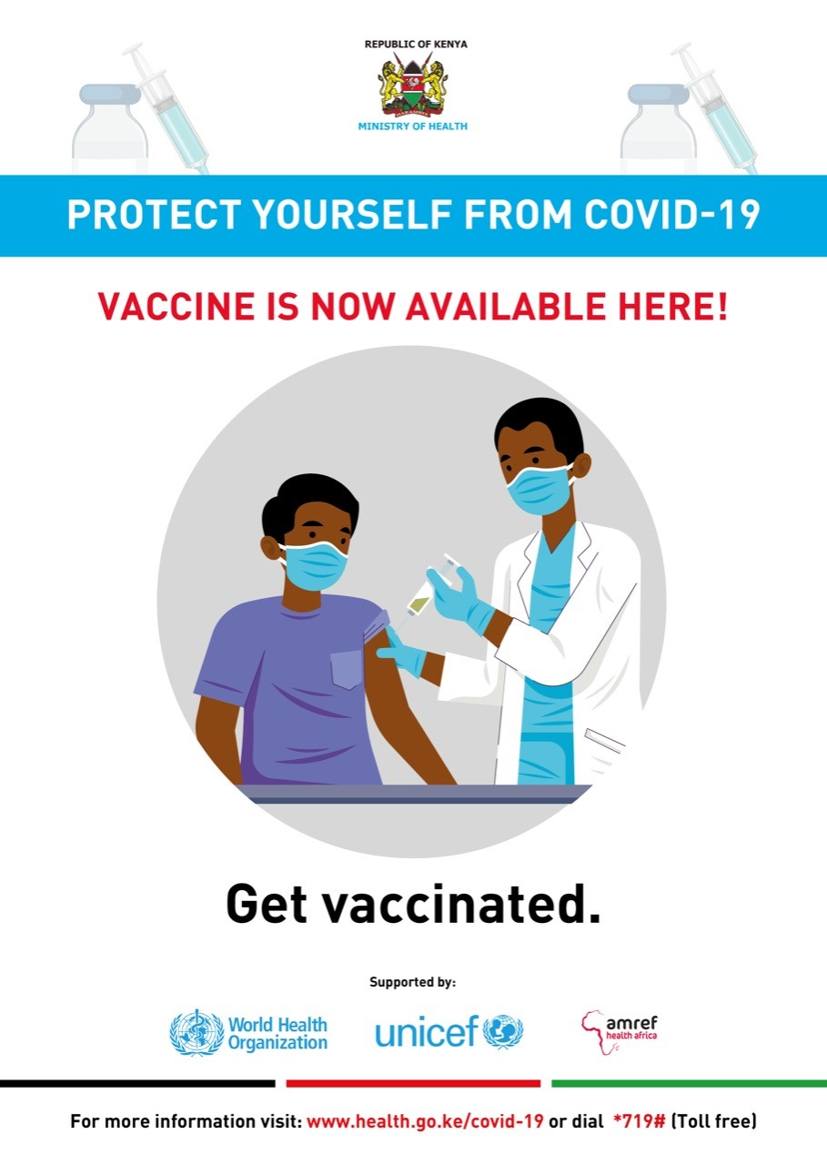
Registration & Vaccination of 18+ years
Registration & Vaccination of 18+ years
Dose 1 91.7 cr.
97% population of 18+ age got vaccinated with 1st dose
Dose 2 83.9 cr.
89.5% population of 18+ age are fully vaccinated.

Slide 14
Precaution Dose
Total Precautionary Dose Administered
4.3 crore
Total Population eligible for Precautionary dose = 26.1 crore
Total Precautionary dose administered = 4.3 crore
Still a large Population is remaining left for precautionary dose i.e. approx. 22 crore
Total Precaution dose administered = 4.3 crore
Precaution dose administered to HCWs, FLWs and 60+ = 3.85 cr.
Precaution dose administered to 18-59 age group = 45 lakh
who got 2nd dose before Oct’21 are eligible for precautionary dose (9 months gap is mandatory between 2nd dose and precautionary dose)

Slide 15
State/UT-wise fully Vaccinated Population compared with National Average
States with high population (Maharashtra, Bihar, Rajasthan) lies below to national average in fully vaccinated population.
Other states – Punjab, Chhattisgarh, Tamil Nadu and Jharkhand also lies below to national average.
Puducherry and Ladakh are the UTs lies below national level.
Northeast Indian states (all 7 sister states) needs more attention to get their population fully vaccinated because these states show much lower value than national average

Slide 16
State/UT-wise fully : Vaccination & Literacy
Ranks as per vaccination per mn population for States/UT with highest/lowest literacy rates
Highest literacy rates
Lowest literacy rates
State | Literacy Rate | Rank | Male : Female Literacy
Kerala | 94 | 13 | 96 : 92
Lakshadweep | 92 | 2 | 96 : 88
Mizoram | 91 | 29 | 93 : 89
Goa | 89 | 8 | 93 : 85
Tripura | 87.2 | 27 | 92 : 83
Daman & Diu | 87.1 | 1 | 92 : 80
Andaman & Nicobar | 86.6 | 6 | 90 : 82
Delhi | 86.2 | 7 | 91 : 81
Chandigarh | 86 | 3 | 90 : 81
Puducherry | 85.9 | 31 | 91 : 81
State | Literacy Rate | Rank | Male : Female Literacy
Assam | 72.0 | 28 | 78 : 66
Chhattisgarh | 70.0 | 25 | 80 : 60
Madhya Pradesh | 69.0 | 20 | 79 : 59
Uttar Pradesh | 67.6 | 22 | 77 : 57
Jammu & Kashmir | 67.2 | 16 | 77 : 56
Andhra Pradesh | 67.0 | 10 | 75 : 59
Jharkhand | 66.4 | 33 | 77 : 55
Rajasthan | 66.1 | 24 | 79 : 52
Arunachal Pradesh | 65.4 | 30 | 72 : 57
Bihar | 62.0 | 32 | 71 : 51

Slide 17
Vaccination status : India vs Globally
Currently India is lagging here, but in future India will overcome this gap because in India vaccination for 12-14 age, 15-17 age, precaut. Dose administered from last some months while in other countries it started earlier.
India set an example here for other countries by its unbelievable results –
18+ = 89.5% fully vaccinated
15-17 age = 63.5% fully vaccinated
12-14 age = 47% fully vaccinated
India need to do more work on administering precautionary dose. Now, India is providing precaut. Dose for 18+ so we can expect this no. will increase in future.

Slide 18
Repurposing CoWIN in India
Blood donation Platform
UIP
ABDM
A decision has been taken to bring UIP under the ambit of CoWIN platform.
Registration of volunteers for blood donation would be enable on CoWIN
Check availability of medical resources
Discover health services & products
Digitise system enables easy tracking & facilitating real-time monitoring.
Blood banks need to register on E-Raktkosh that act as blood center.
Access & view Patient’s Health History
To Health Providers
Instead of physical record, digital Certificates will be stored in Digi-lockers.
Certificate generation on E-Raktkosh portal & available through Arogya setu
HPR data is available on Dashboard- https://dashboard.abdm.gov.in/abdm/

Slide 19
Public Grievances on Social Media
Category | Issues
Correction in certificate | Not eligible for precautionary dose because of wrong date on vaccination certificates. Substantive errors such as in Age (year of birth), CVC name, vaccination date, vaccine type, dose number and date of dose
Appointment Issue | Portal books slot for vaccination, but hospital denies because of unavailability of vaccine.
False Vaccinated info. | Not taken 2nd dose but got SMS that 2nd dose has been administered.
Precautionary Dose | Not available at many centers. Not available for those who had taken Sputnik vaccines. Not available for those who had taken both vaccination abroad.
Registration | Got registered by others on portal now don't know the previously registered mobile no. Got SMS that some unknown registered on my mobile no.

Slide 20
Discussion
As of now, India is leading the COVID-19 Vaccination Program by registering 109.6 crore citizens and by administering vaccines to 196.5 crore.
In this vaccination program, Govt. HCFs played a major role and currently 97% govt. sites are performing vaccination.
12-14 age group showed very good response towards vaccination program (78% partially vaccinated, 47% fully vaccinated) and in future these no. will surely be increased.
Similarly, 15-17 age group shows thumbs up for this vaccination program (89% partially vaccinated and 63.5% fully vaccinated) and moving towards achieving 100% vaccination.
18+ age group showed an incredible result and almost achieve the objective of this vaccination program by achieving 97% partially vaccination and 89.5% fully vaccination.
Need to do more work towards administering precaution dose, as out of 26.1 crore eligible citizens only 4.3 crore has taken precaution dose.
Adults are not showing interest in precaution dose. Out of these 4.3 crore, 3.85 crore citizens are from HCWs/FLWs/60+, means only 45 lakh doses has been administered to 18-59 population.

Slide 21
Discussion
Reason for less precaution dose administered to 18-59 =
Non-availability of booster dose in most of the centres
Paid doses
Majority of youth population is not eligible
Not made mandatory by majority of org. and private sectors
Mizoram achieved 90% child immunization in 2019 but lagging behind in COVID-19 Vaccination.
A decision has been made by GoI to bring UIP and blood donation platform under CoWIN and in future more platforms can be seen to come under CoWIN.
PM Narender Modi addressed CoWIN Global Conclave, to share the CoWIN with other countries as Public Good and many countries also showed interest in CoWIN. Recently Guyana entered into an MoU with India to share CoWIN.
25 million vaccinations recorded in one day.
130+ countries accepting Indian Vax Certificate for Travel.

Slide 22
Conclusion
CoWIN is a Scalable, Inclusive and Open Platform for Universal Vaccination to provide equitable vaccination at scale across 28 states and 8 UTs with 12 languages.
It’s dynamic architecture capable of evolving and accommodating changing circumstances, dual interface: citizen facing and vaccination administrator facing.
Vaccination program was scheduled in a phased manner, different phases for different age group population.
Urban as well as Rural population got benefitted by the portal.
CoWIN being a public good performing good in India’s covid-19 vaccination program by administering 196 crore vaccines to the citizens and in future going to uplift other health related programs.
India plans to repurpose CoWIN to enhance healthcare health status in India.

Slide 23
References
1. COVID-19 pandemic. In: Wikipedia [Internet]. 2022 [cited 2022 Jun 19]. Available from: https://en.wikipedia.org/w/index.php?title=COVID-19_pandemic&oldid=1093779407
2. COVID Live - Coronavirus Statistics - Worldometer [Internet]. [cited 2022 Jun 19]. Available from: https://www.worldometers.info/coronavirus/
3. CoWIN in India: The Digital Backbone for the COVID-19 Vaccination Program [Internet]. [cited 2022 Jun 2]. Available from: https://www.exemplars.health/emerging-topics/epidemic-preparedness-and-response/digital-health-tools/cowin-in-india
4. CoWIN_Overview.pdf [Internet]. [cited 2022 Jun 25]. Available from: https://prod-cdn.preprod.co-vin.in/assets/pdf/CoWIN_Overview.pdf
5. CoWIN Dashboard [Internet]. [cited 2022 Jun 2]. Available from: https://dashboard.cowin.gov.in/
6. MoHFW | Home [Internet]. [cited 2022 Jun 25]. Available from: https://www.mohfw.gov.in/
7. -::-Reproductive Child Health (Rch) :: Govt. Of India [Internet]. [cited 2022 Jun 22]. Available from: https://rchrpt.nhm.gov.in/RCHRPT/Dashboard/PortalDashboard.aspx
8. Raj. Paytm Users In India: Facts & Statistics - 2022 [Internet]. 2021 [cited 2022 Jun 22]. Available from: https://findly.in/paytm-users-in-india/
9. About us | What we do [Internet]. Practo. [cited 2022 Jun 22]. Available from: https://www.practo.com
10. Aarogya Setu [Internet]. [cited 2022 Jun 22]. Available from: https://www.aarogyasetu.gov.in/

Slide 24
References
11. Dr. Mansukh Mandaviya reviews working of eSanjeevani teleconsultation facility at CGHS Hqrs; interacts with beneficiaries, doctors and officials across the country [Internet]. [cited 2022 Jun 22]. Available from: https://pib.gov.in/pib.gov.in/Pressreleaseshare.aspx?PRID=1789963
12. CummulativeCovidVaccinationReport22Jun2022.pdf [Internet]. [cited 2022 Jun 23]. Available from: https://www.mohfw.gov.in/pdf/CummulativeCovidVaccinationReport22Jun2022.pdf
13. India’s Cumulative COVID-19 Vaccination Coverage exceeds 196.77 Cr [Internet]. [cited 2022 Jun 25]. Available from: https://pib.gov.in/pib.gov.in/Pressreleaseshare.aspx?PRID=1836635
14. WHO Coronavirus (COVID-19) Dashboard | WHO Coronavirus (COVID-19) Dashboard With Vaccination Data [Internet]. [cited 2022 Jun 23]. Available from: https://covid19.who.int/table
15. CoWIN: Govt plans to repurpose CoWIN for its Universal Immunisation Programme - The Economic Times [Internet]. [cited 2022 Jun 25]. Available from: https://economictimes.indiatimes.com/news/india/govt-plans-to-repurpose-cowin-for-its-universal-immunisation-programme/articleshow/91827763.cms
16. ABDM-Insights [Internet]. [cited 2022 Jun 8]. Available from: https://dashboard.abdm.gov.in/abdm/
17. CoWIN [Internet]. [cited 2022 Jun 25]. Available from: https://www.cowin.gov.in/

Slide 25
Internship Experience
Skills / topic -
Worked on CoWIN
Worked on e-RUPI
Worked on UIP
Prepare User Manual
Responses to Articles
RFE and its Pursuit Summary
Prepare Flyer
Worked on UHI
Worked on Vaccine Credentials

Slide 26
COWIN: THE DIGITAL BACKBONE FOR THE COVID-19 VACCINATION PROGRAM IN INDIA
Presenter – Mr. Rinku Yadav (PG/21/084)
Mentor – Dr. Anandhi Ramachandran
International Institute of Health Management Research, Delhi
Introduction
Methodology
97% adults got vaccinated with 1st dose
Repurposing CoWIN In India –
CoWIN is a Scalable, Inclusive and Open Platform for Universal Vaccination to provide equitable vaccination at scale across 28 states and 8 UTs with 12 languages.
It connects various stakeholders that ensures flawless vaccination delivery program.
It performs various functions – registration, appointment scheduling, identify verification, verification and certification of each vaccinated member
This study used the data from the Dashboard of CoWIN Platform and from MoHFW portal. The CoWIN dashboard is publicly available on the online portal https://dashboard.cowin.gov.in/ and also the MoHFW provides data publicly on https://www.mohfw.gov.in/
UIP
89.5% adults are fully vaccinated.
Blood donation Platform
Results
ABDM
78% children got vaccinated with 1st dose
Conclusion
CoWIN is a Scalable, Inclusive and Open Platform for Universal Vaccination to provide equitable vaccination at scale across 28 states and 8 UTs with 12 languages Vaccination program was scheduled in a phased manner, different phases for different age group population. Urban as well as Rural population got benefitted by the portal.
CoWIN being a public good performing good in India’s covid-19 vaccination program by administering 196 crore vaccines to the citizens and in future going to uplift other health related programs. India also plans to repurpose CoWIN.
Objectives
47% children got fully vaccinated
Primary objective –
To analyse the COVID-19 Vaccination status in India : dose-wise, age-wise.
Secondary objectives –
To compare the vaccination status of India with global average.
To find out Repurposing CoWIN in India.
Total Population eligible for Precautionary dose = 26.1 crore
Total Precautionary dose administered = 4.3 crore
Still a large Population is remaining left for precautionary dose i.e. approx. 22 crore
89% children got vaccinated with 1st dose
63.5% children got vaccinated.

Slide 27
This Photo by Unknown Author is licensed under CC BY

