Slide 1
“PREPARATION AND ASSESSMENT FOR
PRE-ENTRY LEVEL NABH”
: Journey to NABH Accreditation
ZYNOVA SHALBY HOSPITALS, MUMBAI
MENTOR
Mrs. Divya Agarwal
( Associate Dean-Academics,
Accreditation and Marketing )
IIHMR-Delhi
Presented by
SreeVishak. S
PG/21/111
IIHMR-Delhi

Slide 2
SCREENSHOT OF APPROVAL

Slide 3
OBJECTIVE OF THE STUDY
GENERAL OBJECTIVE:
Primary Objective:
To study the process and requirement for Pre-Entry Level NABH Accreditation for 100 bedded HCO’s
Secondary Objective:
Assess the preparation of Zynova Shalby Hospital for Accreditation.

Slide 4
METHODOLOGY
Study Setting: Zynova Shalby Hospital, Mumbai
Duration: April 18, 2022 To June 17, 2022
Study Design: Exploratory Review
Specialized Department: Quality, Operations And Medical Services Department
Study Tool: Observational learning and Review of NABH Articles
Sources Of Data: Research Articles on NABH and Quality Standards, Primary Observations, Annexures

Slide 5
INTRODUCTION
Improved quality in Healthcare is beneficial to
PATIENTS
HEALTH PROVIDERS
HEALTHCARE ORGANIZATION
NABH is a constituent board of Quality Council of India, set up to operate accreditation programme for healthcare organizations.
Pre-Entry Level NABH 2th Edition for HCO comprises of
10 CHAPTERS
45 STANDARDS
167 OBJECTIVE ELEMENTS

Slide 6
NABH CHAPTERS FOR ENTRY LEVEL HCOs
1. AAC-ASSESSMENT AND CONTINUITY OF CARE | PATIENT- CENTERED
2. COP-CARE OF PATIENT
3. MOM-MANAGEMENT OF MEDICATION
4. PRE-PATIENT RIGHTS AND EDUCATION
5. HIC-HOSPITAL INFECTION CONTROL
6. CQI-CONTINUOUS QUALITY IMPROVEMENT | ORGANIZATON-CENTERED
7. ROM-RESPONSIBILITY OF MANAGEMENT
8. FMS-FACILITY MANAGEMENT AND SAFETY
9. HRM-HUMAN RESOURCE MANAGEMENT
10. IMS-INFORMATION MANAGEMENT SYSTEM

Slide 7
PROCESS FOR ENTRY LEVEL NABH CERTIFICATION
REGISTRATION
After registration, upload all required documents into the portal.
DATA’S TO BE UPLOADED
GENERAL INFORMATION
STATUTORY COMPLIANCES
HOSPITAL STAFFING
CLINICAL SERVICES DETAILS
PHYSICAL INFRASTRUCTURE
QUALITY IMPROVEMENT PROCESS
DOCUMENTATIONS
DESKTOP ASSESSMENT
PHYSICAL ASSESSMENT
NC’s will be raised.
After closure of those NC’s, date will be given for physical assessment.
Officials will ensure whether the hospital follows every norms as per NABH. If YES, Hospital will be accredited.
If any NC’s are raised, after closure of those NC’s, Certificate will be issued

Slide 8
RESULTS
All the required documents were uploaded within 21 date of registration.
CAUTI, CLABSI, VAP, SSI and Attrition Rate were designated as the key performance indicator for desktop assessment.
Clinical personals started following SNDT.
Signages were made bilingual throughout the hospital.
All the consents were made bilingual.
Nurses and staffs were inducted and made aware about NABH.
23 NC’s were raised during the time of desktop assessment.
Physical assessment is been assigned on the first week of July 2022 by the NABH Officials.

Slide 9
CONCLUSION
All the documents required for the NABH Desktop assessment were accurately and timely uploaded to the portal.
NABH officials raised 22 NCs. Following the closure of those NCs, a date for physical assessment is scheduled in the first week of July.
Some gaps were identified during the NABH Mock audit. We worked on closing up those gaps.
All staffs received adequate training on the NABH, scope of services, and other topics, and also a handbook was provided to help them prepare for the physical assessment.

Slide 10
REFERENCES
Gupta, A. and Gupta, C., 2016. Role of National Accreditation Board of Hospitals and Healthcare Providers (NABH) core indicators monitoring in quality and safety of blood transfusion. Asian Journal of Transfusion Science, 10(1), p.37.
David, S. and Valas, S., 2017. National Accreditation Board for Hospitals and Healthcare Providers (NABH) Standards: A review. Current Medical Issues, 15(3), p.231.
Medico-Legal Update, 2020. Identifying Opportunities for Improvement Using Accreditation Standards in a Public Sector Ophthalmichospital in India.
Hope.qcin.org. 2022. QCI - HOPE. [online] Available at: https://hope.qcin.org/pages/index
Nabh.co. 2022. National Accreditation Board for Hospitals & Healthcare Providers (NABH). [online] Available at: https://nabh.co/
Hope.qcin.org. 2022. [online] Available at: https://hope.qcin.org/assets/docs/How%20to%20Apply_16_04.pdf
Hope.qcin.org. 2022. [online] Available at: https://hope.qcin.org/assets/docs/List%20of%20Documents%20for%20HOPE_Locked_5Apr.pdf
Hope.qcin.org. 2022. QCI - HOPE. [online] Available at: https://hope.qcin.org/hospital/hospitalfullregistration

Slide 11
POSTER

Slide 12
THANK YOU.

Slide 13
INTERNSHIP EXPERIENCES
Observed the hospital from the perspective of the administration.
Worked for Pre- Entry level NABH certification
Improved knowledge about clinical forms, procedures, consents, and terminology.
Acquired a comprehensive understanding of the hospital's work flow.
Improved ability to work as part of a team.

Slide 14
Assigned as a member of the Programme committee & Improved ability to organize events.
Improved Hindi language skills.
Part of CODE RED & CODE BLUE Mock drill.

Slide 15
SUGGESTIONS TO ORGANIZATION
An employee feedback form shall be available and the feedback shall be taken once in 2 months.
Patient feedback shall be evaluated weekly, and the nurse whose name appears in the form the most frequently by the patient/relative will be named "Star of the Month."
Hand Hygiene shall be monitored strictly.
EHR shall be implemented. It improves efficiency, reduce cost through decreased paperwork and reduce medical errors.

Slide 16
If EHR is implemented, the OPD can be connected to the OP Pharmacy (medications will be written through EHR), allowing patients to go to the pharmacy, print their prescriptions, and purchase medicines from the OP Pharmacy. Patients on long-term medications may refuse to take medications from OP Pharmacy, while patients with acute illnesses will undoubtedly do so.
Plan for discharge shall be made more efficient.
The hospital website shall be made available at the earliest.

Slide 17
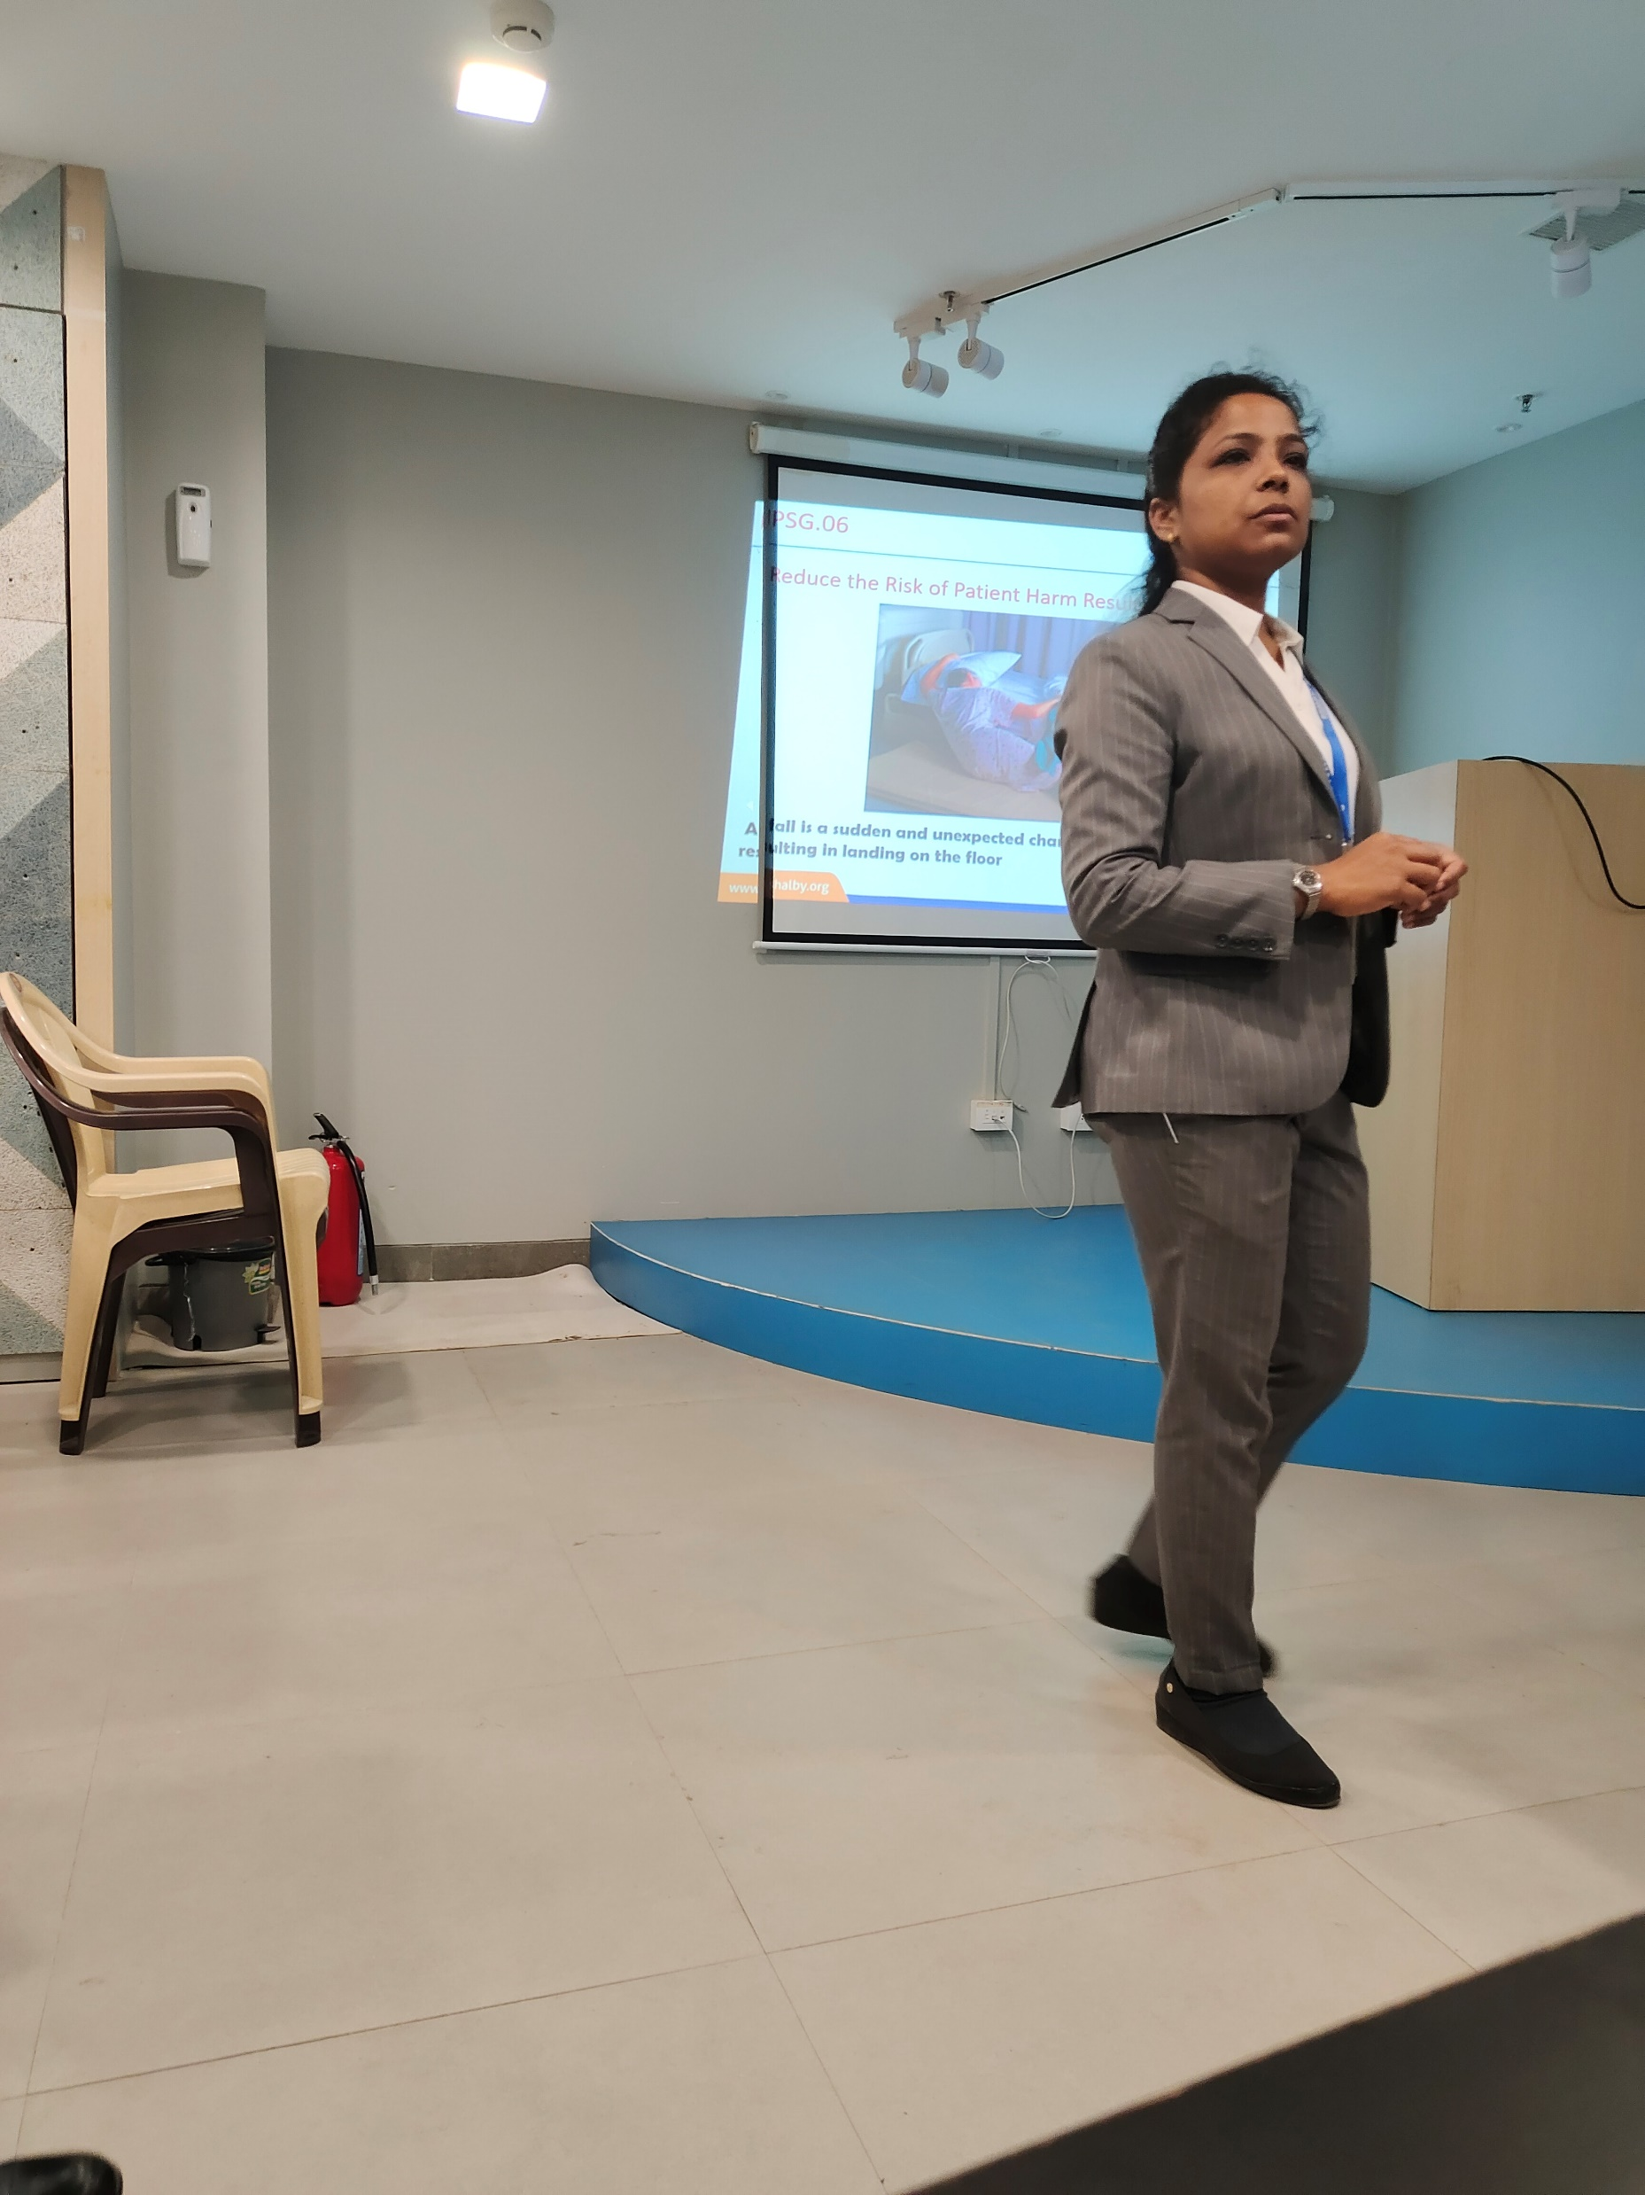
PICTORIAL JOURNEY

Slide 18
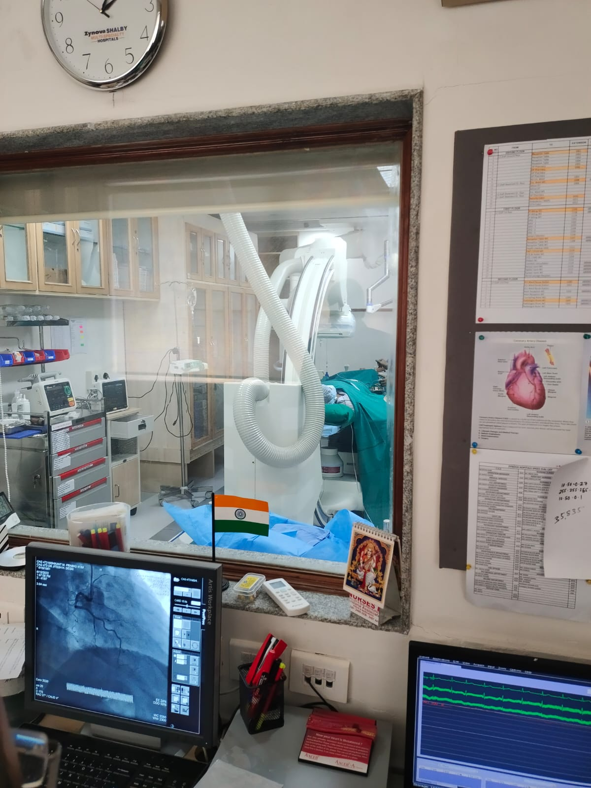
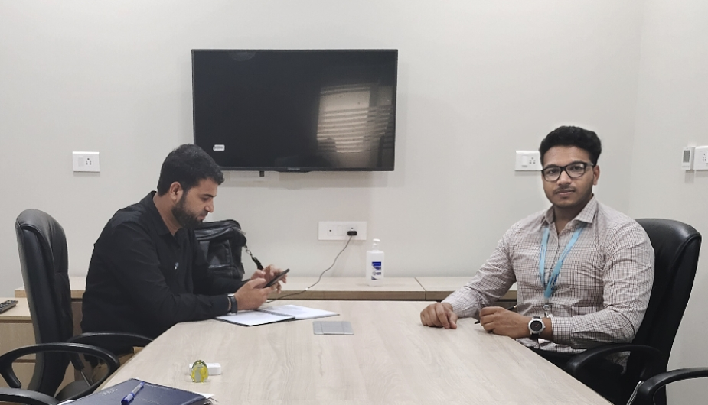

Slide 19
