Slide 1
TO IMPROVE REVENUE OF PHARMACY, RADIOLOGY, PATHOLOGY & PATIENT SATISFACTION Organisation: FORTIS HOSPITAL ANANDAPUR, KOLKATA
Name: Sristi Biswas
Faculty Mentor: Dr. Divya Agarwal

Slide 2
Screenshot of Approval

Slide 3
Introduction
It is believed that strengthening the relationship between healthcare providers and their patients will lead to earlier detection of disease, better patient compliance, reduction cost and improved clinical outcomes among other benefits. In order to abide certain measures can be taken like making sure that the practice looks and feel more engaging. Honouring patients with respect and attention.

Slide 4
Objectives of Your Study
General Objective
To identify the root causes of problems that reduce revenue generation of a medical sector within the context of Fortis hospital.
Specific Objectives
To recommend some beneficial strategies that can help to improve the conversion range of different medical sectors within the context of Fortis hospital.
To investigate the patients' pain points that are reducing revenue generation possibilities for the pharmacy, pathology, and radiology department of Fortis hospital.

Slide 5
Methodology (1/1)
Area of Study: Fortis Hospital, Anandapur, Kolkata
Duration: 2 months
Study Design: Quantitative Study
Specialized Department: Pharmacy, Radiology and Pathology
Study Tool: MS Word and MS Excel
Sources of Data: Primary Observations, Annexures

Slide 6
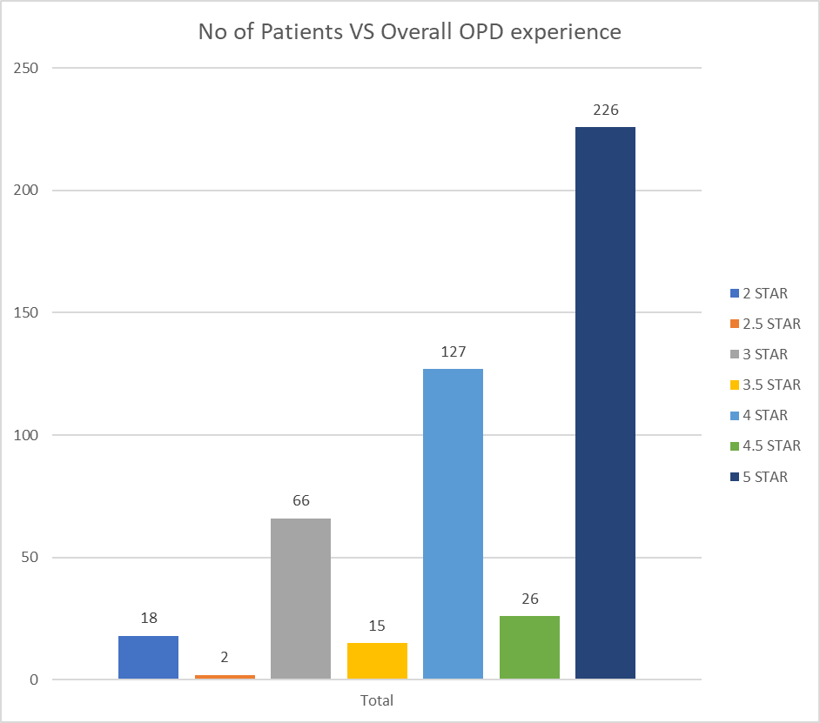
Results (1/2)
Based on the above graph, it has been observed that out of 480 patients, 47.08% of patients gave a rating of 5-star experiences.
On the other hand, 31.88% rated the experience between 4 stars and 5 stars.
Apart from that, it has been also observed that out of 480 patients, 21.04% of patients gave a rating of 2 stars specifying

Slide 7
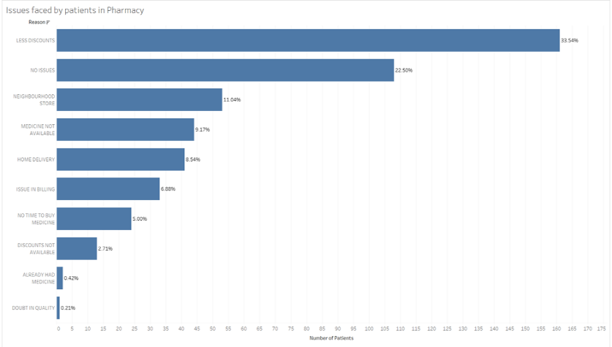
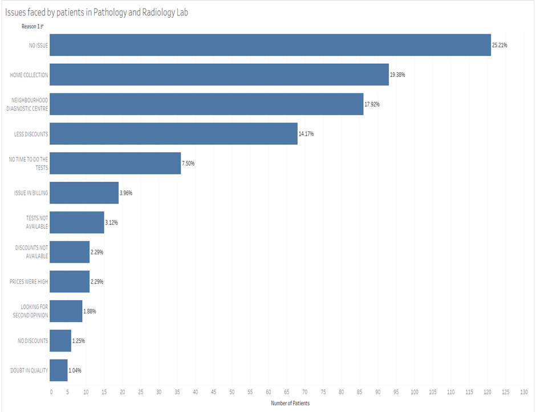
Results (2/2)
In this scenario, it has been observed that out of 480 patients, almost 33.54% have complained regarding the issue of getting fewer discounts.
On the other hand, out of 480 patients, it has been observed that 9.17% complained regarding the unavailability of medicine.
Considering this fact, by assessing the opinions of Barlas (19 p73), it has been found, the prospect of pharmacy and proper discount is considered as a counter rebate and it has created fireworks.

Slide 8
Discussion (1/2)
Gupta (21 p28) asserted that knowing the competitive aspects and payment rates in the healthcare industry the rationing process is essential.
Bokam (42 p398-401) emphasized that World Health Organization has declared that hospitals need to develop their pharmacy department
Figliozzi (43 p102760) commented that after the COVID-19 context the online delivery system has increased in every sector.

Slide 9
Limitations of Study
In the context of the limitation, in the initial stage, patients were not ready to answer the survey questions.
Moreover, I found that patients thought their names would be disclosed after the survey.
In this scenario, I assured them that their terms would never be disclosed in front of the board and at my university, even after completing the survey.

Slide 10
Conclusion
After conducting the survey and analyzing the problems certain measures can be taken for increasing the revenue and enhancing the patient journey. Few points to look are :-
Prioritizing care coordination and patient engagement (associated with satisfaction and outcomes).
Understanding the effects of new care delivery models on patients experiences outcomes.
Developing Robust measurement approaches that provide timely and actionable information to facilitate organizational change.

Slide 11
References (Only Vancouver Style)
Salminen J, Jansen BJ, An J, Kwak H, Jung SG. Automatic persona generation for online content creators: Conceptual rationale and a research agenda. Personas-User focused design. 2019:135-60.
Bharsakade RS, Acharya P, Ganapathy L, Tiwari MK. A lean approach to healthcare management using multi criteria decision making. Opsearch. 2021 Sep;58(3):610-35.
Baashar Y, Alhussian H, Patel A, Alkawsi G, Alzahrani AI, Alfarraj O, Hayder G. Customer relationship management systems (CRMS) in the healthcare environment: A systematic literature review. Computer Standards & Interfaces. 2020 Aug 1;71:103442.
Heath J, Williamson H, Williams L, Harcourt D. “It's just more personal”: Using multiple methods of qualitative data collection to facilitate participation in research focusing on sensitive subjects. Applied Nursing Research. 2018 Oct 1;43:30-5.
Sherif V. Evaluating preexisting qualitative research data for secondary analysis. InForum: qualitative social research 2018 May 1 (Vol. 19, No. 2, pp. 26-42). Freie Universität Berlin.
Sengupta M, Chakrabarti S, Mukhopadhyay I. Waiting time: The expectations and preferences of patients in a paediatric OPD. Journal of Health Management. 2019 Sep;21(3):427-42.
Naaz F, Mohammed I. A time motion study to evaluate the average waiting time in OPD with reference to patient satisfaction in the setting of state-level AYUSH Hospital (India). Medical Journal of Islamic World Academy of Sciences. 2019;27(3):71-6.

Slide 12
TO IMPROVE REVENUE OF PHARMACY, RADIOLOGY, PATHOLOGY & PATIENT SATISFACTION Name of the Researcher:
Introduction
1.1 Rationale
Revenue from pharmacy, radiology, and pathology can be increased accurately along with adequate customer satisfaction from different medical authorities.
The rationale can easily give a detailed analysis of a study along with delivering the issue of the research, and why the problem has been taken by the researcher and the significance of the study can also be included by the researcher in this part effectively (1).
Several times it has been seen that different medical sectors from other countries have not been able to gain their desired revenue generation from their pathology, radiology as well as pharmacy departments (2)
As proposed by Baashar (3 p 103442), different medical sectors from other countries try to gain maximum customer retention possibilities with the help of including full customer satisfaction possibilities from their service-giving activities accordingly.
As a result, the researcher of this paper has also included this hospital's values in maintaining patient centricity, teamwork, ownership, innovation and integrity.
For example, it can be stated that the audiences of this paper would get to know the pain points of the patients that are going to take services from Fortis hospital, which should be mitigated as soon as possible to achieve their desired revenue accordingly.
1.3 Specific Objectives
To identify the root causes of problems that reduce revenue generation of a medical sector within the context of Fortis hospital.
To investigate the patients' pain points that are reducing revenue generation possibilities for the pharmacy, pathology, and radiology department of Fortis hospital.
To recommend some beneficial strategies that can help to improve the conversion range of different medical sectors within the context of Fortis hospital.
1.2 Research Questions
What are the strategies to improve the revenue of the pharmacy, radiology and pathology departments?
What are the patients' pain points that can reduce revenue generation for the Fortis hospital?
What are the root causes of the problems that reduce revenue generation from the medical sector's pharmacy, radiology, and pathology departments?
Which strategies can be included as the solutions for improving the conversion range for different medical sectors within the context of Fortis hospital?
Methods
As proposed by Heath (4 p 30-35), with the help of performing a proper methodology or Data collection method within a research paper, the researcher can easily provide different strategies that have been included for gaining adequate information regarding the research topic to its audiences.
As suggested by Sherif (5 p 26-42), both the primary and secondary data collection methods can be used by a researcher to gain critical data within provided resources.
On the other hand, it has been proposed by Dannels (6 p 402-416) that researchers of different research topics use an accurate Research design which can help them to identify desired data collection sources as per the resources provided to them.
Contradictorily it has been mentioned by Opie (7 p 137), that researchers also use some beneficial research approaches in terms of gaining the help of selecting data from different sources, such as inductive and deductive research approaches.
On the other hand, it has been advised by Žukauskas (8 p 121) that research philosophy is another aspect of the Data collection method or a methodology chapter within a research paper that can help a researcher select required information from different sources per the resources provided for the study.
In the same way, it has been identified by Lê (9 p 308-36), researchers also use specific research methods for selecting and gathering data from required data collection sources, among which qualitative, quantitative and mixed-methods are the most popular.
Results
As proposed by Pasquetto (11 p 1-34), with the help of compiling all the data gathered from different sources, all the team members of a research group and individual researchers can easily store those data accurately and effectively.
Apart from that, it has been also witnessed from the findings of Sengupta (17 p427-42), that OPD is considered an ambulatory care centre that delivers the whole scope of services but fails to maintain a professional appearance searcher in the initial part of the paper.
According to the findings of Naaz (18 p71-6), it has been witnessed that the waiting time of the patients is recognised as the length of the time starting from the entry of the patient into the clinic to the patient leaving the area of OPD
Results
Considering this fact, by assessing the opinions of Barlas (19 p73), it has been found that in Indian healthcare sectors, the prospect of pharmacy and proper discount is considered as a counter rebate and it has created fireworks.
On the other hand, evaluating the viewpoints of Barlas (19 p73), it has been also observed that the highest-cost related to the medication non-adherence rates in the industrialized world has created a risk among the patients.
Gernant (20 p1130-7) articulated that the discount card vendor influences the community pharmacy to remain associated with their preferred networks and due to this reason, most pharmacists are giving fewer discounts to the patients and giving different discount cards.
On the other hand, it has been also elicited by Romano (21 p1876-81), that in the era of unprecedented partisan enmity, surprise billing only reduces patient satisfaction but also reduces the brand image of the healthcare centers.
Brannon (23 p28) opined that with the help of the community diagnostic center, crucial tests of the patients can be brought closer to the home.
Additionally, assessing the findings of Bouzid (24 pe000648), it has been also found that neighborhood diagnostic centers deliver a vast range of elective diagnostic facilities like quick scans and tests compared to acute facilities.
Takeshita (40 pe2024583) articulated that for patient-centric processes in healthcare organizations it is necessary to focus on the individualistic process of consultation.
Conclusion
Throughout the report, the researcher has included all the detailed knowledge regarding this Research report in terms of providing maximum outcomes to its audiences from this research paper.
It has been identified that with the help of efficiently performing a research report, the researcher can quickly gain a conclusion per the requirement of the research topic effectively.
In several cases, it has been seen that researchers do not tend to include maximum knowledge within a research paper as per different aspects of the objectives taken by the researcher in the initial part of the paper.
Hence, it can be suggested that with the help of describing and analysing all the aspects of different objectives taken by the researcher, gaining maximum outcomes and efficiency from the Research report can be possible for a researcher effectively.
Bibliography
Salminen J, Jansen BJ, An J, Kwak H, Jung SG. Automatic persona generation for online content creators: Conceptual rationale and a research agenda. Personas-User focused design. 2019:135-60.
Bharsakade RS, Acharya P, Ganapathy L, Tiwari MK. A lean approach to healthcare management using multi criteria decision making. Opsearch. 2021 Sep;58(3):610-35.
Baashar Y, Alhussian H, Patel A, Alkawsi G, Alzahrani AI, Alfarraj O, Hayder G. Customer relationship management systems (CRMS) in the healthcare environment: A systematic literature review. Computer Standards & Interfaces. 2020 Aug 1;71:103442.
Heath J, Williamson H, Williams L, Harcourt D. “It's just more personal”: Using multiple methods of qualitative data collection to facilitate participation in research focusing on sensitive subjects. Applied Nursing Research. 2018 Oct 1;43:30-5.
Sherif V. Evaluating preexisting qualitative research data for secondary analysis. InForum: qualitative social research 2018 May 1 (Vol. 19, No. 2, pp. 26-42). Freie Universität Berlin.
Sengupta M, Chakrabarti S, Mukhopadhyay I. Waiting time: The expectations and preferences of patients in a paediatric OPD. Journal of Health Management. 2019 Sep;21(3):427-42.

Slide 13
Thank You Any Questions??

Slide 14
Internship Experiences
What did you learn (skill/ topic)?
Overall self comments on Internship
I gained a deeper insight regarding the healthcare facilities of Fortis Hospital
Apart from that, in the context of skill, with the help of this research, I have enhanced my research skill as well as the critical thinking skill
Regarding the internship, I have thoroughly enjoyed my internship in Fortis Hospital this summer
Moreover, I have earned a valuable experience under my belt while assessing various departments of the hospital

Slide 15
Suggestions Given to Organization
In the same way, in terms of identifying the root causes of decreasing revenue generation of this hospital, several online medicine and pathology service providing startups are also taking advantage of customer satisfaction.
Some additional discounts provided by these home service delivery startups are also taking away the possibilities of achieving desired revenue generation.

Slide 16
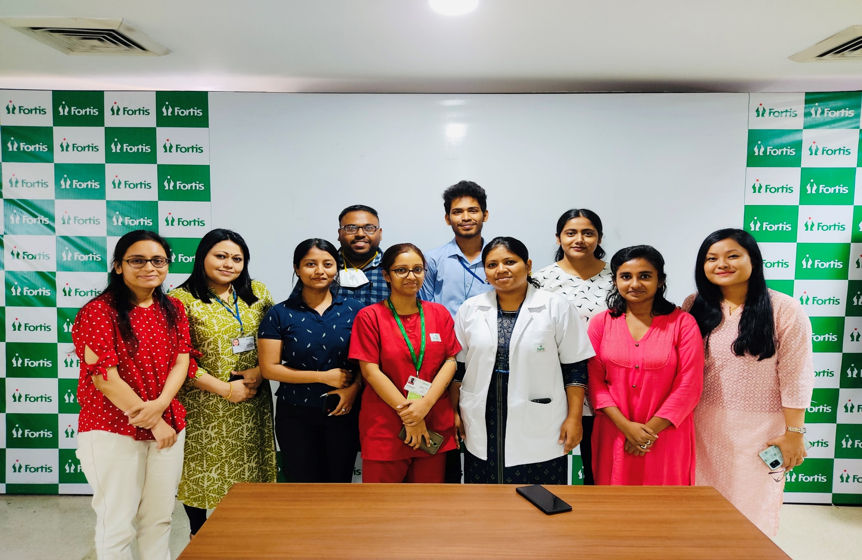
Pictorial Journey (1/2)

