Slide 1
An Exploratory study of Determinants of Intimate partner conflict and Gender Based Violence in Bhatti mines, Chhatarpur area of Delhi
Swadhapriya Das Chaudhuri
Faculty Mentor: Dr. Rohini Ruhil
International Institute Of Health Management Research (IIHMR), Delhi
Internship Organization: Population Services International (PSI)

Slide 2
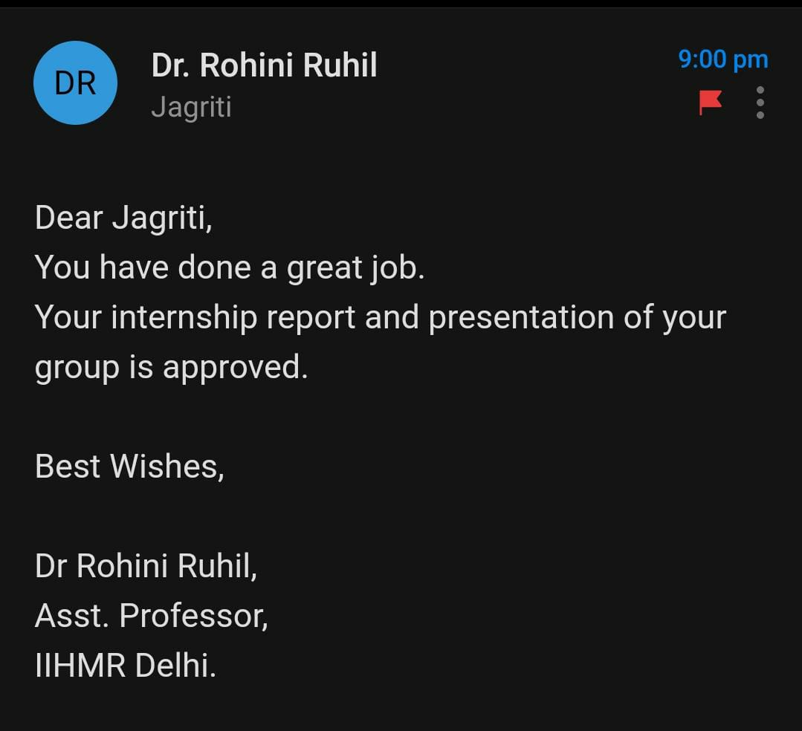
Screenshot of Approval

Slide 3
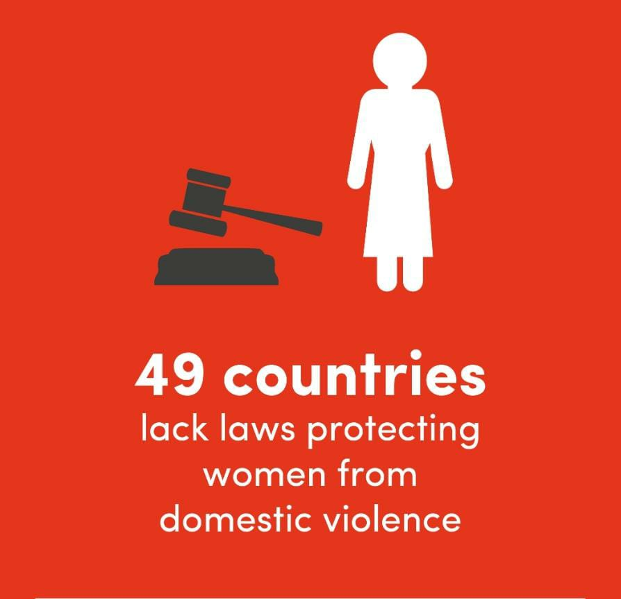
Introduction
Gender based violence (GBV) is the violation of human rights of women & major threat to public health. (1)
WHO - globally every one in three women experience some kind of sexual or/and physical violence in their lifetime.(1)
NFHS-5 data:
~30% of women in India exposed to spousal violence.
violence comparatively more in rural areas (31.6%) compared to urban areas (24.2%).
In Delhi, violence against women were recorded at 22.6%. (2)
Indian married woman - lower education, high number of children, belong to low wealth quintiles, and alcoholic partner are at heightened risk for Intimate Partner Violence (IPV) (3)

Slide 4
Introduction
GBV is highly prevalent, least reported human rights abuses.(4)
~42% men and 52% women justified beating by husband. (5)
Most common reasons for non-reporting:
embarrassment.
belief that violence was a normal part women’s life.(6)
National Commission of Women: Post lockdown complaints of violence against women doubled.(7)
GBV: serious physical, sexual, mental and reproductive health problems, including STDs and unplanned pregnancies.(8)

Slide 5
Aims and Objectives
Aim: To assess prevalence and determinants of gender-based violence including physical, emotional, and sexual violence in women aged 18-49 years in Bhatti mines, Chhatarpur area of Delhi.
Objectives:
To determine the existing status of gender-based violence including physical, emotional, and sexual violence.
To assess the determinants of gender-based violence namely age and age at marriage, disparity in education and incomes of the partners.
To analyse the correlation between deprivation and intimate partner interpersonal conflict.
To analyse the correlation between alcoholism and intimate partner interpersonal conflict.

Slide 6
Methodology
Study design: Cross sectional survey
Study duration: 2 months
Study population: Women aged between 18-49 years who were ever married and were willing to participate in the study in Bhatti mines, Chhatarpur area of Delhi.
Sample Size: sample size studied was 200

Slide 7
Methodology
Study tools:
The Conflict Tactics Scales
Screening tools for alcoholism
2021 Global Multidimensional Poverty Index (MPI) of UNDP
Sampling method:
Systematic randomized sampling
Every 20th house
Method of data collection:
Recorded in the excel sheet (Google form).

Slide 8
Data Analysis
Data analysed using IBM SPSS Version 22 for Windows.
Open-Epi software for Chi-square test.
p <0.05 was considered as statistically significant.

Slide 9
Results
Prevalence of Partner’s Alcoholism:
Prevalence of Deprivation:
Prevalence of GBV:
Prevalence Of Violence | n (%)
Any Violence | 101 (50.0%)
Physical Violence | 73 (36.1%)
Sexual Violence | 19 (9.4%)
Psychological violence | 101 (50.0%)
 | Yes n (%) | No n (%)
Partner’s Alcoholism | 63 (31.2%) | 139 (68.8%)
 | Yes n (%) | No n (%)
Deprivation | 53 (26.2%) | 149 (73.8%)

Slide 10
Results
Early morning alcoholism vs Any violence:
Partner’s Alcoholism vs Any violence:
 | Any Violence Present n (%) | Any Violence Absent n (%)
Early morning alcoholism | 31 (100%) | 0 (0%)
No Early morning alcoholism | 27 (84.4%) | 5 (15.6%)
p-value = 0.028
 | Any Violence Present n (%) | Any Violence Absent n (%)
Alcoholic | 58 (92%) | 5 (7.9%)
Non-alcoholic | 43 (30.9%) | 96 (69.1%)
p-value = 0.0000001

Slide 11
Results
Deprivation Vs Physical violence:
Husband’s education Vs Physical Violence:
 | Physical Violence Present n (%) | Physical Violence Absent n (%)
Uneducated | 27 (45.0%) | 33 (55.0%)
Primary | 17 (48.6%) | 18 (51.4%)
Matriculation | 24 (29.6%) | 57 (70.4%)
Graduation | 5 (19.2%) | 21 (80.8%)
p-value = 0.028
 | Physical Violence Present n (%) | Physical Violence Absent n (%)
Deprivation | 28 (53%) | 25 (47.1%)
No Deprivation | 45 (30.2%) | 104 (69.7%)
p-value = 0.004

Slide 12
Discussion
Socio-demographic: (age and age at marriage)
No statistically significant correlation.
Women married as minors had more odds of experiencing GBV compared to the women married as adults (9)
Education:
Years of schooling of females showed no correlation.
Statistically significance between husband’s education and physical violence.
Earlier studies shows couple with higher education had low level of less severe and severe violence (10)
Working status:
Violence greater where the husband worked outside home for less than 4 days compared the ones who worked for >4 days per day.
Husband’s employment stability is also crucial at determining the risk of domestic violence (11)

Slide 13
Discussion
Deprivation:
Statistically significant correlation found with physical violence,
Physical violence in deprived households = 53% vs Physical violence in non - deprived households = 30%
Justification:
76% out of 73 women facing physical violence justified being beaten up.
Alcoholism:
Highly statistical significance found between partner’s alcoholism and gender-based violence
All the respondents whose partners consumed alcohol early morning faced physical violence.
Alcohol dependency highly increased the prevalence of violence and strongly associated GBV.
Compared to women married to non drinkers,women married to drinkers are twice likely to experience physical and sexual abuse (12)

Slide 14
Limitations of Study
Gender-based violence is a sensitive topic.
Hesitation of few women to report issues of GBV.
Unstable jobs so most of the men stay home for multiple days.
Comparison of GBV with education of women was not possible.

Slide 15
Conclusion
Sustainable Development Goal (SDG) 5 - important to work on the root cause factors that effects or cause gender inequality including gender-based violence.
Understanding and working on various factors - livelihood, standard of living, health, education, alcoholism, deprivation, etc.
Change in social norms and patriarchal mind-set of individuals.
Norm-focused interventions for married girls as well as for child marriage prevention.

Slide 16
References
Violence against women [Internet]. [cited 2022 Feb 21]. Available from: https://www.who.int/westernpacific/health-topics/violence-against-women.html
2. National Family Health Survey (NFHS-5) [Internet]. [cited 2022 Feb 21]. Available from: http://rchiips.org/nfhs/factsheet_NFHS-5.shtml
Dasgupta A, Silverman J, Saggurti N, Ghule M, Donta B, Battala M, et al. Understanding Men’s Elevated Alcohol Use, Gender Equity Ideologies, and Intimate Partner Violence Among Married Couples in Rural India. Am J Mens Health. 2018 Jul;12(4):1084–93.
How Domestic Abuse Has Risen Worldwide Since Coronavirus - The New York Times [Internet]. [cited 2022 Jun 22]. Available from: https://www.nytimes.com/2020/04/06/world/coronavirus-domestic-violence.html
Roy AS, Sen N, Bagchi SS. Gender-based Violence in India in Covid-19 Lockdown. :15.
Palermo T, Bleck J, Peterman A. Tip of the Iceberg: Reporting and Gender-Based Violence in Developing Countries. Am J Epidemiol. 2014 Mar 1;179(5):602–12.

Slide 17
References
7. COVID-19 and violence against women [Internet]. [cited 2022 Jun 22]. Available from: https://www.who.int/publications-detail-redirect/WHO-SRH-20.04
8. Sardinha L, Maheu-Giroux M, Stöckl H, Meyer SR, García-Moreno C. Global, regional, and national prevalence estimates of physical or sexual, or both, intimate partner violence against women in 2018. Lancet Lond Engl. 2022 Feb 26;399(10327):803–13.
9.Fonseka RW, McDougal L, Raj A, Reed E, Lundgren R, Urada L, et al. A mediation analysis of the role of girl child marriage in the relationship between proximity to conflict and past-year intimate partner violence in post-conflict Sri Lanka. Confl Health. 2022 Feb 14;16:5.
10.Rapp D, Zoch B, Khan MMH, Pollmann T, Krämer A. Association between gap in spousal education and domestic violence in India and Bangladesh. BMC Public Health. 2012 Dec;12(1):467.
11.Krishnan S, Rocca CH, Hubbard AE, Subbiah K, Edmeades J, Padian NS. Do changes in spousal employment status lead to domestic violence? Insights from a prospective study in Bangalore, India. Soc Sci Med 1982. 2010 Jan;70(1):136–43.
12.Kiss L, Schraiber LB, Heise L, Zimmerman C, Gouveia N, Watts C. Gender-based violence and socioeconomic inequalities: Does living in more deprived neighbourhoods increase women’s risk of intimate partner violence? Soc Sci Med. 2012 Apr 1;74(8):1172–9.

Slide 19
Thank You Any Questions

Slide 20
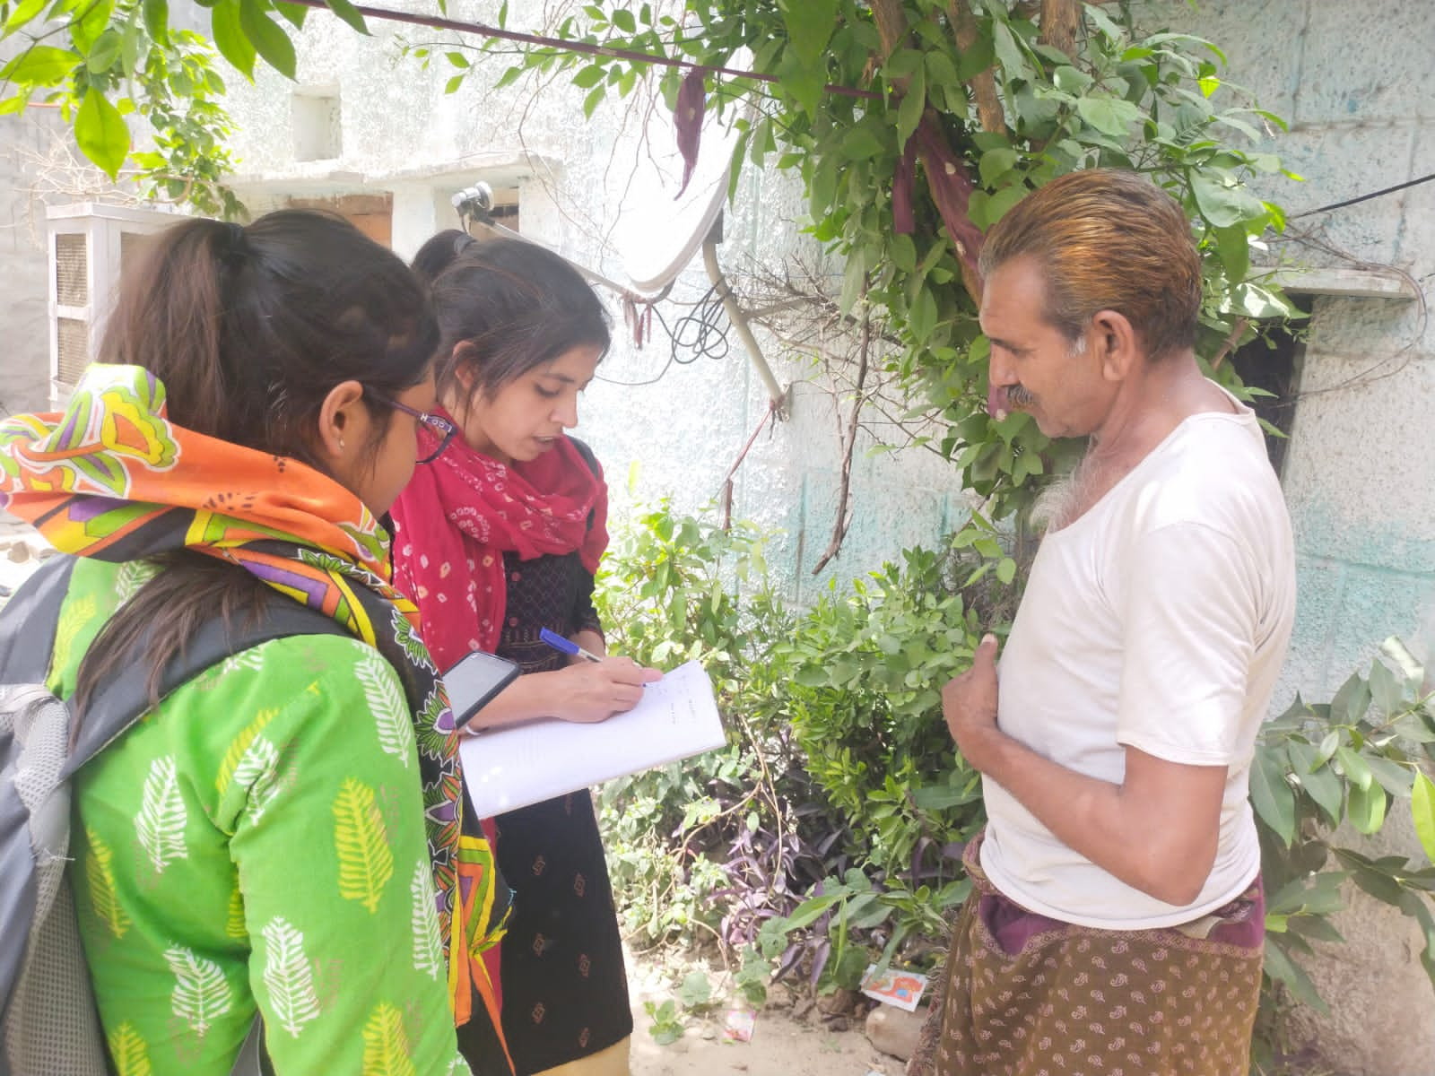
Internship Experiences
Learnings:
General:
Conduct primary research
Household marking
Case Study taking and writing
Digitizing in Geographic Information System(GIS)
Organising programmes for community.
Conducting community meetings
Project learnings:
De constructed the idea of gender during training
Conduct surveys of sensitive topic
Factors leading to GBV
Effect of GBV on women
Analysis of collected data in SPSS
Overall comments on internship:
Implementation of theoretical knowledge.
In-field experience gained.
Enhancement of inter-personal communication skills.
Engagement with the community.
Team work.

Slide 21
Suggestions given to Organization
Sensitizing adolescents and women about gender based violence.
Helping the men who wants to cut off alcohol and tobacco (free rehab if possible).
Educating women about Indian laws against domestic violence.
Introducing women to local NGOs who can help them in building up some skills so that they can earn from home.
Making women groups for addressing the issue of gender based violence.
Improving livelihood (future scope of tourism and metro extension).

Slide 22
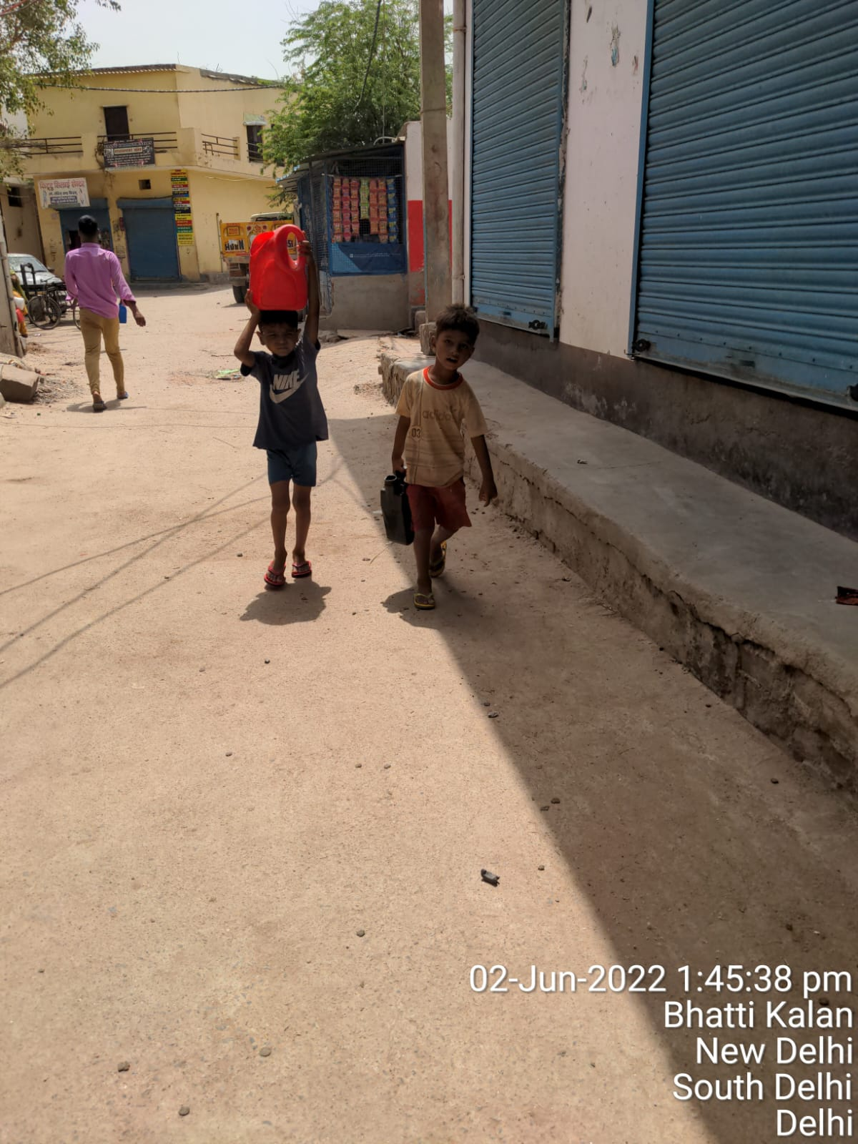
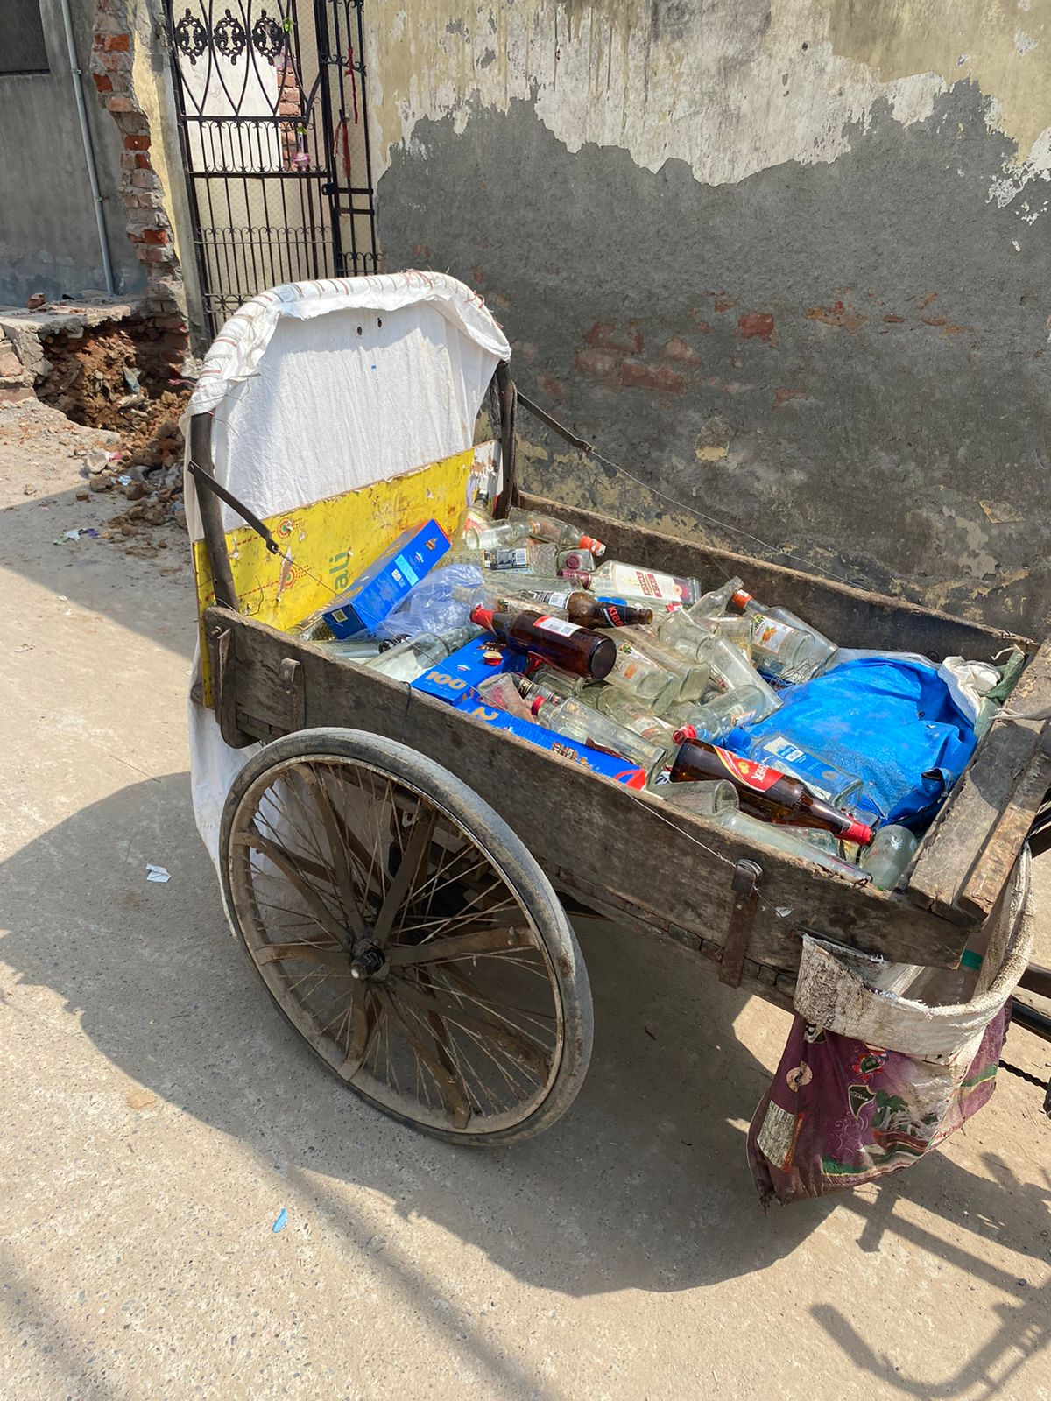

Slide 23
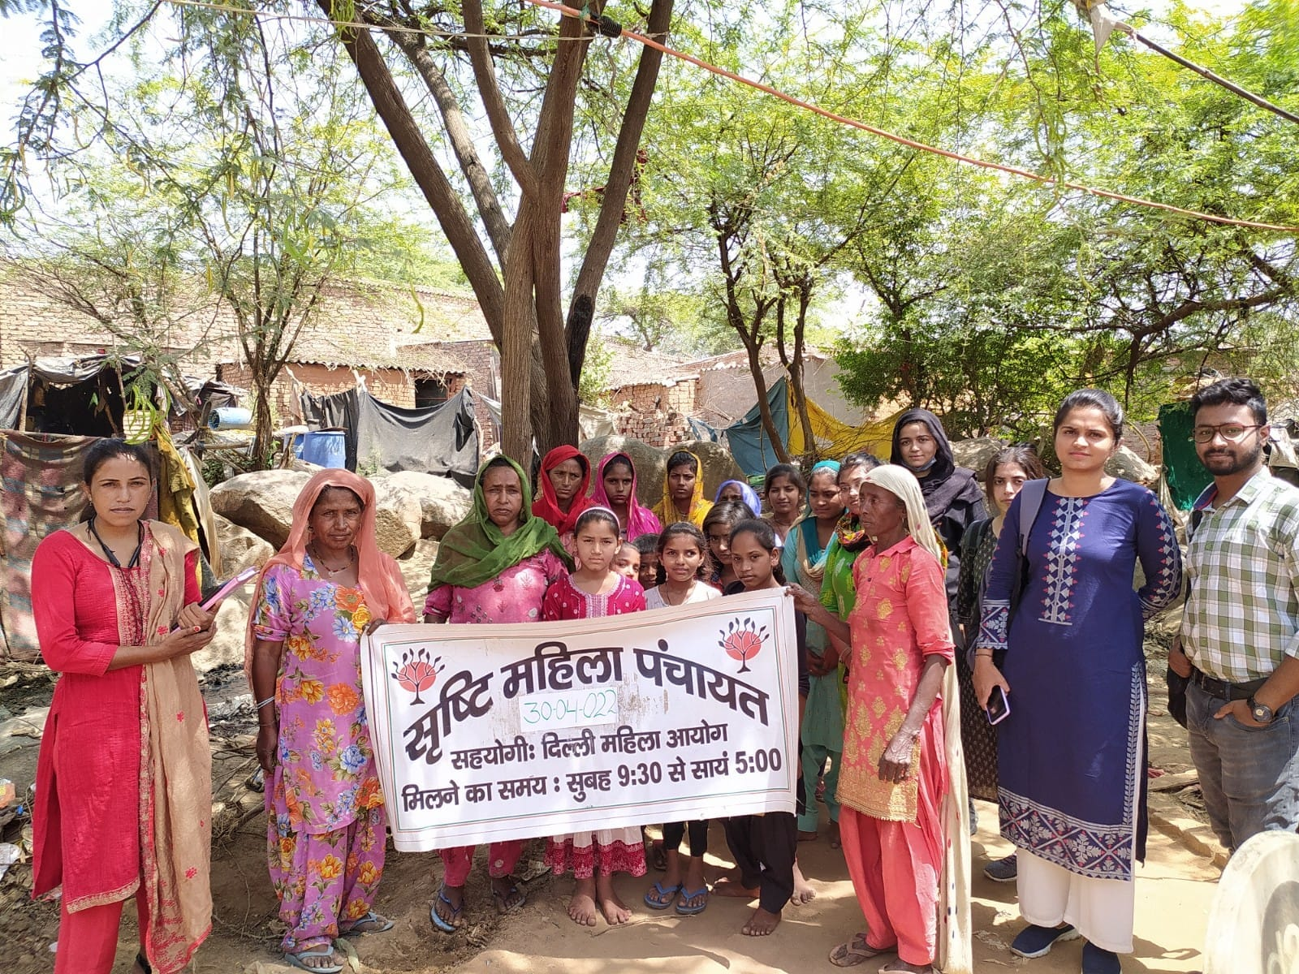
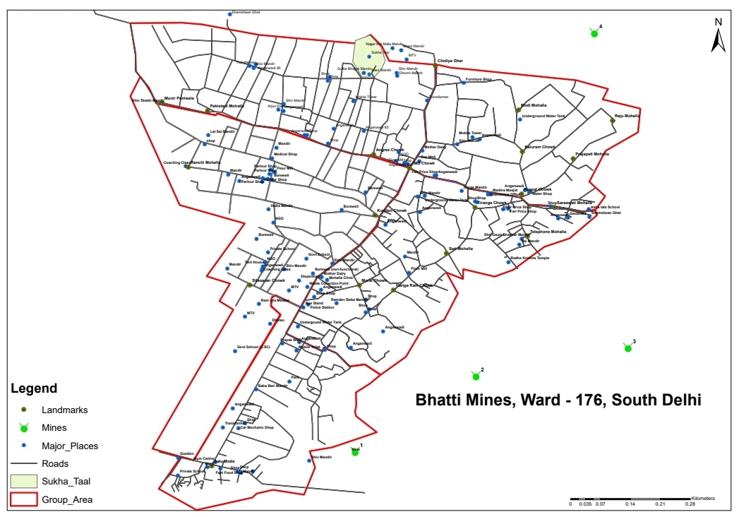
GIS mapping of Bhatti Mines

