Slide 1
Hospital Satisfaction Survey
Manipal Hospital Kolkata
IIHMR DELHI
Faculty Mentor- Ms. Divya Aggarwal

Slide 2
Certificate of Approval

Slide 3
Introduction
Mission Statement
-To enhance Growth , Differentiation and People and to serve patients with smile
-’’Growth’’, to augment patient volumes in existing and new locations through
current and new engines of growth.
-’’Differentiation’’ , by innovation in delivering clinical excellence and enhancing
patient experience.
-’’People’’ , constantly endeavour to upload and improve the organization values

Slide 4
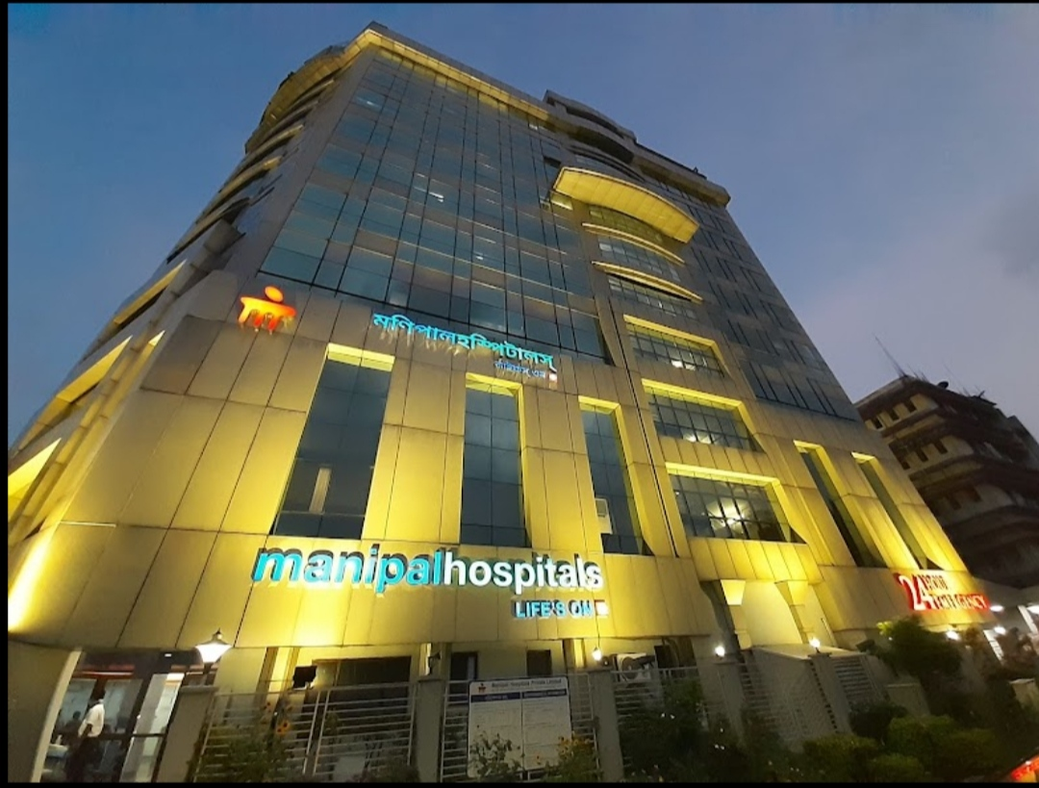
Introduction
A patient’s expectation from a hospital keeps on escalating and this is the reason why it needs to be managed properly in order to improve outcomes and decrease liability
Being empathetic to a patient can enhance their satisfaction level.
On the other hand , the hospital providing the patients their desired medical aid expects the patients to be cooperative, understand the hospital’s policies, rules and regulations and the code of conduct of the hospital so that they can provide value based care

Slide 5
Objectives of the Study
To analyse the contentment of the patients about the behaviour of the hospital staff, and the areas that needs improvement.
To analyse the continuity of care given to the patients
To analyse the code of conduct of the hospital staff
Although the hospital should solely intend to provide medical services to the patients but the hospital also have some basic expectations from the patient side in order to conduct a medical procedure smoothly and in a coordinated manner. This study intends to evaluate these basic suppositions of the hospital staff.

Slide 6
Methodology
Study Design- A cross – sectional study was conducted by an online survey consisting of semi - structured questionnaire using google forms.
Study Period- The study was conducted for a period 3 weeks.
Study Area- The OPD, IPD areas and also the administration departments of Manipal Hospital, Kolkata
Sample size- Sample size was 66 for both the categories respectively.
Study tool- Semi structured questionnaire was created using Google forms to collect data on the satisfaction quotient of the patients and hospital staffs.
Sampling method- Convenience sampling was used for the study.
Method of data collection- Two Google forms were used which included patient’s feedback form and hospital staff’s feedback form which were circulated among eligible participants. The responses were further evaluated by using MS Excel.

Slide 7
Methodology
Inclusion criteria:
The responses for patient feedback were taken from the patients visiting OPD during office hours and the patients in IPD who were in general ward who were conscious enough to give their feedback.
The responses for hospital staff feedback was collected from all the Departmental Heads, Supervisors and Senior Officers.
Exclusion criteria:
Patients of ICU, HDU and those patients of IPD who were not conscious enough to respond.
All the outsourcing staff of the hospital.

Slide 8
Results
Patient feedback:
1. Behaviour and cooperation quotient of the staff of the hospital
2. Agreeability regarding equal treatment of patients irrespective of their age, gender, race, culture, religion
3. Patient response regarding the empathy level of hospital staff

Slide 9
Results
4. Frequency of receiving a denial of a particular patient related service from the hospital's side
5. Suggested areas of improvement by the patients
-Punctuality of the OPD consultants , coordination of different departments, long OPD timings
Hospital Staff Feedback
Response regarding the patient/patient companion following the code of conduct of the hospital in the hospital premises

Slide 10
Results
2. Department mostly facing the above stated problem
3. Response regarding the unwillingness from the patient's side to agree to the amount of bill to be deposited against the medical procedures carried out
4. Frequency of creating chaos by the patient/patient companion regarding insurance policies and their proceedings

Slide 11
Discussion
The study was conducted amongst two groups: patients and hospital staff
Patient Feedback
Most of the patients agreed that the hospital staff were well behaved and supportive
The patients stated that the hospital staff were empathetic enough to understand the stress and panic that they undergo
Most of the patients stated that they got a convincing reply from the hospital management when inquired about any clinical/non clinical procedure
As patients come to Manipal Hospital from different backgrounds, countries and religious groups so the patients agreed that they were treated equally irrespective of their cultural differences
Lastly the patients mentioned few areas of improvement like the punctuality of the doctors, coordination of different departments and improving the infrastructure

Slide 12
Discussion
Hospital Staff Feedback
The hospital staff reported the late arrival of patients for doctor/clinical appointments, due to that it sometimes becomes difficult to manage
Most of the hospital staff mentioned that the patients do not maintain the decorum of the hospital; they play music loudly in their mobile phones, speak loudly and also refuses to maintain the queue at times
The IPD staff stated that the number of visitors per patient were too many that led to disruption in treatment schedule at times
The hospital employees also mentioned the disagreeability from the patients side in accordance with the amount of bill outstanding
The hospital staff reported that patients created a chaos and refused to understand the insurance policies during the discharge procedure which lead to an unwanted situation and also disturbed other patients in the waiting area

Slide 13
Limitations of the Study
Feedback from all employees of the hospital could not be taken as they work in different shifts, some are outsourcing staff
Feedback was taken mostly from the OPD patients in the patient feedback form
All IPD patients could not be included because some were not conscious enough to respond, some were in ICU and HDU
Some patients could not lend time to fill the entire form and left halfway so those responses were filtered out
Few data had to be kept confidential as it was against the policies of the hospital

Slide 14
Conclusion
The study comes to a conclusion with the following :
The patients are satisfied with the behaviour and care given by the hospital staff
The patient/patient companion is convinced enough that the hospital staff are empathetic and are able to handle situations in both stress and emergency
Although the hospital staff did not have any disregards for the patients violating the code of conduct of the hospital, bringing in too many visitors in IPD or creating chaos regarding insurance policies but they had a request that if the patient side could maintain the following then they could provide value based care and in a more coordinated manner

Slide 15
References
Laurent, B., Patrice, F., Elisabeth D., Georges, W. & Jose, L.(2006).Perception and use of the results of patient satisfaction surveys by care providers in a French teaching hospital, International Journal for Quality in Health Care 2006; Vol:18, NO. 5, pp. 359–364. [PubMed]
Oyvind AB, Ingeborg S. S., &Hilde, H., I. (2011). Overall patient satisfaction with hospitals: effects of patient-reported experiences and fulfillment of expectations, British Medical Journal Quality Safety, [online], available at: http://qualitysafety.bmj.com
Kui-Son Choi, Hanjoon Lee, Chankon Kim, Sunhee Lee, (2005),"The service quality dimensions and patient satisfaction relationships in South Korea: comparisons across gender, age and types of service", Journal of Services Marketing, Vol. 19, NO. 3pp. 140 – 149[online],available athttp//dx..org/ 10.1108/08876040510596812

Slide 16
Hospital Satisfaction Survey
By
Tanurima Mondal
International Institute of Health Management Research, New Delhi
Hospital Satisfaction Survey By Tanurima Mondal International Institute of Health Management Research, New Delhi
Introduction
A patient’s expectation from a hospital keeps on escalating and this is the reason why it needs to be managed properly in order to improve outcomes and decrease liability
Being empathetic to a patient can enhance their satisfaction level.
On the other hand , the hospital providing the patients their desired medical aid expects the patients to be cooperative, understand the hospital’s policies, rules and regulations and the code of conduct of the hospital so that they can provide value based care
Objectives of the Study
To analyse the contentment of the patients , behaviour of the staff and areas to be improved.
To analyse the continuity of care given to the patients
To analyse the code of conduct of the hospital staff
Although the hospital should solely intend to provide medical services to the patients but the hospital also have some basic expectations from the patient side in order to conduct a medical procedure smoothly and in a coordinated manner. This study intends to evaluate these basic suppositions of the hospital staff
Methods
Study Design- A cross – sectional study was conducted by an online survey consisting of semi - structured questionnaire using google forms
Study Period- The study was conducted for 3 weeks
Study Area- Mostly the OPD, IPD areas and also the administration departments of Manipal Hospital Kolkata
Sample size- Sample size was taken 66 after segregating all the responses which were answered properly and was insightful.
Study tool- Semi structured questionnaire , created on Google forms was used to collect data on satisfaction quotient of the patient and the hospital staff.
Sampling method- Convenience sampling was used for the study
Method of data collection- The two Google forms, one for patient feedback and the other for hospital staff feedback were circulated among eligible participants and their responses were evaluated
Inclusion criteria- The responses for patient feedback were taken from the patients visiting OPD during office hours and the patients in IPD who were conscious enough to give their feedback. The responses for hospital staff feedback was collected from all theDepartmental Heads, Supervisors and Senior Officers
Exclusion criteria- Patients of ICU, HDU and those patients of IPD who were not conscious enough to respond. All the outsourcing staff .
Results
Satisfaction quotient regarding behaviour and cooperation of the staff of the hospital
Equal treatment of all patients irrespective of their age, gender, race, culture, religion
Response regarding the patient/patient companion following the code of conduct of the hospital
Unwillingness from the patient's side to agree to the amount of bill to be deposited against the medical procedures carried out
Conclusion
The patients are satisfied with the services rendered by the hospital
Although the hospital staff did not have any disregards for the patients violating the code of conduct of the hospital,but they had a request that if the patient side could maintain the following then they could provide value based care and in a more coordinated manner.
Recommendations
Providing the nearest possible timing of doctor’s appointment to the patients according to their order of scheduling
Develop rapport, fear often gets in the way of a patient’s ability to retain key clinical information, including self-care instructions
Address each patient individually

Slide 17
Thank You

Slide 18
Internship Experiences
The first area of learning was the Human Resources Department
Secondly it was an immense adventure and learning being a part of the Internal Audit of the Hospital
Then, in the remaining part of the internship tenure I was sent to different departments of the hospital as a part of the Operations Team to learn and acquire knowledge about the functioning of the different departments in coordination in the hospital from management perspective
Overall it has been a great learning and exposure, groomed myself to be a future manager and learnt about the corporate environment, smoothly negotiating over a subject without offending other colleagues and gelling up with the culture of the organization and it’s employees

Slide 19
Suggestions given to the Organization
The punctuality of the Consultants in the OPD Department should be focused on because too much delaying results in patient refusal and creates a disesteem in the name of the Hospital
Steps should be taken for conduction of the few medical procedures which are sent to outsource to be conducted in the hospital itself
Apart from training the employees on their code of conduct , basic training should also be provided for patient retention and revenue generation
Managing and sourcing the staffs effectively so that the area of more staff requirement is focussed

Slide 20
Pictorial Journey
Documentation of the Internal Audit Report on process

Slide 21
Pictorial Journey
Registering my last attendance as an Intern at Manipal Hospital Kolkata

