Slide 1
Distribution and determinants of Family Planning Method Discontinuation/Switch/Continuation among young low parity couples in Bihar. CARE ,BIHAR
A report By- Danyal Yawar
Guided by- Dr . Sidharth Sekhar Mishra.
IIHMR Delhi.

Slide 2
Introduction
According to the (WHO), family planning is defined as –
“the ability of individuals and couples to anticipate and attain their desired number of children and the spacing and timing of their births. It is achieved through use of contraceptive methods and the treatment of involuntary infertility”.
Methods of family planning methods are mainly of two types Traditional and Modern method
Traditional method are those types of method which people using from so many years people of sixteenth century were using family planning, Traditional method of family planning. It includes Periodic abstinence, Coitus interruptus, Lactational amenorrhea
Modern method Hormonal Contraception, Barrier method, Permanent Contraceptive method, Emergency Contraception.

Slide 3
Objectives of our Study
To explore the current situation of Method switch continuation and discontinuation in family planning.
To explore the reason why a couple changing the methods of Family planning why they continuing the same method or why they discontinued the methods.

Slide 4
Methodology
Antara Client Cohort – an Exploration of user Perspective Tracking (ACCEPT study).
The study cohort was interviewed telephonically
first: mid-September to mid-October 2020 (N=834)
second: December 2020 (N=570)
third: mid-April 2021 (N=444)
A fourth round of follow up interviews were conducted in person using a mix-method approach
Conducted during mid-January 2022
Quantitative interviews: N=712 (15% Lost to follow up)
Qualitative in-depth interviews: N=61*

Slide 5
Results
“Antara Client Cohort – an Exploration of user Perspective Tracking (ACCEPT study)” the finding was Switching to method other than Antara (Modern or Traditional)
Method Switch after 1 dose to Limiting method | 712 | 57% | 43% | 00 | 00
Method Switch after 2 doses to Limiting method | 712 | 61% | 29% | 10% | 00
Method Switch after 3 doses to Limiting method | 712 | 67% | 17% | 16% | 00

Slide 6
Antra discontinuation and method switch after received only one dose during June 19 - January 20.
(n =712) in selected sample 57% opted method switching and 43% did not opted any method in total.
After the study we found that couple who got first dose of Antra 57% switched method due to side effects they opted condoms and other traditional method. And remaining 43% were continued with Antra.
The side effects of Antra was
* Sharp stomach pain spreading to back or shoulder blade
*Yellowing of skin or eyes
* Weakness

Slide 7
Antra discontinuation and method switch after received two dose during December 2020.
(n=712) in selected sample 61% opted method switching and 29% discontinued family planning and remain were still using this method.
After the second dose 61% switched method due to side effects they opted condoms and other traditional method. And remaining 29% discontinued with this method and remaining 10% were still using this method.
Side effect were after second dose of Antra was
* Loss of Appetite
* Sore Throat
* Chest Pain

Slide 8
Antra discontinuation and method switch after received third dose during mid-April 2021.
(n=712) in selected Sample 67 % opted for method switch and 17% discontinued and remaining were still using this method.
After the second dose 67% switched method due to side effects they opted condoms and other traditional method. And remaining 17% discontinued with this method and remaining were still using this method.
The side effects of Antra was
* Continue Stomach pain
* Back pain
* Headache

Slide 9
Thank You

Slide 10
Internship Experiences
What did you learn (skill/ topic)?
Overall self comments on Internship
Visited VHSND and Meet AWW ASHA and ANM and get information about their work role.
Learnt the Basics of & worked on MS-word/Power-point and Excel.
Learnt to do thorough Literature review, developed qualitative tool guide, code dictionary, thematic framework and analysis.
Learnt a lot about basics of Public health.
Got opportunity to get exposed to variety of software and skills required in the field of public health.
Learnt Utilisation of theoretical knowledge into practical life.

Slide 11
Suggestions Given to Organization
Best organisation to work and grow .
Work culture, ethics are the best.
Best place to learn , hub of knowledge.

Slide 12
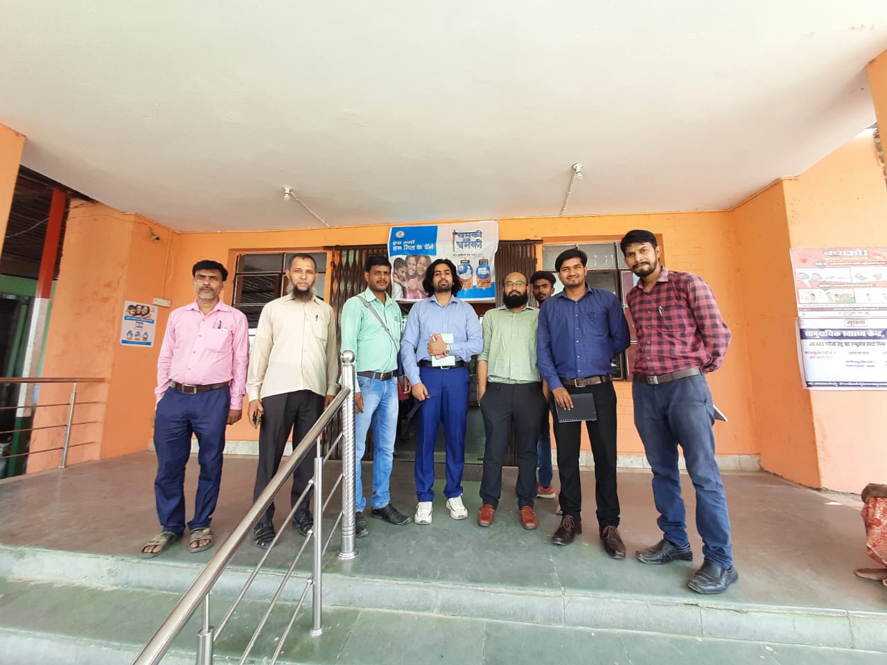
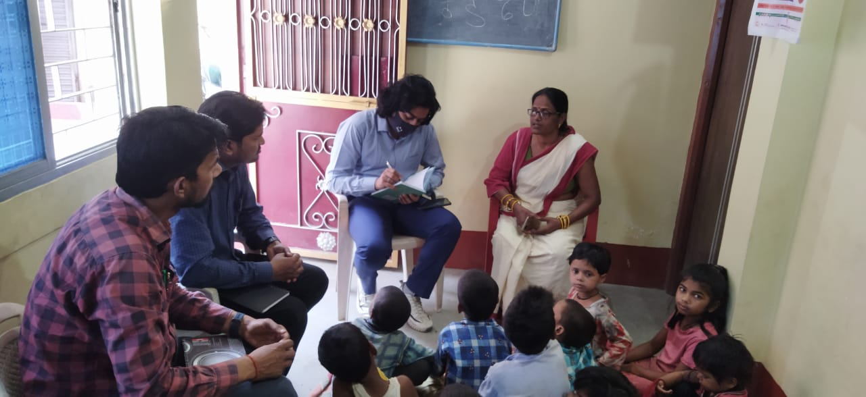
Some Pictures of Internship

