Slide 1
A Descriptive Study to assess the level of compliance of Procedural safety checklist and WHO surgical safety checklist to ensure safe surgery and patient safety in Max Healthcare, Saket for a period of 2 months.
PRESENTED BY:-
DR. MRINAL SHARMA
NITESH KUMARI
KOMAL
NIKITA GAUR
MENTOR:
MS. DIVYA AGARWAL
Associate Dean
IIHMR DELHI

Slide 2
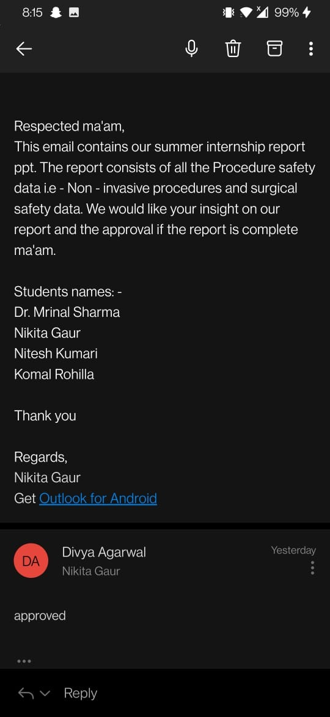
APPROVAL

Slide 3
INTRODUCTION
Surgical care has been an essential component of health care worldwide for over a century.
Surgery is often the only therapy that can alleviate disabilities and reduce the risk of death from common conditions.
While surgical procedures are intended to save lives, unsafe surgical care can cause substantial harm.
Work has been initiated by the global implementation of the WHO Surgical Safety Checklist, a 19-item tool created by WHO in association with the Harvard School of Public Health
Surgical and invasive procedures include all procedures involving an incision or puncture, including, but not limited to, open surgical procedures, percutaneous aspiration, selected injections, biopsy, percutaneous cardiac and vascular diagnostic or interventional procedures, laparoscopies, and endoscopies.
The essential elements of the Universal Protocol are
• the preoperative verification process;
• marking the surgical site; and
• the time-out that is held immediately before the start of the procedure.

Slide 4
OBJECTIVES
To assess the level of compliance of all the elements of Procedural safety checklist
To assess the level of compliance of all the elements of WHO Surgical safety checklist

Slide 5
METHODOLOGY
Study Approach
Quantitative research
Study Design
Descriptive Cross-Sectional Study Design
Study Setting
Operation Theatre & Procedure areas (like Endoscopy, Bronchoscopy, Cath Lab & Interventional Radiology) of Max Healthcare, Saket
Study Population
The population comprises of all the procedural and surgical procedures done by Physicians of Max Healthcare, Saket

Slide 6
Selection Criteria
INCLUSION CRITERIA: All the procedures (conducted in Endoscopy, Bronchoscopy, Cath lab & Interventional radiology) and surgeries (like Neurosurgery, onco-surgery, cardiac surgery, gastro surgery, ENT surgery, General surgery and Laparoscopic surgeries) conducted in the hospital.
EXCLUSION CRITERIA: All the procedures and surgeries conducted at night or on Sunday, Orthopaedic surgeries, transplant surgeries & procedures performed in Brachytherapy and DSA Lab
Study Variables
DEPENDENT VARIABLE: Level of compliance of Procedural safety checklist and WHO surgical safety checklist
Sample Size
P value is taken as 68% as this is the lowest value ranging from 68% to 99% and 68% is the reconcile consent and pre op value.
Sampling Method
P = 68% Q= 1-p
Z= 1.96 e = 0.1 n= 83
Convenience Sampling Techniques: As the Audit was conducted as per the self-convenience in the hospital
But for our study the total sample size taken was 120 i.e., 40 of Procedure safety & 80 of surgical safety

Slide 7
Data Collection Tool
A Procedure safety audit tool was developed with the help of the hospital’s Procedure Safety Checklist and the policy of IPSG- 4 & 4.1
A Surgical Safety audit tool was developed through the WHO surgical safety checklist and the JCI Standard of International Patient Safety Goal of to ensure safe surgery
Development of the tool
Preparation of the blue print of procedure safety and surgical safety audit tool
Preparation of items according to the blue print
Validation of tools by quality manager
Preparation of final audit tool according the elements of the checklist

Slide 8
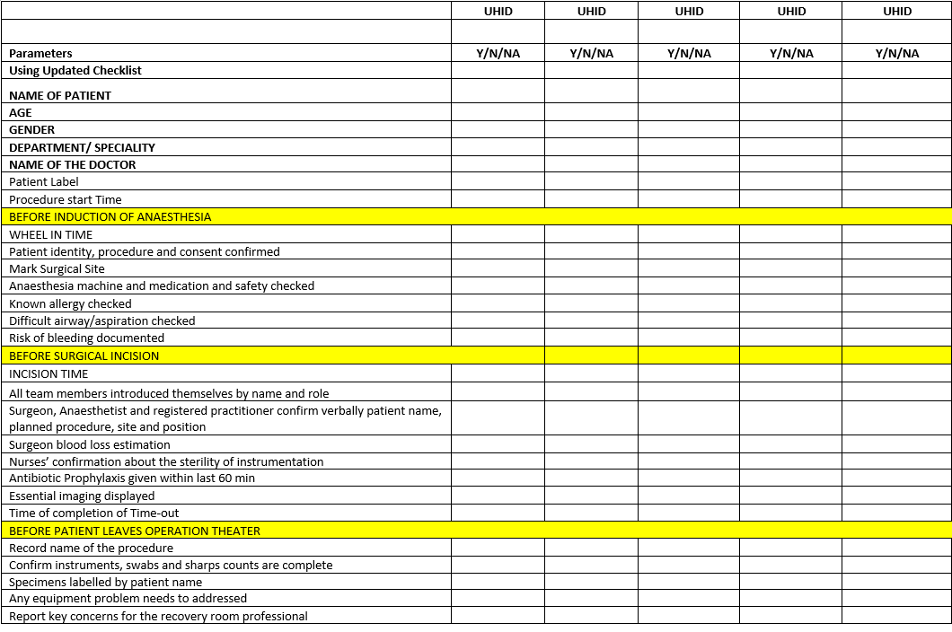
SURGICAL SAFETY CHECKLIST AUDIT TOOL

Slide 9
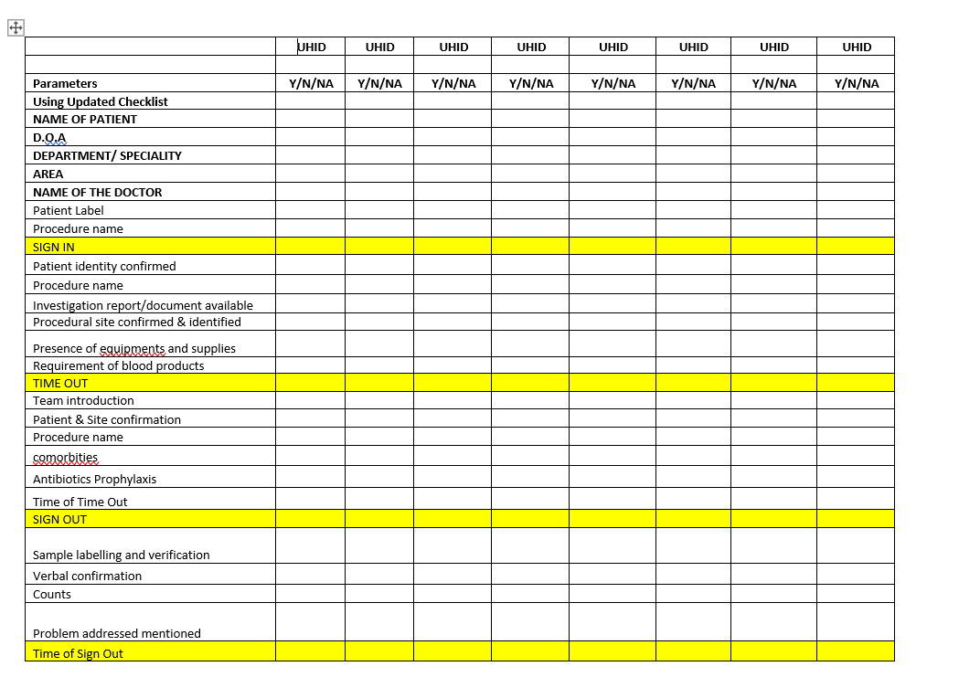
PROCEDURE SAFETY CHECKLIST AUDIT TOOL

Slide 10
METHOD OF DATA COLLECTION
A data was collected through the observation process in the following way:
A procedure safety audit tool was used for the observation and the data was collected from the areas like Endoscopy, Bronchoscopy, Cath Lab, Interventional Radiology where the invasive procedures are done.
A surgical safety audit tool was used for the observation and the data was collected from the Oncology OT, Neurosurgery OT, MAMBS OT, Cardiac Surgery OT, General Surgery OT, ENT OT, Gastro Surgery OT, Urology OT.

Slide 11
DATA ANALYSIS
Analysis and interpretation of the study findings was done by gathering the data and summarizing it in the master sheets
The analysis was done using the descriptive statistics by calculating the average percentage of compliance, Non- compliance and Not Applicable of procedure safety and surgical safety checklist
The analyzed data was presented in the form of tables, Bar Graphs & 3-D column Diagrams

Slide 12
RESULTS
Procedure Safety Checklist Total compliance
Table 1: Compliance, Non- Compliance & Not applicable Percentage of procedure safety checklist
Figure 1: A bar diagram showing the percentage compliance, non-compliance of various parameters of procedure safety checklist

Slide 13
RESULTS
Procedure Safety Checklist compliance
Table 2: Compliance Percentage of procedure safety checklist of various department
 | SIGN IN | TIME OUT | SIGN OUT
CATH LAB | 73 | 70 | 71
BRONCHOSCOPY | 64 | 82 | 82.9
INTERVENTIONAL RADIOLOGY | 53 | 64 | 66
ENDOSCOPY | 60 | 88 | 72
Figure 2: A 3-D Cluster diagram showing the percentage compliance of procedure safety checklist in various Procedure areas

Slide 14
RESULTS
Procedure Safety Checklist Non- Compliance
Table 3: Non-Compliance Percentage of procedure safety checklist of various department
 | SIGN IN | TIME OUT | SIGN OUT
CATH LAB | 22 | 16.7 | 22.5
BRONCHOSCOPY | 23.9 | 17 | 18
INTERVENTIONAL RADIOLOGY | 19 | 11 | 16.5
ENDOSCOPY | 23.9 | 14.9 | 25
Figure 3: A 3-D Cluster diagram showing the percentage non-compliance of procedure safety checklist in various Procedure areas

Slide 15
RESULTS
Procedure Safety Checklist Not Applicable
Table 4: Not applicable Percentage of procedure safety checklist of various department
 | SIGN IN | TIME OUT | SIGN OUT
CATH LAB | 15.2 | 8 | 7
BRONCHOSCOPY | 15 | 10 | 7.5
INTERVENTIONAL RADIOLOGY | 19 | 7 | 4
ENDOSCOPY | 12 | 11.4 | 8
Figure 4: A 3-D Cluster diagram showing the percentage not applicable of procedure safety checklist in various Procedure areas

Slide 16
Surgical Safety Checklist Total Compliance
Table 5: Total percentage compliance & Non- Compliance of surgical safety checklist
 | BEFORE INDUCTION OF ANESTHESIA | BEFORE SKIN INCISION | BEFORE PATIENT LEAVES OT
TOTAL COMPLIANCE | 78.22 | 76.41 | 70.75
TOTAL NON-COMPLIANCE | 21.79 | 23.59 | 29.25
Figure 5: A bar diagram showing the percentage compliance and non-compliance of surgical safety checklist

Slide 17
Surgical Safety Checklist Compliance
Table 6: Compliance Percentage of surgical safety checklist
 | BEFORE INDUCTION OF ANAESTHESIA | BEFORE SKIN INCISION | BEFORE PATIENT LEAVES OT
ONCO SURGERY | 68.57 | 76.25 | 84
GASTRO SURGERY | 62.86 | 67.5 | 66
UROLOGY | 74.29 | 73.75 | 66
MAMBS | 85.71 | 75 | 60
NEURO SURGERY | 91.43 | 81.25 | 64
CARDIAC SURGERY | 85.71 | 78.75 | 62
ENT SURGERY | 74.29 | 71.25 | 74.00
GENERAL SURGERY | 82.86 | 87.5 | 90

Slide 18
Surgical Safety Checklist Compliance
Figure 6: A 3-D Cluster diagram showing the percentage compliance of surgical safety checklist of various departments

Slide 19
Surgical Safety Checklist Non- Compliance
Table 7: Non- Compliance Percentage of surgical safety checklist
 | BEFORE INDUCTION OF ANAESTHESIA | BEFORE SKIN INCISION | BEFORE PATIENT LEAVES OT
ONCO SURGERY | 31.43 | 23.75 | 16
GASTRO SURGERY | 37.14 | 32.5 | 34
UROLOGY | 25.71 | 26.25 | 34
MAMBS | 14.29 | 25 | 40
NEURO SURGERY | 8.57 | 18.75 | 36
CARDIAC SURGERY | 14.29 | 21.25 | 38
ENT SURGERY | 25.71 | 28.75 | 26.00
GENERAL SURGERY | 17.14 | 12.5 | 10

Slide 20
Surgical Safety Checklist Non- Compliance
Figure 7: A 3-D Cluster diagram showing the non- compliance percentage of surgical safety checklist of various departments

Slide 21
DISCUSSION
As World Health Organization estimated that 234 million operations are performed annually around the globe. Of those procedures 9.2% were faced preventable harms daily during surgery across the world.
Although a vast amount of data suggests that a properly implemented SSC reduces preventable mistakes in the OT, there is little known as to how to implement the checklist most effectively. Nearly for the procedure safety checklist the compliance was about 62.5 for sign in, 76 for time out and 72.98 for sign out process. Whereas for the surgical safety checklist the compliance was 78.22 for the before induction of anaesthesia, 76.41 for before skin incision and 70.75 for before patient leaves OT of various parameters of SSC.
As a result, implementing surgical checklists is more challenging than it first seems and involves teamwork, leadership, and flexibility that differs from how it is currently achieved. The idea behind implementing a checklist in surgical and procedure practice was that perioperative morbidity and mortality may be reduced by regularly checking common safety issues, improving team dynamics, and routinely checking common safety issues.

Slide 22
CONCLUSION
The aim of this study was to assess the level of compliance of Procedure safety checklist and WHO surgical safety checklist to ensure safe surgery and patient safety. Thus, this study has contributed to compliance assessment.
The SSC, when conducted correctly, represents an important tool for patient safety. Well-functioning teams encourage mutual respect and trust, which are essential values for all team members doing a safe job for the patient.
The study showed clearly the consequences of insufficient implementation of the SSC. Furthermore, it revealed a gap between the hospital’s procedures and practice related to responsibility for the SSC execution.
Until the SSC execution is a customary practice, the hospital’s management must demand and make the responsible professions accountable for compliance.
To acquire further knowledge and understanding of the SSC issues, similar studies at other operating departments would be interesting, with a view to comparing results. It would also be appropriate to investigate the experiences and opinions of nurse, anesthetists and physicians in surgical teams and procedure team.

Slide 23
RECOMMENDATION
The major finding we observed was that the staff was unaware about the application of procedure and surgical safety checklist
Creating the awareness and making staff knowledgeable about the use of checklist a daily report should submitted to the Team Leader to make it more compliant.
During the audit we communicated and educated the Team leaders about making the staff skill about proper use of the checklist
We observed that their was lack of communication between the team members during the sign in, time out and sign out
Same was communicated to the staff during the audit process
Weekly random visits must be done to OT’s and Procedure areas to see the staff compliance about the use of checklist after submitting the day report to the Team Leaders
The recommendation given to the quality manager was to shoot one video related to the process of procedure and surgical safety and the same to be circulated among Doctor’s, Nurses, Technicians and Anaesthetists

Slide 24
REFERENCES
Dinesh HN, R. S. R, V. SK. Surgical Safety Checklist implementation and its impact on patient safety. International Surgery Journal. 2018;5(11):3640. Available From: http://dx.doi.org/10.18203/2349-2902.isj20184637
Safe surgery [Internet]. Who.int. [cited 12 June 2022]. Available from: https://www.who.int/teams/integrated-health-services/patient-safety/research/safe-surgery
Gong J, Ma Y, An Y, Yuan Q, Li Y, Hu J. The surgical safety checklist: a quantitative study on attitudes and barriers among gynecological surgery teams. BMC Health Services Research [Internet]. 2021 [cited 12 June 2022];21(1):1106. Available from: https://doi.org/10.1186/s12913-021-07130-8
Aveling E, McCulloch P, Dixon-Woods M. A qualitative study comparing experiences of the surgical safety checklist in hospitals in high-income and low-income countries. BMJ Open [Internet]. 2013 [cited 12 June 2022];3(8):e003039. Available from: https://www.ncbi.nlm.nih.gov/pmc/articles/PMC3752057/
Haugen AS, Søfteland E, Eide GE, Sevdalis N, Vincent CA, Nortvedt MW, et al. Impact of the World Health Organization's Surgical Safety Checklist on Safety Culture in the Operating Theatre: A Controlled Intervention Study. British Journal of Anaesthesia. 2013;110(5):807–15. Available From: https://www.researchgate.net/publication/235605206_

Slide 26
TASK PERFORMED DURING INTERNSHIP IN QUALITY DEPARTMENT
We had experience in various field like :
Emergency Time motion study
JCI Internal Audit
Medical File Audit
Risk assessment in hospital areas
Policies Review
Safety Rounds
Down time flow process
IPSG 2 Audit
IPSG 4 Audit
Development of Risk assessment tool like HIRA
Development of suicide risk scale

Slide 27
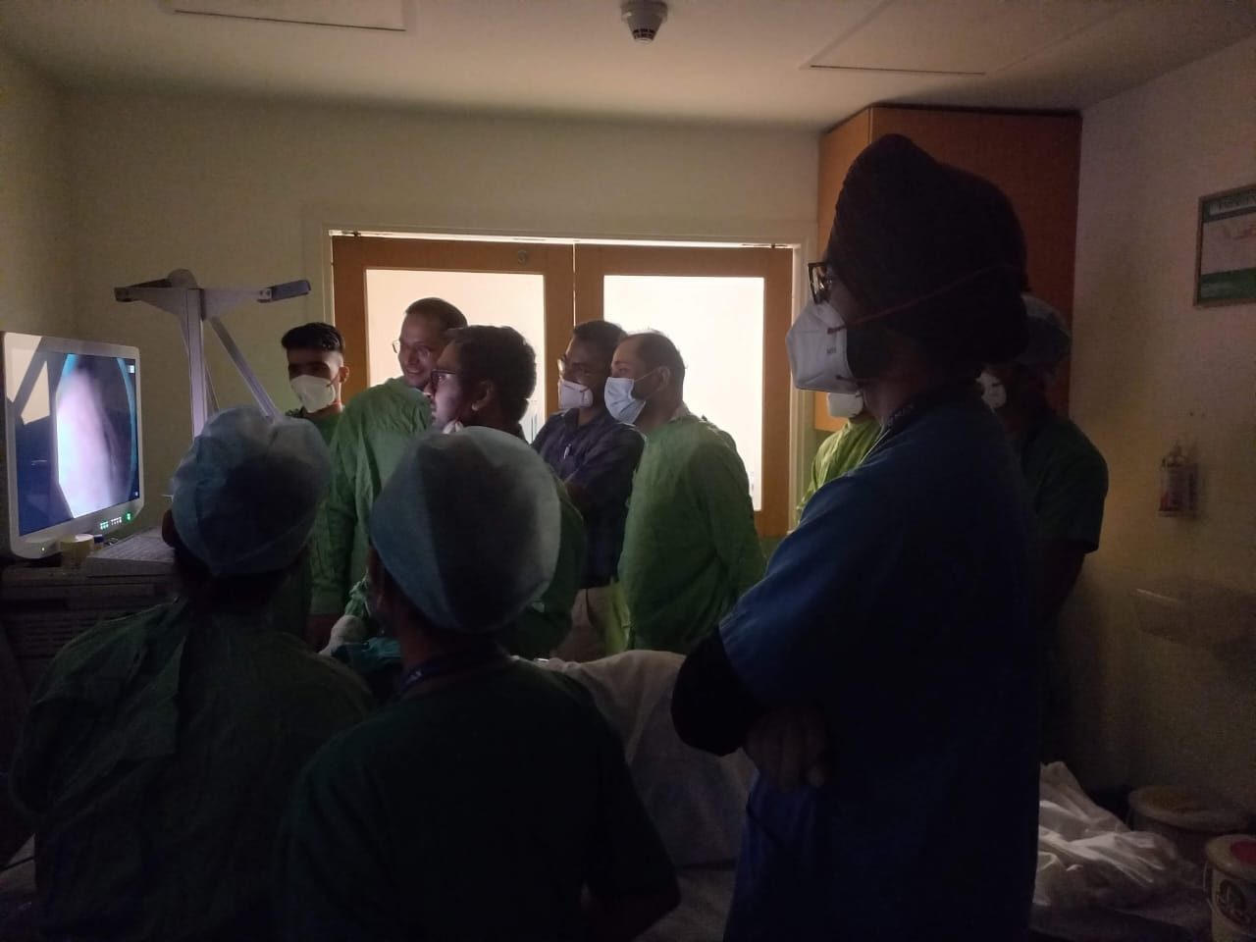
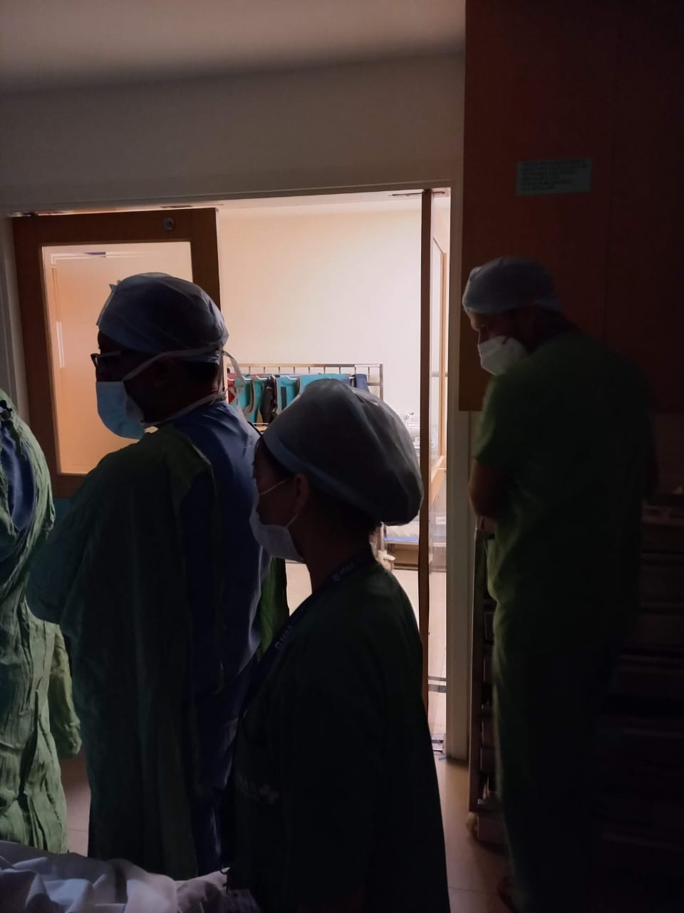
PICTORIAL JOURNEY
PROCEDURE SAFETY AUDIT

Slide 28
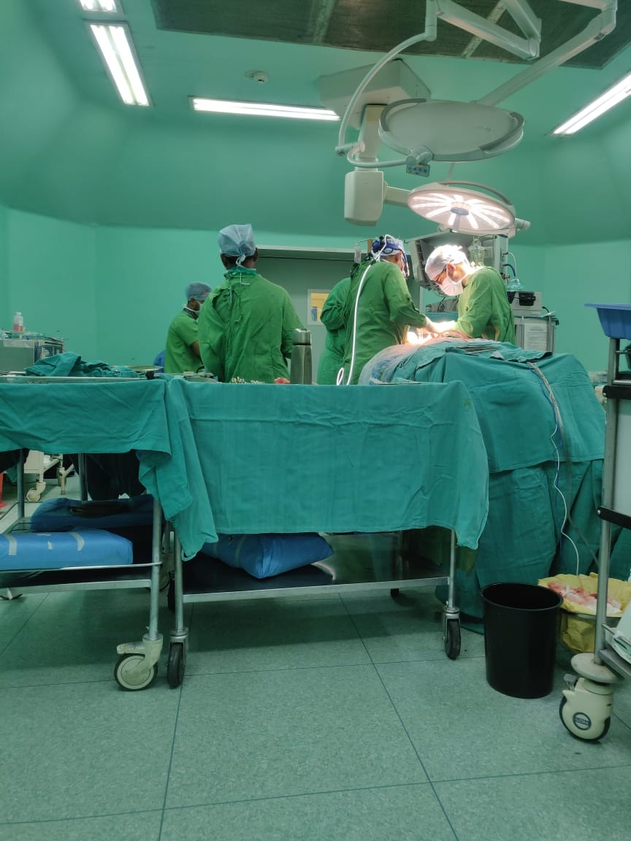
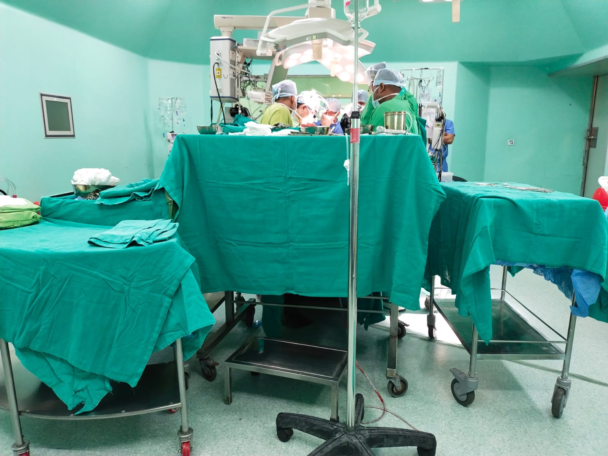
PICTORIAL JOURNEY
SURGICAL SAFETY AUDIT

