Slide 1
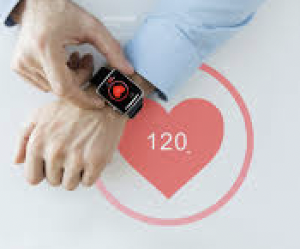
Dissertation
at
IIHMR, Delhi
CHALLENGES AND LIMITATIONS IN USAGE OF WEARABLE MEDICAL DEVICES IN HEALTHCARE: IDENTIFICATION THROUGH TEXT MINING APPROACH
Col Amit Langar (Roll No P/20/006)
Post-graduate Diploma in Hospital and Health Management 2020-2022
Mentor : Dr Anandhi Ramachandran,
Associate Professor at IIHMR, Delhi

Slide 2
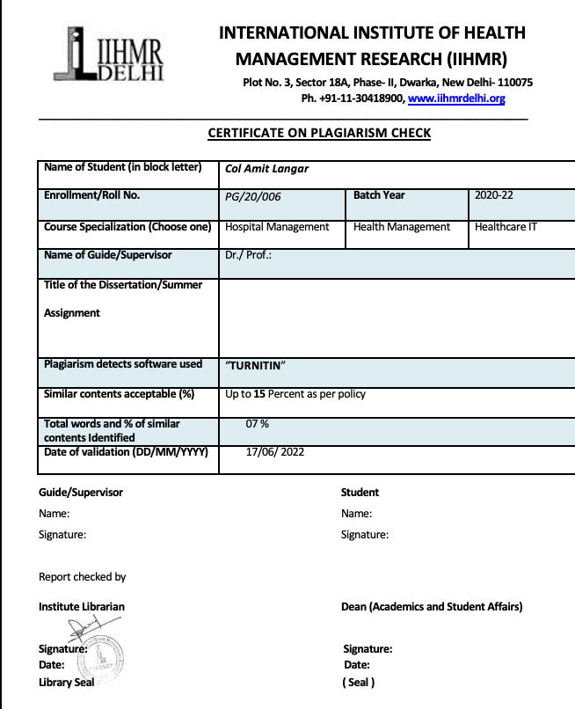
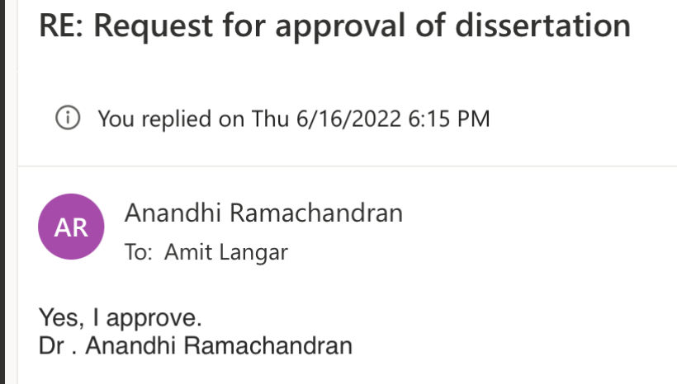
Approval of Mentor
Certificate for Plagiarism Check

Slide 3
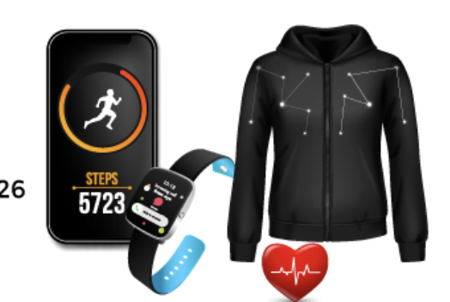
INTRODUCTION
What are Wearable Medical Devices (WMD) ?
Relevance of WMD
Characteristics
Classification
Applications
Preventive Healthcare
Mass Health Awareness
Managing Patients
Managing Ailments and Diseases

Slide 4
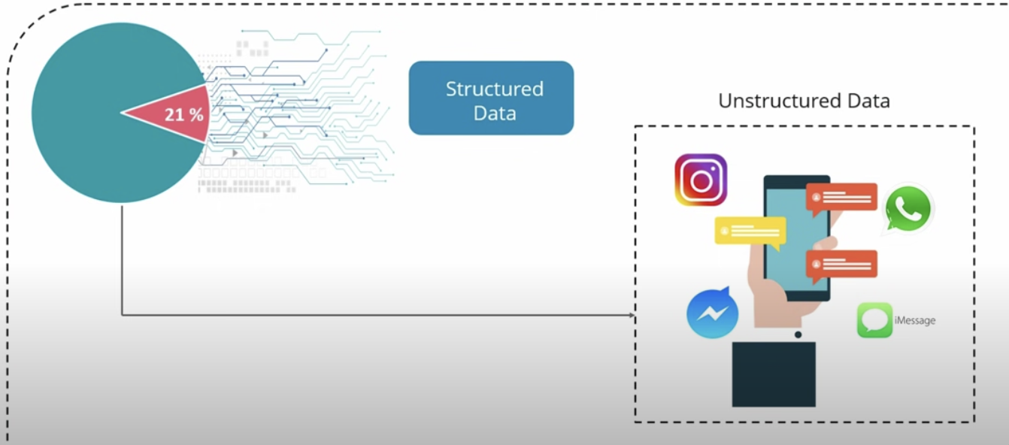
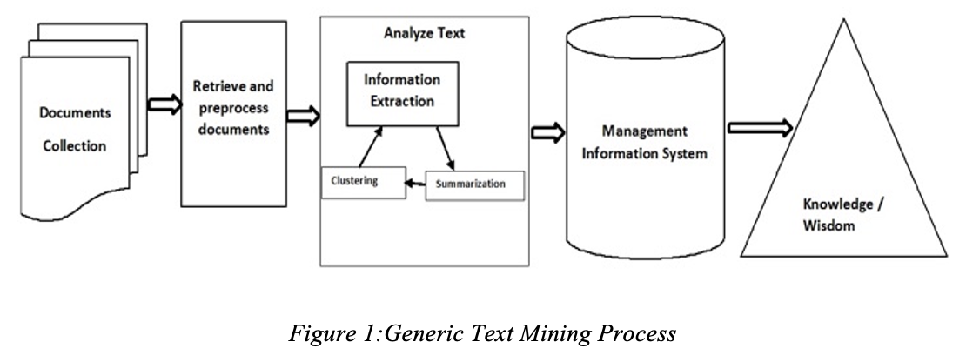
INTRODUCTION
Growth in usage of Wearable Medical Devices
Challenges
Text Mining
Using R – Open Source Software
Generic Text Mining Process

Slide 5
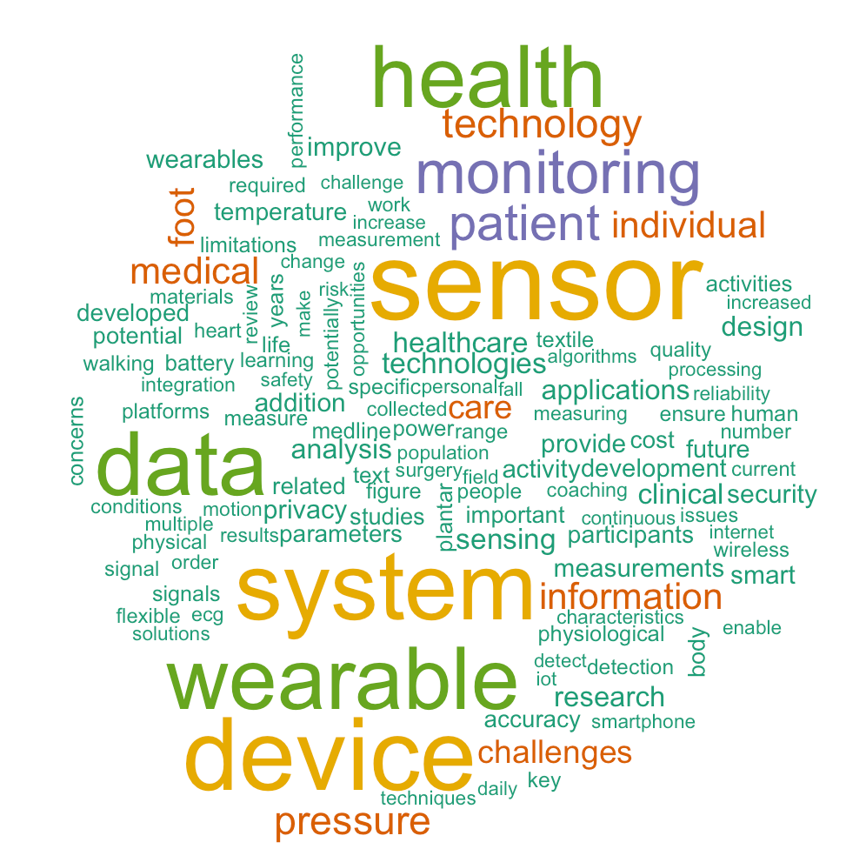
OBJECTIVE
To identify the challenges and limitations in usage of wearable health devices reported in the literature through text-mining approach.

Slide 6
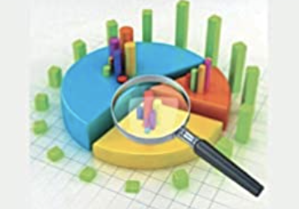
METHODOLOGY
Inclusion Criteria : Full text, English only articles, published within last 12 years
Exclusion Criteria: General description, systematic reviews, books, book chapters, Patents
Step 3: Generating and curating the term list
Step 4: Utilising ‘R’ Language package for text mining.
Step 5: Analysis of the terms to retrieve trends and evaluating the findings.
Research Design: Descriptive Study
Data Collection Method: Secondary data based on published scientific articles
Approach: Text mining with following steps :-
Step 1: Document Search and establishment of corpus – Databases of Pubmed and Google Scholar used.
Step 2: Selection of articles
Modified version of PRISMA guideline used to retrieve articles

Slide 7
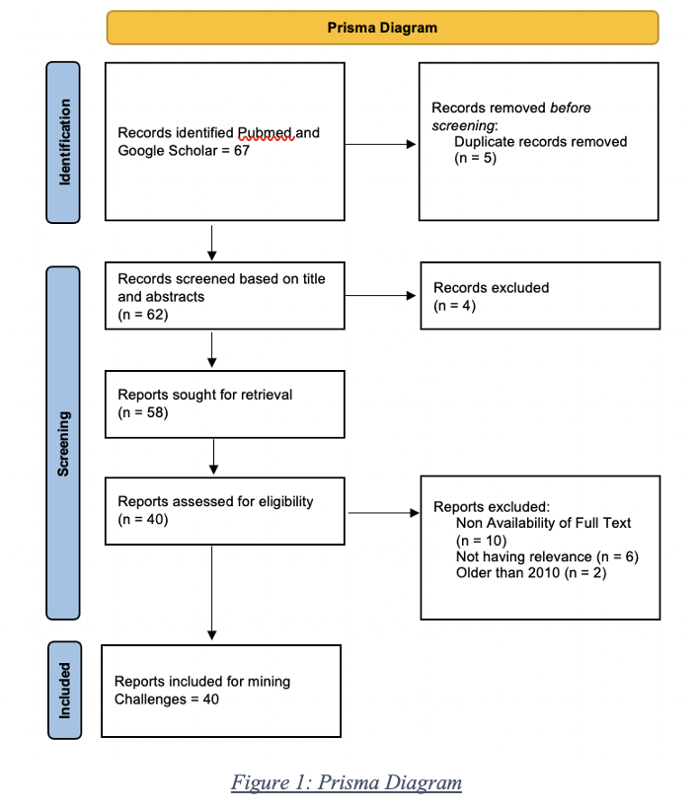
METHODOLOGY

Slide 8
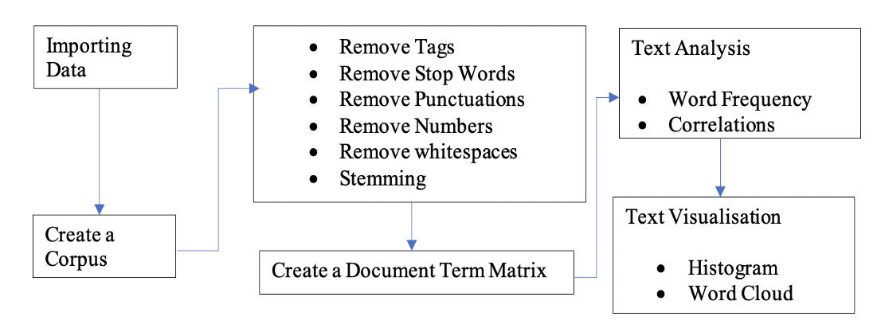
TEXT MINING USING R
Data Selection
Data Cleaning
Information Extraction
Analysis of Information

Slide 9
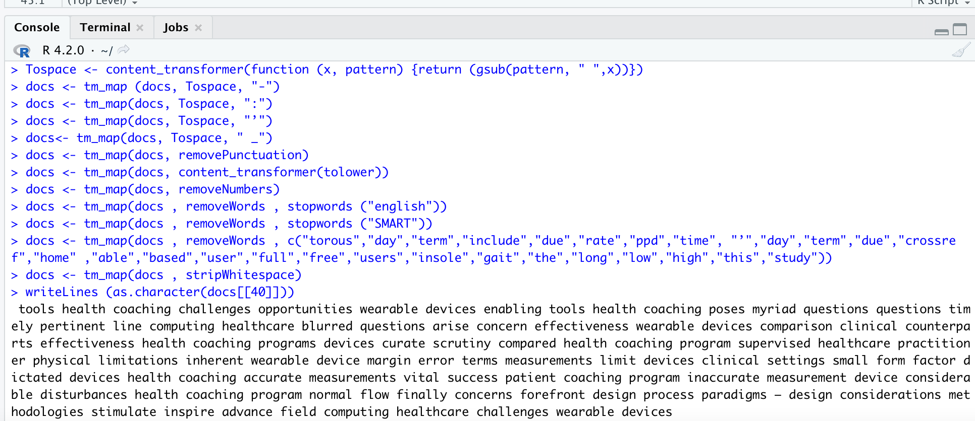
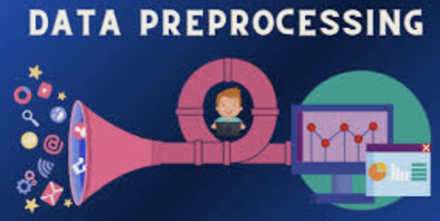
RESULTS
Preprocessing of Data – Remove unwanted characters, numbers, hyphens, punctuations, stripped of white spaces and Stopwords including custom Stopwords
Sample Output
after Pre-processing

Slide 10
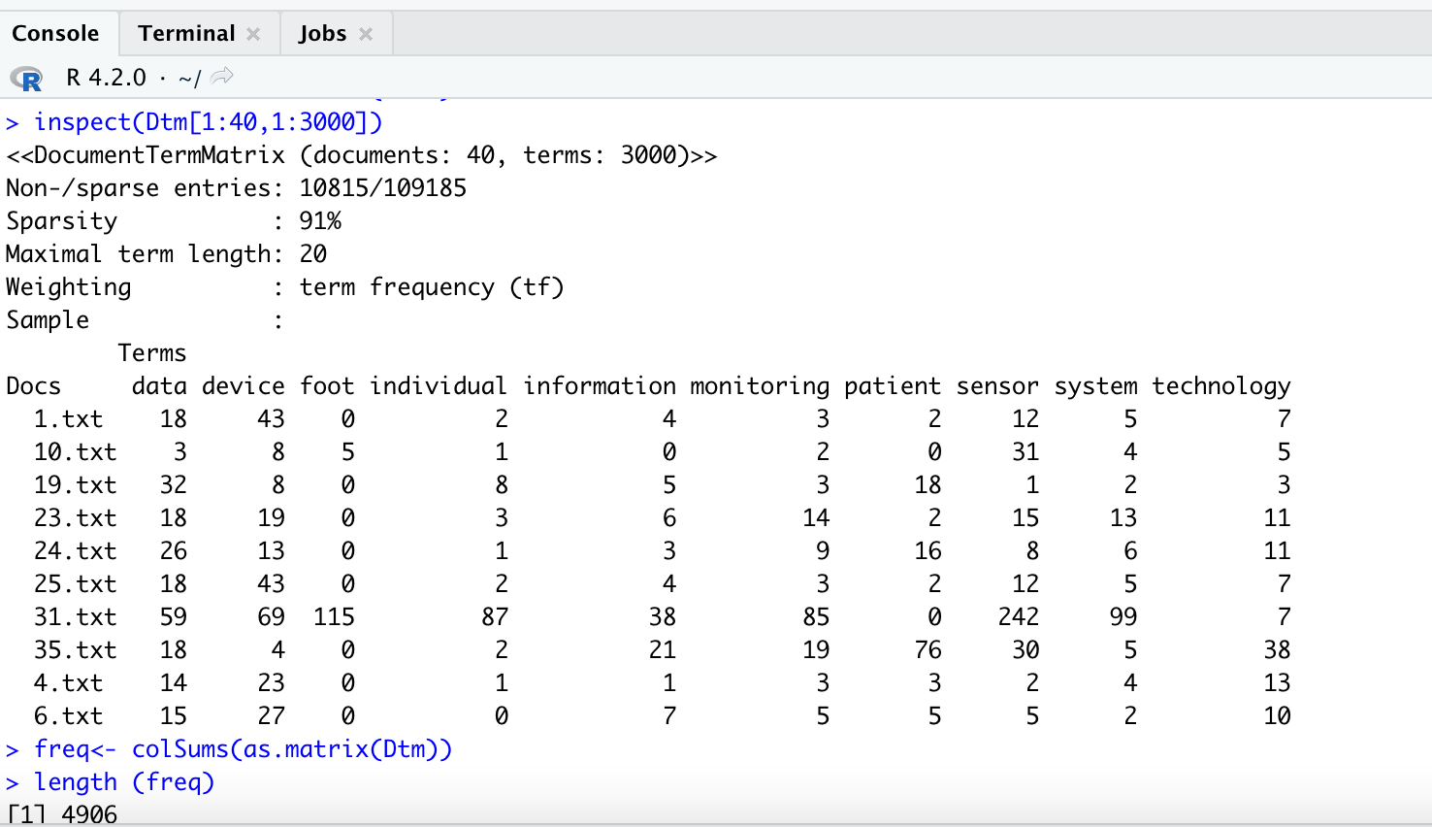
RESULTS
Length, Most Frequent & Least Frequent Terms ( Iteration1)
Output DTM as per given Command ( Iteration 1)
Most Frequent Terms with Minimum Frequency of 40 ( Iteration 1)

Slide 11
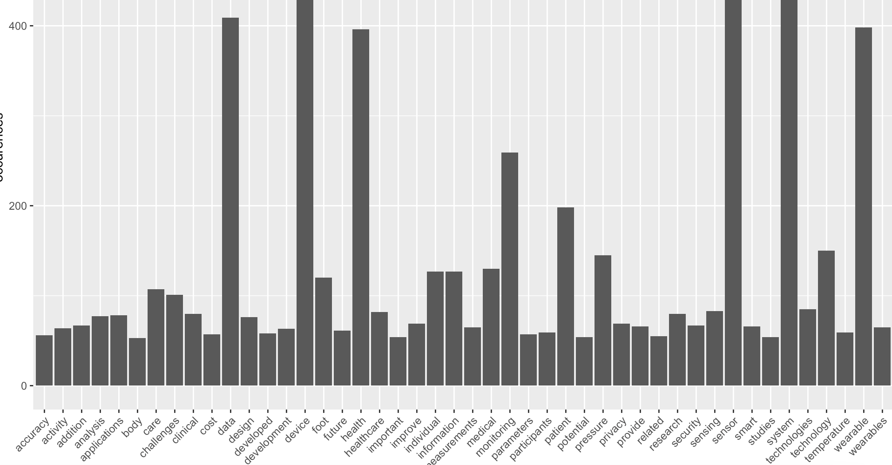
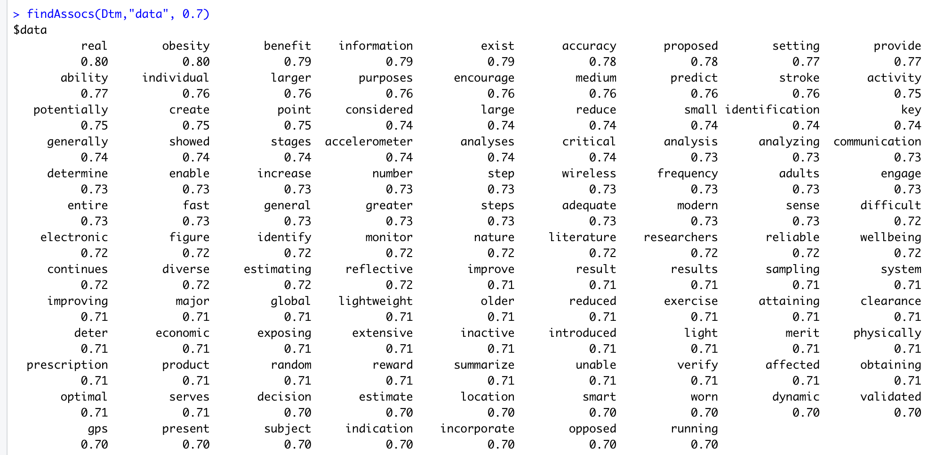
RESULTS

Slide 12
DISCUSSION
Term | Sensor | Device | Data | Monitoring | System | Patient
Frequency | 530 | 477 | 409 | 259 | 202 | 198
Most frequent terms are the broad verticals under which challenges are classified
Accuracy | Activities | Activity | Analysis | Application | Battery
Body | Care | Challenges | Clinical | Cost | Data
Design | Detection | Developed | Device | Ensure | Future
Human | Individual | Information | Limitations | Measurement | Monitoring
Patient | Physiological | Platforms | Potential | Power | Privacy
Research | Sensing | Sensor | Signals | Smart | Specific
Studies | System | Technologies | Temperature | Walking | Wearables
Addition | Quality | Textile | Key | Related | Concerns
Participants | People | Security | Parameters | Text | Years
List of High Frequent Terms ( > 40 times)

Slide 13
DISCUSSION
Freq-uent Term | Relevant Terms with High Correlation (> 0.7)
Sensor | Placement | Pressure | Shape | Embedded | Accuracy | Customisable
 | Impact | Position | Sensitivity | Communication | Reliable | Expensive
Device | Minitat-urised | Monitored | Record | Regulation | Bulky | Accurate
 | Scalable | Wireless | Obtrusive | Smart | Integrated | Worn
Data | Health | Accuracy | Large | Analysis | Commun-ication | Summarise
 | GPS | Diverse | Wireless | Monitor | Encourage | purposes
Monitoring | Measurement | Consistency | Analysis | Smart | Accuracy | Customizable
 | Distant | Diagnoses | Fabric | Insight | Individual | Transmission
System | Parameters | Stability | Accuracies | Budget | Convergence | Customisable
 | Deviation | Minimally | Researched | Sensitivities | Synchronise | Temporal
Patient | Consent | Replacement | Adopting | Aftercare | Inconvenience | Lifestyle
 | Wireless | Reassurance | Expectation | Anonymisation | Interfere | acceptability
Histogram showed highest bars for Terms like Data, Device, Monitoring, Pressure, Sensor, Wearable, Technology and Information.
Word Cloud had biggest terms like health Technology, Monitoring, Patient, Individual, Sensor, Data, Wearability, System , Information and Pressure.

Slide 14
IDENTIFICATION OF CHALLENGES
Data Related
Handling Big Data.
Risk of Dataloss.
Security and Communication of Data.
Interoperability of data from diverse heterogenous devices.
Data Accuracy
Security and Privacy
Threat of Excessive Monitoring.
Security and Ownership.
Communication of Wireless Means.
Lack of Regulations .

Slide 15
IDENTIFICATION OF CHALLENGES
Sensor Related.
Customisable.
Embedded into Healthcare Ecosystem
Placement.
Sensitivity and Accuracy
Individual/ Patient Related.
Convenience.
Acceptability.
Consent and Ethical Issues.
Miscellaneous
Cost issues
Connectivity Issues.
Battery Life.
Issues related to Wireless Networks.

Slide 16
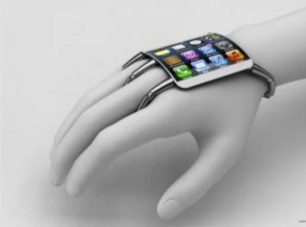
CONCLUSION
Wearable Medical Devices changing healthcare landscape
Need to address challenges at three levels
Providers
Users
Developers
Text-Mining potential to be a potent research tool

Slide 17
LIMITATIONS OF THE STUDY
Specific challenges for different kinds of devices not taken into account
Use of Secondary Data
Limited expertise in Text Mining

Slide 18
DISSERTATION EXPERIENCES
What Did I Learn?
Overall self comments on Dissertation
Insight into Wearable Medical Devices
Text Mining and Analysis
Using R
Research Methodology
Systematic approach applied to complete dissertation
Literature Review
Knowledge building in Text Mining & R
Application
Report writing
Constant interaction with Mentor

Slide 19
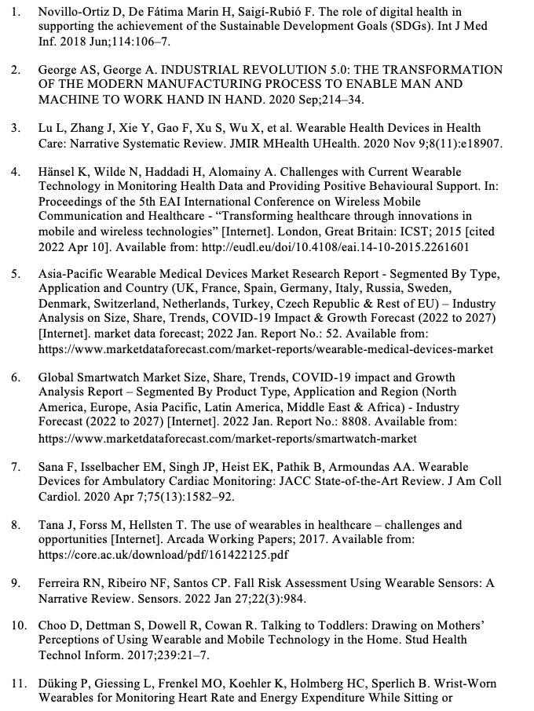
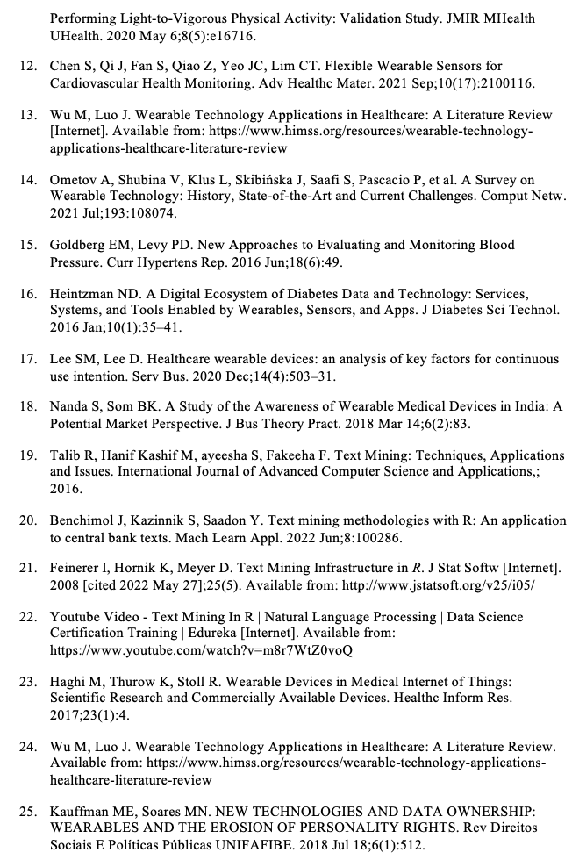
REFERENCES

Slide 20
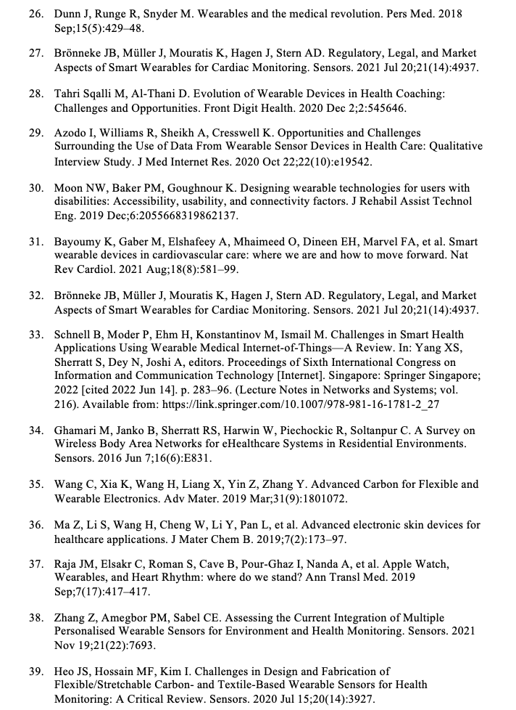
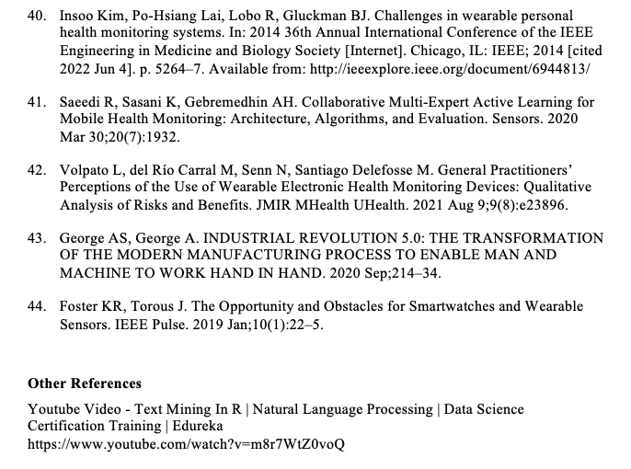
REFERENCES

Slide 21
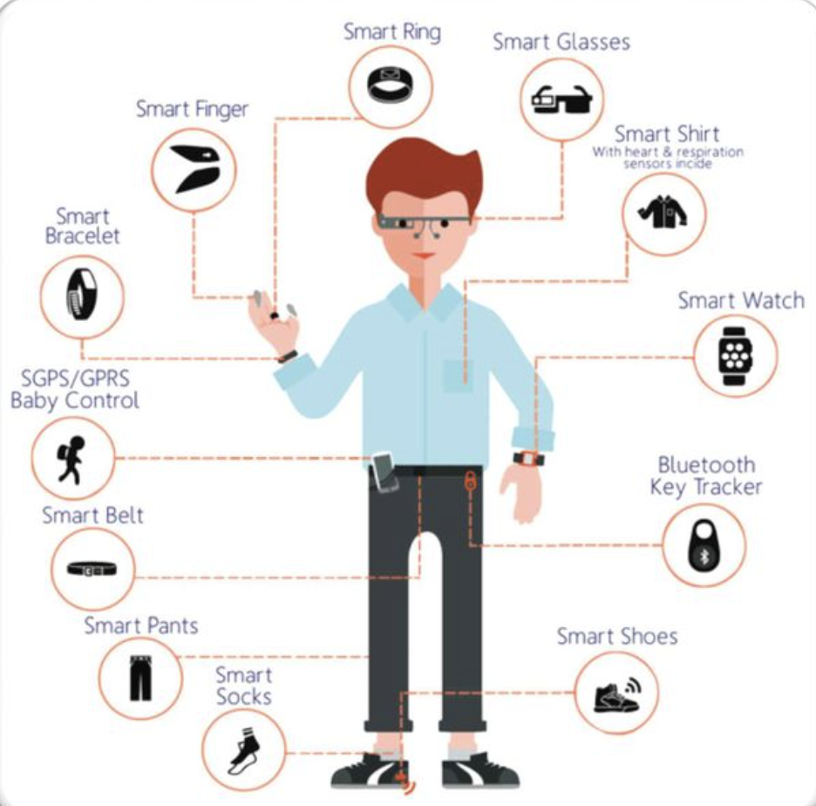
THANK YOU

Slide 22
R SCRIPT USED WITH EXPLANATION
#installing tm package
install.packages("tm")
#loading required package :NLP
library(tm)
#creating a corpus with 40 files in folder corpusA
docs<- Corpus(DirSource('/Users/amitl/Downloads/dissertation/corpusA'))
#inspect a particular document
inspect (docs)
# start pre-processing. Cleaning the data by using Tospace function for removing hyphen, numbers, symbols like colons, underscores etc. Also, the code ensures that if colon is removed between two words, they don’t join to become one by creating a custom transformer - content transformer.
Tospace <- content_transformer(function (x, pattern) {return (gsub(pattern, " ",x))})
docs <- tm_map (docs, Tospace, "-")
docs <- tm_map(docs, Tospace, ":")
docs <- tm_map(docs, Tospace, "’")
docs<- tm_map(docs, Tospace, " _")

Slide 23
# Remove Punctuations
docs <- tm_map(docs, removePunctuation)
# Transform the entire corpus to lower case. Required because R is case sensitive.
docs <- tm_map(docs, content_transformer(tolower))
# Remove numbers. As numbers are not of much value in our text analysis.
docs <- tm_map(docs, removeNumbers)
# Remove standard stopwords using “English” and “SMART” dictionaries
docs <- tm_map(docs , removeWords , stopwords ("english"))
docs <- tm_map(docs , removeWords , stopwords ("SMART"))
# Remove standard custom stopwords identified through iterations
docs <- tm_map(docs , removeWords c("torous","day","term","include","due","rate","ppd","time",

Slide 24
# Strip extraneous white space
docs <- tm_map(docs , stripWhitespace)
# Inspect output
writeLines (as.character(docs[[40]]))
# Install SnowballC package for stemming
install.packages ('SnowballC')
library(SnowballC)
# Stemming the document by removing prefixes and suffixes of similar words – like using, used, usable
docs <- tm_map(docs, stemDocument)
# once stemming is done certain words might be stemmed with wrong spellings. These can be corrected by undermentioned function

Slide 25
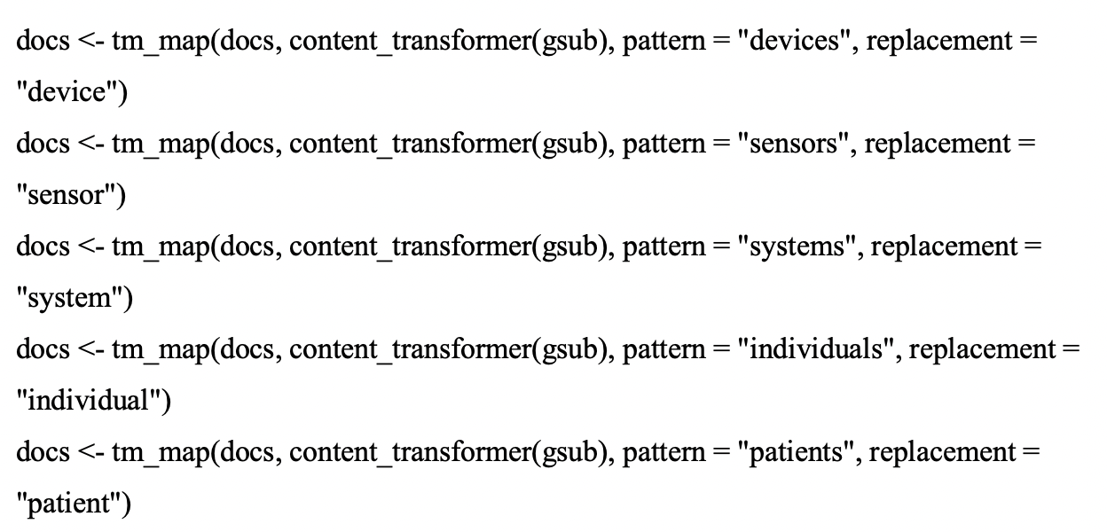
# Create a Document word matrix to check the frequency of words in various documents. All the documents arranged in the row and words arranged in the column
Dtm<- DocumentTermMatrix(docs)
#inspect the part of the matrix
inspect(Dtm[1:40,1:3000])
#collapse matrix by summing over columns- this gets total count over all documents for each term
freq<- colSums(as.matrix(Dtm))

Slide 26
#length should be total number of terms in the corpus
length (freq)
#sort the frequency of the words in ascending order
ordr <- order(freq, decreasing = TRUE)
#list most frequent words
freq[head(ordr)]
#list least frequent words
freq[tail(ordr)]
#remove words
dtmr<-DocumentTermMatrix(docs, control=list(wordLengths=c(4,20), bounds = list(global = c(3, 27))))
freq<- colSums(as.matrix(dtmr))
# length should be total number of terms
length(freq)
#create sort order (asc)
freq<- colSums(as.matrix(Dtm))
#create sort order (asc)
ordr <- order(freq, decreasing =TRUE)
#inspect most frequently occurring terms
freq[head(ordr)]

Slide 27
#inspect lease frequently occurring terms
freq [tail (ordr)]
#list the most frequent terms. Lower bound specified as second argument. Items which have occurred atleast 80 times.
findFreqTerms(Dtm, lowfreq=40)
#find correlations between these frequently occurring words using findAssocs function
findAssocs(Dtm,"data", 0.75)
findAssocs(Dtm,"wearable", 0.6)
findAssocs(Dtm,"challenges",0.65)
findAssocs (Dtm, "healthcare",0.65)
# draw histogram
install.packages("ggplot2")
library(ggplot2)
wf=data.frame(term=names(freq),occurences=freq)
p <- ggplot(subset(wf, freq >50), aes(term, occurences))
p <- p +geom_bar(stat ="identity")
p <- p+theme(axis.text.x=element_text(angle=45, hjust =1))
p
#

Slide 28
draw wordcloud
install.packages ("wordcloud")
library(wordcloud)
#colour palette of Word cloud
install.packages("RColorBrewer")
set.seed(42)
wordcloud(names(freq),freq, min.freq=40, colors=brewer.pal(6,"Dark2"))

