Slide 1
Assessment of Quality Assurance in Radiology Department of a 500 Bedded Hospital: A Cross-Sectional Study
Organization :- Rajiv Gandhi Cancer Institute and Research Centre
Name : Dr. Angika Tiwari
Faculty Mentor : Dr. Vinay Tripathi

Slide 2
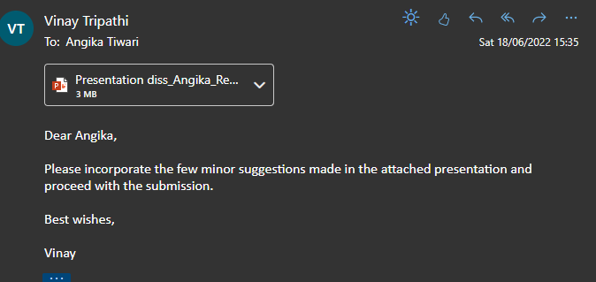
SCREENSHOT OF APPROVAL

Slide 3
LITERATURE REVIEW
A prospective study was undertaken at the radiology department of a 2000-bed tertiary care hospital, where they applied Lean and Six Sigma methods to cut reporting time. A total of 120 patients were tracked for a month to see how long it took them to recover. This resulted in a 42 percent reduction in scan reporting time.
The imaging services cycle turnaround time (TAT) of the Radiology Department of a Tertiary care Hospital in Kolkata was investigated using a DMAIC technique, with Pareto analysis yielding the main reasons of delay in the analyzing stage. During the intervention stage, practical techniques were implemented to improve patient orientation and scan readiness, reducing pre-test waiting time and streamlining processes. In the end, the reporting method helped to cut pre-test and post-test wait times.
The Commonwealth Health Corporation (Cherry and Seshadri, 2000) had major issues with long patient wait times, sluggish radiology report turnaround times, and significant downtime for radiology personnel. The CHC team began implementing the six sigma philosophy by looking at all radiological processes during an 18-month period. The number of errors in the MRI ordering procedure was reduced by 90%. When waiting and exam times were reduced, patient satisfaction improved. The department's total patient volume grew by 25% while staffing was reduced by 14 FTEs.

Slide 4
INTRODUCTION
HOSPITALS : SCENARIO AFTER PANDEMIC ?
REVENUE GENERATING DEPARTMENT IN HOSPITAL?
02
01
ALL GOOD ?
BOTTLENECKS ?
03
04
Radiology is a major source of revenue generation within healthcare. Radiology departments must become more efficient in the face of a changing health-care system and rising competition. Because the healthcare sector is service-oriented, patient happiness is vital in all aspects of the industry.
The quality of care given by Hospital Healthcare Systems across the country is receiving more attention. For the benefit of all, hospitals are searching for ways to improve their processes (services).
A significant bottleneck in the radiology department is timely report turnaround. It's one of the most important criteria in determining how satisfied patients are with imaging services in general.
Non-availability of reports on time .
Delays in report generation and dispatch
Radiology process flow not standardized

Slide 5
RADIOLOGY : OPERATIONAL TERMS AND FLOW
1. Requisition Slip | The HIS records the date and time the OPD patient enters the Radiology department, pays for the test, and receives a requisition number.
2. Prep time/ Waiting time | Time between the end of the requisition and the entrance of the patient into the test room .
3. Patient goes inside scan room | When the patient walks inside the scan room for the first time.
4. Scan starts | The process of scanning starts
5. Scan ends | The process of scanning ends
6. Patient leaves | The patient leaves the scanning room physically.
7. Medical Technologists receives the report | After the Radiologist has completed the report, MT receives it for typing.
8. Typing commencing and completion | The beginning and end times of MT typing
9. Signoff | The Consultant Radiologist has signed off on a typed, amended report.
10. Post test waiting time | The time it takes for a patient's report to be generated after he or she leaves the scan room.
11. Report generated | When the report has been typed and signed off by the radiologist, it is considered complete.
12. Delivered at reception | The period when the technician finishes assembling the report and sends it to reception.

Slide 6
OBJECTIVES OF STUDY
a) To study and document the existing process flow of the Radiology department
b) To find the deficiencies or gaps hindering the quality of services
c) To suggest a roadmap for improving the quality of services

Slide 7
METHODOLOGY
Study area Radiology Department (RGCIRC)
Study design: Cross-sectional study
Study population: Patients (PET SCAN , CT SCAN , MRI)
Sampling: Convenience Sampling
Sample size: 420 patients
Data collection: Both primary and secondary
Primary Data : Structured Questionnaire for patients Perspective
Secondary Data – Systems And Records
Study duration :- 11th March – 14th June
Study Location: - Rajiv Gandhi Cancer Institute and Research Centre The Observed Radiology Departments i.e. PET-SCAN and CT-SCAN was on Ground Floor and MRI on 2nd Floor
.
The Observed Radiology Departments i.e. PET-SCAN and CT-SCAN was on Ground Floor and MRI on 2nd Floor .

Slide 8
Study Framework :- DMAIC was used in the study framework. Here DMAIC theory was applied .
Define Phase | Measure Phase | Analysis Phase | Improvement Phase | Control Phase
SIPOC Voice of Customers Process Mapping | Critical to quality Data Collection Plan | Fishbone Analysis Data Analysis Process Analysis Summary Of Problems | Recommendations Improvement Plan | Continuous Monitoring and training of staff
Exclusion Criteria : Sundays and gazette holidays , Patients tested after 6:00 PM till 8 :00 AM of next day were excluded from the observations , Emergency patients , Old patients
Inclusion Criteria :
The variables chosen were the –
( For PET-SCAN) -OPD/IPD , In-Time , Injection Time , Scanning Time , Reporting Time ,
(For CT and MRI )- OPD/IPD , In –time , Scanning Time , Reporting Time , Reports Approval Time and Reports validation time .
Scheduled Patients ( OPD , IPD )
Urgent case IPD patient was preferred over the scheduled OPD case .
New Patients
Cases which were performed during 8:00 AM – 6:00 PM .
Customers / Patients for feedback

Slide 9
1. DEFINE PHASE
VOICE OF CUSTOMERS ( Patient Feedback )
Sample Size : 70 ( Average of 210 patients from 3 radiology departments )
Most dissatisfying feedback is for reports on time .
 | Quality Indicator | Excellent | Good | Average | Poor
1 | Waiting Time | 20 | 41 | 8 | 1
2 | Quality Housekeeping services | 19 | 40 | 9 | 2
3 | Report on Time | 9 | 25 | 30 | 6
4 | Communication Skills of staff | 26 | 35 | 9 | 0
5 | Billing Services | 22 | 39 | 9 | 0
6 | Competency of Doctors and staff | 28 | 35 | 7 | 0
7 | Courtesy of Staff | 24 | 42 | 4 | 0

Slide 10
2. MEASURE PHASE
From the voice of customers , 5 factors critical to quality were derived on the basis of performance
.
Factors Critical to Quality (CTQ) : Total 5 factors were identified
Table : Factors Critical to Quality
Sr. No. | Factors
1 | Reports on Time
2 | Waiting Time
3 | Quality of Housekeeping services
4 | Communication Skills
5 | Billing Services

Slide 11
Process Mapping ( PET –SCAN , CT- SCAN and MRI )
Preparation in case any contrast study
Patient Registration
Patient walks to waiting room
Report preparation with senior consultant signature
Procedure Preparation
Patient Preparation
Report Dispatch

Slide 12
DATA TIMELINE
PET-SCAN | CT-SCAN | MRI
In-Time 0: 46 min. Injection Time 1:17 min. Scanning Time 26:30 min. Reports Approval | In –Time 15 Min. Scanning Time 18: 43 min. Reporting 7:53 min. Reports Approval 7:45 min. Reports Validation | In- Time 13min. Scanning Time 19:29 min. Reporting 16:45 min. Reports Approval 1:55 min. Reports Validation

Slide 13
GAPS OBSERVED DURING PROCESS MAPPING
 | Piling Up of Requisition Slips at the Reception Counter . Delayed Updation of Billing Entry at radiology cash counter . Add On during Scheduling ( IP cases interferes with OP scheduling )
 | IP patient often gets late due to unavailability of housekeeping staff or mismanagement of file which becomes a reason for delayed TAT .
Procedure Preparation | No Prerequisite Information to patient before scanning specially in contrast studies Frequent Breakdown of machines
Report preparation with senior consultant signature | Less no. of transcriptionist was available for report preparation . Huge Time gap between Report approval and Report Validation .
Patient Registration
Patient walks to waiting room

Slide 14
Possible Improvements Done 1) Installations of a new CT-SCAN and MRI machine . 2) Weekly Monitoring of Machines to avoid the Disruption . 3) Technical Glitch that used to be in the HIS which disrupted the updation of billing entry was corrected . 4) Training to staff ( Front Desk Executive ) , housekeeping staff , nurses of all three departments was given .
WHAT WE DID TO IMPROVE ? LET’S DISCUSS

Slide 15
RECOMMENDATIONS
Written Communication System for patients- As it was observed that some patient’s didn’t know about the pre-requisites like Fasting for 4-6 hours (like for PET-scan and CT- Scan ( Contrast studies) , post procedure instructions . so , they had to wait for longer hours to get the procedure done which directly increased the TAT so for this – A small booklet should be there which should include all the pre- requisites for all the radiology departments that should be followed by the patient before coming for the test in both English and Hindi .
IP cases should be scheduled either in morning or after the rush hours so that it should not interfere in scheduled OP cases .
There should be a online portal for patient’s feedback for every department so that the hospital can look into the bad areas or bottlenecks which are hindering quality of their services .
Pneumatic Shoot should be encouraged to send the files and slips in console room .

Slide 16
RESULTS ( BEFORE IMPROVEMENTS )
CATEGORY | No. of patients observed | No. of patients who failed to follow the SOP for TAT | PERCENTAGE of patients who failed to follow the SOP for TAT | Acc. To SOP of the hospital Turnaround Time (TAT) | Average TAT in observed month
PET – SCAN (OP) PET –SCAN (IP) (OP+ IP) | 59 11 70 | 20 4 24 | 33% 36% 34% | 30 hrs. | 28:07:31
CT- SCAN (OP) CT-SCAN (IP) (OP+ IP) | 56 14 70 | 19 6 25 | 34% 42% 35% | 24 hrs. | 18:59:18
MRI (OP) MRI (IP) ( OP+ IP ) | 61 9 70 | 22 2 24 | 36% 22% 34% | 24 hrs. | 18:46:16

Slide 17
RESULTS ( AFTER IMPROVEMENTS )
CATEGORY | No. of patients observed | No. of patients who failed to follow the SOP for TAT | PERCENTAGE of patients who failed to follow the SOP for TAT | Acc. To SOP of the hospital Turnaround Time (TAT) | Average TAT in observed month
PET – SCAN (OP) PET –SCAN (IP) (OP+ IP) | 55 15 70 | 14 3 17 | 26% 20% 29% | 30 hrs. | 24:02:00
CT- SCAN (OP) CT-SCAN (IP) (OP+ IP) | 58 12 70 | 16 2 18 | 28% 16% 25% | 24 hrs. | 15:45:06
MRI (OP) MRI (IP) ( OP+ IP ) | 57 13 70 | 16 3 18 | 28% 23% 26% | 24 hrs. | 12:30:18

Slide 18
PET –SCAN : showed 5% of improvement in terms of patient who got reports after 30 hrs. and Avg. TAT reduced to 4 hrs.
CT-SCAN : showed 10% of improvement in terms of patient who got reports after 24 hrs. and Avg. TAT reduced to 3 hrs.
.
MRI : showed 8% of improvement in terms of patient who got reports after 24 hrs. and Avg. TAT reduced to 6 hrs.

Slide 19
1. In the Define phase , the main problem statement was defined using Voice of customers and internal department assessment . Later data was collected for 30 days and average TAT (HH:MM:SS) for PET-SCAN (28:07:31) , CT-SCAN ( 18:59:18) and MRI ( 18:46:16) . 2. In the Analysis phase when we calculated the percentage of patients who failed to follow SOP for TAT ; PET –SCAN (34%) , CT-SCAN (35%) and MRI ( 34%) . As a result overall process was analyzed and was modified as per the need in the improvement phase . 3. A fresh data was again collected for 20 days which was compared with the data before improvements . The results were great . Average TAT for all the investigations got reduced , PET –SCAN (24:02:00) , CT-SCAN (15:45:06) and MRI (12:30:18) and percentage of patients who failed to follow SOP for TAT also got reduced ; PET –SCAN( 29%) , CT-SCAN (25%) and MRI ( 26%) . 4. In the control phase , continuous monitoring would be there for the various improvements done in order to have sustainability in the results . 5. DMAIC approach was really useful in improving the quality of services provided in Radiology Department .
CONCLUSIONS

Slide 20
1) Due to shortage of time , patient satisfaction analysis could not be done after the improvement phase of the project . 2) Due to unavailability of a proper radiology information system , there is no proper maintenance of In and Out timings of patient in RIS which could actually help in measuring the patient waiting time for the investigation .
LIMITATIONS

Slide 21
1. Cherry, J. and Seshadri, S. (2000), "Six Sigma: using statistics to reduce process variability and costs in radiology", Radiology Management, November-December, pp. 42-5. 2. Tolga Taner, M., Sezen, B., & Atwat, K. (2012). Application of Six Sigma methodology to a diagnostic imaging process. International Journal Of Health Care Quality Assurance, 25(4), 274-290. doi: 10.1108/09526861211221482 3. Jamie Workman-Germann, Purdue University “Implementing Lean Six Sigma Methodologies in the Radiology Department of a Hospital Healthcare System”. Regenstrief Center for Healthcare Engineering,2007, pp. 5 4. Carolyn Pexton, “Applying Six Sigma to improve diagnostic imaging.” Case Study published in isixsigma.com 5. Taner, Mehmet Tolga; Sezen, Bulent; Atwat, Kamal M. “ Application of Six Sigma Methodology to a diagnostic imaging process . International Journal of Health Care Quality Assurance; Bradford Vol. 25, Iss. 4, (2012): 274-90. DOI:10.1108/09526861211221482 “
REFERENCES

Slide 22
Dissertation Experiences
What did you learn (skill/ topic)?
SOFT SKILLS can touch human lives.
Effective Decision making skills
Ability to solve problems
Empathy towards other people
Overall self comments on Dissertation
The overall experience of working in one of the best cancer hospital was great . I got to work with renowned Nuclear Medicine practitioner and the best radiology teams where they gave me insights about the whole procedure .
The best part of this dissertation was to interact with lots and lots of patients during the visits to departments during feedbacks and rounds because no one better then them gave the ground reality of quality of the services provided by hospital and we now know why this hospital is known as the best oncology care hospital .

Slide 23
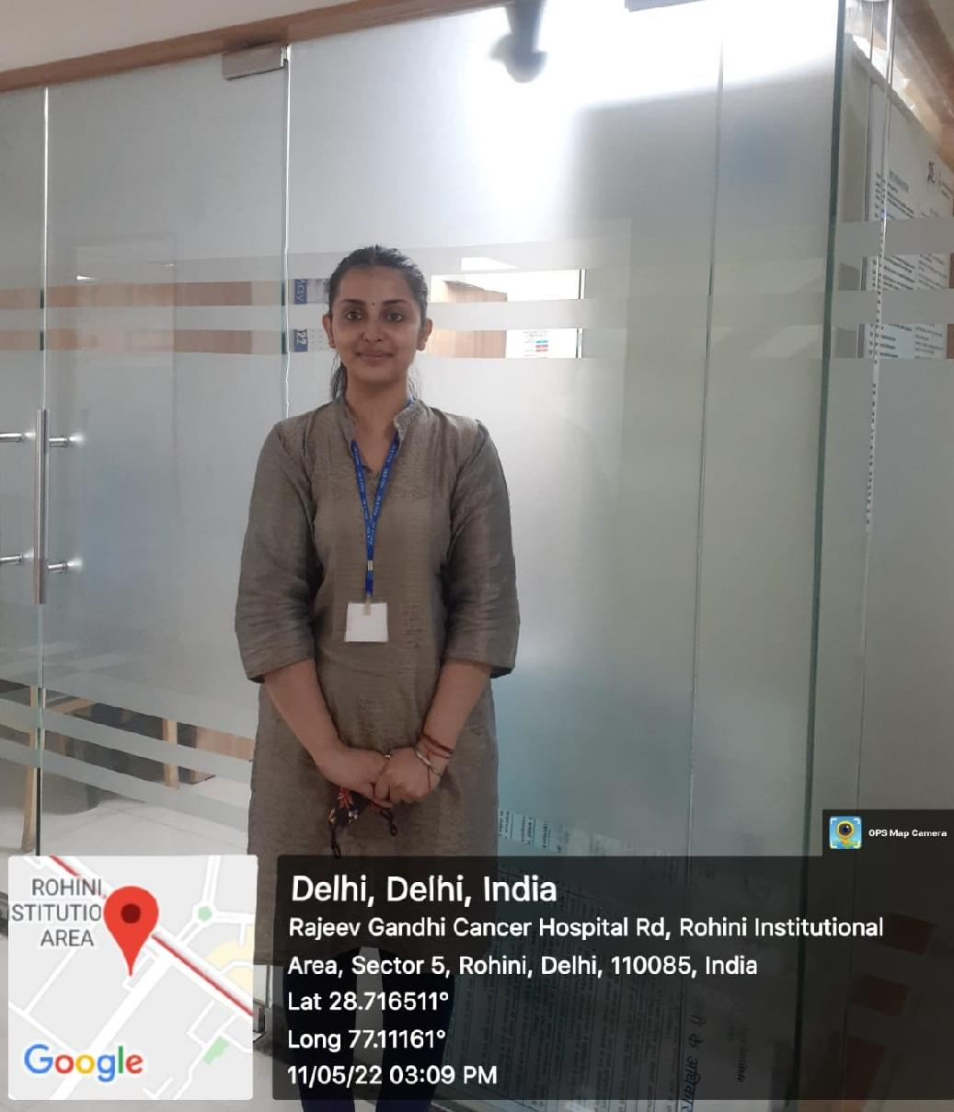
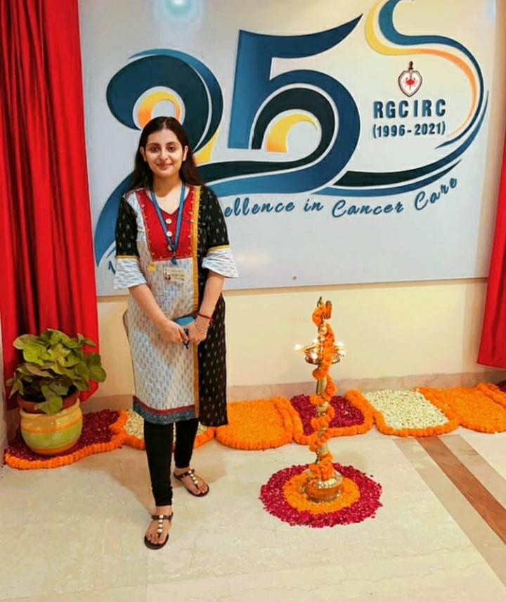
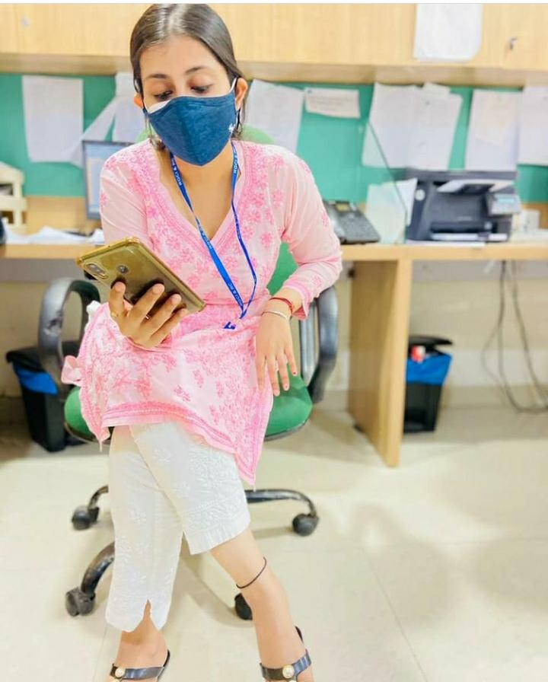
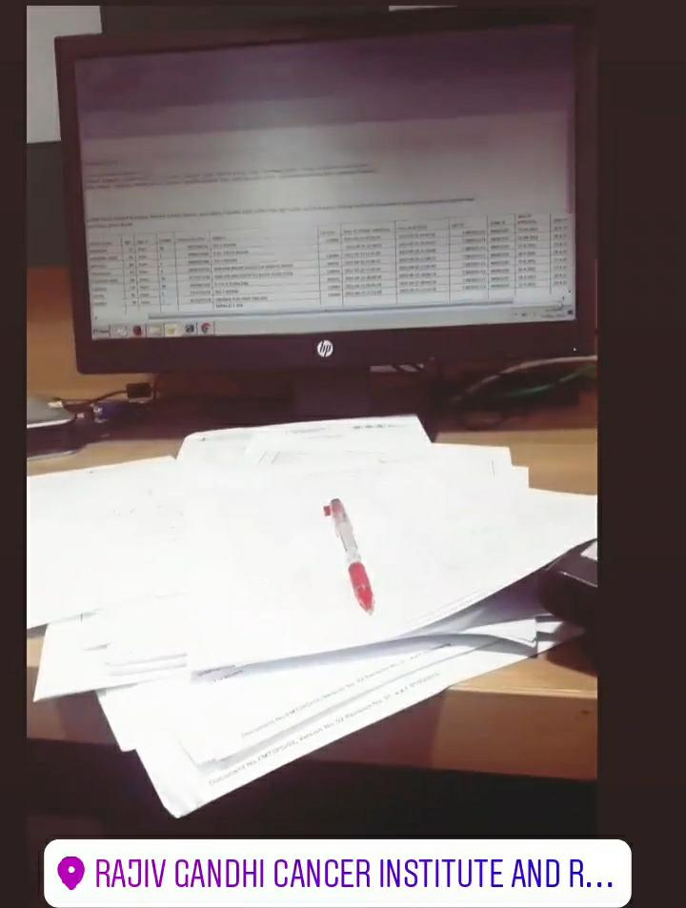
Pictorial Journey

