Slide 1

How to Conduct a Clinical Trial of an Artificial Intelligence Model in Medical Imaging
Presented by: Dr Khushboo Arora
Guided by: Dr Vinay Tripathi
Dr Anandhi Ramachandran
IIHMR Delhi

Slide 2
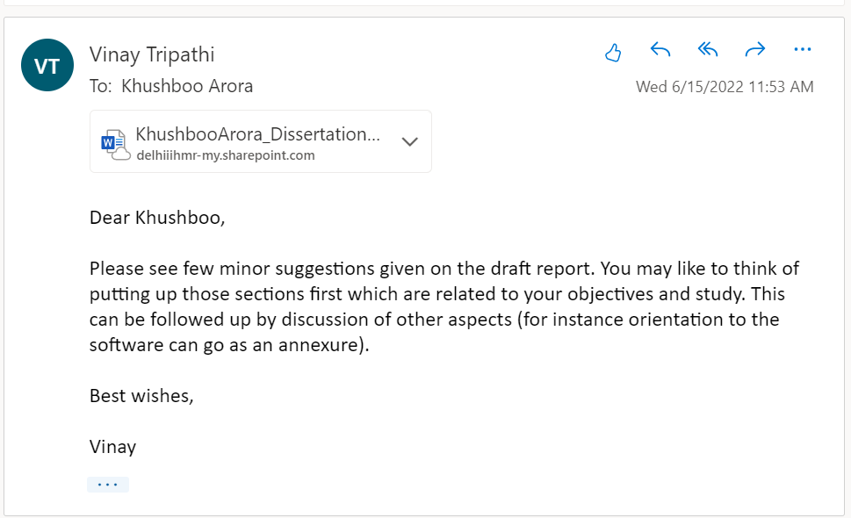
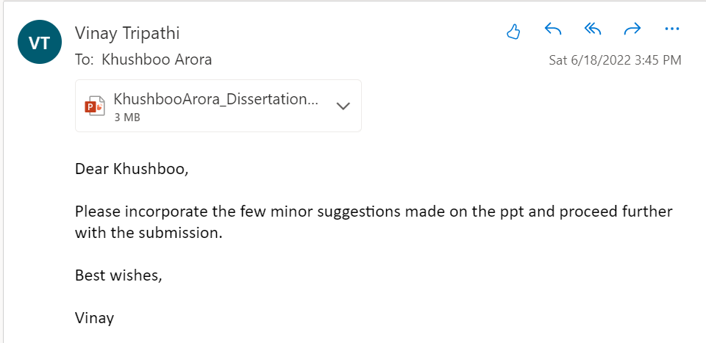
Screenshot of Approval

Slide 3
Introduction
An AI pilot project might be a useful beginning point for an AI journey because all firms are starting from scratch. It assists in swiftly validating use cases, assessing risks, and calculating ROI. The lack of clear commercial objectives and outcomes causes the majority of early AI efforts to fail.
The main goal of a pilot project is to serve as a reference point for future implementations, rather than to solve any fundamental concerns.
The number of resources required changes depending on the project requirements, as it does with all projects. If a company lacks an experienced AI team, it's best to collaborate with a skilled external partner to successfully complete the AI pilot project.
As a result, in order to be successful with the AI pilot project, it is critical to use a huge collection of accurate content.
Although AI pilot projects are intended to be basic and manageable, they nonetheless necessitate a significant amount of skill and the appropriate resources to be implemented successfully.
Thus, the purpose of this study is to tell how to conduct a pilot study/clinical trial of an Artificial Intelligence Model in Medical Imaging.

Slide 4
Introduction
S.No | Item | Description
1 | Reading Services | Professional fee of readers
 |  | Lead Reader honorarium
 |  | Reader Training charges
 |  | Reading coordination and support
2 | CARPL Annotation Platform | Base platform fee for readers (7 readers, 150scans per reader, 2 reading sessions
 |  | Platform customization
 |  | Cloud Hosting & Infrastructure Cost
 |  | AI Output Integration
3 | Others | Administrative fee, maintenance, and support

Slide 5
Objectives of Study
Recruit seven readers for the Study - 7 US board certified radiologists, 4 readers with less than 4 years of experience, 3 readers with more than 4 years of experience reading Chest X-rays. Two reads per reader as per supplied protocol.
End-to-end coordination of the study between Sponsor and readers
Provide a technological platform (Reading & Truthing tool) for running the study as per study protocol.
Data ingestion, including DICOM images and corresponding AI outputs (supplied by Sponsor) along with orchestration of study viewing as per the protocol.
Study output data would be provided to Sponsors in a mutually agreed format.

Slide 6
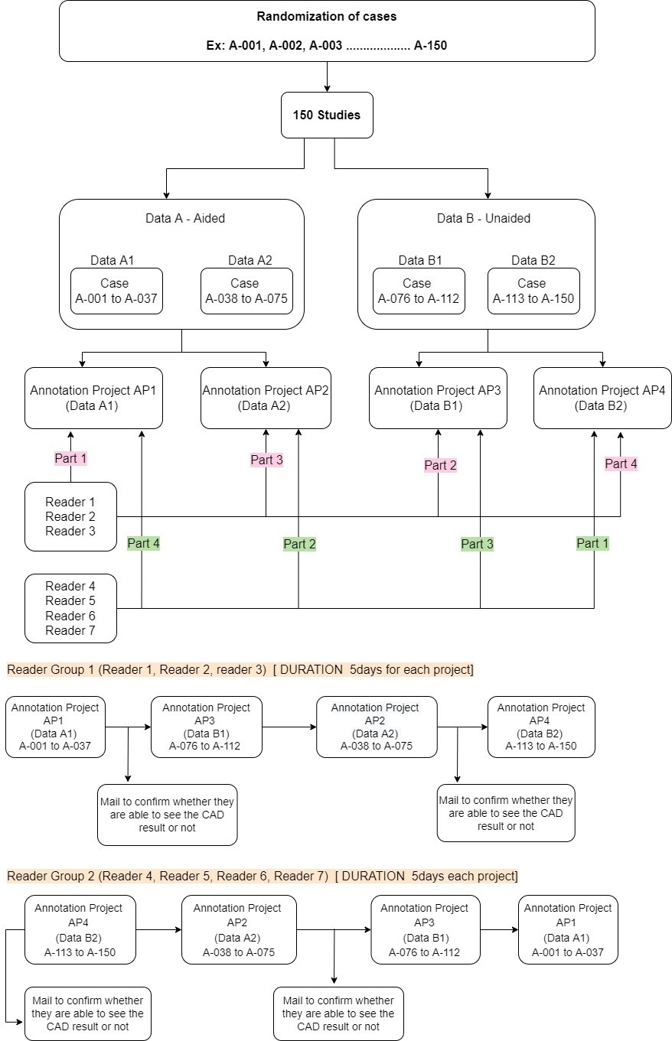
Methodology

Slide 7
Methodology
I was actively involved in training the radiologists to utilize the features of the platform efficiently.
The following tasks were handled by CARPL team:
Demo sessions
Data curation and cleaning
Uploading the data on to the platform
Gathering requirements for customization of platform as per clients’ needs
Creation of annotation templates and projects
Tracking the annotation status
Providing support 24*7
How the platform was utilized by me to conduct the clinical trial is explained below in further slides

Slide 8
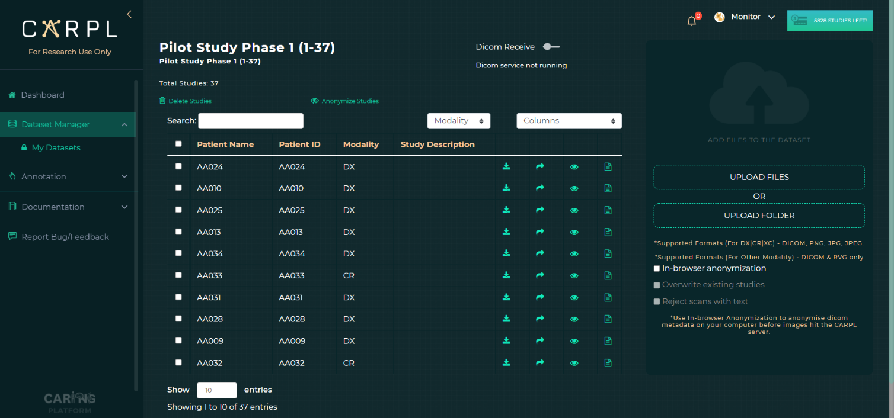
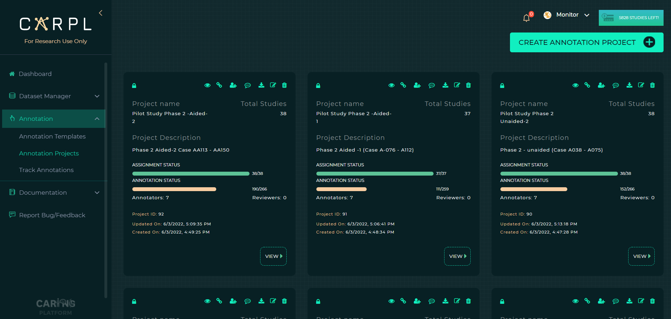
Results
Successful upload of data with anonymization
Annotation templates linked to annotation projects that were successfully assigned to 7 users (radiologists)

Slide 9
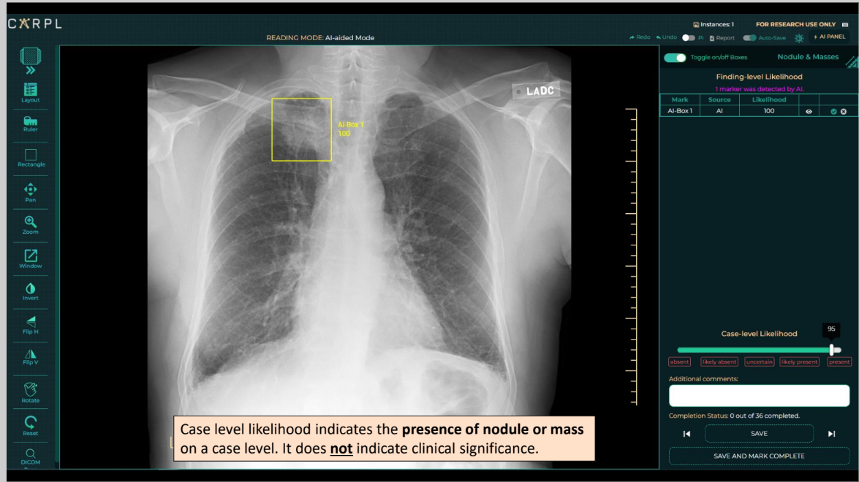
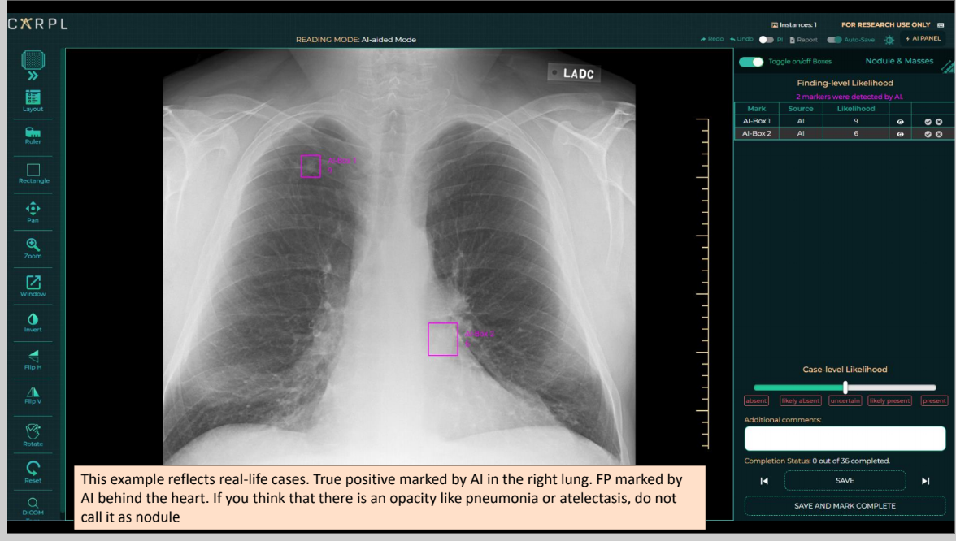
Results

Slide 10
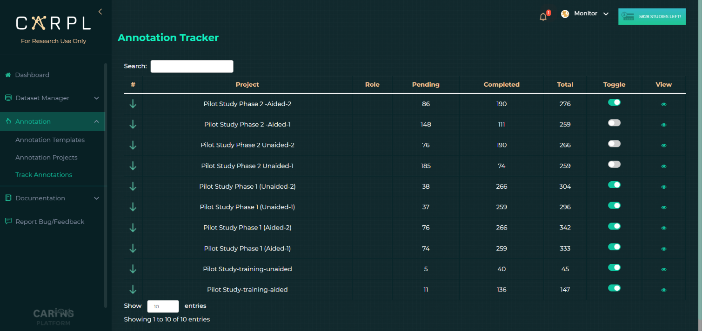
Results
Tracking the annotations and assigning projects as per protocol

Slide 11
Discussion
Medical imaging annotations require the knowledge of a qualified radiologist, and using Platform as a Service such as CARPL can be advantageous:
Faster production of high-quality labelled datasets,
Lower cost of getting annotations on huge datasets,
Faster development of machine learning or artificial intelligence for a variety of medical imaging jobs
The platform could be used by researchers and commercial vendors to speed up the annotation and development of medical imaging datasets. Labelling for categorization and object identification activities, as well as data and project management tools, are already accessible options.

Slide 12
Discussion
The usefulness of a web-based solution that is simple to apply on both a local and global scale is presented in this research study. For the user-friendliness of the interface, we recommend using a small amount of functions. Additionally, as an option, we supply annotators with additional clinical information, such as radiological reports or patient history, in order to improve annotation accuracy.
Currently, healthcare providers, big national research institutes, and huge research institutes own the majority of the data. Finally, sharing all data, regardless of state, will aid in the creation of new value. Even yet, actively sharing data without recompense for intellectual labor, such as annotation and curation, that reflects the benefits of the organization that owns it, would be difficult. We want to keep improving the CARPL system and, in the near future, to represent the value of data and use it as a currency for data exchanges.
CARPL’s aim is to overcome prior research constraints by providing a powerful platform that can scale and add new functionality quickly by connecting different modules in the lifecycle of an artificial algorithm.

Slide 13
Limitations of the Study
CARPL does not yet feature image segmentation algorithms.
Platform lacks full support for volumetric images and non-image DICOM instances like DICOM-SEG and DICOM-SR.

Slide 14
Conclusion
By using CARPL platform, the client was able to conduct a pilot study that was a “dry-run” for pivotal study intended for FDA clearance. Using CARPL’s PaaS features, the client was able to assess whether AI can help readers read more accurately.
The confidence score feature on the platform helped the radiologists decide on the confidence of finding presence rather than its measure of actionability or malignancy.
CARPL is a medical imaging-specific collaborative annotation platform that effectively helps the user do annotations and gives indications for assessing the value of data and annotators' efforts.

Slide 15
References
https://carpl.ai/
Witowski J, Choi J, Jeon S, Kim D, Chung J, Conklin J, Longo MG, Succi MD, Do S. MarkIt: a collaborative artificial intelligence annotation platform leveraging blockchain for medical imaging research. Blockchain in Healthcare Today. 2021 May 5
Rubin DL, Akdogan MU, Altindag C, Alkim E. ePAD: an image annotation and analysis platform for quantitative imaging. Tomography. 2019 Mar;5(1):170-83
Urban T, Ziegler E, Lewis R, Hafey C, Sadow C, Van den Abbeele AD, Harris GJ. LesionTracker: extensible open-source zero-footprint web viewer for cancer imaging research and clinical trials. Cancer research. 2017 Nov 1;77(21):e119-22.
Philbrick KA, Weston AD, Akkus Z, Kline TL, Korfiatis P, Sakinis T, Kostandy P, Boonrod A, Zeinoddini A, Takahashi N, Erickson BJ. RIL-contour: a medical imaging dataset annotation tool for and with deep learning. Journal of digital imaging. 2019 Aug;32(4):571-81.
Chen S, Guo J, Wang C, Xu X, Yi Z, Li W. DeepLNAnno: a web-based lung nodules annotating system for CT images. Journal of medical systems. 2019 Jul;43(7):1-9.

Slide 16
Thank You
Any Questions

Slide 17
Suggestions to the Organization where the Study was Conducted
Adherence to timelines
Back-up plans for radiologists, in case of emergency situations

Slide 18
Dissertation Experiences
What did you learn (skill/ topic)?
Overall self comments on Dissertation
AI Lifecycle Management
Data Management
AI Usability and Validation
CARPL as a platform has wide range of features that can be explored for different use cases as per the requirement.

Slide 19
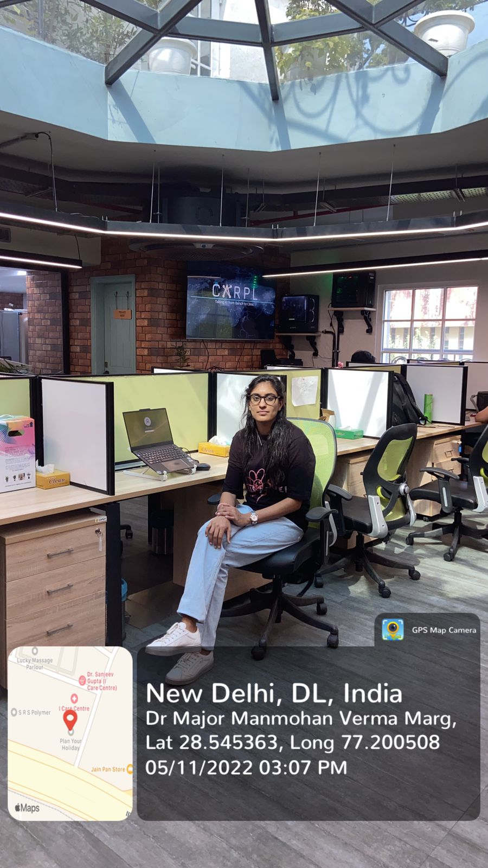
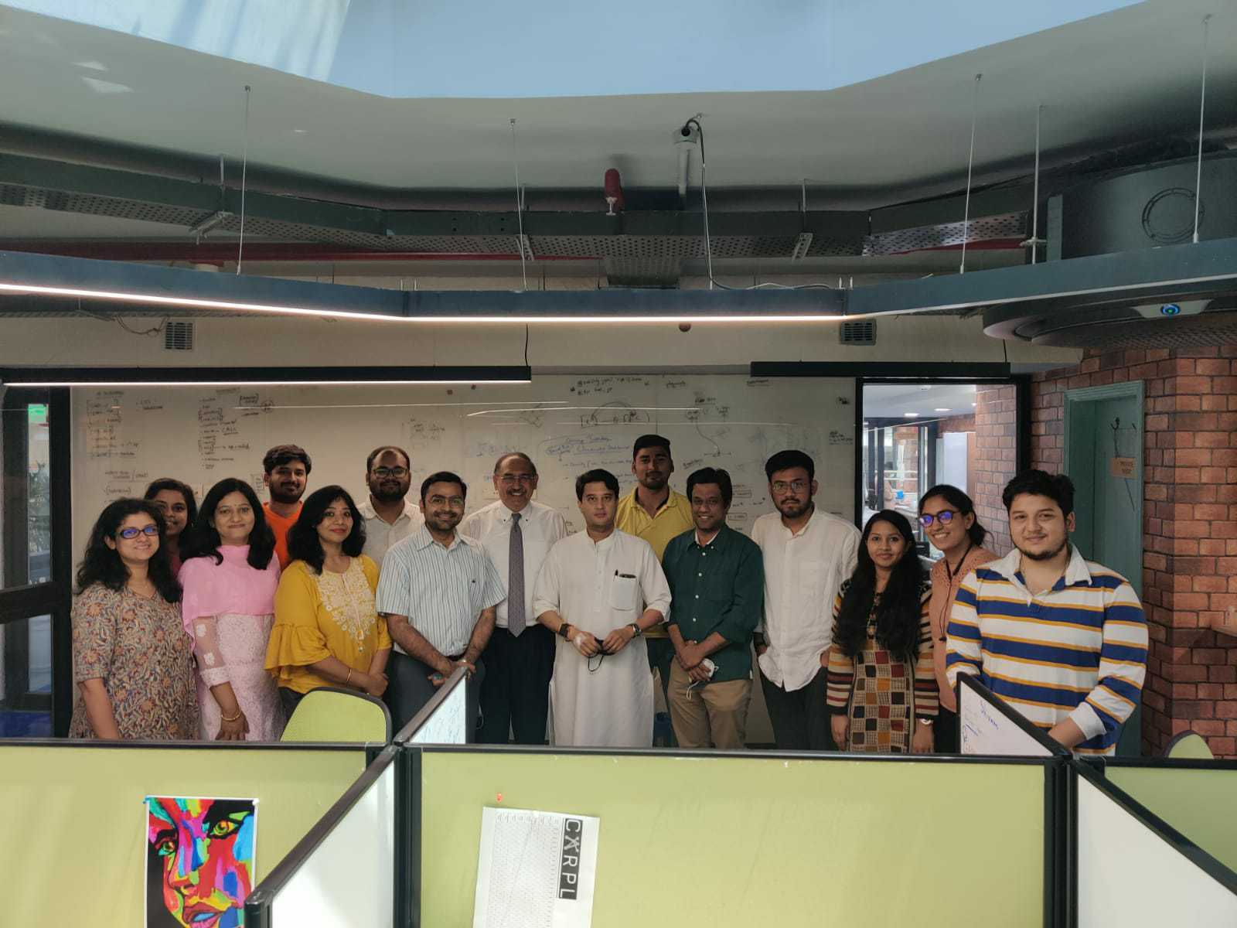
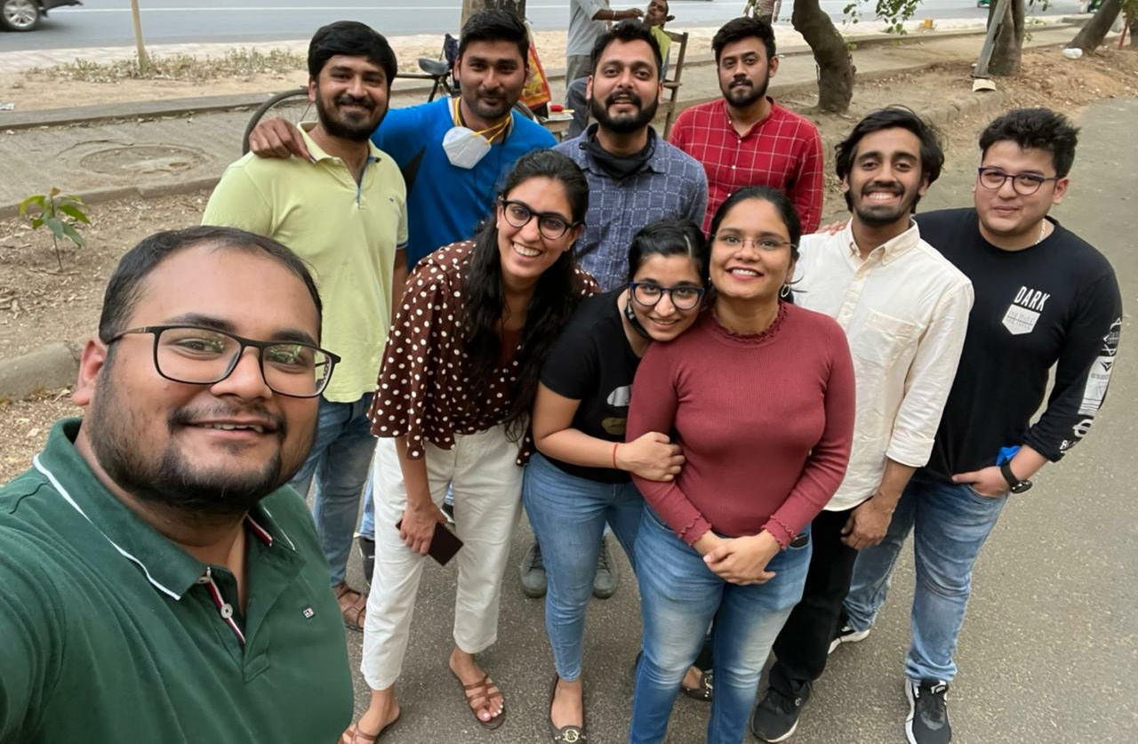
Pictorial Journey
THE FAMOUS CARPL’S OFFICE SPACE
FREQUENT CELEBRITY VISITS AT CARPL
TIME OUT SESSIONS

Slide 20

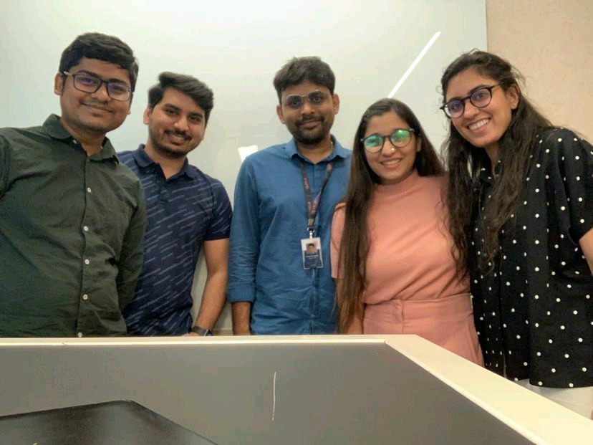
Pictorial Journey
OFF-SITE
ON-SITE

