Slide 1
Healthcare Software Maintenance in a Medium sized Healthcare IT organization through Analysis of Tickets Severity
Presented by: Dr. Mansi
Faculty Mentor: Dr. Anandhi Ramachandran
International Institute of Health Management Research, New Delhi

Slide 2
Screenshot of Approval

Slide 3
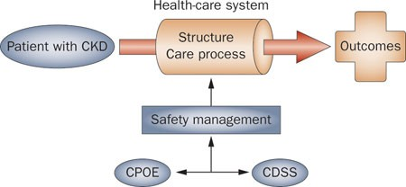
Introduction
The healthcare industry is highly dynamic, it integrates technology into processes to improve patient’s efficiency and quality of life.
Healthcare system must meet the required standards as it is subject to regulatory guidelines and other health compliance requirements.
Computerized Physician Order Entry with Clinical Decision Support System enhances patient safety and are examples of information systems that enable healthcare organizations to enhance clinical processes, control costs, and respond to the need for excellent care.

Slide 4
Introduction
Software Product management is a discipline and a business process that manages the process from product inception to delivery.
Lifecycle phases: Pre-Delivery Phase & Post Delivery Phase
Software System Development- Pre Delivery Phase, evaluated based on technical quality.
Post-delivery quality aspects of software include the quality of the product, in addition to the quality of service provided to the customer.
Software maintenance is a crucial post-delivery endeavour that plays a vital role for client gratification.
Ticket Resolution in Software Maintenance and Service Delivery
Ticket reporting and resolution is a key aspects of software maintenance.
Tickets are raw, unprocessed data that have an enormous amount of information.
They help track and coordinate software maintenance efforts.
This study is based on analysing the existing Turn-around time for tickets raised and identify the reasons for deviation from standard time.

Slide 5
Objectives of the study
01
02
03
04
Based on the above to recommend steps that can be taken for closing the tickets within the standard time.
To analyse the severity and frequency of the issues (tickets) raised by customer in various modules of KareXpert Digital Platform
To analyse the time taken to close the tickets in the existing software maintenance process in the organization.
To perform root cause analysis of the turnaround time of the tickets.

Slide 6
Methodology
Study Design Observational
Study Setting KareXpert Hospital Information System
Study Duration 01/02/2022 to 30/04/2022
Data Type Primary- tickets raised, type, frequency, created date and time, date of closure
Data collection Tool :Customer Ticketing Tool(containing reports of tickets raised), Interaction with technical team
Data Collection: Search strings utilized were combinations of terms: Healthcare, IT, software, tickets, severity, software quality, maintenance, CDSS, CPOE, ticket analytics
Ethical Consideration: No identification data like name of facility (client) was collected

Slide 7
Result
I. Analysis of Severity and Frequency of The Issues (Tickets) Raised by Customer in Various Modules of KareXpert Digital Platform
Total Number of Tickets raised from Feb to April = 736 Tickets
Severity Level 1/ Urgent Priority- Critical impact; resolution within one hour of notification
Severity Level 2/ High Priority - Significant impact; resolution within two hours of notification
Severity Level 3/ Medium Priority - Some impact; resolution within one business day of notification
Severity Level 4/ Low Priority- Minimal impact; resolution within two to three business days of notification

Slide 8
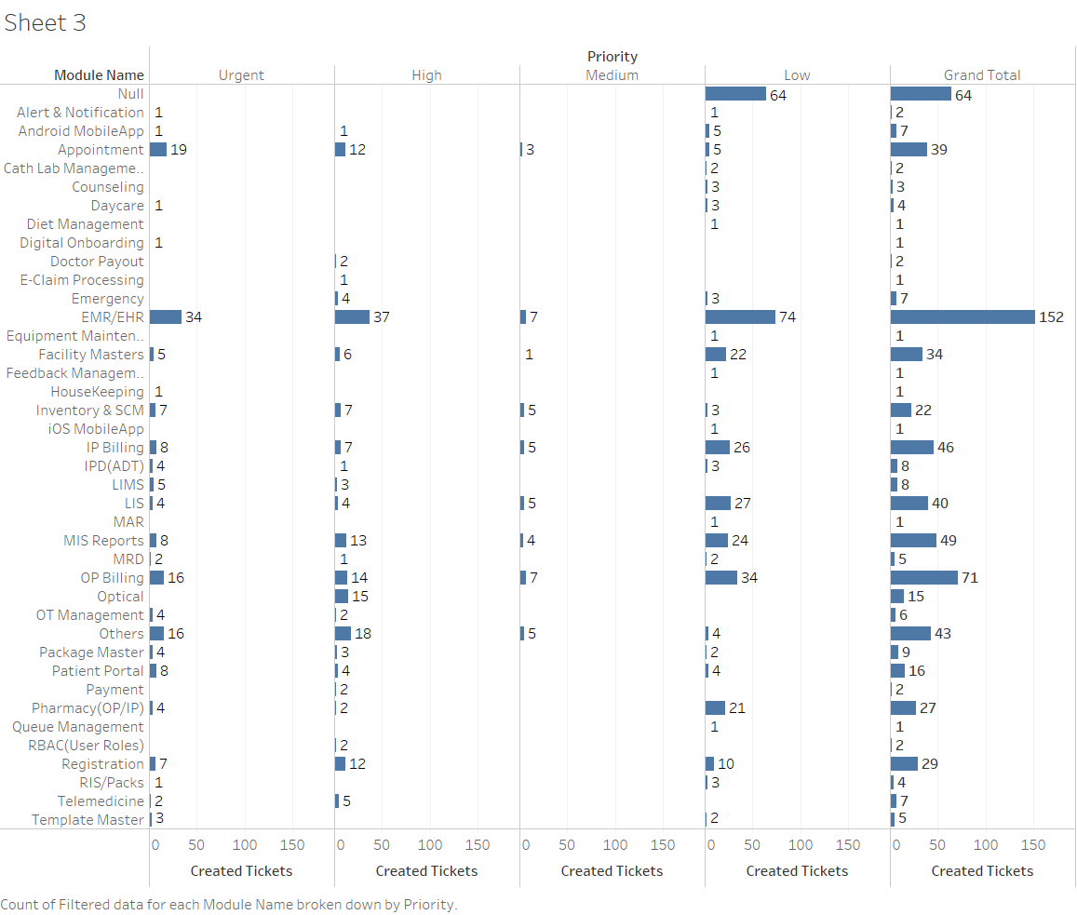
Result

Slide 9
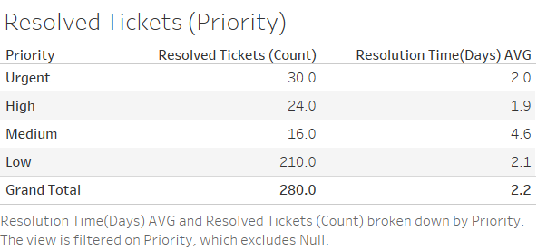
Result
II. Analyse The Time Taken to Close the Tickets in The Existing Software Maintenance Process
Total Number of Tickets Resolved from Feb to April = 280 Tickets
Tickets raised by sources:
Phone- 61.48%
Portal- 37.81%
Module Name | Resolved Tickets (%) | Module Name | Resolved Tickets (%)
Not Defined | 0.36% | LIS | 11.39%
Alert & Notification | 0.71% | MIS Reports | 6.76%
Android MobileApp | 0.71% | MRD | 0.71%
Appointment | 3.20% | OP Billing | 12.46%
Day care | 1.42% | Others | 0.71%
Diet Management | 0.36% | Package Master | 0.71%
Digital Onboarding | 0.36% | Patient Portal | 0.36%
Emergency | 1.78% | Pharmacy (OP/IP) | 5.34%
EMR/EHR | 23.49% | RBAC (User Roles) | 0.36%
Facility Masters | 9.25% | Registration | 2.14%
Inventory & SCM | 3.20% | RIS/Packs | 0.71%
IP Billing | 10.68% | Telemedicine | 0.36%
IPD(ADT) | 1.42% | Template Master | 0.71%
LIMS | 0.36%

Slide 10
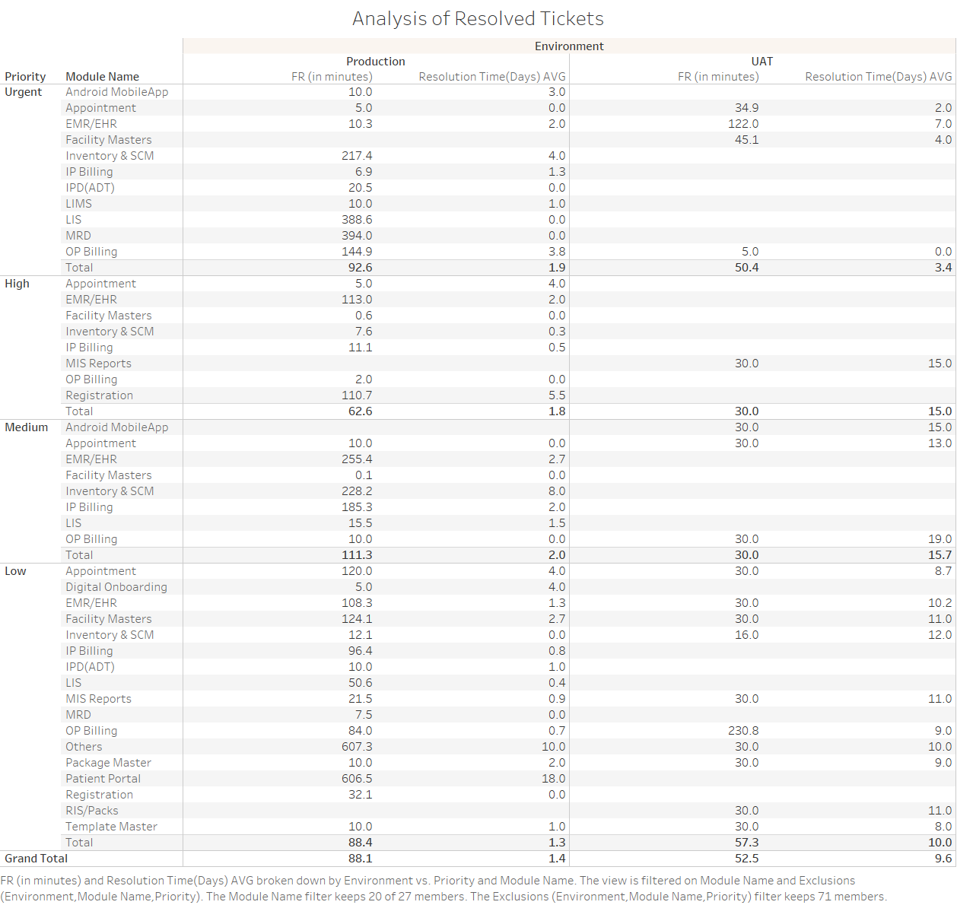

Slide 11
Result
Turnaround Time for the respective months:
M-01 – Six Days
M- 02 – Nine Days
M-03 – Six Days
III. Root Cause Analysis of the Turnaround Time of the Tickets
Project Requirement
Issue
People
Requirement description was inadequate
Lack of adequate supervision in some cases
Lack of proper training
Untold expectations (ex- New Features)
Lack of user involvement
Change coordination
Communication gap
Time constraints
Missing awareness for need for documentation
Software
Maintenance
Sometimes Unreliable procedure of testing
Rework leads to increase cost
Documentation of the issue not done correctly
Incomplete Testing (Tight schedule)
Tool not used to its full capacity
Testing
Tool

Slide 12
Discussion
A customer when raises a ticket, there is a provision for them to define the type of ticket as change request, when they want any change in the existing workflow or process or an incident, when they encountered any incident while running the software. When product modification is required , then the request is forwarded. The developers responsible for maintenance are selected and the service ticket is sorted, according to the priority assigned.
According to the analysis, 54.45% of the total resolved tickets were change requests, 37.37% of the total were incident, which were raised by the customers.
In our study, we found that majority of tickets contained queries entered by users during their lifecycle. User input requests resulted in resolution times, nearly double the service resolution times measured by users.
It was noted that the first response time was delayed, but the resolution was provided within two days, this delay in the first response was the major factor that resulted in the overall increase in the turn-around time.

Slide 13
Limitations of the study
As in any software application, the KareXpert Hospital Information System is open to a huge set of enhancements in the future and ticket resolution is an important task within the software maintenance process of the organization under study.
Lack of generalizability: Done in a single healthcare IT organization.
Limited time-frame for the study.
Study was performed on the data extracted from customer ticketing tool, in some cases we did not have access to sufficient data to support our inferences.
While the customer ticketing tool is the recommended communication channel between customers(users), analysts and operations team, there can be communication over chat and phone (not accessible for analysis because of confidentiality and privacy reasons)

Slide 14
Suggestions to the organization where study was conducted
While testing and gathering project requirements, early detection and defect prevention should be done.
Weekly trainings can be conducted for new employees under the supervision of senior and experienced professionals.
Adequate prioritization of activities should be done to understand the best options from different options with the right balance of resources and outcomes involved.
Issue raised should be properly documented and assigned to the correct person in-charge.
Avoiding unnecessary lags, when an issue is reported, taking ownership, and avoiding tossing can result in early resolution of the tickets.

Slide 15
Conclusion
Implementation of an effective maintenance strategy at the point of service reflects the high profitability and high level of customer satisfaction of the business.
A thorough analysis of tickets and related details will prove to be beneficial in long run.
From our study we found that around 40% of reduction in average turnaround time is possible, with proper management.
Enhancement activities can be done in the saved time.
This will help project managers to plan and allocate team members to different project activities depending on the estimation and prediction of the turn-around time in subsequent periods.

Slide 16
References
Zhao, P., Yoo, I., Lavoie, J., Lavoie, B. J., & Simoes, E. Web-Based Medical Appointment Systems: A Systematic Review. Journal of medical Internet research, 19(4), e134. 2017 [cited 9 May 2022]. Available from: https://doi.org/10.2196/jmir.6747
ESEC/FSE '09: Proceedings of the 7th joint meeting of the European software engineering conference and the ACM SIGSOFT symposium on the foundations of software engineering. Pages 111-120. 2009. [cited 25 April 2022]. Available from: https://doi.org/10.1145/1595696.1595715
Defect Severity And Priority In Testing With Examples And Difference [Internet]. Software Testing Help. 2022 [cited 9 May 2022]. Available from: https://www.softwaretestinghelp.com/how-to-set-defect-priority-and-severity-with-defect-triage-process/
Hsin Li T. et. al. Incident Ticket Analytics for IT Application Management Services [Internet]. Ieeexplore.ieee.org. 2014 [cited 9 May 2022]. Available from: https://ieeexplore.ieee.org/abstract/document/6930581
L’Erario A, Thomazinho H, Fabri J. An Approach to Software Maintenance: A Case Study in Small and Medium-Sized Businesses IT Organizations. International Journal of Software Engineering and Knowledge Engineering [Internet]. 2020 [cited 9 May 2022];30(05):603-630. Available from: https://www.worldscientific.com/doi/10.1142/S0218194020500217
Christa S, V S. Analysis of ticket severity: A case study [Internet]. Ieeexplore.ieee.org. 2017 [cited 20 April 2022]. Available from: https://ieeexplore.ieee.org/document/7975568/
P Lientz B, Swanson E. Software maintenance management [Internet]. 1980 [cited 20 April 2022]. Available from: https://www.researchgate.net/publication/234794062_Software_Maintenance_Management
Li J, Stålhane T. Cost drivers of software corrective maintenance: An empirical study in two companies [Internet]. 2010 [cited 20 April 2022]. Available from: https://www.researchgate.net/publication/221307737_Cost_drivers_of_software_corrective_maitenance_An_empirical_study_in_two_companies
Software Engineering — Software Life Cycle Processes — Maintenance [Internet]. Mireilleblayfornarino.i3s.unice.fr. 2006 [cited 20 April 2022]. Available from: https://mireilleblayfornarino.i3s.unice.fr/lib/exe/fetch.php?media=teaching:reverse:10.1109_ieeestd.2006.235774.pdf
COSTABILE M. Handbook of Software Engineering and Knowledge Engineering [Internet]. Google Books. 2001 [cited 20 April 2022]. Available from: https://books.google.co.in/books?hl=en&lr=&id=ILLcsh36RpEC&oi=fnd&pg=PA179&ots=24m-Nf56-p&sig=OGZCSzhEB7r7mkrlDW0wo8heg5U&redir_esc=y#v=onepage&q&f=false
Incident Ticket Analytics for IT Application Management ..., https://www.researchgate.net/profile/Ying-Li-285/publication/286668462_Incident_Ticket_Analytics_for_IT_Application_Management_Services/links/569d02ed08ae27633ac97b76/Incident-Ticket-Analytics-for-IT-Application-Management-Services.pdf.
1. L'Erario A, Christine Seródio Thomazinho H, Augusto Fabri J. An Approach to Software Maintenance: A Case Study in Small and Medium-Sized Businesses IT Organizations | International Journal of Software Engineering and Knowledge Engineering [Internet]. Worldscientific.com. 2020 [cited 1 May 2022]. Available from: https://www.worldscientific.com/doi/10.1142/S0218194020500217

Slide 17
Thank You Any Questions?

