Slide 1

Understanding OT Utilization and Impact on Major Surgeries due to Covid-19 at
Venkateshwar Hospital, Dwarka
Under the guidance of
Dr Nikita Sabherwal
Associate Professor
IIHMR, Delhi

Slide 2
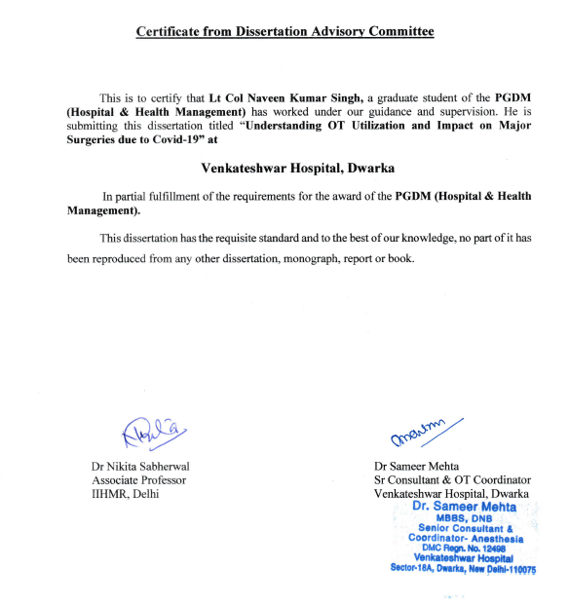
SCREENSHOT OF APPROVAL

Slide 3
INTRODUCTION
Creation of OT in Hospital requires financial burden and resources. It is estimated that 40% of Hospital budget is utilized in OTs annually.
Utilization of OT has direct impact on the revenue generation for the Hospital.
50 to 60% of total revenue is generated from OTs in a Hospital.
Hospital to ensure optimal utilization of manpower, resources and equipment to increase the efficiency, patients’ satisfaction and revenue.
Key Elements:
  Layout and availability of equipment.
  Well trained OT Staff.
  Positive attitude and responsiveness of OT staff.
  Proper planning and scheduling of OTs.
  Lowering supply cost by standardizing equipment usage and its selection.
  Eliminating duplicate and manual operations to streamline workflow.

Slide 4
INTRODUCTION
Impact of Covid-19
  Re-allocation of resources and staff to deal with rush of patients with Corona virus.
  Elective surgeries were being postponed around the world.
  Efforts made to prioritize cases that require surgery, limit time spent in Hospitals to lower risk of infection with Covid-19.
  Adverse impact on developing countries like India due to limited health-care infrastructure.
  More than 6 Lakhs elective surgeries were delayed or cancelled in India by June 2020 (International Research Consortium).
  Cancellation of surgeries may have adverse impact on patients resulting in death or life long disability.
(1)

Slide 5
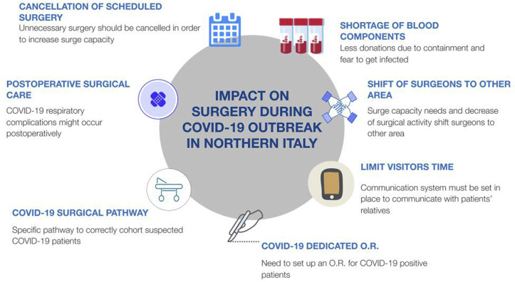
LITERATURE REVIEW
Impact on COVID-19 on surgical practice.
  Paper Published in International Journal of Surgery in Jul 2020.
  Prioritization of Surgical Cases as per specialties.
(2,3)

Slide 6
LITERATURE REVIEW
(4)
Too long to wait : The Impact of COVID-19 on Elective Surgeries.
  Paper published in Lancet Rheumatology in Feb 2021.
  Highlights issue of waiting period for Elective Surgeries.
  10 Million people in UK were awaiting surgery after outbreak of pandemic.
  1 lakh people waiting for joint replacement Surgery.
  Living with pain was strongly associated with substance abuse and impaired mental health.
  90% of Patients having axial pain had clinical depression and 60% with knee replacement surgery.

Slide 7
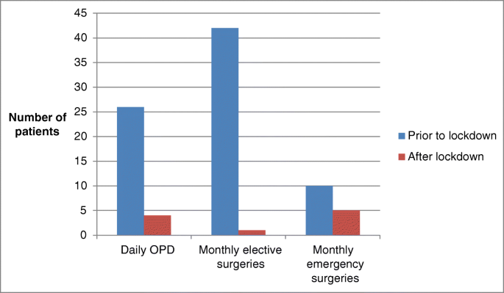
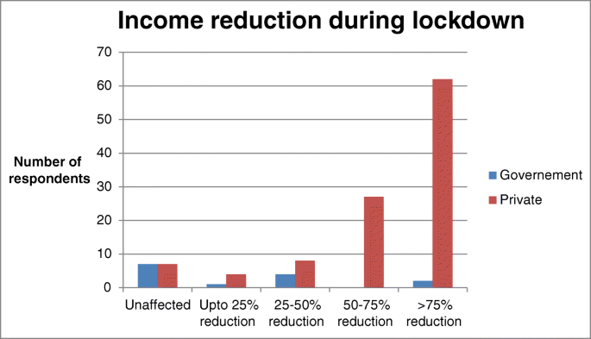
LITERATURE REVIEW
(5)
Impact of COVID-19 on General Surgical Practice in India.
  Paper published in Indian Journal of Surgery in Jun 2020.
  Survey questionnaire was distributed to Surgeons.
  Data on number of Surgeries carried out and financial losses were evaluated.

Slide 8
OBJECTIVES
Analyse utilization of OT at Venkateshwar Hospital, Dwarka for last three Years.
Analyse change in pattern in each specialities at different durations of Covid-19 waves and during normal times.
Analyse the impact on revenue generation in OT due to the lockdown during Covid-19 waves.

Slide 9
RESEARCH METHODOLOGY
Cross sectional study to understand utilization of OT.
Type of Study : Retrospective.
Location of Study : Venkateshwar Hospital, Dwarka.
Type of Data : Secondary Data of Surgeries carried out in the Hospital in the Year 2019, 2020, 2021 and 2022 (up to Mar 2022).
Study Duration : 15 Mar 2022 to 14 Jun 2022.
Data Collection Method : From OT register and MRD of Hospital.
Sample Size : Complete Data of all Surgeries carried out in last tree years were analysed hence no sampling method was used.
Data Analysis : Use of Excel sheet and bar graphs and Pie Chart.

Slide 10
RESEARCH METHODOLOGY
Expected Outcome
  Whether proper and judicious scheduling of cases have been carried out.
  Whether time take to carry out surgeries reduced or increased due to pandemic.
  Whether cancellation of surgeries affect utilization of OTs.
  Importance of streamlining of work flow and standardization of surgical procedures.

Slide 11
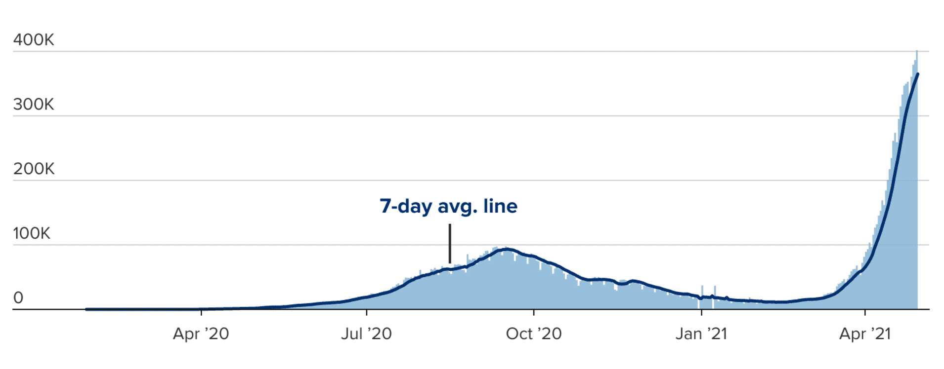
DATA ANALYSIS

Slide 12
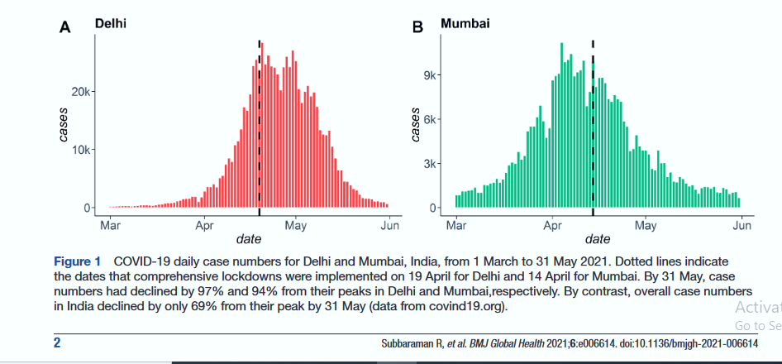
DATA ANALYSIS

Slide 13
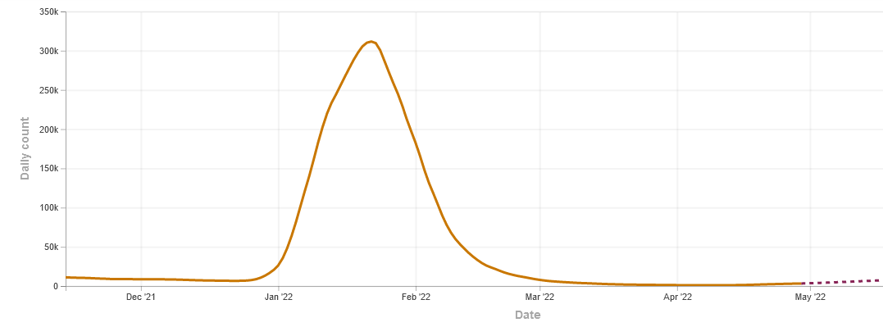
DATA ANALYSIS

Slide 14
DATA ANALYSIS
Specialties in which surgical procedures being carried out at Venkateshwar Hospital, Dwarka :
    Surgical Oncology.
    General Surgery.
    Orthopedics Surgery.
    Urology and renal transplant.
    Obstetrics & Gynecological Surgery.
    Gastrointestinal Surgery.
    Neuro Surgery.
    Ophthalmology.
    Cardiothoracic Surgery.
    Liver Transplant Surgery.
    Dental.
    Geriatric Surgery.
    Pediatric and Neonatal Surgery.
    ENT and Cochlear Implant Surgery.
    Plastic Surgery

Slide 15
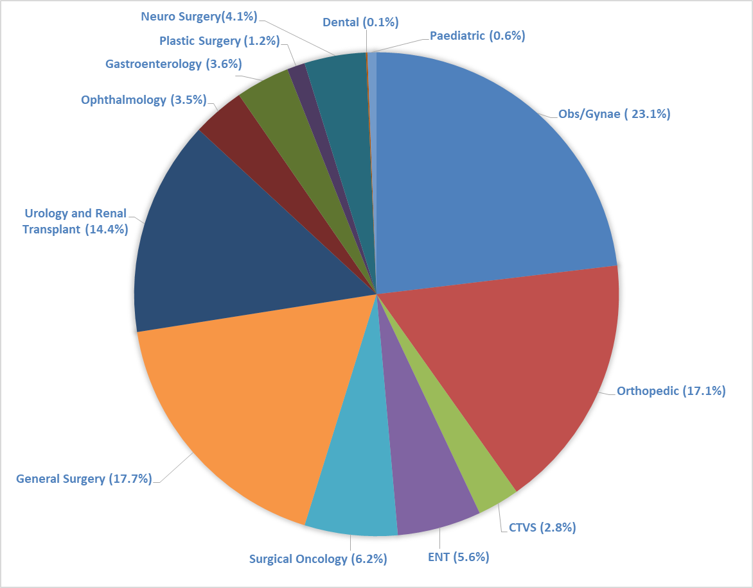
Percentage wise distribution of Surgeries at Venkateshwar Hospital

Slide 16
DATA ANALYSIS

Slide 17
DATA ANALYSIS

Slide 18
DATA ANALYSIS

Slide 19
DATA ANALYSIS

Slide 20
RESULT
Number of Surgical Procedures being carried out at Venkateshwar Hospital have reduced significantly in Year 2020 and 2021.
Reduction in Surgeries were comparatively more during second wave from April 21 to Jun 21 in relation to first wave from Jul 20 to Nov 20 and remaining months.
During third wave the reduction was less as compare to first and second wave.
Specialities which were less effected due to pandemic :
  Obs & Gynae.
  CTVS.
  Surgical Oncology.
  Urology and Renal Transplant.

Slide 21
RESULT
Specialities which were most effected:
  ENT and Cochlear Implant Surgery.
  General Surgery.
  Ophthalmology.
  Plastic Surgery.
Number of Hours OT Utilization was reduced in first and second Covid waves with reduction up to 74% and 71% respectively during surge in Cases.
During third wave the reduction was only 10-15%.

Slide 22
RECOMMENDATIONS
Prioritization of Surgical Procedures to be done in consideration with patients’ demand and availability of resources.
Effect on postponing of surgeries with primarily result to be examined.
Feasibility of alternate approaches that do not necessitate OTs.
Presence of co-morbidities and elevated risk of complications.
Surgical teams to encourage phone or video consultations wherever possible and cancel non-essential follow ups.
Daily conferences should be held to examine workload on OTs and approaches to deal with backlog.
Dedicated ‘clean’ and ‘dirty’ Operating Rooms to prevent spread of infection.

Slide 23
RECOMMENDATIONS
Surgical consent to be customized to avoid face-to-face contact using online documents.
Create a coherent leadership team and frequent communication processes to reduce rumors and false information about Covid-19.
Administrative jobs for clinical staff to be reduced so that medical professionals are available for surgical procedures.
Staff should obtain complete epidemiologic history of patients including recent travel history.
Adherence to follow guidelines for using personal hygiene to restrict spread of infection.
Hospitals should verify whether patients admitted for surgeries have any previous record of being COVID positive for further studies.

Slide 24
LIMITATIONS
  Study to be completed in fixed period of time.
  Data has been taken from Hospital Records which may have some percentage of error while recording.
  Exact data of number of surgeries cancelled on each day due to surge in cases of COVID patients.
  Exact availability of staff on each day was not available due to spread of infection with Covid-19.

Slide 25
CONCLUSION
Surgeons have become valuable resource for health care system to deal with Covid-19 outbreak.
Surgeons should continue to offer safe and effective care throughout pandemic till specific protocols for each speciality is created and followed.
Study to be carried out to determine difficulties faced by patients due to cancellation and how they overcome.
Number of deaths or disabilities that may have occurred due to cancellation of surgeries are directly or indirectly attributed to Covid-19.
Though various guidelines have been issued at national and International level, there is still lot of confusion about the best procedures to be followed.
With cases of Covid-19 still being reported throughout the world, need for continuous prevention and infection control to be in place.

Slide 26
REFERENCES
1. Effect of COVID-19 pandemic lockdowns on planned : an international, prospective, cohort study, The Lancet Oncology, Volume 22, Issue 11, 2021, Pages 1507-1517, ISSN 1470-2045, https://doi.org/10.1016/S1470-2045(21)00493-9.
2. Al-Jabir A, Kerwan A, Nicola M, Alsafi Z, Khan M, Sohrabi C, O'Neill N, Iosifidis C, Griffin M, Mathew G, Agha R. Impact of the Coronavirus (COVID-19) pandemic on surgical practice - Part 2 (surgical prioritisation). Int J Surg. 2020 Jul;79:233-248. doi: 10.1016/j.ijsu.2020.05.002. Epub 2020 May 12. PMID: 32413502; PMCID: PMC7217115.
3. Ahmed Al-Jabir, Ahmed Kerwan, Maria Nicola, Zaid Alsafi, Mehdi Khan, Catrin Sohrabi, Niamh O'Neill, Christos Iosifidis, Michelle Griffin, Ginimol Mathew, Riaz Agha, Impact of the Coronavirus (COVID-19) pandemic on surgical practice - Part 1, International Journal of Surgery, Volume 79, 2020, Pages 168-179, ISSN 1743-9191, https://doi.org/10.1016/j.ijsu.2020.05.022.
4. Stoner R. The Impact of COVID-19 on Surgical Practice – A Summary. World J Surg Surgical Res. 2021; 4: 1272.
5. Nasta, A.M., Goel, R., Kanagavel, M. et al. Impact of COVID-19 on General Surgical Practice in India. Indian J Surg 82, 259–263
(2020). 26 June 2020 https://doi.org/10.1007/s12262-020-02443-0
6. COVIDSurg Collaborative, Elective surgery cancellations due to the COVID-19 pandemic: global predictive modelling to inform surgical recovery plans, British Journal of Surgery, Volume 107, Issue 11, October 2020, Pages 1440–1449, https://doi.org/10.1002/bjs.11746
Sharma N, Sharma P, Basu S, et al. (October 24, 2021) Second Wave of the COVID-19 Pandemic in Delhi, India: High Seroprevalence not a Deterrent?. Cureus 13(10): e19000. doi:10.7759/cureus.19000
8. World health Organization 2021, WHO Coronavirus (Covid-19) Dashboard accessed on 06 Jun2022, <https://covid19.who.int/
9. Delhi Government 2022, Corona Dashboard accessed on 31 Mar 2022, < https://coronabeds.jantasamvad.org/

Slide 27
THANK YOU

