Slide 1
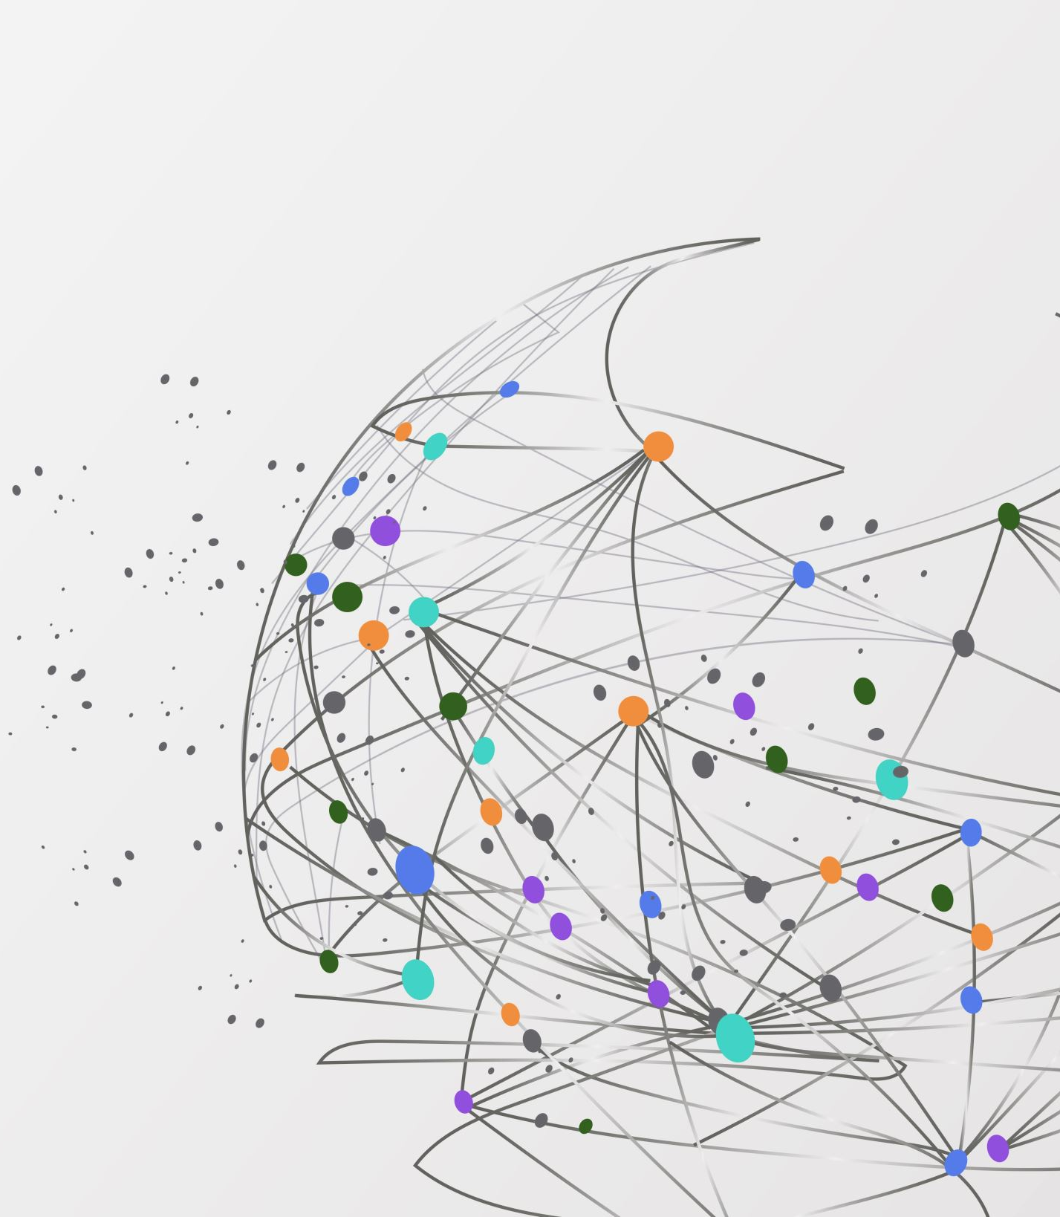
A study on converting Traditional Hospitals to Smart Hospitals with the assistance of future digital healthcare technologies such as AI, Machine Learning
Submitted by Dr. Pragyan P. Mishra

Slide 2
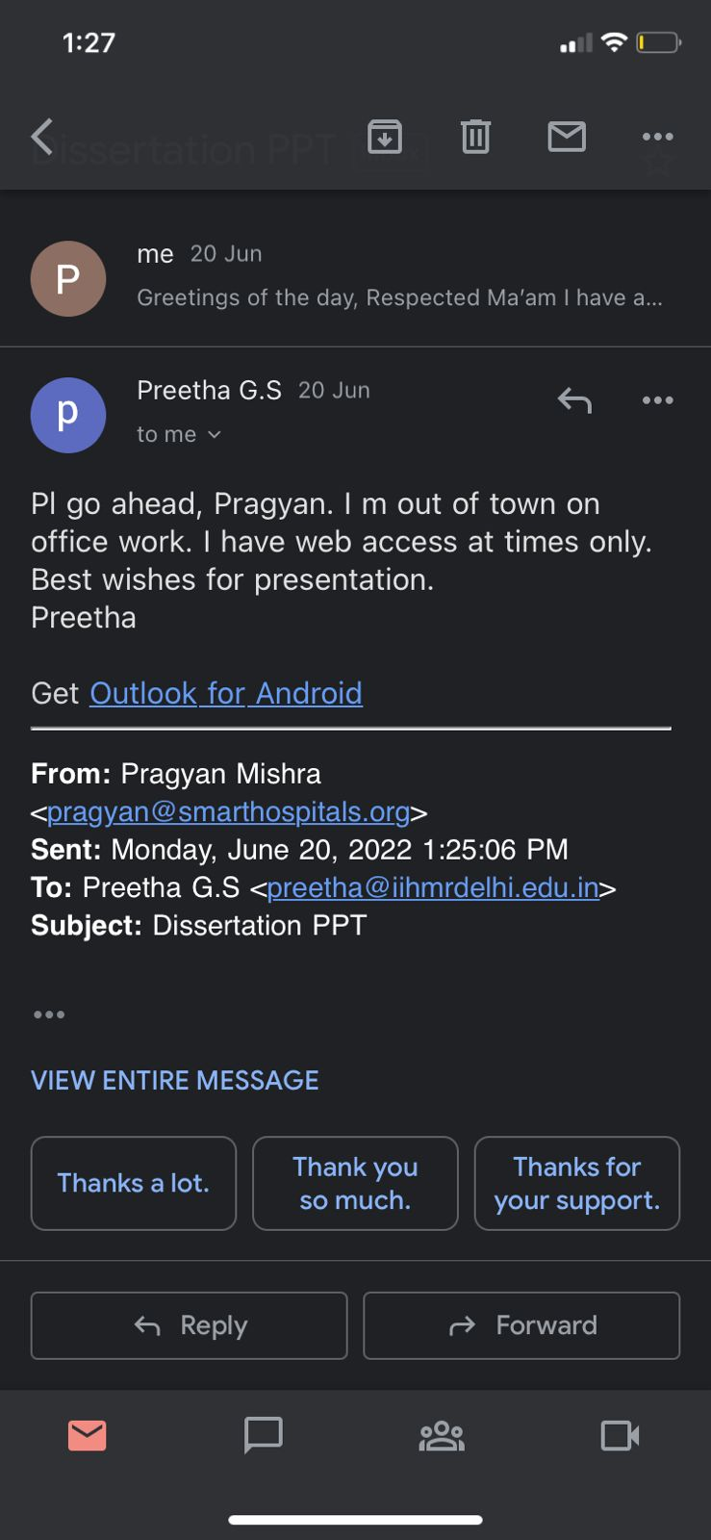
Approved by Dr. Preetha GS

Slide 3
The certificate is awarded to
Name: Dr. Pragyan Pallav Mishra
Title: Pre-Sales & Relationship manager
and has successfully completed his/her Project on
Title of the Project
A study on converting Traditional Hospitals to Smart Hospitals with the assistance of future digital healthcare technologies such as AI, Machine Learning
Date: 10/06/2022
Organization
Avisa Smart Hospitals
He comes across as a committed, sincere & diligent person who has a
a strong drive & zeal
We wish him all the best for future endeavors
Dr. Aswini Naidu Dilraj Kaur
Training & Development Zonal Head-Human Resources

Slide 4
Overview of Avisa smart hospital
Avisa smart hospital is built on the back of advanced technology and smart hospital features including cloud computing, Artificial Intelligence (AI) and machine learning
With our smart hospital solutions, we aim to create a smart environment that fosters better interaction between the various working systems of a hospital inclusive of features like book hospital bed online and book doctor consultation online
Smart pharmacy enabled digital prescription, which includes sensor enabled pen and paper that would follow the doctor's method of writing their own prescription in paper
Through AI the paper would automatically capture the patient's digital prescription into the patient as well as the doctor’s app
Born from the objective of bridging the gap between healthcare services and optimal patient care, Avisa Smart Hospitals is disrupting the way hospitals, clinics, diagnostic centers, and pharmacies operate utilizing a highly integrated hospital management software

Slide 5
Avisa’s solution to problems for Hospitals & Patients
To Provide a Seamless journey to a patient by
Patient Acquisition & Retention
Queue Management
Real time tracking of data
Digitalization of records
Hospital Digital Presence
One stop solution with diagnostic & pharmacy ,insurance & homecare
Patient counselling & education
Converting a Traditional Hospital to Smart Hospital

Slide 6
Introduction
Rapidly evolving digital technological innovations are affecting and changing all sectors' integrated information management processes
Because of the high efficiency of these innovations, the health sector has been forced to undergo a digital transformation in order to improve the technologies and methodologies used in healthcare management systems
The Internet of Things (IoT) technology plays a key role in this transformation, allowing many devices to connect and collaborate
Connecting machines is bringing businesses closer to their customers while also providing a tangible return on investment
Healthcare is experiencing a hardware and software revolution.
In terms of hardware, the use of the internet, mobile phones, and smartphones is on the rise. Artificial intelligence, robotics, genomics, telemedicine, virtual and augmented reality, and other medical technologies are becoming disruptive
In terms of software/information, a vast amount of medical data, peer support, and open-access clinical studies and guidelines are becoming widely available. It not only leads to the possibility of better quality and more information being obtained in healthcare, but also to the possibility of self-care

Slide 8
Objectives
The objective of this study to observe and determine the transformation of traditional hospitals into smart hospitals
To recommend appropriate suggestions for converting traditional hospitals into smart hospitals
To facilitate quicker decision making by the Doctors with the usage of IOT device, Doc Pen, Avisa app, and so on

Slide 9
Methodology
Research Design: Descriptive study
Data collection: I have collected data from various research papers through PubMEd, Google scholar, and Avisa’s publications
I have gone through 20 research papers; out of them I have selected 8 papers for literature review

Slide 10
Literature Review
In 2009, IBM (Armonk, NY, USA) proposed the "Smart Planet" concept. Smart healthcare is a health-care delivery system that uses IoT and mobile apps to dynamically access information, connect people, resources, and institutions in the healthcare ecosystem, and then intelligently manages and responds to those needs. Smart healthcare can promote interaction among all stakeholders in the healthcare industry, ensuring that participants receive the services they require, assisting parties in making informed decisions, and facilitating resource allocation
Qi et al, As per this research paper, the author evaluated different IOT applications in smart healthcare from various angles (i.e., Blood pressure monitoring, monitoring of oxygen saturation, health beat monitoring etc.). Secondly, the author reviewed the existing work of IOT that enable technologies for smart healthcare applications. From various perception, such as infrastructure and current technologies (i.e., Networking, Sensing and Data processing technologies)
Islam et al, In this review, the author centered on IoT-based healthcare technologies and present architecture for healthcare network and platforms that support access to the IoT backbone and enable medical data reception and transmission Second, the paper provides detailed research events and how the IOT can be used to address chronic disease supervision, pediatrics, elderly care, and fitness management

Slide 11
Literature Review
Baker et al. In this review, the author presented a new model for a future smart healthcare system that can be applied to both special (i.e., special condition monitoring) and general systems. Secondly, the author presented the overview of the state-of-the-art works related to the component (I.e., wearables and non-intrusive sensors monitoring blood pressure, blood oxygen level and vital signs) of the presented model. Secondly, the author review on short-range and long-range communication standards for smart healthcare.
Dhanvijay et al. In this review, the author emphasized various IoT-based healthcare systems for wireless Body Area Network (WBAN) that can enable smart healthcare data reception and transmission Second, the author provided a thorough examination of resource management, power, energy, security, and privacy issues in IoT-based smart healthcare.
Hyuktae kwan et al. Smart hospital services can be classified into the following types: services based on location recognition and tracking technology that measures and monitors the location information of an object based on short-range communication technology; high-speed communication network-based services based on new wireless communication technology; IOT-based services that connect objects embedded with sensors and communication functions to the internet; mobile health services such as cell phones, tabs, and wearables; AI-based services for the diagnosis.

Slide 12
Results
Smart devices acts as a mediator between the patient and doctor (even if they are far away), resulting in a new kind of doctor/patient relationship articulated around scientific knowledge, leading to the emergence of new smart health care models
Smart devices works as a tool for activity quantification, allowing users to track their activities, evaluate their progress, and project their progress toward a goal
Smart devices can help hospitals in providing more efficient services to patients

Slide 13
Challenges & Limitations
Ethics: Smart hospital has the potential to empower more people to take control of their health and, as a result, become more aware and informed. It does, however, raise a slew of ethical concerns. Who owns the health information gathered? Who wants to share their medical information? What happens to the new influxes of health data? When designing a smart hospital, all these factors must be considered
Patients' apprehension about technology: In terms of hardware, the use of the internet, mobile phones, and smartphones is on the rise. Artificial narrow intelligence, robotics, genomics, telemedicine, virtual and augmented reality, and other medical technologies are becoming disruptive
Integration problems: Many new smart hospital devices require their own app that may or may not integrate with various routers, smart hubs and other systems in the hospital
Device configuration: The configuration of smart devices should be very user-friendly. Many devices, however, still require manual intervention. In this situation, the need for AI-based configuration is obvious in order to ensure that devices are set up quickly and effectively

Slide 14
Conclusion
Patients are increasingly expecting seamless digital interactions as well as a healthcare experience that is as innovative and advanced as that of other service industries
Recent technological advancements and an explosion of non-urgent care options, healthcare consumers are more empowered than ever before to find healthcare organizations that meet (or exceed) their expectations
Medical practice has become increasingly reliant on health information technology
Utilize existing and emerging technologies to make on-time appointments a priority
Build processes around patients, streamline appointment workflows, and make sure everyone is in and out as quickly as possible
Allow patients to submit medical forms ahead of time using digital check-in services. Allow customers to book and reschedule appointments online with ease
Telehealth/telemedicine and other virtual care services should be integrated
Utilize physician assistants (PAs) and nurse practitioners (NPs) for routine or non-urgent visits to stay on schedule

Slide 15
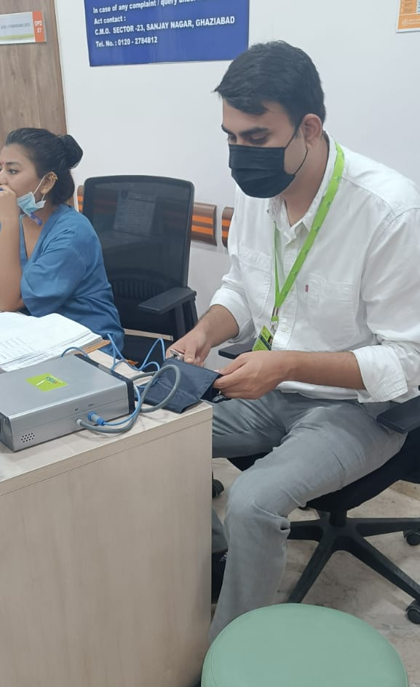
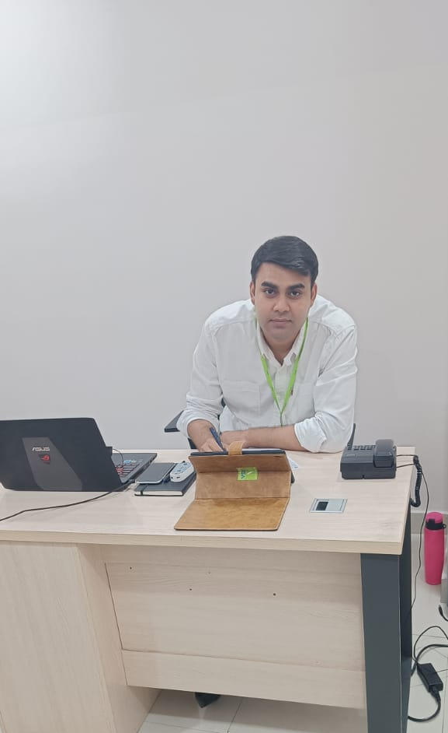
Pictorial journey at Avisa smart hospital

Slide 16
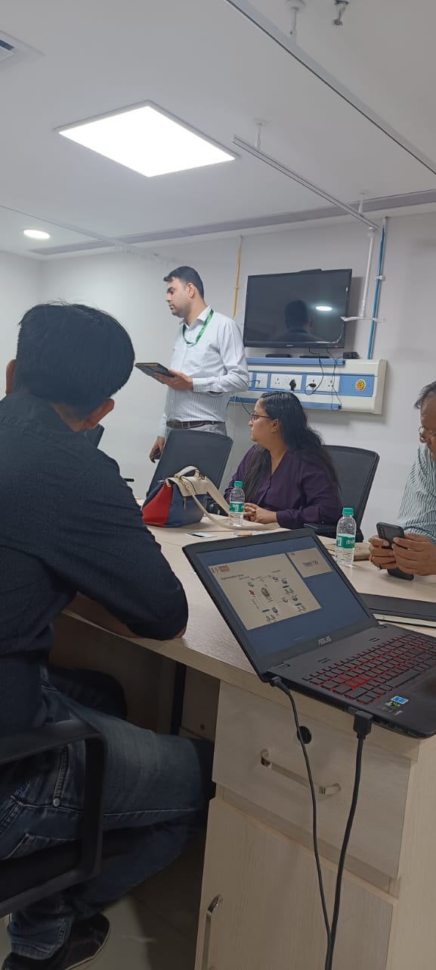
Pictorial journey at Avisa smart hospital

Slide 17
Pictorial journey at Avisa smart hospital

Slide 18
References
Holzinger, Article: Weakly structured data in health-informatics: the challenge for humancomputer interaction. In: Proceedings of INTERACT 2011 Workshop: Promoting and Supporting Healthy Living by Design, pp. 5–7. IFIP (2011)
Duerr-Specht, M., Goebel, R., Holzinger, Article: Medicine and health care as a data problem: will computers become better medical doctors? In: Holzinger, A., Roecker, C., Ziefle, M. (eds.) Smart Health. LNCS, vol. 8700, pp. 21-39. Springer, Heidelberg
Culler, D.E., Mulder : Smart sensors to network the world. Sci. Am.
Al Ketbi. L.M.B., & Al Deen. S.Z. (2018). The attitudes and beliefs of general practitioner towards clinical practice guidelines: a qualitative study in Al Ain, United Arab Emirates. Asia Pacific family medicine, 17(1). Retrieved August 31, 2019 From: https://www.ncbi.nlm.nih.gov/pmc/arti cles/PMC5975561/pdf/12930_2018_Articl e_41.pdf
Bmcpublichealth.biomedicalcentral.com
Link.springer.com

