Slide 1
A study on interoperability implementation in India and to find gaps and challenges associated with it
Presented by -
Prativa Priyadarshini
Mentor-
Dr Nikita Sabherwal
IIHMR Delhi

Slide 2
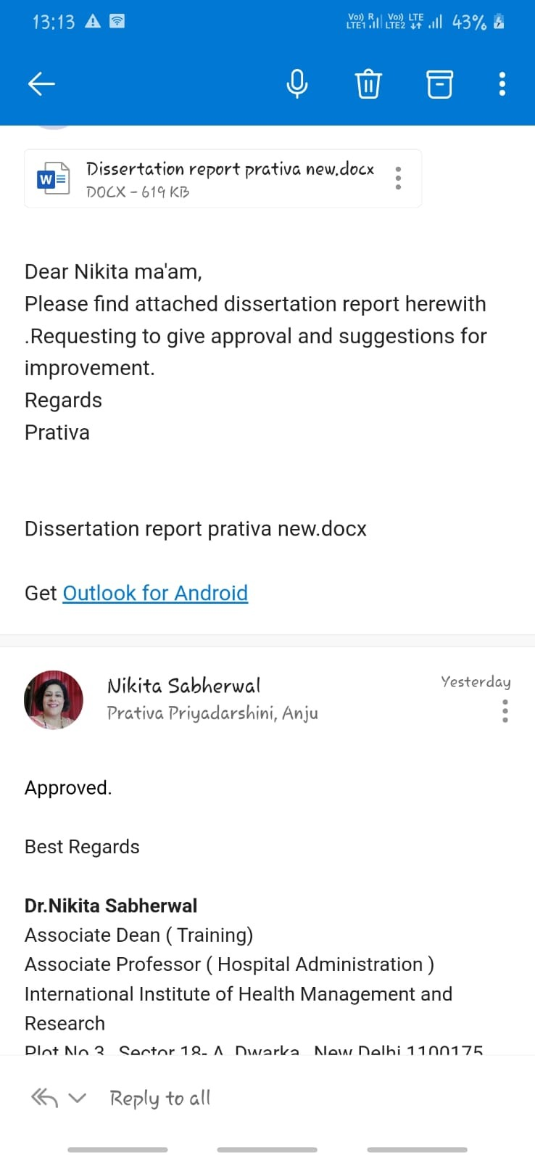
Screenshot of Approval
Protocol Approval
Report Approval

Slide 3
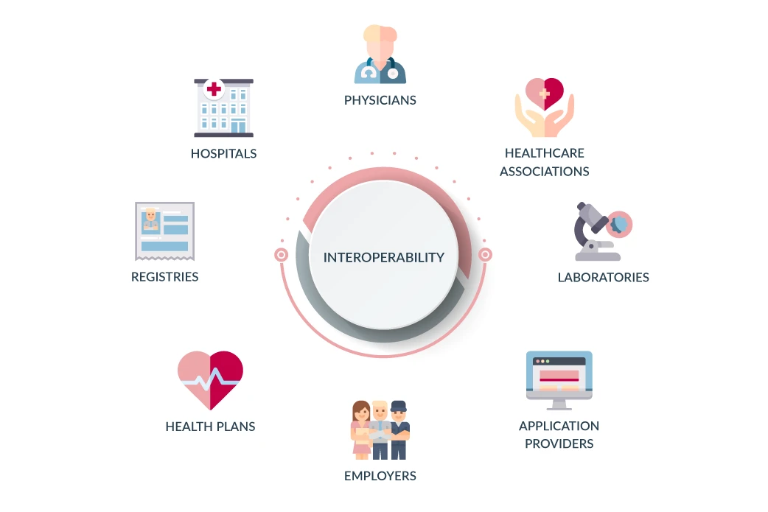
Introduction
According to IEEE Standards Computer Dictionary, Interoperability is defined as an ability of two or more systems or components to exchange information and to use the information that has been exchanged
Ayushman Bharat Digital Mission (ABDM) which is a flagship initiative by National Health Authority

Slide 4
Introduction
BENEFITS
Reduced the patient waiting time
Increase productivity
Reduce cost
Reduce error
Better public health data
CHALLENGES
Managing inconsistent information across multiple sources
Validating electronic requests for patient information
Overcoming organizational resistance to sharing data
The high cost of hiring specialists to manage interoperability
Making data readily available is now a requirement.

Slide 5
Objectives of Your Study
To find out current implementation status of interoperability in India among various healthcare organization.
To find out gaps and challenges for interoperability implementation In India.

Slide 6
Methodology (1/2)
Study design
A descriptive cross-sectional study using a self – administrative question will be applied.
Study Area
Employees of different healthcare organization who have working knowledge of Healthcare standards.
Study Duration
1 May 2022- 10 June 2022

Slide 7
Methodology (2/2)
Study Population-
Employees of different health IT companies who have working knowledge of Healthcare standards.
Sample size-
Exhaustive sampling procedures was considered
Source of data collection-
Google form was circulated in LinkedIn and community circle
Study Tool –
Google Form

Slide 8
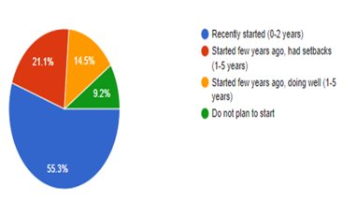
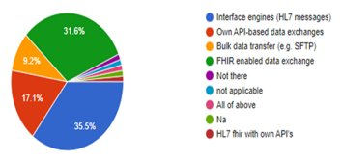
RESULTS (1/3)
Interoperability journey of respondent
Interoperability Standards currently used in Indian Health Industry ​

Slide 9
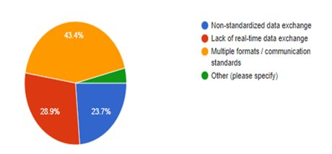
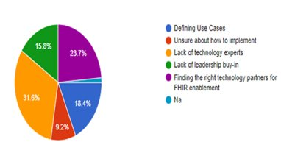
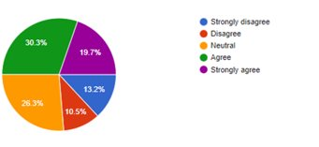
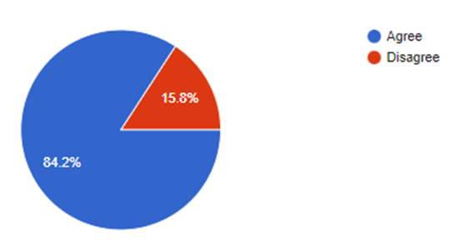
Response on Biggest challenges in interoperability in India ​
Biggest challenge to shift to a FHIR-based interoperability platform​
Missing data or irrelevant data can cause poor usability and negative impact on providers workflow
Block chain for medical records confidentially​

Slide 10
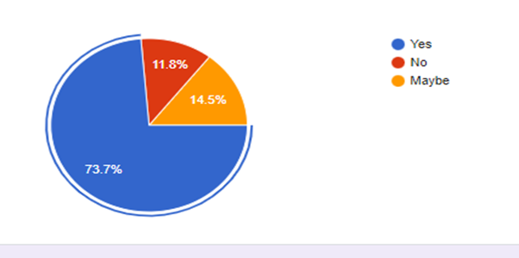
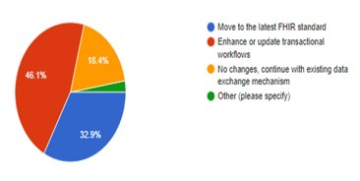
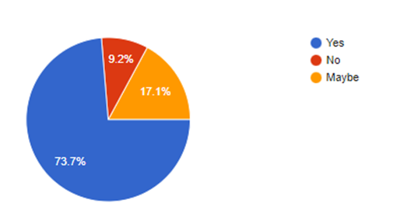
Standardized Summary Record
Changes required in the current
Interoperability environment used in Indian healthcare organizations​
NDHM Effectiveness

Slide 11
Discussion (1/2)
The lack of healthcare
technology experts.
Enhancing and updating transactional workflow
can make significant difference in India’s
current interoperability environment.
Multiple data exchange format, lack of real time none standardize information exchange across various organization

Slide 12
Discussion (1/2)
It is important to find
right technology partner
and identifying correct
case for FHIR
enablement
in the organization.
Majority of Indian Health
organization
are using FHIR/HL7 standard and
few still have their own API
based data exchange platform.
ABDM can put milestones in India for encouraging organization for adapting similar standard and formats for better care delivery

Slide 13
Limitations of the Study

Slide 14
Conclusion
Interoperability is prerequisite for taking healthcare sector towards advance technology. At first, they were concerned with achieving interoperability in particular domains, then with putting in place common infrastructure.
Ensuring end to end health information exchange with open standard presents new challenges. EHR and health information integration will win situation for patient, healthcare and life science industry. It is complex to take up ethical , legal semantic and geographical interoperability .

Slide 15
References
Ayaz M, Pasha MF, Alzahrani MY, Budiarto R, Stiawan D. The Fast Health Interoperability
Resources (FHIR) Standard: Systematic Literature Review of Implementations, Applications, Challenges and Opportunities. JMIR Med Inform. 2021 Jul 30;9(7):e21929.
Saripalle R, Runyan C, Russell M. Using HL7 FHIR to achieve interoperability in patient health record. Journal of Biomedical Informatics. 2019 Jun 1;94:103188.
Wadhwa M. Electronic Health Records in India. :23.
The HL7® Survival Guide — Chapter 2: Pros and Cons of Interfacing Capabilities [Internet]. Caristix. 2012 [cited 2022 Jun 4]. Available from: https://caristix.com/blog/2012/11/hl7-survival-guide-chapter-2/
What is HL7 and why does healthcare need it? [Internet]. OH Blog. 2020 [cited 2022 Jun 4]. Available from: https://blog.orionhealth.com/what-is-hl7-and-why-does-healthcare-need-it/
Interoperability [Internet]. RingCentral UK Blog. 2021 [cited 2022 Jun 5]. Available from: https://www.ringcentral.co.uk/gb/en/blog/definitions/interoperability/
A study on interoperability implementation in India [Internet]. Google Docs. [cited 2022 Jun 12]. Available from: https://docs.google.com/forms/d/e/1FAIpQLSeliiiyuxZhusGCqxk8vY3Z81itJRe3LDJtlkm4YXz_z5YoJQ/viewform?usp=drive_web&usp=embed_facebook
Health Level Seven International - Homepage | HL7 International [Internet]. [cited 2022 Apr 22]. Available from: https://www.hl7.org/
HL7 FAQ | HL7 Questions and Answers by PilotFish Integration Experts [Internet]. Healthcare Integration Engine. [cited 2022 Jun 4]. Available from: https://healthcare.pilotfishtechnology.com/hl7-faq/
How Privacy and Security Can Overcome Interoperability Challenges in Healthcare [Internet]. Imprivata. [cited 2022 Jun 5]. Available from: https://www.imprivata.com/blog/how-privacy-and-security-can-overcome-interoperability-challenges-in-healthcare
Interoperability in Healthcare | HIMSS [Internet]. [cited 2022 Jun 5]. Available from: https://www.himss.org/resources/interoperability-healthcare

Slide 16
Thank You
Any Questions

Slide 17
Suggestions to the Organization where the Study was Conducted

Slide 18
Dissertation Experiences
What did you learn (skill/ topic)?
Overall self comments on Dissertation

