Slide 1
Gap Analysis of Functional Requirements of Existing Building Blocks of Digital Health Interventions of NHA. Ernst & Young
Name: SALONI CHAWLA (PG/20/065)
Faculty Mentor: Dr. Rohini Ruhil
IIHMR Delhi

Slide 2
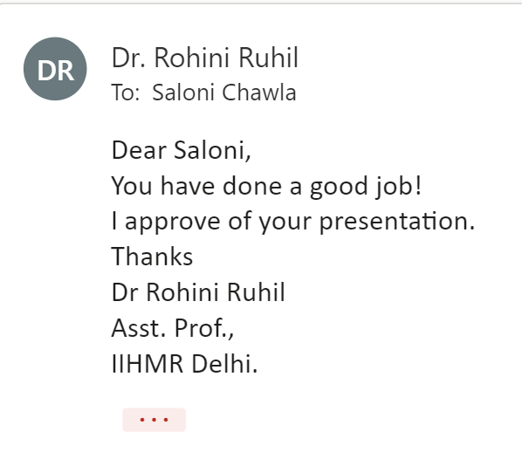
SCREENSHOT OF APPROVAL

Slide 3
INTRODUCTION
Digital Health Intervention
The intervention aims to develop the backbone necessary to support the integrated digital health infrastructure. It will bridge the existing gap amongst different stakeholders of Healthcare ecosystem through digital highways.
The broad vision of this ecosystem is to:
support universal health coverage in an efficient, accessible, inclusive, affordable, timely and safe manner
provides a wide-range of data, information, and infrastructure services, duly leveraging open, interoperable, standards- based digital systems; and
ensures the security, confidentiality, and privacy of health-related personal information.

Slide 4
INTRODUCTION
Sl. No. | Building block classification | Building Blocks
1 | Existing Building Blocks | ABHA ID
2 |  | Healthcare Professionals Registry (HPR)
3 |  | Health Facility Registry (HFR)
4 |  | Health Professional ID (HPID)
5 |  | ABDM App (PHR)
6 |  | Sandbox
7 |  | Grievance Portal
8 |  | ABDM Website
BUILDING BLOCKS
The digital intervention provides an approach to establish a Federated Architecture. Key building blocks have been identified by taking into consideration, the most common requirements of the overall health ecosystem. Building blocks are designed to be cross‐functional.
The Existing building blocks:
These are building blocks which have already been launched under pilot by ABDM and were live as of 20th August,2021.
Table 1: The ABDM Building Blocks

Slide 5
OBJECTIVES
General Objective:
To perform a Gap Analysis Study of Functional Requirements of Existing Building Blocks for Digital Health Interventions of National Health Authority.
Specific Objectives:
To study the specified business requirements and operations of the national level pilot roll out of each existing building block of the digital intervention.
To provide suggestions for improvement of the gaps identified in the existing building blocks based on the pilot roll out.
5

Slide 6
Stakeholder Consultation
Process Mapping
Team Review Meetings
Documentation Review
METHODOLOGY
STUDY DESIGN
Descriptive Study
TYPE OF DATA
Secondary Data
DURATION
2 Months (15 March 2022- 15 May 2022)
TOOL USED
Gap Analysis Matrix
MIXED
APPROACH

Slide 7
RESULT – HPR & HFR
Building Block | Requirement Sub-category | Functional Requirement | Category of issue identified | Suggested improvements
HPR | Healthcare Professionals ID Generation | KYC Authentication | Software Deficiency | HPR should have the functionality and be integrated with the Council Software to allow easy access, verification, and authorization of health professionals for registration in HPR.
HPR | Integration with other systems | Linkage with ABDM Health Records and HFR | Software Deficiency | The HPR system should support Open API Integration with ABDM Health Records and HFR so that users are able to view correct and updated health professional’s information fetched from HPR in ABDM Health Records.
HFR | Authentication & Verification | e-Sign | Process Gap | A Digital Signature tool should be provided HF during completion of authentication & verification flow
HFR | Integration & Mobile Application | Mobile application (Android/IOS) | Software Deficiency | Development of mobile based HFR tool can be taken into consideration.
HFR | Application Improvement | Not Applicable | UI/UX design issue | There should be back button available on the HFR webpage for ease of user navigation.
HFR | Bug | Not Applicable | Validation Issue | System should be designed such that an error message is displayed if mandatory fields are not filled in by the user.
HFR | Bug | Not Applicable | UI/UX design issue | The functionality to view full health facility profile should be made available to all authorized users who log into the system.
Table 2: Gap Analysis Matrix- HPR & HFR

Slide 8
RESULT – ABHA ID & HPID
Building Block | Requirement Sub-category | Functional Requirement | Category of issue identified | Suggested improvements
ABHA ID | ABHA ID creation | Self-Registration through Passport | Process Gap | To create ABHA ID, a passport supported KYC option shall be made available to users.
ABHA ID | Consent Recording | Consent Recording with name and mobile number | Process Gap | Users shall be provided with the functionality to record consent for ABHA ID creation using name and mobile number.
 | Communication | Communication of ABHA ID through email | Process Gap | The functionality to communicate users about the ABHA ID details via email should be enabled.
 | Integration | Single sign on | Software Deficiency | The functionality to allow users to login in the integrated ABDM system via single sign on with ABHA ID should be enabled.
HPID | Registration | KYC Authentication | Process Gap | The functionality to register and create HPID via PAN and/or Passport as means of KYC authentication should be made available.
HPID | Registration | Offline Healthcare Professional ID creation | Process Gap | The implementing agency shall take into consideration setting up of offline platforms in areas with no internet access to support creation of HP ID.
HPID | Linkage | HPID Linkage with public/private applications | Software deficiency | A Software can be developed to enable linkage of public /private domains with the HP ID of all stakeholders present in ABDM.
Table 3: Gap Analysis Matrix- ABHA ID & HP ID
8

Slide 9
RESULT – ABHA APP & SANDBOX
Building Block | Requirement Sub-category | Functional Requirement | Category of issue identified | Suggested improvements
ABHA App (PHR) | Enable/disable Biometric | Biometric authentication (face/fingerprint) | Process Gap | The app should provide user with the functionality to login through biometric authentication.
ABHA App (PHR) | PHR app: Opt-out | Opt-Out process (Deactivate/ Delete functionality). | Process Gap | The system should allow users to deactivate and move out of ABHA number.
ABHA App (PHR) | PHR app: Opt-in | Opt-in process (Reactivate functionality) | Process Gap | The system should allow users to reactivate the ABHA account.
ABHA App (PHR) | Record Viewing and Management | Viewing of health records of all family members | Process Gap | The system should allow users to view health records of family members using the same registered mobile number.
ABHA App (PHR) | Integrations | Grievance Redressal | Process Gap | The ABDM App should support integration with grievance portal for redressal of any complaints registered by the users. The App should have the functionality to allow users to register grievances via the app.
SANDBOX | Website Maintenance | Sandbox website content | Process Gap | The sandbox environment should have website maintenance and compliance document.
Sandbox | Documentation | Sandbox website content | Documentation error | The Sandbox webpage should display a Help manual for each section of Sandbox.
Sandbox | Test Bench availability | Test Environment | Software Deficiency | The test environment can be made more user friendly and easier to comprehend by new users
Sandbox | API documentation | API Document availability | Documentation error | API document for each API should be made available
Table 4: Gap Analysis Matrix- ABHA App & Sandbox

Slide 10
RESULT –ABDM WEBSITE
Building Block | Requirement Sub-category | Functional Requirement | Category of issue identified | Suggested improvements
ABDM WEBSITE | Content management | Regularly update content | Software Deficiency | The ABDM Website can be integrated with a Content management system to create, manage, and modify content on the website.
ABDM Website | Website Analytics | Site analytics | Software Deficiency | The ABDM Website can be integrated with an MIS to generate website analytics reports and insights.
ABDM Website | Mobile Responsive | Mobile responsive user interface. | Software Deficiency | All ABDM Website functionalities which are non-functional on mobile shall be identified and necessary action should be taken to improve the same.
ABDM Website | Multilingual UI | Multiple Languages | Software Deficiency | The ABDM Website can be made available at least in Hindi & English. It can also be made available in other common regional languages such as Marathi, Punjabi, Tamil, Telugu, Malayalam Kannada, Gujrati, Bengali, Odia, Assamese.
Table 5: Gap Analysis Matrix- ABDM Website

Slide 11
RESULT – GRIEVANCE PORTAL
Building Block | Requirement Sub-category | Functional Requirement | Category of issue identified | Suggested improvements
Grievance Portal | Ticket management | Multiple communication channels | Software Deficiency | The grievance application database should be integrated with other grievance communication channels such as Chatbot, WhatsApp, email, PHR etc.
Grievance Portal | Ticket management | Supporting Documents | Software Deficiency | The system should provide users with option to remove the supporting documents they have uploaded on the grievance portal.
Grievance Portal | Ticket management | AI/ML Support | Software Deficiency | The software can be integrated with AI/ML technology for functionality such as automatic grievance escalation based on aging of submitted grievances.
Grievance Portal | Grievance Resolution | Capturing Details | Software Deficiency | The grievance form on the portal should display a multiple select checkbox option under grievance category to allow users to select and submit grievances for different categories at once.
Grievance Portal | Grievance Resolution | Helpdesk Support | Software Deficiency | The grievance portal application should be integrated with a helpdesk/contact center.
Grievance Portal | Multilingual | Multiple language to raise the grievance issues. | Software Deficiency | The portal design can be upgraded to be displayed at least in two major languages: English and Hindi. It should also support upgradation to other regional languages as well in future.
Table 6: Gap Analysis Matrix- Grievance Portal
11

Slide 12
DISCUSSION
Gap analysis covers a comprehensive process to identify, understand, address, and bridge gaps in software product functionalities and service delivery.
This study has successfully identified various process, technical, documentation and software gaps in 8 existing building blocks
. Most of them were either technical or process gaps.
Most gaps were identified in Grievance Portal, followed by HFR ABHA App and HFR.
Least gaps were identified in HP ID, ABHA ID and HPR block.
The gaps mapped out shall be overcome by mentioned corrective efforts to close the quality chasm and improve the overall functionality of the Digital Health Intervention.
Building Block | Number of Functional Requirements | Number of Suggestions provided for issues identified
HPR | 14 | 3
HFR | 15 | 5
ABHA ID | 19 | 3
HP ID | 8 | 3
ABHA APP | 19 | 5
SANDBOX | 5 | 4
ABDM WEBSITE | 12 | 4
GRIEVANCE PORTAL | 19 | 6
Table 7: Comparison between number of Functional requirements and Suggestions provided for Issues identified for each block

Slide 13
LIMITATIONS OF THE STUDY
It may not be possible to study all aspects of the process and requirements in its entirety thoroughly during the limited time period of this review.
This study may not necessarily comment on all the function / process related matters perceived as important by the concerned management.
The requirement gap analysis is performed between March – May 2022. Since the blocks are under continuous improvement and enhancement material changes will occur in further requirements which are not be reflected in this report.

Slide 14
CONCLUSION
The study was carried out in National Health Authority (NHA) under Ernst & Young, New Delhi to identify gaps in the functional requirements of the existing building blocks of for Digital Health Interventions of National Health Authority.
The study established that there still exist various technical, software and process gaps in the existing Building Blocks in the pilot roll out.
Improvement suggestions and follow up actions to overcome these product gaps have also been incorporated in the study.
Implementation of these shall help in improving the workflows and user experience of these building blocks as envisioned.

Slide 15
REFERENCES
NHA | Official website Ayushman Bharat Digital Mission [Internet]. [cited 2022 Apr 9]. Available from: https://abdm.gov.in/
L. Amaral and J. Faria,"A Gap Analysis Methodology for the Team Software Process," in 2012 Eighth International Conference on the Quality of Information and Communications Technology, Porto, Portugal, 2010 pp. 424-429.
Amalfitano, D., De Simone, V., Scala, S. et al. A model-driven engineering approach for supporting questionnaire-based gap analysis processes through application lifecycle management systems. Software Qual J28, 2020, 535–565
NHA | Official website Ayushman Bharat Digital Mission [Internet]. [cited 2022 Apr 9]. Available from: https://abdm.gov.in/
National Health Authority | GOI [Internet]. [cited 2022 Jun 15]. Available from: https://nha.gov.in/
Official Website Ayushman Bharat | PMJAY | National Health Authority [Internet]. [cited 2022 Jun 15]. Available from: https://pmjay.gov.in/
NHA | Official website Ayushman Bharat Digital Mission [Internet]. [cited 2022 Jun 15]. Available from: https://abdm.gov.in/abdm-components
NDHM Sandbox [Internet]. [cited 2022 Jun 15]. Available from: https://sandbox.abdm.gov.in/

Slide 16
Thank You
Any Questions

Slide 17
DISSERTATION EXPERIENCES
What did I learn (skill/ topic)?
Overall self comments on Dissertation
BRD/FRS/SRS/GAR Technical Documentation
UI/UX & Wireframe Designing
RFP/Bids and Proposals (Public Health, Insurance, PPP Projects, etc.)
Team Building
Stakeholder Discussions
The overall experience of the dissertation was very enlightening, filled up with new learnings and experiences. It gave me an opportunity to implement on ground what we learnt in classroom.

Slide 18
SUGGESTIONS TO THE ORGANISATION
The organisation is known for its tax, auditing, assurance, strategy consulting services.
The organisation is venturing into healthcare technology consulting as well. It shall continue to do so with even greater zeal and resources to become market leaders for this sector as well.

Slide 19
PICTORIAL JOURNEY Project Team

Slide 20
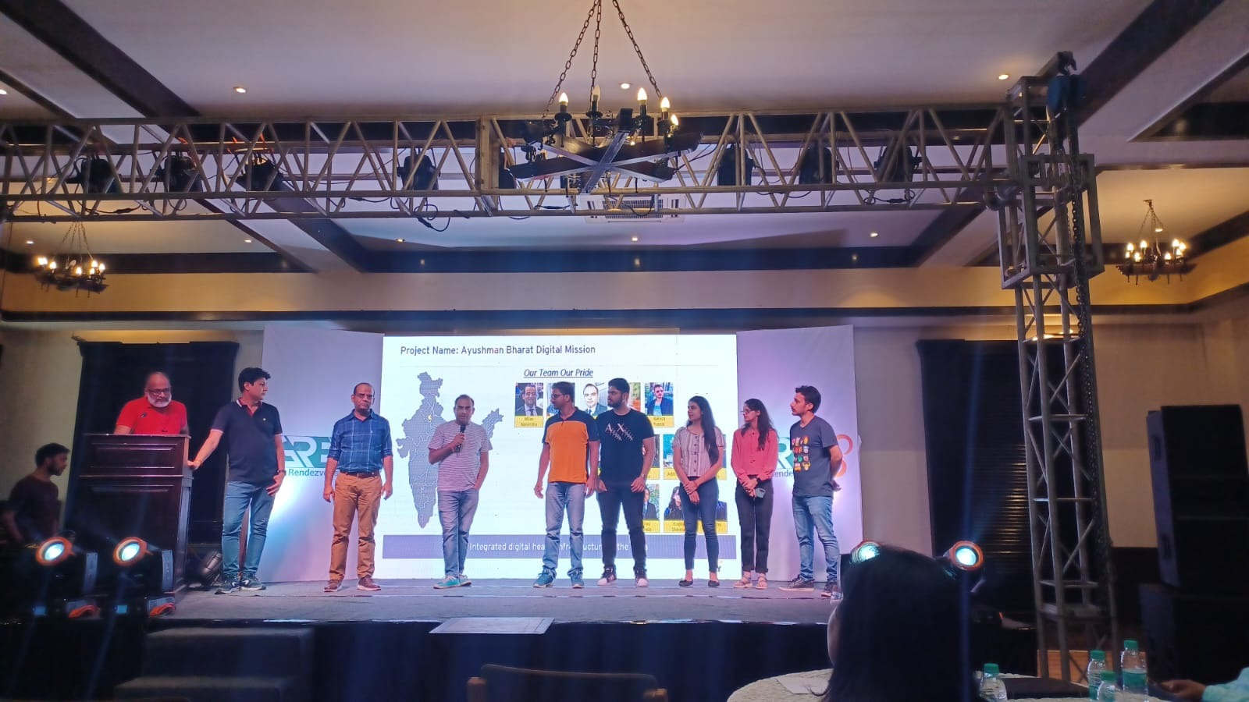
PICTORIAL JOURNEY

