Slide 1
Implementation of FAIR (Findable, Accessible, Interoperable, Reusable) Data Principles in Biomolecular Data through Polly
Dr. Shivani
PG/20/074
Mentor: Dr. Sidharth Sekhar Mishra
IIHMR Delhi

Slide 2
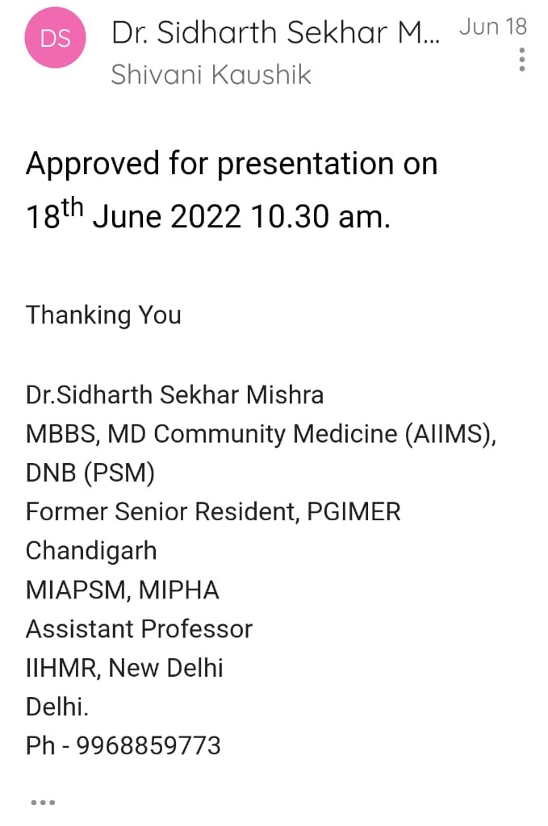
Screenshot of Approval

Slide 3
Introduction
Science is distinguished for its transparency, openness, and reproducibility
Traditional research methodology is to generate data for the publication of articles, which are soon forgotten once they have served their purpose
It is high time to necessitate the development of public and private capacity for high-quality data management so that fair principles are entrenched in the data generated
Biomedical data is not fair, and making this data fair is a challenge

Slide 4
Objectives
To outline existing scientific knowledge available on FAIR data in biomedical science
To highlight the process of delivering ML ready data through Polly

Slide 5
Methodology
Research design: Review study
Data type: Secondary data
Data collection: Literature review
Data source: Published articles, Data from organization
Keywords: FAIR Data, FAIRIfication, Metadata, Biomedical data

Slide 6
Realizing the value of data assets in Pharmaceutical industry
Implementing FAIR has the potential to significantly improve the adequacy and efficiency of drug discovery, therapeutic development in the biopharmaceutical sector. Making data assets within biopharma FAIR and public data more discoverable and accessible for both machines and people will enhance the value of those resources

Slide 7
Realizing the value of data assets in Pharmaceutical industry
The benefits for the biopharma industry will be substantial, and they include:
accelerating innovation due to the accessibility of FAIR data for use
cutting the time from drug discovery to market value by expediting clinical studies
constructing more-personalized medicines by leveraging FAIR real-world data to complement appropriate treatment to pertinent patient cohorts; and
empowering data sharing and collaborative partnerships across industries.

Slide 8
Expected Business Impact
Quantifying the predicted business impact of implementing FAIR in terms of ROI.
This can be assessed in terms of time and money savings to enable:
(i)greater findability for existing data.
(ii) rapid access to the data
(iii) easier access to harmonized and high-quality data for data analysis.
After the deployment of FAIR, the RoI parameters will be based on lower costs and quicker processing times to identify and develop better therapeutic treatments, leading to a perceptible rise in the productivity of the R&D pipeline.

Slide 9
Industry examples:
Organization 1:developed a FAIR platform for 3000 users across three major sites. Upon running the new FAIR platform for two months, the firm gathered usage data based on user clickthrough rates.
RESULTS:
In 60 days, 900 000 pages on this FAIR platform were visited.
An estimate of approximately 5 million page visits was provided for the year.
By making improved search results available with direct access to the target repository, each of these FAIR-enhanced views saved approximately five seconds, which led to a computation of around 3.5 full-time employees' worth of time saved annually.

Slide 10
Industry examples:
Organization 2: A production plant was taken out of action for months. When the necessary specialized data were finally located, it was revealed that the problem had already happened three times and that using FAIR's "findability" would have enabled a much more timely resolution.
Organization 3 (Roche): Roche effectively used FAIRification in four of their therapeutic fields, including ophthalmology, autism, asthma, and COPD.
FAIRification strengthened its procedures to better curation and management of data and metadata as a consequence of the project.

Slide 11
Cost-Benefit Analysis of FAIR data in research (Europe)
The lack of FAIR data in the research industry affects research activities and opportunities for further research and innovation.
Indicators to gauge the impact of non- FAIR data on research:

Slide 12
Cost-Benefit Analysis of FAIR data in research (Europe)
Indicator | Cost of non FAIR data (in euros) | Positive impact of FAIR data
Time spent | €4.5 billion annually | Time saving for academicians- 3.2% Time saving for researchers- 4.5%
Cost storage | €5.3 billion a year | Implementing fair data principles can reduce data redundancy by reducing data storage across various repositories by 20%
License cost | €360 milion a year | Increasing the scope of open access to research from 45% to 70%
Research retraction | €4.Million annually | Fair data can reduce the retraction rate of data by 50%
Double funding | €25 million. | At least 80% of duplicate financing can be prevented
Interdisciplinarity | Not quantifiable | Researchers may acquire fresh insights and share information more easily if they have access to diverse data from other disciplines attributable to FAIR.
Potential economic expansion | Anticipated economic benefit €11.7 billion and €22.1 billion | fuels the growth of jobs and a higher GDP by maximizing the value of research and furthering science

Slide 13
Methodology
Research design: Review study
Data type: Secondary data
Data collection: Literature review
Data source: Published articles, Data from organization
Keywords: FAIR Data, FAIRIfication, Metadata, Biomedical data

Slide 14
FAIRification
"FAIRification" is a term coined to describe the process of making data discovery and reusing FAIR.
The principles were developed in 2014 as a framework of guiding principles and practices for stewardship of scientific data in the biomedical sciences.
The concepts have acquired a lot of momentum in research and research policy since then.
These are expected to become a pillar of research policy and research data management plan standards
Machine Actionability
Controlled Access
For reliable processing of sensor data, automating the data retrieval from data repositories through APIs is crucial. Each one of the FAIR principles requires the use of computers and computer-assisted data management and analysis.
FAIR principles essentially attempt to make foundation requirements for data sharing clearly evident, such as criteria for acquiring and providing data access, privacy, and publishing and usage barriers.

Slide 15
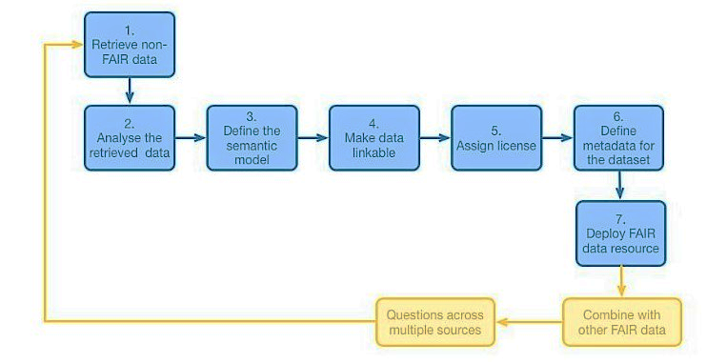
FAIRification Process
GO FAIR's FAIRification process

Slide 16
Case Study- Roche
The objective was to FAIRify legacy datasets in various Therapeutic Areas (TA) and also to build mechanisms for future research's potential FAIRification
Strategic Plan
Identify and develop use cases, as well as research studies that are relevant. Age and applicability of a dataset, and the significance of a study for fostering translational research
Restriction of access based on Study Informed Consent Forms and study status that ensures data protection.
Determine the sections of the data that require FAIRification, or the data that would be useful in drug discovery and development.

Slide 17
Design the FAIRification process and resources. Using the Clinical Data Interchange Standards Consortium and sponsor extensions, use reference data to harmonize and standardize the data set. The FAIR principles are completely implemented in Roche's reference data.
Perform thorough quality assurance and evaluate FAIRness in line with curation norms.
Value is determined through close collaboration with data scientists.
Outcomes
Roche effectively used FAIRification in four of their therapeutic fields, including ophthalmology, autism, asthma, and COPD.
FAIRification strengthened its procedures to better curation and management of data and metadata as a consequence of the project.

Slide 18
FAIR Data
Every day, academic labs and institutions worldwide produce humongous amounts of multi-omics data through experimental works and deposit it in public repositories.
This data holds potency for reuse and discovery but is dispersed across multiple disparate sources and lacks standardization.
FAIR Data Stewardship
F: Findable
e.g., BBMRI-ERIC Directory
I: Interoperable
e.g., GA4GH Genomic Data Toolkit
A: Accessible
e.g., European genome–phenome archive
R: Reusable
e.g., BRCA exchange

Slide 19
Ethical Values of FAIR
Findability
Accessibility
Better and more inclusive research-removing obstacles to data sharing amongst research groups.
Transparency-data owner must offer information about the source, processing
Economical- saves resource expenses, eliminates unnecessary duplication of work and promotes the replication for validation of studies
The legitimacy of a number of tasks- the job of quality data generation becomes more acknowledged
Accountability- Fair and unambiguous distribution of duties
Trust- accessible on the background of confidentiality between researchers and stakeholders
Benefit to the community: Data providers share data with community
Value addition to the health- aid in the development of safer technology and to enhance patient outcomes

Slide 20
Interoperability
Reusability
Distribution of the benefits and opportunities- ensure that everyone has equal access to information and benefits from data, particularly with regard to deprived scientific or societal groups
Reproducibility- essential verification and replication of results.
Novelty- interoperability of data allows for a larger sample size which in turn paves the way for newer questions
Quality - improve the quality of findings.
Reciprocity- data providers, gain acknowledgement from the research community and/or the general public when they make their data reusable
Benefit Sharing- several publications will result from the (re) usage of the same data.
Non-maleficence- preserve people's privacy and data
Freedom of research - enabling data to be reused for different research projects
Human dignity and autonomy- Freedom to provide consent for the data collection and sharing and the ability to withdraw consent at any point of time

Slide 21
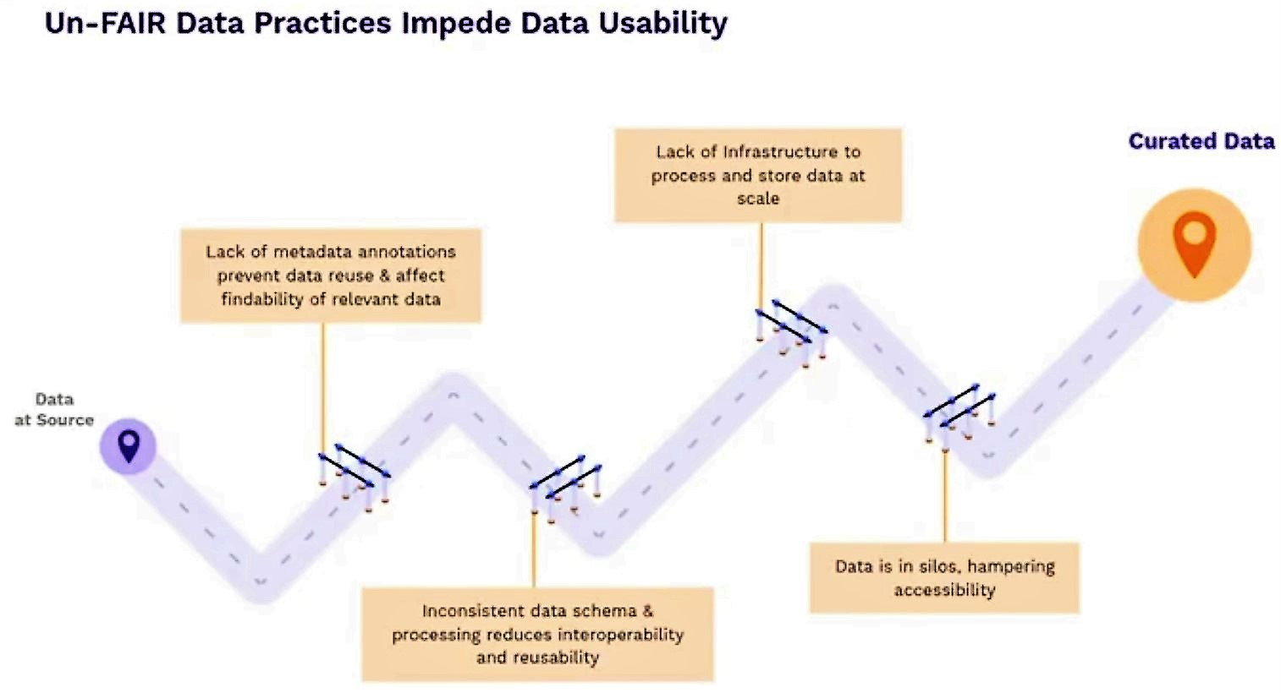
Discussion
Pain points in data usability
Lack of metadata annotations prevents data reuse and affect the findability of relevant data
Inconsistent data schema and processing reduce interoperability and reusability
Lack of infrastructure to process raw data at scale
Data is in silos, hampering accessibility
Barriers in data usability (Source: Elucidata)

Slide 22
Polly
SaaS platform
Polly is a cloud platform which gathers and stores public or premium biomedical data; the data is stored in curated form, which allows users to access and analyze highly curated, structured, harmonized data using either application (GUI) or coding (Polly Python).
Public sources
Curated, ML-ready biomedical data
Researchers
Proprietary sources
Premium Data

Slide 23
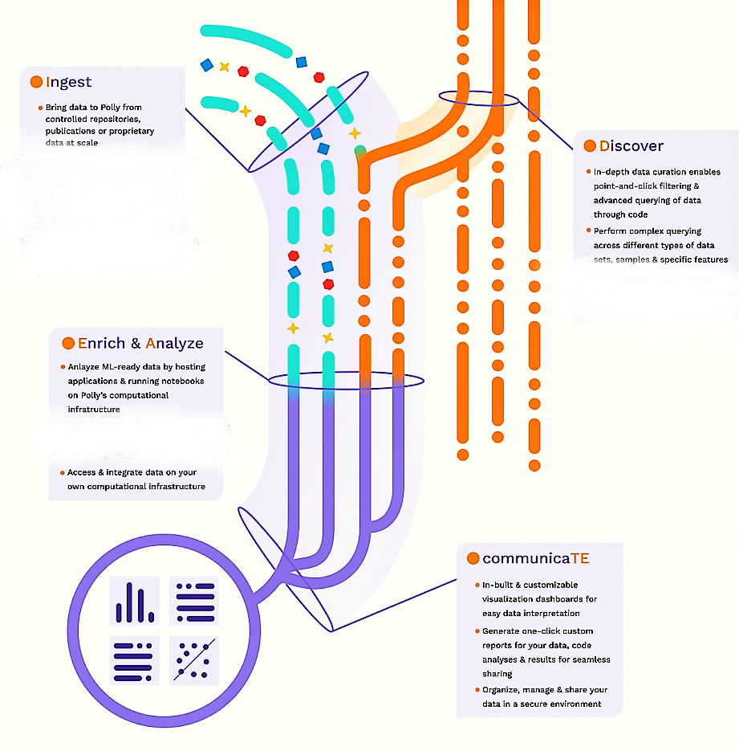
IDEATE Framework
Ingest
Discover
Enrich and Analyze
Communicate
IDEATE Framework (Source: Elucidata)

Slide 24
Data Ingestion, Pre-processing & Curation
Data Engineering
and Harmonization
Polly Connectors
Curation
PollyBERT
Data engineering: consistent data ingestion and storage to provide data formats
Metadata harmonization-standardized ontologies for annotation at the dataset and sample level to increase the findability of data for reuse
Harmonizing multiple file formats into a consistent organization on a single data infrastructure.
Through the curation pipeline, data is harmonized with the metadata using ontologies and data is saved in accessible formats
H5ad files that support more large and complex data like single-cell RNAseq
The process of curation involves both people and advanced ML.
One consistent schema
Ontology-based mapping of text related to disease, cell type, cell line, tissue, and drug allows data to be curated at scale.

Slide 25
Curation at Scale
> 7 Lacs datasets
> 20 data types
32 data sources
Four million curated samples
300 organisms (>80% humans)
Curation at Scale
(Source: Elucidata)

Slide 26
Metadata Annotation
Annotating different kinds of metadata in different data sets using the same molecular identifiers and tagging each sample with similar information.
Difficult to identify the disease name “acute myeloid leukemia” as it is present under the source name, making it almost impossible to recognize the disease until one glances closer at the source name.
Metadata annotation
(Source: Elucidata)

Slide 27
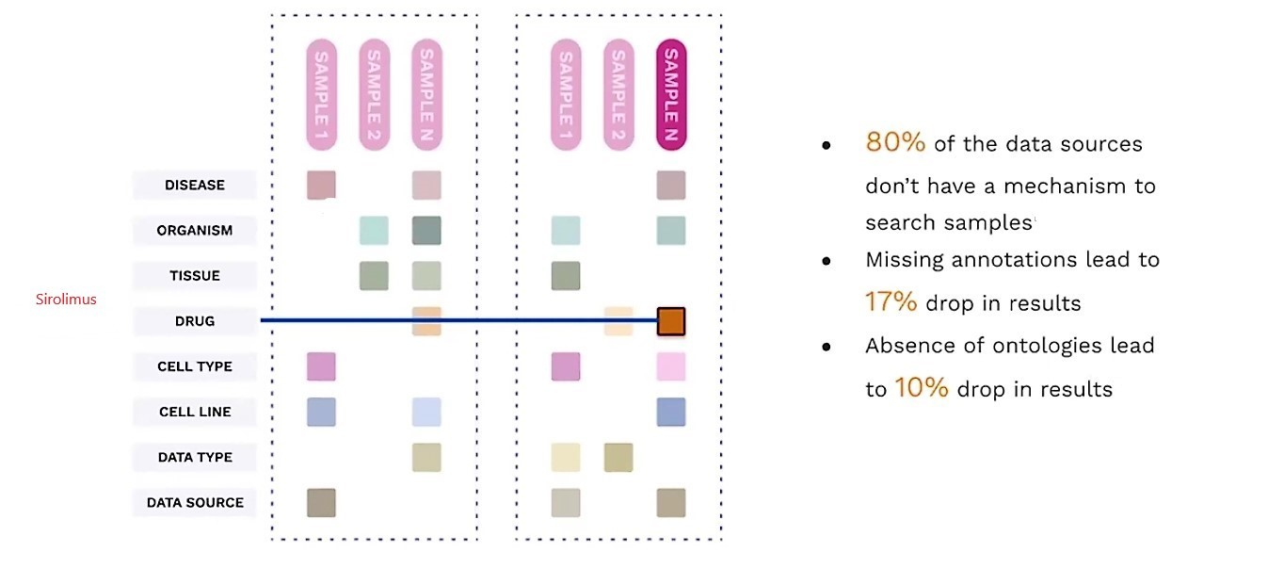
Need for curation at scale
Need for curation at scale
(Source: Elucidata)

Slide 28
Searching for Datasets on Polly
(Source: Elucidata)

Slide 29
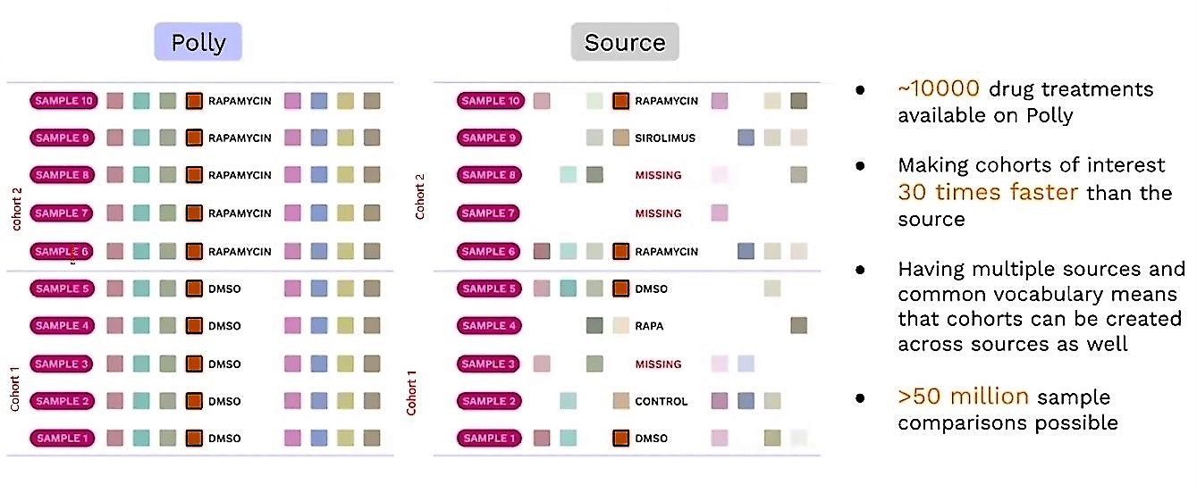
Analysis on Polly vs Sources: Rapamycin treatment
(Source: Elucidata)

Slide 30
Steps in Curation
Data is collected from various sources (private/ proprietary) and then annotated weakly by ML models, after which expert annotation is carried out by bioinformaticians and scientists. This data is then fed to the ML model, which learns and curates better in the next annotation.
Data download
Data audit and ingestion
Curation
Bio-medical data from sources :such as GEO, GDC, TCGA, LINCS, ImmPort, and publications along with metadata associated with these data will be downloaded and stored.
Ingestion gathers data and brings it into a data processing system where it can be stored, analyzed, and accessed.
Proprietary Data: Data ingestion and then auditing
Public data: data auditing then ingestion
Double-blinded curation
Consensus
Post Consensus
Discussion Expert Review

Slide 31
Limitations of the Study
FAIRification of Data is a relatively newer concept; hence the research is in a budding stage
There is not enough literature available where research groups or companies are implementing FAIR policies in research work
As the organizational data is confidential, hence only some documents could be included in the study

Slide 32
Conclusions
Advantages of Fair data
Challenges in Implementation of Fair data
Enhances the rate of discovery
Ensures that no major breakthroughs are missed.
Enhances the scientific and academic record's integrity
Many in the research community are beginning to see open and FAIR data as a crucial aspect of today's research business.
The cost element- upfront expenditure
Culture shock
Compliance barrier

Slide 33
A FAIR future for all?
While it is not required for organizations or individuals to use data management principles, it is strongly encouraged in today's rapidly changing scientific field. We're at the beginning of AI-driven science, which has the potential to address some of the world's most pressing scientific issues, and data will be at the focus of it all.
We have the opportunity now to work together and develop guidelines for our data to advance research. The alternative is to wait for the stage when technology compels organizations to format and standardize all their data. Then, the companies without FAIR standards will be one step behind, racing to meet the basic requirements needed to derive value from their data.
We now have the possibility to collaborate and set criteria for our data in order to study it further. Another option is to wait until technology forces organizations to format and standardize all their data. Companies that do not adhere to FAIR principles will fall behind, racing to achieve the minimum criteria for extracting value from their data.

Slide 34
References
van Vlijmen H, Mons A, Waalkens A, Franke W, Baak A, Ruiter G, Kirkpatrick C, da Silva Santos LO, Meerman B, Jellema R, Arts D. The need of industry to go FAIR. Data Intelligence. 2020 Jan 1;2(1-2):276-84.
Wise J, de Barron AG, Splendiani A, Balali-Mood B, Vasant D, Little E, Mellino G, Harrow I, Smith I, Taubert J, van Bochove K. Implementation and relevance of FAIR data principles in biopharmaceutical R&D. Drug discovery today. 2019 Apr 1;24(4):933-8.
Mons B, Neylon C, Velterop J, Dumontier M, da Silva Santos LO, Wilkinson MD. Cloudy, increasingly FAIR; revisiting the FAIR Data guiding principles for the European Open Science Cloud. Information Services & Use. 2017 Jan 1;37(1):49-56.
Wilkinson MD, Dumontier M, Aalbersberg IJ, Appleton G, Axton M, Baak A, Blomberg N, Boiten JW, da Silva Santos LB, Bourne PE, Bouwman J. The FAIR Guiding Principles for scientific data management and stewardship. Scientific data. 2016 Mar 15;3(1):1-9.
Fair cookbook [Internet]. FAIR Cookbook. The FAIR Cookbook; 2020 [cited 2022Jun14]. Available from: https://faircookbook.elixir-europe.org/content/recipes/introduction/metadata-fair.html

Slide 35
References
European Commission, Directorate-General for Research and Innovation, Open innovation, open science, open to the world : a vision for Europe. Publications Office; 2016. Available from: doi/10.2777/061652
Boeckhout M, Zielhuis GA, Bredenoord AL. The FAIR guiding principles for data stewardship: fair enough?. European journal of human genetics. 2018 Jul;26(7):931-6.
Lezaun J, Montgomery CM. The pharmaceutical commons: Sharing and exclusion in global health drug development. Science, Technology, & Human Values. 2015 Jan;40(1):3-29.
Knoppers BM. Framework for responsible sharing of genomic and health-related data. The HUGO journal. 2014 Dec;8(1):1-6.
GO fair Initiative [Internet]. Go FAIR. 2018 [cited 2022Jun14]. Available from: https://www.go-fair.org/fair-principles/
FAIRification of clinical trial data – Roche [Internet]. 2017 [cited 2022 Jun14]. Available from https://fairtoolkit.pistoiaalliance.org/use-cases/fairification-of-clinical-trial-data-roche/

Slide 36
Thank You!

Slide 37
Suggestions to the Organization where the Study was Conducted
The organization is lacking in approaching their target consumers because of lack of sales force. Lot of work which can be outsourced is being done by employees which reduces their productivity.
As the product is a technical platform not everyone can be a consumer to the product hence there can’t be impulse buying behaviour, hence approaching right target is imperative.
The Organization can make use of sales navigator and especially inmails of linkedin so as to increase visibility for right target.

Slide 38
Dissertation Experiences
What did you learn (skill/ topic)?
Technical sales
Customization for email marketing
Polly- SaaS Platform
Lead generation and Lead Qualification
Created a master data for marketing and sales team

Slide 39
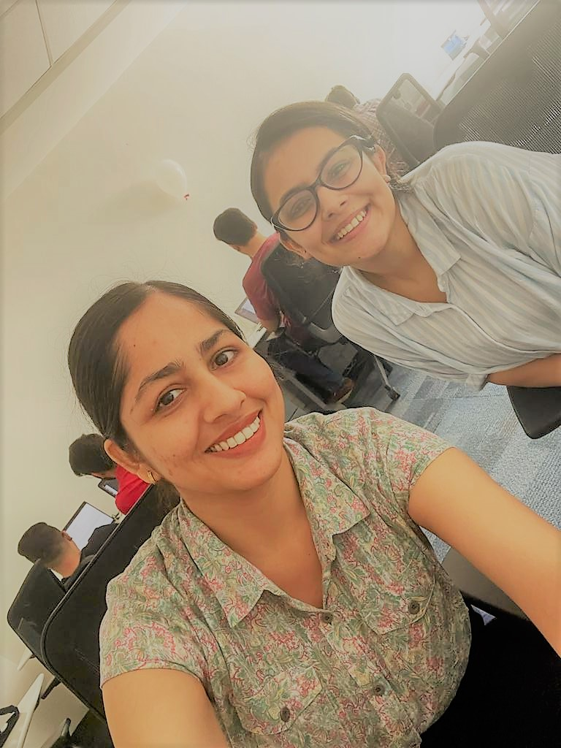
Pictorial Journey
First day at Office
12 May 2022

