Slide 1

IPSG(International Patient Safety Goals)
Park Hospital, Gurugram
SHIWANI JHA
DR. SUKESH BHARDWAJ
IIHMR, DELHI

Slide 2
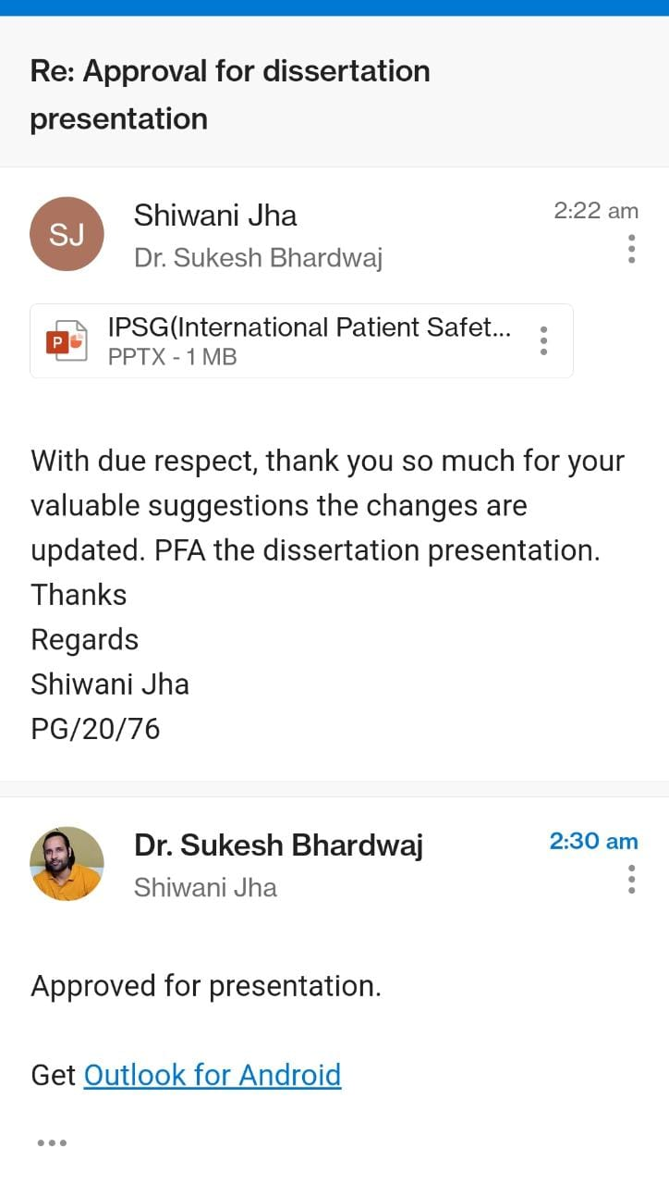
Screenshot of Approval

Slide 3
Introduction (1/2)
Patient safety is a serious global public health issue and in developed countries 10 percent of patients is harmed while receiving hospital care.
In some developing countries the risk of health care-associated infection is as much as 20 times higher than in developed countries. In recent years, countries have increasingly recognized the importance of improving patient safety.
The failure to identify patients correctly continues to result in medication errors, transfusion errors, testing errors, wrong person procedures, etc. Effective communication will reduces errors and improve results patient safety.
The purpose of the IPSG is to promote specific improvements in patient safety.

Slide 4
Introduction (2/2)
International patient safety goals consist of six goals as follows:
Identify Patients Correctly
Improve Effective Communication
Improve the Safety of High Alert Medication
Ensure Safe Surgery
Reduce the Risk of Healthcare Associated Infections
Reduce the Risk of Patient Harm Resulting from Falls

Slide 5
Objectives of Your Study
OBJECTIVES
General Objective:
To make healthcare providers understand whether they are meeting the expectations of the Joint commission international to improve the overall safety of the patient.
Specific Objectives:
To study the data and to assess the compliance level of international patient safety goals by the staff of the Park Hospital (Gurugram)
To identify the various gaps and issues in the process and procedure that corresponds to Joint Commission International standards.
To analyze the data and provide with effective measures to improve the overall patient safety in the hospitals.

Slide 6
Methodology (1/2)
Study Design-Descriptive and cross-sectional study
Study Period: The study was conducted from 2nd Feb, 2022 to 2nd April, 2022.
Study Area: Park Hospital, Gurugram
Study Size: 120 patients , Park hospital Gurugram
Sampling Technique: Simple random sampling was carried out for the study.
Study Variables: Patient safety in Park hospital
Methods of data collection: IPSG audit tools checklist from Hospital

Slide 7
Results (1/8)
IPSG-1 Feb data

Slide 8
Results (2/8)

Slide 9
Results (3/8)
IPSG-1 March data

Slide 10
RESULTS (4/8)

Slide 11
Results (5/8)
IPSG-2 feb data

Slide 12
Results (6/8)

Slide 13
Results (7/8)
IPSG-2 march data

Slide 14
Results (8/8)

Slide 15
Discussion (1/2)
IPSG 1
As per the report it was revealed that during the month of February and march, 2022 the patients identification was fully complying with 100 percent effectiveness.
IPSG 2
As per the report is was found that 2 patients critical test results were not documented and 2 patients in house transfer forms are completed when patients are transferred from one level of care to another was not met.
The effectiveness of the IPSG 2 had some variance in two parameters, rest all the parameters reported 100 percent of effectiveness.

Slide 16
Discussion (2/2)
There was 98% compliance in the month of February.
In the month of march it was reported that 3 parameters were having variance. Rest all the parameters showed 100 percent result.
The effectiveness of the patients showed variance in 3 parameters. Rest all the parameters showed 100 percent result.
During the month of march 97 percent compliance was met for the IPSG2.

Slide 17
Limitations of the Study
The major limitation of the study is that research was conducted in one hospital hence the data can vary from one hospital to another.

Slide 18
Conclusion
Identifying patients accurately forms the first step of patient safety and providing the right care. Failing to correctly identify patients can compromise the patient’s situation.
Patients should always be identified using two identifiers.
The patients should be identified accurately from the admission into the hospital, before any diagnostic procedures.
The hospital should pay special attention to new born and comatose patients. Implementation of new and improved strategies and intervention should reduce the incidence of patient misidentification to a large extent.
Also pre and post training could be taken to look for the training effectiveness on enhancing IPSG awareness among the clinical staff.

Slide 19
References
https://www.gavinpublishers.com/article/view/residents-awareness-about-international-patient-safety-goals-cross-sectional-study
http://researchonline.ljmu.ac.uk/id/eprint/4334/1/157938_Salem%27s%20PhD%20Nov.2014.pdf
https://store.jointcommissioninternational.org/jci-accreditation-standards-for-hospitals-7th-edition/
https://images.app.goo.gl/PT8Kyf8b54pCvXWcA

Slide 20
Suggestions to the Organization where the Study was Conducted
It should introduce and implement a system to report and register incidences related to misidentification of patients
It should provide training regarding the importance of IPSG goals to clinical, para-clinical and non-clinical staff.
It should conduct audits regarding IPSG goals
It should be displayed importance of correct identification on notice boards.
It should introduce new technology like bar coding.
It should have an organizational protocol for identifying patients

Slide 21
Dissertation Experiences
What did you learn (skill/ topic)?
Overall self comments on Dissertation
In my Dissertation period, I have also experienced Two assessment of NABH 5th Edition of-
Park hospital, Gurgaon sector -47 & Park Healing Touch hospital, Ambala
Desktop Surveillance of-Park Kailash Hospital, Behror
NABH Documentations.
It was great learning experience.

Slide 22
AUDIT TOOL 1/2

Slide 23
AUDIT TOOL 1/2

Slide 24
Thank you

