Slide 1
To Assess Awareness of Digital Health Interventions, Telemedicine, And Digital Health Reporting ERNST & YOUNG
Sidhanshu Bajaj ( PG/20/080)
Dr.Sumant Swain
IIHMR Delhi

Slide 2
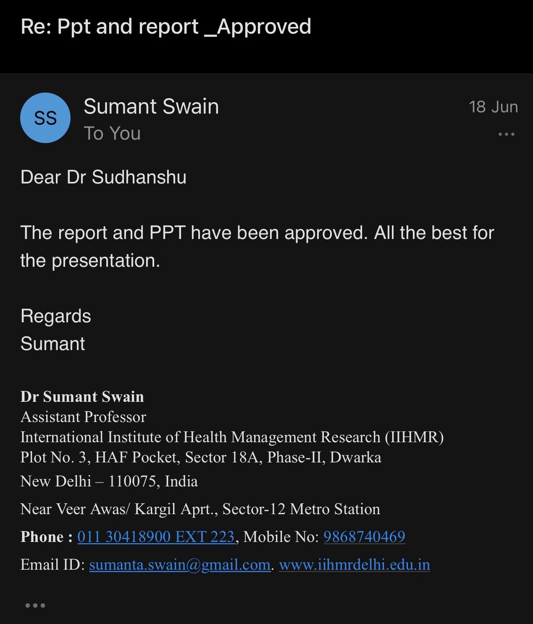
Screenshot of Approval

Slide 3
Introduction
Digital technologies are now a part of everyday life, and the world's population has never been more connected.
Innovation is occurring on an unprecedented scale, particularly in the digital sphere. Nonetheless, the way to improve and get better access to healthcare for population remains largely untapped, and there is enormous potential for using digital health practices
India's digital health program promotes use of such digital tools to accomplish healthcare goals and places a high value on teleconsultation in community health centres.
Teleconsultation aims to create a platform through which a semi healthcare provider can interact with patients to doctors via a technology platform

Slide 4
Introduction
The overall aim of the Digital Health interventions is to build an ecosystem that:
(i) supports health for all that is universal health coverage in an economically way, accessible , integrated, inexpensive, responsive, and manner that is safe for everyone;
(ii) covers a diverse range of information and helps in achieving a transparent, interoperable, standards-based digital systems for everyone; and
(iii) ensures the safety, secrecy, and confidentiality of health-related information of the patients
Electronic medical records, also known as digital health reporting or EMR, are digital version of paper records, reports, charts, diagnostics reports in a clinician's workplace.

Slide 5
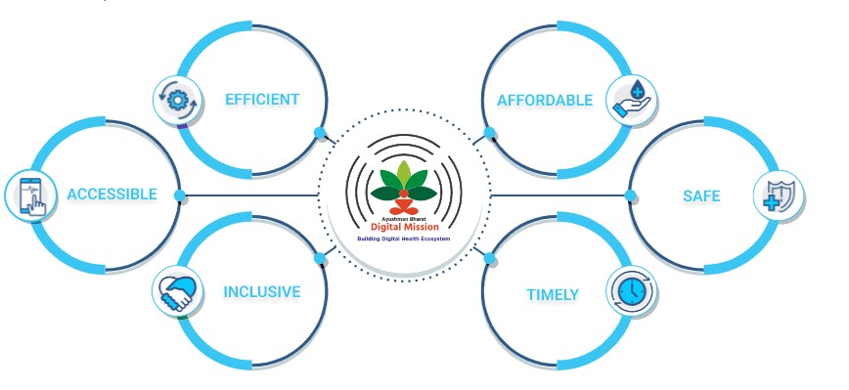
Objectives of the Study
General Objective:
To Assess Awareness of Digital Health Interventions, Telemedicine, And Digital Health Reporting
Specific Objectives:
To gather and analyze the data collected for digital health interventions , telemedicine and digital health reporting
To suggest methods of improving the usage and awareness of Digital Health Interventions , Telemedicine , and Digital Health Reporting

Slide 6
Methodology
Study Design : Cross-sectional study design
Study Period: The study was be conducted from 4st April to 5th June 2021
Study Area: The data was collected from Health professionals and Patients/Citizen at Sub National Level
Sampling Technique: Convenient and snowball sampling techniques
Sample Size: For the study, a total of 100 participants were surveyed.
Research Instrument: A survey was administered in semi structure questionnaire. Participants were surveyed through a Google Form and the survey would be sent to in Google Form through WhatsApp/ Email.
Study Ethics: The study has been approved by the Student Research Board of the IIHMR.

Slide 7
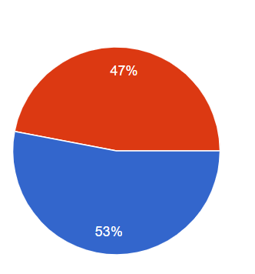
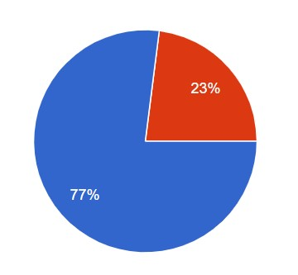
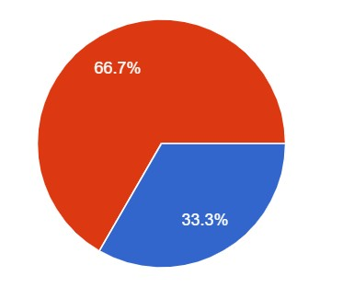
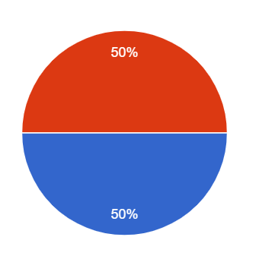
Results
HEALTH PROFESSIONAL ID
AWARENESS OF DIGITAL HEALTH INTERVENTIONS (ABDM)
Do you know what is Ayushman Bharat Digital Health mission (ABDM)?
Are you a Health Professional?
If Yes do you have Health Professional ID?
Health Professionals and Awareness of ABDM
Health Professional | HP ID | Awareness about ABDM
53 | 33 | 50
Total % | 62.3% | 94.3%
Do you know how can create your own ABHA ID or health ID?
n = 100

Slide 8
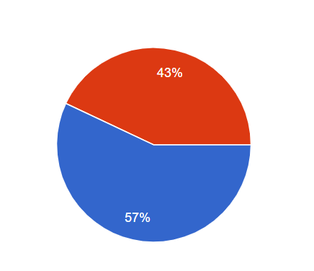
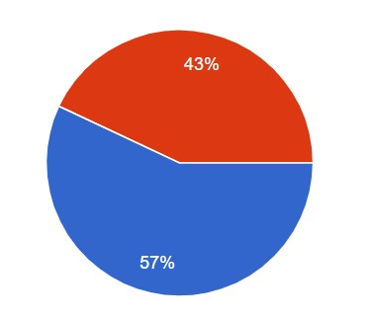
Results
AWARENESS OF DIGITAL HEALTH INTERVENTIONS (ABDM)
Awareness of Digital Health Interventions (AGE -WISE)
Age | Yes | No | Total | Yes % | No %
25 and below | 41 | 18 | 59 | 69.5% | 30.5%
26-35 | 29 | 4 | 33 | 87.9% | 12.1%
36-45 | 3 | 0 | 3 | 100.0% | 0.0%
46-55 | 4 | 1 | 5 | 80.0% | 20.0%
Do you know what is the purpose of ABHA ID or health ID?
Do you have idea about the key features of ABDM?
n = 100
What do you think can be the benefits of ABHA ID

Slide 9
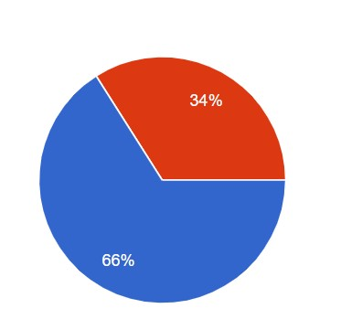
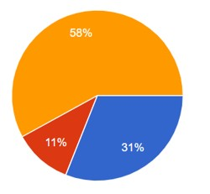
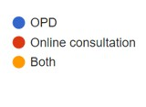
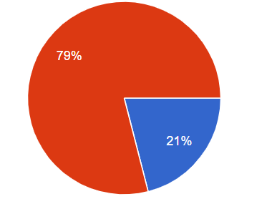
Results
TELEMEDICINE& DIGITAL HEALTH REPORTING
Have you ever used Telemedicine?
Did you face any problem while using telemedicine?
n = 100
Do you prefer physical or digital reports

Slide 10
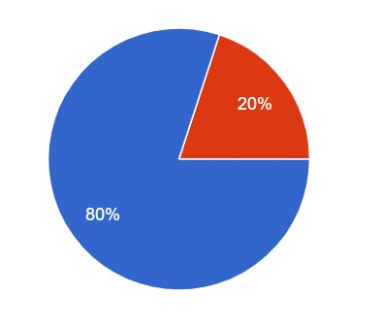
Results
DIGITAL HEALTH REPORTING & CONSENT
 | % Participants That had Digital Reports | % Participants that wanted to Access Health Reports Electronically | % Participants Used any App for Accessing Health Reports
Yes | 51% | 87% | 44%
No | 49% | 13% | 56%
Age Wise Consent
Age | Yes | No | No % | Yes %
25 and Below | 50 | 9 | 15.3% | 84.7%
26-35 | 25 | 8 | 24.2% | 75.8%
Will you feel comfortable if you can give access to your reports to your attending doctor with your consent?
Did you know you can access all your health reports from one ABHA PHR App of ABDM
n = 100

Slide 11
Discussion
This study shows doctors are aware of what role Digital health interventions plays as out of 53 health professionals 94 % were aware about role Digital health interventions and 62 % had Health professional ID’s
After receiving the results, it was seen that good amount of people had knowledge about role Digital health interventions that was 77 % of the participants and participants were able to identify the purpose and features of the ABDM that was 57 % of the participant as compared to the Chavi et al study had shown more awareness about ABDM.
Both the studies had the same sample size but the current study not only focuses on the medical background but also on the nonmedical background participants.
This shows patients and doctors are aware of what role ABDM plays. This study is conducted in June 2022 as compared to the study of Chavi et al conducted last year in 2021 and study was done on the interns, resident doctors of single college. The current study had a good response from the participants who were able to identify the benefits of ABHA Number.

Slide 12
Discussion
In the study conducted by Prateek et al, It was observed that 43 % of the participants had insufficient knowledge of Telemedicine and 52 % had insufficient knowledge about its application
As compared to the current study which had 77% of the participants knew about telemedicine and 72 % had no problem using it.
It was observed that participants were willing to use digital forms of reporting and preferred to have reports on their mobiles or tablets.
But on the contrary 31 % Participants preferred OPD consultation over only 11 % who preferred online consultation. This reflects people’s perception of the fact that OPD consultation are better but still almost 58 % preferred both.
Most of the participants had no issue with sharing consent of reports with their doctors in the age group of 25 and below and 26-35.
It was observed that only 52% knew that the ABDM PHR app had the feature for viewing the records in the app only, and people are preferably using other PHR apps to access their records like TATA 1MG, Lal Path lab or Practo.

Slide 13
Limitations of the Study
It may not be possible to study all aspects of knowledge, awareness, and perception of citizens in the study about Digital health
Study was conducted online, so response of the participants could be biased, and limited age group were covered with limited time and because of low sample size result could be skewed.
The study may not comment on large group of people about awareness of telemedicine or digital health or digital health reporting. .

Slide 14
Recommendation
People can be educated more about the Digital health interventions of NHA. The government shall take up initiatives such as utilise IEC materials to spread awareness about the same.
People don’t know much about the ABDM PHR App, initiatives can be taken for the same such as promotion of ABDM App on common social media platforms.
Application based telemedicine and digital health reporting should be promoted. User friendly applications should be developed to support increased uptake of telemedicine services by people.

Slide 15
Conclusion
This study was conducted from April to June in 2022
It was observed in the study that participants of this study had a good knowledge of Digital health interventions and what are the key features and purpose of the ABDM, and more than half of the participants knew how to create Health ID.
It was observed that health professionals were also aware of Health Professional ID and almost 62 % of them had HP ID. Digital health is an integral part of the Indian economy and citizens being aware of the national digital health plans and the digital health shows a promising and positive response.
Telemedicine and digital health reporting play a very important role in digital health and making patient consultation and health records easily accessible, so to study the awareness for the same is crucial and know the perception of people behind the same.
This study got to know the awareness of these digital interventions and how people are perceiving it.

Slide 16
References
NHA | Official website Ayushman Bharat Digital Mission [Internet]. [cited 2022 Apr 9]. Available from: https://abdm.gov.in/
NHA | Official website Ayushman Bharat Digital Mission [Internet]. [cited 2022 Jun 15]. Available from: https://abdm.gov.in/abdm-components
NDHM Awareness among young doctors. Int J Recent Sci Res.
Gudi N, Lakiang T, Pattanshetty S, Sarbadhikari SN, John O. Challenges and prospects in india’s digital health journey. Indian J Public Health. 2021 Jun;65(2):209–12.
Malhotra P, Ramachandran A, Chauhan R, Soni D, Garg N. Assessment of Knowledge, Perception, and Willingness of using Telemedicine among Medical and Allied Healthcare Students Studying in Private Institutions. Telehealth Med Today [Internet]. 2020 Nov 27 [cited 2022 Jun 14];5(4). Available from: https://telehealthandmedicinetoday.com/index.php/journal/article/view/228

Slide 17
Thank You
Any Questions

Slide 18
Suggestions to the Organization where the Study was Conducted
EY has a very strong hand in taxation and assurance. For them technology is something they have a good idea about, but they need good amount of people who know about healthcare and IT.
Tech consulting in healthcare could be difficult for start but EY has managed to do good in it and they should constantly hire good resources and work on as many digital projects for development and have strong hand in technology too.

Slide 19
Dissertation Experiences
What did you learn (skill/ topic)?
Overall self comments on Dissertation
Stakeholder Consultation
Business requirement documentation
Functional/System requirement specification documentation
Gap Analysis Reports
The overall experience was pretty exciting as I learned a lot and faced new challenges everyday and worked closely with the government officials to develop the best system that can be there for digital healthcare.

Slide 20
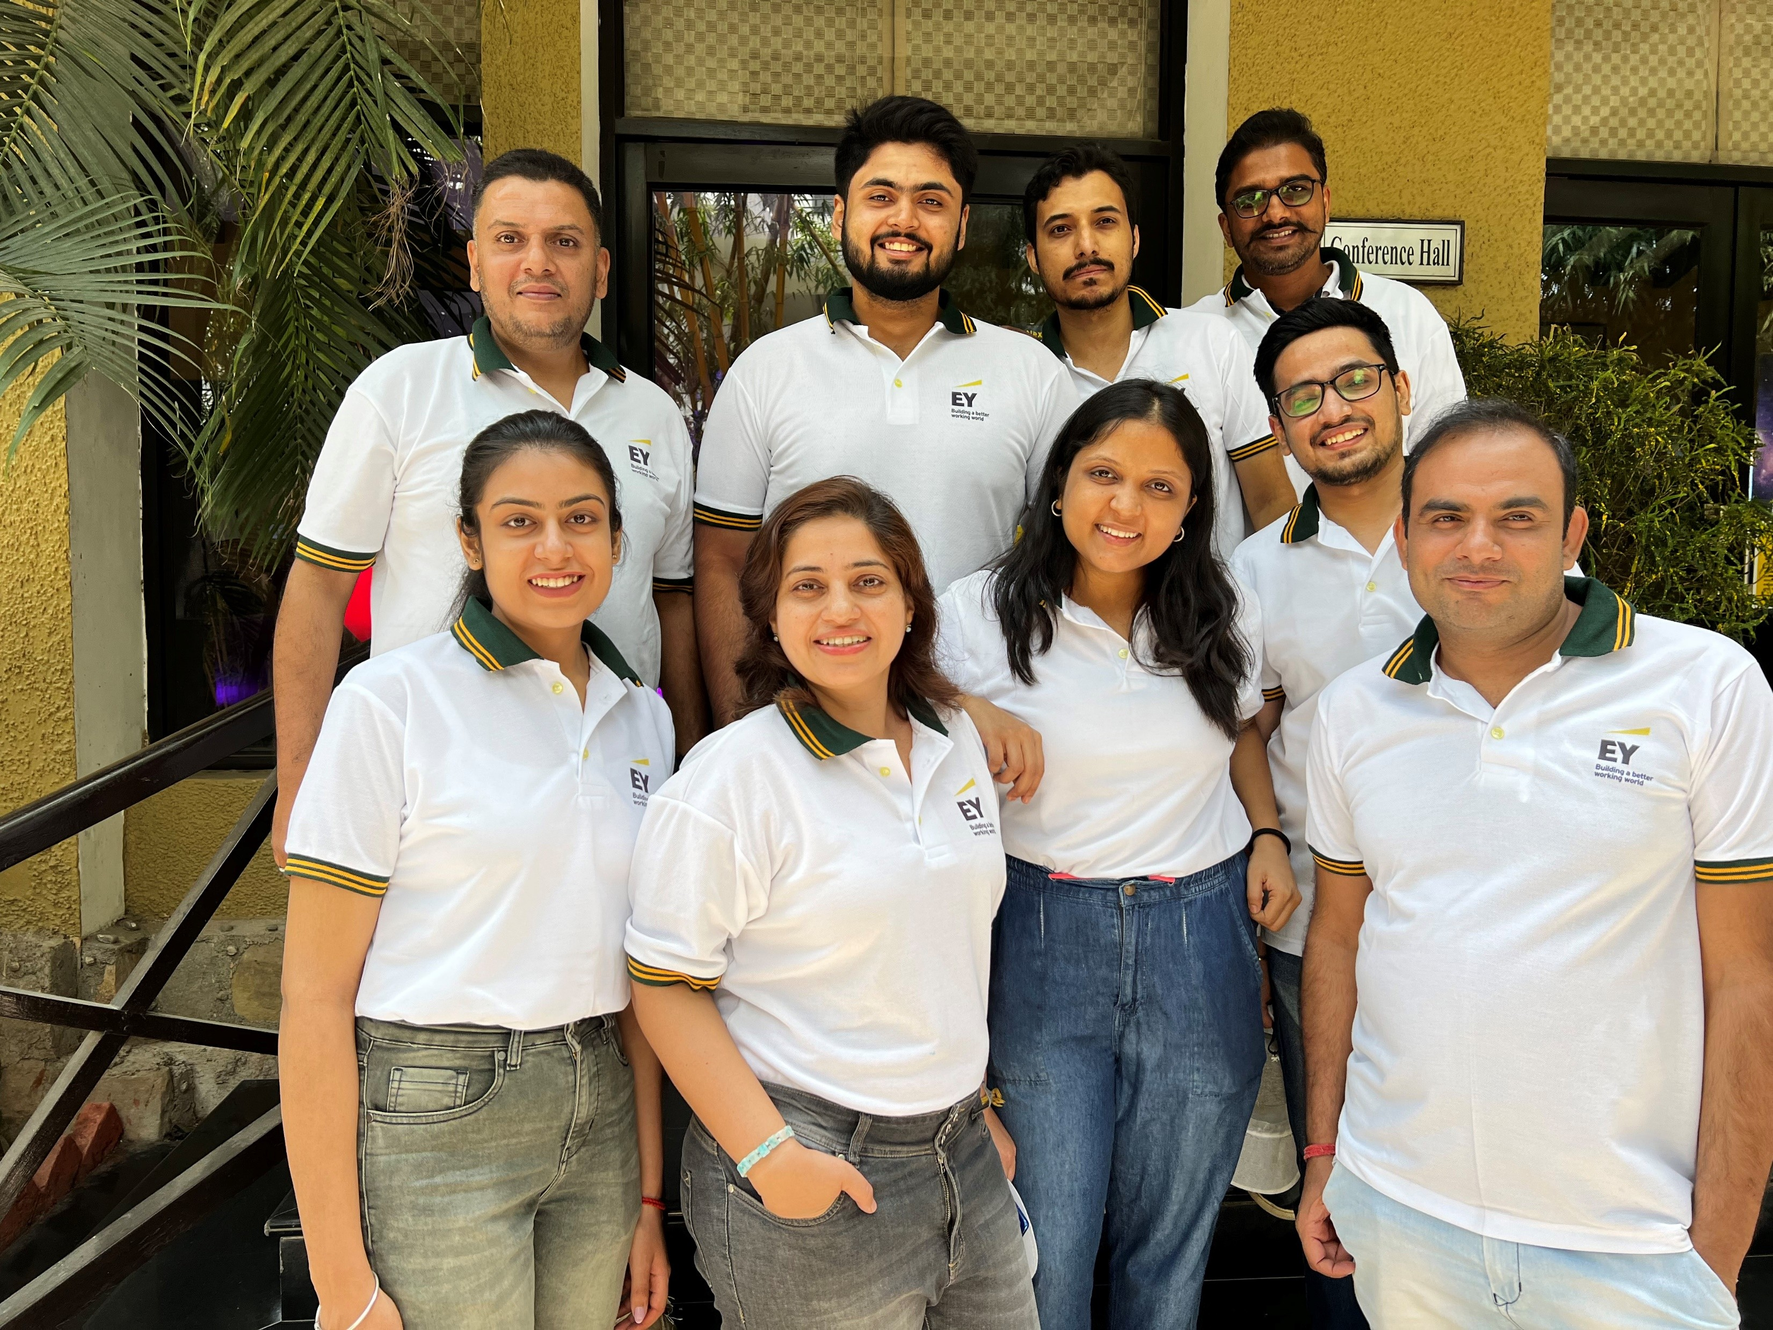
Pictorial Journey
Project Team

Slide 21
Pictorial Journey

