Slide 1
A comparative study of a Government & Private Hospital
Effect of Covid -19 Pandemic on usage and disposal of surgical disposables:
Dr. Somya Mathur,
Dr. Vinay Tripathy,
IIHMR Delhi

Slide 2
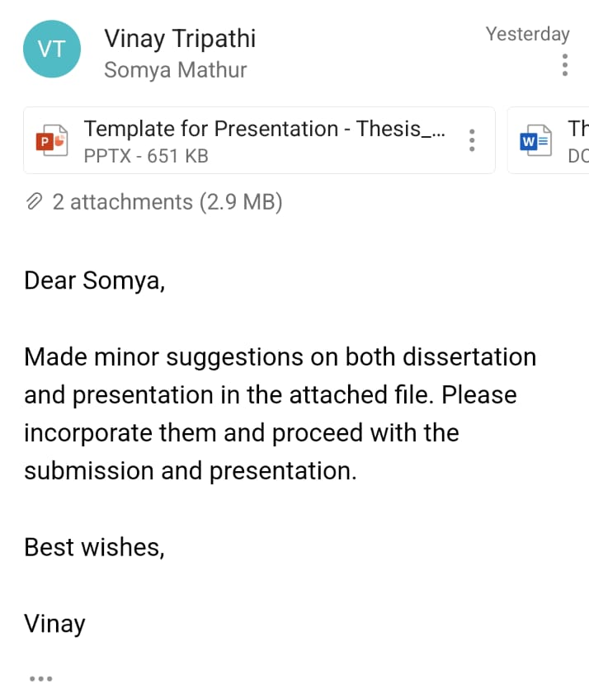
SCREENSHOT OF APPROVAL

Slide 3
INTRODUCTION
Infection control has always been a major area of concern in medical industry.
Medical surgical disposable not only helps in the prevention of spread of infection but also reduces the burden on hospitals and thereby reducing the length of stay of a patient in a hospital.
These devices are used one time on one patient during a medical procedure and then are discarded.
The medical surgical disposable device industry is a billion-dollar industry as the cost of these surgical disposable devices is on a higher side as compared to the reusable surgical devices.

Slide 4
INTRODUCTION
The demand of these disposable surgical items are on a rise as the use of surgical disposable plays a very critical role in the infection control during and after surgery.
Unlike reusable medical surgical device which needs to be sterilized before every use, disposable surgical devices are pre sterilized and can be directly used on a patient and thereafter can be discarded.
This also reduces the chances of cross contamination between patients and hospital staff.

Slide 5
REVIEW OF LITERATURE
Covid 19 first case in India was reported in Jan 2020 and as of now India has reported [2]
The rise in cases increased the usage of more reliable and less infection causing alternatives in Hospitals and healthcare set ups. These included surgical drapes, gowns, PPE kits, Masks, shoe cover etc.
Surgical practice have been extensively impacted by Covid-19 infection, issues such as workforce and staffing, procedural prioritization, intraoperative virus transmission. As well as surgical education are affected by the virus spread.
[3]Arch Surg. 1976. In today's multibillion dollar industry for health devices, disposable products play a key role. Disposable products used by surgeons prove that economy has a very limited role in converting from reusable to disposable products.

Slide 6
REVIEW OF LITERATURE
The major reasons depends upon various factors including but not limited to Surgeons/operators preference, product availability in the specific area, ease of procurement of product, ease of use or usability, dependence of certain factors like infection control , safety, and, in some cases, manufacturer's promotion.
[4] Agraw T. Multiple reports on micro plastic pollution due to increase in plastic products has seen to be impacting the environment in recent years. The disposables used in surgery and hospitals including face masks surgical drapes, gowns, head cap etc are made up of these micro plastics. The aquatic life has majorly been affected due to the use of these micro plastics multiple reports are there showing the same but still is not proved. The face masks and other disposable surgical items can also reach out to the aquatic.

Slide 7
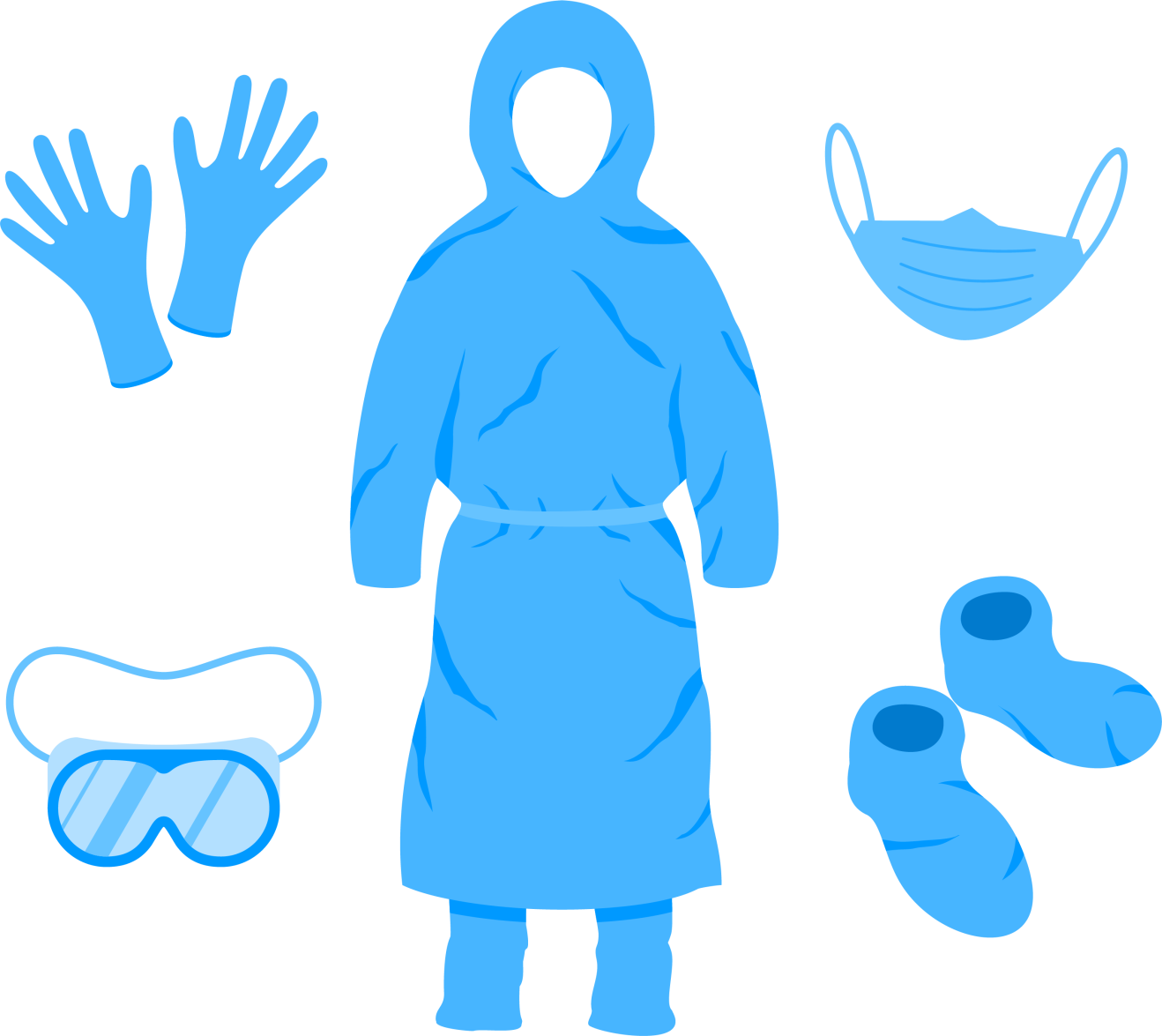
OBJECTIVES OF YOUR STUDY
To examine the need of surgical disposable in medical industry specifically during COVID-19 time
To compare the change in usage trend of surgical disposable and standard operating procedure before and after covid-19 pandemic.
To examine the process of disposing the surgical disposal before and after COVID-19 pandemic
To find out the financial implications of increased use of surgical disposables on both patient and medical industry including, hospitals

Slide 8
METHODOLOGY
Study Design: A descriptive cross sectional study
Study Area: Government and private hospital in Delhi
Data Source: Both Primary and secondary data are used for the study. Secondary data includes the study that includes the implications of use of surgical disposable in hospitals like the cost incurred, change in the use of different types of surgical disposables like surgical drapes, gowns, kits like disposable HIV kit, disposable sleeves etc.
Tools for collection of primary data: Interview in the form of questionnaire done from the purchase officer/Doctor/OT in charge
Study Duration: 1st April 2022 to 15th May 2022.
Expected outcomes: Understand Overall outcome of use of surgical disposables in the hospital including its Impact on the patients wellbeing

Slide 9
Metro Heart Hospital, Noida
Approx. Hops. Investment in Covid 19 (Rs L)
More than 50 Crore annual
RESULTS QUANTITATIVE
Total Annual Procurement (Rs L)
21crore
Purchase Value
Per month (In Rs L)
Purchase Value - Before Covid Per month (In Rs L)
R. P CENTER OF OPHTHALMOLOGY AIIMS, New Delhi
Product Category
Approx. Hops. Investment for covid-19 (Rs L)
Gloves
450000
450000
71crore
Syringes
300000
250000
Total Annual Procurement (Rs L)
Cannula
910000
910000
47.3Crore
Infusion sets
130000
100000
Annual Surgical Consumables Proc (Rs L)
Masks
40000
40000
71Crore
Drapes
50000
30000
Others surgical consumables
700000
550000

Slide 10
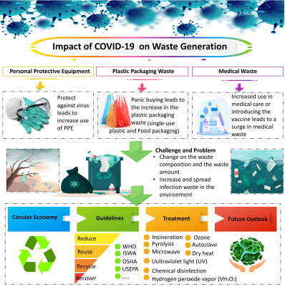
RESULTS

Slide 11
INTERPRETATIONS
Comparative chart of Operators Preference between surgical disposable and reusable
HOSPITAL CRITERIA |  | AIIMS R.P. CENTER | METRO HEART
 | Choice of disposable | Reusable | Disposable
 | Ease of use (operator) | Reusable | Disposable
 | Surgeons Preference | Reusable | Disposable
 | Number of surgeries performed in a day | 180 | 30
 | Mode of PROCUREMENT of disposable surgical devices | Tender bid through Government E portal or GeM | Through multiple local vendors/traders
 | Ease of Procurement of Surgical Devices | The hospital requirement was fulfilled as soon as the raise in demand. | The hospitals suffered a lot of issues while procuring s the local vendors were also engaged to fulfill government
 | Mode of waste management | As per government guidelines 2021 for covid19 waste management | As per CPCB guidelines 2016
A.
B.
C.
D.
E.
F.
G.

Slide 12
DISCUSSION
The pandemics like covid-19 open a plethora of circumstances to ponder upon for a country like India.
The infection spread in community has higher chances to occur as the population is high.
The government acted as an aid in providing opportunities to local small manufacturers of medical devices to work freely in the pandemic.
However, the countries preparedness to fight a pandemic was found to be lacking in infrastructure and planning. The big government facilities had all the aids needed but the small healthcare setups struggled to provide protective gears even to their staff in the beginning of pandemic.
The situation was even more grieve in the Tier 2 Tier 3 cities where the local manufacturers were in scarcity.

Slide 13
DISCUSSION
Biomedical waste disposal protocols have been stringent and are followed by all the organization since 2016. The amendments in the protocols helped in protection of healthcare workers as well as the mode of transportation of BMW.
The disposables helped in protection of spread of infection and is the only effective way to stop cross infection i.e., Infection from one person to another in proximity.
But the recycling of such waste comes as a new challenge as all the disposable are composed of micro plastic that has been affecting the aquatic life since long period of time.
Research on multiple level are in progress to find a replicable yet effective protective kit to control the spread of infection.

Slide 14
CONCLUSION
Covid-19 Pandemic has been one of the most aggressive spreading infections in the history of humankind.
The healthcare sector preparedness to fight such pandemics in the future can be laid from the lessons learnt in this pandemic.
All though India has a high population but the disease spread in India and the disease control was done effectively by the administration with help of organizations like Medi Karma that helped not just government organizations by providing the supplies that were required during the pandemic but also private organizations got benefitted.
The hospitals like AIIMS have an environmental safety approach therefore are now preferring the non-disposable or reusable surgical kits over disposable ones as the disposable surgical kits have a significant amount of micro plastic that is not good for the environment

Slide 15
CONCLUSION
The New Covid19 protocols for the biomedical waste management not only helped the hospitals to effectively manage the infectious Biomedical waste but also helped in providing adequate protection to the healthcare worker safety who were involved in the Biomedical waste management.
The expenditure for both the hospitals were high according to the need and demand.

Slide 16
LIMITATIONS OF THE STUDY
The quantitative data from All India Institute of Medical science including figures of expenditure on disposable in SCoV2 infection was not collected as per the government guidelines and ethics committee of AIIMS New Delhi.
Ophthalmology canter of AIIMS was surveyed during the study.
Number of Consumable used in a day is approx. and not accurate.

Slide 17
REFERENCES
Medi Karma - Home [Internet]. Medikarma.in. 2022 [cited 16 June 2022]. Available from: http://www.medikarma.in/index.html
MoHFW | Home [Internet]. Mohfw.gov.in. 2022 [cited 15 June 2022]. Available from: https://www.mohfw.gov.in/
Laufman H. Use of Disposable Products in Surgical Practice. Archives of Surgery. 1976;111(1):20.
Aragaw T. Surgical face masks as a potential source for micro plastic pollution in the COVID-19 scenario. Marine Pollution Bulletin. 2020;159:111517.
Sachdeva S. Biomedical waste and solid waste management draft rules, 2015: A comment. International Journal of Health &amp; Allied Sciences. 2016;5(2):129.
6. Teymourian T, Teymoorian T, Kowsari E, Ramakrishna S. Challenges, Strategies, and Recommendations for the Huge Surge in Plastic and Medical Waste during the Global COVID-19 Pandemic with Circular Economy Approach. Materials Circular Economy. 2021;3(1).
AIIMS spent over Rs 71 crore till November on COVID-19 n. AIIMS spent over Rs 71 crore till November on COVID-19, no separate funds from Centre: RTI [Internet]. The New Indian Express. 2022 [cited 18 June 2022]. Available from: https://www.newindianexpress.com/cities/delhi/2021/jan/05/aiims-spent-over-rs-71-crore-till-november-on-covid-19-no-separate-funds-from-centre-rti-2245653.html
Parashar N, Hait S. Plastics in the time of COVID-19 pandemic: Protector or polluter?. 2022.
Ronnie M. Pandemics, Public Health and Social Science. Archives of Community Medicine and Public Health. 2021;:008-011.

Slide 18
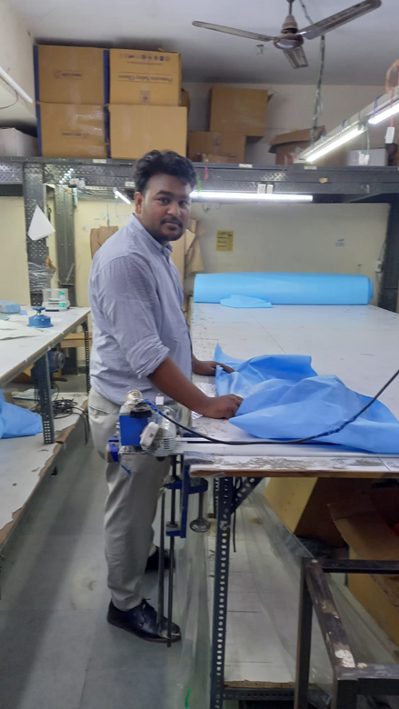
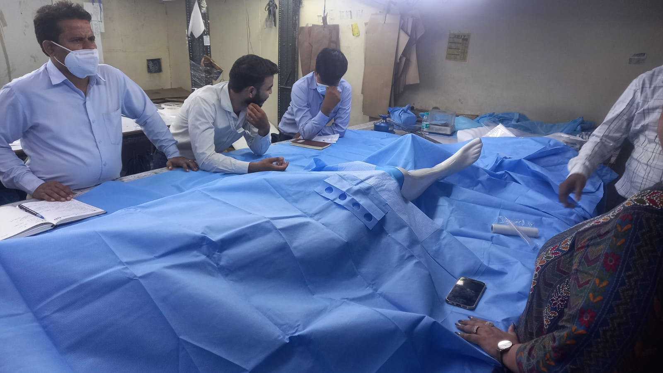
PICTORIAL JOURNEY

Slide 20
Suggestion To Organization
The Organization needs more training program for the products that are manufactured.
The Organization may plan to include EO sterilization plant within the manufacturing unit of the organization.
Should expand its horizons by introducing a research unit where the new materials can be studied for improvement of quality of product.

