Slide 1
Study of SNCU Community & Facility Follow up
UNICEF
Mr. TANUJ KAUSHIK
Mentor:- Mrs. Divya Aggarwal

Slide 2
APPROVAL

Slide 3
Introduction
Special Newborn Care Units (SNCUs) have been established at district hospitals and subdistrict hospitals with annual delivery load more than 3000 to provide care for sick newborns,that is, all type of neonatal care except assisted ventilation and major surgeries. It is a separate unit in close proximity to the labour room with 12 or more beds, and managed by adequately trained doctors, staff nurses and support staff to provide 24x7 services.
In 2008 there were fewer than 20 SNCUs countrywide. Today, close to 1 million babies are treated in more than 700 SNCUs in India every year.
At 2015, at Sadar Hospital (DH), govt. of Bihar started SNCU with 12 beds facility, with the support of UNICEF. In May 2022, SNCU, purnea has 24 functional beds with 24 x 7 availablity of pediatrician, more than 18 Staff nurses, 2 cleaning staff and 3 secuirty guards. Also with availability of Child Line staff for unclaimed children when needed.

Slide 4
Introduction
Concept of follow ups.
Followup is the act of making contact with a patient or caregiver at a later, specified date to check on the patient's progress since his or her last appointment. Appropriate followup can help you to identify misunderstandings and answer questions, or make further assessments and adjust treatments.
Community follow up :- done by ASHA on Day 1, 3, 7, 14, 21, 28 and 42
Facility follow up :- In SNCU on Day 8, 1 Month, 3 Months, 6 Months and 1 year.

Slide 5
OBJECTIVES
To Examine and Analyse the Functioning of SNCU.
To Examine and Analyse the Monitoring of Community follow up.
To Examine and Analyse the Monitoring of Facility follow up.

Slide 6
METHODOLOGY
Study area and population-
It is descriptive, quantitative research study.
Geographical location used in study in limited to Purnea, District of Bihar.
Neonates, Children below 1 year of age (there are some exceptions) were taken for the study.
Data is taken from the “SNCUonline” link by Govt. Of India, NHM and UNICEF, along with NFHS 5 and external sources like Research paper, Articles and Other Publications.
Inclusion criteria-
➢Infants (0 days - 1 year)
➢All genders and castes are taken into consideration.
Exclusion Criteria-
➢Children not admitted in SNCU.
➢Children outside Purnea District.

Slide 7
METHODOLOGY
Duration-
➢January 2022 - May 2022
Materials and methods-
•After taking approval from officials, SNCU data was extracted from “SNCUonline” portal.
•General tabulation is the format for data analysis.
•WPS Excel is used for the data analysis.
Outcome measures-
•Number of children admitted in SNCU.
•Figures of gender, caste and age based data.
•Outcome of inborn and outborn weather discharged after treatment, Referred, LAMA or expired.
•Number of targets achieved in community and facility follow ups.

Slide 8
Results

Slide 9
Results
14%
20.3%
16.6%
16.0%
14.4%
15.9%
11.4%
34.1%
16.2%
8.7%
16.0%
18.5%
16.7%

Slide 10
Results

Slide 11
Results

Slide 12
Discussion
21.5% referred to Bhagalpur GMCH or Patna because of lack of vantilator facility in SNCU Purnea.
Out of 16.6% of deaths took place major population were referred in.
Population of males were higher in SNCU, because more number of male birth in the district.
Population of OBC increased rapidily from 2011 to 2022, possible reason for highest number of admission and highest number of deaths.
The growth of community follow up was low in march because of all the trainings scheduled for ASHA workers at financial year end.
In faciliy follow up, the reason of dip in the month of February can be, that climate was worse in the month of January, with 5 to 10º C along with heavy rainfall due to western disturbances, which is not suitable for newborns.

Slide 13
Limitations of the Study
This study only used percentage data rather than actual figures.
The study only focused on data of SNCU, purnea from the period of January 2022 to May 2022, therefore no comparison with other studies.
During the period of this study the District Hospital is being transferred to Government Medical College and Hospital which indirectly effect the study.

Slide 14
Conclusion
The study was conducted in SNCU, of Government Medical College and Hospital, at Purnea Bihar from January 2022 to May 2022. It was observed that the outcome during the period was 60.3 % of population was treated and discharged from SNCU , 21.5 % of population were referred to higher facilities, 16.6 % of Child Death cases and 0.6 % of population opted for LAMA . The study also stated that even though number of males were admitted more, but percentage of female deaths were more. The population of OBC category were highest in the SNCU and on the basis of age, less than 1 day of age population were highest. Community follow ups of the discharged children has to be done on day 1,3,7,14,21 and 28 by ASHA worker and this was monitored by SNCU. The constant improvement can be seen through out the year of 2022 in Community Follow ups and average was above 50%. Facility follow ups are clinical check up of patients on Day 8 after discharged followed by 1 month, 3 months, 6 months and 1 year. In purnea due to various reasons this data was below 20% throughout the year, and need improvements.

Slide 15
References
Kumar H, Khanna R, Alwadhi V, Bhat AA, Neogi SB, Choudhry P, Saboth PK, Khera A. Catalytic Support for Improving Clinical Care in Special Newborn Care Units (SNCU) Through Composite SNCU Quality of Care Index (SQCI). Indian Pediatr. 2021 Apr 15;58(4):338-344. PMID: 33883309.
Kumar H, Bhat A, Alwadhi V, Maria A, Khanna R, Neogi SB, Khera A. An Assessment of Implementation of Family Participatory Care in Special Newborn Care Units in Three States of India. Indian Pediatr. 2021 Apr 15;58(4):349-353. Epub 2021 Jan 2. PMID: 33408278.
Saboth Md PK, Sarin PhD E, Alwadhi Md V, et al. Addressing Quality of Care in Pediatric Units using a Digital Tool: Implementation Experience from 18 SNCU of India. J Trop Pediatr. 2021;67(1):fmab005. doi:10.1093/tropej/fmab005
Sen A, Mahalanabis D, Singh AK, Som TK, Bandyopadhyay S. Impact of a district level sick newborn care unit on neonatal mortality rate: 2-year follow-up. J Perinatol. 2009 Feb;29(2):150-5. doi: 10.1038/jp.2008.177. Epub 2008 Oct 23. PMID: 18946480.
Sulthana, S.A. Sardar, et al. "Study of the morbidity pattern in the special new born care unit (SNCU) at a tertiary care teaching Hospital in Kurnool District, Andhra Pradesh, India." Journal of Evolution of Medical and Dental Sciences, vol. 4, no. 52, 29 June 2015, pp. 8999+. Gale OneFile: Health and Medicine,

Slide 16
Thank You
Any Questions?

Slide 17
Suggestions to the Organization where the Study was Conducted
Increase HR in SNCU
Indent at least 2 ventilators for SNCU, Purnea.
Improvise management for facility follow ups.
Improvise monitoring of ASHA workers for community follow up.

Slide 18
Dissertation Experiences
Preperation of LaQshya, Kayakalp, NQAS certification.
Monitoring, reporting, identifying gaps, and working on action plans of government health facilities (including SNCU, GMCH, PHCs, CHCs, FRUs, SHD, APHCs and UPHCs) with
Monitoring and reporting of NBCC, PMSMA, HMIS, CDR, MDR, HBYC, HBNC, WASH, Community and Facility followups.
Facilitate various UNICEF and Govt. Of India training programs for healthcare workers.
Assist and reporting of district, state, national and international team visits by UNICEF and other government bodies.
I learnet how to be a team player.
I gained experince how to handle complicated things and how to get things done in government facilities.
I have learnt multitaskg and time management.
I have sharpen my skills of problem solving abilities.
The most important I have learnt how to be adaptable in any environment.

Slide 19
Pictorial Journey
HBNC and HBYC monitoring visit
PMSMA Monitoring and Records review

Slide 20
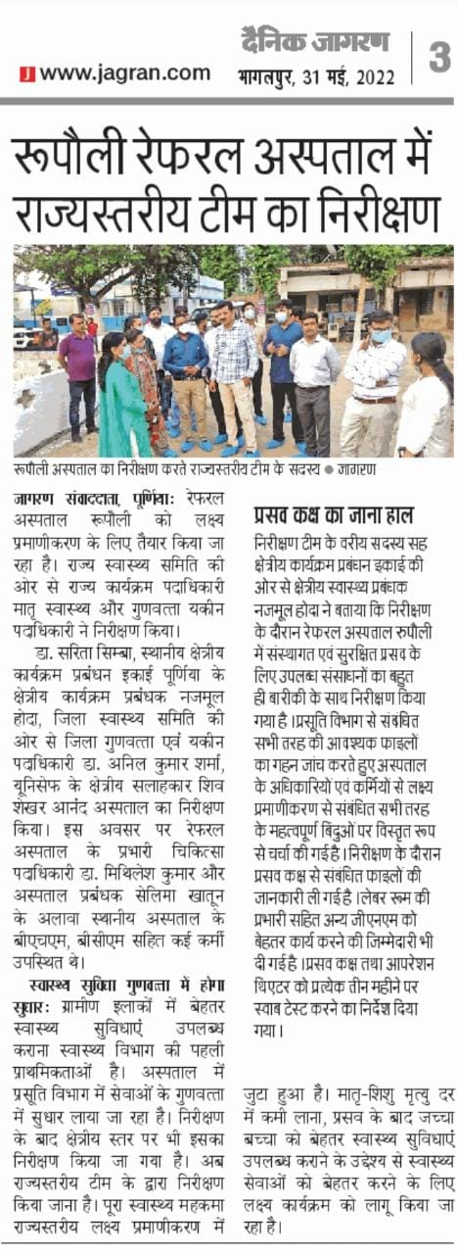
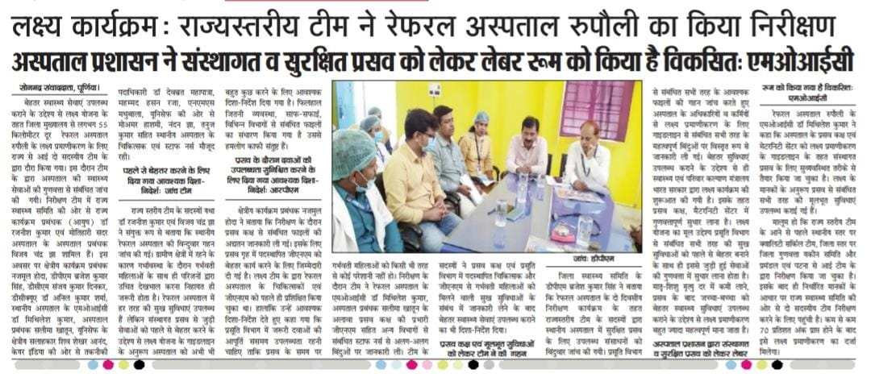
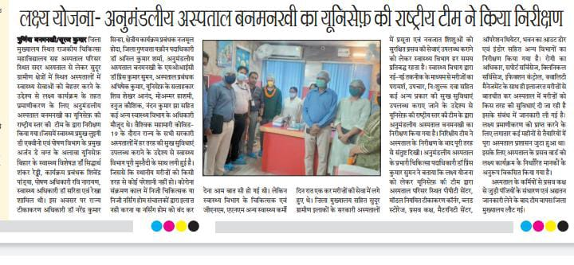
Pictorial Journey
On the day of LaQshya Certification
Media Coverage

