Slide 1
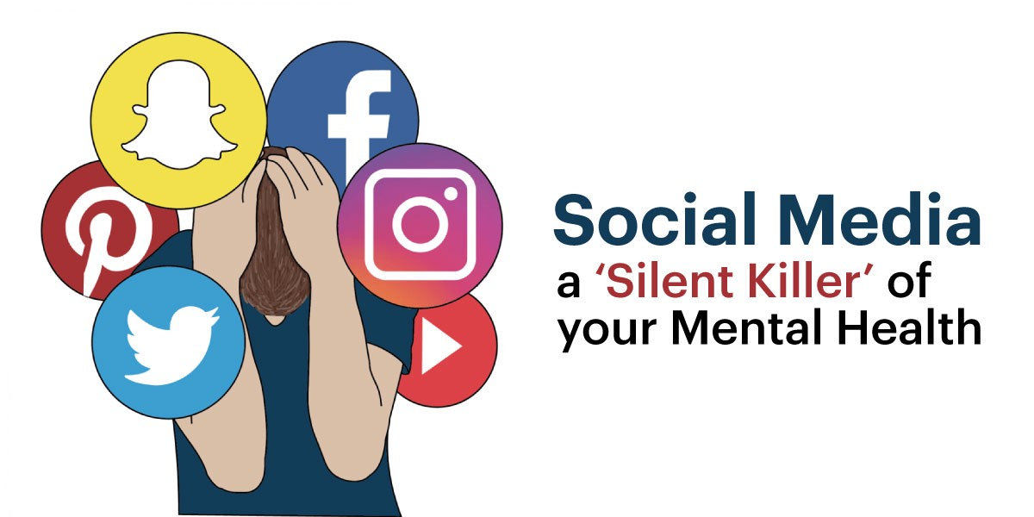
IMPACT OF SOCIAL MEDIA ON MENTAL HEALTH OF ADOLESCENT – A narrartive review
At
IQVIA Consulting &Information Services India Pvt. Ltd.
Presented By - Dr. Aarushi Khosla
(PG/21/002)
Healthcare IT
Under Guidance- Dr. Punit Yadav(Dissertation Mentor)

Slide 2
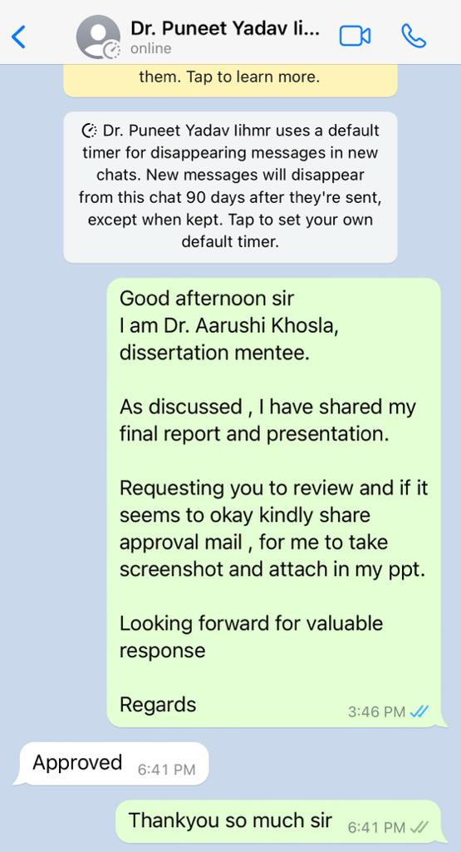
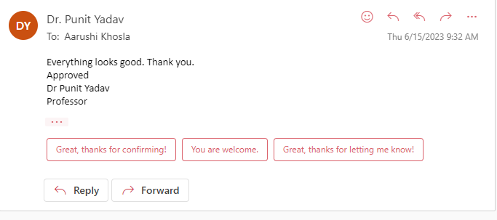
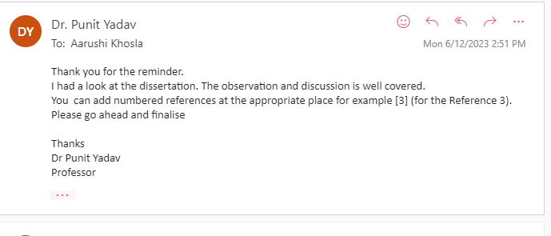
Approval by Dr. Punit Yadav

Slide 3
TABLE OF CONTENTS
1 | INTRODUCTION
2 | OBJECTIVE OF STUDY
3 | RESEARCH STRATEGY
4 | RESULT
5 | DISCUSSION
6 | REFERENCES
7 | PICTORIAL JOURNEY

Slide 4
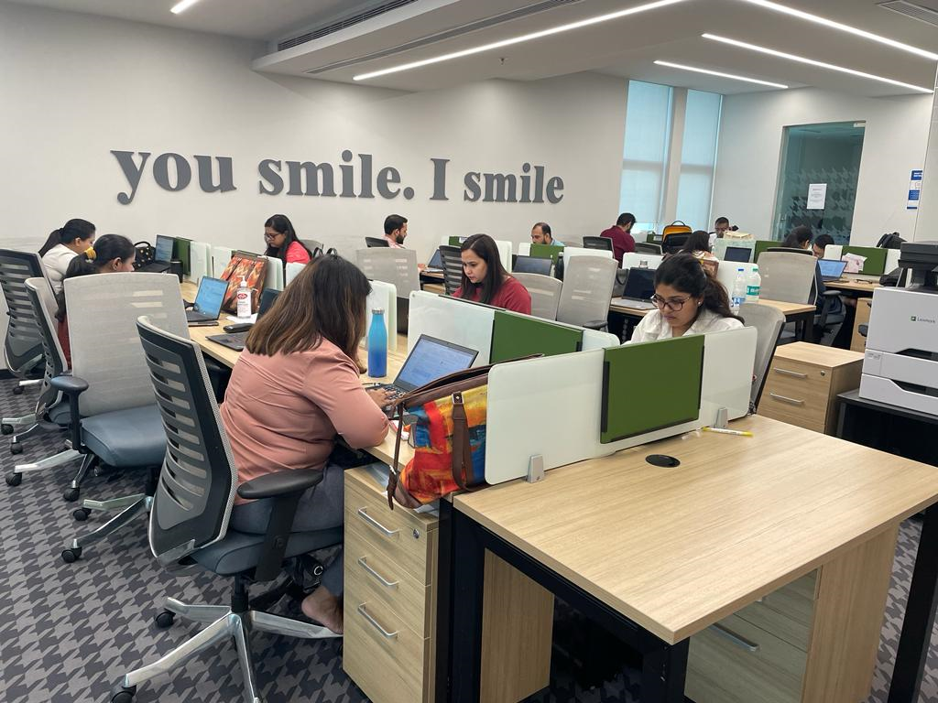
INTRODUCTION
ABOUT ORGANISATION
IQVIA is a global leader in providing research and consulting in healthcare and life sciences sector
IQVIA is the world’s leading provider of healthcare survey, consulting & health intelligence services with over 60 years of experience.
We have a strong focus on the Government and Public sector (GPS) in India. Our Public Health Government Practice in India works with the key Central Ministries, State Governments and International Donor Agencies across India
We have prior experience of working on projects funded by government and international donor agencies including The World Bank, UNDP, CHAI, JSI, USAID Deliver, NPPA, DoP, Niti Aayog, PSI, BMGF, DFID, Pharmexcil, Tata Trusts, and Micronutrient Initiative etc.
IQVIA Health has significant experience in advising Governments across the world in areas ranging from healthcare surveys to technology to transformational insights.
IQVIA ,New Delhi

Slide 5
ABOUT THE PROJECT
Human beings are social creatures that require companionship of others to make progress in life.
Thus being socially connected with other people relive stress, anxiety, depression but lack of social connection can seriously lead to mental illness.
SOCIAL MEDIA
There are 4.76 billion social media users around the world in January 2023, equating to 59.4% of the total global population.
Social media users have continued to grow over the past 12 months with 137 million users joining over last time ,That equates to annualized growth of 3 percent, at an average of 4 new users.
Recent figures show that 9 in 10 users use social media each month.
In India, adolescents and teenagers between the ages of 13 and 19 make up 31 percent of the overall number of people who use social media (Statista, 2021)

Slide 6
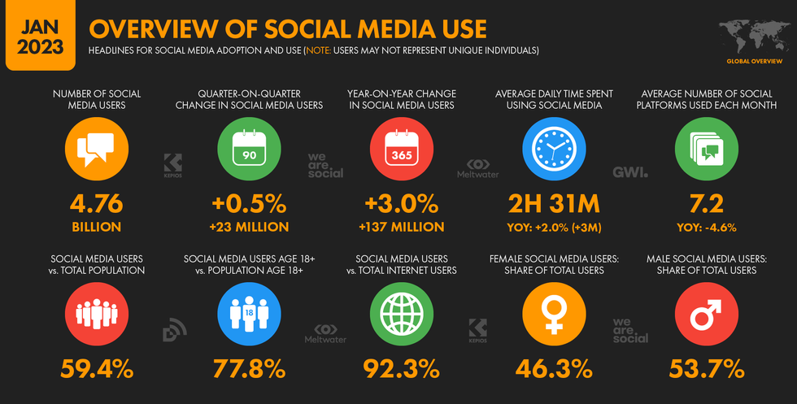
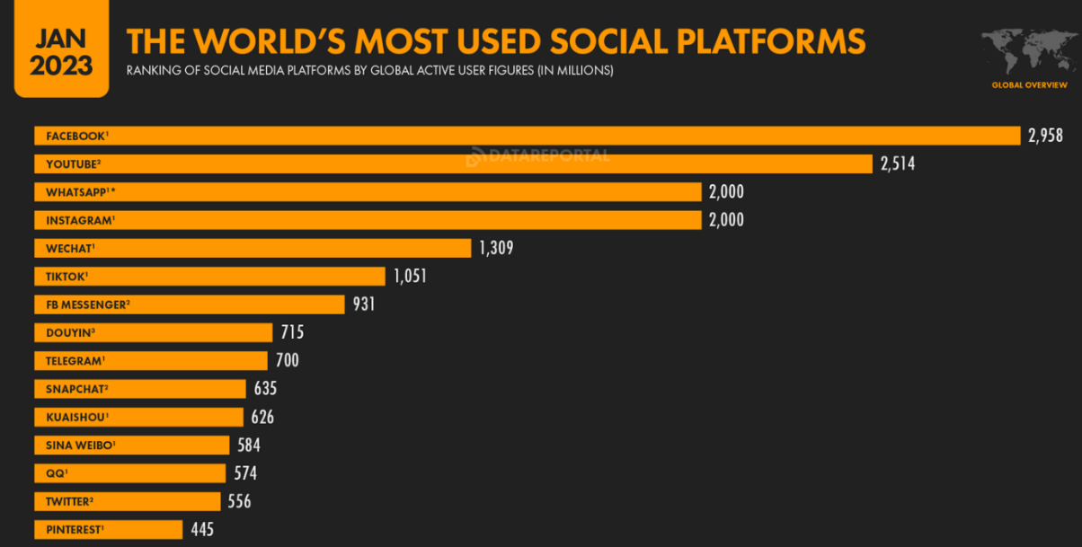
The world's biggest social media platform- Facebook remains on top of world's biggest social media platform, but there are now 6 social media platforms that each claim one billion or monthly active users.
Source: Global Social Media Statistics- Data Reportal.

Slide 7
IMPACT ON MENTAL HEALTH
1
Physical, emotional and social changes, including exposure to poverty, abuse, or violence, can make adolescents vulnerable to mental health problems.
2
It is estimated that 1 in 7 (14%) 10-19 year-olds experience mental health conditions, yet these remain largely unrecognized and untreated.
3
The COVID-19 pandemic paved the way for social media platforms spreading information and making communication easy, but also led to an increase in spreading fake news and misinformation among people all around the world.
4
According to WHO reports, it is estimated that 3.6% of 10-14 year-olds and 4.6% of 15-19 year-olds experience an anxiety disorder.
5
Suicide is the fourth leading cause of death among 15 to 29year-olds.
6
Globally, one in seven 10-19-year-olds experiences a mental disorder, accounting for 13% of the global burden of disease in this age group.
7
Depression, anxiety and behavioural disorders are among the leading causes of illness and disability among adolescents.

Slide 8
RESEARCH QUESTION | How social media usage is affecting the mental health of adolescent?
OBJECTIVES OF STUDY | To assess the impact of social media usage on mental health of adolescents. To observe negative impact of social media on behavior change in adolescents.

Slide 9
REVIEW STRATEGY
The review will be carried out adhering to the guidelines of standard Preferred Reporting Items for Systematic Reviews and Meta-Analysis (PRISMA) for narrative review
SOURCES OF DATA
Research articles and Research paper from Pub Med & Google Scholar
KEYWORDS
mental health, social media, social media AND adolescent health, infodemic, social media AND behaviour change
SELECTION CRITERIA
Inclusion criteria- Published articles of past 5 years , full text research papers will be included in the review focusing on the adolescent mental health.
Exclusion criteria- Duplicate papers and non- reviewed articles will be excluded in selected final articles.
06

Slide 10
REVIEW STRATEGY
Assessing the quality
ACTIVITY 3
Assessing Relevance
ACTIVITY 2
Assessing Appropriateness of the Search Keywords
ACTIVITY 1

Slide 11
REVIEW STRATEGY
Step 1- Search on PubMed and Google Scholar using the following keywords related to Social media impact and infodemic effect on mental health of adolescents.
(SOCIAL MEDIA, SOCIAL MEDIA AND MENTAL HEALTH OR INFODEMIC MANAGEMENT, SOCIAL MEDIA AND FAKE NEWS )
N= 72
Step 2- Limiting the time span to past 5 yrs
N=56
Assessing Appropriateness of the Search Keywords
Step 3- Focus articles on full text research paper, articles published. Excluding proceeding paper, books, book chapters and review articles.
N=45
Step 4 - Limiting to English language
N=45
06

Slide 12
REVIEW STRATEGY
Initial sorting of the articles titles and abstracts led to the exclusion of articles that did not focus on mental health and impact on mental health
The papers excluded were on the grounds of trade publications, editorial handbooks, overlapping studies in close contexts of social media and mental health
Assessing Relevance
The study tries to acknowledge the recent trends of social media impact on mental health of adolescent and to understand the impact lead to behavior change signs on adolescents
45 articles were selected for deeper reading

Slide 13
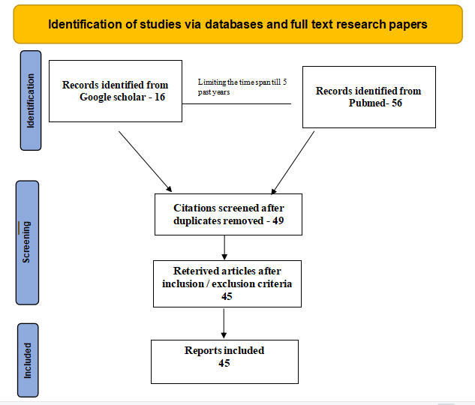
REVIEW STRATEGY
PRISMA Guidelines for Narrative Review
Assessing the quality

Slide 14
RESULT
Out of 72 articles , 45 articles were being chosen for deeper learning after applying exclusion/inclusion criteria
45 articles were time based i.e past 5 years
12 were research papers in which describes that social media has an impact on mental health of adolescent
7 were cross-sectional studies and 3 longitudinal studies and rest were systematic reviews.
Outcome
The magnitude of association between social media use and depressive symptoms was larger for girls than for boys
In 2019, it was estimated that one in seven adolescents experience mental disorders.
This amounts to an estimated 166 million adolescents (89 million boys and 77 million girls) boys and girls globally
Combination description
The study also suggests adolescents, both boys and girls, are known to be active users of social media.
The findings suggest that excessive use of social media can lead to various mental health issues, including anxiety, depression, loneliness, and low self-esteem.

Slide 15
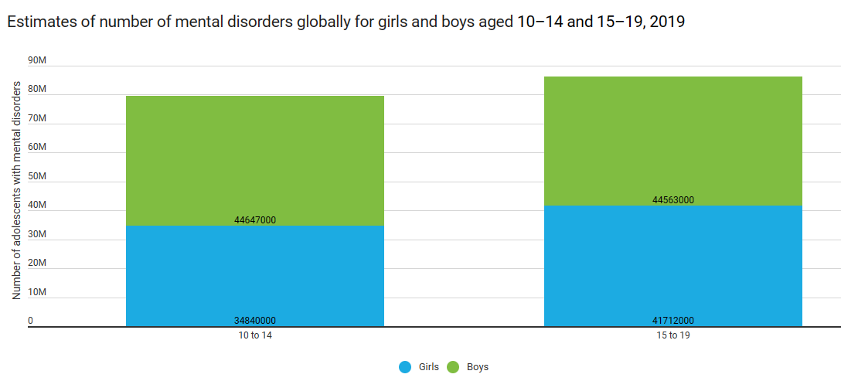
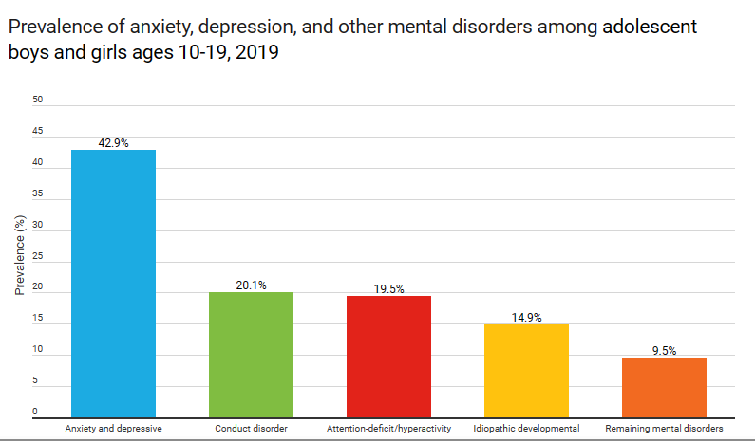
WHO estimates of mental health disorders in adolescents (global)
UNICEF analysis based on estimates from the Institute for Health Metrics and Evaluation (IHME), Global Burden of Disease Study, 2019, as presented in the State of the World’s Children Report 2021

Slide 16
RESULT
KEY FINDINGS
The main focus of research papers were on the behavioral signs such as anxiety and depression.
12
Research Papers
It has been indicated that the prolonged use of social media platforms such as Facebook may be related to negative signs and symptoms of depression, anxiety, and stress.
The aim of filling the gap by examining social media impact on mental health, which is sedentary behavior, which, if in excess, raises the risk of health problems
Some teens experience anxiety from social media related to fear of loss, which causes teens to try to respond and check all their friends messages and messages on a regular basis.

Slide 17
RESULT
KEY FINDINGS
The main focus of the studies indicated high emotional and behavioral difficulty rates compared to age-based norms.
7
CROSS SECTIONAL
STUDIES
Social Media frequency use and Social media addiction had differential effects on the children's functioning.
The studies also focused on social media use at time of COVID-19
Some teens experience examining the psychological effects of COVID-19 adolescents described an increase in anxiety and depression among the study populations

Slide 18
RESULT
KEY FINDINGS
This finding suggest highlighting the higher risk of developing elevated social media use and social media addiction among children with impulse control or behavioral dysregulation.
3 LONGITUDNAL
STUDIES
Negative parenting creates a cycle of disengagement between parents and their children, resulting in children's increased reliance on digital media for regulation negative affect
It describes while many adolescents used social media excessively only adolescent whose use was characterized by high behavioral and emotional dependency showed related emotional, behavioral, and academic difficulties.

Slide 19
RESULT
KEY FINDINGS
The main focus was on social deprivation in adolescence might have far-reaching consequences.
23
SYSTEMATIC
REVIEWS
Studies have focused on loneliness in humans and have reported a connection between self-reported loneliness and mental health problems
In particular those aged 13–17 years indicate that technologies like social media make them feel more connected with their friends help them interact with more diverse groups of people and allow them to access social support during tough times

Slide 20
DISCUSSION
1
This study has attempted to systematically analyze the existing literature on the effect of social media use on mental health.
2
In the 16 studies, anxiety and depression were the most commonly measured outcomes.
3
The prominent risk factors for anxiety and depression emerging from this study comprised time spent, activity & addiction to social media.
4
Depression is one of the unintended significance of unnecessary use of social media.
5
Females were found to be more addicted to social media as compared with males.
6
Social media use increased during covid 19 pandemic, including the usage of a variety of social media platforms (eg snapchat , instagram , tiktok )
7
Individual's who reported more frequent experiences of Fear of Missing Out (FoMO) tended to use social media more frequently to seek and share information.

Slide 21
REFERENCES
1) Karim F, Oyewande AA, Abdalla LF, Chaudhry Ehsanullah R, Khan S. Social Media Use and Its Connection to Mental Health: A Systematic Review. Cureus. 2020 Jun 15;12(6):e8627. doi: 10.7759/cureus.8627. PMID: 32685296; PMCID: PMC7364393.
2) Developing health status index using factor analysis. [Mar;2020 ];Mohamad M, Juahir H, Ali NAM, Kamarudin MKA, Karim F, Badarilah N. J Fund Appl. 2017 9:83–92.
3) Digital News Report. [Mar;2020 ];Newman N, Fletcher R, Kalogeropoulos A, Nielsen R
4) Meeting the challenges of evidence-based policy: the Campbell collaboration. Petrosino A, Boruch RF, Soydan H, Duggan L, Sanchez-Meca J. Ann Am +-Acad Pol Soc Sci. 2001;578:14–34
5) The impact of online social networking on adolescent psychological well-being (WB): a population-level analysis of Korean school-aged children. Kim HH. Int J Adolesc Youth. 2017;22:364–376
6) Social media use and mental health among young adults. Berryman C, Ferguson C, Negy C. Psychiatr Q. 2018;89:307–314.
7) Does time spent using social media impact mental health?: An eight year longitudinal study. Coyne SM, Rogers AA, Zurcher JD, Stockdale L, Booth M. Comput Hum Behav. 2020;104:106160
8) For better or for worse? A systematic review of the evidence on social media use and depression among lesbian, gay, and bisexual minorities. Escobar-Viera C, Whitfield D, Wessel C, et al. https://mental.jmir.org/2018/3/e10496/ JMIR Ment Health. 2018;5:10496.
9) https://www.who.int/health-topics/infodemic#tab=tab_1
09

Slide 22
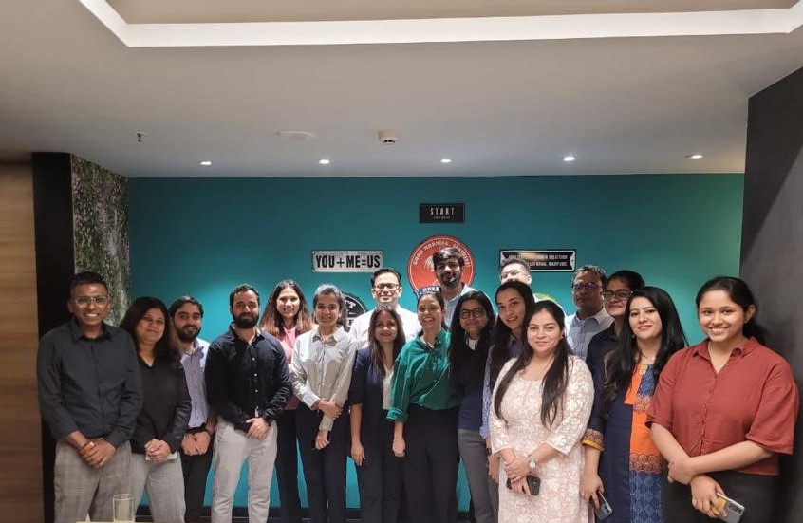
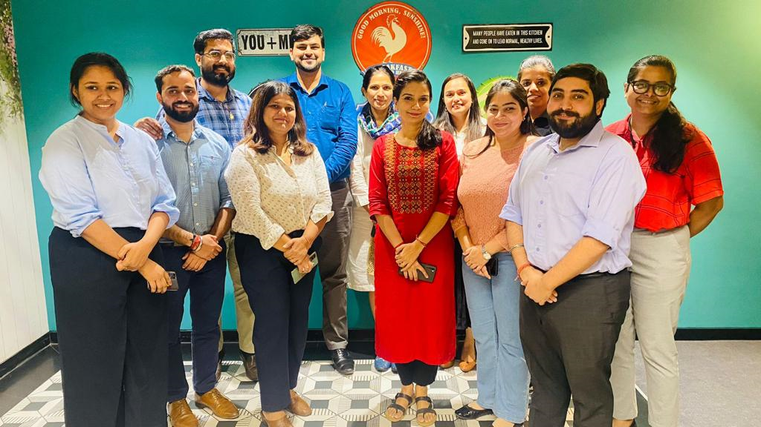
Journey at IQVIA
DISEASE MANAGEMENT & HEALTH SYSTEMS
09

Slide 23
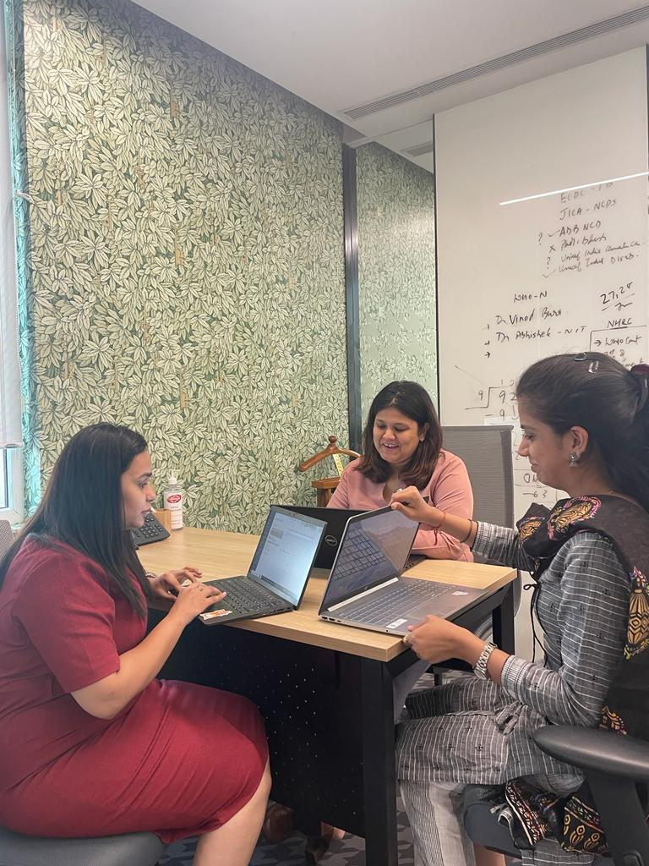
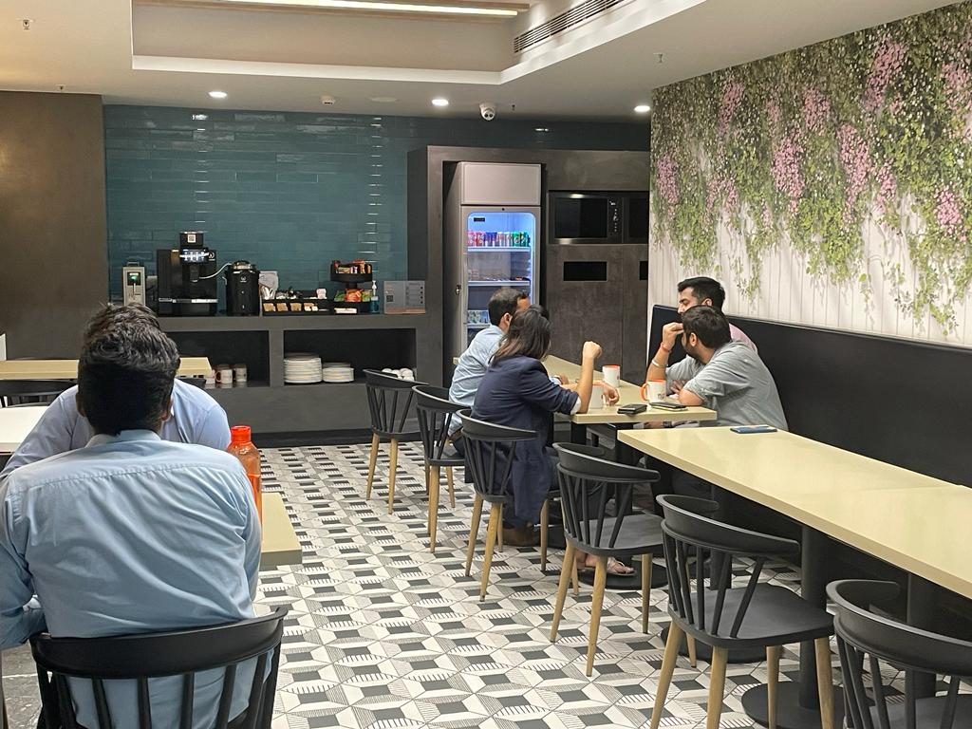
Journey at IQVIA
09

Slide 24
THANK YOU
09

