Slide 1
PATIENT SATISFACTION : EX-SERVICEMEN CONTRIBUTORY HEALTH SCHEME (ECHS)
By
Col Aditya Chopra – R No PG/005/21-23
Mentor- Dr Vinay Tripathi, IIHMR

Slide 2
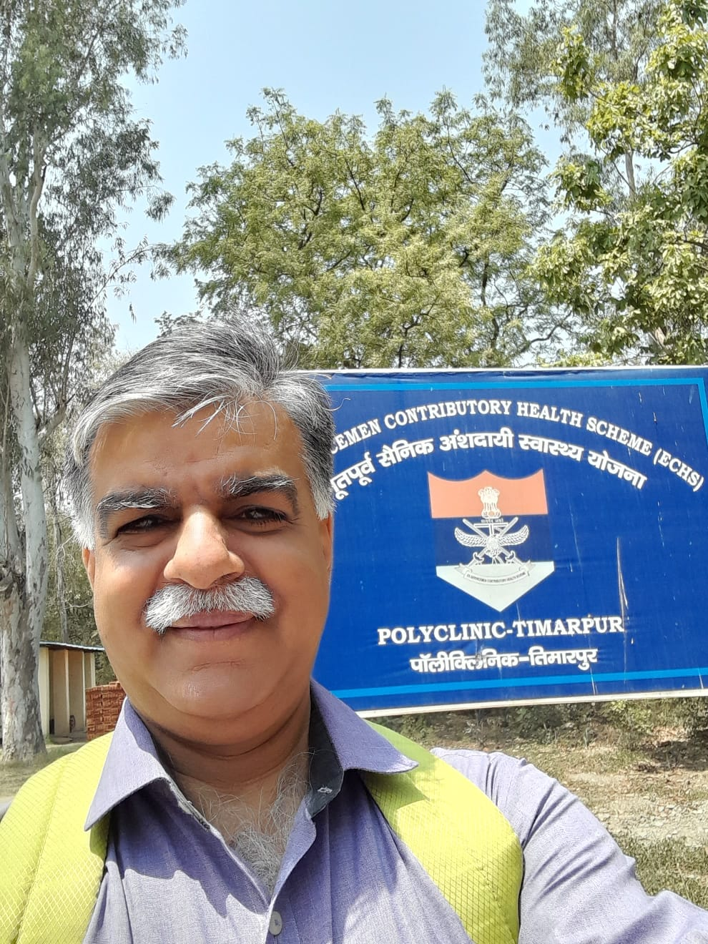
PREVIEW
Mentor Approval
Introduction
Key Questions / Objectives
Methodology
Results
Discussion

Slide 3
Mentors Approval

Slide 4
Introduction
ECHS. Launched on 1st April 2003 for medical cover to veterans
Success of ECHS System
Patient Satisfaction (Overall experience) at ECHS Polyclinics
Type of Polyclinics( Dependency)
Type A - Above 20,000
Type B - Above 10,000
Type C - Above 5,000
Type D - Above 1,500
Area of Study: ECHS Polyclinic, Timarpur, New Delhi

Slide 5
Research Questions / Objectives
Primary Research Question. What is the satisfaction level of the beneficiaries of Ex-Servicemen Contributory Health Scheme (ECHS), at ECHS,Polyclinic at Timarpur, New Delhi ?
Secondary Research Questions.
(a) What are the aspects of ECHS scheme, with which the beneficiaries are satisfied/ happy ?
(b) What are the shortcomings at the ECHS polyclinic?
(c) Is there any correlation between communication with the doctor which can be arrived at, with respect to patient satisfaction?
Objective The objective of the study is to assess the patients’ satisfaction level of the beneficiaries of Ex-Servicemen Contributory Health Scheme (ECHS)

Slide 6
METHODOLOGY - CONDUCT OF STUDY
Study Area: ECHS Polyclinics at Timarpur
Study Design: Cross-sectional study
Data Collection Tools: Semi structured questionnaire and interviews
Study Population: ECHS Beneficiaries of a ECHS Polyclinic at Timarpur(New Delhi).
Time : One Month for data collection
Sampling Method: Convenience
Data Analysis Tool: Microsoft Excel & SPSS
Data Analysis Method : Descriptive analysis for summarizing the data & Correlation analysis
Exclusion Criteria - Consent not given/ unwilling.
Inclusion Criteria – Patients visiting Polyclinic

Slide 7
Aspects related to patient satisfaction
Technical Quality
Interpersonal Manners.
Communication.
Financial Aspects
Time spent with the doctor.
Accessibility.
General Satisfaction
Scale of Assessment – Strongly Agree, Agree, Neutral, Agree, Strongly Disagree

Slide 8
METHODOLOGY - CONDUCT OF STUDY
SCALE | QUESTIONS
General Satisfaction | 3,17
Technical Quality | 2,4,6,14
Interpersonal manner | 10,11
Communication | 1,13
Financial Aspects | 5,7
Time Spent with Doctor | 12,15
Accessibility | 8,9,16,18
Some questions have been worded so that agreement reflects satisfaction with the medical care.
Some questions have been worded so that agreement reflects dissatisfaction with the medical care.
All questions must be scored to reflect high satisfaction with the medical care.
After question scoring, questions within the same subscale should be averaged together to create a seven scale average score.
Scale of Assessment – Strongly Agree, Agree, Neutral, Agree, Strongly Disagree

Slide 9
QUESTIONNAIRE
Your Age (in years)
(a) 30 to 40 (b) 41 to 50 (c) 51 to 60 (d) 61 to 70 (e) 71 to 80 (f) Above 80
1. Doctors are good about explaining the reasons for the medical tests?
2. I think that my doctor's clinic has everything needed to provide me medical care ?
3. The medical care I have been receiving is just about perfect ?
4. Sometimes doctors make me wonder if their diagnosis is correct ?
5. I feel confident that I can get the medical care I need without being set back financially
6. When I go for medical care, they are careful to check everything when treating and examining me
.

Slide 10
QUESTIONNAIRE
QUESTIONNAIRE
7. I sometimes have to spend own money to buy medicines and get other diagnostic tests done at my cost
8. I have easy access to the medical specialists I need
9. Where I get medical care, people have to wait too long for emergency treatment
10. Doctors act too business like and impersonal towards me
11. My doctors treat me in a very friendly and courteous manner
12. Those who provide my medical care sometimes hurry too much when they treat me

Slide 11
QUESTIONNAIRE
QUESTIONNAIRE
13. Doctors sometimes ignore what I tell them
14. I have some doubts about the ability of the doctors who treat me
15. Doctors usually spend plenty of time with me
16. I find it hard to get an appointment for the medical care right away
17. I am dissatisfied with some things about the medical care I receive
18. I am able to get medical care whenever I need it

Slide 12
Scoring System: Questionnaire
Question Number | Response Number | Score Value
1,2,3,5,6,8,11,15,18 | 1 | 5
 | 2 | 4
 | 3 | 3
 | 4 | 2
 | 5 | 1
4,7,9,10,12,13,14,16, 17 | 1 | 1
 | 2 | 2
 | 3 | 3
 | 4 | 4
 | 5 | 5

Slide 13
Analysis
The analysis of the age profile of the respondents shows that out of the 158 participants, participated in the survey. The age profile was from 40 years to 80 plus years with both male and female respondents. The respondents were from different strata of the Armed forces hierarchy with different educational backgrounds
Interpretation.
It is important to consider this distribution when interpreting the results of the study, as the perspectives and experiences respondents may differ in the context of the effectiveness of the ECHS.

Slide 14
RESULTS

Slide 15
1. Doctors are good about explaining the reasons for the medical tests
Statistics
N Valid 158
Mean 3.40
Std. Deviation 1.094
Agree | 73
Disagree | 25
Neutral | 32
Strongly Agree | 18
Strongly Disagree | 10
Analysis
The analysis suggests that approximately 58% ( 91) of the participants agree that doctors are good in explaining the reasons for the medical tests whereas 22% of participants feel that they are not informed about the reasons for the medical tests.
Interpretation.
Effective doctor-patient communication is a central clinical function in building a therapeutic doctor-patient relationship, which is the heart and
art of medicine. This is important in the delivery of high-quality health care. Much patient dissatisfaction and many complaints are due to breakdown in the doctor-patient relationship. Also brings to the forefront the competence of the doctors employed also.

Slide 16
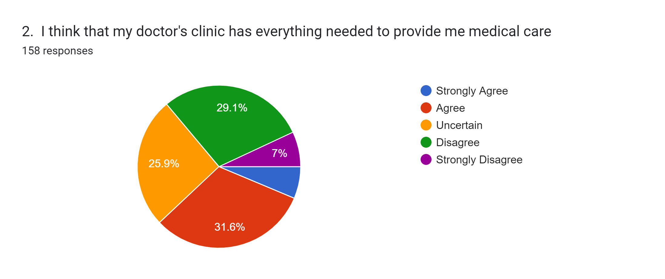
Statistics
N Valid 158
Mean 3.01
Std. Deviation 1.064
Agree | 50
Disagree | 46
Neutral | 41
Strongly Agree | 10
Strongly Disagree | 11
Grand Total | 158
Analysis
Only 6 % of the respondents strongly feel that the facilities in the polyclinic are adequate whereas 36 % feel otherwise, 32% are not sure and are in a dilemma.
Interpretation.
There is an urgent need to upgrade the facilities at ECHS , Polyclinic

Slide 17
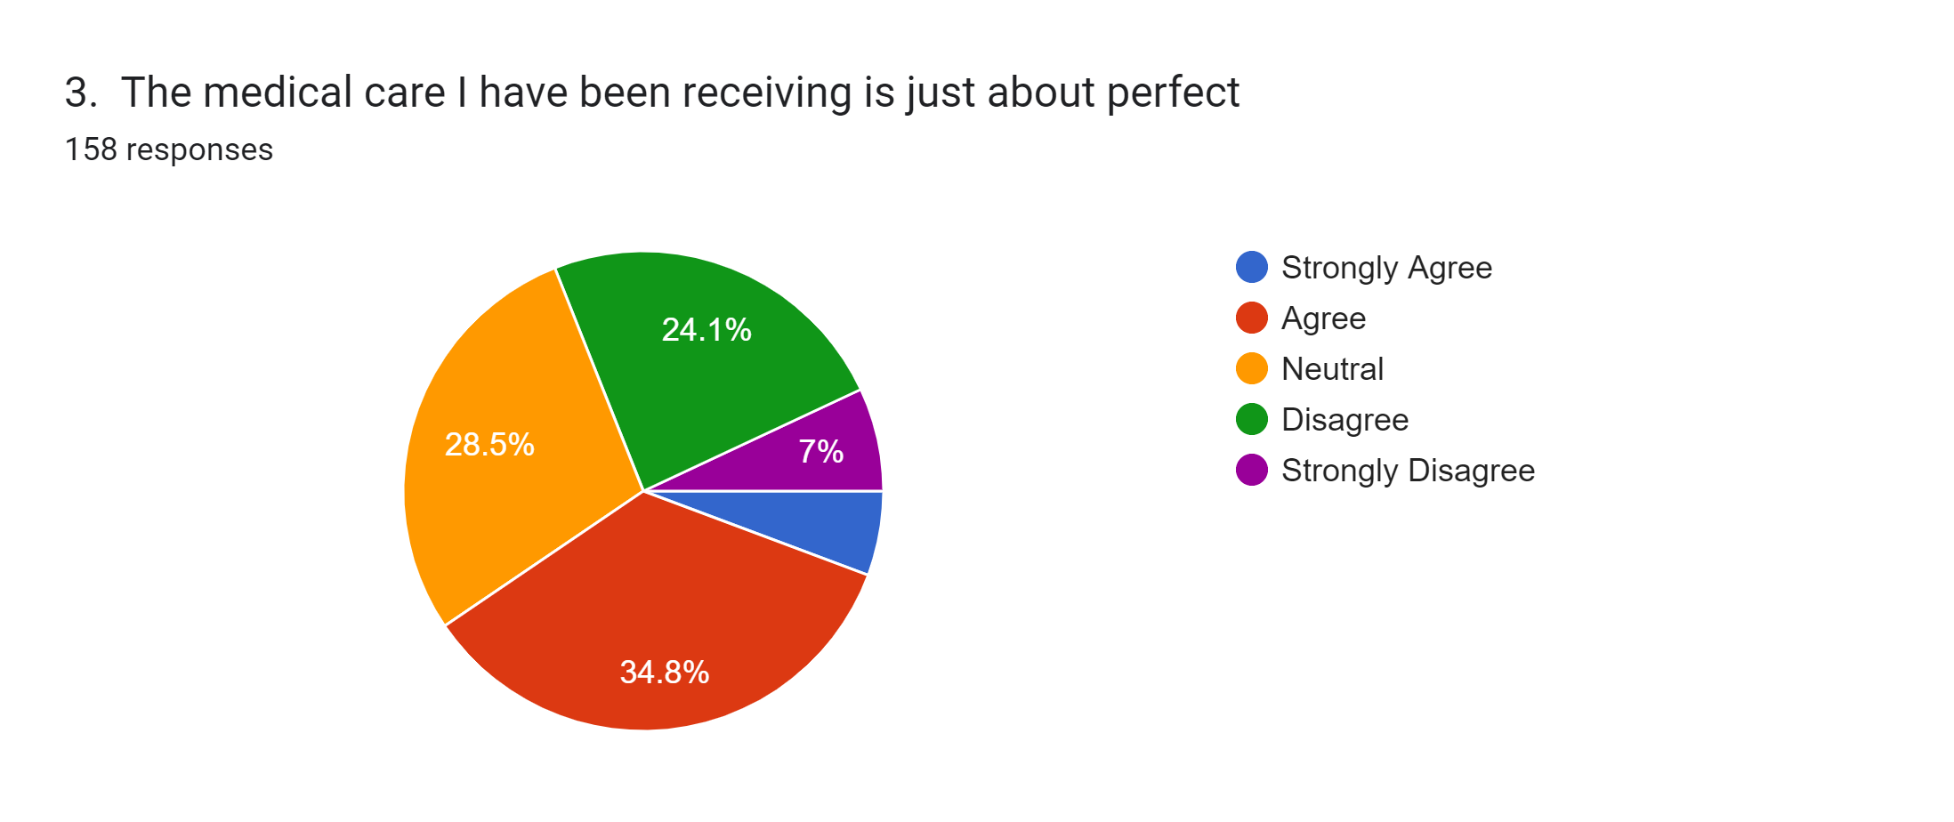
Statistics
N Valid 158
Mean 3.08
Std. Deviation 1.04
Agree | 55
Disagree | 38
Neutral | 45
Strongly Agree | 9
Strongly Disagree | 11
Analysis
The analysis points out that the medical care provided at the ECHS Polyclinic. Only 41% feel that medical care they have been receiving is just about perfect, whereas 59 % of the respondents are either not sure and disagree in varying proportions.
Interpretation.
Health care should be safe, effective, patient-centered, timely, efficient, and equitable.

Slide 18
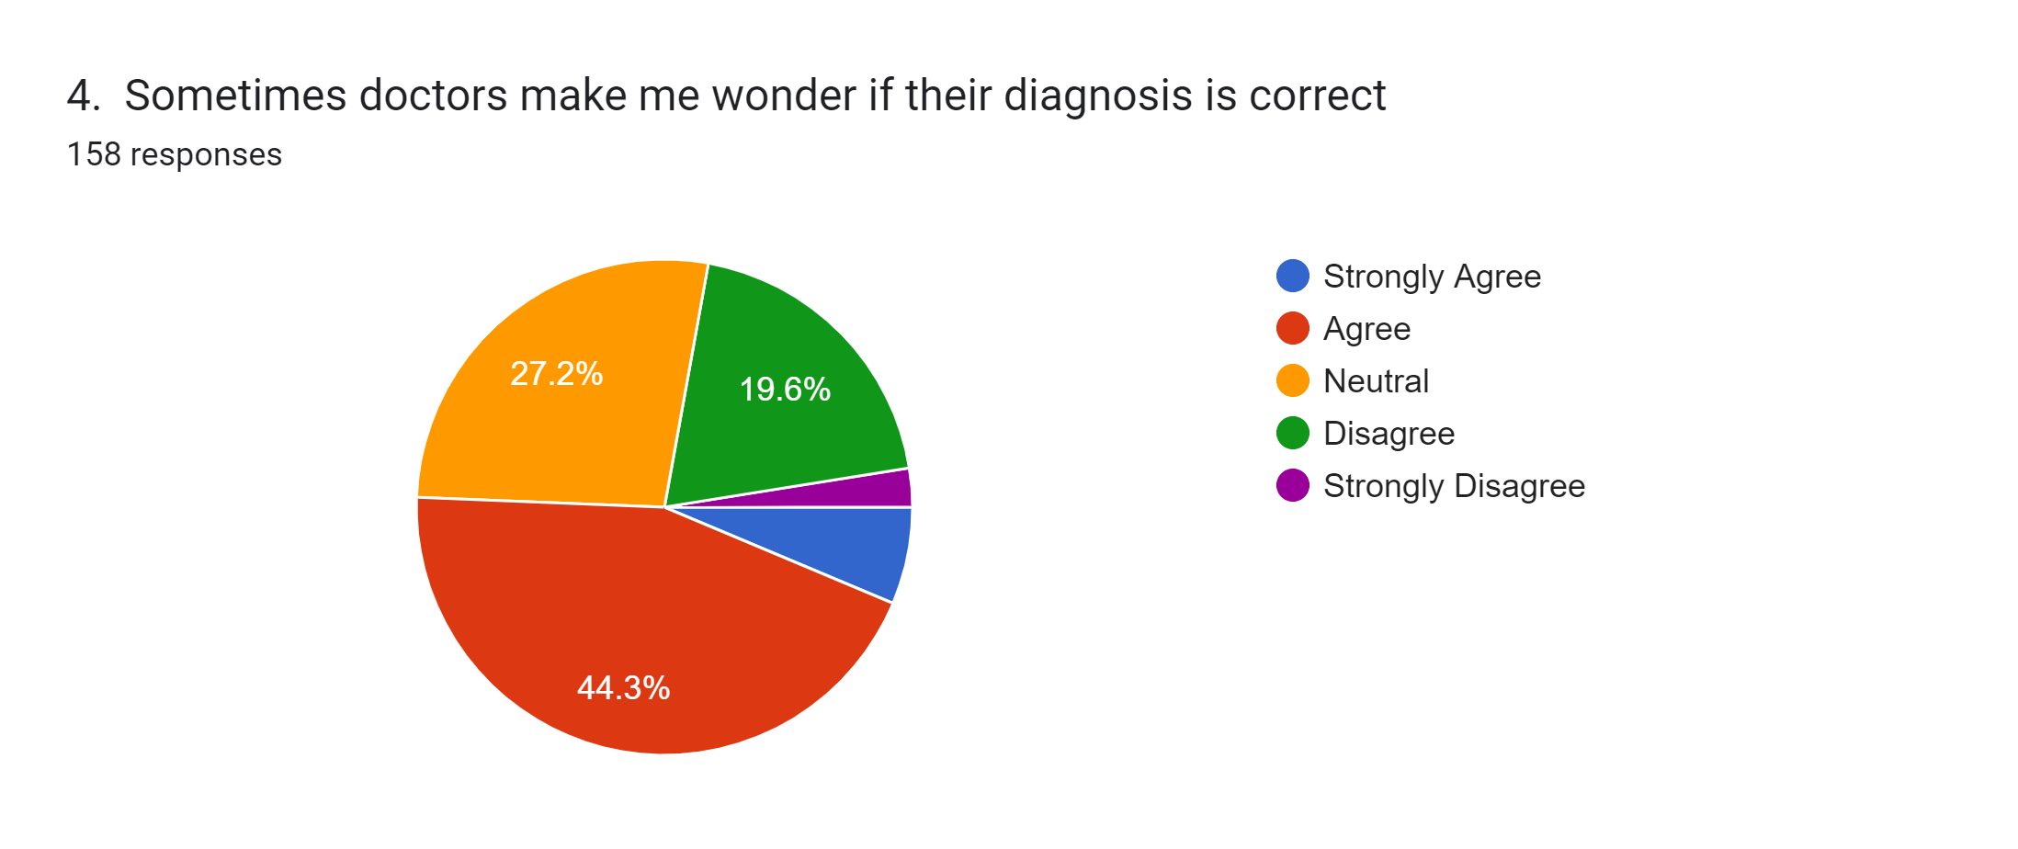
Statistics
N Valid 158
Mean 2.68
Std. Deviation 0.94
Agree | 70
Disagree | 31
Neutral | 43
Strongly Agree | 10
Strongly Disagree | 4
Analysis
This question points out to the competence of the doctor or physician available at the polyclinic 51% of the surveyed respondents feel that the diagnosis is correct.
Interpretation.
In health care there is a complex interaction between provider and patient; this remains at the very core of the healing process and has always had a pronounced impact on patient health and recovery. Communication is the key and use of latest technology and procedures. Having experts on the panel of doctors.

Slide 19
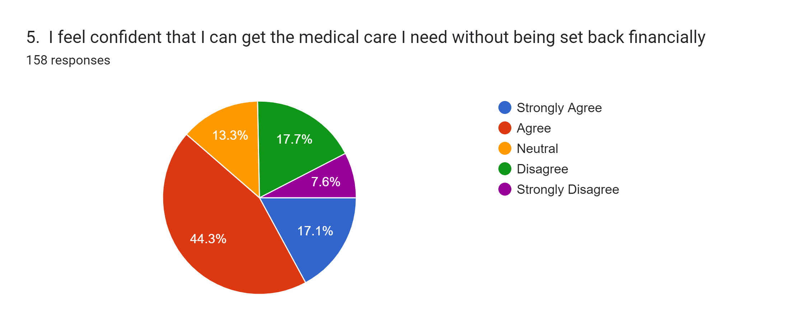
Statistics
N Valid 158
Mean 3.46
Std. Deviation 1.18
Agree | 70
Disagree | 28
Neutral | 21
Strongly Agree | 27
Strongly Disagree | 12
Analysis
62% of respondents feel that the facilities at ECHS polyclinic are adequate and they won’t have to go outside for medical care so as to burden them financially
Interpretation.
Health care should be safe, effective, patient-centered, timely, efficient, and equitable.

Slide 20
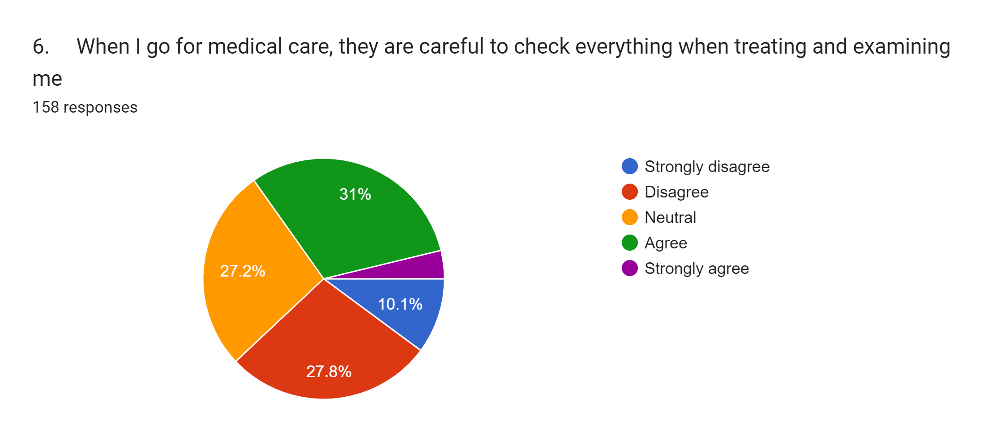
Statistics
N Valid 158
Mean 2.91
Std. Deviation 1.06
Agree | 49
Disagree | 44
Neutral | 43
Strongly agree | 6
Strongly disagree | 16
Analysis
38% respondents feel that the checkups at ECHS are not comprehensive whereas 27% feel that doctors are careful when treating and examining them
Interpretation
These challenging interactions may arise due to discrepancies in expectation, perception and/or communication between the patient and medical practitioner, and could be caused by the doctor, by the patient or by both. The optimal approach in dealing with a challenging interaction is to prevent it. If that is not possible, then it is best to create the conditions for dealing with a difficult situation in a manner that is open and safe for all, and to develop the skills of active listening and effective communication

Slide 21
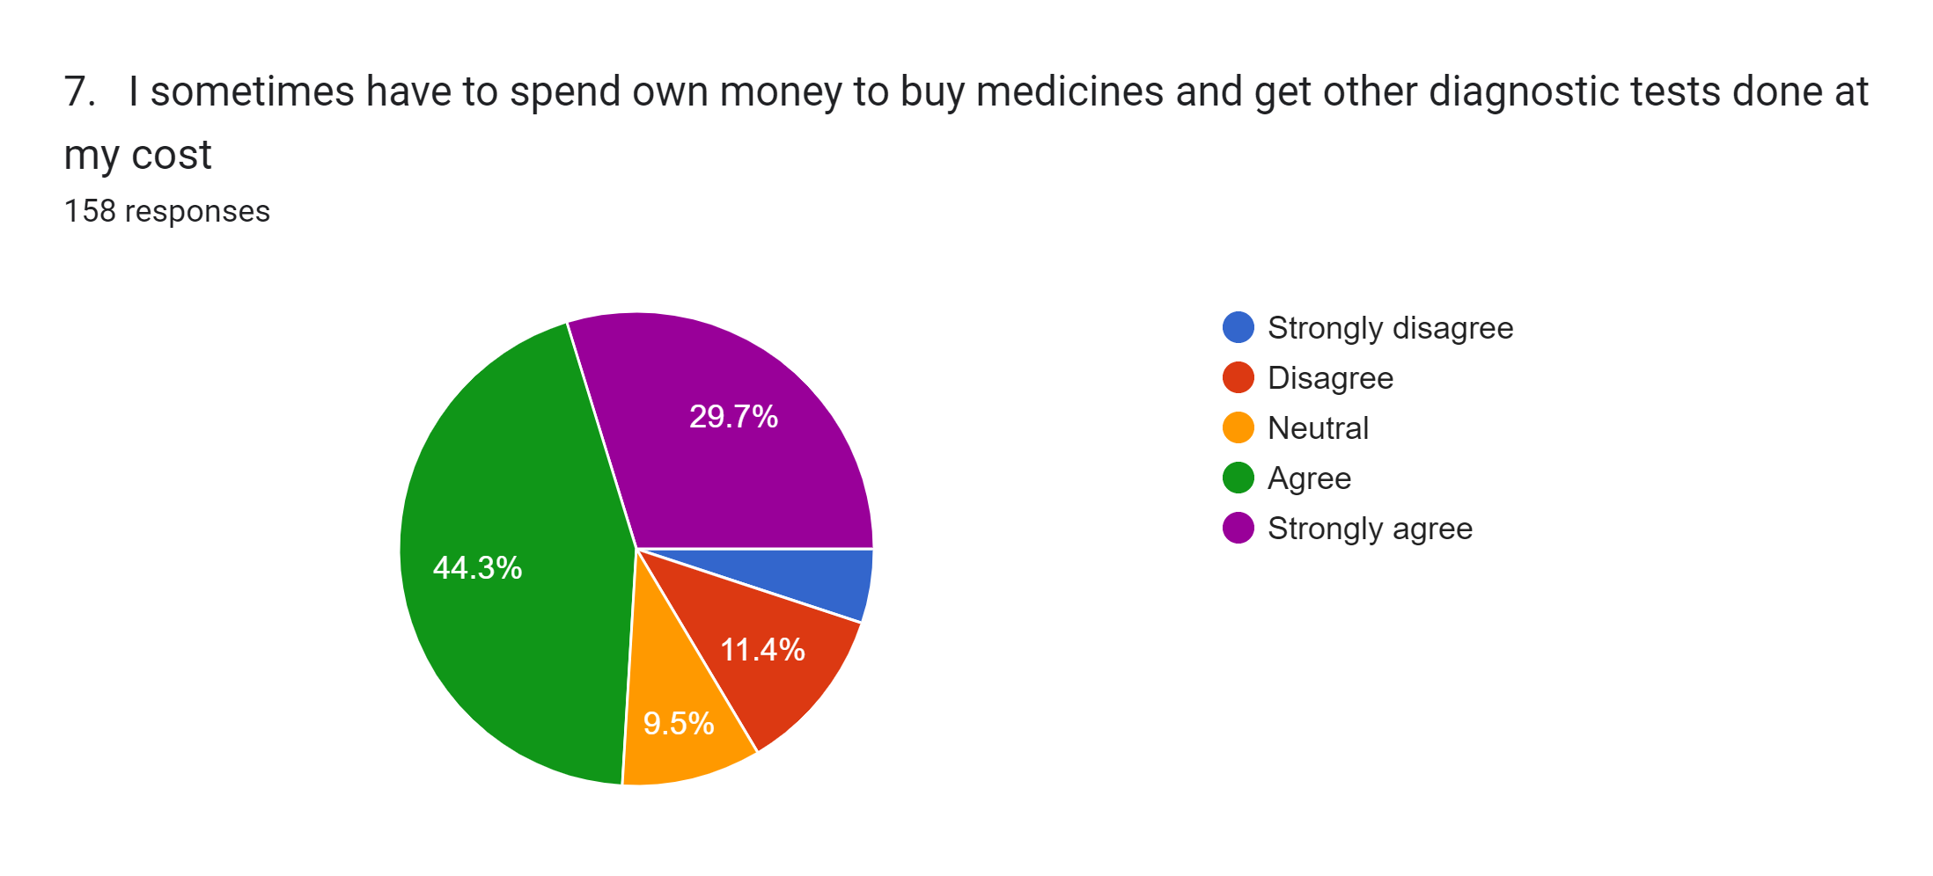
Statistics
N Valid 158
Mean 2.18
Std. Deviation 1.134
Agree | 70
Disagree | 18
Neutral | 15
Strongly agree | 47
Strongly disagree | 8
Analysis
This covers the aspect of OOPE wherein a large percentage of respondents have stated that they have to spend money from their own pockets 74%.
Interpretation
Institute measures for provision of medicines, quick referrals , easy disbursement of bills

Slide 22
Statistics
N Valid 158
Mean 2.940
Std. Deviation 1.164
Agree | 52
Disagree | 48
Neutral | 30
Strongly agree | 11
Strongly disagree | 17
Analysis
40 % believe that accessibility to medical specialists is easy
Interpretation
Empanelment of more hospitals, existing facilities of MI Rooms and Military Hospitals

Slide 23
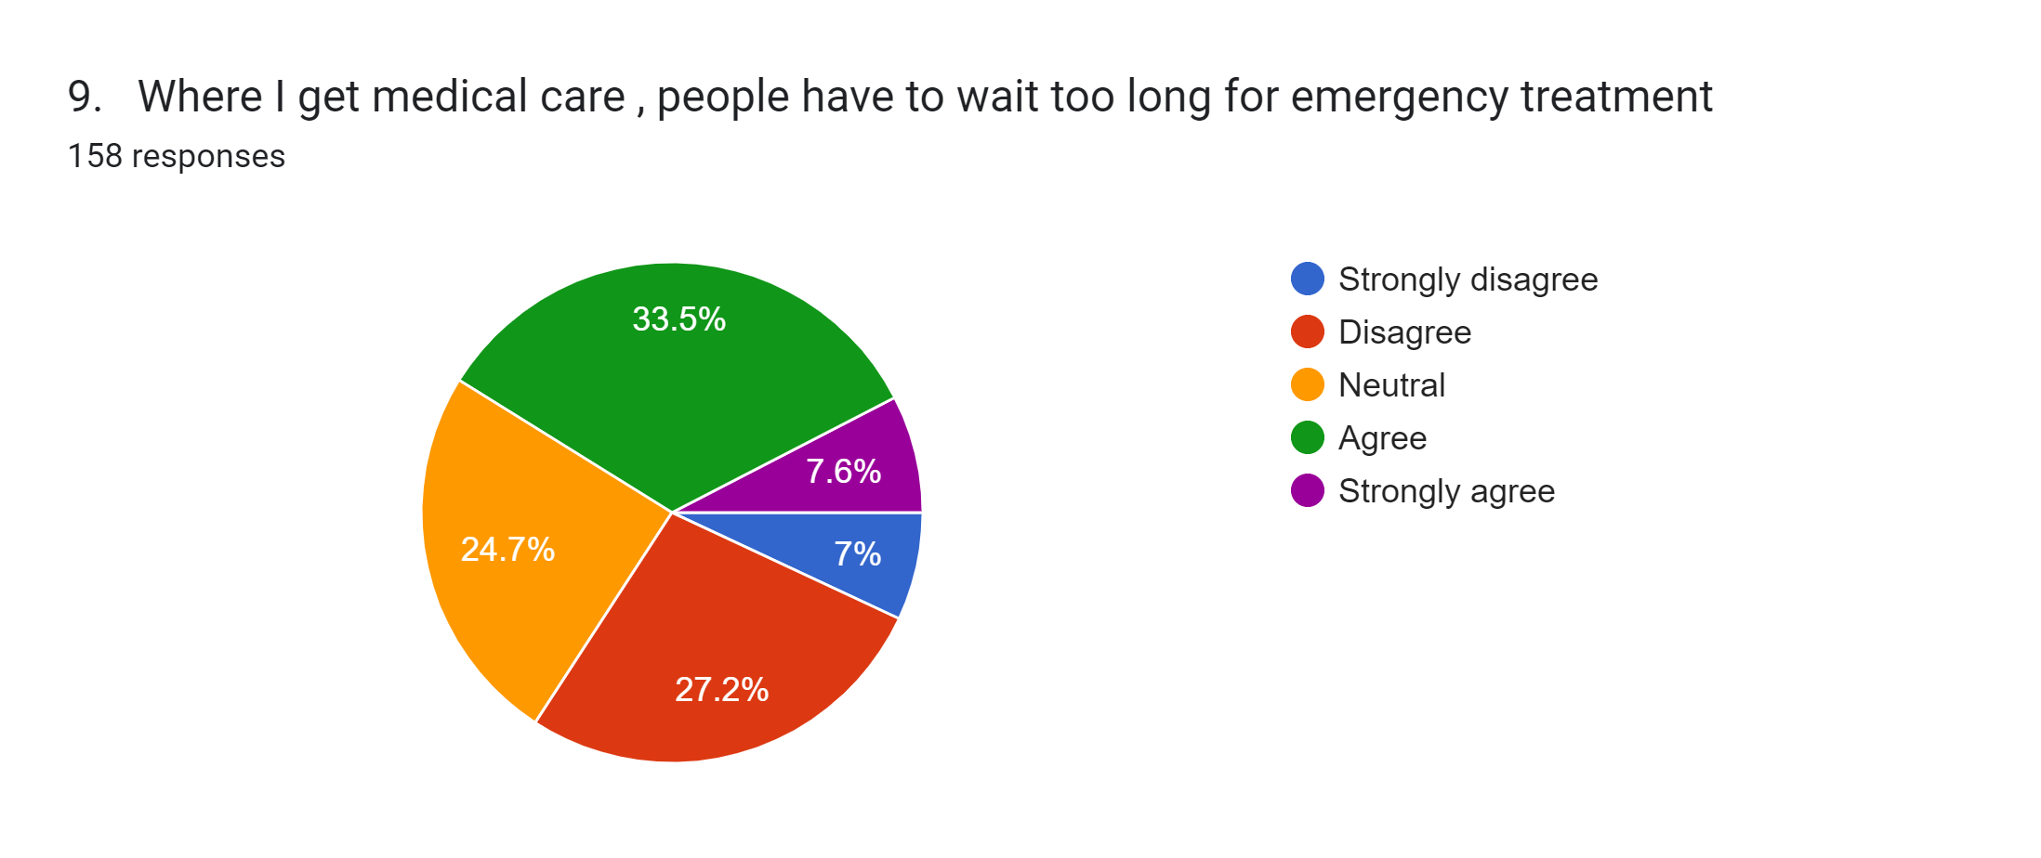
Statistics
N Valid 158
Mean 2.92
Std. Deviation 1.094
Agree | 53
Disagree | 43
Neutral | 39
Strongly agree | 12
Strongly disagree | 11
Grand Total | 158
Analysis
Only 40% think that the waiting period for emergency treatment is too long
Interpretation.
More empanelled hospitals, access to service hospitals

Slide 24
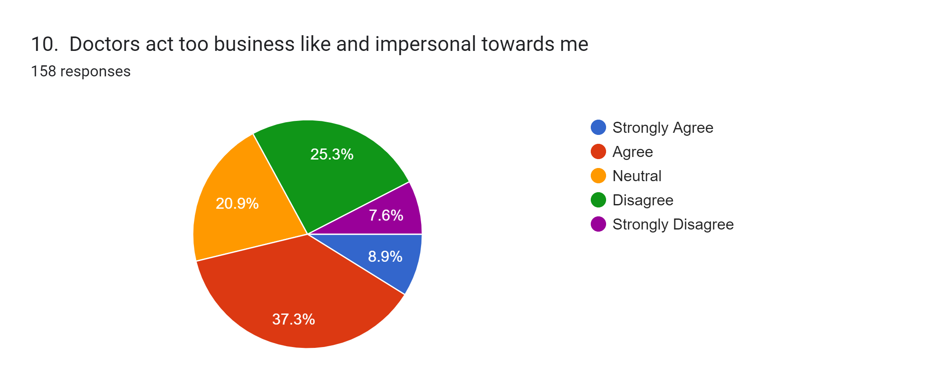
Statistics
N Valid 158
Mean 2.850
Std. Deviation 1.124
Agree | 59
Disagree | 40
Neutral | 33
Strongly Agree | 14
Strongly Disagree | 12
Analysis
47% respondents believe that doctors are more like businessman
Interpretation
Empanelment of more hospitals, existing facilities of MI Rooms and Military Hospitals

Slide 25
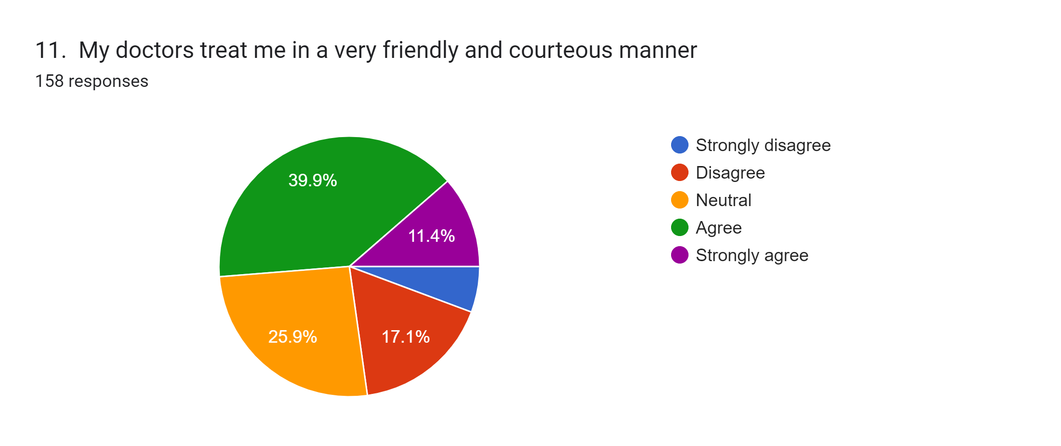
Statistics
N Valid 158
Mean 3.340
Std. Deviation 1.08
Agree | 63
Disagree | 27
Neutral | 41
Strongly agree | 18
Strongly disagree | 9
Analysis
51% think that the doctors treat them in a friendly and courteous manner
Interpretation
Empanelment of more hospitals, existing facilities of MI Rooms and Military Hospitals

Slide 26
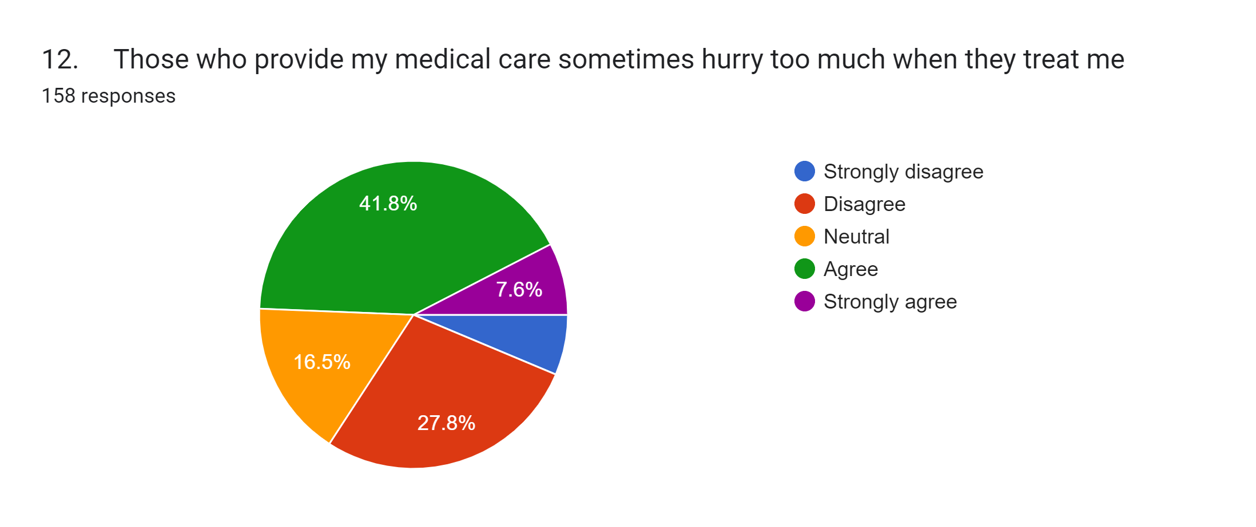
Statistics
N Valid 158
Mean 2.840
Std. Deviation 1.109
Agree | 66
Disagree | 44
Neutral | 26
Strongly agree | 12
Strongly disagree | 10
Analysis
50% think that doctors are in hurry to treat them
Interpretation
Empanellment of more hospitals, existing facilities of MI Rooms and Military Hospitals

Slide 27
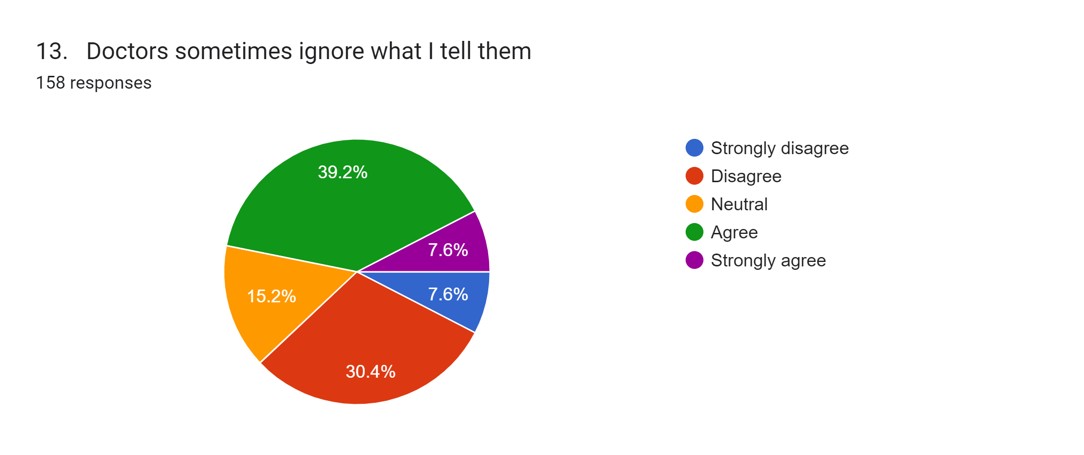
Statistics
N Valid 158
Mean 2.91
Std. Deviation 1.32
Agree | 62
Disagree | 48
Neutral | 24
Strongly agree | 12
Strongly disagree | 12
Analysis
46% respondents consider that doctors at times ignore them and their problems
Interpretation.
“When there’s no space for the scalpel, words are the surgeon’s only tool.”

Slide 28
Statistics
N Valid 158
Mean 3.140
Std. Deviation 1.10
Agree | 41
Disagree | 53
Neutral | 39
Strongly agree | 9
Strongly disagree | 16
Analysis
45% respondents only ,trust their doctors abilities.
Interpretation
The relationship struggles when doctors look at patients only as ‘problems’ that need to be ‘solved’, and when patients look at doctors only as people with ‘solutions’ that need to work perfectly.

Slide 29
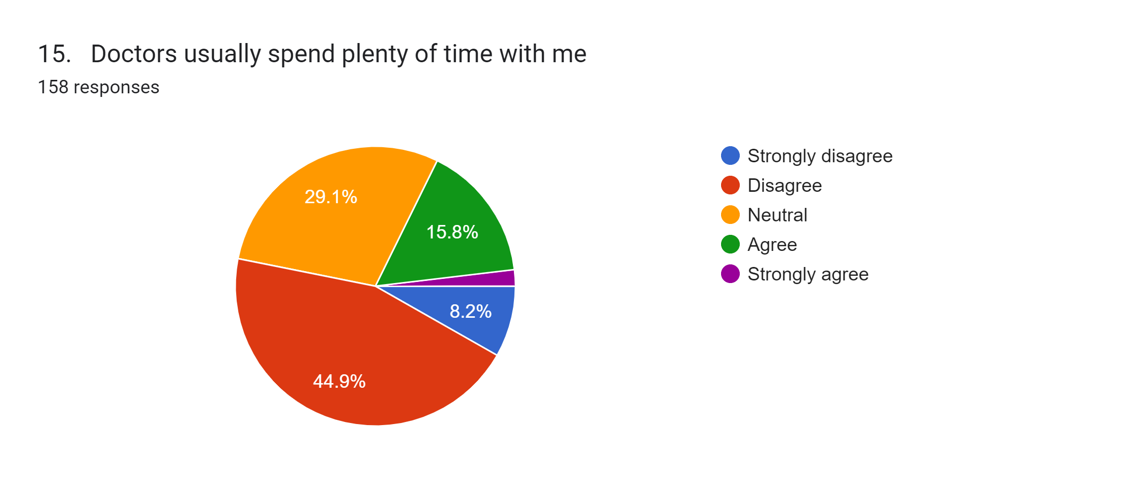
Statistics
N Valid 158
Mean 2.580
Std. Deviation .92
Agree | 25
Disagree | 71
Neutral | 46
Strongly agree | 3
Strongly disagree | 13
Analysis
The analysis is about the time spent by the doctor with the patient, 20% agree that doctors give them a patient hearing.
Interpretation
Use Simple Language. Clinical terms are used regularly in conversations between doctors. ...
Be Direct. When negative news is communicated to patients, it's natural to want to soften the delivery. ...
Encourage Questions. ...
Be Empathetic. ...
Make Doctor Patient Communication Meaningful.

Slide 30
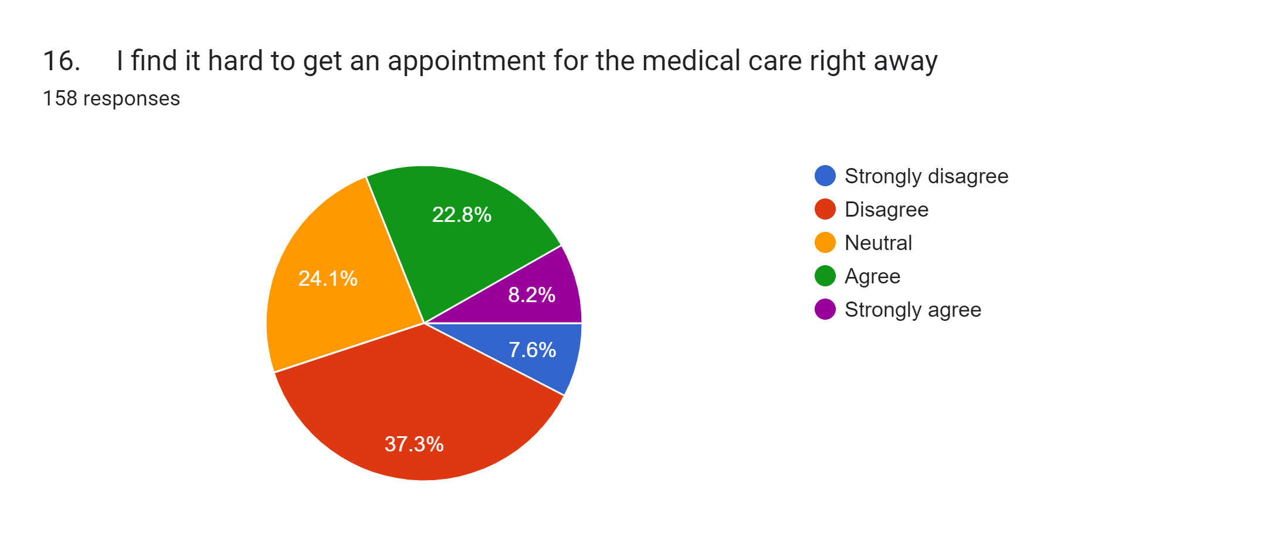
Statistics
N Valid 158
Mean 3.12
Std. Deviation 1.10
Agree | 36
Disagree | 59
Neutral | 38
Strongly agree | 13
Strongly disagree | 12
Analysis
45% respondents find it hard to get an appointment.
Interpretation
Online registration, Empanelment of more hospitals, existing facilities of MI Rooms and Military Hospitals

Slide 31
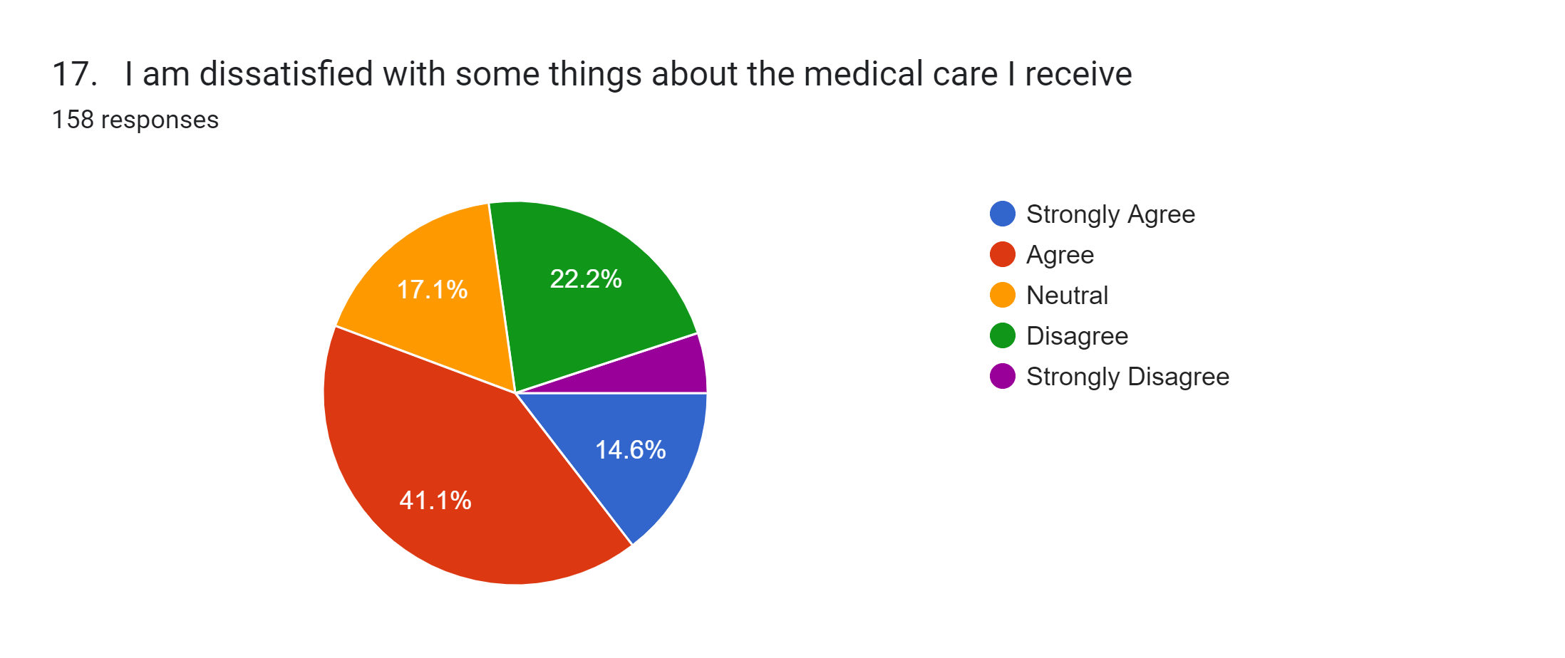
Statistics
N Valid 158
Mean 2.61
Std. Deviation 1.24
Agree | 65
Disagree | 35
Neutral | 27
Strongly Agree | 23
Strongly Disagree | 8
Analysis
55% respondents are dissatisfied with certain things about the medical care they receive.
Interpretation
Personal interaction immediately for resolving the issues raised.
For queries where instant reply cannot be given, views and clarification are sought from different sections and then the reply is communicated to the indl by tele, e-mail and by letter wherever required.
Feedback system on regular basis

Slide 32
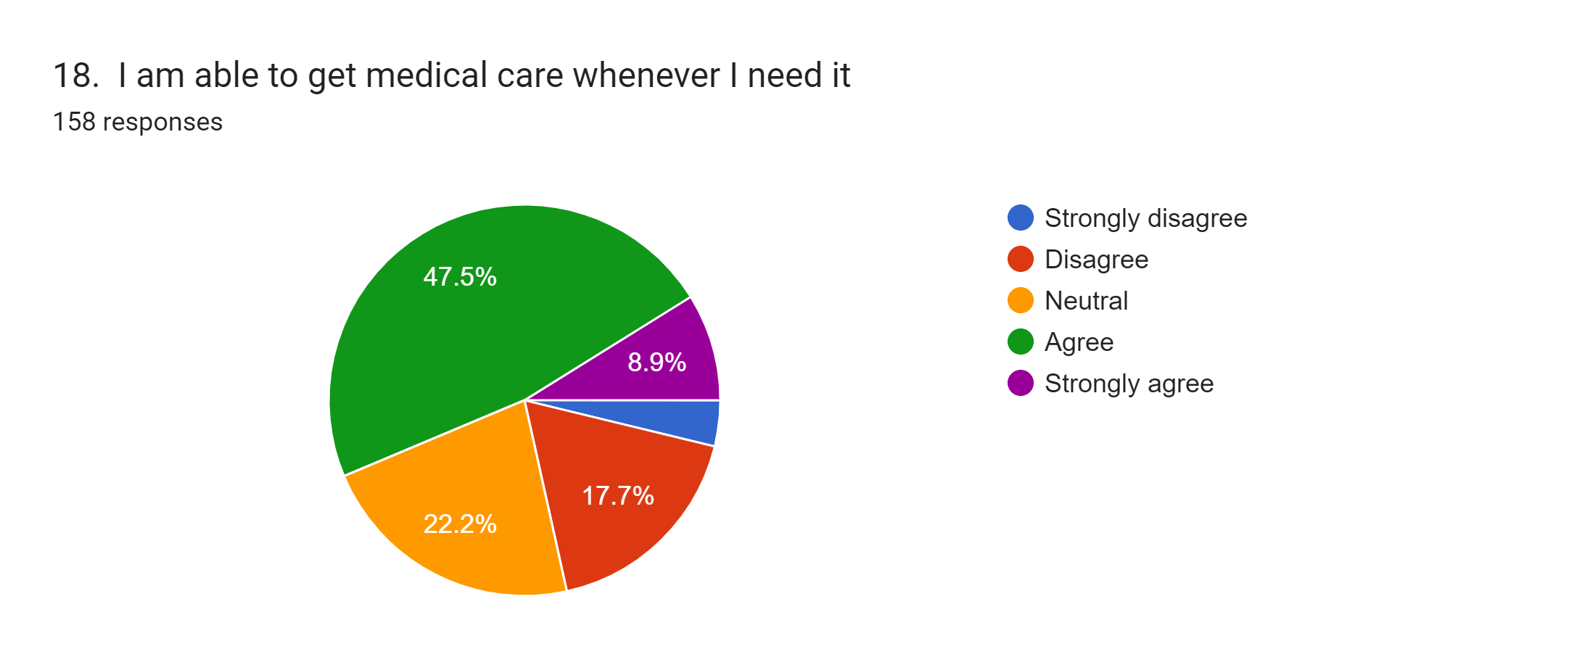
Statistics
N Valid 158
Mean 3.40
Std. Deviation 0.994
Agree | 75
Disagree | 28
Neutral | 35
Strongly agree | 14
Strongly disagree | 6
Analysis
The analysis showcases the accessibility of medical facilities to the respondents .Data shows that out of the 158 participants, 57% are able to get medical facilities whenever they need. 43% respondents not satisfied with the medical treatment
Interpretation
Empanelment of more hospitals, existing facilities of MI Rooms and Military Hospitals, easing of procedures for referrals and reimbursement

Slide 33
UNIVARIATE STATISTICS FOR SUBSCALES OF QUESTIONNAIRE
SCALE | MEAN | SD | QUESTIONS | MEAN | SD
General Satisfaction | 2.85 | 1.14 | 3 17 | 3.08 2.61 | 1.04 1.24
Technical Quality | 2.94 | 1.04 | 2 4 6 14 | 3.01 2.68 2.91 3.16 | 1.06 0.94 1.06 1.10
Interpersonal manner | 3.09 | 1.10 | 10 11 | 2.85 3.33 | 1.12 1.08
Communication | 3.15 | 1.20 | 1 13 | 3.40 2.91 | 1.09 1.32
Financial Aspects | 2.82 | 1.15 | 5 7 | 3.46 2.18 | 1.18 1.13
Time Spent with Doctor | 2.71 | 1.01 | 12 15 | 2.84 2.58 | 1.10 0.92
Accessibility | 3.10 | 1.09 | 8 9 16 18 | 2.94 2.92 3.12 3.40 | 1.16 1.09 1.10 0.99

Slide 34
Descriptive Statistics
Mean Std. Deviation N
13. Doctors sometimes ignore what I tell them 2.91 1.136 158
10. Doctors act too business like and impersonal towards me 2.85 1.128 158
Correlations
13. Doctors sometimes ignore what I tell them
10. Doctors act too business like and impersonal towards me
13. Doctors sometimes ignore what I tell them Pearson Correlation 1 .556**
Sig. (2-tailed) .000
Sum of Squares and Cross-products202.759 111.962
Covariance 1.291 .713
N 158 158
10. Doctors act too business like and impersonal towards me Pearson Correlation .556** 1 Sig. (2-tailed) .000
Sum of Squares and Cross-products 111.962 199.652
Covariance .713 1.272
N 158 158
**. Correlation is significant at the 0.01 level (2-tailed).

Slide 35
Descriptive Statistics
Mean Std. Deviation N
13. Doctors sometimes ignore what I tell them 2.91 1.136 158
14. I have some doubts about the ability of the doctors who treat me 3.16 1.109 158
Correlations
13. Doctors sometimes ignore what I tell them
14. I have some doubts about the ability of the doctors who treat me
13. Doctors sometimes ignore what I tell them Pearson Correlation 1 .628**
Sig. (2-tailed) .000
Sum of Squares and Cross-products 202.759 124.215
Covariance 1.291 .791
N 158 158
14. I have some doubts about the ability of the doctors who treat me Pearson Correlation .628** 1
Sig. (2-tailed) .000
Sum of Squares and Cross-products 124.215 193.044
Covariance .791 1.230
N 158 158
**. Correlation is significant at the 0.01 level (2-tailed).

Slide 36
LIMITATIONS OF STUDY
Sub optimal response rate.
Indifferent attitude of Polyclinic Staff
Language Barrier
IQ Levels of dependents and ex servicemen

Slide 37
RESULTS
DISCUSSION
Almost 65% of respondents indicated that they were satisfied with ECHS care.
Age was weakly associated with satisfaction.
A multiple linear regression indicated that the major determinants of patient satisfaction were accessibility and communication.
Communication with the doctor had stronger correlation with satisfaction.
There is dearth of facilities at the polyclinic. Only 6% respondents satisfied.

Slide 38
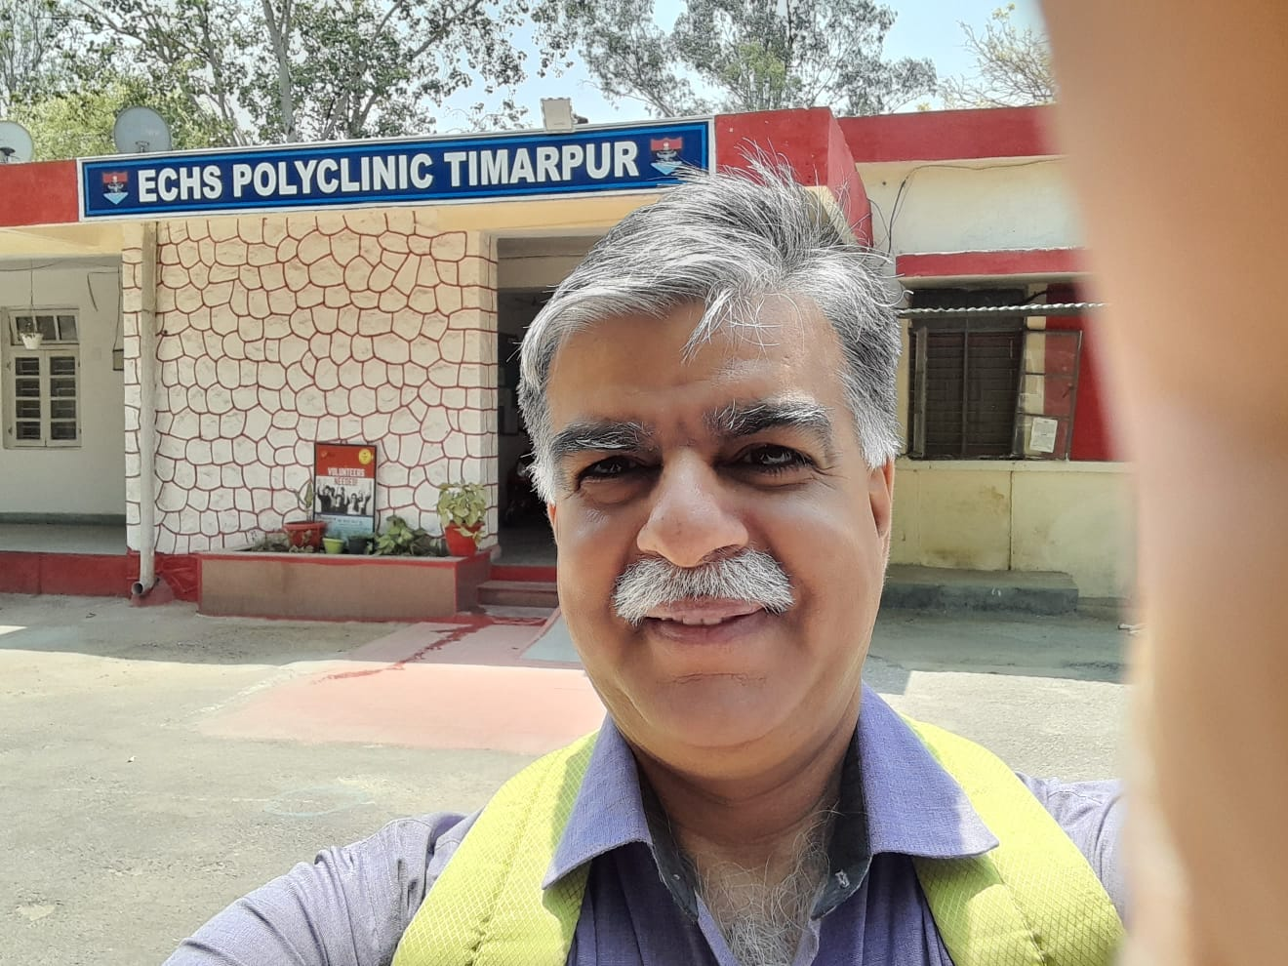
Thank You

Slide 39
REFERENCES
References.
COECHS. History, Organization & Functioning of ECHS, Published on Official ECHS Web Portal, 2022, Available at www.https://echs.gov.in
Singh T K, Ex-Servicemen Contributory Health Scheme (ECHS), Internship Report (Unpublished), 2021. Available at IIHMR, Delhi Library
Varshney Deepak, Audit of ECHS Polyclinic, Dissertation Report (Unpublished), 2021. Available at IIHMR, Delhi Library
Hussain Abid & Others, Measuring hospital satisfaction, Research Gate, July 2019,
Mayuri Duggirala, Patient perceived Satisfaction, Research gate, Aug2008,

