Slide 1
Exploring the Post Intervention experiences of elderly Diabetic type-2 Patients: A Qualitative Research study
SilverGenie Pvt. Ltd., Gurugram
Presented by- Ms. Avinash Kaur Sodhi
Faculty Mentor- Prof. Preetha G.S
IIHMR Delhi

Slide 2
Mentor Approval

Slide 3
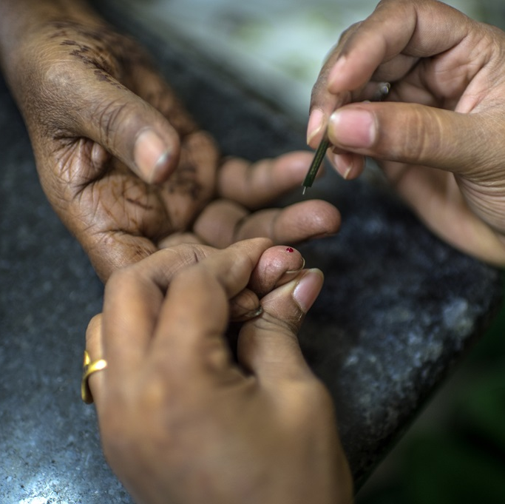
Introduction
India is facing a triple burden of pre-diabetes, diabetes, and obesity. Unhealthy eating habits and physical inactivity have been linked to the onset and progression of type 2 diabetes mellitus
Lifestyle modification is an important measure taken to modify the dietary patterns and physical activity, hence helps in control of Diabetes and Hypertension

Slide 4
Objectives of the study
explore the post-intervention experiences of elderly diabetic patients who have undergone a specific intervention for the period of 3 months.
The study seeks to gain insights into the perceptions, experienced by these individuals.

Slide 5
Methodology
Study Design- qualitative research study.
Inclusion criteria- above the age of 60 years who undergone specific intervention.
Data collection- Semi-structured open-ended in-depth interviews was conducted telephonically.
Data analysis- was done manually by conventional qualitative content analysis. the data is categories in themes and sub-themes based on the similar responses.
Ethical Consideration- All the credentials were kept confidential and were used for the purpose of this research only.

Slide 7
Results Theme-1 Personal Experience
Comorbidity
"Yes, I have hypertension along with diabetes and taking the medications for same."
“I have arthritis problem along with diabetes”
Age of diabetes diagnosed
“I was diagnosed with diabetes at the age of 37” participant 3,5 and6
‘I don’t remember the exact time, but I think somewhere between the age of 35- 40’
Technology
“It used to motivate me to go for a 30mins walk regularly”
“my watch was not working properly so I was unable to track my daily walking duration”

Slide 8
Theme-2 Lifestyle modification
Fitness session
“I get to know about different yoga asanas, which I was not aware previously”
“due to arthritis, I was not able to do physical activity at the pace it used to do earlier”
Healthy eating
“As I have high blood cholesterol, this diet plan not only helped me with diabetes but also lowered my blood cholesterol level”
“This diet plan was not very helpful to me but after fasting for 30 days in Ramadan my insulin intake reduced from 6units to 4 units.”
Monitoring blood sugar
“I didn’t check my blood sugar for the last 3 months.”
“as I am on insulin my blood sugar is moderate to low so don’t monitor this regularly.”
“After this session I developed a habit of checking blood sugar twice a month.”

Slide 9
Theme-3 Quality of life
Physical Health
15 out of 20 mentioned no chronic illness as such. While 5 of them stated that “we have chronic illness but not terribly we are on medication for that Illness.”
Mental and emotional Well-being
Every participant stated the same response while discussing with them personally and most of the participants stated that “yes! I have little bit of stress in life which is normal, everyone has problems in life, but it didn’t bother that much.”
Freedom and safety
No major safety issues was noticed

Slide 10
Theme-4 Barriers and facilitators
“everything is good and well executed 3 months plan for diabetic management my blood sugar level also goes down at that time, but according to me I think the cost which they are charging for 3 months course is little bit expensive​
​
“Since I lived in north-east India, and the program run by team from Delhi, it connects with me on just a call away, so for me I don’t feel any barrier about the program and working.”​

Slide 11
Conclusion
The study revealed that the interventions positively influenced the participants' overall lifestyle and well-being.
The support and guidance received during the interventions played a crucial role in fostering a positive outlook and emotional resilience among the participants.
Overall, this qualitative study provides valuable insights into the post-intervention experiences of elderly patients with type 2 diabetes and highlights the potential benefits of lifestyle enhancement interventions.

Slide 12
Limitations of the study
Sample size is small
Difficult to detect rare events- since the participants age is above 60.
Increased Risk of Sampling Bias- where the selected participants may not be representative of the larger population.
Limited Generalizability- The results may only represent the specific characteristics and experiences of the individuals in the sample.

Slide 13
References
Saboo B, Misra A, Kalra S, Mohan V, Aravind SR, Joshi S, Chowdhury S, Sahay R, Kesavadev J, John M, Kapoor N, Das S, Krishnan D, Salis S; Diabetes India ‘Decode Fiber’ Expert Consensus Group. Role and importance of high fiber in diabetes management in India. Diabetes Metab Syndr. 2022 May;16(5):102480. doi: 10.1016/j.dsx.2022.102480. Epub 2022 Apr 22. PMID: 35594690.
Lancet global health report- the burden of diabetes in India.
Misra A, Gopalan H, Jayawardena R, Hills AP, Soares M, Reza-Albarrán AA, Ramaiya KL. Diabetes in developing countries. J Diabetes. 2019 Jul;11(7):522-539. doi: 10.1111/1753-0407.12913. Epub 2019 Apr 11. PMID: 30864190.
World Health Organization. Diabetes action now: an initiative of the World Health Organization and the International Diabetes Federation.
Ministry of Health and Family Welfare, Government of India. National Action Plan and Monitoring Framework for Prevention and Control of Noncommunicable Diseases (NCDs) in India. World Health Organization; (2013)
World Health Organization (WHO). Global Action Plan for the Prevention and Control of Noncommunicable Diseases: 529 2013–2020. World Health Organization. (2013).
Unnikrishnan R, Mohan V. Whither diabetes research in India today? Diabetes Metab Syndr. 2020 May-Jun;14(3):195-198. doi: 10.1016/j.dsx.2020.02.007. Epub 2020 Feb 19. PMID: 32145680.

Slide 14
Thank You
Any Questions

