Slide 1
Maternal and childhood nutrition with special focus on anaemia in five districts of Rajasthan: A situational analysis
Dr. Avish Sethi
Under the guidance of
Dr. Sidharth Sekhar Mishra

Slide 2
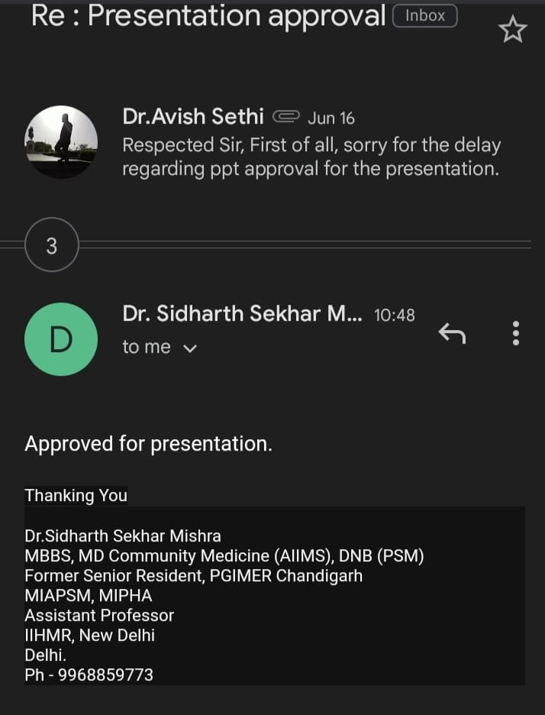
Mentor Approval

Slide 3
Content
Introduction
Objectives
Methodology
Results
Summary of findings
Discussion
Conclusion
Pictorial Journey

Slide 4
Introduction
India is home to one-third of the world's undernourished children. Maternal and childhood nutrition is a serious public health problem in India, particularly in Rajasthan, where malnutrition is endemic.
Malnutrition can have long-term consequences for a woman at different stages of her life. The "life cycle approach" to satisfying women's nutritional demands can assist them in improving their nutrition.
Several initiatives have been launched by the government at both the national and state levels in recent years to address the issue of malnutrition.

Slide 5
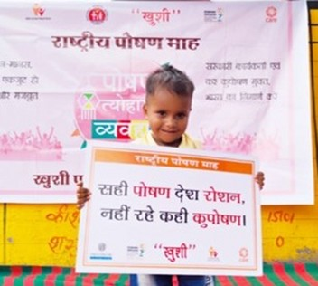
Introduction
The project HANSA is being implemented with the goal to strengthen the efficacy of government’s Integrated Child Development Services (ICDS) Program, so as to improve the health and well-being of children below 6 years of age.
Purpose of HANSA:-
By this research, aid in the mapping of children's and mother’s nutritional
status.

Slide 6
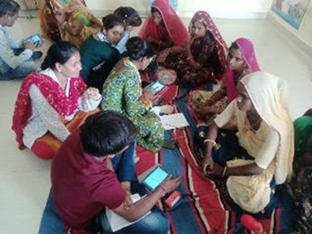
Objectives
To generate robust district level understanding of the state of nutrition of children aged 0-59 months.
To assess the anaemia status of the pregnant and lactating mothers.

Slide 7
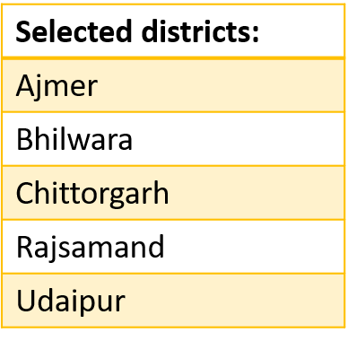
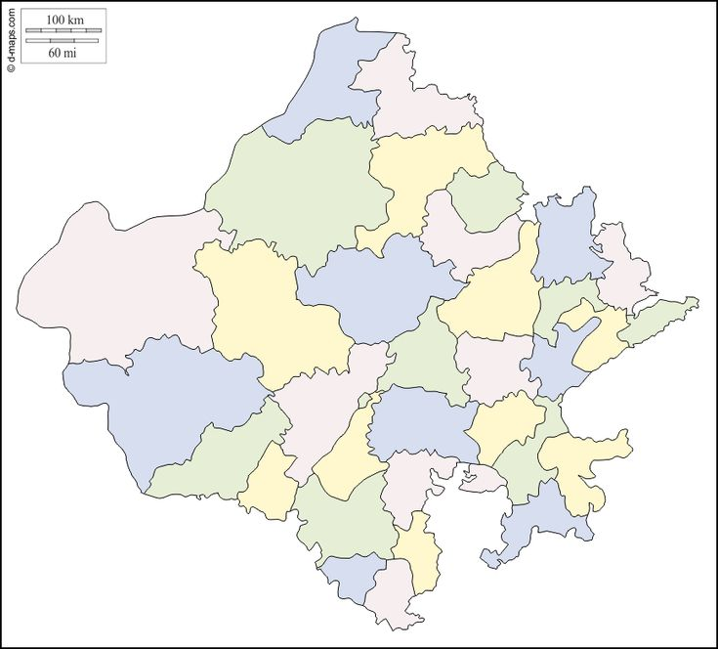
Methodology
The Health and Nutrition Situation Assessment (Project HANSA) was carried out in five districts in Rajasthan: Ajmer, Bhilwara, Chittorgarh, Rajsamand, and Udaipur.
Study Design
Cross-sectional study with multi-stage design using stratified random sampling with proportional allocation followed by systematic sampling at the sampled Anganwadi Centre catchment areas with a random start.
Project Area

Slide 8
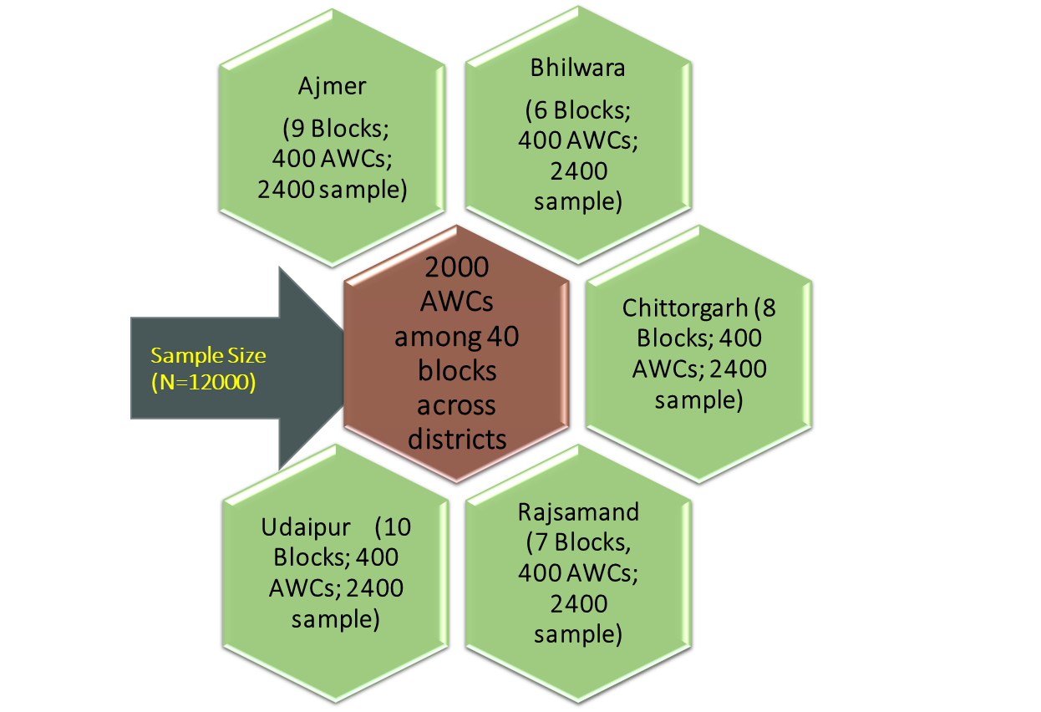
Sampling Strategy
A total of 400 AWCs were randomly selected from each district (proportionally stratified by rural & tribal).
Selection of one random individual from each age groups in each sampled AWCs, after listing following a random start until one individual from each of the targeted age groups has been performed.
The whole process included listing followed by 6 interviews per Anganwadi Centre.
Baseline Components
Targeted Age Groups
Household Survey
Anthropometric Measurements
Hb level estimation
0-5 months
6-11 months
12-23 months
24-35 months
36-71 months
Adolescent girls
Household Survey

Slide 9
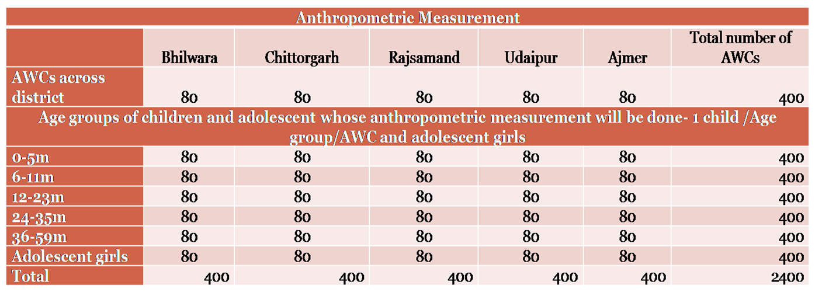
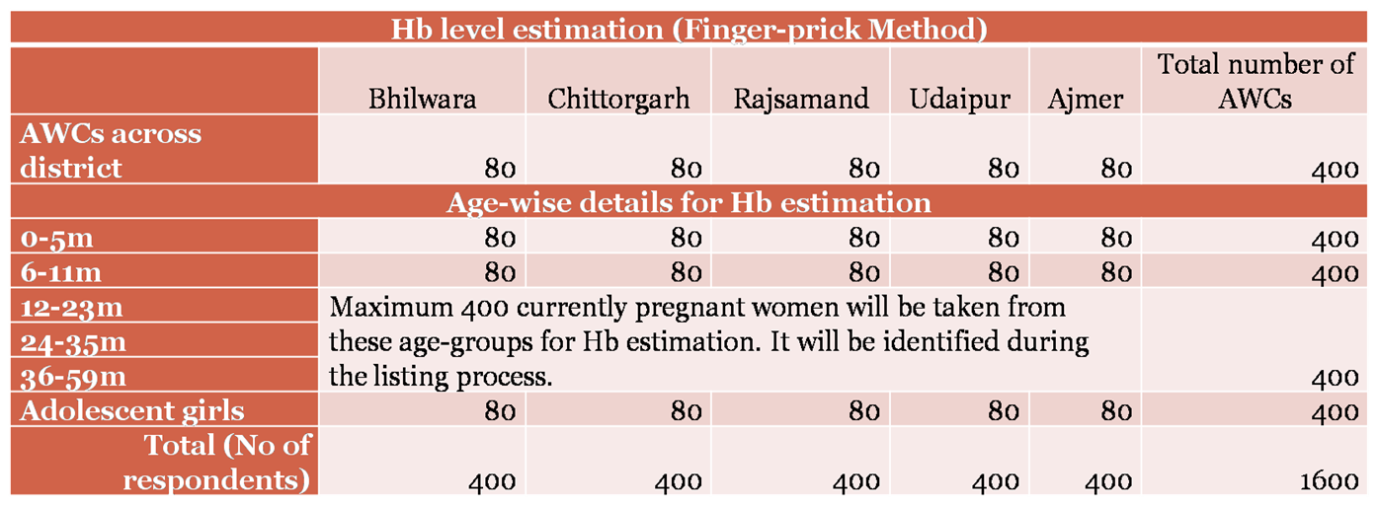
Inclusion & Exclusion Criteria:
Include:
0-59 months children
Exclude:
Adolescent Girls
Inclusion & Exclusion Criteria:
Include:
Mothers of 0-59 months children
Exclude:
Adolescent Girls

Slide 10
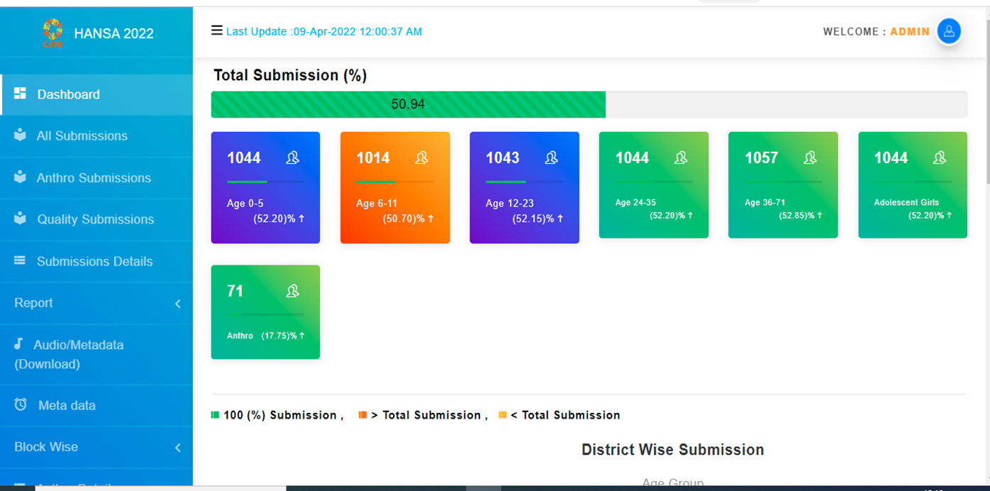
Study Tools
Data Quality Assurance Mechanism
The household survey having structured, closed ended, questionnaire-based interviews, assisted by CAPI (Computer Assisted Personal Interview) involving eligible respondents in selected districts.
Spot Checks , Back Checks & Audio Checks (overall 15%) of all data, for randomly sampled interviews.
Real time data monitoring through dashboard.

Slide 11
Results
N= 1500

Slide 13
These are the significant indicators whose p value is less than 0.05

Slide 14
These are the significant indicators whose p value is less than 0.05

Slide 15
Summary of Results
Overall, the study concluded that while most mothers were aware of nutritionally balanced dietary habits and their actual implementation.
Mothers with a higher socioeconomic status who were more educated, employed, and had a higher socioeconomic status, had more knowledge and maintained better dietary habits than those with a lower socioeconomic status who were less educated, unemployed, or had a lower socioeconomic status.
Maternal employment was also found to be a substantial positive predictor of high nutritional status, most likely because it enables mothers to improve their social standing by providing access to education, health care, decision-making, and economic independence.
Also, the parental education is relevant to improving children's nutrition.

Slide 16
Discussion
Maternal and childhood nutrition are critical components of global health and development, and Anaemia is a frequent nutritional shortage that affects both mother and children.
Mother nutritional health differed greatly based on demographic parameters such as education, occupation, and socioeconomic level.
Children from lower income families with mother who have no formal education or have only passed the eighth grade are more likely to be underweight whereas mothers who use smartphone, exposed to social media, have one or fewer than three children are less likely to be underweight.
Based on our finding, children who live in a joint household were less likely to be stunted.
In some studies, found that children aged 6–8 months, the delayed introduction of supplementary meals is related to stunting and severe stunting.

Slide 17
Discussion
Anaemia is a severe global public health concern that mostly affects young children and pregnant women, affecting 40% of pregnant mother and 42% of children under the age of five globally.
According to NFHS 5 data, In India, over 33% of children under the age of five are underweight, 36% have stunted development and 17% have wasted growth,
Whereas in Rajasthan, 35% of children under the age of five are underweight, 39% have stunted growth, 22% have wasted growth.
In reproductive age range, Anaemia affects 53% of women in India and 56% of women in Rajasthan.
To address this, a comprehensive approach focusing on mother and child nutrition is necessary, including boosting access to nutrient-rich diet, developing knowledge of appropriate dietary practices.

Slide 18
Conclusion
Overall, study provide important insights on the state of nutritious dietary practices in the region and serves as a platform for developing targeted interventions to improve nutrition status in the region.
More study is needed to understand the variables that contribute to observed disparities in nutritious dietary knowledge and practices among mothers as well as to create effective strategies for improving the uptake of these practices.
There is still much work to be done in this domain at the individual, family and community level and by increasing maternal education and lowering poverty can help lessen India's malnutrition burden.
To solve this issue, policymakers, healthcare professionals, and communities must all work together.

Slide 19
References
Johri M, Subramanian S, Koné GK, Dudeja S, Chandra D, Minoyan N, et al. Maternal Health Literacy Is Associated with Early Childhood Nutritional Status in India. The Journal of Nutrition. 2016;146(7):1402-10.
Sengupta P. EPIDEMIOLOGICAL CORRELATES OF UNDER-NUTRITION IN UNDER-5 YEARS CHILDREN IN AN URBAN SLUM OF LUDHIANA. Health and Population: Perspectives and Issues. 2010.
Nutrition S-Co. Nutrition Through out the Life Cycle. 2000.
Nutrition ASbtCot. nding Malnutrition by 2020: an Agenda for Change in the Millennium. 2000.
Feskens EJM, Bailey R, Bhutta Z, Biesalski H-K, Eicher-Miller H, Krämer K, et al. Women’s health: optimal nutrition throughout the lifecycle. European Journal of Nutrition. 2022;61(1):1-23.
Subramanian SV, Ackerson LK, Davey Smith G, John NA. Association of Maternal Height With Child Mortality, Anthropometric Failure, and Anemia in India. JAMA. 2009;301(16):1691-701.
Martorell R, Young MF. Patterns of Stunting and Wasting: Potential Explanatory Factors. Advances in Nutrition. 2012;3(2):227-33.
Dhami MV, Ogbo FA, Osuagwu UL, Ugboma Z, Agho KE. Stunting and severe stunting among infants in India: the role of delayed introduction of complementary foods and community and household factors. Global Health Action. 2019;12(1):1638020.
Chowdhury TR, Chakrabarty S, Rakib M, Afrin S, Saltmarsh S, Winn S. Factors associated with stunting and wasting in children under 2 years in Bangladesh. Heliyon. 2020;6(9):e04849.
Choudhury KK, Hanifi MA, Rasheed S, Bhuiya AJJoH, Population, Nutrition. Gender inequality and severe malnutrition among children in a remote rural area of Bangladesh. 2000:123-30

Slide 20
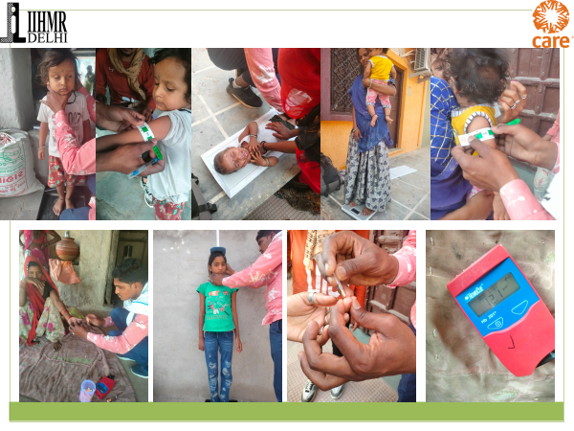
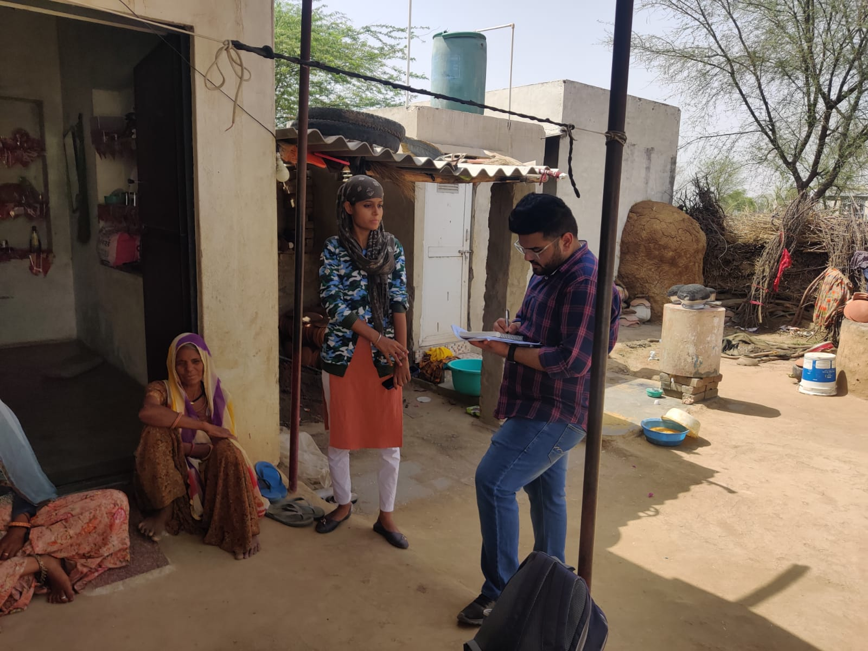
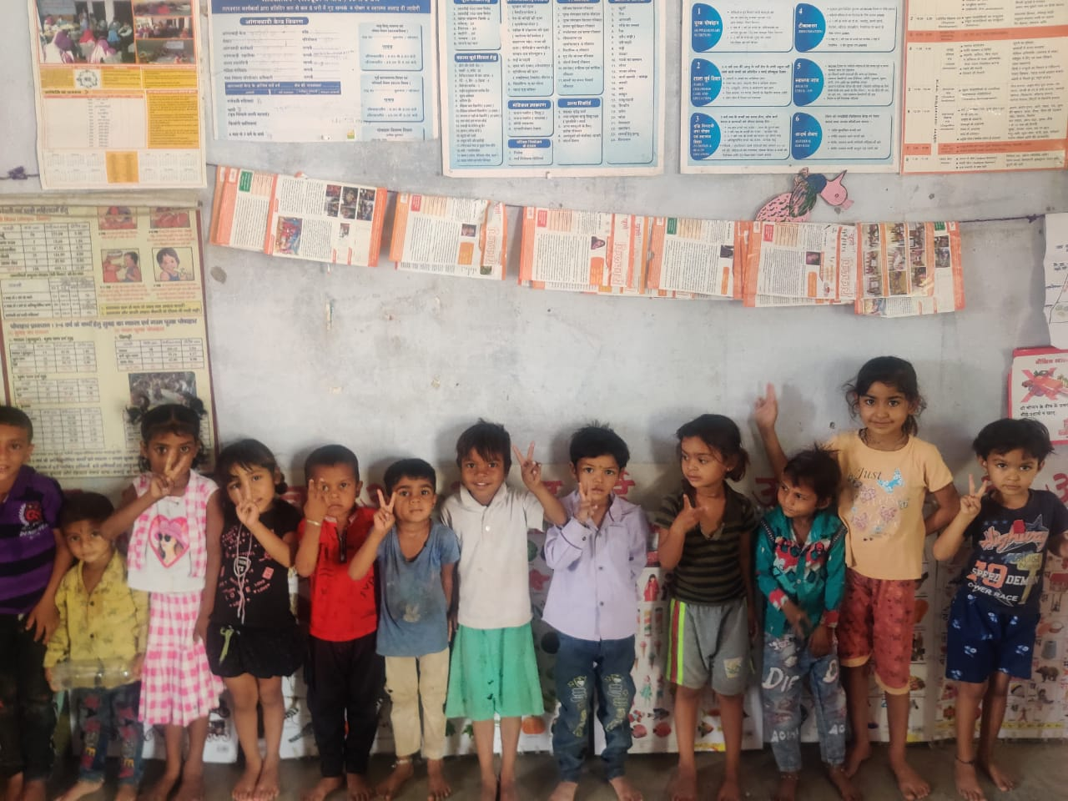
Pictorial Journey

