Slide 1
The Role of FDA 510K Approval in the Clearance of Software as a Medical Device Curio Digital Therapeutics
INSTITUTION MENTOR – DR. SUMESH KUMAR (ASSOCIATE DEAN ACADEMICS AND STUDENT AFFAIRS)
ORGANISATION MENTOR DR. PANKAJ GUPTA VP-DIGITAL SOLUTIONS AND COMPLIANCES
SUBMITTED AND PRESENTED BY: DR. DIVYA GUPTA PG/21/33

Slide 2
Mentor Approval

Slide 3
INTRODUCTION
Software as a Medical Device is defined by the International Medical Device Regulators Forum (IMDRF) as "software intended to be used for one or more medical purposes that perform these purposes without being part of a hardware medical device
A device that has been legally marketed is one that was marketed before May 28, 1976 (a pre amendments device), has been reclassified from Class III to Class II or I

Slide 4
Objectives of the Study
PRIMARY OBJECTIVE : To analyse the number of SaMD (software as a medical device which have undergone 510K Approval.
SECONDARY OBJECTIVE : To find out the failure rate of 510k approval

Slide 5
Methodology
STUDY TYPE – Secondary Research
STUDY DURATION – 15TH February to 15th May ( 3 Months)
METHOD OF DATA COLLECTION – Public domain forums, Pub med, FDA sites, Google Books, Research Gate
METHOD OF DATA ANALYSIS – Microsoft Excel (quantifiable data )

Slide 6
Methodology
INCLUSION CRITERIA – Studies that include literature specifically on SAMD which complies with 510k Approval
EXCLUSION CRITERIA- Studies that include literature about hardware and non – medical device and which do not complies with 510k approval

Slide 7
Results
The study reveals that there are 23 Companies Globally from which only 17(73%) of the companies have been approved for 510k approval working on Class I, II, and III products.

Slide 8
cont..
The study revealed that among that 17 count of the approval of 510k there were 8 companies which provide 510k approval and are involved in SaMd product line but they are solution service companies which provide consultation areas, They act as service solution approach for the product to meet the regulatory compliances.

Slide 9
cont..
The statistical representation of the product line on which companies are working .
The product count is representing the number of product and the Y axis count represent how many companies are working on particular product count.
The data includes both the product line which are 510k and not 510k approved.

Slide 10
Cont..
The class I,II,III devices in SaMD Product
Total Number of the companies working on the products are : 15
Companies working for Class I = 5
Companies working for Class II = 2
Companies working for Class III = 2
Companies working for class I,II= 6
Total percentage area of these different classes holding by the companies are shown in the form of Pie Chart

Slide 11
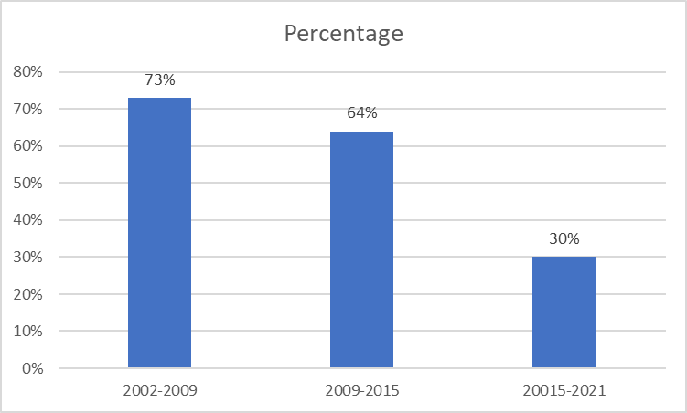
Cont..
Total article studied – 57
Failure Rate Trend Analysis
2002- 2009 = 73%
2009-2015 = 64%
2015-2021 = 30%

Slide 12
DISCUSSION
The study found that ISO 13845 comes with the certification of ISO 9001 , CE Mark plays an important role for the certification for 510K.
The global market trend analysis shows that SaMd will dominate by 38 percent which is only 1.86%from 2012 to 8.3 % in 2015 to 21% in 2019 in the market found in the previous studies
India itself is the largest producer of SaMd but the devices are still in the process of registration.
It was also found that the dominant market is North American region for the SaMD and othe regulatory compliances in the ASIAN specific region.

Slide 13
Conclusion
It was seen that the latent flow is the reason for the 510k Failure submission
Regulatory compliance is the pinpoint key for the submission of CE Mark ISO 9001 and 13845 to complete these pointers
Still the devices are to be certified by the statutory body but the regulatory body of each country is different
The strength of the research study was that the global SaMD data was able to be found but the 510k regulatory is limited to the North American Zone, Other regulatory compliances needed to be studied and researched for the same purposes

Slide 14
REFERENCES
Fda.gov. [cited 2023 Mar 31]. Available from: https://www.fda.gov/medical-devices/premarket-submissions-selectin
510(k)
Health C for D and R. Software as a Medical Device (SaMD) [Internet]. FDA. 2020. Available from: https://www.fda.gov/medical-devices/digital-health-center-excellence/software-medical-device-samd
clearances [Internet]. U.S. Food and Drug Administration. FDA; [cited 2023 Mar 31]. Available from:https://www.fda.gov/medical-devices/device-approvals-denials-and-clearances/510k-clearances
Darrow JJ, Avorn J, Kesselheim AS. FDA Regulation and Approval of Medical Devices: 1976-2020. JAMA. 2021 Aug 3;326(5):420
FDA 510(k) Clearance - Dangerous Fast-Track Approval Process [Internet]. Drugwatch.com. [cited 2023 Mar 31]. Available from: https://www.drugwatch.com/fda/510k-clearance

Slide 15
Thank You

Slide 16
Pictorial Journey

Slide 17
Pictorial Journey

