Slide 1
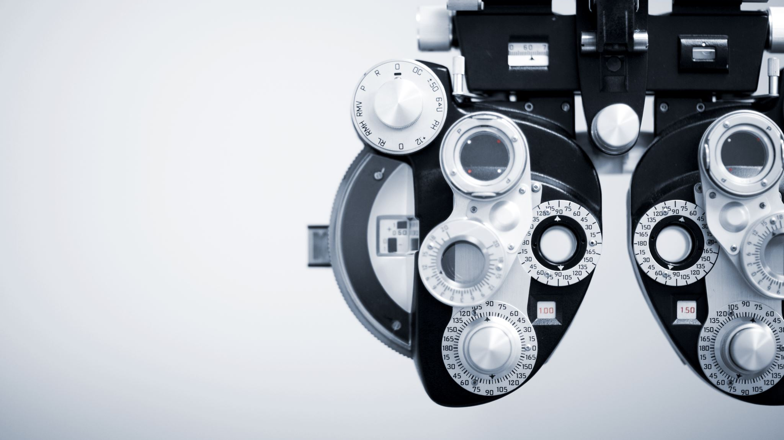
A study on best practices of product implementation and phases of implementation of a product in Eye-Q Hospital, Understanding of requirements. Eye-Q Super Specialty Eye Hospitals
Dr Nidhi Yadav
IIHMR Delhi

Slide 2
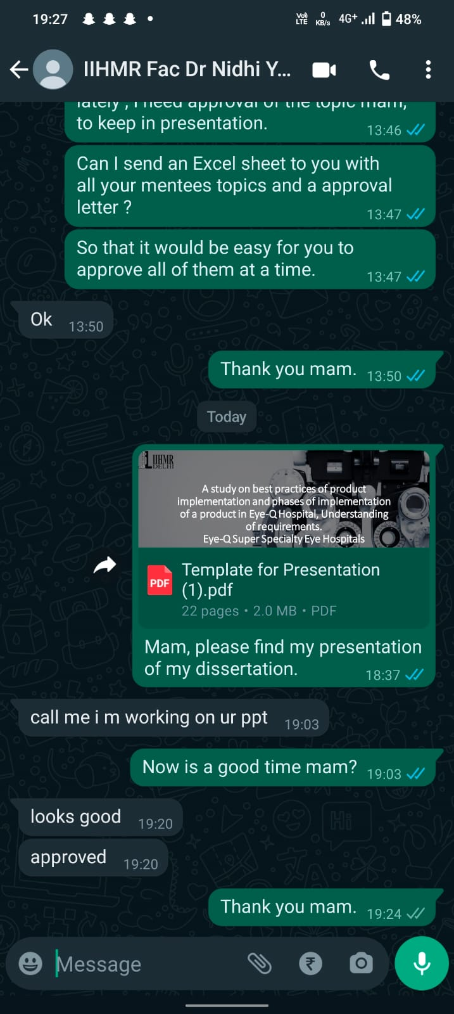
Mentor Approval

Slide 3
Introduction
Product deployment is essential for healthcare data analysis and visual representation.
Planning, understanding requirements, and proper execution are essential for successful implementation.
Best practices and phases of product adoption at Eye-Q Hospital.
Eliciting and understanding needs for data analysis and visual representation.
Mixed-methods approach to collect data and gain insights into implementation process and to previous discussions.
Healthcare organizations, product implementation teams, and healthcare professionals will benefit from insights.

Slide 4
Introduction about the product
Title : Darpan (Dashboard for Analytical Review of Projects Across the Nation)
Purpose : Automated Data visualization tool and CRM tool.
Task : Automated generation of a dashboards, make CRM campaigns and seamless patient engagement
Features : Mysql Queries with eased user interface. Dashboard user interface changing according to the needs and data filtering option
CRM Users : Product Managers and marketing team(digital and corporate)
Dashboard Viewers : Hierarchy based data inspection for regular monitoring.

Slide 5
About Darpan
DARPAN is a dashboard that transforms complex organizational data into visually appealing charts.
It provides real-time project monitoring without the need for coding or programming via web services.
DARPAN combines multiple data sources into a centralized, user-friendly platform to improve analytical capabilities.
The dashboard quickly identifies trends and allows for drilling down into district-level project data.
DARPAN presents information objectively, allowing technical administration to identify areas for improvement and understand successes and pain points

Slide 6
Objectives of Your Study
Determine the key factors that contribute to the successful implementation of a product in hospitals.
Analyze the various phases of implementation and their impact on the overall success of the process.
Examine the methods used in the hospital setting for understanding and eliciting requirements from stakeholders.
Assess the efficacy of these methods in ensuring that product implementation meets the needs of the hospital and its stakeholders.
Precise understanding how the data generated by the HMIS Software is being used to provide insights to the Senior Leadership Team and the Operational Managers for the purpose of improving the business and business processes

Slide 7
Methodology
Data Collection Methods: Data will be collected from one-on-one interviews, secondary data, surveys, and blank questionnaires.
Sampling Strategy: All stakeholders will be included, and the sample size could be up to 60 people.
Data Analysis Techniques: JIRA tool will be used to manage specific requirements, and a project charter will be maintained.

Slide 8
Methodology
The study will employ a mixed-methods research design, combining both quantitative and qualitative data to gain a more comprehensive understanding of the implementation process.
The quantitative data will be collected through a survey of hospital staff involved in the implementation process, while
The qualitative data will come from in-depth interviews and case studies.

Slide 9
Methodology
The study involves a comparative analysis of the different case studies and the current procedure followed.
Intrigue study of the implementation process and selecting the best practice according to the dynamics of the organization.
The model of development and implementation is an agile methodology model.

Slide 10
Phases of Implementation
Maintenance Phase
Hardware and software maintenance
Dismantle former testing and version servers
Phase 2 implementation
Adaption Phase
Defect life cycle Documentation
Change requests
New requirement elicitation of next phase
Phase 2 SRS
Functional testing
Permission testing
User KT sessions
Transition phase
Defect life cycle Documentation
Change requests
New requirement elicitation of next phase
Phase 2 SRS
Phase 1 implementation
Pilot group implementation
SLT testing and analytics dashboard
Production testing
KT sessions to pilot group

Slide 11
Results
The above-mentioned details are the advantage of the product post implementation and how its contributing to the revenue by increasing the patient footfall.
Campaign success rate screenshots
1 2 3

Slide 12
Key Factors that Contribute to the successful implementation
Challenge post phase 1 | Resolved | Key Factor Contributed
Compliance and hindrances while using the software | Broadcasts, user manuals | Clear Communication and Stakeholder Engagement
Campaign postponement issues | After the ports have been released and IP, giving MySql public access to beta 3 server | Intra-departmental communication issues and comprehensive planning and project management
Data Security issues | Designed protocols for user ID creation and access specifications | Understanding the structure of organization and privileges of users
Change requests | New SRS documents and change logs have been created and designed | Requirements are not be gathered but are to be elicitated. Personal interviews are supposed to be done with all the stakeholders
Defect Lifecyle documentation | After intense discussions with the backend developer | Vendor support and collaboration

Slide 13
Various phases of Implementation
Phase 1 – Pilot implementation to SLT and IT team.
Transition Phase – Defect Lifecyle, production functional testing, change requirements and new requirements
Phase 2 – Dashboard implementation of business summaries to authenticated users.
Transition Phase – Defect Lifecyle, production functional testing, change requirements and new requirements
Phase 3 – CRM implementation to the Product managers.
Phase 4 – New Dashboard creations and graphs

Slide 14
Comparative analysis of the now and then
Existing
Changes
Cluttered user master
ID creation from backend
Data security concern
Lack of SPOC ( Product leader)
Software testing
Data Validation
Cleaned user master
ID creation by Admin team
Data authentication with recent protocols
KT to the SPOC and self-support
Testing on multiple levels
Rewriting the SRS and logics for defects and updates

Slide 15
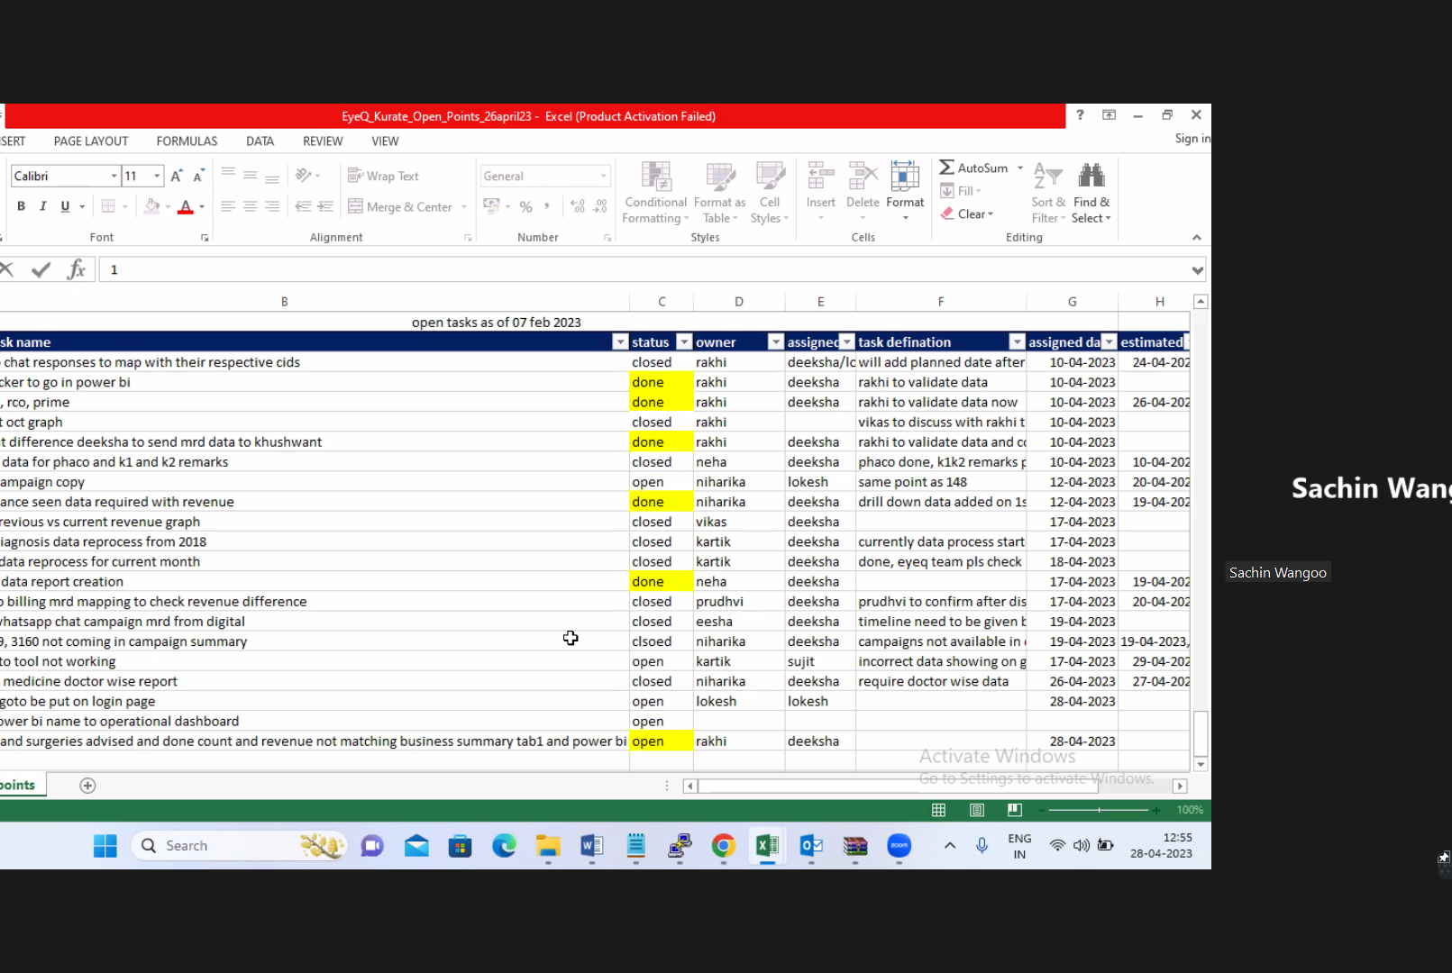
Traceability Matrix
Define Evaluation Criteria
Collect Data
Analyze Data
Compare against Objectives
Seek Feedback
Identify Lessons Learned
Make Recommendations
Continuous Improvement

Slide 16
Contribution to business development

Slide 17
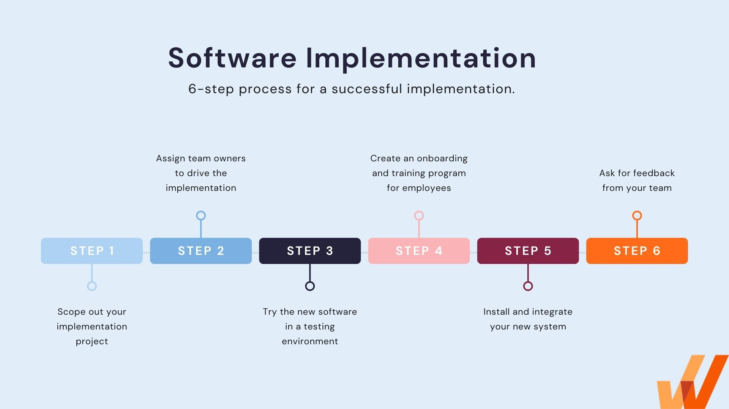
Discussion

Slide 18
Discussion
Agile Methodology of development.
Data Validation techniques.
Hardware aspects of implementation.
Hardware requirement elicitation for healthcare projects.

Slide 19
Conclusion
The best practices of the software implementation doesn’t just come with excellent coding, it comes with the following
Proper planning of implementation.
Stakeholder engagement.
Regular hurdles.
Requirement elicitation post implementation.
Proper requirement elicitation before development.
Continued support.
Product leadership and product SPOC.
Resource allocation.
Intra department communication.
Risk management and mitigation .
Execution and compliance monitoring.
Continuous improvement.

Slide 20
References
Trimmer, K. J. (2012). Factors contributing to success or failure of health information systems: A systematic literature review. Journal of the American Medical Informatics Association, 19(2), 201-208.
Lluch, M. (2011). Healthcare professionals' organizational barriers to health information technologies—A literature review. International Journal of Medical Informatics, 80(12), 849-862.
Lapão, L. V., & Gregório, J. (2014). Assessment of barriers to implement eHealth systems in hospitals. Acta Médica Portuguesa, 27(6), 768-774.
Mair, F. S., May, C., & Finch, T. (2007). Technology, organization, and integration in health care: Advances in implementation science. Journal of Health Services Research & Policy, 12(1_suppl), 36-42.
Van Limburg, M., van Gemert-Pijnen, J. E., Nijland, N., Ossebaard, H. C., Hendrix, R. M., & Seydel, E. R. (2011). Why business modeling is crucial in the development of eHealth technologies. Journal of Medical Internet Research, 13(4), e124.
Ammenwerth, E., Iller, C., & Mahler, C. (2006). IT-adoption and the interaction of task, technology and individuals: A fit framework and a case study. BMC Medical Informatics and Decision Making, 6(1), 3.
Abdekhoda, M., Ahmadi, M., Dehnad, A., & Hosseini, A. F. (2016). Failure mode and effects analysis of healthcare technology implementation: A systematic review. Journal of Medical Systems, 40(4), 90.
Holden, R. J., & Karsh, B. T. (2009). The technology acceptance model: Its past and its future in health care. Journal of Biomedical Informatics, 43(1), 159-172.
Harrison, M. I., & Koppel, R. (2007). Workflow technology in healthcare: Benefits, challenges, and problems. Studies in Health Technology and Informatics, 129(Pt 1), 812-816.
Stausberg, J., & Koch, D. (2010). Inpatient health information system adoption: A systematic literature review. International Journal of Medical Informatics, 79(10), 690-709.

Slide 21
Pictorial Journey

Slide 22
Thank You
Any Questions
Experience of Transforming from Responsible to Accountable

