Slide 1
A comparative study of the generic drug substitution policy of USA and India
COGNITIO ANALYTICS, GURUGRAM
Submitted by- Kinshuk Jain
Roll No.- PG/21/048
Faculty Mentor- Dr. Sukesh Bharadwaj
IIHMR Delhi

Slide 2
Mentor Approval

Slide 3
Introduction (1/2)
US Healthcare

Slide 4
Introduction (2/2)
According to the FDA, it may be permissible for the prescribing physician to demand that a certain brand be dispensed ("dispense as written") as a medical necessity ("brand medically necessary") when differences of these types are significant in the care of a specific patient. States with particular drug substitution laws. Some states like Hawaii and Oklahoma prohibits chemists from substituting any similar drug, medicine, chemical, or pharmaceutical preparation without the prescriber's or buyer's consent.
In India, the regulation for generic drug substitution is primarily governed by the Drugs and Cosmetics Act, 1940, and the Drugs and Cosmetics Rules, 1945. These regulations provide guidelines and requirements for the substitution of branded drugs with their generic equivalents. The emphasis is on promoting the use of affordable generic drugs to increase access to healthcare and reduce healthcare expenditure. However, it is important to note that the specific implementation and enforcement of generic drug substitution policies may vary across different states and healthcare facilities in India. The regulatory authority in India for drugs is the Central Drugs Standard Control Organization (CDSCO). CDSCO is responsible for the regulation and control of the import, manufacture, distribution, and sale of drugs in India. It operates under the Ministry of Health and Family Welfare and ensures that drugs available in the Indian market are safe, effective, and of good quality.

Slide 5
Objectives of Your Study
Primary Objective-
To conduct a comparative analysis of the generic drug substitution policies in the USA and India.
Secondary Objective-
To analyze and compare the legislative and regulatory frameworks governing generic drug substitution in the USA and India.
To identify best practices and lessons learned from the generic drug substitution policies in the USA and India that can inform policy development and improvement in both countries.

Slide 6
Methodology (1/2)
Study Design- Descriptive Review Study
Study Area- USA and India
Duration of Study- 3 Months
Data collection method- Relevant scholarly articles, research papers, policy documents, and reports related to generic drug substitution policies in the USA and India.
Keywords- Generic drug substitution policy, Brand drug substitution policy, drug substitution rules/ laws/ regulations, USA, India.

Slide 7
Methodology (2/2)
Data Analysis-
Data was analysed considering the 3 main laws in USA i.e., DAW, patient’s consent and physician’s consent with respect to laws and report given by Indian articles and CCI (Competition Commission of India) report.
Study Population-
Inclusion criteria- Articles and data related to drug substitution rules focussing on USA and India.
Exclusion criteria- Articles and data related to drug substitution rules focussing on other countries were not considered.

Slide 8
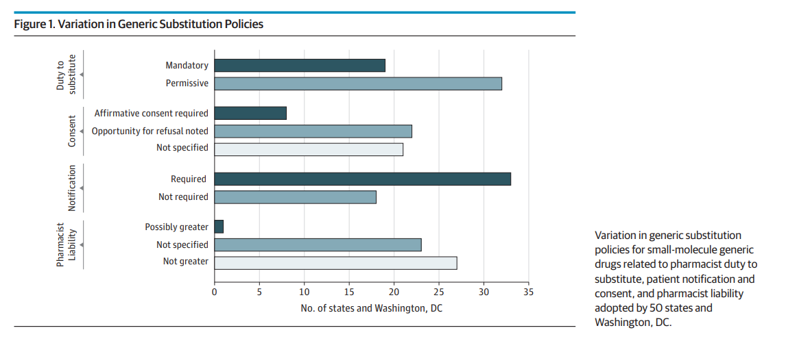
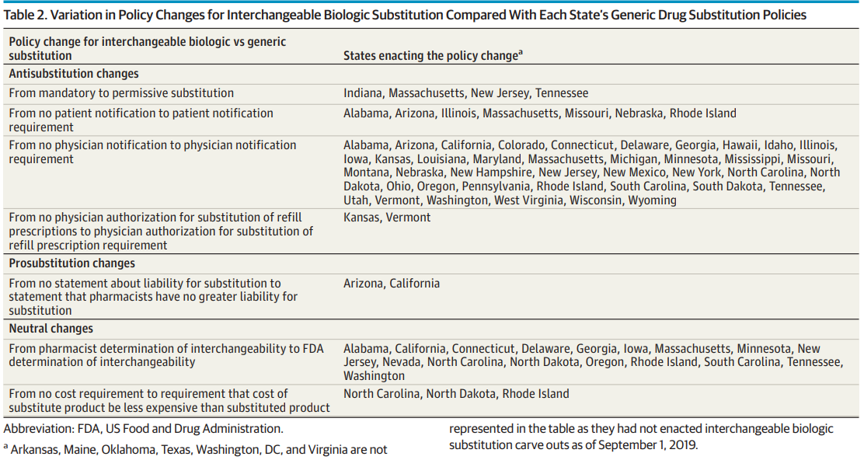
Results (1/3)
Variation in US Laws

Slide 9
Results (2/3)
LAW | US | INDIA
DAW (Dispense as Written) | YES (Also known as Brand medically necessary) | Substitution is Illegal.
PRESUMED CONSENT | Presumed consent laws have a negative and significant effect on brand name drug purchases. | NO
EXPLICIT CONSENT | The impact of changing from presumed consent to explicit consent is more significant indicating that people who are familiar with generic drugs tend to have a reduced response to explicit consent laws. | NO
MANDATORY SUBSTITUTION | YES | NO
GDUFA (Generic Drug User Fee Act) | YES | GMP & other ISO certifications.

Slide 10
Results (3/3)
IN ORDER TO ACHIEVE COMPREHENSIVE & COORDINATED REGULATORY APPROACH (CCI)
According to the CCI report
Uniform and Effective Implementation of Quality Standards
Substitution by retailers or chemists is also illegal in India. Prescriptions with generic chemical names give merchants and chemists more authority.
The threat of substitution by online pharmacies not supported by a prescription, patient data and prescription privacy, and risks of self-medication are the primary issues.
Indian government is trying to replace the current legislation with a new law that will control medications, cosmetics, and medical equipment in line with changes in the pharmaceutical business. In order to fill the legislative void and establish the required regulatory protections for the online distribution and sale of medications, e-pharmacy may be included within the scope of the proposed law.
Until the nation passes its data protection law, the essential laws must be enforced to preserve patient privacy and sensitive personal medical data.
Formulating policies in the pharmaceutical sector comes with its own set of difficulties. Achieving public health goals involves implementing various policy and regulatory measures, with competition being just one aspect.
Better Transparency
Periodic and Scientific
Testing of Drugs
National Digital Drugs Databank
Quality Control across
the Supply Chain
Quality Control in
Public Procurement
Standard Compliance Marks for Unbranded Generic Drugs
Awareness Creation
Improved Availability

Slide 11
Discussion
The USA relies heavily on market competition and regulatory processes, while India adopts a more centralized approach with price regulation and a focus on generic drug production. Despite these differences, both countries share a common objective of increasing access to affordable medicines and reducing healthcare expenditure.
In the USA, there is significant variation in drug product selection laws across states. While some states mandate generic substitution by pharmacists, others permit it but do not require it.
India, on the other hand, has its own set of regulations governing generic drug substitution. Retailers and chemists are not permitted to replace a prescribed brand with another brand containing the same chemical.
Both countries also face challenges in ensuring the quality of generic drugs. The Generic Drug User Fee Act (GDUFA) has been implemented to enhance the review and approval process of generic drugs, ensuring their safety, efficacy, and quality.
Indian pharma sector follows Good Manufacturing Practices (GMP) guidelines to ensure quality, safety, and efficacy of pharmaceutical products through rigorous manufacturing standards and processes.
Awareness campaigns, improved availability of standard-compliant generic drugs, and better supply chain management are crucial for increasing consumer confidence and access to affordable medicines.
While competition is an important aspect, it is essential for governments and regulators to actively shape the pharmaceutical market to ensure affordable medicines for all. Harmonizing regulations, strengthening regulatory bodies, and creating awareness among stakeholders are vital steps in achieving these goals.

Slide 12
Conclusion
The comparative analysis of policy frameworks surrounding generic drug substitution in the USA and India reveals distinct approaches and varying regulations.
The USA relies on market competition and regulatory processes, while India adopts a centralized approach with price regulation and a focus on generic drug production.
The concept of "dispense as written" or "brand medically necessary" acknowledges that certain patients may require specific brand-name drugs due to individual needs or medical reasons in USA.
Ensuring stringent regulations, high manufacturing standards, and comprehensive research can bridge the gaps between branded and generic drug formulations.
Presumed consent and explicit consent laws have been found to impact the purchase of brand name drugs.
GDUFA, the Generic Drug User Fee Act in the USA, aims to ensure the safety, effectiveness, and quality standards of generic drugs. It has had a positive impact on the Indian pharma sector, as India remains a major exporter of generic drugs to the US.
In India, regulations regarding generic drug substitution and brand substitution by retailers and chemists need improvement.
The findings from this study emphasize the importance of policy and regulatory measures to achieve public health goals, ensure access to affordable medicines, and actively influence the structure of the pharmaceutical market.

Slide 13
Recommendations (for both the countries)
1. Harmonization of Generic
Drug Substitution Laws
6. Strengthening Regulatory Infrastructure
2. Strengthening Physician Involvement
7. International Collaboration
3. Public Awareness and Education
8. Data Protection and Privacy
4. Updated QA Rules & Standards
9. Research and Development
5. Encouraging Competition and
Price Transparency
10. Government Leadership
and Policy Support

Slide 14
References
Sacks CA, Van de Wiele VL, Fulchino LA, Patel L, Kesselheim AS, Sarpatwari A. Assessment of variation in state regulation of generic drug and interchangeable biologic substitutions. JAMA Intern Med [Internet]. 2021 [cited 2023 Jun 14];181(1):16–22. Available from: https://pubmed.ncbi.nlm.nih.gov/32865564/
Rome BN, Sarpatwari A, Kesselheim AS. State laws and generic substitution in the year after new generic competition. Value Health [Internet]. 2022 [cited 2023 Jun 14];25(10):1736–42. Available from: https://pubmed.ncbi.nlm.nih.gov/35487821/
Beran RG. Generic substitution and advice to patients -potential legal medicine consequences - from A (Australia) to U (United Kingdom or United States of America). Seizure [Internet]. 2021;91:515–9. Available from: https://www.sciencedirect.com/science/article/pii/S1059131121000911
Song Y, Barthold D. The effects of state-level pharmacist regulations on generic substitution of prescription drugs. Health Econ [Internet]. 2018;27(11):1717–37. Available from: http://dx.doi.org/10.1002/hec.3796
Pardhe SP. A descriptive cross-sectional study to evaluate the Generic Drug User Fee Act: A boon or loss to the Indian generic pharmaceutical industry. J Appl Pharm Sci [Internet]. 2019 [cited 2023 Jun 14];9(2):44–51. Available from: https://japsonline.com/abstract.php?article_id=2841&sts=2
View of knowledge and perceptions of generic drugs: A cross sectional study [Internet]. Jddtonline.info. [cited 2023 Jun 14]. Available from: https://jddtonline.info/index.php/jddt/article/view/5412/4565
https://timesofindia.indiatimes.com/india/us-medicare-could-have-saved-1-billion-by-substituting-branded-drugs-says-study/articleshow/65522927.cms
https://www.fda.gov/drugs/generic-drugs/office-generic-drugs-2022-annual-report

Slide 15
Thank You
Any Questions

Slide 16
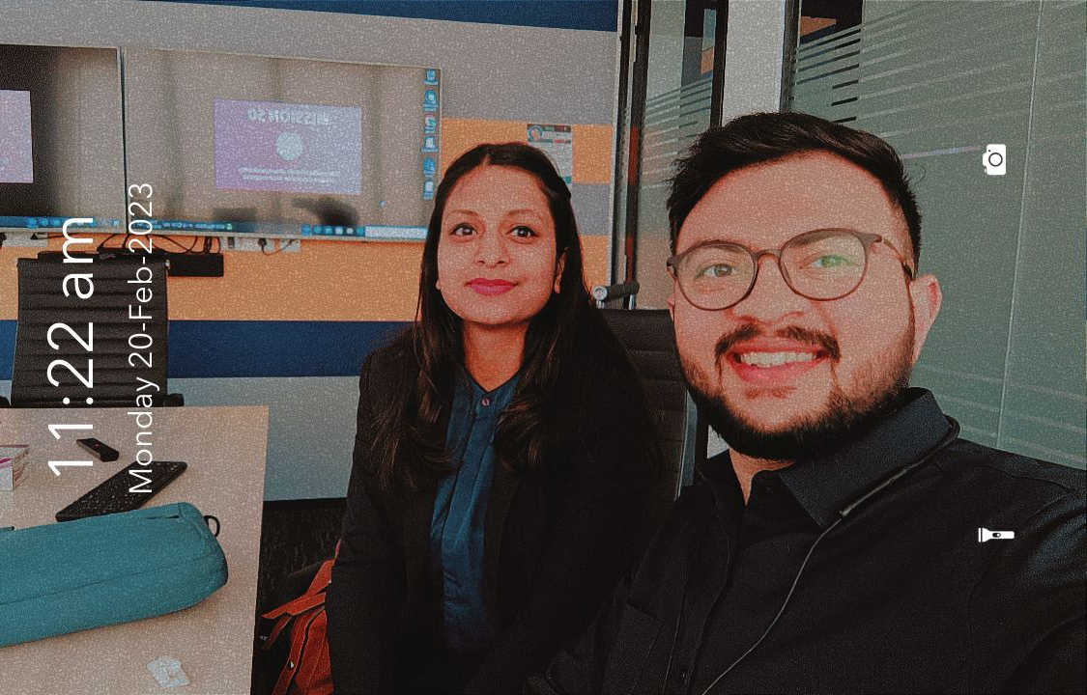
Pictorial Journey (1/2)
Team IIHMR Delhi at Cognitio Analytics
One with the “BOSS”

Slide 17
Pictorial Journey (2/2)
One with the “CEOs” of Cognitio Analytics
One with the CEO of Lenskart

