Slide 1
Study on post implementation evaluation of health information system implemented in a cancer hospital in Delhi At Rajiv Gandhi Cancer Institute and Research Center By
KRITIKA SINGH
Under Guidance of
Dr. Anandhi Ramachandran
IIHMR Delhi

Slide 2
Mentor Approval

Slide 3
Introduction
Efficient information management in hospitals is crucial for delivering high-quality care, necessitating the adoption of Hospital Information Systems (HIS) to replace manual processes with technology-enabled systems.
The ongoing technological transformation in healthcare requires collaboration between clinical and technical departments, resulting in the development of new governance and organizational frameworks.
Successful implementation of evidence-based processes and fostering collaboration among healthcare professionals and IT staff enhances patient-centric care, productivity, safety, workflow efficiency, and treatment outcomes.
Leadership alignment, multidisciplinary team participation, clinical leader sponsorship, and IT facilitation are vital for managing the transition and ensuring effective and high-quality care in hospitals.

Slide 4
The Components of Clinical Transformation Follow The Methodology and Include:

Slide 5
Objectives of Study
The objective of this study is
Primary Objective
To identify the gaps in technical requirements of the existing Hospital Information System (HIS) through post-implementation evaluation.
Specific Objectives
To understand the workflow of the existing HIS in the tertiary cancer care hospital and identify gaps
To analyze the perception of the stakeholders regarding the impact of identified gaps on the efficiency and usability of the system.
Based on the above recommend strategies for addressing any identified gaps to improve the overall functionality and performance of the HIS.

Slide 6
Methodology
Study Design: This study was designed as a cross-sectional study, which allowed for the collection of data at a single point in time.
Study Area: The study was conducted in the OPD area of the healthcare facility RGCI New Delhi
Duration of the Study: 3 months (7th February 2023 – 7th May 2023)
Type of Data: The data used in this evaluation was secondary data. The data sources included existing feedbacks gathered from stakeholders through a checklist and an MIS report for a period of one month.
Sampling size: 25
Sampling technique: convenience sampling is used due to the easy accessibility of the available samples. Online distribution of a Google Forms questionnaire allowed for a convenient and efficient data collection process.
Study population: End users (OPD patient care service staff and executives)

Slide 7
Methodology
Selection criteria:-
Inclusion criteria: OPD patient care service providers and executive staff using PARAS actively on HIS.
Exclusion criteria: Nursing staff that is not actively using HIS software.
Data collection tool: Structured Questionnaire is used to survey all the employees who use the HIS, asking them to rate its effectiveness on the Likert scale of 1 to 5 where 1 being the least satisfactory and 5 being the most satisfactory. The 5 components of the evaluation were in terms of sharing of information & communication, performance, security, user acceptability, and technical support.
Data collection procedure: The data collected through the survey was analyzed using descriptive statistics. The mean were calculated for each component of the evaluation, i.e., sharing of information & communication, performance, security, user acceptability, and technical support. The data collected through the MIS report was also analyzed using Microsoft excel.
Ethical consideration: The study followed ethical guidelines, obtained approval from the healthcare facility, and ensured confidentiality of participant responses and collected data. The aggregated results were presented to maintain anonymity and data was used solely for the evaluation's purpose.

Slide 8
Result The study includes 5 components, namely sharing of information & communication, performance, security, user acceptability, and technical support, with each component consisting of 4 to 5 technical requirements, making a total of 23 covered in all the bar graphs.
1.
2.
Technical Requirement 1 interpretation from rating 1 to 5:
Poor: 4% (1 respondent)
Unsatisfactory: 20% (5 respondents)
Satisfactory: 20% (5 respondents)
Very satisfactory: 44% ( 11 respondents)
Outstanding: 12% ( 3 respondents)
Technical Requirement 2 interpretation from rating 1 to 5:
Poor: 4% (1 respondent)
Unsatisfactory: 20% (5 respondents)
Satisfactory: 44% (11 respondents)
Very satisfactory: 16% (4 respondents)
Outstanding: 16% (4 respondents)

Slide 9
Result
3.
4.
Technical Requirement 3 interpretation from rating 1 to 5:
Poor: 4% (1 respondent)
Unsatisfactory: 12% (3 respondents)
Satisfactory: 44% (11 respondents)
Very satisfactory: 28% (7 respondents)
Outstanding: 12% ( 3 respondents)
Technical Requirement 4 interpretation from 1 to 5:
Poor: 12% (3 respondent)
Unsatisfactory: 24% (6 respondents)
Satisfactory: 32% (8 respondents)
Very satisfactory: 20% (5 respondents)
Outstanding: 12% ( 3 respondents)

Slide 10
Result
5.
6.
Technical Requirement 5 interpretation from rating 1 to 5:
Poor: 16% (4respondent)
Unsatisfactory: 12% (3 respondents)
Satisfactory: 44% (11 respondents)
Very satisfactory: 24% (6 respondents)
Outstanding: 4% ( 1 respondents)
Technical Requirement 6 interpretation from rating 1 to 5:
Poor: 8% (2 respondent)
Unsatisfactory: 32% (8 respondents)
Satisfactory: 36% (9 respondents)
Very satisfactory: 20% (5 respondents)
Outstanding: 4% ( 1 respondents)

Slide 11
Result
7.
8.
Technical Requirement 7 interpretation from rating 1 to 5:
Poor: 8% (2 respondents)
Unsatisfactory: 28% (7 respondents)
Satisfactory: 36% (9 respondents)
Very satisfactory: 24% (6 respondents)
Outstanding: 4% ( 1 respondents)
Technical Requirement 8 interpretation from rating 1 to 5:
Poor:(0 respondent)
Unsatisfactory: 16% (4 respondents)
Satisfactory: 52% (13 respondents)
Very satisfactory: 20% (5 respondents)
Outstanding: 12% ( 3 respondents)

Slide 12
Result
9.
10.
Technical Requirement 9 interpretation from rating 1 to 5:
Poor: 8% (2 respondents)
Unsatisfactory: 16% (4 respondents)
Satisfactory: 52% (13 respondents)
Very satisfactory: 20% (5 respondents)
Outstanding: 4% ( 1 respondents)
Technical Requirement 10 interpretation from rating 1 to 5:
Poor: 4% (1 respondent)
Unsatisfactory: 20% (5 respondents)
Satisfactory: 40% (10 respondents)
Very satisfactory: 56% (9 respondents)
Outstanding: ( 0 respondent)

Slide 13
Result
11.
12.
Technical Requirement 11 interpretation from rating 1 to 5:
Poor:(0 respondent)
Unsatisfactory: 16.7% (4 respondents)
Satisfactory: 45.8% (11 respondents)
Very satisfactory: 33.3% (8 respondents)
Outstanding: 4.2% ( 1 respondents)
Technical Requirement 12 interpretation:
Poor: 8% (2respondent)
Unsatisfactory: 16% (4 respondents)
Satisfactory: 44% (11 respondents)
Very satisfactory: 16% (4 respondents)
Outstanding: 16% ( 4 respondents)

Slide 14
Result
13.
14.
Technical Requirement 13 interpretation from rating 1 to 5:
Poor:(0 respondent)
Unsatisfactory: 12% (3 respondents)
Satisfactory: 48% (12 respondents)
Very satisfactory: 28% (7 respondents)
Outstanding: 12% ( 3 respondents)
Technical Requirement 14 interpretation from rating 1 to 5:
Poor: 4% (1 respondent)
Unsatisfactory: 12% (3 respondents)
Satisfactory: 24% (6 respondents)
Very satisfactory: 48% (12 respondents)
Outstanding: 12% ( 3 respondents)

Slide 15
Result
15.
16.
Technical Requirement 15 interpretation from rating 1 to 5:
Poor: 4% (1 respondent)
Unsatisfactory: 12% (3 respondents)
Satisfactory: 52% (13 respondents)
Very satisfactory: 20% (5 respondents)
Outstanding: 12% ( 3 respondents)
Technical Requirement 16 interpretation from rating 1 to 5:
Poor: 8% (2 respondent)
Unsatisfactory: 16% (4 respondents)
Satisfactory: 36% (9 respondents)
Very satisfactory: 28% (7 respondents)
Outstanding: 12% ( 3 respondents)

Slide 16
Result
17.
18.
Technical Requirement 17 interpretation from rating 1 to 5:
Poor: (0 respondent)
Unsatisfactory: 12% (3 respondents)
Satisfactory: 32% (8 respondents)
Very satisfactory: 40% (7 respondents)
Outstanding: 16% ( 4 respondents)
Technical Requirement 3 interpretation from 1 to 5:
Poor: 16.7% (4 respondent)
Unsatisfactory: 20.8% (5 respondents)
Satisfactory: 45.8% (11 respondents)
Very satisfactory: 8.3% (2 respondents)
Outstanding: 8.3% ( 2 respondents)

Slide 17
Result
19.
20.
Technical Requirement 19 interpretation from rating 1 to 5:
Poor: 4% (1 respondent)
Unsatisfactory: 8% (2 respondents)
Satisfactory: 28% (7 respondents)
Very satisfactory: 44% (11 respondents)
Outstanding: 16% ( 4 respondents)
Technical Requirement 20 interpretation from rating 1 to 5:
Poor: (0 respondent)
Unsatisfactory: 16% (4 respondents)
Satisfactory: 44% (11 respondents)
Very satisfactory: 36% (9 respondents)
Outstanding: 4% ( 1 respondents)

Slide 18
Result
21.
22.
Technical Requirement 21 interpretation from rating 1 to 5:
Poor: 8.3% (2 respondent)
Unsatisfactory: 16.7% (4 respondents)
Satisfactory: 33.3% (8 respondents)
Very satisfactory: 33.3% (8 respondents)
Outstanding: 8.3% ( 2 respondents)
Technical Requirement 22 interpretation from rating 1 to 5:
Poor: 4% (1 respondent)
Unsatisfactory: 24% (6 respondents)
Satisfactory: 32% (8 respondents)
Very satisfactory: 28% (7 respondents)
Outstanding: 12% ( 3 respondents)

Slide 19
Result
23.
Technical Requirement 23 interpretation from rating 1 to 5:
Poor: 4% (1 respondent)
Unsatisfactory: 24% (6 respondents)
Satisfactory: 28% (7 respondents)
Very satisfactory: 36% (9 respondents)
Outstanding: 8% ( 2 respondents)

Slide 20
Bugs Identified
There were a total of 28 issues reported under the HIS system. These issues were classified into two categories, namely bugs and change requests. Out of the 28 issues, 9 were classified as bugs, while 19 were classified as change requests

Slide 21
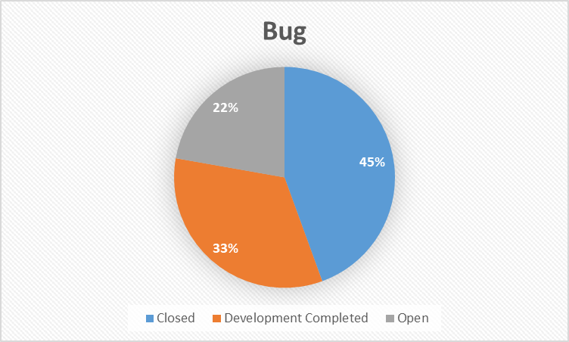
Closed Request: 53% of change requests have been resolved and closed, implying that the remaining requests are still open and being addressed.
Development and Completed Request: 31% of change requests have been worked on and completed, which may include requests that are completed but not yet closed.
Open Request: 16% of change requests are still open and awaiting action.
45% of bugs have been closed, indicating resolution and no longer impacting the system.
33% of bugs have been marked as development completed, undergoing testing before release.
22% of bugs remain open, still affecting the system and being investigated or actively worked on.

Slide 22
Findings

Slide 23
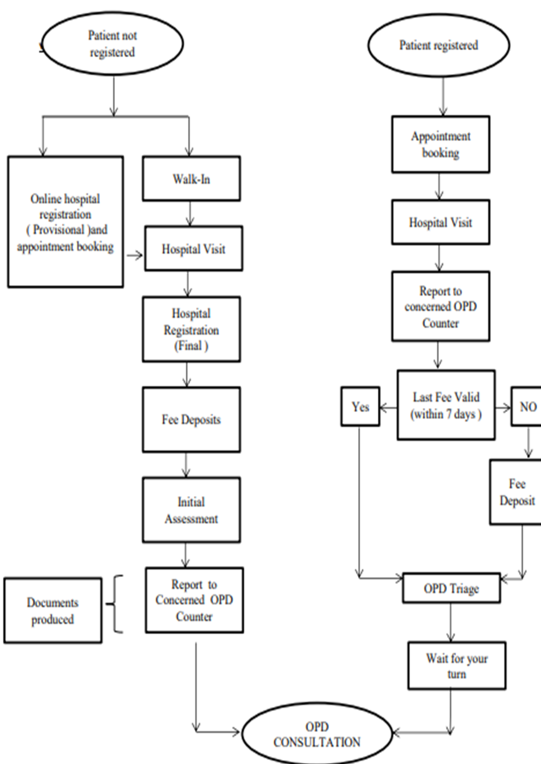
OPD Workflow

Slide 24
Discussion
Ease of Access: The majority of users had mixed satisfaction levels, with a significant proportion rating it as average (44%) and some rating it as below average (20%). There is room for improvement to enhance user experience.
Usefulness of Shared Information: The perception of usefulness was neutral, with the majority rating it as average (3), indicating a need for further improvement. However, a notable portion found the information valuable, but not essential (rated 4 or 5).
Timely Availability of Information: The timeliness of information was perceived as moderate (rated 3) by the majority, but improvements are needed as some users found it untimely (16%). Both timely and untimely ratings (2 or 5) were received by 12% of respondents.
Accuracy of Shared Information: The accuracy of shared information requires attention, as the majority rated it as average (32%) and a significant proportion rated it below average (24%). Enhancements are necessary to improve accuracy and reduce below-average ratings.
Timeliness of Shared Information: Users' ratings for timeliness were mixed, with the majority rating it as moderate (44%). However, there is room for improvement, as some users found it highly timely (4%) while others perceived it as untimely (16%).

Slide 25
Discussion
Response Time: The response time varied, with the majority receiving an average rating (68%). However, there is room for improvement, as a small percentage experienced slow (8%) or fast (4%) response times.
Reduction of Technical Issues: Users experienced a moderate level of improvement in reducing technical issues, but a significant portion still rated it low (32% rated 1 or 2), indicating the need for further enhancements.
Upgrade Frequency: The upgrade frequency of the software was generally positively rated, indicating overall user satisfaction (majority rating of 3, 4, or 5). However, a small portion rated it below average (16% rated 2).
System Performance: The system performance was perceived as moderately good, with ratings indicating a balanced distribution between not exceptionally good or bad, suggesting the need for ongoing monitoring and improvements.
Integration with Other Technologies: The integration of the software with other technologies and hospital systems was generally perceived as satisfactory, with room for improvement as a significant portion rated it as average (2) or good (3). Ongoing efforts are needed to enhance integration capabilities.

Slide 26
Recommendations
For the component 1 sharing of information and communication the statistical analysis indicates that there is generally room for improvement in terms of information availability, accuracy, and timeliness. While the ease of access and usefulness received positive ratings, efforts should be made to enhance the software's performance in these areas to better meet users' needs and expectations.
For the component 2 performance the statistical analysis reveals opportunities for improvement in response time, reduction of technical issues, upgrade frequency, and integration with other technologies. Addressing these areas could enhance user satisfaction and the software's performance in the hospital environment.
For component 3 security the statistical analysis suggests that improvements can be made in enhancing the perceived security of the software's features, addressing reported suspicious activities, and potentially refining the features for prohibiting unauthorized access. These findings highlight the importance of continuous evaluation and enhancement of security measures to ensure user trust and protection of sensitive information.

Slide 27
Recommendations
For the component 4 user acceptability the statistical analysis highlights the need for improvements in meeting end users' expectations, relevance for daily duties, department requirements, and overall user satisfaction. Addressing these areas can help enhance the software's performance, usability, and user satisfaction.
For the component 5 technical support the statistical analysis highlights areas where improvements can be made, such as enhancing pre-implementation training, strengthening software security monitoring, improving software maintenance support, optimizing IT support for software-related queries, and increasing the quickness in responding to technical issues. Addressing these areas can contribute to better user experiences, increased satisfaction, and improved overall performance of the software system.

Slide 28
Conclusion
In conclusion, the analysis of the technical requirements under 5 components for HIS i.e. sharing information and communication, Performance, security, user acceptability, technical support has revealed several critical gaps that need to be addressed to improve the efficiency and effectiveness of healthcare delivery. The identified gaps span four critical areas, namely interoperability, data management, security and usability.
These gaps have the potential to negatively impact patient care, data accuracy, and security. Therefore, healthcare providers and policymakers must prioritize efforts to address these gaps and invest in HIS systems that are designed to meet these critical requirements.
Addressing the identified gaps is a crucial step towards achieving this goal, and it is essential for healthcare providers and policymakers to prioritize efforts to address these gaps and invest in HIS systems that are designed to meet these critical requirements.

Slide 29
References
Han JM, Chae YM, Boo EH, Kim JA, Yoon SJ, Kim SW. Performance analysis of hospital information system of the national health insurance corporation ilsan hospital. Healthc Inform Res [Internet]. 2012;18(3):208–14. Available from: http://dx.doi.org/10.4258/hir.2012.18.3.208
Kim HH, Cho K-W, Kim HS, Kim J-S, Kim JH, Han SP, et al. New integrated information system for pusan national university hospital. Healthc Inform Res [Internet]. 2011 [cited 2023 Jun 13];17(1):67–75. Available from: https://pubmed.ncbi.nlm.nih.gov/21818459/
Choi J, Kim JW, Seo J-W, Chung CK, Kim K-H, Kim JH, et al. Implementation of consolidated HIS: Improving quality and efficiency of healthcare. Healthc Inform Res [Internet]. 2010 [cited 2023 Jun 13];16(4):299–304. Available from: https://pubmed.ncbi.nlm.nih.gov/21818449/
Jeyakumar T, McClure S, Lowe M, Hodges B, Fur K, Javier-Brozo M, et al. An education framework for effective implementation of a Health Information System: Scoping review. J Med Internet Res [Internet]. 2021 [cited 2023 Jun 13];23(2):e24691. Available from: https://pubmed.ncbi.nlm.nih.gov/33625370/
[cited 2023 Jun 13]. Available from: http://://pubmed.ncbi.nlm.nih.gov/27919399/
[cited 2023 Jun 13]. Available from: http:////www.mdpi.com/1718-7729/21/5/1923
Ammenwerth E, Ehlers F, Hirsch B, Gratl G. HIS-Monitor: an approach to assess the quality of information processing in hospitals. Int J Med Inform [Internet]. 2007;76(2–3):216–25. Available from: https://www.sciencedirect.com/science/article/pii/S1386505606001158
Ali M, Cornford T, Klecun E. Exploring control in health information systems implementation. Stud Health Technol Inform [Internet]. 2010 [cited 2023 Jun 13];160(Pt 1):681–5. Available from: https://pubmed.ncbi.nlm.nih.gov/20841773/

Slide 30
Thank You
Any Questions

Slide 31
Pictorial Journey
Rajiv Gandhi Cancer Institute and Research Center New Delhi Rohini

Slide 32
Pictorial Journey
OPD Patient Care Service Department

